Slide 1
Prepositions

Slide 2
Prepositions can be very tricky. They’re usually considered small words, although “throughout,” which most definitely is not a small word, is a preposition.
A preposition is a word that indicates the relationship between a noun or pronoun and other words in a sentence. That definition doesn’t really clear it all up, so consider the examples below:
The boy ran into the room.
“Into” shows the relationship between “ran” & “room.” [Where (the room) did the boy run?]
The man from Spain doesn’t speak Spanish.
“From” shows the relationship between “man” & “Spain.”
(Which man? The one from Spain.)

Slide 3
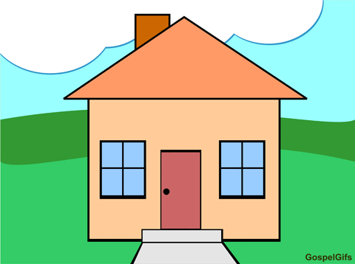
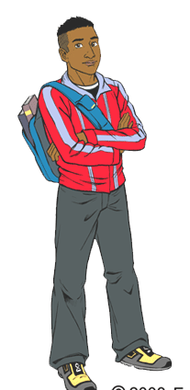
Think about it this way: what’s the relationship between the boy & the house?
The boy is beside the house.
The boy is on the house.

Slide 4
The boy is under the house.
The boy is in the house.
The boy is between the houses.

Slide 5
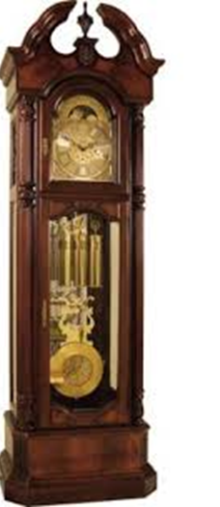
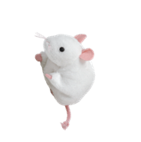
In each of the cases above, the preposition shows the relationship between “boy” & “house.”
Sometimes teachers like to say that a preposition is anywhere a mouse can run:
A mouse can run up a clock.
…or down a clock.

Slide 6
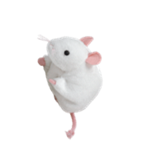
A mouse can run across the room.

Slide 7
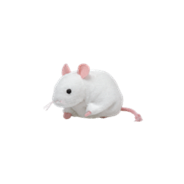
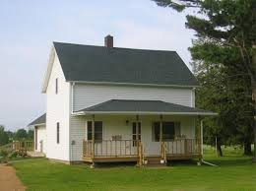
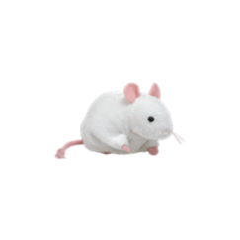
A mouse can run over the river
and through the woods
to Grandma’s house.

Slide 8
But those two “tests” (something’s position relative to something else, like the house & the boy, & wherever a mouse can run) don’t always work. For example, in
He has a cup of coffee
“of” is a preposition. It tells nothing about the cup’s location, & a mouse cannot run “of coffee.” But it DOES show the relationship between “cup” & “coffee”: it tells us that the cup holds coffee. The following sentences are similar:
He is the pitcher for the team.
“For” shows the relationship between “pitcher” & “team”.
Kids always love stories about pirates.
“About” shows the relationship between “stories” & “pirates.”
He bought the car with cash.
Here, “with” shows the relationship between “bought” & “cash,” not between “car” & “cash.” He bought how? With cash. In fact, you can take the words “the car” out, & the sentence still makes sense, since “with cash” goes with “bought,” not “car.”

Slide 9
It’s important to know that prepositions must be followed by a noun or pronoun.
Everyone went except our friends.
The boy sat beside the girl.
We went to the store.
She gave the letter to him.
She won’t do a favor for anyone.
You often hear that it’s incorrect to end a sentence with a preposition. We do all sorts of things in everyday speech that are “incorrect,” but when you write a formal paper, expect to see red marks on the following sentence:
That’s the man I work for.
Ending with “for” is not allowed. There’s always a way to make it precede a noun or pronoun. You’d rewrite the sentence to read as follows:
That’s the man for whom I work.
And then there’s the ever popular “Where is he at?” in which case, you simply drop the “at.”

Slide 10
Below is a list of prepositions. The author’s claim is that this is all of the prepositions in English, but that is highly doubtful, &, at any rate, it’s much better to understand prepositions than to learn to recognize them from memory. Besides the fact that there are prepositions missing from the list, some words have a function besides that of preposition.
The first thing to capture your attention is probably the compound prepositions (“in front of,” “instead of,” etc.). Compound prepositions are not uncommon, & there are certainly more than you see on this list. Usually, although not necessarily always, they end with a simple preposition (like “of,” as all the compound prepositions on this list do).

Slide 11
Something else you’ll notice, if you look a bit more closely, is that a couple of these prepositions look like verbs. That’s because they can be verbs as well as prepositions. Usage is very important in determining a word’s part of speech (i.e., is it a preposition? Is it a verb?)
I am considering two different colleges.
In the above sentence, “considering” is a verb. It has the helping verb “am” & is an action verb.
I don’t think they’ll play today, considering the rain that’s now falling.
In this sentence, “considering” is a preposition. How do we know that? For one thing, any verb that ends with –ing must have a helping verb with it. For another, no one is doing the action of “considering,” & someone/something has to be doing the action for it to be an action. “Considering” is, as prepositions must be, followed by a noun (“rain”). It’s a bit more difficult than with other prepositions to see the relationship created between “rain” & another word in the sentence. In this case, “considering” actually shows the relationship between “rain” & everything that comes before:
I don’t think they’ll play today. --Why?– Rain

Slide 12
“Like” is also a verb as well as a preposition:
I like chocolate.
In the above sentence, “like” is a verb. Someone is doing the action.
I want some chocolate like yours.
In the above sentence, “like” is a preposition. It’s not a verb, because no one is doing the action. It’s followed by a pronoun, & it shows the relationship between “chocolate” & “yours.”

Slide 13
If you’ve mastered verbs, it probably isn’t hard for you to understand when “considering” & “like” are verbs & when they’re not. But there are some words, like “before” & “after,” that can be prepositions or conjunctions, & you haven’t studied conjunctions yet. But even just understanding prepositions, you can decide if it’s a preposition or not:
I went to Subway before school.
I went to Subway before school started.
In one of the sentences above, “before” is a preposition; in the other, it’s a conjunction. Can you tell in which it’s a preposition?
It’s the first sentence. In that sentence, “before” is followed by a noun. In the second sentence, it’s followed by a noun (subject) & VERB. A preposition can’t be followed by a noun that’s doing an action; it has to be followed by a plain old noun (or pronoun).

Slide 14
**Note about “to”:
“To” (NOT “too” or “two”) is frequently a preposition. But remember—prepositions are followed by a noun or pronoun. If “to” is followed by a verb, it’s not a preposition:
I want to eat.
He doesn’t know how to drive a car.
To know him is to love him.
In all the cases above, “to” is followed by a verb & therefore NOT a preposition.
Prepositions can be tricky, but you master them the way you master everything else: practice.

Slide 15
Identify all the prepositions in this excerpt from Harry Potter & the Chamber of Secrets.
October arrived [and spread] a damp chill over the grounds and into the castle. Madam Pomfrey, the nurse, was kept busy by a sudden spate of colds among the staff and students. Her Pepperup potion worked instantly, though it left the drinker smoking at the ears for several hours afterward. Ginny Weasley, who had been looking pale, was bullied into taking some by Percy. The steam pouring from under her vivid hair gave the impression that her whole head was on fire.
Raindrops the size of bullets thundered on the castle windows for days on end; the lake rose, the flower beds turned into muddy streams, and Hagrid's pumpkins swelled to the size of garden sheds. Oliver Wood's enthusiasm for regular training sessions, however, was not dampened, which was why Harry was to be found, late one stormy Saturday afternoon a few days before Halloween, returning to Gryffindor Tower, drenched to the skin and splattered with mud.
Even aside from the rain and wind it hadn't been a happy practice session. Fred and George, who had been spying on the Slytherin team, had seen for themselves the speed of those new Nimbus Two Thousand and Ones. They reported that the Slytherin team was no more than seven greenish blurs, shooting through the air like missiles.

Slide 16
October arrived [and spread] a damp chill over the grounds and into the castle. Madam Pomfrey, the nurse, was kept busy by a sudden spate of colds among the staff and students. Her Pepperup potion worked instantly, though it left the drinker smoking at the ears for several hours afterward. Ginny Weasley, who had been looking pale, was bullied into taking some by Percy. The steam pouring from under her vivid hair gave the impression that her whole head was on fire.
Raindrops the size of bullets thundered on the castle windows for days on end; the lake rose, the flower beds turned into muddy streams, and Hagrid's pumpkins swelled to the size of garden sheds. Oliver Wood's enthusiasm for regular training sessions, however, was not dampened, which was why Harry was to be found, late one stormy Saturday afternoon a few days before Halloween, returning to Gryffindor Tower, drenched to the skin and splattered with mud.
Even aside from the rain and wind it hadn't been a happy practice session. Fred and George, who had been spying on the Slytherin team, had seen for themselves the speed of those new Nimbus Two Thousand and Ones. They reported that the Slytherin team was no more than seven greenish blurs, shooting through the air like missiles.

Slide 17
Preposition Exercise page

