Slide 1
Adverbs

Slide 2
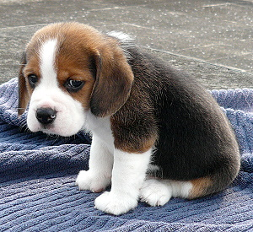
Adverbs describe verbs, adjectives, or other adverbs.. Adverbs usually answer the questions when, why, where, how, or to what extent.
He walked (how?) slowly.
We arrived (when?) late.
He’s sitting (where?) here.
He ran fastest (to what extent?).
He ran barefoot (how?).
When adverbs answer questions like that, they’re describing the verb. If they describe an adjective or another adverb, they usually come right before that adjective or adverb.
The puppy is very sad. (“Very” describes the adjective “sad.”)
He walked very slowly. (“Very” describes the adverb “slowly.”)
.
Sometimes the adverb describes the whole sentence:
Fortunately, no one knew the truth.
These adverbs are almost always set off with a comma.

Slide 3
You may have heard that adverbs end with –ly. Most words (although not all) that end with –ly ARE adverbs, but not all adverbs end with –ly.
In general, -ly is added to adjectives to make them adverbs:
This is a slow car. – They travelled slowly.
This is a soft coat. -- She whispered softly.
This is a clear day. – He spoke clearly.
Of course, not all adjectives can be made into adverbs:
This is a green car. – “greenly”????
This is a tall man. – “tallly”?????
Watch out for a few words like “friendly,” which is an adjective, not an adverb:
This is a friendly dog.

Slide 4
Note that the –ly adverbs on the previous page answer the question “how””
This is a slow car. – They travelled slowly.
This is a soft coat. -- She whispered softly.
This is a clear day. – He spoke clearly.
Consider these adverbs that answer the question “when”:
We left yesterday.
We eat at Subway sometimes.
We always eat at Subway.
The following adverbs answer the question “where”:
You live here.
I live there.
He lives nearby.
All of the adverbs on this page modify the verb in the sentence.

Slide 5
These adverbs answer “to what extent”:
He is so sick.
I ran very quickly.
You ate too soon.
All the adverbs on this page modify an adjective or an adverb.
Let’s look at some more adverbs that modify the entire sentence:
Sadly, my best friend can’t come to the party.
Amazingly, the boy didn’t break his neck.
No one got hurt, luckily.
If the adverb modifies the verb, you can ask one of the questions:
He shook his head sadly. – How did he shake his head? – Sadly.
But if it modifies the whole sentence, no question makes sense:
Sadly, my best friend can’t come to the party. -- “How did my best friend not come to the party?” – That doesn’t make sense. “Sadly” is commenting on the entire sentence.
Note: if an adverb modifies the whole sentence, it’s set off with a comma. If it modifies the verb, it’s usually not.

Slide 6
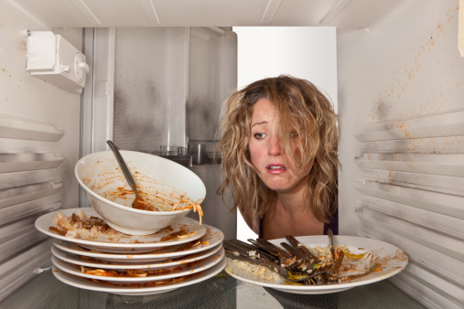
Adverbs can sometimes be tricky, because sometimes they don’t really seem to answer any of the questions very directly, but once you get used to looking for them, you should find them fairly easy.
So let’s start: identify the adverb in the sentence below.
Your friends never help with the dirty dishes.

Slide 7
No. That is NOT an adverb.

Slide 8
Yes! “Never” is an adverb answering the question “when?”

Slide 9
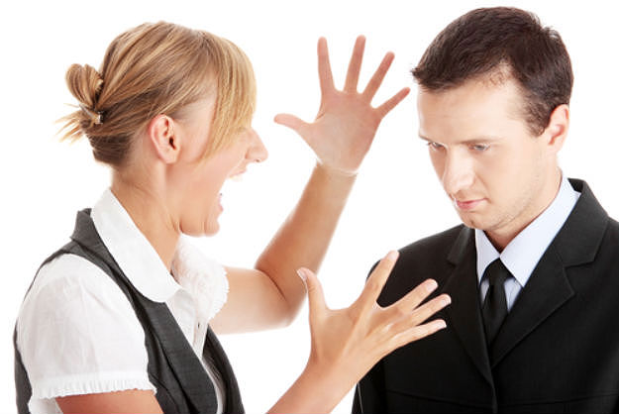
Identify the adverb in the sentence below.
If he wants to work in this business, he really needs to learn to listen.

Slide 10
No. That is NOT an adverb.

Slide 11
Yes! “Really” is an adverb answering the question “to what extent does he need to listen?”

Slide 12
Identify the adverb in the sentence below.
Leaving your laptop in a place like this is a super bad idea.

Slide 13
No. That is NOT an adverb.

Slide 14
Yes! “Super” is an adverb answering the question “to what extent?” How bad? Super bad.
“Super” used in this way is colloquial; you wouldn’t use it in a formal paper. But you can tell it’s an adverb by asking the right question. Also, you can tell it’s not an adjective because it doesn’t modify “idea.” Look at the sentence again:
Leaving your laptop in a place like this is a super bad idea.
Is it a super idea? No—”super” doesn’t describe “idea.” “Bad” describes the noun “idea,” & “super” tells just how bad the adjective “bad” is.

Slide 15
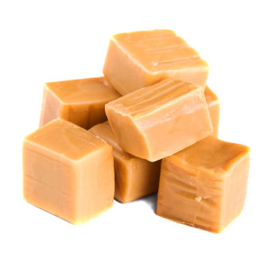
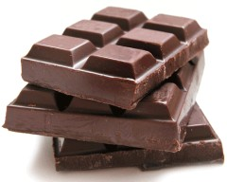
Identify the adverb in the sentence below.
I love chocolate; my boyfriend, however, prefers caramel.

Slide 16
No. That is NOT an adverb.

Slide 17
Yes! “However” is an adverb.
It’s very important to understand that “however” is an adverb, because there’s going to be a point where you might think it’s something else. But it’s ALWAYS an adverb. It modifies the whole second half of the sentence, making it contradict (go against) the first half.
Consider:
I love chocolate; my boyfriend, however, prefers caramel.
Could you say,
“I love chocolate; my boyfriend, however, loves chocolate”?
No—that wouldn’t make sense. “However” is an adverb that tells you you’re about to hear something that’s different from the first half of the sentence.

Slide 18
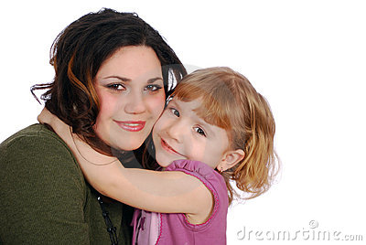
Identify the adverb in the sentence below.
Maddy is going to give me a big hug if I get to see her today.

Slide 19
No. That is NOT an adverb.

Slide 20
Yes! “Today” is an adverb that answers the question “when?”

Slide 21
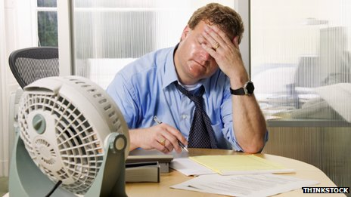
Identify the adverb in the sentence below.
She does not want to visit her friend during the hottest months of the summer.

Slide 22
No. That is NOT an adverb.

Slide 23
Yes! “Not” is an adverb. It’s a little difficult to figure out what typical question it might answer, but it should be easy for you to see that it modifies “want.” It totally changes the meaning of “want,” right?
She wants to visit. ≠ She does not want to visit.

Slide 24
Identify the adverb in the sentence below.
The girl is happy because she did well on the test she took.

Slide 25
No. That is NOT an adverb.

Slide 26
Yes! “Well” is a question that answers the question “how (did she do)?”

Slide 27
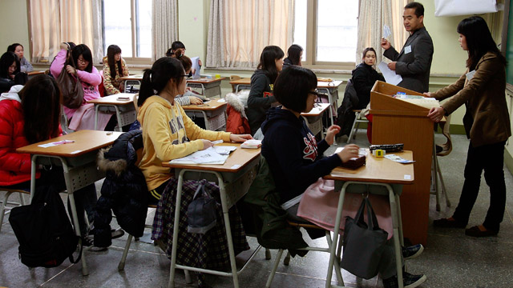
Identify the adverb in the sentence below.
I promised my students that I would have the tests graded soon.

Slide 28
No. That is NOT an adverb.

Slide 29
Yes! “Soon” is an adverb answering the question “when?”

Slide 30
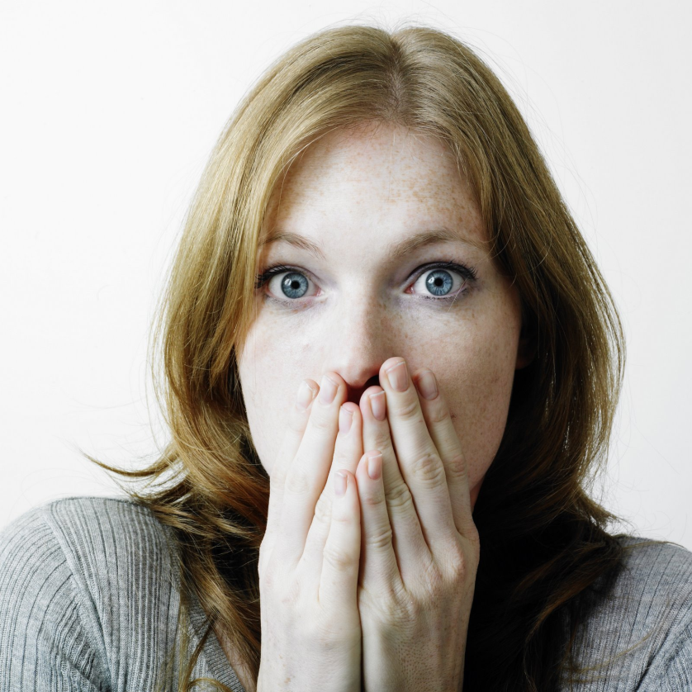
Identify the adverb in the sentence below.
I heard what happened, and I’m so terribly sorry that you had to experience that.

Slide 31
No. That is NOT an adverb.

Slide 32
Yes! Both “so” & “terribly” are adverbs. “Sorry” is an adjective that describes “I”; “terribly” is an adverb that describes the adjective “sorry” (Sorry to what extent? Terribly.); “so” is an adverb that modifies the other adverb “terribly” (Terribly to what extent? So terribly.).

Slide 33
As you probably expect, what’s on the next slide is an excerpt from a work of literature in which you will have to identify all the adverbs. You may find this exercise more difficult that previous exercises. For example, is there an adverb in this sentence, & if so, what is it?
The children skipped along the banks of the river.
There is no adverb in that sentence. You may have thought “along” was an adverb. Does it answer the question “where?” No; “along the banks of the river” answers the question “where?” If the sentence were
The children skipped along as their mother watched.
“along” would be an adverb. But if it’s part of a PHRASE (a group of words) that answers one of the adverb questions (when? Why? Where? etc.), it’s not an adverb.

Slide 34
Identify all the adverbs in this excerpt from “Heidi.”
For some days past Fraulein Rottenmeier had gone about rather silently and as if lost in thought. As twilight fell, and she passed from room to room, or along the long corridors, she was seen to look cautiously behind her, and into the dark corners, as if she thought some one was coming silently behind her and might unexpectedly give her dress a pull. Nor would she now go alone into some parts of the house. If she visited the upper floor where the grand guest-chambers were, or had to go down into the large mysterious council-chamber, where every footstep echoed, and the old senators with their big white collars looked down so solemnly and immovably from their frames, she regularly called Tinette to accompany her, in case, as she said, there might be something to carry up or down. Tinette on her side did exactly the same; if she had business upstairs or down, she called Sebastian to accompany her, and there was always something he must help her with which she could not carry alone. More curious still, Sebastian, also, if sent into one of the more distant rooms, always called John to go with him in case he should want his assistance in bringing what was required. And John readily obeyed, although there was never anything to carry, and either might well have gone alone; but he did not know how soon he might want to ask Sebastian to do the same service for him. And while these things were going on upstairs, the cook, who had been in the house for years, would stand shaking her head over her pots and kettles, and sighing,

Slide 35
For some days past Fraulein Rottenmeier had gone about rather silently and as if lost in thought. As twilight fell, and she passed from room to room, or along the long corridors, she was seen to look cautiously behind her, and into the dark corners, as if she thought some one was coming silently behind her and might unexpectedly give her dress a pull. Nor would she now go alone into some parts of the house. If she visited the upper floor where the grand guest-chambers were, or had to go down into the large mysterious council-chamber, where every footstep echoed, and the old senators with their big white collars looked down so solemnly and immovably from their frames, she regularly called Tinette to accompany her, in case, as she said, there might be something to carry up or down. Tinette on her side did exactly the same; if she had business upstairs or down, she called Sebastian to accompany her, and there was always something he must help her with which she could not carry alone. Sebastian, also, if sent into one of the more distant rooms, always called John to go with him in case he should want his assistance in bringing what was required. And John readily obeyed, although there was never anything to carry, and either might well have gone alone; but he did not know how soon he might want to ask Sebastian to do the same service for him. And while these things were going on upstairs, the cook, who had been in the house for years, would stand shaking her head over her pots and kettles, and sighing.

Slide 36
Adverbs Exercises page

