Slide 1
Adjectives

Slide 2
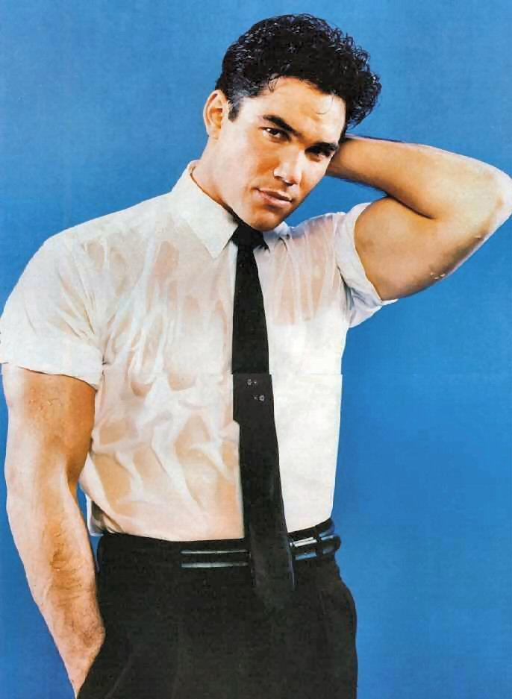
An adjective is a word that describes, identifies, modifies, or quantifies a noun or a pronoun.
Adjectives that describe are probably the easiest:
Dean Cain is
dark
tall
gorgeous
rich

Slide 3
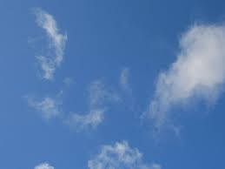
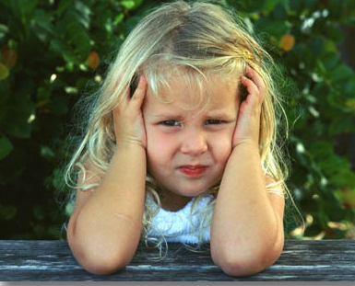
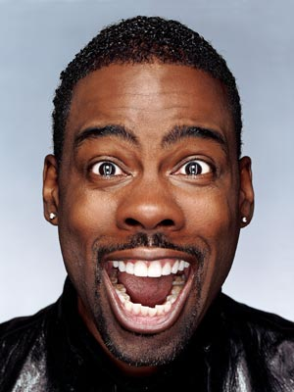
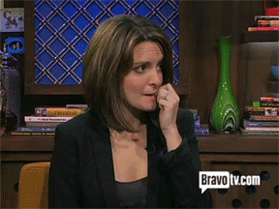
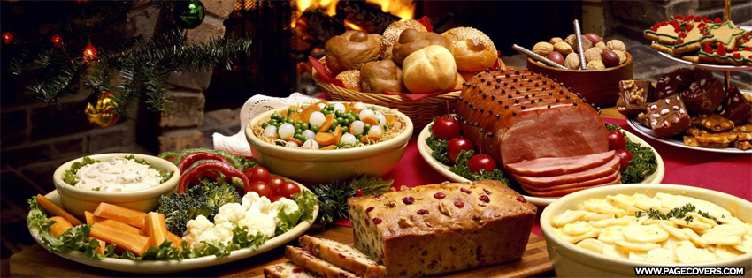
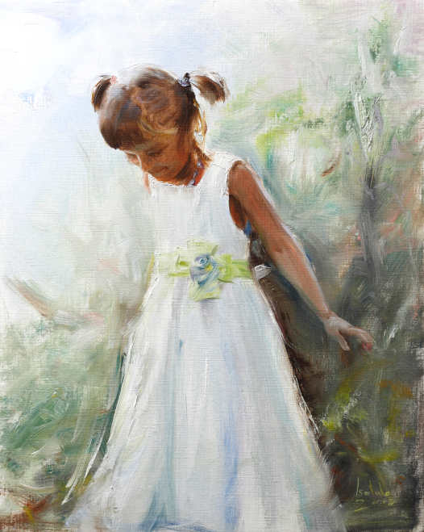
More descriptive adjectives
blue sky
young girl
funny man
nervous woman
delicious food
new dress

Slide 4
But don’t forget that besides describing nouns & pronouns, adjectives can identify them:
Which man? That man? No, the other man.
All three highlighted words are adjectives that identify the noun. It shouldn’t surprise you that “this” is called a DEMONSTRATIVE adjective, since you learned in the pronoun presentation that, when “this” replaces a noun, it’s a demonstrative pronoun. Likewise, you shouldn’t be surprised to learn that the following adjectives are called POSSESSIVE adjectives:
my house your car her friends

Slide 5
And remember that adjectives also quantify nouns or pronouns:
two puppies
many children
several tests
Adjectives normally come before the noun/pronoun that they describe/quantify/modify, but occasionally they come after:
The woman is tall. – “Tall” describes “woman.”
We painted the house blue. – “Blue” describes “house.”

Slide 6
Two final notes: First, the words “a,” “an,” & “the” are considered adjectives, although they’re better known as “articles.” But when you’re assigning words to one of the 8 parts of speech, “adjective” is the category where they go.
Second, just as there are proper & common nouns, there are proper & common adjectives. Proper adjectives normally come from proper nouns:
I went to Italy because I love Italian food.
“Italy” is a proper noun, & “Italian” is a proper adjective.
We bought a Victorian house. (Meaning a house built during the
reign of England’s Queen Victoria.)
If you mastered nouns & pronouns in the last 2 presentations, you should find adjective identification a piece of cake. If you think a word is an adjective, there HAS to be a noun or pronoun that the adjective describes/modifies/identifies. So let’s see how you do:
The man in the gray suit does not know a thing.
Click on the adjective in the above sentence. (In this exercise, articles don’t count, so don’t click on an article.)

Slide 7
NO. That word is NOT an adjective. It does not describe/identify/modify a noun or pronoun.

Slide 8
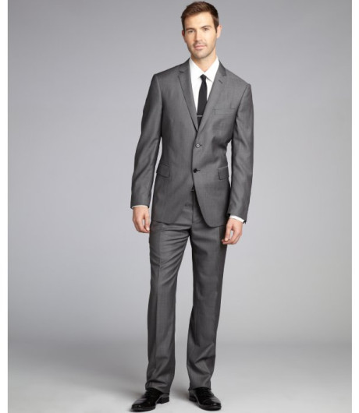
Yes! “Gray” describes “suit.”

Slide 9
Click on the adjective. (In this exercise, articles don’t count, so don’t click on an article.)
She insists on doing whatever she wants every day.

Slide 10
NO. That word is NOT an adjective. It does not describe/identify/modify a noun or pronoun.

Slide 11
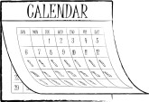
Yes! “Every” describes/identifies “day.”

Slide 12
Click on the adjective. (In this exercise, articles don’t count, so don’t click on an article.)
If you really wanted to see your sister, you could make time for her.

Slide 13
NO. That word is NOT an adjective. It does not describe/identify/modify a noun or pronoun.

Slide 14
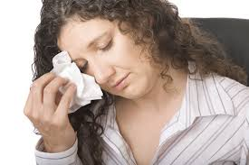
BTW, if you chose “really,” what noun or pronoun does that go with? Does “really” identify/describe “you”? Or “sister”? Or “time”?
Yes! “Your” is a POSSESSIVE adjective that identifies “sister.”

Slide 15
Click on the adjective. (In this exercise, articles don’t count, so don’t click on an article.)
I know that you want to give the guy money, but that isn’t a good idea.

Slide 16
NO. That word is NOT an adjective. It does not describe/identify/modify a noun or pronoun.

Slide 17
Yes! “Good” describes “idea.”
BTW, if you chose “that,” what noun or pronoun does “that” identify? The first “that” in the sentence comes before pronoun, but does it identify the pronoun? “Which you? –That you”? No. We’ll talk about exactly what it is in the presentation on conjunctions, but it’s definitely not an adjective, since it doesn’t identify any noun or pronoun. The second “that” stands in place of a noun (“idea”), so it’s a pronoun, not an adjective.

Slide 18
Click on the adjective. (In this exercise, articles don’t count, so don’t click on an article.)
You’ll know the house when you see it, because the shutters are always open in the summer.

Slide 19
NO. That word is NOT an adjective. It does not describe/identify/modify a noun or pronoun.

Slide 20
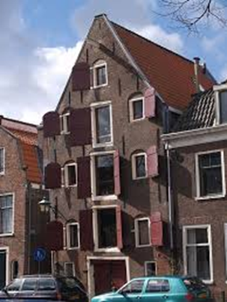
Yes! “Open” describes “shutters” in spite of the fact that “open” comes after “shutters” rather than before it.

Slide 21
Identify the adjectives in this excerpt from The Scarlet Letter.
The young woman was tall, with a figure of perfect elegance, on a large scale. She had dark and abundant hair, so glossy that it threw off the sunshine with a gleam, and a face which, besides being beautiful from regularity of feature and richness of complexion, had the impressiveness belonging to a marked brow and deep black eyes. She was lady-like, too, after the manner of the feminine gentility of those days; characterized by a certain state and dignity, rather than by the delicate, evanescent, and indescribable grace, which is now recognized as its indication. And never had Hester Prynne appeared more lady-like, in the antique interpretation of the term, than as she issued from the prison. Those who had before known her, and had expected to behold her dimmed and obscured by a disastrous cloud, were astonished, and even startled, to perceive how her beauty shone out, and made a halo of the misfortune and ignominy in which she was enveloped. It may be true, that, to a sensitive observer, there was something exquisitely painful in it. Her attire, which, indeed, she had wrought for the occasion, in prison, and had modelled much after her own fancy, seemed to express the attitude of her spirit, the desperate recklessness of her mood, by its wild and picturesque peculiarity. But the point which drew all eyes, and, as it were, transfigured the wearer,--so that both men and women, who had been familiarly acquainted with Hester Prynne, were now impressed as if they beheld her for the first time,--was that SCARLET LETTER, so fantastically embroidered and illuminated upon her bosom. It had the effect of a spell, taking her out of the ordinary relations with humanity, and inclosing her in a sphere by herself.

Slide 22
If you reached this page without first having written down the adjectives from the previous page, go BACK!
The young woman was tall, with a figure of perfect elegance, on a large scale. She had dark and abundant hair, so glossy that it threw off the sunshine with a gleam, and a face which, besides being beautiful from regularity of feature and richness of complexion, had the impressiveness belonging to a marked brow and deep black eyes. She was lady-like, too, after the manner of the feminine gentility of those days; characterized by a certain state and dignity, rather than by the delicate, evanescent, and indescribable grace, which is now recognized as its indication. And never had Hester Prynne appeared more lady-like, in the antique interpretation of the term, than as she issued from the prison. Those who had before known her, and had expected to behold her dimmed and obscured by a disastrous cloud, were astonished, and even startled, to perceive how her beauty shone out, and made a halo of the misfortune and ignominy in which she was enveloped. It may be true, that, to a sensitive observer, there was something exquisitely painful in it. Her attire, which, indeed, she had wrought for the occasion, in prison, and had modelled much after her own fancy, seemed to express the attitude of her spirit, the desperate recklessness of her mood, by its wild and picturesque peculiarity. But the point which drew all eyes, and, as it were, transfigured the wearer,--so that both men and women, who had been familiarly acquainted with Hester Prynne, were now impressed as if they beheld her for the first time,--was that SCARLET LETTER, so fantastically embroidered and illuminated upon her bosom. It had the effect of a spell, taking her out of the ordinary relations with humanity, and inclosing her in a sphere by herself.

Slide 23
Adjective Exercises

