Slide 1
Addiction
A pathological or abnormal relationship with an object or event with three common elements:
Exposure = definite beginning and end
Compulsion = engage in despite negative consequences
Loss of control = search for highs changes to desire to avoid the lows

Slide 2
Drug Dependence as a Disease
The disease can be described.
The course of the disease is predictable and progressive.
The disease is primary.
The disease is permanent.
The disease is terminal.
© 2008 McGraw-Hill Higher Education. All rights reserved.

Slide 3
Addiction and the Brain
Addiction is a brain disease with a genetic basis.
Brain programmed to pay extra attention to salience.
Salience=special relevance. I.E. Life Sustaining activities.
Brain associates those activities with pleasure or reward.
Dopamine is a reward or pleasure neurotramsmitter.
Drugs of abuse act in different ways to dramatically increase dopamine.
Because of the increase, the brain decreases dopamine receptors which results in an overall decrease in dopamine in the brain.
Therefore, pleasure decreases, resulting in a higher amount of the drug to produce the same effect.
© 2008 McGraw-Hill Higher Education. All rights reserved.

Slide 4
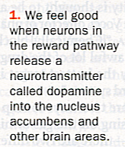
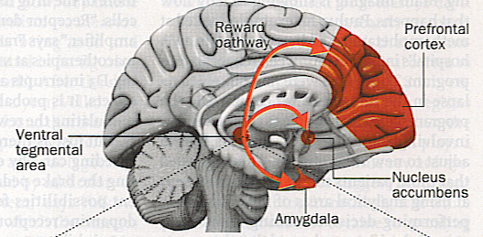
Addiction and the Brain

Slide 5
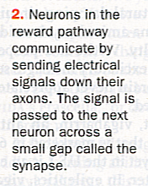
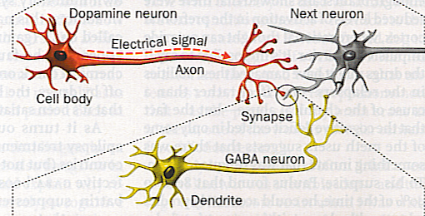
Addiction and the Brain

Slide 6
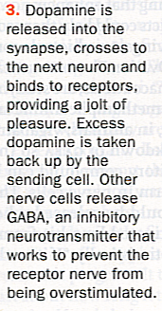
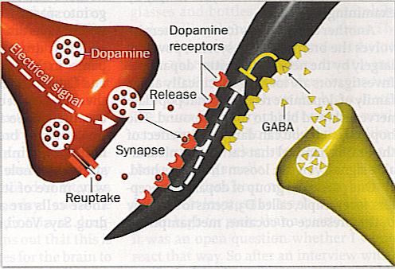
Addiction and the Brain

Slide 7
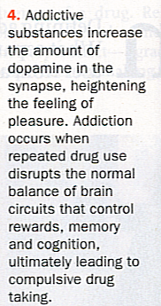
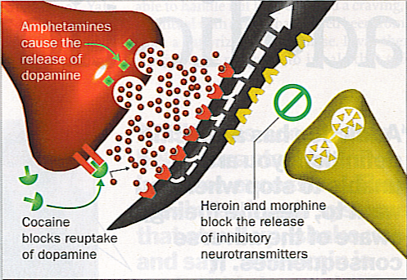
Addiction and the Brain

Slide 8
Addiction Risk Factors

Slide 9
Addiction Risk Factors
EXAMPLES OF RISK AND PROTECTIVE FACTORS
Risk Factors | Domain | Protective Factors
Early Aggressive Behavior | Individual | Self-Control
Poor Social Skills | Individual | Positive Relationships
Lack of Parental Supervision | Family | Parental Monitoring and Support
Substance Abuse | Peer | Academic Competence
Drug Availability | School | Anti-Drug Use Policies
Poverty | Community | Strong Neighborhood Attachment

Slide 10
Alcohol
Alcohol is technically known as ethyl alcohol or ethanol.
It is a central nervous system depressant drug.
Slows brain function
Slows reaction time
Dulls alertness
Impairs coordination
Intensifies emotions
Increases risk taking
Lowers inhibitions
Disrupts judgment and reasoning.

Slide 11
Alcohol
Alcohol is processed by the liver at an approximate rate of 1 oz. per hour.
Speed of absorption depends on:
- weight,
- gender,
- speed of consumption,
- food intake
- type of beverage
- gender
Tolerance is the body’s physical adjustment to the habitual use of a chemical.

Slide 12
Behavioral Effects of Alcohol
Number Drinks | Ounces EtOH | BAC | Time of Removal | Effects
1 | ½ | .02 | 1 hour | Feeling relaxed
2 1/2 | 1 ¼ | .05 | 2 ½ hours | Feeling “high”, ↓inhibitions, ↑confidence, ↓judgement
5 | 2 1/2 | .10 | 5 hours | Memory impaired, coordination reduced, slurred speech
10 | 5 | .20 | 10 hours | Slowed reflexes, erratic changes in feelings
15 | 7 ½ | .30 | 15hours | Stuporous, complete loss of coordination
20 | 10 | .40 | 20 hours | Coma, Dealth

Slide 13
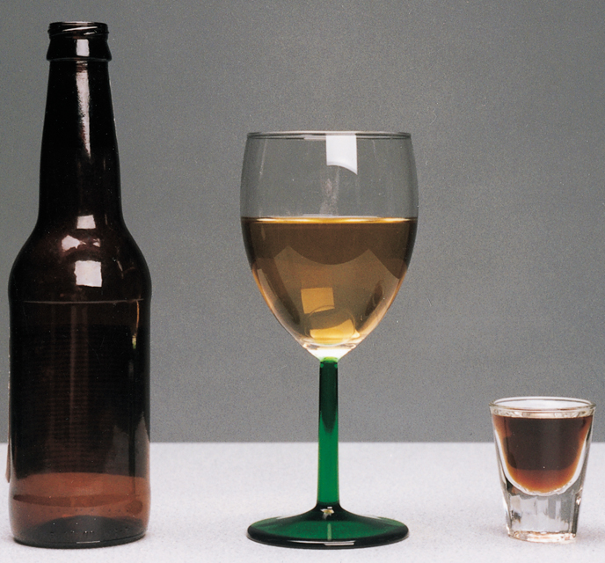

Slide 14
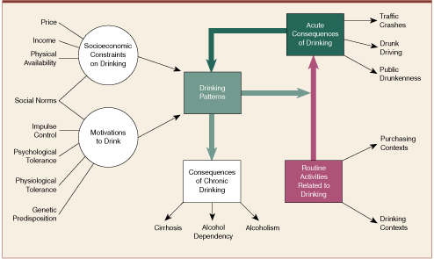
Drinking Patterns

Slide 15
Impact of Alcohol
Alcohol is a factor in:
50% of deaths in motor vehicle crashes,
33% drownings,
50% deaths caused by fire,
50% homicides,
33% of suicides,
66% of assaults,
50% domestic violence,
90% of campus rapes,
40% of academic problems.
#1 killer of teenagers: drinking and driving.
Significant factor in all risk behavior especially sexual decisions.
© 2008 McGraw-Hill Higher Education. All rights reserved.

Slide 16
ALCOHOL
Alcohol is a toxin, and harmful effects on the body are great!
Brain damage
Nerve damage
Heart disease, high blood pressure, stroke
Cancer
Depress immune function
Liver failure
Malnutrition

Slide 17
ALCOHOL ABUSE
The following symptoms are associated with alcohol abuse:
Temporary blackouts or memory loss.
Recurrent arguments or fights with family members or friends.
Continuing use of alcohol to relax, to cheer up, to sleep, to deal with problems, or to feel "normal."
Headache, anxiety, insomnia, nausea, or other unpleasant symptoms when you stop drinking.
Flushed skin and broken capillaries on the face; a husky voice; trembling hands; chronic diarrhea; and drinking alone, in the mornings, or in secret. These symptoms are specifically associated with chronic alcoholism.
Keep in mind that alcohol abuse is different from alcohol dependence.
With abuse, a person uses alcohol in excess but mat not have regular cravings, a need to use daily, and/or withdrawal symptoms during sudden stoppage.

Slide 18
ALCOHOLISM
Alcoholism, also known as “alcohol dependence,” is a disease that includes at least three of the following symptoms:
You cannot quit drinking or control how much you drink.
You need to drink more to get the same effect.
You have withdrawal symptoms when you stop drinking. These include feeling sick to your stomach, sweating, shakiness, and anxiety.
You spend a lot of time drinking and recovering from drinking, or you have given up other activities so you can drink.
You have tried to quit drinking or to cut back the amount you drink but haven't been able to.
You continue to drink even though it harms your relationships and causes physical problems.

Slide 19
HOW MUCH IS TOO MUCH
You are at risk of drinking too much and should talk to your doctor if you are:
A woman who has more than 3 drinks at one time or more than 7 drinks a week.
A man who has more than 4 drinks at one time or more than 14 drinks a week.
http://www.youtube.com/watch?v=17NOkPgDcFU&feature=related
http://www.webmd.com/video/alcohol-drug-hope

Slide 20
Copyright © The McGraw-Hill Companies, Inc. Permission required for reproduction or display.
One in five women drink during pregnancy.
Alcohol use during pregnancy can cause Fetal Alcohol Syndrome – leading cause of mental retardation in the Western world.
Even a small amount can cause Fetal Alcohol Effect (FAE).
Photo credit: ©PhotoDisc
© 2008 McGraw-Hill Higher Education. All rights reserved.

Slide 21
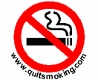
CIGARETTES AND NICOTINE
http://www.webmd.com/smoking-cessation/slideshow-13-best-quit-smoking-tips-ever

Slide 22
Tobacco Use
Regular smokers lose 6 minutes of life with every cigarette they smoke! – 2 hours lost per day!
Even moderate use of any tobacco product could reduce life expectancy by 5 to 7 years.
#1 preventable cause of death – more than 400,000 deaths per year in the U.S.
Factor in heart disease, cancer, emphysema, COPD, high blood pressure, stroke, high LDL levels, etc.
Smoking is responsible for 30% of all cancers.
© 2008 McGraw-Hill Higher Education. All rights reserved.

Slide 23
TRENDS IN SMOKING
Smoking declined from 42% of adults 18 and over to 25% from 1965 to 1990.
80% of adult smokers began smoking by age 18. (1991 survey)
In 1997 47 million US adults continue to smoke. (27% men 22% women)
4.5 million children age 12-17 smoke cigarettes
Daily smokers who think that they will not smoke in five years, nearly 75% are still smoking five to six years later.
70% of adolescent smokers wish they had never started smoking in the first place.
In Georgia, 23.7% of adults 18 and over smoke. (Utah 13.9% Nevada 31.5%)
In Georgia 13.8% of Middle School students smoke. (4.4% use spit tobacco)

Slide 24
Trends in per capita cigarette consumption for selected states and the average consumption across all states, 1980-2003
United States
California
Massachusetts
Data from: Orzechowski W, Walker RC. The tax burden on tobacco: historical compilation 2003: Volume 36. Arlington (VA): Orzechowski and Walker; 2003.
Notes:
In recent years, there have been increased efforts by states to implement comprehensive tobacco control programs. Between 1990 and 2003, tobacco consumption has declined from 133 to 79 packs per capita in the United States, with even greater declines among states with strong tobacco control programs.

Slide 25
Trends in Cigarette Smoking Prevalence* (%), by Gender, Adults 18 and Older, US, 1965-2004
Men
Women
*Redesign of survey in 1997 may affect trends.
Source: National Health Interview Survey, 1965-2004, National Center for Health Statistics, Centers for Disease Control and Prevention, 2005.
Notes:
The reduction in cigarette consumption has been associated with a decrease in adult smoking prevalence in both men and women since 1965. The difference in cigarette smoking across gender narrowed from 1965 to 1985, a result of smoking becoming more popular among women and higher rates of quitting among male smokers following the Surgeon General’s Report.

Slide 26
Current* Cigarette Smoking Prevalence (%), by Gender and Race/Ethnicity, High School Students, US, 1991-2003
*Smoked cigarettes on one or more of the 30 days preceding the survey. Source: Youth Risk Behavior Surveillance System, 1991, 1995, 1997, 1999, 2001, 2003, National Center for
Chronic Disease Prevention and Health Promotion, Centers for Disease Control and Prevention, 2004.
Notes:
Reduction in cigarette smoking among youth is an important factor in reducing prevalence and addiction in adulthood. Smoking among high school students increased from 1991 to 1997 and then began to decline. It is thought that the increase in smoking from 1991 to 1997 was due to aggressive youth targeted marketing and promotions; tobacco companies greatly increased their expenditures and promotions during that period. The subsequent decline is thought to be due to increased price of cigarettes as well as tobacco control efforts. Patterns were similar for Whites, African Americans, and Hispanics and for males and females.

Slide 27
Nicotine Addiction|
Physiological dependence: | Tolerance Dependence Withdrawal symptoms
Psychological dependence:
Sociocultural Factors: | Social activity Numerous daily rituals Family origin and cultural practices
Stimulation | Tension reduction
Handling | Habit
Pleasurable relaxation | Craving
Human genetics, early family experiences, environmental factors and societal influences appear to work together in complex ways, to set the addictive cycle in motion.
At times tobacco can act as a stimulant and at other times it may produce tranquilizing effects.

Slide 28
Nicotine combines with a number of neurotransmitters in the brain and may contribute to the following effects:
Dopamine: | Pleasure, suppress appetite | Norepinephrine: | Arousal, suppress appetite
Acetylcholine: | Arousal, cognitive enhancement | Vasopressin: | Memory improvement
Serotonin: | Mood modulation, suppress appetite | Beta-endorphin: | Reduce anxiety / tension
Tobacco is as addictive as heroin (as a mood & behavior altering agent).
Nicotine is:
1000 X more potent than alcohol
10-100 X more potent than barbiturates
5-10 X more potent than cocaine or morphine
A 1-2 pack per day smoker takes 200-400 hits daily for years. This constant intake of a fast acting drug (which affects mood, concentration & performance).. eventually produces dependence. Pressures to relapse are both behaviorally & pharmacologically triggered.
Quitting involves a significantly serious psychological loss... a serious life style change.

Slide 29
The Chemicals in Cigarettes
Tobacco smoke contains more than 4,000 chemicals. Many are known to be harmful substances, and according to Health Canada, about 50 of these chemicals cause cancer in humans, including 2-naphthylamine, 4-aminobiphenyl, arsenic, benzene and nickel. Some of the harmful chemical substances found in cigarette smoke are:
Acetaldehyde Acetamide Acetone Acrolein Acrylonitrile 4-Aminobiphenyl Ammonia Aniline Arsenic Benzaanthracene Benzene Benzoapyrene Benzobfluoranthen | Benzokfluoranthene Cadmium Captan Carbon disulfide Carbon monoxide Catechol Chromium VI Chrysene DDT Dibenza,hacridine Dibenza,hanthracene Dibenza,jacridine | Dibenzoa,epyrene Dibenzoa,hpyrene Dibenzoa,ipyrene 1,1-Dimenthylhydrazine Formaldehyde Hydrogene cyanide Hydroquinone Lead 1-Naphthylamine 2-Naphthylamine Nickel 2-Nitropropane | Nitrosodi-n-butylamine N-Nitrosodiethanolamine N-Nitrosodiethylamine N-Nitroso-n-methylethylamine N'-Nitrosonornicotine N-Nitrosopiperidine N-Nitrosopyrrolidine Phenol Pyridine Quinoline Styrene 2-Toluidine Urethane

Slide 30
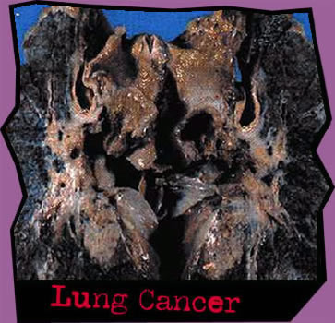
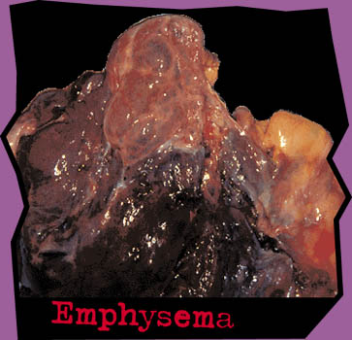

Slide 31
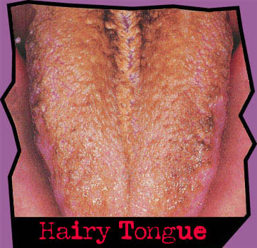
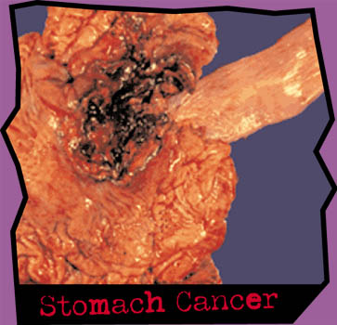

Slide 32
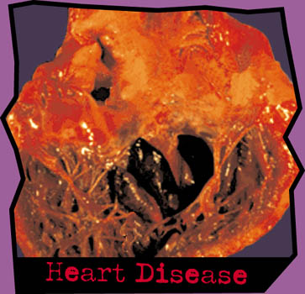
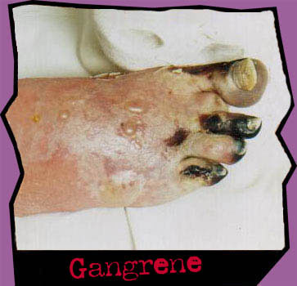
http://www.youtube.com/watch?v=dn50mTEGnrU

Slide 33
How to Quit Smoking
Identify your reasons.
Identify your barriers to quitting.
Make a plan for dealing with temptations.
Change to a brand you find distasteful.
Involve your friends and family.
Set a date.
On the day you quit, toss out all cigarettes, tobacco, and other paraphernalia.
After quitting, change your normal routine.
When you crave, chew on carrots, pickles, sugarless gum or a toothpick.
Mark your progress.
http://www.webmd.com/video/how-to-quit-smoking
© 2008 McGraw-Hill Higher Education. All rights reserved.

Slide 34
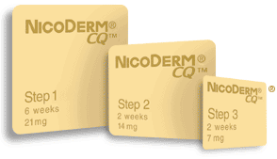
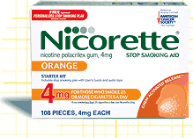
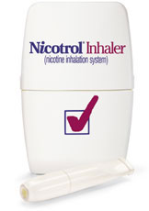
Nicotine Replacement Therapy
Drug Therapy
http://www.huffingtonpost.com/2011/06/20/cigarette-warnings-labels-photos-fda_n_880885.html#s295464

Slide 35
Passive Smoking
Passive smoking or secondhand smoke is breathing air polluted by tobacco smoke.
Passive smoking causes more than 60,000 deaths per year.
It acts as a carcinogen.
It can worsen medical conditions such as asthma, emphysema, and anemia, increases Sudden Infant Death Syndrome, increases infections in children.
© 2008 McGraw-Hill Higher Education. All rights reserved.

Slide 36
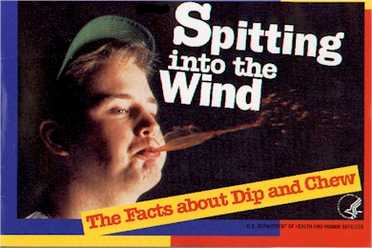

Slide 37
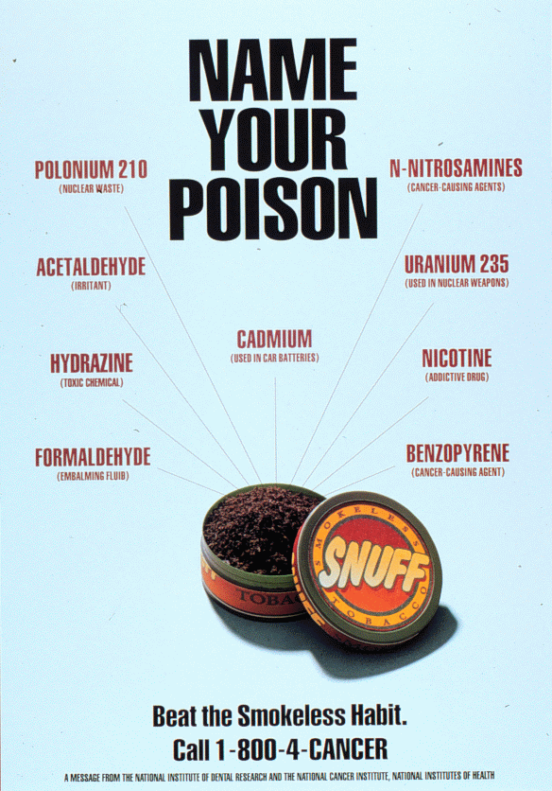

Slide 38
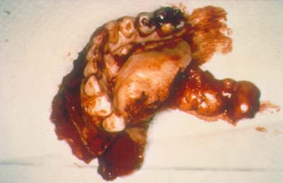
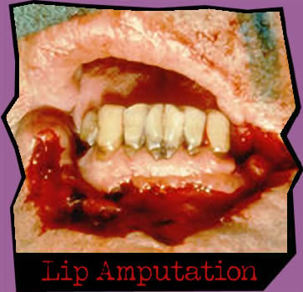
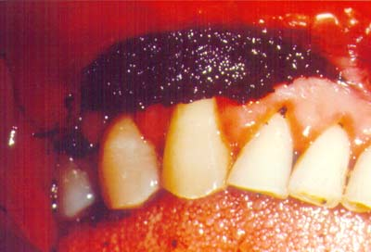

Slide 39
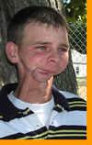
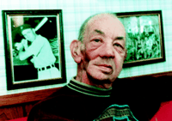

Slide 40
DRUG ABUSE
http://www.webmd.com/drug-medication/slideshow-commonly-abused-drugs

