Slide 1

14
Network Goods
SLIDES CREATED BY ERIC CHIANG
Ajv123ajv / Dreamstime.com
CHAPTER 14 SLIDE 1

Slide 2
CHAPTER OBJECTIVES
Describe the similarities and differences among the three main types of networks.
Explain what a network good is and how consuming a network good generates an external benefit.
Describe the steps in deriving a demand curve for a network good.
Describe how the opposing forces of the network effect and price effect determine who are core users and casual users of network goods.

CHAPTER 14
SLIDE 2

Slide 3
CHAPTER OBJECTIVES
Describe how networks can rapidly expand or decline due to network effects.
Describe the strategies firms use to compete in the market for network goods.
Discuss the role of regulation in promoting network efficiency and competition.
Explain how interconnection promotes competition in industries with essential facilities.
CHAPTER 14
SLIDE 3

Slide 4
NETWORK
A TYPE OF STRUCTURE THAT CONNECTS ONE ENTITY WITH ANOTHER
There are three types of networks:
  physical
  virtual
  social
CHAPTER 14
SLIDE 4

Slide 5

MARTIAL TREZZINI/EPA/CORBIS
  PHYSICAL NETWORKS ARE CONNECTED BY A PHYSICAL STRUCTURE SUCH AS FIBER OPTICS, SATELLITES, OR TRANSPORTATION ROUTES.
CHAPTER 14
SLIDE 5

Slide 6
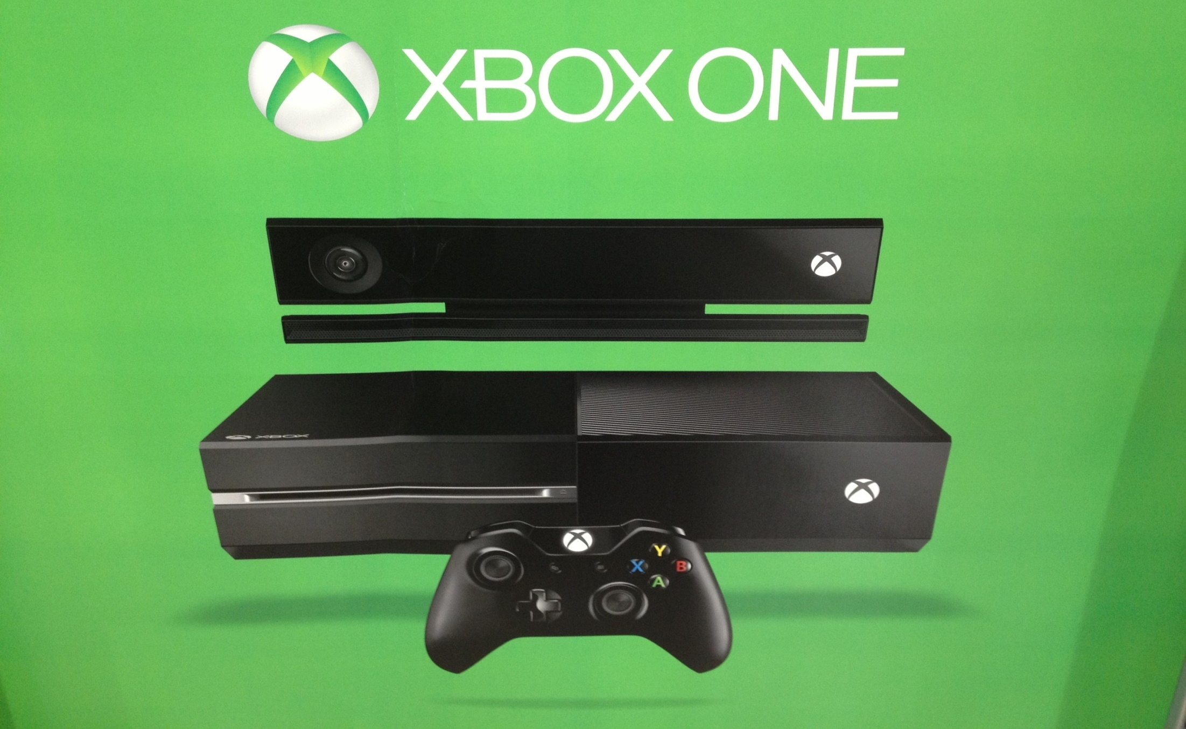
ERIC CHIANG
  VIRTUAL NETWORKS ARE CONNECTED BY GROUPS OF PEOPLE USING THE SAME TYPE OR BRAND OF GOOD OR SERVICE.
CHAPTER 14
SLIDE 6

Slide 7

ERIC CHIANG
  SOCIAL NETWORKS ARE CONNECTED VIRTUALLY BUT ALSO MORE DIRECTLY THROUGH CONTACTS WITHIN THE NETWORK.
CHAPTER 14
SLIDE 7

Slide 8

DANIELOIZO/DREAMSTIME.COM
  A network good describes a type of good or service whose existence depends on the a physical, virtual, or social network.
CHAPTER 14
SLIDE 8

Slide 9

GINASANDERS/DREAMSTIME.COM
  A NETWORK EFFECT OCCURS WHEN THE VALUE OF A PRODUCT RISES AS MORE PEOPLE USE THE PRODUCT, WHICH ENCOURAGES EVEN MORE PEOPLE TO USE IT.
CHAPTER 14
SLIDE 9

Slide 10

JASON KEMPIN/GETTY IMAGES
  IN 2013, JUSTIN TIMBERLAKE RELEASED HIS NEW SONGS FREE ON MUSIC STREAMING SITES. THEIR POPULARITY SOARED, LEADING TO A TOP-SELLING ALBUM ONCE RELEASED (A NETWORK EFFECT).
CHAPTER 14
SLIDE 10

Slide 11

NETWORK EXTERNALITY VS. EFFECT
  NETWORK EXTERNALITY
  NETWORK EFFECT
    AN EXTERNAL BENEFIT GENERATED FROM THE CONSUMPTION OF A NETWORK GOOD
INFLUENCE OF NETWORK EXTERNALITIES ON CONSUMERS’ DECISION MAKING
CHAPTER 14
SLIDE 11

Slide 12
NETWORK EFFECTS
Each consumer produces an external benefit, the difference between D_{P} and D_{S}.
S
This external benefit produces a network effect that shifts both D_{P} and D_{S} farther to the right.
PRICE
D_{S1}
D_{S}
D_{P1}
D_{P}
0
QUANTITY OF SUBSCRIBERS
CHAPTER 14
SLIDE 12

Slide 13
DEMAND CURVES FOR NETWORK GOODS
A network demand curve reflects the fact that the value of a good initially rises as more people purchase or subscribe to the good.
Two assumptions:
  The short-run supply curve is limited to the capacity of a firm’s fixed investment and therefore is vertical.
  Each short-run supply curve corresponds to a demand curve for that supply.
CHAPTER 14
SLIDE 13

Slide 14
A SMALL NETWORK WITH FIXED CAPACITY
S₀
S₁
A small network starts with a small demand.
As the network expands, the network effect increases demand but is offset by the price effect.
PRICE
P₁
P₀
D₁
D₀
Q₀
Q₁
NETWORK EXPANSION (Q)
CHAPTER 14
SLIDE 14

Slide 15
THE NETWORK DEMAND CURVE
As the network expands further, the network demand curve is developed, with an upward sloping portion and then a downward sloping portion.
PRICE
NETWORK DEMAND CURVE
CORE USERS
CASUAL USERS
NETWORK EXPANSION (Q)
CHAPTER 14
SLIDE 15

Slide 16
NETWORK DEMAND CURVE
  CORE USERS
  CASUAL USERS
    CONSUMERS FOR WHOM THE NETWORK EFFECT DOMINATES THE PRICE EFFECT
CONSUMERS FOR WHOM THE PRICE EFFECT DOMINATES THE NETWORK EFFECT
CHAPTER 14
SLIDE 16

Slide 17
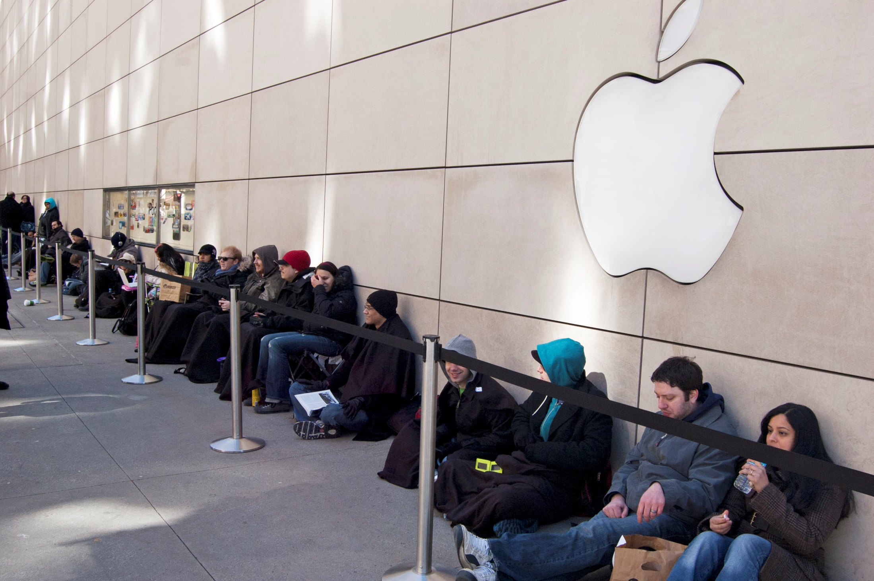
JKIRSH/DREAMSTIME.COM
  CORE USERS ARE THE FIRST TO TRY NEW PRODUCTS. THEY ARE REPRESENTED BY THE UPWARD SLOPING PORTION OF THE NETWORK DEMAND CURVE.
CHAPTER 14
SLIDE 17

Slide 18

LISAFX/DREAMSTIME.COM
  CASUAL USERS ARE MORE PRICE CONSCIOUS. THEY ARE REPRESENTED BY THE DOWNWARD SLOPING PORTION OF THE NETWORK DEMAND CURVE.
CHAPTER 14
SLIDE 18

Slide 19
ECONOMIES OF SCALE AND MARGINAL COST
Network goods generally require a very large fixed cost to produce.
Once the network good is produced, the marginal cost of providing it to customers is minimal.
Firms exhibit large economies of scale.
CHAPTER 14
SLIDE 19

Slide 20
EQUILIBRIUM IN THE MARKET FOR NETWORK GOODS
The tipping point is the quantity at which network effects are strong enough to expand the network to equilibrium at point d.
PRICE
TIPPING POINT
c
d
MARGINAL COST
b
NETWORK DEMAND CURVE
a
NETWORK EXPANSION (q)
CHAPTER 14
SLIDE 20

Slide 21
VIRTUOUS VERSUS VICIOUS CYCLES
  VIRTUOUS CYCLE
  VICIOUS CYCLE
    OCCURS WHEN NETWORK EFFECTS PUSH DEMAND TO THE RIGHT, ADDING EVEN MORE VALUE TO THE NETWORK
OCCURS WHEN A REDUCTION IN DEMAND CAUSES MORE PEOPLE TO AVOID THE PRODUCT, MAGNIFYING THE EFFECT
CHAPTER 14
SLIDE 21

Slide 22

PSL IMAGES/ALAMY
  DROPBOX GAINED OVER 50 MILLION USERS IN ONE YEAR AS ITS POPULARITY ROSE THROUGH NETWORK EFFECTS, CREATING A VIRTUOUS CYCLE.
CHAPTER 14
SLIDE 22

Slide 23

ANDRES RODRIGUEZ | DREAMSTIME.COM
MYSPACE
  OTHER FIRMS ARE SUBJECT TO VICIOUS CYCLES. MYSPACE LOST MOST OF ITS SUBSCRIBERS AFTER 2007.
CHAPTER 14
SLIDE 23

Slide 24
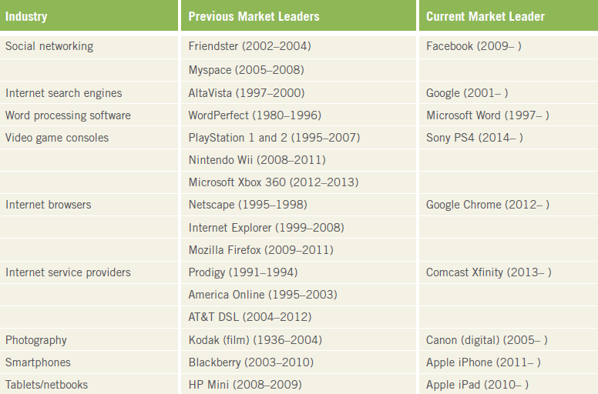
  VIRTUOUS AND VICIOUS CYCLES ABOUND AS OLD PRODUCTS ARE REPLACED WITH NEW PRODUCTS.
CHAPTER 14
SLIDE 24

Slide 25
COMPETITION IN NETWORK GOODS
Network effects cause some firms to flourish rapidly and others to fail quickly.
The determinant of a product’s success is not always its quality but rather the competitive strategies to capture market share via network effects.
Firms spend significant money to protect and gain market share using:
  teaser strategies.
  lock-in (switching costs) strategies.
  market segmentation.
CHAPTER 14
SLIDE 25

Slide 26

CAMMERAYDAVE/DREAMSTIME.COM
  TEASER STRATEGIES ARE DEALS OFFERED UP FRONT TO ATTRACT NEW CUSTOMERS (SUCH AS A FREE SMARTPHONE, LOW-INTEREST FINANCING, ETC.).
CHAPTER 14
SLIDE 26

Slide 27
SWITCHING COSTS
A COST IMPOSED ON CONSUMERS WHEN THEY CHANGE PRODUCTS OR SUBSCRIBE TO A NEW NETWORK. THEY INCLUDE MONETARY AND NONMONETARY COSTS AND OFTEN ARE SUBSTANTIAL FOR NETWORK GOODS.
CHAPTER 14
SLIDE 27

Slide 28

STEWART COHEN/PAM OSTROW/BLEND IMAGES/CORBIS
  A LOCK-IN STRATEGY IS USED TO MAKE IT HARDER TO LEAVE A NETWORK (SUCH AS LOSING LOYALTY BENEFITS) BY RAISING THE SWITCHING COSTS.
CHAPTER 14
SLIDE 28

Slide 29
MARKET SEGMENTATION
Firms differentiate their products to allow similar goods to be priced differently to different groups of consumers.
Firms price discriminate, which increases profits.
Market segmentation strategies include:
  versioning.
  intertemporal pricing.
  peak-load pricing.
  bundling.
CHAPTER 14
SLIDE 29

Slide 30

FLYNT | DREAMSTIME.COM
  VERSIONING OCCURS WHEN FIRMS OFFER DIFFERENT PRICING BASED ON THE TYPE OF SERVICES DESIRED (SUCH AS CABLE PLANS).
CHAPTER 14
SLIDE 30

Slide 31
INTERTEMPORAL AND PEAK-LOAD PRICING
INTERTEMPORAL PRICING
A versioning strategy: A firm differentiates a product by its timing. An example of intertemporal pricing is airlines raising the price of tickets the closer one books to the travel date.
PEAK-LOAD PRICING
A versioning strategy: A product’s price is higher during periods of higher demand and lower during periods of lower demand. Free night and weekend wireless plans are an example of peak-load pricing.
CHAPTER 14
SLIDE 31

Slide 32
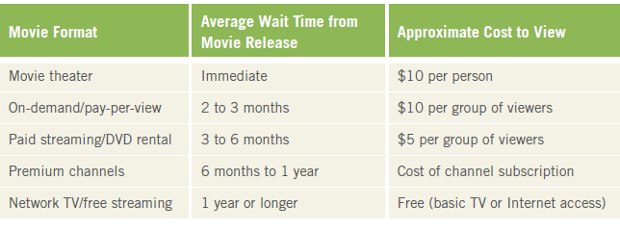
INTERTEMPORAL PRICING OF MOVIES
CHAPTER 14
SLIDE 32

Slide 33
PEAK-LOAD PRICING
MC
Peak demand pricing is higher than off-peak pricing.
P_{P}
PRICE
P_{O}
D (PEAK)
MR (PEAK)
MR (OFF PEAK)
D (OFF PEAK)
Q_{O}
Q_{P}
OUTPUT
CHAPTER 14
SLIDE 33

Slide 34


AJV123AJV/DREAMSTIME.COM
BUNDLING
PACKAGING SEVERAL ADD- ONS INTO A SINGLE PRODUCT WITH ONE PRICE. ALLOWS FIRMS TO CAPTURE CUSTOMERS OF RELATED PRODUCTS.
CHAPTER 14
SLIDE 34

Slide 35
PROMOTING COMPETITION
INDUSTRY STANDARDS
A common format that is used, for example, in televisions, DVRs, and software programs
ESSENTIAL FACILITIES
Inputs that are needed to produce a product or to allow a person to consume a product
INTERCONNECTION
The physical linking of networks to another network’s essential facilities. Prevents one firm from blocking another firm from accessing its essential facilities to prevent competition.
CHAPTER 14
SLIDE 35

Slide 36
SHOULD NETWORK GOODS BE REGULATED?
The government generally aims to ensure that competition for network goods leads to low prices and choices of quality goods.
It also must ensure that regulations do not impede productivity or impose burdensome costs on firms.
Bad regulation can sometimes be worse than no regulation.
CHAPTER 14
SLIDE 36

Slide 37
KEY CONCEPTS
Network
Physical network
Virtual network
Social network
Network good
Network externality
Network effect
Network demand curve
Core user
Casual user
Tipping point (critical mass)
Virtuous cycle
Vicious cycle
Teaser strategies
Switching cost
Lock-in strategies
Market segmentation
Versioning
Intertemporal pricing
Peak-load pricing
Bundling
Industry standard
Essential facility
Interconnection
CHAPTER 14 SLIDE 37

Slide 38
WHICH OF THE FOLLOWING IS A NETWORK EFFECT?
A
A BLACK FRIDAY SALE ENCOURAGES YOU TO BUY A TV.
B
YOUR FRIEND CANCELS HER GYM MEMBERSHIP, SO YOU DO TOO.
C
YOU USE YOUR HOLIDAY BONUS TO PAY OFF BILLS.
D
A PARADE COMES TO TOWN, DISRUPTING TRAFFIC ALL DAY.
E
YOUR MOM SENDS YOU A SHIRT, WHICH YOU GIVE TO CHARITY.
CHAPTER 14
SLIDE 38
Notes:
Answer: B

Slide 39
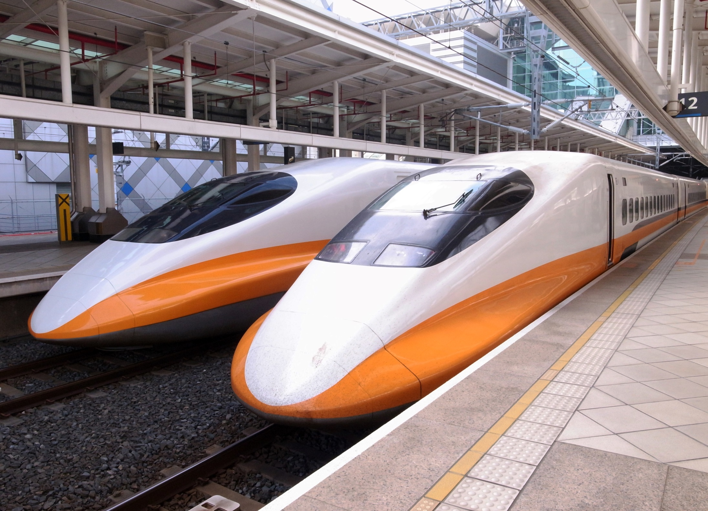
PRACTICE QUESTION
WAYNE0216 | DREAMSTIME.COM
HIGH-SPEED TRAINS ARE A BIG INVESTMENT, ESPECIALLY IN THE UNITED STATES WHERE TRAINS ARE NOT POPULAR. WHAT STRATEGIES COULD BE USED TO GENERATE A VIRTUOUS CYCLE?
CHAPTER 14
SLIDE 39
Notes:
Answer: For high-speed trains to succeed, enough people must ride them so that additional trains and routes can be added, further enhancing their value. To produce a virtuous cycle, it may be necessary to offer teaser deals, such as half-price rides for a year, or generous loyalty programs that make it difficult to leave once hooked.

Slide 40
AT WHICH PART OF THE NETWORK DEMAND CURVE ARE NETWORK EFFECTS STRONGEST?
A
UPWARD SLOPING PORTION
B
DOWNWARD SLOPING SECTION
C
PEAK
D
ORIGIN
E
VERY END OF THE CURVE
CHAPTER 14
SLIDE 40
Notes:
Answer: A

Slide 41

PRACTICE QUESTION
MOST OF YOUR FRIENDS DO NOT USE THE SAME WIRELESS PROVIDER AS YOU. WHAT MUST HAPPEN TO MAKE SURE YOUR CALLS AND TEXT MESSAGES GO THROUGH?
ANDRES RODRIGUEZ | DREAMSTIME.COM
CHAPTER 14
SLIDE 41
Notes:
Answer: The wireless carriers must be connected to each other’s essential facilities. This is called interconnection. For example, AT&T must agree to connect calls that start from a Verizon or Sprint customer and vice versa. The same is true for international service: foreign carriers must complete calls that originate in another country.

Slide 42
WHEN YOU BUY A NEW COMPUTER, IT OFTEN COMES PRELOADED WITH A LOT OF SOFTWARE. WHAT STRATEGY IS BEING USED?
A
A TEASER STRATEGY
B
VERSIONING
C
INTERTEMPORAL PRICING
D
BUNDLING
E
PEAK-LOAD PRICING
CHAPTER 14
SLIDE 42
Notes:
Answer: D

Slide 43
14
END OF CHAPTER
SLIDES CREATED BY ERIC CHIANG
Tshooter/Shutterstock; Anton Balazh/Shutterstock
CHAPTER 14
SLIDE 43

