Slide 1

11
The Labor Market
SLIDES CREATED BY ERIC CHIANG
Digital Vision / Getty Images
CHAPTER 11 SLIDE 1

Slide 2
CHAPTER OBJECTIVES
Discuss the tradeoffs between work and leisure according to the substitution and income effects.
Explain why an individual labor supply curve is backward-bending.
Describe the factors that can change labor supply.
Describe the factors that can change labor demand.
Determine the competitive market equilibrium for labor.

CHAPTER 11
SLIDE 2

Slide 3
CHAPTER OBJECTIVES
Identify the ways in which economic discrimination can occur.
Describe the concept of segmented labor markets and how they affect wage levels.
Identify the federal laws and policies aimed at combating discrimination.
Describe the history, costs, and benefits of trade unions.
Discuss how the labor market has adapted to changing economic conditions over the last few decades.
CHAPTER 11
SLIDE 3

Slide 4
COMPETITIVE LABOR MARKETS
Competitive labor markets are similar to competitive product markets. Several key assumptions:
  Firms operate in competitive industries with many buyers and sellers, a homogeneous product, and easy entry and exit.
  All workers are regarded as equally productive.
  Information in the industry is widely available and accurate.
CHAPTER 11
SLIDE 4

Slide 5

PAUL BRADBURY/GETTY IMAGES
THE SUPPLY OF LABOR: THE TIME AN INDIVIDUAL IS WILLING TO WORK AT VARIOUS WAGE RATES
CHAPTER 11
SLIDE 5

Slide 6

INDIVIDUAL LABOR SUPPLY
  SUBSTITUTION EFFECT
  INCOME EFFECT
    WORKERS CHOOSE MORE HOURS AS WAGES RISE (OPPORTUNITY COST OF LEISURE RISES).
WORKERS CHOOSE FEWER HOURS WHEN WAGES RISE AND MORE HOURS WHEN WAGES FALL.
CHAPTER 11
SLIDE 6

Slide 7
BACKWARD BENDING INDIVIDUAL LABOR SUPPLY
S_{L}
W₃
Income effect dominates substitution effect at higher wages.
WAGE RATE
W₂
Substitution effect dominates income effect at lower wages.
W₁
0
l₁
l₂
HOURS OF WORK
CHAPTER 11
SLIDE 7

Slide 8
MARKET LABOR SUPPLY
Unlike individual labor supply curves, the market labor supply curve is positively sloped: Higher wages attract more workers (e.g., point a to point b).
S₀
S₁
b
W₂
WAGE RATE
a
Market labor supply can shift (e.g., point a to point c) in response to various factors.
W₁
c
0
L₁
L₂
HOURS OF WORK
CHAPTER 11
SLIDE 8

Slide 9
SHIFTS IN LABOR SUPPLY
The following factors can lead to a shift of the labor supply curve:
  Demographic changes
  Nonwage aspects of jobs
  Wages in alternative jobs
  Nonwage income
CHAPTER 11
SLIDE 9

Slide 10

THE FIRM’S DEMAND FOR LABOR IS DERIVED FROM DEMAND FOR ITS PRODUCT AND THE PRODUCTIVITY OF LABOR.
ERIC CHIANG
CHAPTER 11
SLIDE 10

Slide 11
MARGINAL REVENUE PRODUCT, MRP_{L}
Amount of additional revenue one worker earns for the firm
MRP_{L} = MPP_{L} × MR
MPP_{L} is the marginal physical product of labor: the additional output from adding one more worker.
CHAPTER 11
SLIDE 11

Slide 12
VALUE OF THE MARGINAL REVENUE PRODUCT, VMP_{L}
In competitive labor markets, the firm is a price taker, which means MR = P.
MRP_{L} = MPP_{L} × P = VMP_{L}
For competitive firms, profits are maximized when labor is hired to the point where VMP_{L} = wage rate.
CHAPTER 11
SLIDE 12

Slide 13

LOU LINWEI/ALAMY
FIRMS HIRE WORKERS BASED ON THEIR VALUE RELATIVE TO THEIR COST: MRP_{L} = W.
CHAPTER 11
SLIDE 13

Slide 14
SHIFTS IN LABOR DEMAND
The following factors can lead to a shift of the labor demand curve:
  Changes in product demand
  Changes in productivity
  Changes in the prices of other inputs
Equilibrium in competitive labor markets occurs at the intersection of supply and demand.
CHAPTER 11
SLIDE 14

Slide 15
MARKET DEMAND FOR LABOR
FIRM’S DEMAND FOR LABOR
S_{L}
Firm hires L_{e} workers, where W_{e} = MRP_{L} = VMP_{L}
WAGE RATE
WAGE RATE
W_{e}
W_{e}
MRP_{L} = VMP_{L}
D_{L}
L_{e}
L_{e}
LABOR
LABOR
CHAPTER 11 SLIDE 15

Slide 16
ELASTICITY OF DEMAND FOR LABOR
=
% Δ QUANTITY_{L}
% Δ WAGE
Measures responsiveness of quantity of labor demanded to changes in wages. Factors include:
elasticity of demand for the product.
ease of input substitutability.
labor’s share of total production costs.
CHAPTER 11
SLIDE 16

Slide 17
ECONOMIC DISCRIMINATION
WORKERS OF EQUAL ABILITY AND PRODUCTIVITY ARE PAID DIFFERENT WAGES OR ARE OTHERWISE DISCRIMINATED AGAINST.
RESULT: MEMBERS OF DIFFERENT GROUPS ARE SEGREGATED INTO DIFFERENT OCCUPATIONS.
CHAPTER 11
SLIDE 17

Slide 18
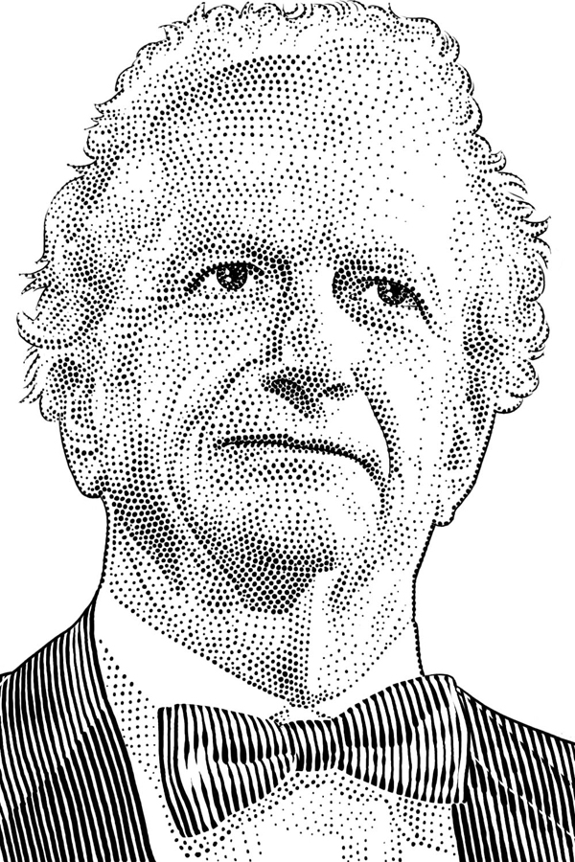
GARY BECKER (1930–2014)
Explained demographic changes and criminal behavior by focusing on economic incentives.
Argued that discrimination is economically detrimental to all parties.
Won Nobel Prize in Economics in 1992
CHAPTER 11
SLIDE 18

Slide 19
BECKER’S THEORY OF DISCRIMINATION
  NON-DISCRIMINATING FIRMS
  DISCRIMINATING FIRMS
    MUST PAY HIGHER WAGES FOR “PREFERRED” WORKERS, RESULTING IN HIGHER COSTS AND LOWER PROFITS
CAN HIRE FROM A LARGER SUPPLY OF WORKERS AT LOWER WAGES, RESULTING IN LOWER COSTS AND GREATER PROFITS
CHAPTER 11
SLIDE 19

Slide 20

WAVEBREAKMEDIA LTD/DREAMSTIME.COM
BECKER’S CONCLUSION: PRESSURES OF MARKET COMPETITION SHOULD DRIVE DISCRIMINATION TO ZERO IN THE LONG RUN.
CHAPTER 11
SLIDE 20

Slide 21
LIMITATIONS TO BECKER’S THEORY
Adjustment costs of firing unproductive workers and hiring new workers can be high.
Women may be less mobile than men and less willing to accommodate employer’s demands (such as travel).
Women may continue to choose more flexible career paths that do not penalize extended absences from the labor market.
CHAPTER 11
SLIDE 21

Slide 22
SEGMENTED LABOR MARKETS
Occur when labor markets split into separate parts, leading to wage differentials. Theories include:
❶
  Dual labor market hypothesis: labor market is split into primary and secondary sectors.
  Job crowding hypothesis: occupations ARE BROKEN into predominantly male and female jobs.
  Insider-outsider theory: workers are segregated into union and nonunion sectors.
❷
❸
CHAPTER 11
SLIDE 22

Slide 23
JOB CROWDING/DUAL LABOR MARKET
MALE-DOMINATED JOBS
FEMALE-DOMINATED JOBS
S₁
S₀
S₀
S₂
W₁
WAGE RATE
WAGE RATE
W_{e}
W_{e}
W₂
D
D
M₁
M₀
F₀
F₂
INDUSTRY OUTPUT
INDUSTRY OUTPUT
Discrimination in male-dominated jobs shifts the supply left, pushing wages higher, while female-dominated jobs see wages fall.
CHAPTER 11 SLIDE 23

Slide 24
PUBLIC POLICY TO
COMBAT DISCRIMINATION
❶
  EQUAL PAY ACT OF 1963 REQUIRES THAT WOMEN AND MEN RECEIVE EQUAL PAY FOR EQUAL WORK.
  CIVIL RIGHTS ACT OF 1964 PROHIBITS DISCRIMINATION BASED ON RACE, COLOR, SEX, RELIGION, NATIONALITY.
  EXECUTIVE ORDER 11246 ESTABLISHED AFFIRMATIVE ACTION.
❷
❸
CHAPTER 11
SLIDE 24

Slide 25
PUBLIC POLICY TO
COMBAT DISCRIMINATION
❹
  AGE DISCRIMINATION IN EMPLOYMENT ACT OF 1967 PROTECTS WORKERS OVER AGE 40 FROM AGE DISCRIMINATION.
  AMERICANS WITH DISABILITIES ACT (1990) PROHIBITS DISCRIMINATION BASED ON PHYSICAL OR MENTAL DISABILITIES.
  EMPLOYMENT NONDISCRIMINATION ACT (PROPOSED) WOULD PROHIBIT DISCRIMINATION BASED ON SEXUAL ORIENTATION OR GENDER IDENTITY.
❺
❻
CHAPTER 11
SLIDE 25

Slide 26

PHILIP GOSTELOW/AURORA PHOTOS/CORBIS
UNIONS ARE ASSOCIATIONS OF EMPLOYEES THAT BARGAIN WITH EMPLOYERS OVER THE TERMS AND CONDITIONS OF WORK.
CHAPTER 11
SLIDE 26

Slide 27
TYPES OF UNIONS
  INDUSTRIAL UNION
  CRAFT UNION
    REPRESENTS MEMBERS OF A SPECIFIC CRAFT OR OCCUPATION (EXAMPLE: AIR TRAFFIC CONTROLLERS— PATCO)
REPRESENTS ALL WORKERS EMPLOYED IN A SPECIFIC INDUSTRY (EXAMPLE: AUTO WORKERS—UAW)
CHAPTER 11
SLIDE 27

Slide 28
BENEFITS VS. COSTS OF UNION MEMBERSHIP
Benefits include:
  higher wages and job benefits through collective bargaining.
  greater job security against arbitrary or vindictive decisions by management.
Costs include:
  membership dues.
  costs of strikes (lost wages).
  loss of some individual flexibility.
CHAPTER 11
SLIDE 28

Slide 29
TYPES OF UNION STRUCTURES
CLOSED SHOP
Only union members are hired.
UNION SHOP
Nonunion workers can be hired but must join the union within a specified time.
AGENCY SHOP
Nonunion workers may be hired but must pay union dues for its services.
CHAPTER 11
SLIDE 29

Slide 30
HISTORY OF AMERICAN UNIONS
Wagner Act (1935)
  Prohibited a variety of unfair labor practices, including firing workers for engaging in union activities.
  Required employers to “bargain in good faith.”
Taft-Hartley Act (1947)
  Prohibits unfair labor practices by unions.
  Helped balance the Wagner Act by outlawing closed shops and permitting states to pass right-to-work laws.
CHAPTER 11
SLIDE 30

Slide 31

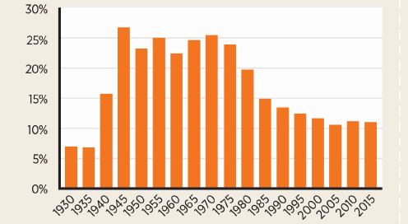
AP PHOTO/KEVORK DJANSEZIAN
UNION MEMBERSHIP HAS FALLEN SINCE THE 1970s.
CHAPTER 11
SLIDE 31

Slide 32

DAVID R. FRAZIER/THE IMAGE WORKS
THE AVERAGE UNION WAGE IS 10% to 20% HIGHER THAN THE AVERAGE NONUNION WAGE WITHIN THE SAME INDUSTRY.
CHAPTER 11
SLIDE 32

Slide 33
UNIONS AND WAGES
UNION SECTOR
NONUNION SECTOR
S₁
S₀
S₀
S₂
W₁
WAGE RATE
WAGE RATE
W_{e}
W_{e}
W₂
D
D
L₁
L₀
L₀
L₂
INDUSTRY OUTPUT
INDUSTRY OUTPUT
Unions reduce labor supply to push wages higher; this causes an increase in supply in the nonunion sector, reducing wages.
CHAPTER 11 SLIDE 33

Slide 34





JOBS OF THE FUTURE FOCUS MORE ON SERVICES, SUCH AS HEALTH CARE, TRANSPORTATION, AND INFORMATION TECHNOLOGY.
JETTA PRODUCTIONS/GETTY IMAGES
STEFANIE GREWEL/CORBIS
CHAPTER 11
SLIDE 34

Slide 35

CHARLES PERTWEE/CORBIS
INCREASED TECHNOLOGY AND THE GROWTH OF HIGH-SKILLED JOBS HAS LED TO GREATER IMPORTANCE OF EDUCATION.
CHAPTER 11
SLIDE 35

Slide 36
Supply of labor
Substitution effect
Income effect
Demand for labor
Marginal physical product of labor
Marginal revenue product
Value of the marginal product
Elasticity of demand for labor
Economic discrimination
Segmented labor markets
Closed shop
Union shop
Agency shop
Right-to-work laws
KEY CONCEPTS
CHAPTER 11
SLIDE 36

Slide 37
WHICH OF THE FOLLOWING FACTORS WOULD SHIFT THE MARKET LABOR SUPPLY CURVE TO THE RIGHT?
A
AN INCREASE IN NONWAGE INCOME FROM INVESTMENTS
B
A REDUCTION IN EMPLOYER HEALTH CARE COVERAGE
C
AN INCREASE IN THE WAGES IN OTHER INDUSTRIES
D
AN INCREASE IN MINIMUM AGE FOR RETIREMENT BENEFITS
CHAPTER 11
SLIDE 37
Notes:
Answer: D

Slide 38

PRACTICE QUESTION
RAMIN TALAIE/CORBIS
YOU RECEIVE A RAISE FROM $10 TO $15 PER HOUR, SO YOU REDUCE YOUR HOURS TO STUDY MORE. IS YOUR SUBSTITUTION OR INCOME EFFECT STRONGER?
CHAPTER 11
SLIDE 38
Notes:
Answer: Income effect is stronger than the substitution effect in this case.

Slide 39
SUPPOSE IMMIGRATION LAWS TIGHTEN. WHAT WILL LIKELY HAPPEN TO WAGES AND EMPLOYMENT IN THE LABOR MARKET?
A
WAGES WOULD FALL; EMPLOYMENT WOULD RISE.
B
WAGES WOULD FALL; EMPLOYMENT WOULD FALL.
C
WAGES WOULD RISE; EMPLOYMENT WOULD RISE.
D
WAGES WOULD RISE; EMPLOYMENT WOULD FALL.
CHAPTER 11
SLIDE 39
Notes:
Answer: D

Slide 40

PRACTICE QUESTION
STEWART COHEN/PAM OSTROW/BLEND IMAGES/CORBIS
WHICH LAW MADE IT A REQUIREMENT THAT WOMEN AND MEN BE PAID EQUALLY FOR THE SAME TYPE OF WORK?
CHAPTER 11
SLIDE 40
Notes:
Answer: The Equal Pay Act of 1963

Slide 41
IN WHAT TYPE OF WORKPLACE ARE NONUNION HIRES ALLOWED, BUT THEY MUST JOIN THE UNION WITHIN A SPECIFIED PERIOD?
A
OPEN SHOP
B
CLOSED SHOP
C
UNION SHOP
D
AGENCY SHOP
CHAPTER 11
SLIDE 41
Notes:
Answer: C

Slide 42
11
END OF CHAPTER
SLIDES CREATED BY ERIC CHIANG
Tshooter/Shutterstock; Anton Balazh/Shutterstock
CHAPTER 11
SLIDE 42

