Slide 1
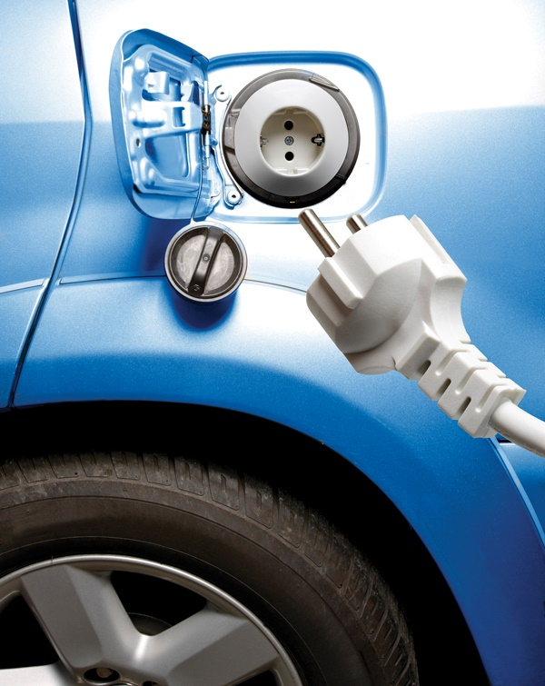
7
Production and Costs
SLIDES CREATED BY ERIC CHIANG
WESTEND61/SUPERSTOCK
CHAPTER 7 SLIDE 1

Slide 2
CHAPTER OBJECTIVES
Describe the nature of firms and markets.
Explain the difference between accounting and economic costs and how they affect the determination of profits.
Differentiate between the short run and long run.
Describe the nature of short-run production, total product, marginal product, and average product.
Differentiate among increasing, decreasing, and negative marginal returns.

CHAPTER 7
SLIDE 2

Slide 3
CHAPTER OBJECTIVES
Describe and compare the differences among fixed costs, variable costs, marginal costs, and average costs.
Explain the importance of marginal costs in the firm’s production decision.
Use a graph to show the relationship between the short-run average total cost and marginal cost curves.
Describe long-run costs.
Describe the reasons for economies and diseconomies of scale.
CHAPTER 7
SLIDE 3

Slide 4

JAMES LEYNSE/CORBIS
FIRM: AN ECONOMIC INSTITUTION THAT TRANSFORMS INPUTS TO GOODS AND SERVICES FOR CONSUMERS
CHAPTER 7
SLIDE 4

Slide 5

FIRMS
ALL FIRMS MUST DETERMINE:
  WHAT A MARKET WANTS.
  HOW TO PRODUCE THE GOOD OR SERVICE.
❶
❷
CHAPTER 7
SLIDE 5

Slide 6
TYPES OF FIRMS
  SOLE PROPRIETORSHIPS
  PARTNERSHIPS
  CORPORATIONS
CHAPTER 7
SLIDE 6

Slide 7
SOLE PROPRIETORSHIPS
One owner
Easy to start
Limited access to financial capital
Owner’s personal assets subject to unlimited liability
CHAPTER 7
SLIDE 7

Slide 8
PARTNERSHIPS
More than one owner
Can divide tasks among partners
  Division of labor
Personal assets of all owners subject to unlimited liability
  Includes negligence by partners
CHAPTER 7
SLIDE 8

Slide 9
CORPORATIONS
Owners called stockholders
Have legal rights (much like an individual)
Can raise money by issuing stocks and bonds
Owners protected by limited liability
  Losses limited to value of stock
CHAPTER 7
SLIDE 9

Slide 10

ROBERT HARDING WORLD IMAGERY/CORBIS
THE GOAL OF BUSINESSES IS TO MAXIMIZE PROFITS.
PROFITS = TOTAL REVENUE − TOTAL COST
REVENUE = PRICE PER UNIT × QUANTITY
CHAPTER 7
SLIDE 10

Slide 11
ECONOMIC COSTS
Include both explicit and implicit costs
  EXPLICIT COSTS
  IMPLICIT COSTS
    EXPENSES PAID DIRECTLY TO SOME ENTITY (WAGES, LEASE PAYMENTS, RAW MATERIALS, TAXES, ETC.)
OPPORTUNITY COSTS OF USING RESOURCES (DEPRECIATION, ASSET DEPLETION, FORGONE WAGES)
CHAPTER 7
SLIDE 11

Slide 12

IMAGE SOURCE/CORBIS
ACCOUNTING COSTS: INCLUDE ONLY EXPLICIT COSTS
CHAPTER 7
SLIDE 12

Slide 13
ACCOUNTING VS. ECONOMIC PROFIT
  ACCOUNTING PROFIT
  ECONOMIC PROFIT
    TOTAL REVENUE − EXPLICIT COSTS
TOTAL REVENUE − EXPLICIT COSTS − IMPLICIT COSTS
CHAPTER 7
SLIDE 13

Slide 14
ECONOMIC AND NORMAL PROFIT
A normal rate of return is the return just sufficient to keep investors satisfied; it therefore represents the opportunity cost of capital.
If a firm’s rate of return on capital falls below the normal rate of return, investors will put their funds to use elsewhere.
CHAPTER 7
SLIDE 14

Slide 15
ECONOMIC AND NORMAL PROFIT
A firm earns an economic profit when profits are greater than zero after implicit costs are considered.
A normal profit equals an economic profit of zero.
CHAPTER 7
SLIDE 15

Slide 16
SHORT RUN VERSUS LONG RUN
The short run is a period when at least one factor of production is fixed and cannot be altered.
  Plant capacity is fixed.
The long run is a period sufficient for a firm to adjust all factors of production, including plant capacity.
  Firms can enter or exit the industry.
CHAPTER 7
SLIDE 16

Slide 17
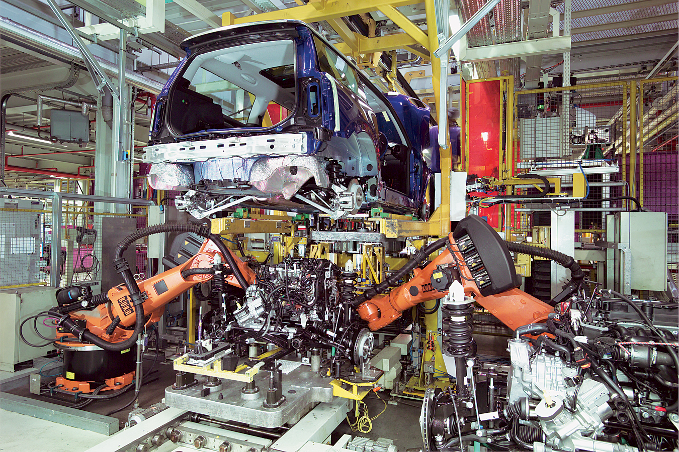
CHRISTOPHER HONEYWELL/ALAMY
PRODUCTION IS THE PROCESS OF TURNING INPUTS INTO OUTPUTS. THE COST STRUCTURE DEPENDS ON THE NATURE OF THE PRODUCTION PROCESS.
CHAPTER 7
SLIDE 17

Slide 18
PRODUCTION IN THE SHORT RUN
Marginal product is the change in output resulting from a one-unit increase in labor (ΔQ/ΔL)
  Marginal product initially rises as more workers are hired, then falls as diminishing returns set in.
Average product is total output divided by the amount of labor input (Q/L).
CHAPTER 7
SLIDE 18

Slide 19

EIGHTFISH/ALAMY
DIMINISHING RETURNS TO LABOR OCCUR AS MORE WORKERS ARE USED. IF TOO MANY WORKERS ARE USED, NEGATIVE RETURNS TO LABOR CAN RESULT.
CHAPTER 7
SLIDE 19

Slide 20
PRODUCTION IN THE SHORT RUN
b
30
A firm undergoes increasing returns to point a, decreasing returns to point b, then negative returns.
25
TP
a
20
OUTPUT
15
10
5
1
2
3
4
5
6
12
a
Marginal product and average product both rise and then fall. MP crosses the AP at its maximum.
10
8
AP AND MP
6
4
AP
2
b
1
2
3
4
5
6
QUANTITY
MP
CHAPTER 7
SLIDE 20

Slide 21
PRODUCTION COSTS IN THE SHORT RUN
Fixed costs (overhead) do not vary with the quantity produced.
Variable costs rise as the level of output increases.
Total costs are the sum of fixed and variable costs.
  TC = FC + VC
CHAPTER 7
SLIDE 21

Slide 22
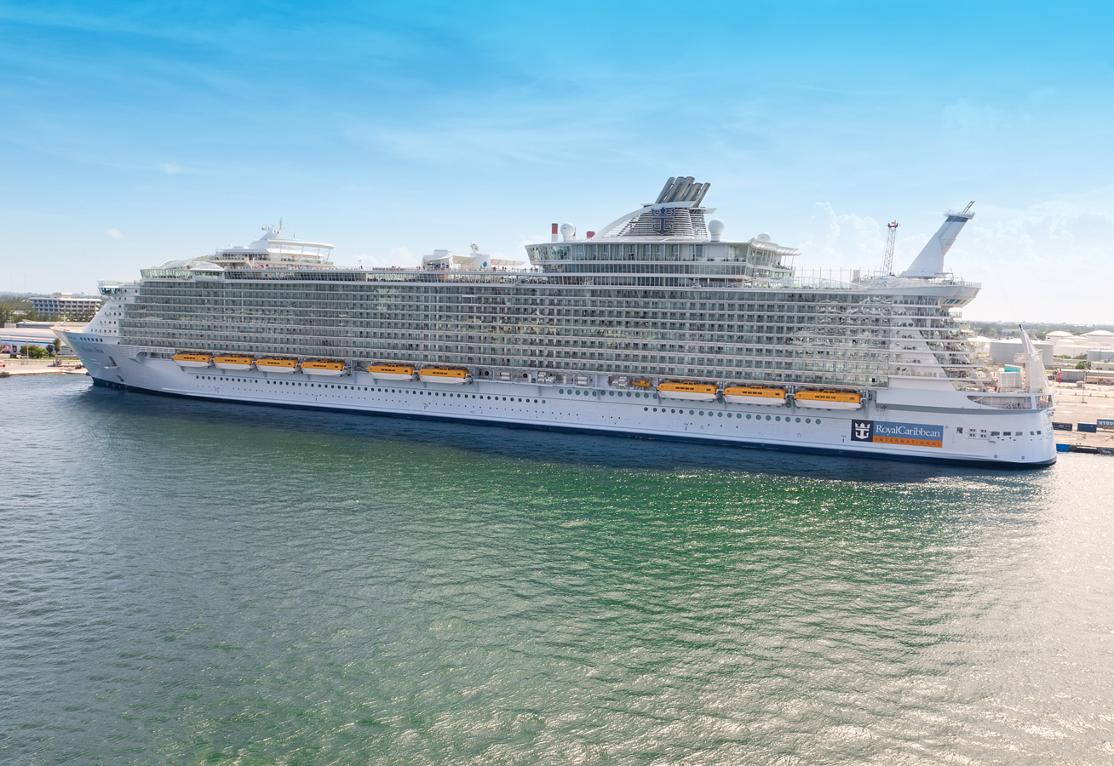
RUTH DREAMSTIME.COM
BUILDING A CRUISE SHIP IS A FIXED COST THAT DOES NOT DEPEND ON THE NUMBER OF PASSENGERS WHO WILL TRAVEL ON IT.
CHAPTER 7
SLIDE 22

Slide 23
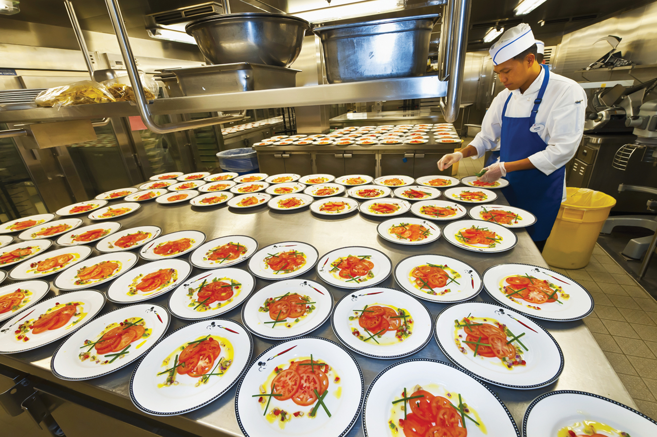
BLAINE HARRINGTON/AGE FOTOSTOCK
FOOD PREPARATION IS A VARIABLE COST ON A CRUISE SHIP: THE MORE PASSENGERS, THE GREATER THE FOOD COST.
CHAPTER 7
SLIDE 23

Slide 24

KOOBOOKI/THINKSTOCK
SUNK COSTS: ALREADY INCURRED; CANNOT BE RECOVERED. RATIONAL DECISIONS ABOUT FUTURE PROFITS IGNORE SUNK COSTS.
CHAPTER 7
SLIDE 24

Slide 25
PRODUCTION COSTS IN THE SHORT RUN
Marginal cost: The change in total cost from the production of one more unit of output. MC = ΔTC/ΔQ
Average cost: A measure of productivity (in terms of cost efficiency)
  Average fixed cost: FC/Q
  Average variable cost: VC/Q
  Average total cost: TC/Q
CHAPTER 7
SLIDE 25

Slide 26

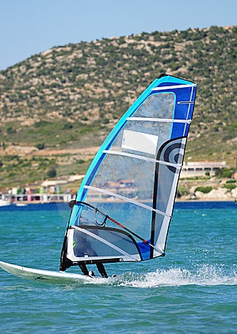
PRODUCTION COSTS IN THE SHORT RUN
Fill in the missing numbers in the table.
SENAI AKSOY/DREAMSTIME.COM
Quantity | FC | VC | TC | MC | AVC | ATC
0 |  |  | 50 | — | — | —
1 |  | 30 |  | 30
2 | 50 |  | 100 |  |  | 50
3 |  |  |  |  | 25
4 |  |  | 155
5 |  | 140 |  | 35 |  | 38
CHAPTER 7
SLIDE 26

Slide 27
PRODUCTION COSTS IN THE SHORT RUN
Answers:
SENAI AKSOY/DREAMSTIME.COM
Quantity | FC | VC | TC | MC | AVC | ATC
0 | 50 | 0 | 50 | — | — | —
1 | 50 | 30 | 80 | 30 | 30 | 80
2 | 50 | 50 | 100 | 20 | 25 | 50
3 | 50 | 75 | 125 | 25 | 25 | 42
4 | 50 | 105 | 155 | 30 | 26 | 39
5 | 50 | 140 | 190 | 35 | 28 | 38
CHAPTER 7
SLIDE 27

Slide 28
AVERAGE FIXED COST
1,200
The average fixed cost curve always decreases as production increases.
1,000
800
AVERAGE FIXED COST
600
a
400
b
200
AFC
1
2
3
4
5
6
OUTPUT
CHAPTER 7
SLIDE 28

Slide 29
SHORT RUN COST CURVES
Both the AVC and ATC curves are U-shaped.
  At relatively low levels of output, the curves slope downward, reflecting increasing returns as average costs fall.
  As production rises, diminishing returns set in, and average costs rise.
CHAPTER 7
SLIDE 29

Slide 30
AVERAGE AND MARGINAL COSTS
1,200
1,000
MC
ATC
The marginal cost curve crosses the minimum points of the ATC and AVC curves.
800
d
AVC
COST
600
c
400
200
1
2
3
4
5
6
OUTPUT
CHAPTER 7
SLIDE 30

Slide 31
PRODUCTION COSTS IN THE LONG RUN
In the long run, all inputs can be adjusted; therefore, there are no fixed costs in the long run.
  Firms choose the plant size appropriate for their market; plant size can be adjusted as output levels change.
  Each plant size is associated with a unique long-run cost structure.
CHAPTER 7
SLIDE 31

Slide 32
LONG-RUN AVERAGE TOTAL COST
In the long run, firms build plants that achieve the lowest possible average cost based on the output level.
COSTS
ATC₁
ATC₃
ATC₂
ATC₀
ATC₁
LRATC
0
Q₀
Q₁
Q₂
OUTPUT
CHAPTER 7
SLIDE 32

Slide 33
ECONOMIES OF SCALE
As a firm’s output increases, its long-run average total costs tend to fall. Economies of scale result from:
  specialization of labor and management.
  better use of capital.
  complementary production techniques.
CHAPTER 7
SLIDE 33

Slide 34
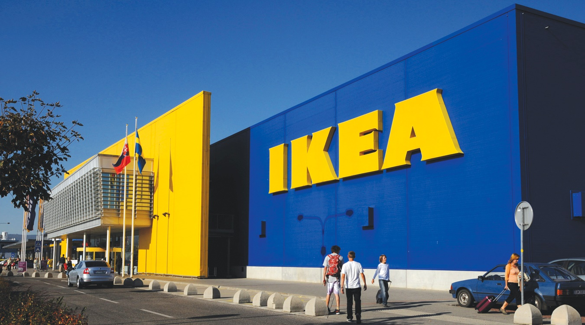
RETAILER IKEA ACHIEVES TREMENDOUS ECONOMIES OF SCALE AS IT EXPANDS ACROSS THE GLOBE.
LOFIK/DREAMSTIME.COM
CHAPTER 7
SLIDE 34

Slide 35
DISECONOMIES OF SCALE
As firms continue to grow, they eventually encounter diseconomies of scale as average total costs rise. This can be due to:
  increased bureaucracy in management.
  increased cost of a scarce resource used in production.
  increasingly difficult terrain or rising operational costs.
CHAPTER 7
SLIDE 35

Slide 36
RETURNS TO SCALE
COSTS
Average long-run costs change with output as economies of scale wear out.
LRATC
Economies
of scale
ATC_{min}
Constant returns to scale
Diseconomies of scale
0
Q₀
Q₁
OUTPUT
CHAPTER 7
SLIDE 36

Slide 37

ERIC CHIANG
ECONOMIES OF SCOPE: PRODUCING INTERDEPENDENT PRODUCTS (AS DOES PROCTER & GAMBLE) HELPS TO REDUCE PRODUCTION AND MARKETING COSTS.
CHAPTER 7
SLIDE 37

Slide 38
ROLE OF TECHNOLOGY
Technology alters the shape of the long-run ATC curve.
  Enhances production techniques
  Improves global communications
  Provides computing power for easier expansion and economies of scale
CHAPTER 7
SLIDE 38

Slide 39
KEY CONCEPTS
Firm
Sole proprietorship
Partnership
Corporation
Profit
Total revenue
Total cost
Economic costs
Explicit costs
Implicit costs
Accounting profit
Economic profit
Normal profits
Short run
Long run
Production
Marginal product
Average product
Increasing marginal returns
Diminishing marginal returns
Fixed costs
Variable costs
Sunk costs
Marginal cost
Average fixed cost
Average variable cost
Average total cost
Long-run average total cost
Economies of scale
Constant returns to scale
Diseconomies of scale
Economies of scope
CHAPTER 7 SLIDE 39

Slide 40
WHICH OF THE FOLLOWING IS AN EXPLICIT COST?
A
CAPITAL DEPRECIATION
B
REDUCTION IN HOME VALUES
C
LOST PROFIT OPPORTUNITIES
D
RAW MATERIAL EXPENDITURES
E
DEPLETION OF BUSINESS ASSETS
CHAPTER 7
SLIDE 40
Notes:
Answer: D

Slide 41
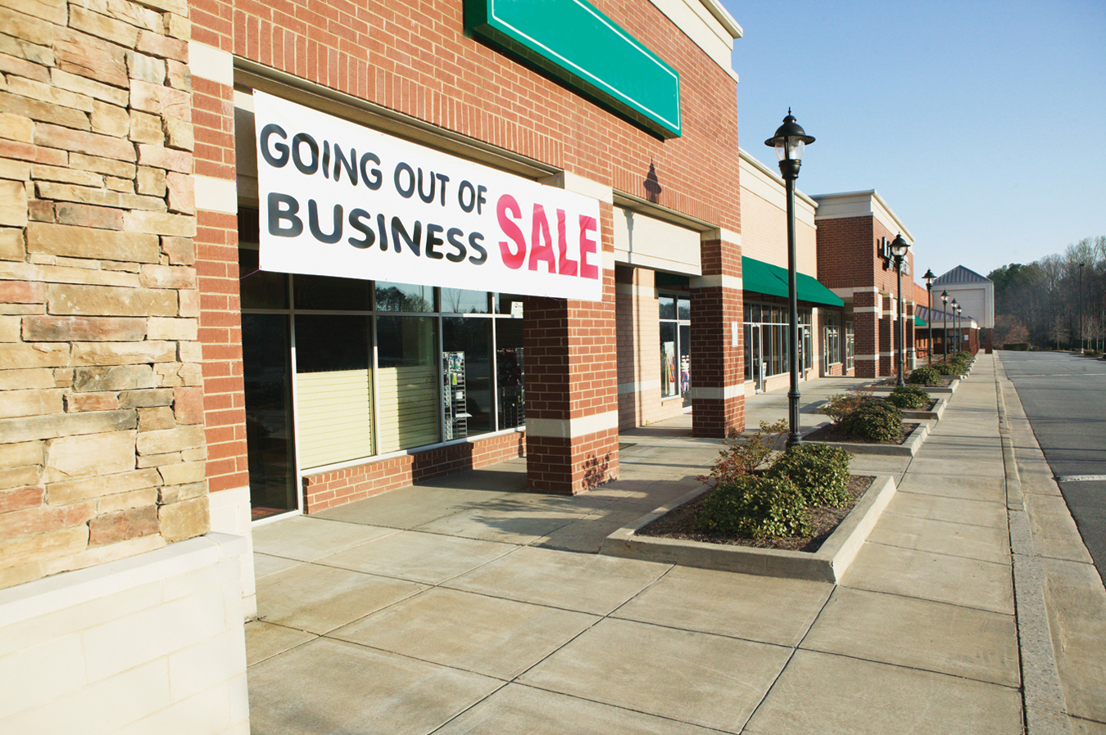
PRACTICE QUESTION
© RICK BARRENTINE/CORBIS
EXPLAIN WHY SOME STORES GO OUT OF BUSINESS EVEN AS THEY ARE EARNING A POSITIVE ACCOUNTING PROFIT.
CHAPTER 7
SLIDE 41
Notes:
Answer: Making an accounting profit does not guarantee a successful business, because many opportunity costs are not factored in to accounting profit. For example, if one works 80 hours per week running a sole proprietorship and earns only a small accounting profit, it is likely that economic profit is negative.

Slide 42
WHICH OF THE FOLLOWING COSTS IS GENERALLY ASSUMED TO BE FIXED?
A
A LEASE ON A BUILDING
B
UTILITY BILLS
C
STAFF WAGES
D
TRANSPORTATION EXPENSES
E
ALL OF THE ANSWERS ARE CORRECT.
CHAPTER 7
SLIDE 42
Notes:
Answer: A

Slide 43
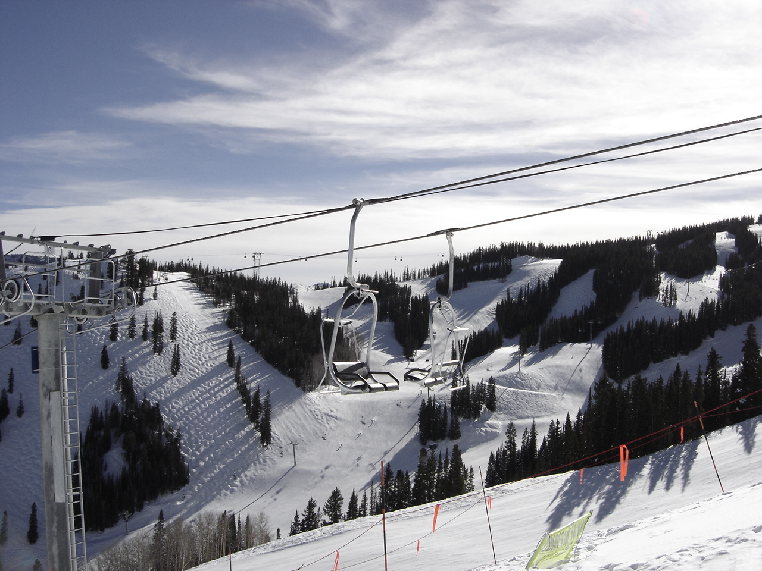
PRACTICE QUESTION
WHAT ARE SOME FIXED COSTS AND VARIABLE COSTS INCURRED BY SKI RESORTS?
ERIC CHIANG
CHAPTER 7
SLIDE 43
Notes:
Answer: Fixed costs include maintaining the chair lifts and operating the snow making equipment, costs that do not vary with the number of skiers. Variable costs include food, staff wages, and other costs that increase with the number of skiers.

Slide 44
IF A BAKERY CAN PRODUCE 100 CUPCAKES FOR $100 AND 200 CUPCAKES FOR $150, WHAT IS THE MARGINAL COST PER CUPCAKE FOR THE ADDITIONAL 100 CUPCAKES?
A
$0.25
B
$0.50
C
$0.75
D
$1.00
CHAPTER 7
SLIDE 44
Notes:
Answer: B

Slide 45
7
END OF CHAPTER
SLIDES CREATED BY ERIC CHIANG
Tshooter/Shutterstock; Anton Balazh/Shutterstock
CHAPTER 7
SLIDE 45

