Slide 1

4
Markets and Government
SLIDES CREATED BY ERIC CHIANG
Lonely Planet Images / Getty
CHAPTER 4 SLIDE 1

Slide 2
CHAPTER OBJECTIVES
Define the concepts of consumer surplus and producer surplus, and explain how they are used to measure the benefits and costs of market transactions.
Use consumer surplus and producer surplus to describe the gains from trade.
Explain the causes of deadweight loss and how markets can mitigate them.

CHAPTER 4
SLIDE 2

Slide 3
CHAPTER OBJECTIVES
Understand why markets sometimes fail to provide an optimal outcome.
Describe what an effective price ceiling or price floor does to a market and how it creates shortages or surpluses.
Determine the winners and losers when price ceilings and price floors are implemented.
CHAPTER 4
SLIDE 3

Slide 4
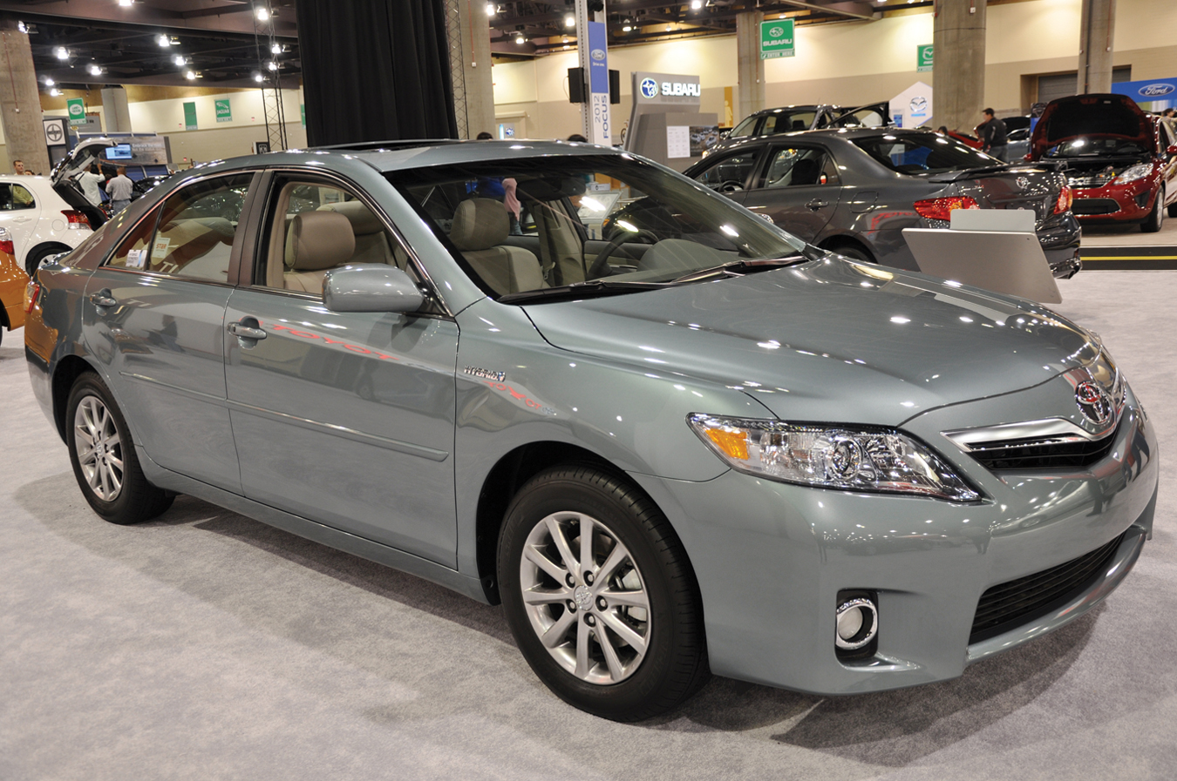
RITU JETHANI/DREAMSTIME.COM
CONSUMER SURPLUS
THE DIFFERENCE BETWEEN MARKET PRICE AND WHAT CONSUMERS ARE WILLING TO PAY
CHAPTER 4
SLIDE 4

Slide 5

PHILIP GOSTELOW/AURORA PHOTOS/CORBIS
PRODUCER SURPLUS
THE DIFFERENCE BETWEEN MARKET PRICE AND THE PRICE AT WHICH FIRMS ARE WILLING TO SUPPLY IT
CHAPTER 4
SLIDE 5

Slide 6
SURPLUS
CONSUMER
& PRODUCER
Buyer’s maximum willingness to pay (WTP)
$20,000
CONSUMER
SURPLUS
$
$
$
$
$
$
$
$
Consumer surplus (WTP – Price) = $2,800
Negotiated price = $17,200
PRODUCER
SURPLUS
Producer surplus (Price – WTS) = $2,200
$15,000
Seller’s minimum willingness to sell (WTS)
CHAPTER 4
SLIDE 6

Slide 7
CONSUMER AND PRODUCER SURPLUS
CONSUMER SURPLUS IS A FORM OF SAVING BECAUSE CONSUMERS ARE WILLING TO PAY MORE THAN THE MARKET PRICE.
PRODUCER SURPLUS IS A FORM OF EARNING BECAUSE BUSINESSES ARE WILLING TO PROVIDE A GOOD OR SERVICE BELOW THE MARKET PRICE.
CHAPTER 4
SLIDE 7

Slide 8


INDIVIDUAL CONSUMER SURPLUS
Consumer A is willing to pay $11...
P
12
S₀
11
10
Consumer A’s surplus is $11 $−$ $6 = $5.
9
8
7
6
Consumer B is willing to pay $10; consumer surplus is $10 $−$ $6 = $4.
…but the price is just $6.
D₀
And so on…
Q
0
1 2 3 4 5 6
CHAPTER 4
SLIDE 8

Slide 9
TOTAL CONSUMER SURPLUS
P
12
S₀
11
10
The sum of all individual consumer surplus
9
8
consumer surplus
7
6
The area below the demand curve and above the price
D₀
Q
0
1 2 3 4 5 6
CHAPTER 4
SLIDE 9

Slide 10
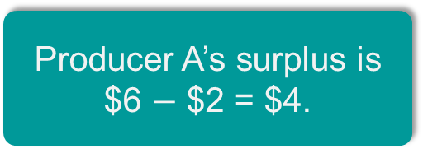
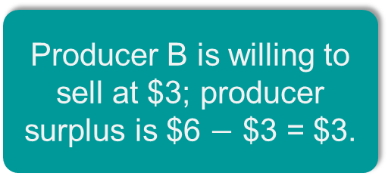
INDIVIDUAL PRODUCER SURPLUS
P
S₀
The price is $6…
Producer A’s surplus is $6 $−$ $2 = $4.
6
Producer B is willing to sell at $3; producer surplus is $6 $−$ $3 = $3.
5
4
…but producer A is willing to sell at $2.
3
2
And so on…
D₀
1
Q
0
1 2 6
CHAPTER 4
SLIDE 10

Slide 11
TOTAL PRODUCER SURPLUS
P
S₀
The sum of all individual producer surplus
6
The area above the supply curve and below the price
producer surplus
1
D₀
Q
0
6
CHAPTER 4
SLIDE 11

Slide 12
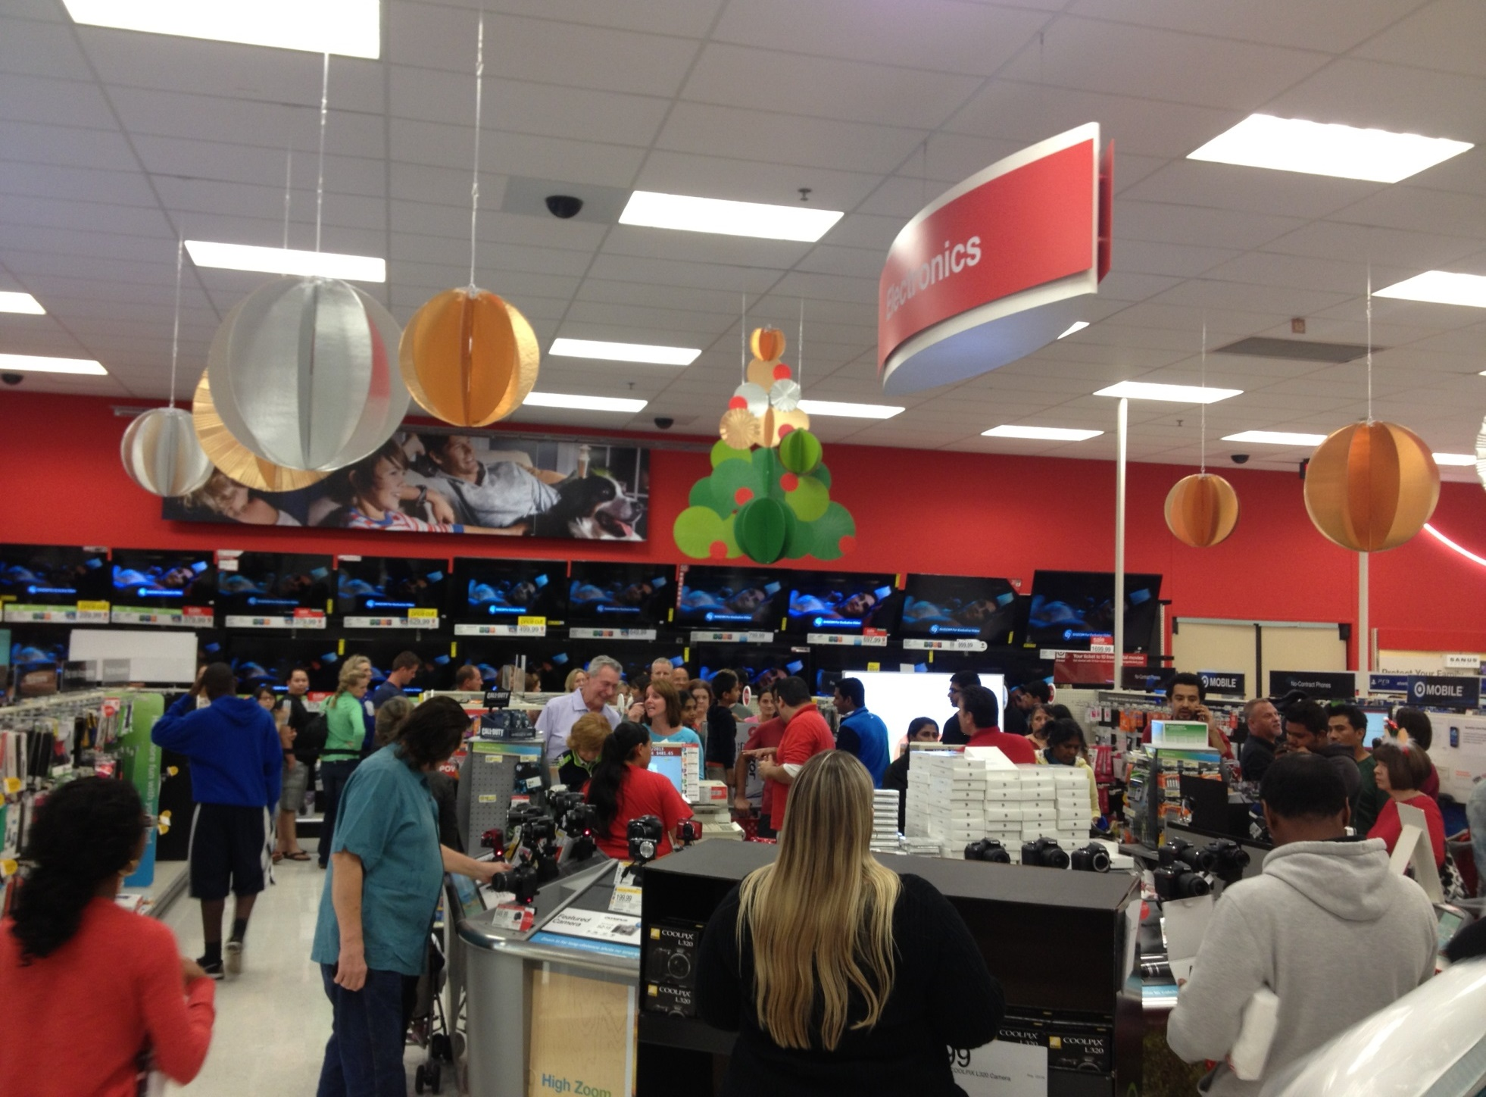
MARKET EFFICIENCY
MARKETS ARE EFFICIENT WHEN THEY GENERATE THE LARGEST POSSIBLE AMOUNT OF NET BENEFITS TO ALL PARTIES INVOLVED.
ERIC CHIANG
CHAPTER 4
SLIDE 12

Slide 13
TOTAL SURPLUS
THE SUM OF CONSUMER AND PRODUCER SURPLUS THAT IS MAXIMIZED WHEN MARKETS ARE EFFICIENT:
TS = CS + PS
CHAPTER 4
SLIDE 13

Slide 14
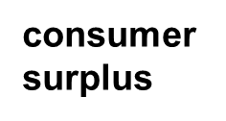
WHEN PRICES EXCEED EQUILIBRIUM
Price rises to $400; quantity falls to 10.
P
S₀
400
New consumer surplus
300
Transferred to producers
producer surplus
Deadweight loss
D₀
Q
0
10
20
CHAPTER 4
SLIDE 14

Slide 15
DEADWEIGHT LOSS
THE LOSS OF CONSUMER SURPLUS AND PRODUCER SURPLUS CAUSED BY THE INEFFICIENCY OF A MARKET THAT IS NOT OPERATING AT EQUILIBRIUM
CHAPTER 4
SLIDE 15

Slide 16
WHEN PRICES ARE BELOW EQUILIBRIUM
Price falls to $200; quantity falls to 10.
P
S₀
Deadweight loss
300
Transferred to consumers
producer surplus
200
New producer surplus
D₀
Q
0
10
20
CHAPTER 4
SLIDE 16

Slide 17
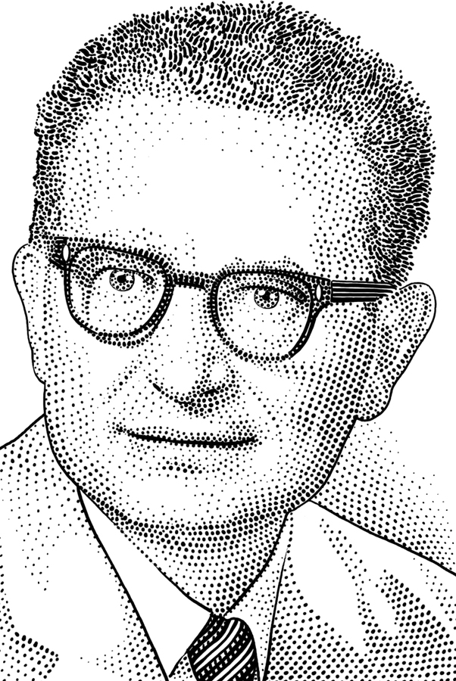
PAUL SAMUELSON (1915–2009)
Won Nobel Prize in Economics in 1970 (first American to do so)
Broad research interests; prolific writer
  Developed MIT’s Economics Department
  Advised President Kennedy
  Sold 4 million copies of his textbook, Economics
CHAPTER 4
SLIDE 17

Slide 18
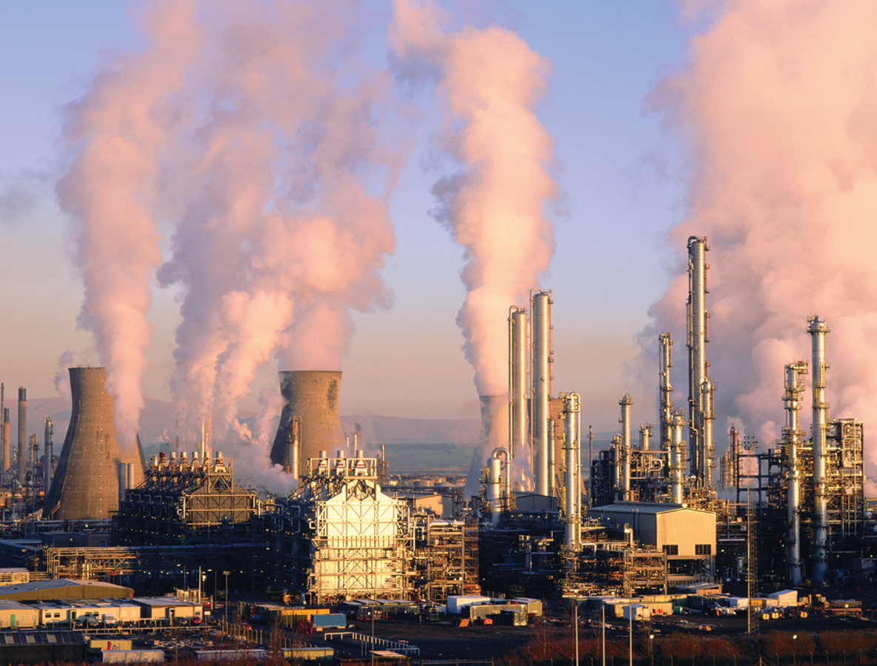
AGE FOTOSTOCK/SUPERSTOCK
MARKETS ARE USUALLY BUT NOT ALWAYS EFFICIENT. MARKET FAILURE IS FAILURE TO PROVIDE THE SOCIALLY OPTIMAL AMOUNT OF GOODS AND SERVICES.
CHAPTER 4
SLIDE 18

Slide 19
SOURCES OF MARKET FAILURE
MARKETS FAIL BECAUSE OF FOUR MAIN REASONS:
    LACK OF COMPETITION
    INFORMATION IS NOT SHARED BY ALL PARTIES
    EXISTENCE OF EXTERNAL BENEFITS OR COSTS
    EXISTENCE OF PUBLIC GOODS
CHAPTER 4
SLIDE 19

Slide 20

LACK OF COMPETITION
MARTYN GODDARD/CORBIS
When a market lacks competition, a firm can raise prices without worrying that other firms will undercut its price.
CHAPTER 4
SLIDE 20

Slide 21

ASYMMETRIC INFORMATION
OCCURS WHEN ONE PARTY TO A TRANSACTION HAS BETTER INFORMATION THAN ANOTHER PARTY. THIS PREVENTS SOME TRADES FROM TAKING PLACE.
RANDY FARIS/CORBIS
CHAPTER 4
SLIDE 21

Slide 22

TIM PANNELL/CORBIS
EXTERNAL
BENEFIT
OCCURS WHEN AN ACTION HAS A POSITIVE EFFECT ON A THIRD PARTY.
CHAPTER 4
SLIDE 22

Slide 23

CORBIS
EXTERNAL
COST
OCCURS WHEN AN ACTION INFRINGES ON A THIRD PARTY’S WELFARE.
CHAPTER 4
SLIDE 23

Slide 24

SUSAN E. DEGGINGER/ALAMY
PUBLIC
GOODS
CHAPTER 4
SLIDE 24

Slide 25

PUBLIC GOODS
  NOT EXCLUSIVE
  NONRIVAL
    ONCE A PUBLIC GOOD IS PROVIDED, NO ONE CAN BE EXCLUDED FROM CONSUMING IT.
ONE PERSON’S CONSUMPTION DOES NOT DIMINISH OTHERS’ BENEFIT.
CHAPTER 4
SLIDE 25

Slide 26

PRICE CEILINGS
PRICE FLOORS
⇒

CHAPTER 4
SLIDE 26

Slide 27
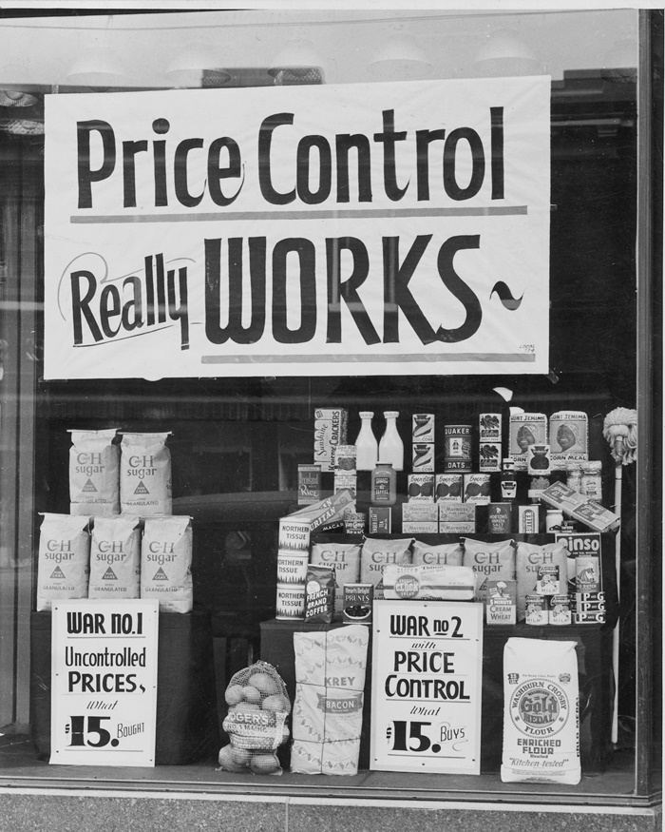
FRANKLIN D. ROOSEVELT LIBRARY, HYDE PARK, NY
PRICE
CONTROLS
LAISSEZ-FAIRE: A MARKET THAT IS ALLOWED TO FUNCTION WITHOUT ANY GOVERNMENT INTERVENTION
CHAPTER 4
SLIDE 27

Slide 28
PRICE CEILING
P
A government-set maximum price that can be charged for a good or service.
Price ceilings lead to shortages.
S₀
P_{e}
Price ceiling
Shortage
D₀
0
Q
Q_{S}
Q_{D}
CHAPTER 4
SLIDE 28

Slide 29
PRICE FLOOR
P
A government-set minimum price that must be charged for a good or service.
Price floors lead to surpluses.
Surplus
S₀
Price floor
P_{e}
D₀
0
Q
Q_{D}
Q_{S}
CHAPTER 4
SLIDE 29

Slide 30
Consumer surplus
Producer surplus
Total surplus
Deadweight loss
Market failure
Asymmetric information
Laissez-faire
Price ceiling
Misallocation of resources
Price floor
KEY CONCEPTS
CHAPTER 4
SLIDE 30

Slide 31
IF A PRICE CEILING IS SET ABOVE THE EQUILIBRIUM, THE RESULT IS:
A
A SHORTAGE.
B
A SURPLUS.
C
A DEADWEIGHT LOSS.
D
NO CHANGE TO THE EQUILIBRIUM.
E
BOTH A AND C.
CHAPTER 4
SLIDE 31
Notes:
Answer: D

Slide 32
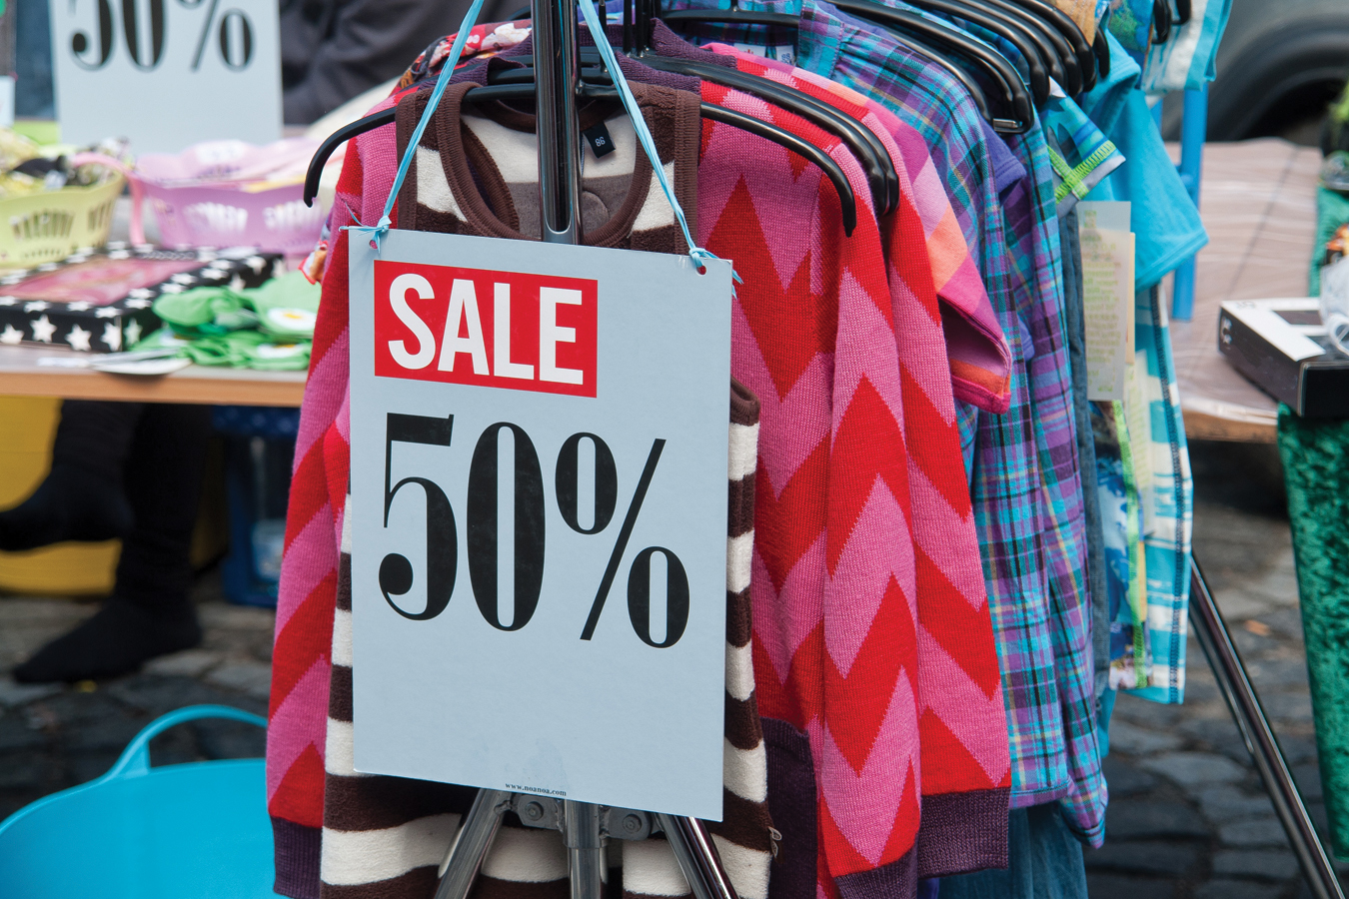
PRACTICE QUESTION
RON ZMIRI/AGE FOTOSTOCK
WHY WOULD BUYING THE CHEAPEST GOODS POSSIBLE NOT ALWAYS MAXIMIZE CONSUMER SURPLUS?
CHAPTER 4
SLIDE 32
Notes:
Answer: Consumer surplus is the difference between a consumer’s willingness-to-pay (or what they value a good to be worth) and the price. Just because a product has a low price does not mean the most consumer surplus is achieved, because the perceived value of that good is likely to be low as well. Consumer surplus is maximized when one buys a high-valued product at a low price.

Slide 33
MARKET FAILURE CAN BE CAUSED BY ALL OF THE FOLLOWING EXCEPT:
A
LACK OF COMPETITION.
B
PUBLIC OWNERSHIP OF RESOURCES.
C
EXTERNAL BENEFITS OR COSTS.
D
TOO MUCH COMPETITION KEEPING THE PRICES TOO LOW.
E
NONE OF THE ANSWERS IS CORRECT.
CHAPTER 4
SLIDE 33
Notes:
Answer: D

Slide 34
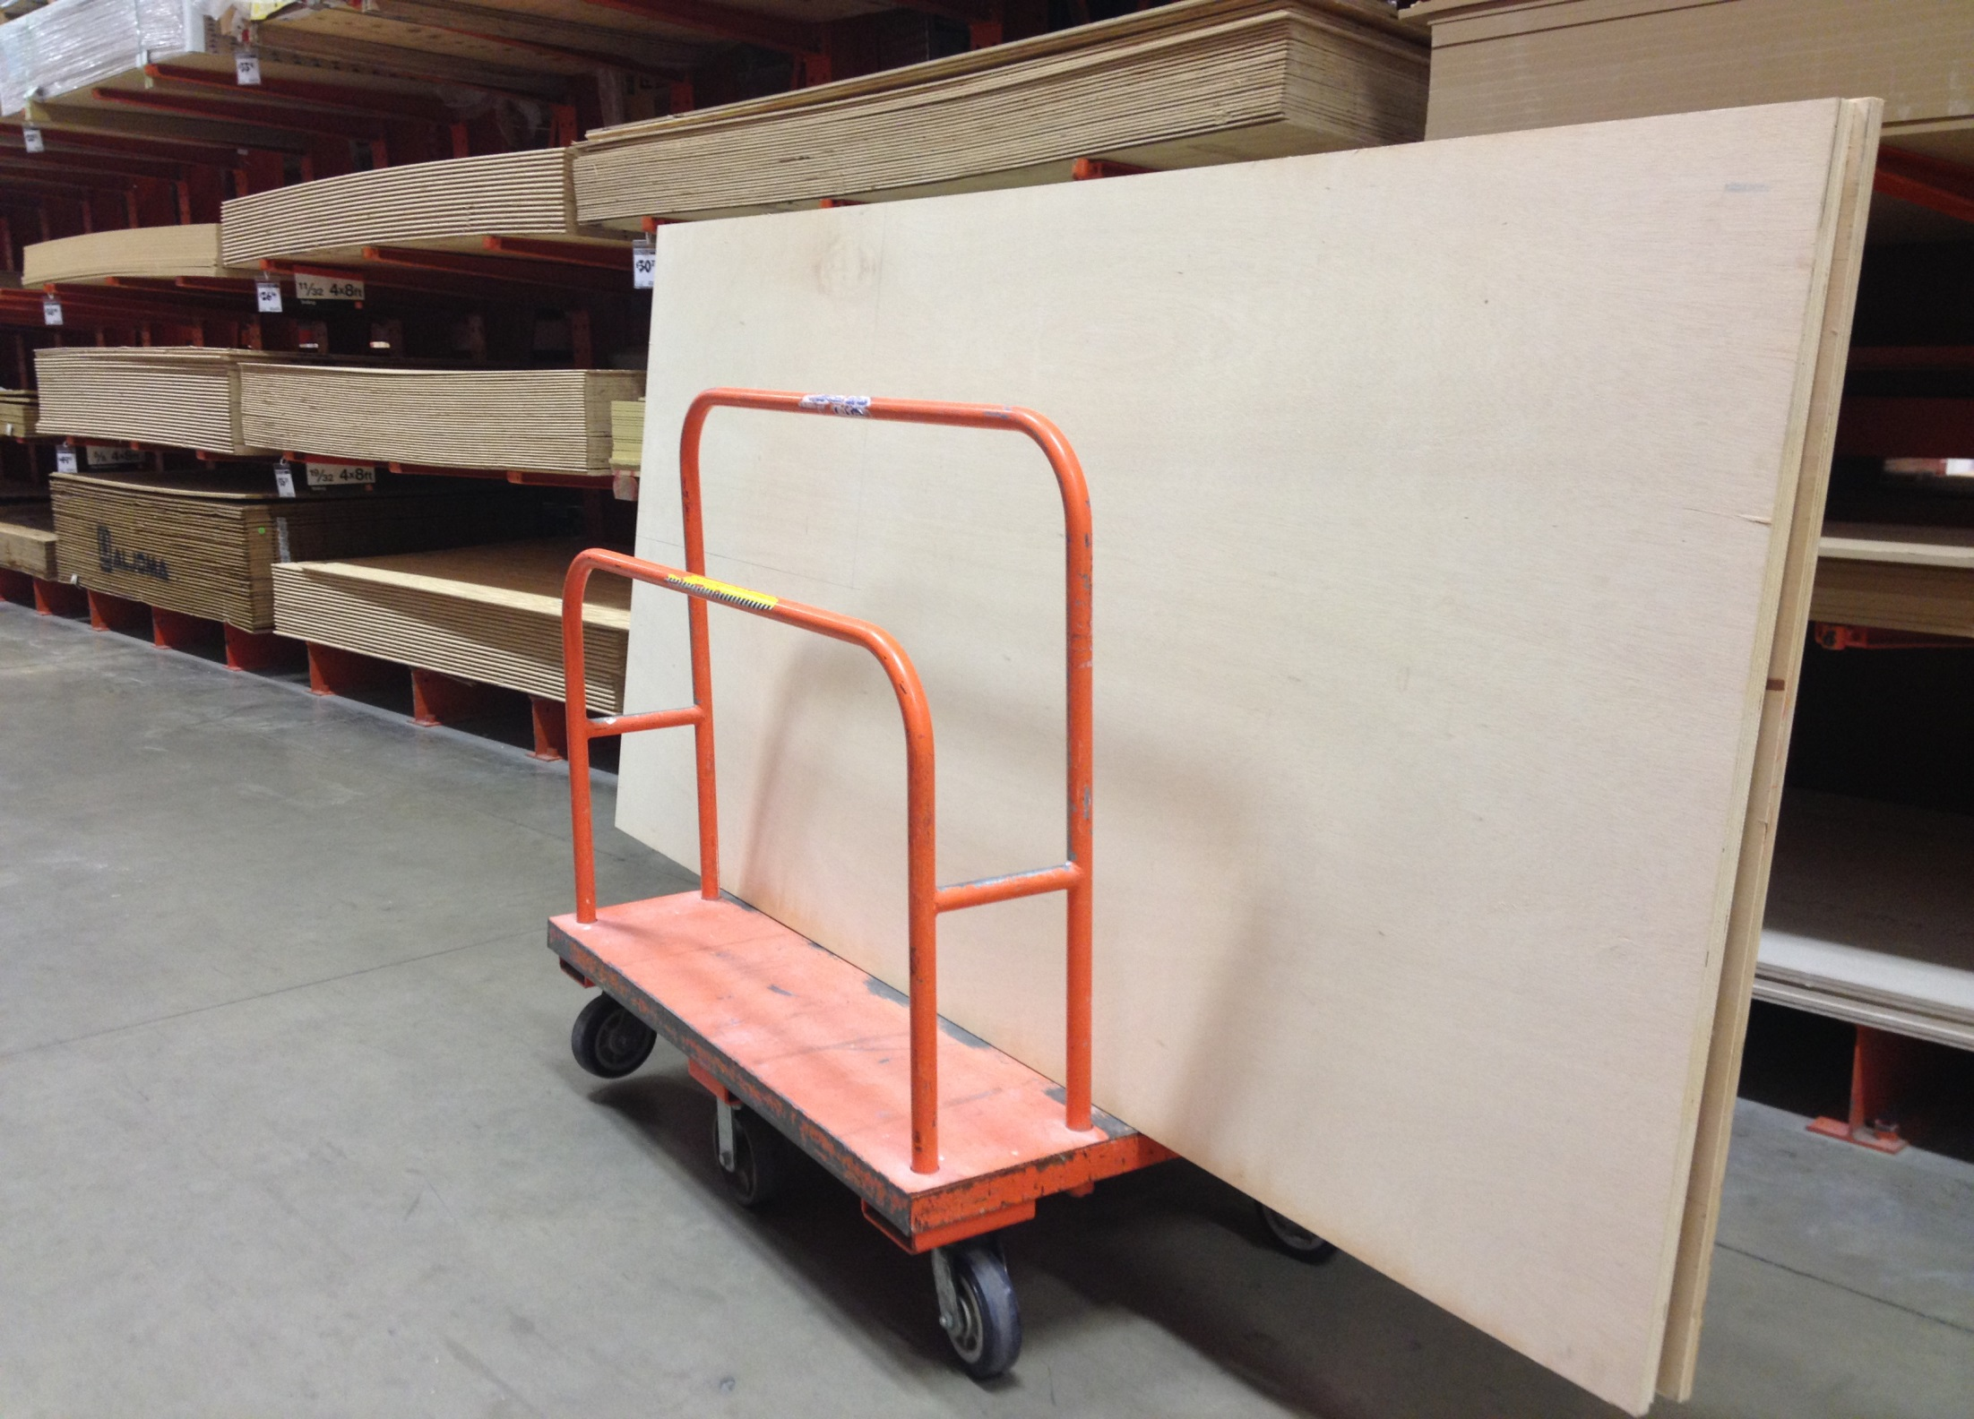
PRACTICE QUESTION
ERIC CHIANG
PRICE GOUGING LAWS ARE ENFORCED DURING TIMES OF NATURAL DISASTERS. WHAT ARE THE COSTS OF THESE LAWS, AND HOW MIGHT THEY BE MINIMIZED?
CHAPTER 4
SLIDE 34
Notes:
Answer: Price gouging laws act as a price ceiling at the pre-crisis price levels. However, during natural disasters, demand for many goods such as gas, batteries, and building materials spike, creating a shortage. These costs can be minimized if incentives are given to increase supply, such as subsidies to firms who provide critical supplies during times of emergency.

Slide 35
WHICH OF THE FOLLOWING GENERATES
AN EXTERNAL BENEFIT?
A
OBTAINING AN ANNUAL FLU VACCINATION
B
DRIVING A CAR ON A CROWDED HIGHWAY
C
BUYING A PAIR OF SHOES THAT ARE ON CLEARANCE
D
BURNING LEAVES IN THE BACKYARD
E
ALL OF THE ANSWERS ARE CORRECT.
CHAPTER 4
SLIDE 35
Notes:
Answer: A

Slide 36
4
END OF CHAPTER
SLIDES CREATED BY ERIC CHIANG
Tshooter/Shutterstock; Anton Balazh/Shutterstock
CHAPTER 4
SLIDE 36

