Slide 1

Production, Economic Growth, and Trade
2
SLIDES CREATED BY ERIC CHIANG
SAND DUNES- INTST/DREAMSTIME.COM; MICROCHIP-CULTURA CREATIVE/ALAMY
CHAPTER 2 SLIDE 1

Slide 2
CHAPTER OBJECTIVES
Describe the three basic questions that must be answered by any economy.
Describe production and the factors that go into producing various goods and services.
Describe the opportunity cost an economy incurs to increase the production of one product.
Use a production possibilities frontier (PPF) to analyze the limits of production.

CHAPTER 2
SLIDE 2

Slide 3
CHAPTER OBJECTIVES
Describe economic growth and how it is stimulated by education and training, capital accumulation, and technological improvements.
Describe the concepts of absolute and comparative advantage.
Explain how specialization and trade can lead to gains for all countries involved.
CHAPTER 2
SLIDE 3

Slide 4

BASIC ECONOMIC QUESTIONS EACH SOCIETY MUST ANSWER
  WHAT GOODS AND SERVICES ARE TO BE PRODUCED?
  HOW ARE THESE GOODS AND SERVICES TO BE PRODUCED?
  WHO WILL RECEIVE THESE GOODS AND SERVICES?
❶
❷
❸
CHAPTER 2
SLIDE 4

Slide 5


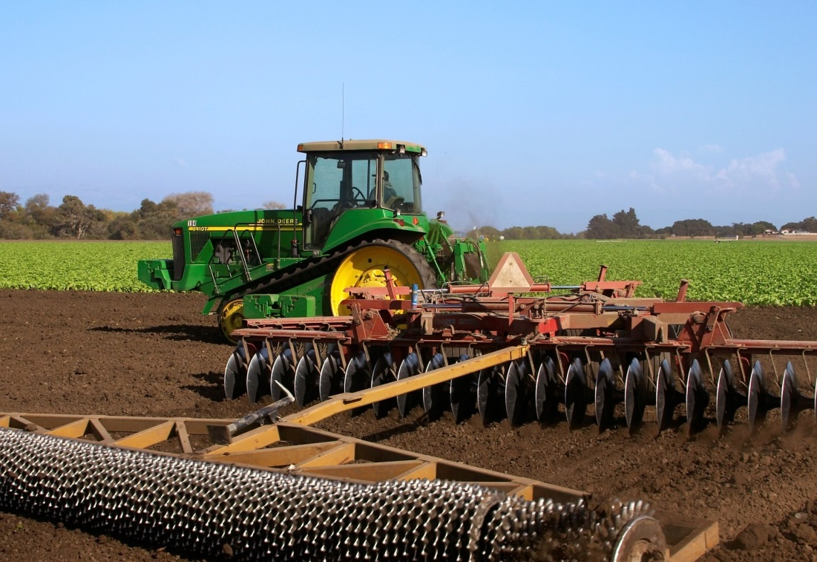

JOEL ZATZ/ALAMY
BIALASIEWICZ/DREAMSTIME.COM
LAND
LABOR
DAVID GUBERNICK/AGSTOCK IMAGES/CORBIS
FACTORS
OF PRODUCTION
DAVID SAILORS/CORBIS
CAPITAL
IDEAS
CHAPTER 2
SLIDE 5

Slide 6
PRODUCTION:
THE PROCESS OF CONVERTING FACTORS OF PRODUCTION TO OUTPUTS
FACTORS OF PRODUCTION (INPUTS)
LAND
PRODUCTION
METHOD
LABOR
CAPITAL
OUTPUT
(GOODS AND SERVICES)
ENTREPRENEURIAL ABILITY (IDEAS)
CHAPTER 2
SLIDE 6

Slide 7
PRODUCTION EFFICIENCY
AND ALLOCATIVE EFFICIENCY
PRODUCTION EFFICIENCY: GOODS AND SERVICES ARE PRODUCED AT THEIR LOWEST POSSIBLE RESOURCE (OPPORTUNITY) COST.
ALLOCATIVE EFFICIENCY: THE MIX OF GOODS AND SERVICES IS JUST WHAT SOCIETY DESIRES.
CHAPTER 2
SLIDE 7

Slide 8

PRODUCTION POSSIBILITIES FRONTIER
MOLIMA/DREAMSTIME.COM
A MODEL THAT SHOWS THE COMBINATIONS OF TWO GOODS A SOCIETY CAN PRODUCE AT FULL EMPLOYMENT
CHAPTER 2
SLIDE 8

Slide 9
PRODUCTION POSSIBILITIES FRONTIER
THE PPF ALLOWS US TO ANSWER:
  HOW MUCH CAN BE PRODUCED?
  WHAT WILL IT COST TO CHANGE THE PRODUCTION MIX?
❶
❷
CHAPTER 2
SLIDE 9

Slide 10
PRODUCTION POSSIBILITIES FRONTIER
12
10
PPF
BACKPACKS | TABLETS
12 | 0
10 | 1
8 | 2
6 | 3
4 | 4
2 | 5
0 | 6
8
BACKPACKS (THOUSANDS)
6
4
2
2
4
6
8
10
12
TABLETS (THOUSANDS)
CHAPTER 2
SLIDE 10

Slide 11
PRODUCTION POSSIBILITIES FRONTIER
THE PPF SHOWS THE COMBINATIONS OF GOODS THAT CAN BE PRODUCED.
12
10
8
POINTS UNDER THE PPF ARE ATTAINABLE BUT INEFFICIENT.
BACKPACKS (THOUSANDS)
h
6
4
i
POINTS OUTSIDE THE PPF ARE UNATTAINABLE.
2
2
4
6
8
10
12
TABLETS (THOUSANDS)
CHAPTER 2
SLIDE 11

Slide 12
OPPORTUNITY COST
THE COST OF A GOOD IN TERMS OF ANOTHER THAT MUST BE GIVEN UP.
BACKPACKS | TABLETS
12 | 0
10 | 1
8 | 2
6 | 3
4 | 4
2 | 5
0 | 6
TO PRODUCE ONE MORE TABLET, TWO BACKPACKS MUST BE GIVEN UP.
CHAPTER 2
SLIDE 12

Slide 13
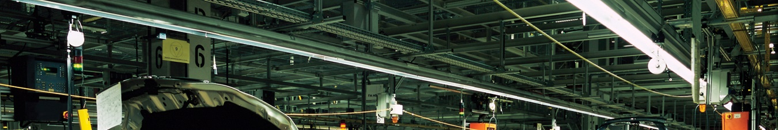
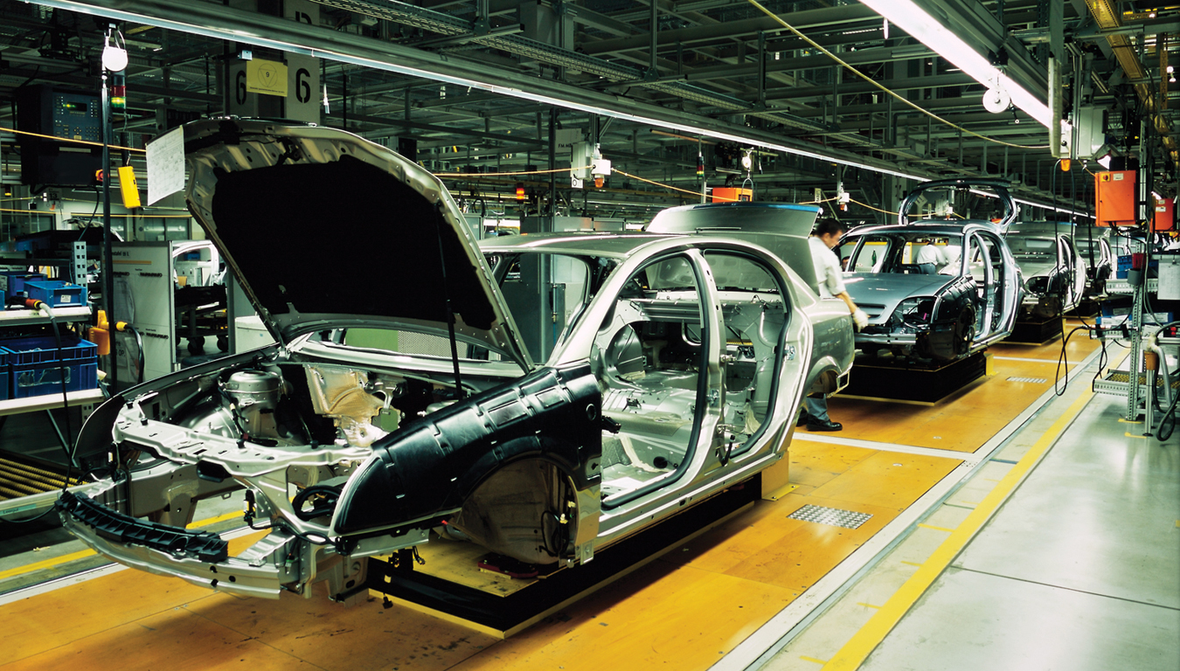
INCREASING OPPORTUNITY COST
IN MOST CASES, LAND, LABOR, AND CAPITAL CANNOT EASILY BE SHIFTED FROM PRODUCING ONE GOOD TO ANOTHER.
RAINER PLENDL/DREAMSTIME. COM
CHAPTER 2
SLIDE 13
Notes:
JB: Fix header

Slide 14
A MORE REALISTIC PPF
POINT | BACKPACKS | TABLETS | OPPORTUNITY COST
a | 12,000 | 0 | —
b | 10,000 | 3,200 | 2,000/3,200 = 0.625
c | 6,000 | 5,200 | 4,000/2,000 = 2.00
d | 0 | 6,000 | 6,000 / 800 = 7.50
a
12
b
10
BACKPACKS (THOUSANDS)
OPPORTUNITY COST INCREASES AS WE SPECIALIZE.
c
6
d
3
5
6
TABLETS (THOUSANDS)
CHAPTER 2
SLIDE 14

Slide 15

PPF AND ECONOMIC GROWTH
VOLODYMYR VYSHNIVETSKYY | DREAMSTIME.COM
PPF SHIFTS TO THE RIGHT AS AN ECONOMY GROWS AS A RESULT OF:
EXPANDING RESOURCES.
IMPROVING TECHNOLOGIES.
CHAPTER 2
SLIDE 15

Slide 16
SHIFTS IN THE PPF
AN OUTWARD SHIFT OF THE PPF MEANS ECONOMIC GROWTH.
BACKPACKS (THOUSANDS)
PPF₁
PPF₀
TABLETS (THOUSANDS)
CHAPTER 2
SLIDE 16

Slide 17
HOW WILL A RECESSION
AFFECT A COUNTRY’S PPF?
A
IT WILL SHIFT PPF INWARD.
B
IT WILL SHIFT PPF OUTWARD.
C
IT WILL PRODUCE AT A POINT BELOW AN UNCHANGED PPF.
D
IT WILL PRODUCE AT A POINT ABOVE AN UNCHANGED PPF.
E
A RECESSION DOES NOT AFFECT THE PPF AT ALL.
CHAPTER 2
SLIDE 17
Notes:
Answer: C

Slide 18

SPECIALIZATION, COMPARATIVE ADVANTAGE, AND TRADE
ZUMA WIRE SERVICE/ALAMY
SPECIALIZATION AND TRADE INCREASE PRODUCTION. THEY OCCUR:
BETWEEN PEOPLE.
BETWEEN NATIONS.
CHAPTER 2
SLIDE 18

Slide 19
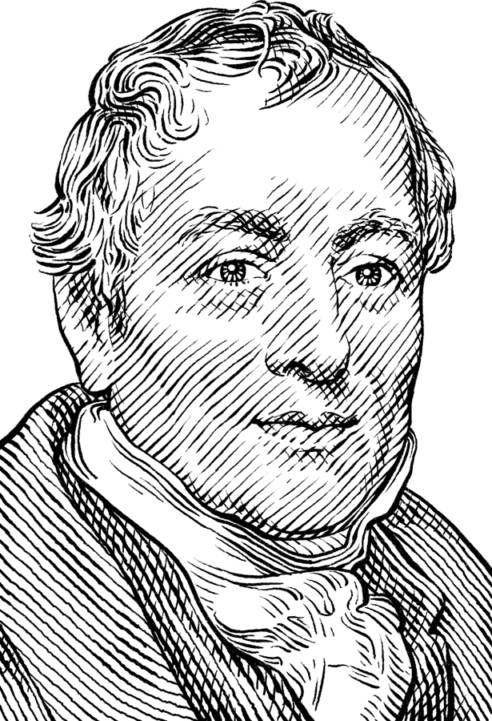
DAVID RICARDO (1772–1823)
Argued against Corn Laws (high tariffs on imported grain) in British Parliament
Developed key idea:
  Comparative advantage: still the ideological foundation for free trade
CHAPTER 2
SLIDE 19

Slide 20
THE REASON FOR TRADE
  ABSOLUTE ADVANTAGE
  COMPARATIVE ADVANTAGE
    ONE COUNTRY CAN PRODUCE MORE OF A GOOD THAN ANOTHER COUNTRY.
ONE COUNTRY’S OPPORTUNITY COST IS LOWER THAN ANOTHER COUNTRY’S.
CHAPTER 2
SLIDE 20

Slide 21
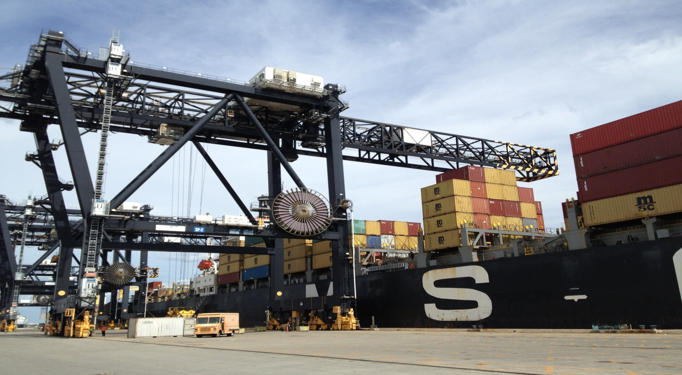
ERIC CHIANG
ALL COUNTRIES CAN GAIN FROM TRADE IF THEY FOLLOW THEIR COMPARATIVE ADVANTAGE.
CHAPTER 2
SLIDE 21

Slide 22
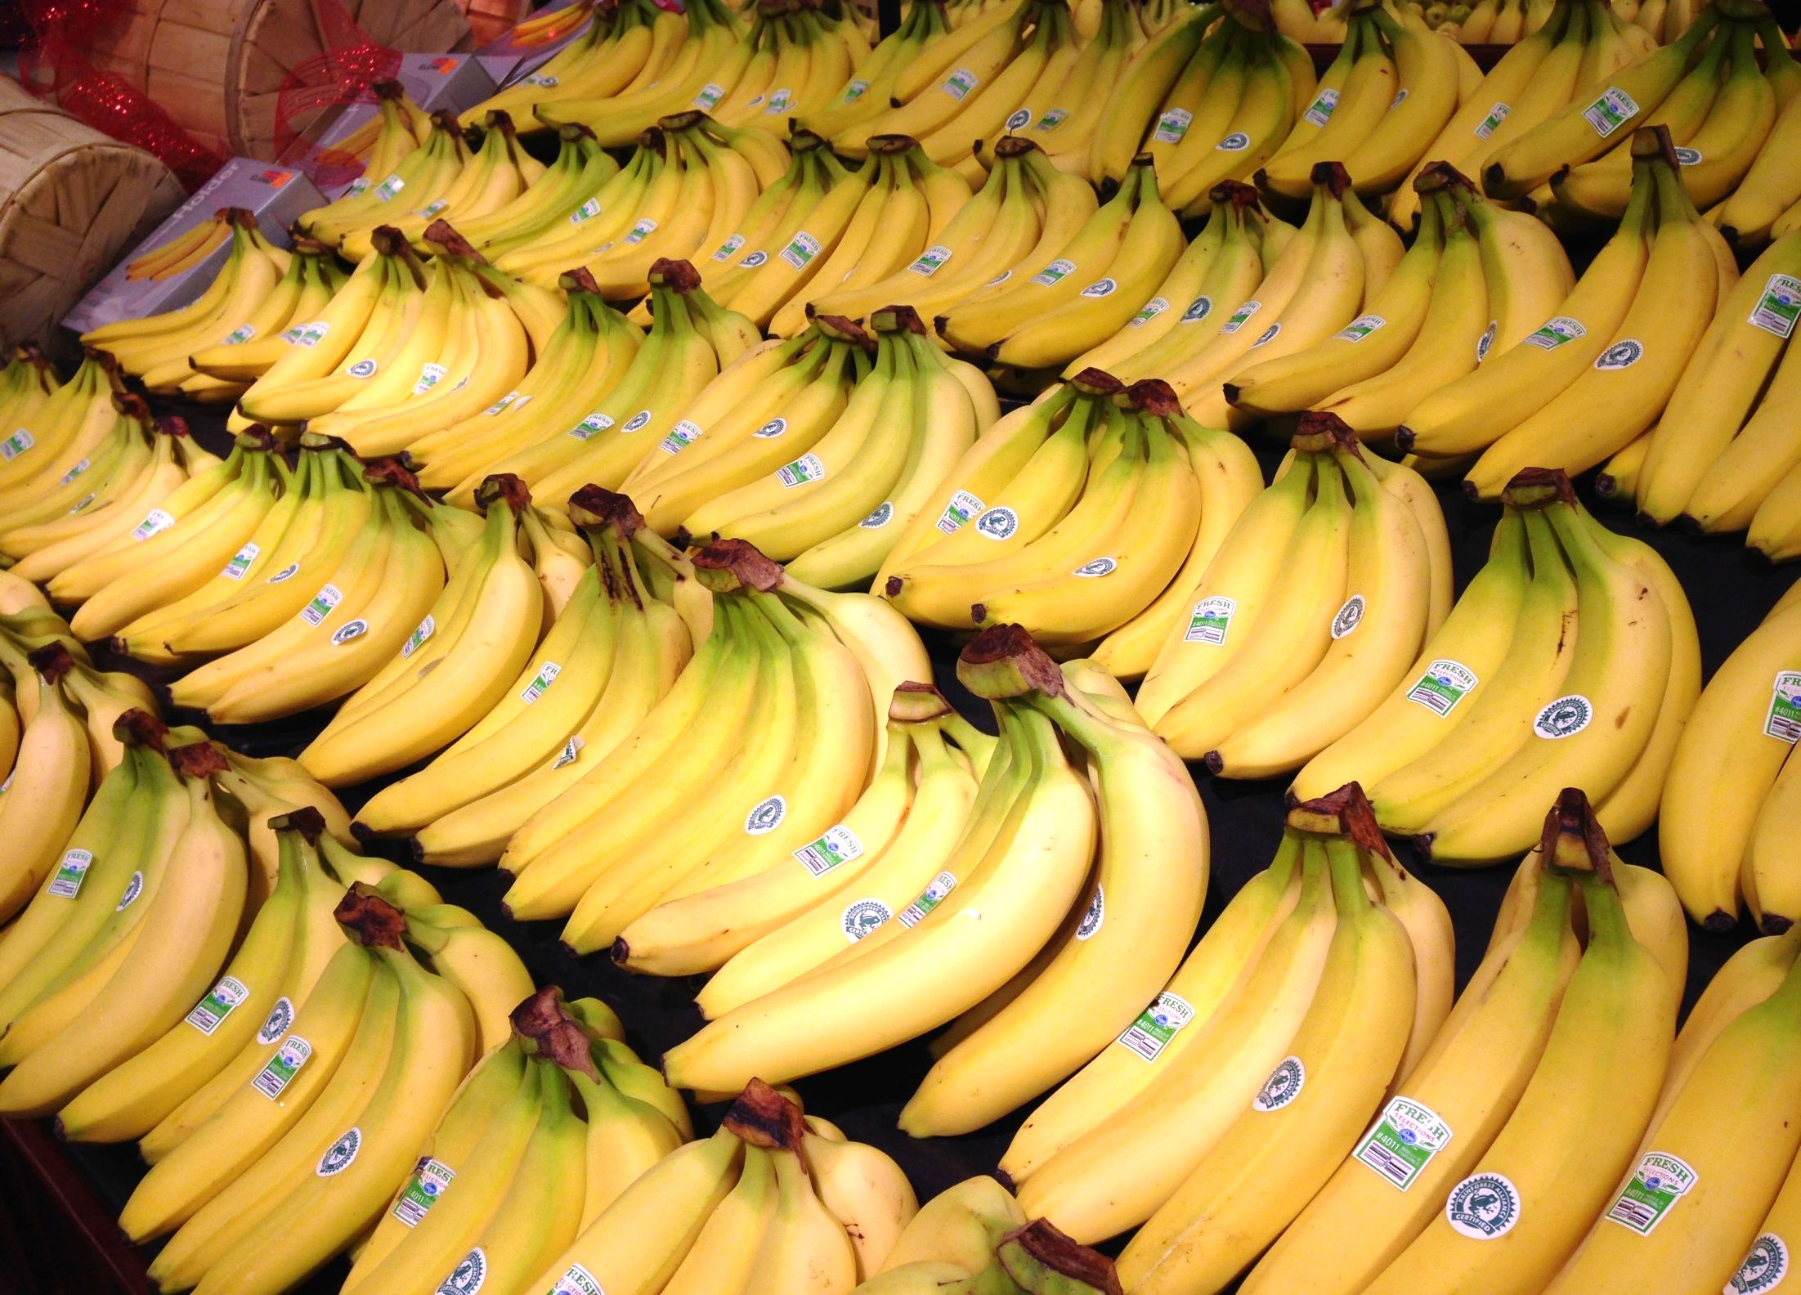
PRACTICE QUESTION
ERIC CHIANG
EXPLAIN WHY THE UNITED STATES IMPORTS BANANAS FROM CENTRAL AMERICA RATHER THAN GROW THEM DOMESTICALLY.
CHAPTER 2
SLIDE 22
Notes:
Answer: Bananas grow more efficiently in tropical climates. Therefore, Central American countries tend to have a comparative advantage in producing bananas. By importing bananas, the United States can use its resources to produce other products in which it has a comparative advantage.

Slide 23
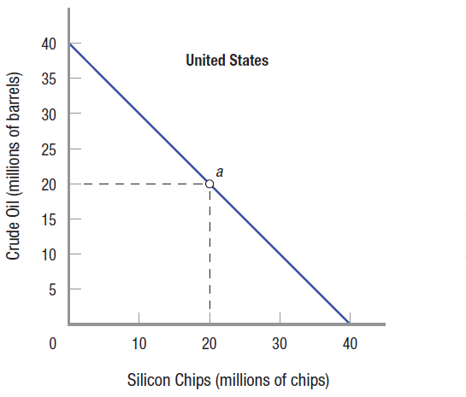
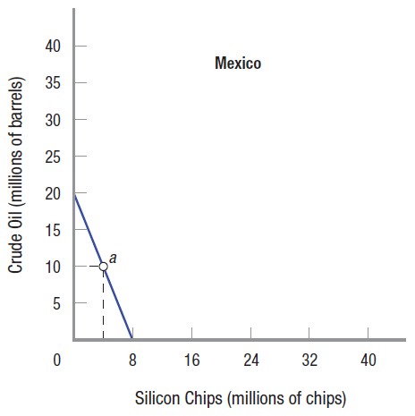
COMPARATIVE ADVANTAGE
SHOULD THERE BE TRADE?
WHO SHOULD PRODUCE WHAT?
CHAPTER 2
SLIDE 23

Slide 24
COMPARATIVE VS. ABSOLUTE ADVANTAGE
DON’T CONFUSE THE CONCEPTS:
EVEN THOUGH ONE COUNTRY CAN PRODUCE MORE OF BOTH GOODS, TRADE IS STILL BENEFICIAL.
FOCUS ON OPPORTUNITY COSTS.
MEXICO HAS A LOWER OPPORTUNITY COST OF CRUDE OIL, SO IT EXPORTS OIL TO THE UNITED STATES.
CHAPTER 2
SLIDE 24

Slide 25

DETERMINING COMPARATIVE ADVANTAGE
TO DECIDE WHO SHOULD PRODUCE WHAT, COMPARE THE OPPORTUNITY COSTS BETWEEN NATIONS.
COST OF ONE BARREL OF OIL
UNITED STATES MEXICO
40 / 40 = 8 / 20 =
1 SILICON CHIP 0.4 SILICON CHIP
CHAPTER 2
SLIDE 25

Slide 26
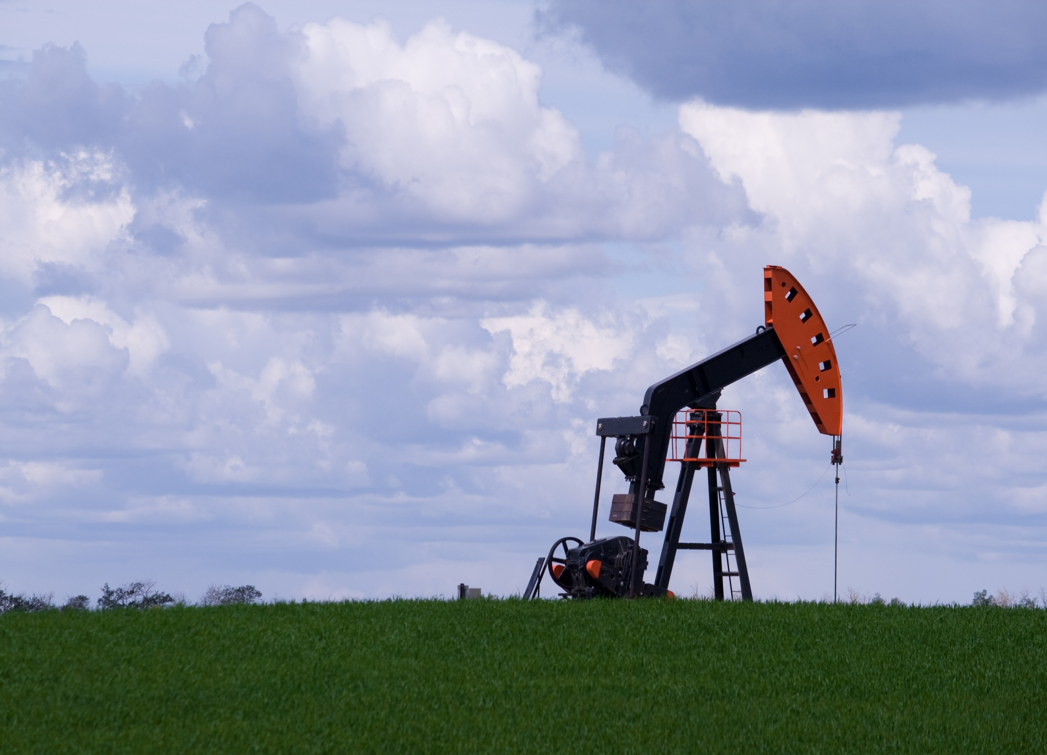
© MTPHOTOSTOCK | DREAMSTIME.COM
COMPARATIVE ADVANTAGE
MEXICO HAS A LOWER OPPORTUNITY COST OF OIL THAN THE UNITED STATES. THEREFORE, IT HAS A COMPARATIVE ADVANTAGE IN OIL PRODUCTION.
CHAPTER 2
SLIDE 26

Slide 27
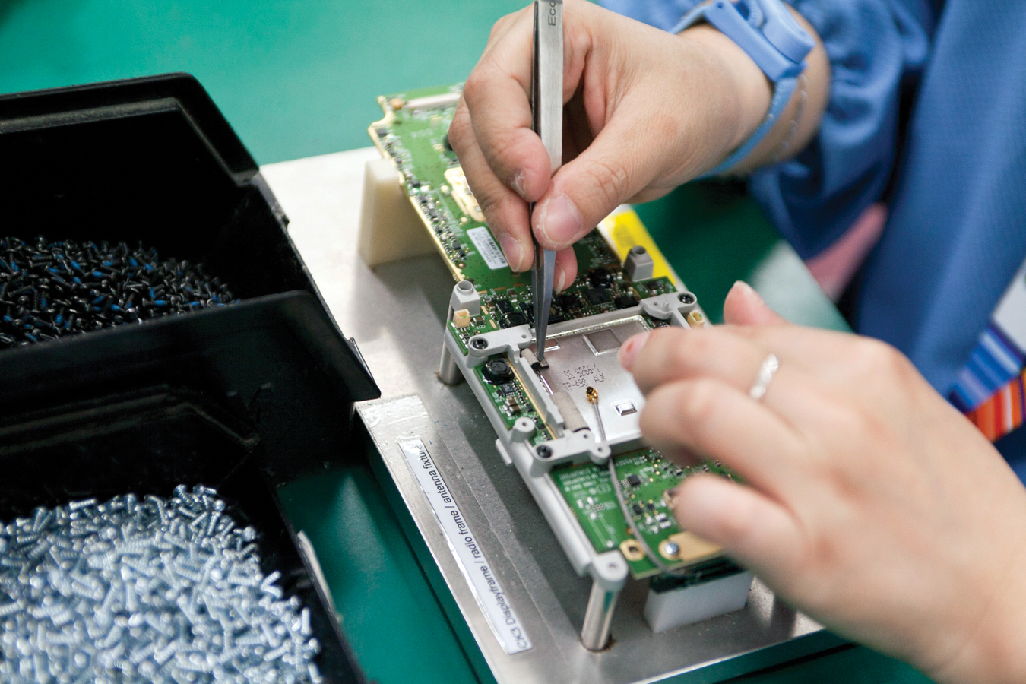
PRACTICE QUESTION
© CHARLES PERTWEE/CORBIS
EXPLAIN WHY THE UNITED STATES HAS A COMPARATIVE ADVANTAGE IN MICROCHIP PRODUCTION.
CHAPTER 2
SLIDE 27
Notes:
Answer: The United States has an abundance of modern technological equipment and a skilled labor force, giving it a comparative advantage in producing technology goods such as microchips.

Slide 28
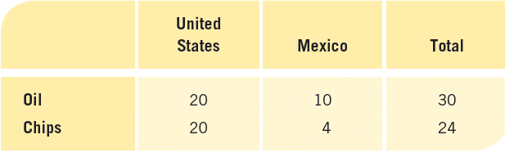
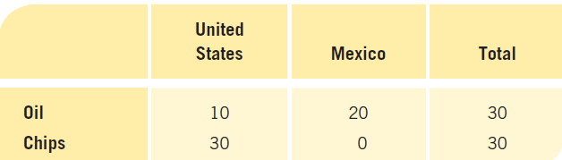
THE GAINS FROM TRADE
BEFORE TRADE
WITH SPECIALIZATION
CHAPTER 2
SLIDE 28

Slide 29
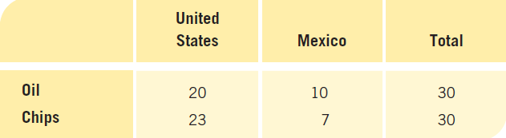
THE GAINS FROM TRADE
AFTER TRADE (WITH EACH COUNTRY SPLITTING THE EXTRA OUTPUT PRODUCED WITH SPECIALIZATION):
BOTH COUNTRIES GAIN FROM TRADE.
CHAPTER 2
SLIDE 29

Slide 30
PRACTICAL CONSTRAINTS ON TRADE
COSTS OF TRADE, INCLUDING TRANSPORTATION, COMMUNICATIONS, AND GENERAL COSTS OF BUSINESS. HOWEVER, THESE COSTS HAVE FALLEN IN RECENT DECADES.
DIMINISHING RETURNS TO SPECIALIZATION
GOVERNMENTS LIMITING TRADE TO HELP CERTAIN INDUSTRIES OR IN RESPONSE TO A RECESSION.
CHAPTER 2
SLIDE 30

Slide 31
Production
Resources
Land
Labor
Capital
Entrepreneurs
Production efficiency
Allocative efficiency
PPF (production possibilities frontier)
Opportunity cost
Absolute advantage
Comparative advantage
KEY CONCEPTS
CHAPTER 2
SLIDE 31

Slide 32
IN THE FOLLOWING PPF, HOW WOULD POINT e BE ACHIEVED?
A
THIS POINT CAN NEVER BE ACHIEVED.
e
B
A NEW, ABUNDANT RESOURCE IS FOUND.
a
C
A COUNTRY ENTERS A SEVERE RECESSION.
D
A COUNTRY’S PREFERENCES FOR GOODS CHANGES.
E
A COUNTRY CREATES JOBS FOR ITS UNEMPLOYED.
CHAPTER 2
SLIDE 32
Notes:
Answer: B

Slide 33
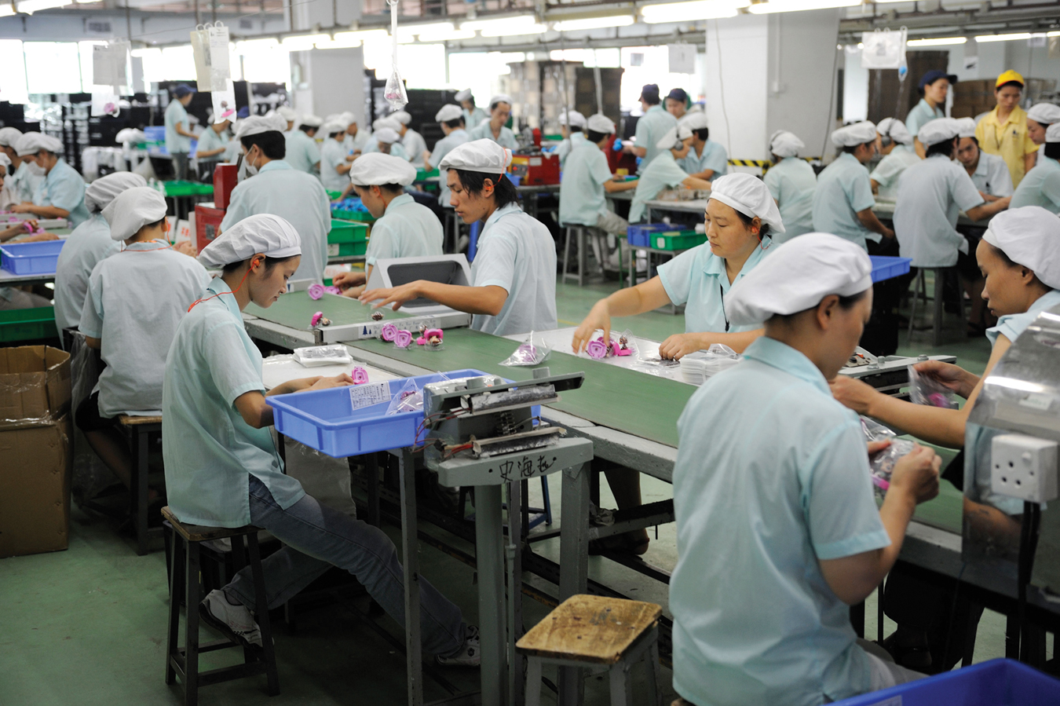
PRACTICE QUESTION
LOU LINWEI/ALAMY
WHY IS PRODUCING GOODS AT THE LOWEST POSSIBLE COST NOT ENOUGH TO SATISFY THE COMMON DEFINITIONS OF EFFICIENCY?
CHAPTER 2
SLIDE 33
Notes:
Answer: Producing goods and services at their lowest possible cost would achieve production efficiency, but not necessarily allocative efficiency. Allocative efficiency is also important, and is achieved when the mix of goods and services produced is what society desires.

Slide 34
FRANCE CAN PRODUCE 50 CAMERAS OR 100 CHEESES. GERMANY CAN PRODUCE 200 CAMERAS OR 300 CHEESES. WHICH COUNTRY HAS AN ABSOLUTE ADVANTAGE IN CHEESE PRODUCTION?
A
FRANCE
B
GERMANY
C
BOTH COUNTRIES
D
NEITHER COUNTRY
CHAPTER 2
SLIDE 34
Notes:
Answer: B

Slide 35

PRACTICE QUESTION
CAN A RICH AND PRODUCTIVE COUNTRY BENEFIT FROM TRADE WITH A POOR COUNTRY WITH LOW PRODUCTIVITY?
FABINUS08/DREAMSTIME.COM
CHAPTER 2
SLIDE 35
Notes:
Answer: Yes, all countries can benefit from trade as long as each produces goods in which they have a comparative advantage. Even when one country has an absolute disadvantage in producing all goods, it will still have a comparative (relative) advantage in something.

Slide 36
FRANCE CAN PRODUCE 50 CAMERAS OR 100 CHEESES. GERMANY CAN PRODUCE 200 CAMERAS OR 300 CHEESES. WHICH COUNTRY HAS A COMPARATIVE ADVANTAGE IN CHEESE PRODUCTION?
A
FRANCE
B
GERMANY
C
BOTH COUNTRIES
D
NEITHER COUNTRY
CHAPTER 2
SLIDE 36
Notes:
Answer: A

Slide 37
2
END OF CHAPTER
SLIDES CREATED BY ERIC CHIANG
Tshooter/Shutterstock; Anton Balazh/Shutterstock
CHAPTER 2
SLIDE 37

