Slide 1

Open Economy Macroeconomics
27
SLIDES CREATED BY ERIC CHIANG
TYLER OLSON / AGEFOTOSTOCK
CHAPTER 27 SLIDE 1

Slide 2
CHAPTER OBJECTIVES
Define the current account and the capital account in the balance of payments between countries.
Explain the difference between nominal and real exchange rates.
Describe the effects of currency appreciation or depreciation on imports and exports.
Describe the effects of changes in inflation rates, disposable income, and interest rates on exchange rates.

CHAPTER 27
SLIDE 2

Slide 3
CHAPTER OBJECTIVES
Explain the differences between fixed and flexible exchange rate systems.
Describe the implications for fiscal and monetary policies of fixed and flexible exchange rate systems.
CHAPTER 27
SLIDE 3

Slide 4
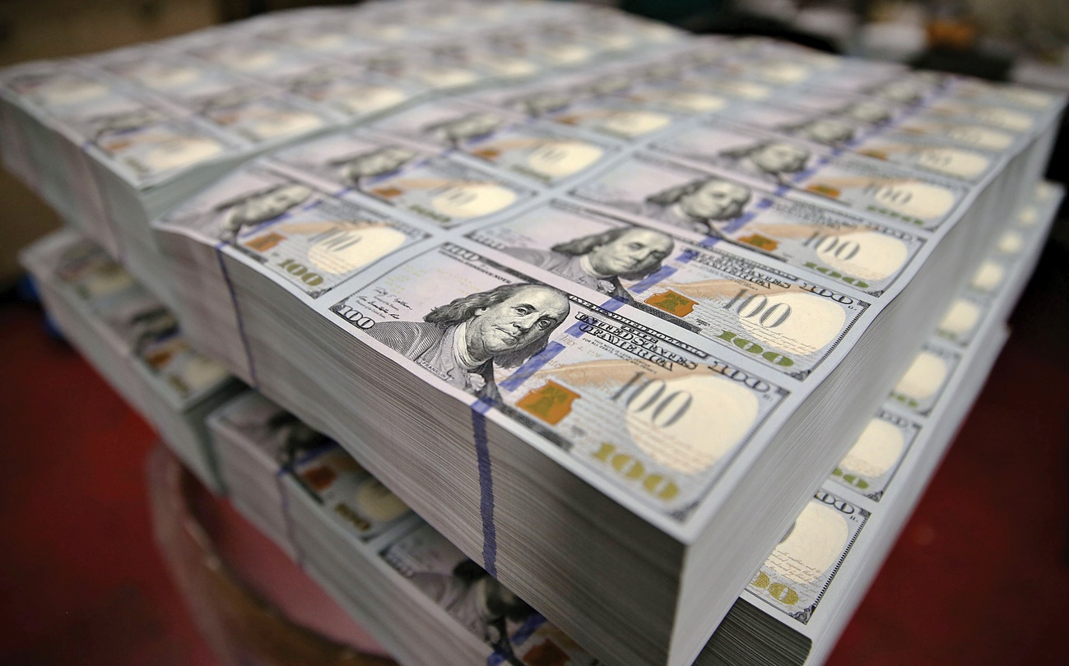
DAVID PEARSON/ALAMY
THE BALANCE OF PAYMENTS CONSISTS OF ALL PAYMENTS RECEIVED FROM AND MADE TO FOREIGN COUNTRIES. IT INCLUDES THE CURRENT ACCOUNT AND CAPITAL ACCOUNT.
CHAPTER 27
SLIDE 4

Slide 5
THE CURRENT ACCOUNT
Includes the following components:
  imports and exports: the balance of trade
  income flows: wages, rents, interest, and profit that Americans earn abroad, less the corresponding income foreigners earn in the United States
  net transfers of money: foreign aid, stipends paid to foreign students, and money that foreign workers in the United States send back to their families
CHAPTER 27
SLIDE 5

Slide 6
THE CAPITAL ACCOUNT
Summarizes the flow of money into and out of domestic and foreign assets. This includes:
  investments by foreign companies in domestic plants or subsidiaries.
    The profits of these investments, however, are counted in the current account.
  foreign holdings of U.S. assets. This includes portfolio investments: mutual funds, stocks, bonds, and bank deposits.
CHAPTER 27
SLIDE 6

Slide 7
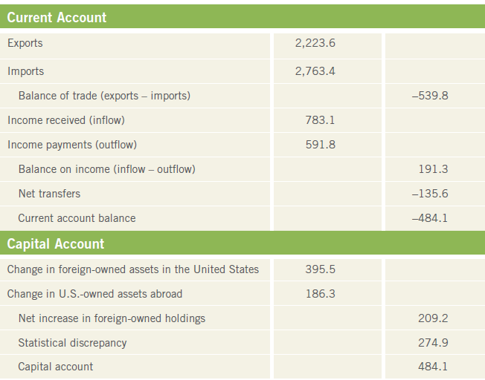
THE BALANCE OF PAYMENTS (2015)
The current and capital accounts balance each other out.
CHAPTER 27
SLIDE 7

Slide 8
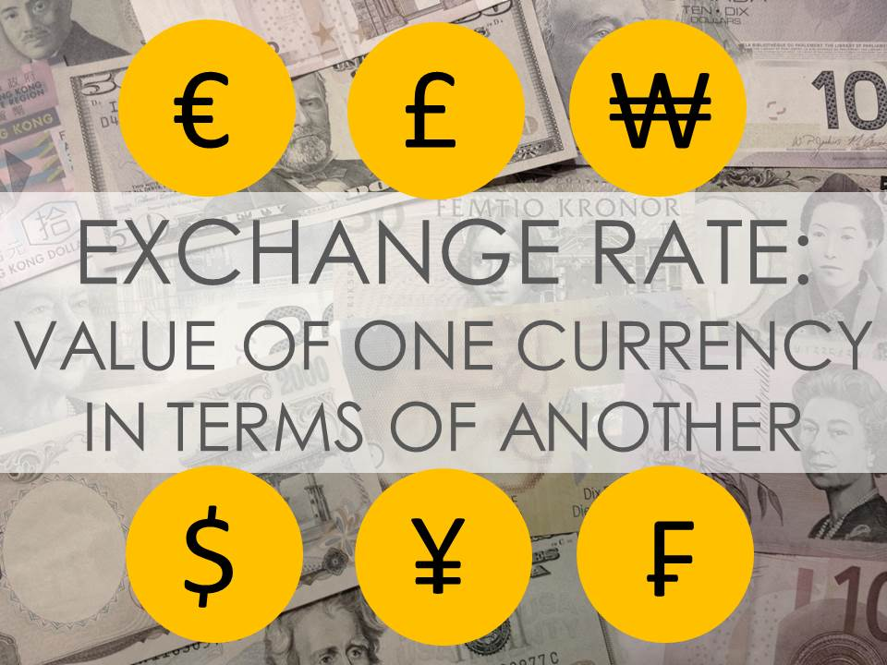
ERIC CHIANG
CHAPTER 27
SLIDE 8

Slide 9
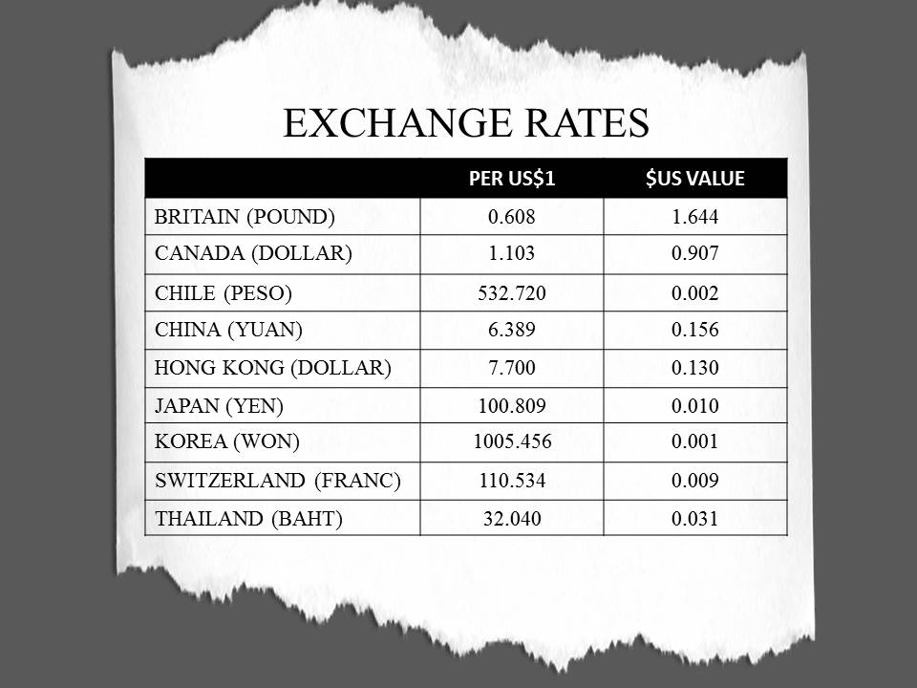
U.S. DOLLAR EXCHANGE RATES
CHAPTER 27
SLIDE 9

Slide 10

NOMINAL VS. REAL EXCHANGE RATE
  NOMINAL EXCHANGE RATE
  REAL EXCHANGE RATE
THE NOMINAL EXCHANGE RATE MULTIPLIED BY THE RATIO OF PRICES IN THE TWO COUNTRIES
    THE PRICE OF ONE COUNTRY’S CURRENCY IN ANOTHER CURRRENCY
CHAPTER 27
SLIDE 10

Slide 11
REAL EXCHANGE RATE
Takes the price level of both countries into account:
  e_{r} = e_{n} × (P_{d} / P_{f})
e_{r} is the real exchange rate.
e_{n} is the nominal exchange rate.
P_{d} is the domestic price level.
P_{f} is the foreign price level.
CHAPTER 27
SLIDE 11

Slide 12

PETER WINDMANN/MAURITIUS/SUPERSTOCK
PURCHASING POWER PARITY IS THE EXCHANGE RATE THAT ALLOWS CURRENCY TO BUY THE SAME QUANTITY OF GOODS OR SERVICES IN ANOTHER COUNTRY.
CHAPTER 27
SLIDE 12

Slide 13
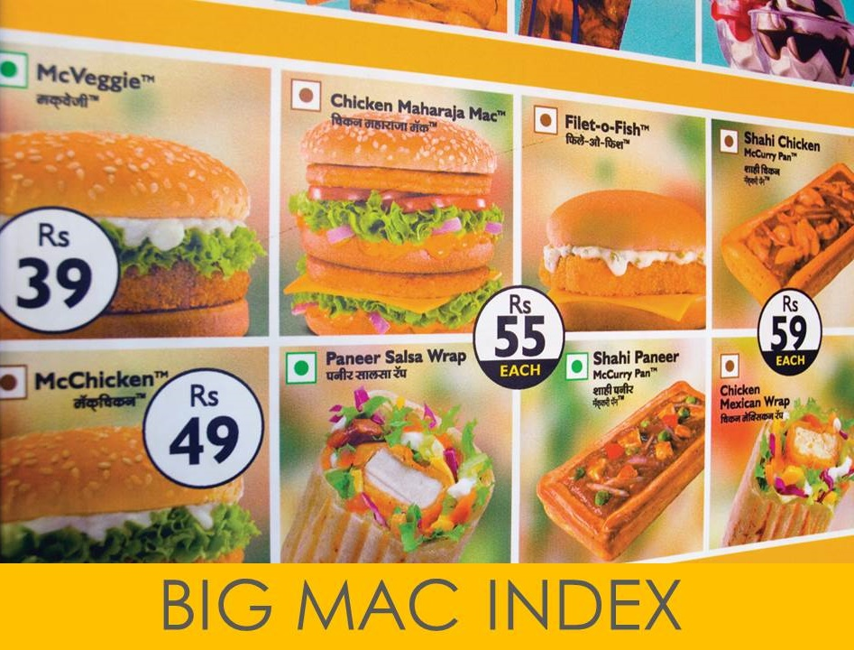
DAVID PEARSON/ALAMY
CHAPTER 27
SLIDE 13

Slide 14
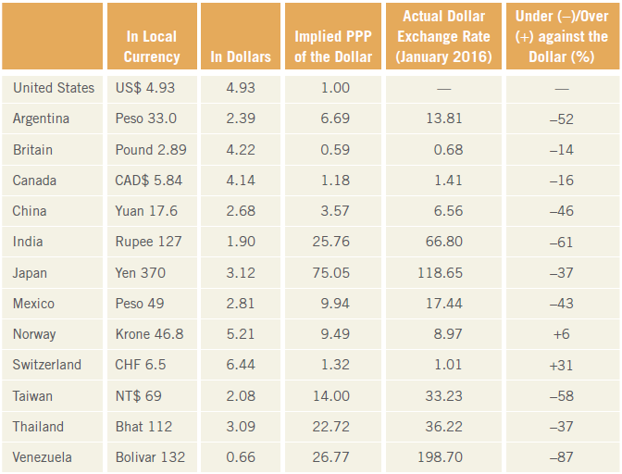
THE BIG MAC INDEX
A general approximation of purchasing power parity.
CHAPTER 27
SLIDE 14

Slide 15
A MARKET FOR FOREIGN EXCHANGE
The foreign exchange market for dollars has an upward-sloping supply and a downward-sloping demand.
The supply of dollars to the market reflects demand for other currencies.
With perfectly flexible exchange rates, an equilibrium will be established in which quantity demanded will equal quantity supplied.
CHAPTER 27
SLIDE 15

Slide 16
THE FOREIGN EXCHANGE MARKET
MARKET FOR DOLLARS
At exchange rate e₁, there is excess demand for dollars; the dollar will appreciate.
S$
e₂
e
At exchange rate e₂, there is excess supply of dollars; the dollar will depreciate.
EXCHANGE RATE (POUNDS PER DOLLAR)
e₀
e₁
D$
The market settles into equilibrium at exchange rate e₀.
0
Q₁
Q₀
Q₂
QUANTITY OF DOLLARS
CHAPTER 27 SLIDE 16

Slide 17
CURRENCY APPRECIATION & DEPRECIATION
A currency appreciates when its value rises relative to other currencies and depreciates when its value falls.
If dollars ($) are traded for pounds (£), an appreciating pound will mean a depreciating dollar.
  ↑£ = ↓$ and ↓£ = ↑$
CHAPTER 27
SLIDE 17

Slide 18
CURRENCY APPRECIATION AND DEPRECIATION
MARKET FOR DOLLARS
The dollar will appreciate if the demand for dollars rises.
S₀
0.75
At the new equilibrium, the price of the dollar rises.
EXCHANGE RATE (POUNDS PER DOLLAR)
0.56
D₁
D₀
0
Q₀
Q₁
QUANTITY OF DOLLARS
CHAPTER 27 SLIDE 18

Slide 19
CURRENCY APPRECIATION AND DEPRECIATION
MARKET FOR POUNDS
S₀
When the dollar appreciates in value, the pound depreciates.
1.78
EXCHANGE RATE (DOLLARS PER POUND)
1.33
D₀
D₁
0
Q₁
Q₀
QUANTITY OF POUNDS
CHAPTER 27 SLIDE 19

Slide 20
DETERMINANTS OF EXCHANGE RATES
❶
  Changes in consumers’ preferences
  Changes in income growth
  Changes in inflation
  Changes in interest rates
❷
❸
❹
CHAPTER 27
SLIDE 20

Slide 21
EXCHANGE RATES AND CURRENT ACCOUNT
As rates of inflation rise in a country:
its exports will be relatively more expensive.
if inflation exceeds that of other countries, exports fall.
the decline in exports worsens the current account position.
As domestic disposable income rises:
a country will import more goods.
the increase in imports worsens the current account position.
CHAPTER 27
SLIDE 21

Slide 22
EXCHANGE RATES AND CAPITAL ACCOUNT
IF EXCHANGE RATES ARE CONSTANT AND ASSETS OF TWO COUNTRIES ARE PERFECTLY SUBSTITUTABLE, REAL INTEREST RATES WILL BE EQUAL: r_{US} = r_{UK}.
A rise in interest rates in one country will cause capital to flow in.
If the dollar is expected to appreciate against the pound, interest rates in the United Kingdom must be higher to prevent capital outflow: r_{US} = r_{UK} − Δε.
CHAPTER 27
SLIDE 22

Slide 23
EXCHANGE RATES AND AD/AS
A change in nominal exchange rates will affect imports and exports and therefore shift aggregate demand.
  If the U.S. dollar depreciates, U.S. products become more attractive in foreign markets and exports rise while imports fall, shifting AD to the right.
Higher-priced imported production inputs and wage demands shift SRAS to the left, back to long-run equilibrium.
CHAPTER 27
SLIDE 23

Slide 24
EXCHANGE RATES AND AD/AS
SRAS₁
Currency depreciation shifts AD to the right as imports fall and exports rise.
LRAS
SRAS₀
P₂
b
P₁
a
AGGREGATE PRICE LEVEL (P)
e
Rising input prices (due to higher-priced imports) and higher wage demands push SRAS to the left, back to long-run equilibrium.
P₀
AD₁
AD₀
0
Q_{f}
Q₁
AGGREGATE OUTPUT (Q)
CHAPTER 27
SLIDE 24

Slide 25
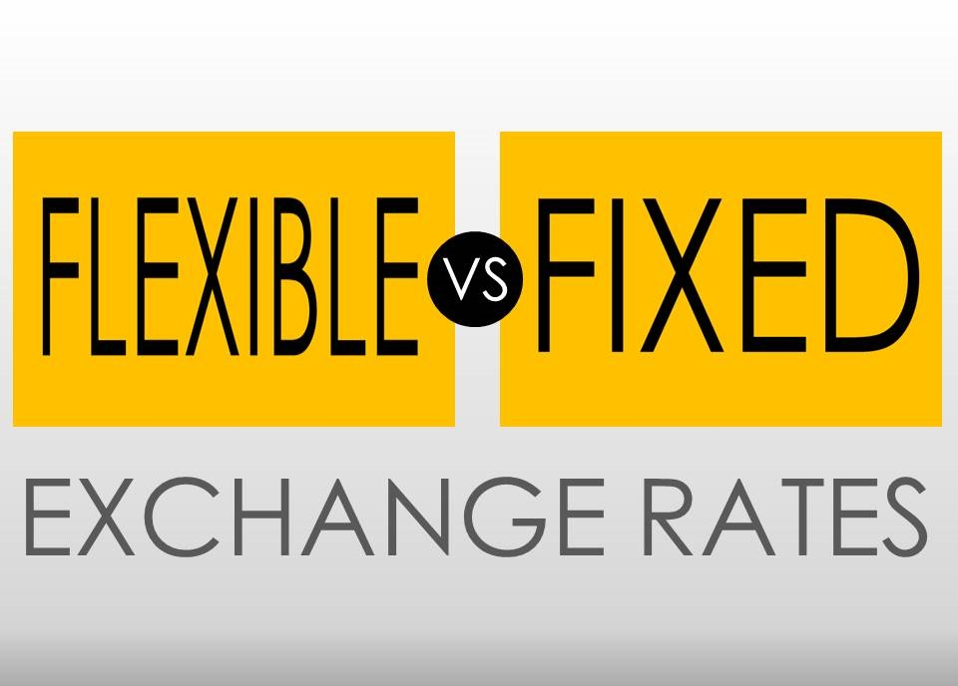
CHAPTER 27
SLIDE 25

Slide 26
FLEXIBLE VS. FIXED EXCHANGE RATES
  FLEXIBLE EXCHANGE RATE
  FIXED EXCHANGE RATE
    DETERMINED IN INTERNATIONAL CURRENCY MARKETS, GIVEN A COUNTRY’S MACRO POLICIES
EACH GOVERNMENT DETERMINES ITS EXCHANGE RATE AND USES MACRO POLICY TO MAINTAIN IT
CHAPTER 27
SLIDE 26

Slide 27

TOM GRILL/CORBIS
THE GOLD STANDARD TIED CURRENCY VALUES TO QUANTITIES OF GOLD. IF A COUNTRY’S IMPORTS EXCEEDED EXPORTS, ITS DEFICIT WAS PAID IN GOLD.
CHAPTER 27
SLIDE 27

Slide 28
FROM GOLD STANDARD TO BRETTON WOODS
Before the Great Depression, most of the world’s economies were on the gold standard.
After World War II, representatives of 44 countries met in Bretton Woods, New Hampshire, to establish a new international monetary system of fixed exchange rates. The IMF was set up.
By the early 1970s, the fixed-rate system had mostly collapsed.
CHAPTER 27
SLIDE 28

Slide 29
TODAY’S FLEXIBLE RATE SYSTEM
MOST COUNTRIES TODAY OPERATE ON A FLEXIBLE EXCHANGE RATE SYSTEM IN WHICH THE VALUE OF CURRENCY FLOATS IN THE MARKET.
However, exceptions apply, as some countries still use fixed exchange rates:
  Some countries peg their currency to another currency.
  Some countries give up their currency altogether and use another country’s currency.
CHAPTER 27
SLIDE 29

Slide 30

JAKE WYMAN/CORBIS
THE HONG KONG DOLLAR IS PEGGED (MAINTAINS A FIXED RATE) TO THE U.S. DOLLAR AT A RATE OF HK$7.80 TO US$1.
CHAPTER 27
SLIDE 30

Slide 31

MORLEY READ/ALAMY
A FEW COUNTRIES, SUCH AS ECUADOR, GAVE UP THEIR CURRENCY ALTOGETHER AND ADOPTED THE U.S. DOLLAR—DOLLARIZATION.
CHAPTER 27
SLIDE 31

Slide 32
POLICIES UNDER FIXED EXCHANGE RATES
An expansionary monetary policy will reduce U.S. interest rates.
  Capital flows out of the United States in search of higher returns.
  U.S. money supply drops.
  Domestic interest rates rise.
  Aggregate demand shifts leftward.
Monetary policy is hampered when exchange rates are fixed.
CHAPTER 27
SLIDE 32

Slide 33
MONETARY POLICY & FIXED EXCHANGE
Expansionary monetary policy reduces interest rates and shifts ad₀ to the right to ad₁.
SRAS₀
P₁
b
P₂
c
As capital flows out, u.S. money supply falls and interest rates rise, shifting ad left and reversing some of the expansionary effects.
AGGREGATE PRICE LEVEL (P)
a
P₀
AD₁
AD₂
AD₀
0
Q₀
Q₂
Q₁
AGGREGATE OUTPUT (Q)
CHAPTER 27
SLIDE 33

Slide 34
FISCAL POLICY AND FIXED EXCHANGE
An expansionary fiscal policy will increase aggregate demand.
  Price level rises as AD increases.
  Higher income and prices lead to higher interest rates, which attract capital inflow.
  Increased capital inflow reduces interest rates, enhancing the expansionary effect.
Fiscal policy is reinforced when exchange rates are fixed.
CHAPTER 27
SLIDE 34

Slide 35
FISCAL POLICY AND FIXED EXCHANGE
Expansionary fiscal policy shifts ad₀ to the right to ad₁.
SRAS₀
P₂
c
b
Rising interest rates invite foreign capital to flow into the country, reducing interest rates and shifting AD further to the right, to AD₂.
P₁
AGGREGATE PRICE LEVEL (P)
a
P₀
AD₂
AD₁
AD₀
0
Q₀
Q₁
Q₂
AGGREGATE OUTPUT (Q)
CHAPTER 27
SLIDE 35

Slide 36
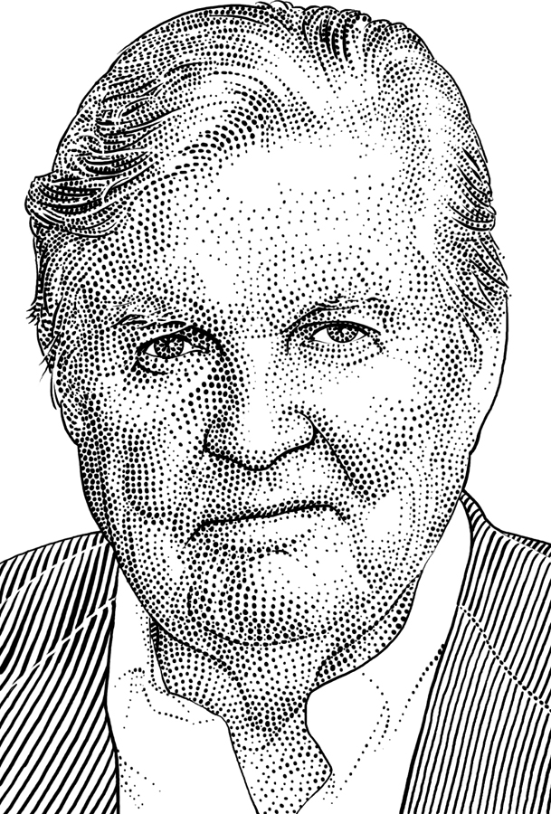
ROBERT MUNDELL
Developed supply-side economic theory with Arthur Laffer.
Researched movements in international capital and exchange rates.
Wrote about benefits and costs of nations adopting a single currency.
  Won Nobel Prize in 1999
CHAPTER 27
SLIDE 36

Slide 37
MONETARY POLICY WITH FLEXIBLE EXCHANGE
If exchange rates are flexible, expansionary monetary policy will:
  increase the money supply and reduce interest rates.
  lead to capital outflow in search of higher returns.
  increase supply of dollars in currency markets, causing a depreciation.
  result in greater exports.
Monetary policy is reinforced with flexible exchange rates.
CHAPTER 27
SLIDE 37

Slide 38
FISCAL POLICY WITH FLEXIBLE EXCHANGE
If exchange rates are flexible, expansionary fiscal policy will:
  Increase interest rates and lead to a capital inflow.
  Increase demand for dollars in currency markets, causing an appreciation.
  Result in greater imports.
Fiscal policy is hampered with flexible exchange rates.
CHAPTER 27
SLIDE 38

Slide 39
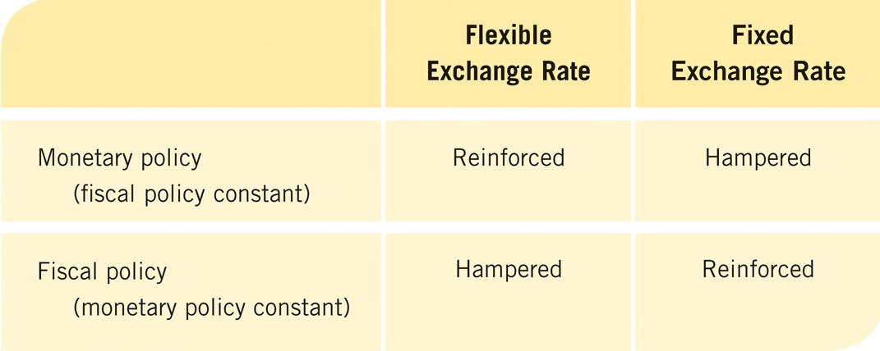
SUMMARY OF MONETARY AND FISCAL POLICY EFFECTIVENESS
CHAPTER 27
SLIDE 39

Slide 40
Current account
Capital account
Exchange rate
Nominal exchange rate
Real exchange rate
Purchasing power parity
Appreciation (currency)
Depreciation (currency)
Fixed exchange rate
Flexible or floating exchange rate
Dollarization
KEY CONCEPTS
CHAPTER 27
SLIDE 40

Slide 41
WHICH OF THE FOLLOWING IS NOT A COMPONENT OF THE CURRENT ACCOUNT?
A
INVESTMENTS MADE BY FOREIGN COMPANIES IN DOMESTIC PLANTS
B
INCOME FLOWS INTO AND OUT OF THE COUNTRY
C
TRANSFERS OF MONEY INTO AND OUT OF THE COUNTRY
D
PAYMENTS FOR IMPORTS OF GOODS AND SERVICES
E
PAYMENTS FOR EXPORTS OF GOODS AND SERVICES
CHAPTER 27
SLIDE 41
Notes:
Answer: A

Slide 42

PRACTICE QUESTION
PETER WINDMANN/MAURITIUS/SUPERSTOCK
IN THAILAND, A MASSAGE CAN COST AS LITTLE AS $10 AN HOUR. WHY DOES PURCHASING POWER PARITY NOT HOLD?
CHAPTER 27
SLIDE 42
Notes:
Answer: For purchasing power parity to hold, products must be easily traded between countries so prices and exchange rates can equalize. Services such as massages are not tradable, and therefore price differences will be common between countries, especially countries like Thailand, which has lower wages than the United States and a larger supply of massage therapists.

Slide 43
IF US$1 BUYS 1.25 AUSTRALIAN DOLLARS, HOW MANY U.S. DOLLARS WILL 1 AUSTRALIAN DOLLAR BUY?
A
0.25
B
1.25
C
2.0
D
0.8
E
2.25
CHAPTER 27
SLIDE 43
Notes:
Answer: D

Slide 44
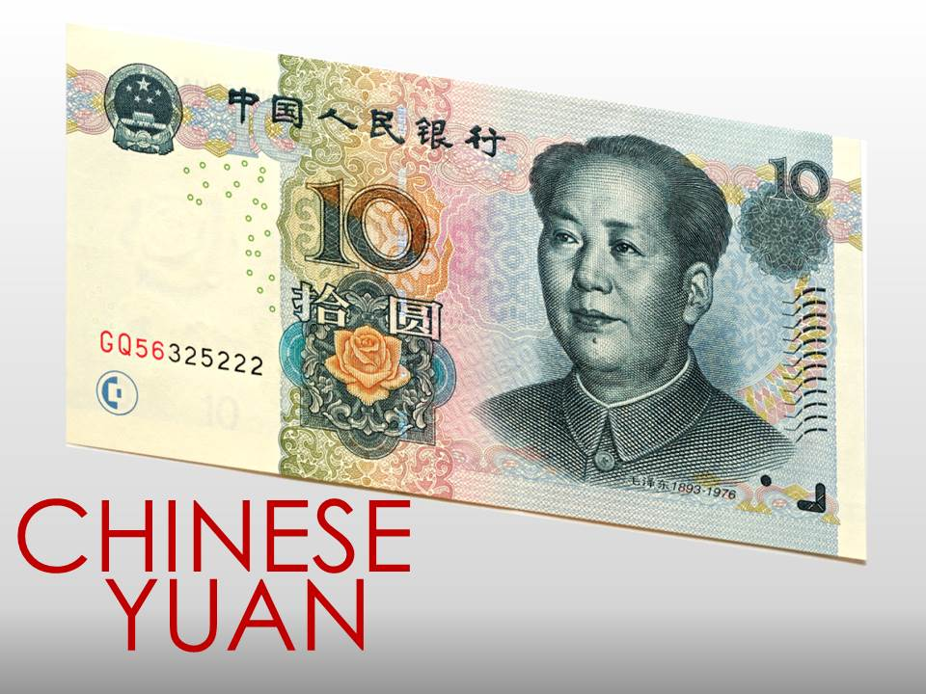
PRACTICE QUESTION
GLYN THOMAS/ALAMY
CHINA IS ACCUSED OF UNDERVALUING ITS YUAN RELATIVE TO THE U.S. DOLLAR. HOW DOES CHINA DO THIS?
CHAPTER 27
SLIDE 44
Notes:
Answer: To keep the value of the yuan down, the Chinese government must generate artificial demand for U.S. dollars relative to the yuan. It does this by hoarding U.S. dollars that were used to buy Chinese goods. By holding U.S. dollars, it reduces the supply of dollars on the foreign exchange market, boosting the value of the dollar and reducing the value of the yuan.

Slide 45
WHICH OF THE FOLLOWING WOULD CAUSE A CURRENCY TO DEPRECIATE IN A FLEXIBLE CURRENCY EXCHANGE MARKET?
A
RISING INTEREST RATES
B
A REDUCTION IN THE MONEY SUPPLY
C
REDUCED DEMAND FOR IMPORTED GOODS
D
A SURGE IN FOREIGN DEMAND FOR A COUNTRY’S GOODS
E
INCREASED INVESTMENT ABROAD
CHAPTER 27
SLIDE 45
Notes:
Answer: E

Slide 46
27
END OF CHAPTER
SLIDES CREATED BY ERIC CHIANG
Tshooter/Shutterstock; Anton Balazh/Shutterstock
CHAPTER 27
SLIDE 46

