Slide 1

24
Monetary Policy
SLIDES CREATED BY ERIC CHIANG
INCAMERASTOCK / ALAMY
CHAPTER 24 SLIDE 1

Slide 2
CHAPTER OBJECTIVES
Explain the importance of interest rates on the economy and how they affect our daily lives.
Explain the goals of monetary policy and how the Fed uses policies to expand or contract the economy.
Contrast classical monetary theory with Keynesian and monetarist theories.
Describe the equation of exchange and its implications for monetary policy in the long run.

CHAPTER 24
SLIDE 2

Slide 3
CHAPTER OBJECTIVES
Determine the effectiveness of monetary policy when demand or supply shocks occur.
Describe the debate on whether the Fed should have discretion or be governed by simple monetary rules.
Describe the federal funds target, the Taylor rule, and how they are used in modern monetary policymaking.
Explain why extraordinary powers were used in response to the financial crisis of 2008.
Discuss the monetary policy challenges faced by the European Central Bank following the financial crises affecting Eurozone members.
CHAPTER 24
SLIDE 3

Slide 4
MONETARY POLICY
POLICIES AIMED AT CONTROLLING THE MONEY SUPPLY TO TARGET INTEREST RATES IN AN ECONOMY
The twin goals of monetary policy are:
economic growth with low unemployment.
stable prices with moderate long-term interest rates.
CHAPTER 24
SLIDE 4

Slide 5

ARIEL SKELLEY/BLEND IMAGES/CORBIS
INTEREST RATES AFFECT THE MANNER IN WHICH WE BORROW AND CONSUME AND THE WAY IN WHICH WE SAVE AND INVEST.
CHAPTER 24
SLIDE 5

Slide 6

LOOSE OR TIGHT MONETARY POLICY?
EXPANSIONARY MONETARY POLICY
Used in times of economic downturn to boost aggregate demand. The Fed purchases bonds in open market operations to push the interest rate lower, leading to more spending and investment.
CONTRACTIONARY MONETARY POLICY
Used when inflationary pressures build up in the economy. The Fed sells bonds in open market operations to push the interest rate higher, slowing down or reducing aggregate demand.
CHAPTER 24
SLIDE 6

Slide 7
EXPANSIONARY MONETARY POLICY
Expansionary monetary policy reduces interest rates, which leads to greater aggregate demand, shifting the AD curve to the right.
AGGREGATE PRICE LEVEL (P)
AD₁
AD₀
AGGREGATE OUTPUT (Q)
CHAPTER 24
SLIDE 7

Slide 8
CONTRACTIONARY MONETARY POLICY
Contractionary monetary policy raises interest rates, which leads to lower aggregate demand, shifting the AD curve to the left.
AGGREGATE PRICE LEVEL (P)
AD₁
AD₀
AGGREGATE OUTPUT (Q)
CHAPTER 24
SLIDE 8

Slide 9
SHORT RUN VERSUS LONG RUN
  LRAS CURVE
  SRAS CURVE
    VERTICAL BECAUSE OUTPUT IS FIXED IN THE LONG RUN, WAGES AND PRICES BEING FLEXIBLE
UPWARD SLOPING BECAUSE HIGHER PRICES CAN TEMPORARILY INCREASE OUTPUT
CHAPTER 24
SLIDE 9

Slide 10
THE LONG RUN: CLASSICAL THEORY
Classical economists focus on long-run adjustments in economic activity:
  They assume that wages, prices, and interest rates are flexible.
  As a result, labor, product, and capital markets are expected to adjust to keep the economy at full employment.
A product of the classical theory is the quantity theory of money.
CHAPTER 24
SLIDE 10

Slide 11
THE EQUATION OF EXCHANGE
The quantity theory of money is defined by the equation of exchange:
  M × V = P × Q
M is the supply of money.
V is velocity of money (average number of times money is spent in a year).
P is the price level.
Q is the economy’s real output level.
CHAPTER 24
SLIDE 11

Slide 12
THE EFFECT OF MONETARY POLICY
Classical economists believe that expansionary monetary policy only creates inflation.
  Velocity (V) is assumed to be fixed.
  Output (Q) is fixed at full employment.
  As a result, any change in money supply will translate directly to a change in prices.
CHAPTER 24
SLIDE 12

Slide 13
THE CLASSICAL MODEL
LRAS
In the classical model, the economy is at full employment. An increase in aggregate demand only results in higher prices at the same output.
b
P₁
AGGREGATE PRICE LEVEL (P)
e
P₀
AD₁
AD₀
AGGREGATE OUTPUT (Q)
CHAPTER 24
SLIDE 13

Slide 14
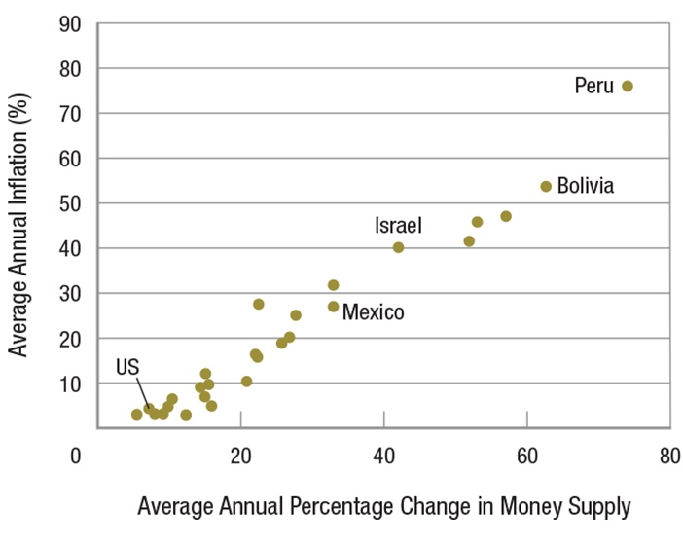
MONEY GROWTH AND INFLATION
CHAPTER 24
SLIDE 14

Slide 15
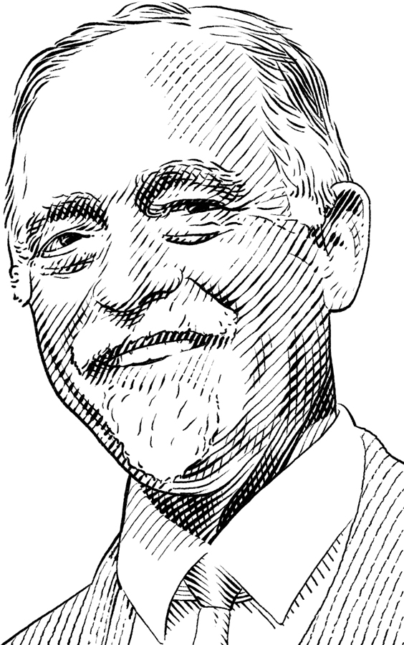
IRVING FISHER (1867–1947)
Developed a theory to measure the utility of commodities.
Showed the interest rate as the link between capital and income.
Developed key idea: equation of exchange
CHAPTER 24
SLIDE 15

Slide 16

ROBERT HARDING WORLD IMAGERY/CORBIS
MONEY ILLUSION IS THE PERCEPTION THAT WEALTH RISES WHEN THE MONEY SUPPLY GROWS. THE DELAYED REACTION IN WAGES AND PRICES MAKES THEM STICKY.
CHAPTER 24
SLIDE 16

Slide 17
THE KEYNESIAN MODEL
Keynes argued that economies can get stuck out of equilibrium.
Wages and prices are sticky in the short run.
  An increase in the money supply would lower interest rates, leading to increased investment and aggregate demand.
A liquidity trap occurs when interest rates are so low that monetary policy becomes ineffective.
CHAPTER 24
SLIDE 17

Slide 18

OLIVIER LE QUEINEC/DREAMSTIME.COM
KEYNESIANS BELIEVE FISCAL POLICY (SUCH AS GOVERNMENT SPENDING) IS EFFECTIVE DURING ECONOMIC DOWNTURNS.
CHAPTER 24
SLIDE 18

Slide 19
THE MONETARIST MODEL
Associated with the work of Milton Friedman.
  Consumption depends on income and wealth: permanent income hypothesis.
  Monetarists believe that the crowding out effect makes fiscal policy ineffective.
Monetarists believe an increase in money supply will increase spending in the short run but leads only to inflation in the long run.
CHAPTER 24
SLIDE 19

Slide 20
MONETARIST MODEL
SRAS₁
An increase in the money supply results in higher output in the short run.
LRAS
SRAS₀
P₂
P₁
a
In the long run, as prices adjust, SRAS shifts left and the economy returns to long-run output at a higher price level.
AGGREGATE PRICE LEVEL (P)
e
P₀
AD₁
AD₀
0
Q_{f}
Q₁
AGGREGATE OUTPUT (Q)
CHAPTER 24
SLIDE 20

Slide 21
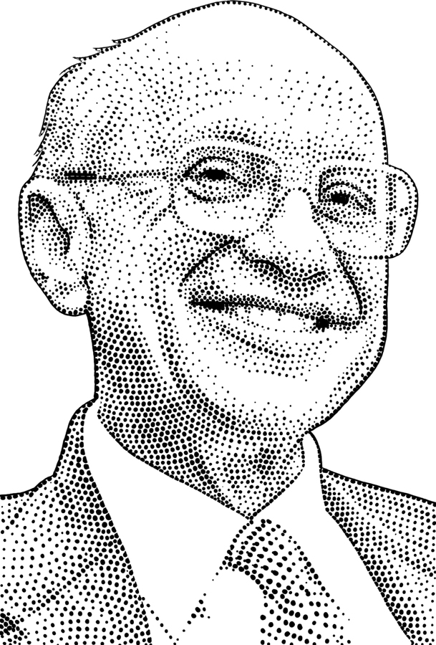
MILTON FRIEDMAN (1912–2006)
Emphasized monetary policy over fiscal policy.
Advocated a policy of consistent growth in the money supply.
  Won Nobel Prize in 1976 for work on monetary theories and the concept of permanent income.
CHAPTER 24
SLIDE 21

Slide 22
A SUMMARY OF MONETARY POLICY
In the long run, increases in the money supply lead to inflation.
  Classical economists believe this happens immediately, so monetary and fiscal policies are ineffective.
Keynesians believe that in the short run, fiscal policy is effective.
Monetarists believe that in the short run, monetary policy is effective.
CHAPTER 24
SLIDE 22

Slide 23
A SUMMARY OF MONETARY THEORIES
Short Run
Long Run
Classical Theory
Keynesian Theory
Monetarist Theory
Monetary policy is ineffective. The economy always self-adjusts.
Fiscal policy is effective, while monetary policy is ineffective in times of deep recession.
Fiscal policy is ineffective because government spending crowds out consumption and investment; monetary policy is effective.
Economy self-adjusts via flexible prices. Money leads only to price changes.
Economy adjusts to a long-run equilibrium; increased money supply leads to higher prices.
Economy adjusts to long-run equilibrium; increased money supply leads to higher prices.
CHAPTER 24
SLIDE 23

Slide 24
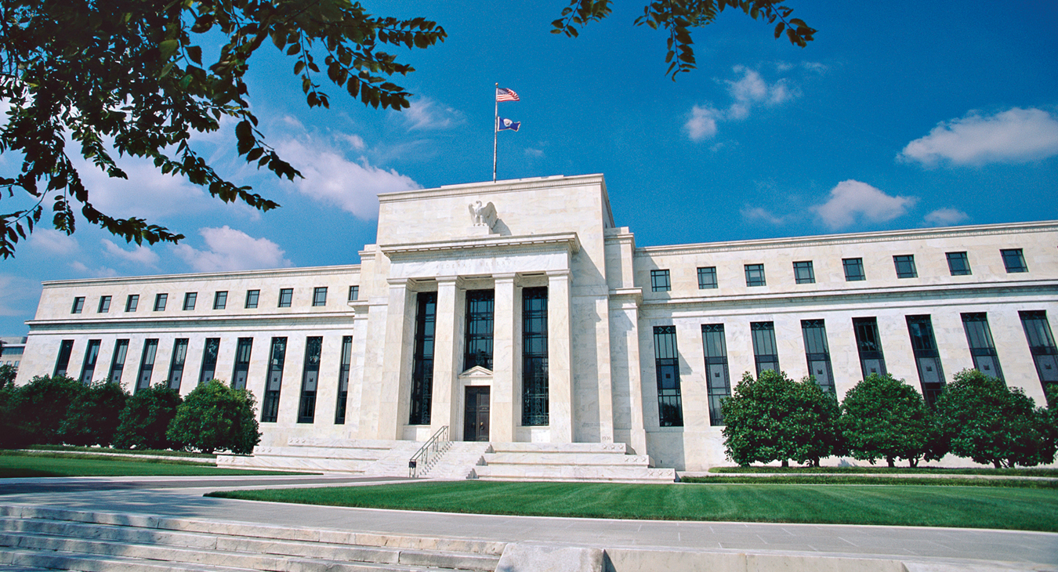
HISHAM IBRAHIM/CORBIS
PRICE STABILITY IS THE FED’S FOCUS IN THE LONG RUN. BUT HOW SHOULD THE FED RESPOND TO SHORT-RUN SHOCKS?
CHAPTER 24
SLIDE 24

Slide 25
DEMAND SHOCKS & MONETARY POLICY
LRAS
When a demand shock pushes output below long-run equilibrium…
SRAS
AGGREGATE PRICE LEVEL (P)
a
P₁
…monetary policy can shift AD back to the right to restore long-run output and prices.
P₀
e
AD₁
AD₀
0
Q₀
Q_{f}
AGGREGATE OUTPUT (Q)
CHAPTER 24
SLIDE 25

Slide 26
SUPPLY SHOCKS & MONETARY POLICY
SRAS₁
A negative supply shock reduces output and raises prices.
LRAS
SRAS₀
P₂
b
Monetary policy is not effective in combatting supply shocks. If AD shifts to the right, price level rises further. If AD shifts to the left, output worsens.
P₁
AGGREGATE PRICE LEVEL (P)
e
P₀
AD₁
AD₀
0
Q₁
Q_{f}
AGGREGATE OUTPUT (Q)
CHAPTER 24
SLIDE 26

Slide 27
MODERN MONETARY POLICY
  EASY MONEY, ACCOMMODATIVE MONETARY POLICY
  TIGHT MONEY, RESTRICTIVE MONETARY POLICY
    FED ACTS TO INCREASE THE MONEY SUPPLY TO STIMULATE THE ECONOMY.
FED ACTS TO DECREASE THE MONEY SUPPLY TO FIGHT INFLATION.
CHAPTER 24
SLIDE 27

Slide 28
RULES VERSUS DISCRETION
Some economists advocate a monetary rule (as opposed to discretion) to guide policymakers. Types of rules include:
❶
  monetary growth rule.
  inflation targeting.
  the Taylor rule.
❷
❸
CHAPTER 24
SLIDE 28

Slide 29
MONEY VERSUS INFLATION TARGETING
MONETARY GROWTH RULE
Increasing the money supply by a set percentage each year at a level consistent with long-term price stability and economic growth. It is slow to correct severe economic shocks.
INFLATION TARGETING
Setting a target on the inflation rate, usually around 2% per year, and adjusting monetary policy to keep inflation in that range. It is difficult to correct for supply shocks.
CHAPTER 24
SLIDE 29

Slide 30
THE TAYLOR RULE
To address both inflation and output, the Fed can follow the Taylor rule:
  Fed funds target rate = 2 + current inflation rate + ½(inflation gap) + ½(output gap)
How close is the actual Fed funds rate to the Taylor rule estimate?
CHAPTER 24
SLIDE 30

Slide 31
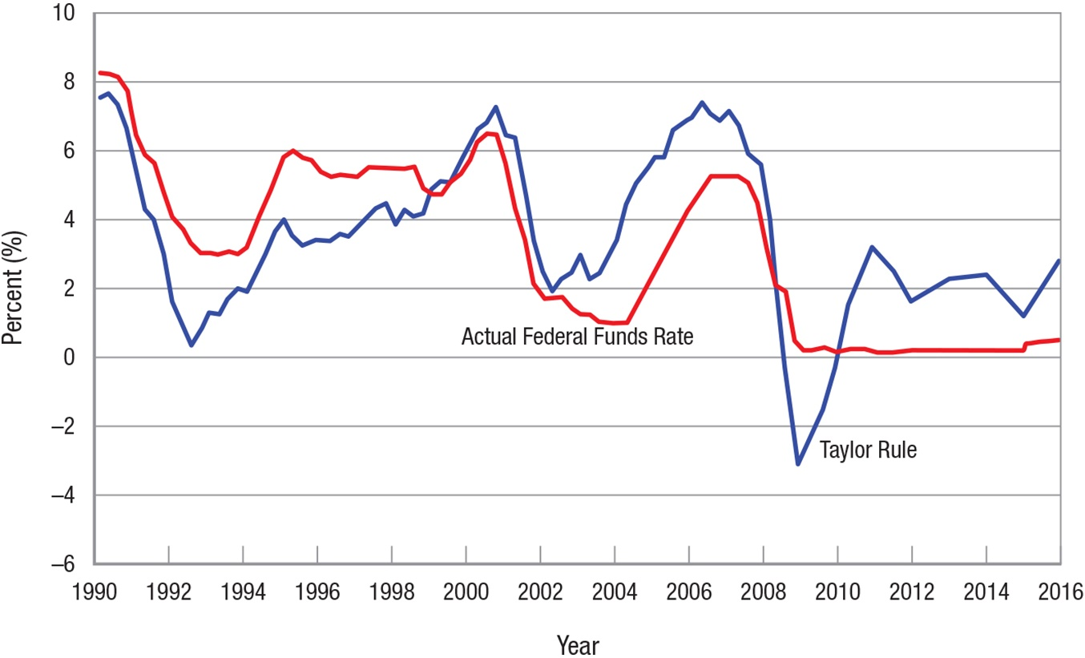
FED FUNDS RATE AND THE TAYLOR RULE
CHAPTER 24
SLIDE 31

Slide 32
TRANSPARENCY AND THE FED
After Alan Greenspan became chairman of the Fed in 1987:
  The Fed’s secrecy policy changed.
  Beginning in 1994, the Fed released a policy statement each time it changed interest rates.
  Beginning in 2000, the Fed released a statement after every meeting even if the policy remained the same.
The Fed recognized that monetary policy is less effective when people are uncertain what the Fed will do.
CHAPTER 24
SLIDE 32

Slide 33
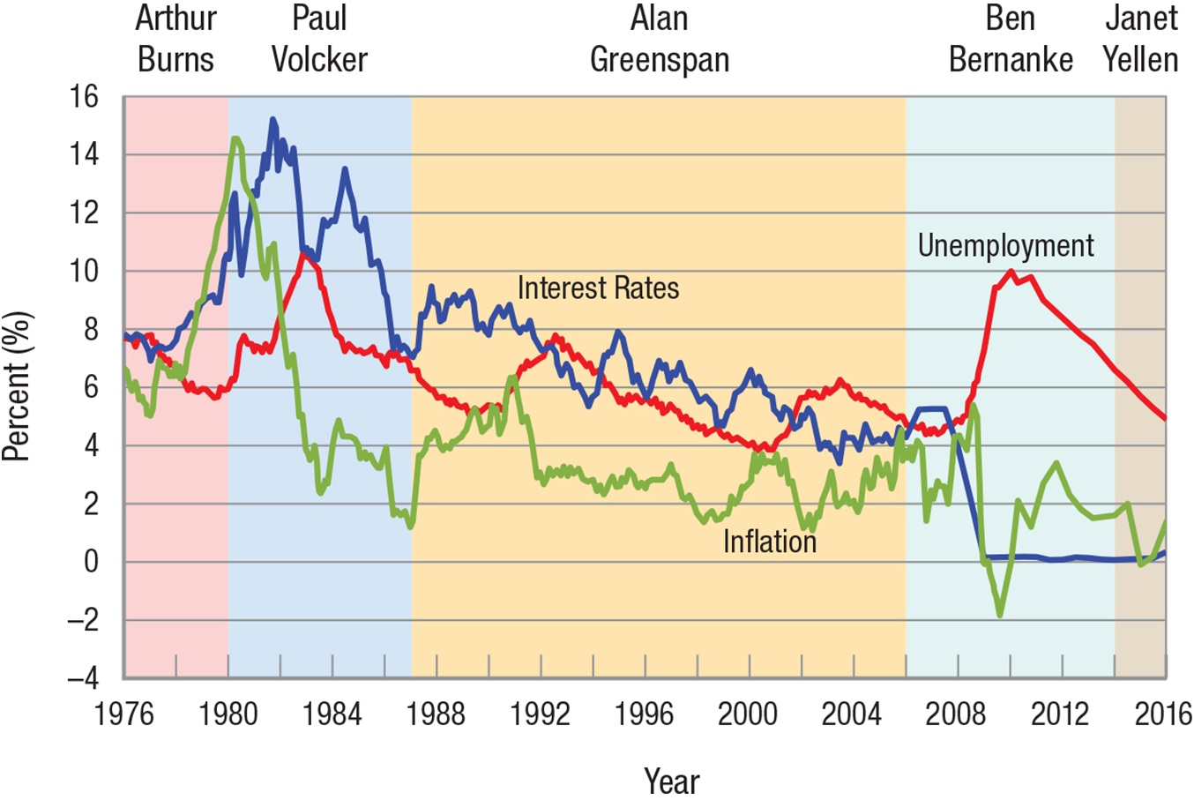
RECORD OF THE FED’S PERFORMANCE
CHAPTER 24
SLIDE 33

Slide 34

MONETARY POLICY CHALLENGES
STOCKPHOTO/THINKSTOCK
LOW INTEREST RATES AND BAD INCENTIVES RESULTED IN A HOUSING BUBBLE THAT COLLAPSED AFTER 2006.
CHAPTER 24
SLIDE 34

Slide 35

RICK BARRENTINE/CORBIS
THE 2007–2009 U.S. RECESSION AND ITS SUBSEQUENT SLOW RECOVERY LED THE FED TO TAKE EXTRAORDINARY ACTIONS.
CHAPTER 24
SLIDE 35

Slide 36
FED ACTIONS TO STEM THE CRISIS
It used normal monetary policy tools and some it hadn’t used since the 1930s.
By December 2008, the Fed had lowered the federal funds target rate to essentially zero percent.
The Fed then turned to extraordinary measures when it began making massive loans to banks and buying large amounts of risky assets.
CHAPTER 24
SLIDE 36

Slide 37

THE EUROZONE WAS CREATED IN 1992 BY
12 NATIONS THAT ENVISIONED A SINGLE CURRENCY TO FACILITATE TRADE.
WALTER BIBIKOW/JAI/CORBIS
CHAPTER 24
SLIDE 37

Slide 38
THE EUROZONE CRISIS
Each member of the Eurozone must satisfy certain economic criteria.
In 2007, the Eurozone expanded beyond the original 12 members to include several eastern European nations.
As a result of the worldwide financial crisis, Eurozone members began to have problems in 2008.
CHAPTER 24
SLIDE 38

Slide 39

BILDBROKER.DE/ALAMY
IRELAND WAS THE FIRST EUROZONE MEMBER TO FACE A FINANCIAL CRISIS IN 2008. ABOUT HALF OF EUROZONE MEMBERS FOLLOWED.
CHAPTER 24
SLIDE 39

Slide 40
RESOLVING THE EUROZONE CRISIS
The European Central Bank took extraordinary actions to prevent the collapse of the euro.
Bailouts and loans were provided in exchange for austerity measures and greater scrutiny of economic policies.
The European Stability Mechanism was set up to facilitate loans to Eurozone members.
CHAPTER 24
SLIDE 40

Slide 41
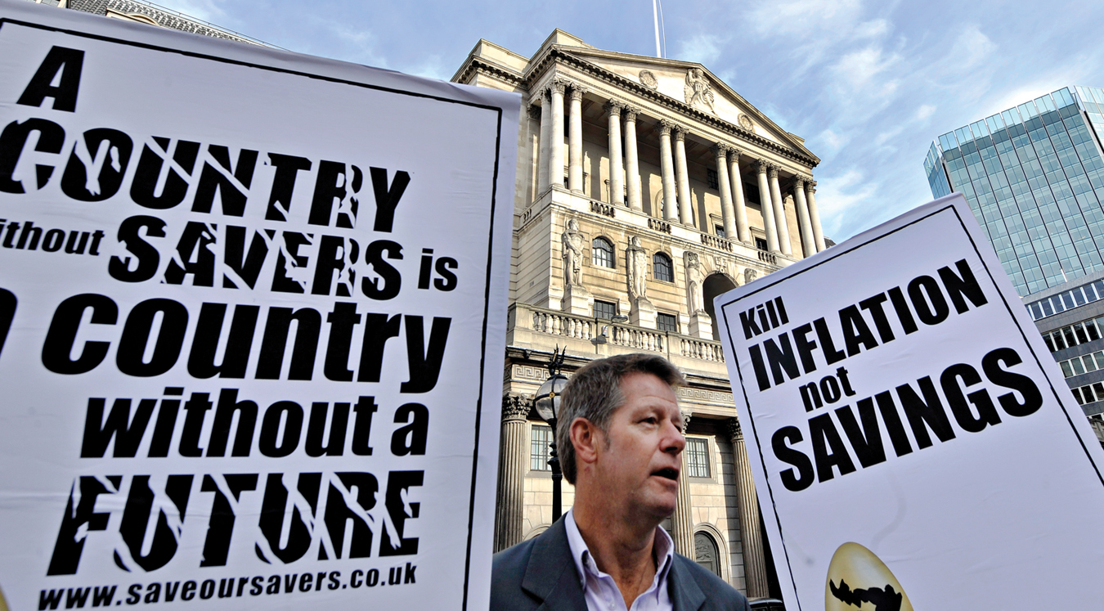
ANDY RAIN/EPA/CORBIS
EXTRAORDINARY ACTIONS BY THE FED AND ECB LED TO SOME CRITICISMS AS LONG-TERM INFLATION BECAME MORE LIKELY.
CHAPTER 24
SLIDE 41

Slide 42
Expansionary monetary policy
Contractionary monetary policy
Equation of exchange
Money illusion
Liquidity trap
Easy money, quantitative easing, or accommodative monetary policy
Tight money or restrictive monetary policy
Monetary rule
Inflation targeting
Taylor rule
KEY CONCEPTS
CHAPTER 24
SLIDE 42

Slide 43
WHAT IS THE APPROPRIATE POLICY FOR THE FED TO USE IN A SEVERE RECESSION?
A
EXPANSIONARY MONETARY POLICY
B
CONTRACTIONARY MONETARY POLICY
C
EXPANSIONARY FISCAL POLICY
D
CONTRACTIONARY FISCAL POLICY
E
EXPANSIONARY MONETARY AND FISCAL POLICY
CHAPTER 24
SLIDE 43
Notes:
Answer: A

Slide 44
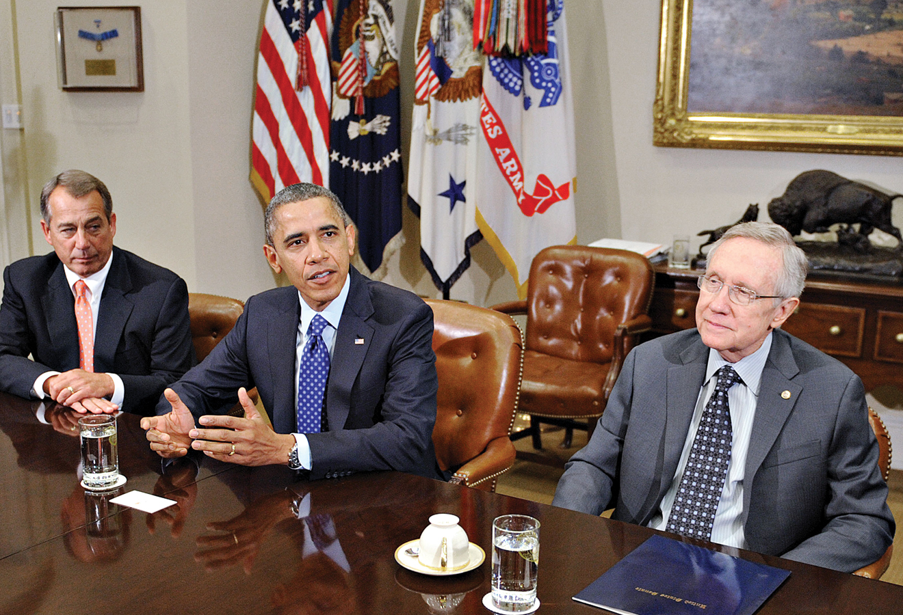
PRACTICE QUESTION
OLIVIER DOULERY-POOL/GETTY IMAGES
HOW DO CLASSICAL, KEYNESIAN, AND MONETARIST THEORIES CORRESPOND TO POLICIES USED BY TODAY’S POLITICAL PARTIES?
CHAPTER 24
SLIDE 44
Notes:
Answer: Today’s political parties vary in their views, even within each party. However, very loose comparisons can be made with the various monetary theories. Classical economists believe in a limited role for government in markets, not too unlike the modern Tea Party or Libertarian party. Monetarists believe in using monetary policy over fiscal policy, which is closer to the Republican party. Keynesians believe that fiscal policy is most effective, particularly government spending to jump-start an economy, and this is closer to the Democratic party.

Slide 45
ACCORDING TO THE EQUATION OF EXCHANGE, WHAT IS THE LEVEL OF OUTPUT IF M = 1,000, V = 5, AND P = 20?
A
10
B
50
C
100
D
250
E
5,000
CHAPTER 24
SLIDE 45
Notes:
Answer: D

Slide 46

PRACTICE QUESTION
VOLKER MOEHRKE/CORBIS
WHAT KIND OF SHOCK DO RISING FUEL PRICES CAUSE, AND HOW EFFECTIVE IS MONETARY POLICY TO CORRECT IT?
CHAPTER 24
SLIDE 46
Notes:
Answer: Rising fuel prices cause a supply shock because the change raises the prices of almost every good. Supply shocks are difficult to correct with monetary policy, because the shock causes both an increase in prices and a decrease in output. Correcting one problem using monetary policy will lead to a worsening of the other problem.

Slide 47
IF INFLATION IS 3%, THE TARGET INFLATION RATE IS 2%, AND THE ECONOMY IS 3% ABOVE ITS LONG-RUN OUTPUT, WHAT IS THE FED FUNDS TARGET USING THE TAYLOR RULE?
A
5%
B
6%
C
7%
D
8%
CHAPTER 24
SLIDE 47
Notes:
Answer: C

Slide 48
24
END OF CHAPTER
SLIDES CREATED BY ERIC CHIANG
Tshooter/Shutterstock; Anton Balazh/Shutterstock
CHAPTER 24
SLIDE 48

