Slide 1

23
Money Creation and the Federal Reserve
SLIDES CREATED BY ERIC CHIANG
FLIRT/SUPERSTOCK
CHAPTER 23 SLIDE 1

Slide 2
CHAPTER OBJECTIVES
Explain how banks create money by accepting deposits and making loans.
Define fractional reserve banking and explain why banks can lend much more than they keep in reserves.
Explain how the money multiplier works and how it makes monetary policy decisions very powerful.
Define a money leakage and explain how it affects the money multiplier.

CHAPTER 23
SLIDE 2

Slide 3
CHAPTER OBJECTIVES
Describe the history and structure of the Federal Reserve System.
List the important banking functions conducted by the Federal Reserve regional banks and their branches.
Describe the Federal Reserve’s principal monetary tools.
Analyze the federal funds rate and how it affects all other interest rates.
Explain why the Federal Reserve’s policies take time to affect the economy.
CHAPTER 23
SLIDE 3

Slide 4

JAMES LEYNSE/CORBIS
  MONEY IS CREATED WHEN FINANCIAL INSTITUTIONS ACCEPT DEPOSITS AND MAKE LOANS.
CHAPTER 23
SLIDE 4

Slide 5
CREATING MONEY
Banks (financial institutions) act as a bridge between savers and borrowers.
A bank’s ability to make loans (to create money) is limited to a certain percentage of its total customer deposits.
Banks must hold a percentage of their total deposits as reserves.
CHAPTER 23
SLIDE 5

Slide 6

BANKING RESERVES
  RESERVE RATIO
  RESERVE REQUIREMENT
MINIMUM REQUIRED LEVEL OF RESERVES A BANK MUST HOLD AS CASH OR AS A FED DEPOSIT
    LEVEL OF RESERVES A BANK HOLDS AS A PERCENTAGE OF TOTAL DEPOSITS
CHAPTER 23
SLIDE 6

Slide 7
FRACTIONAL RESERVE BANKING SYSTEM
When a bank receives a deposit, a portion of it is held in reserve. The rest is lent out, which begins money creation.
$1,000 Deposit
Cash reserves + deposits at the Fed
Loans to consumers and businesses
CHAPTER 23
SLIDE 7

Slide 8
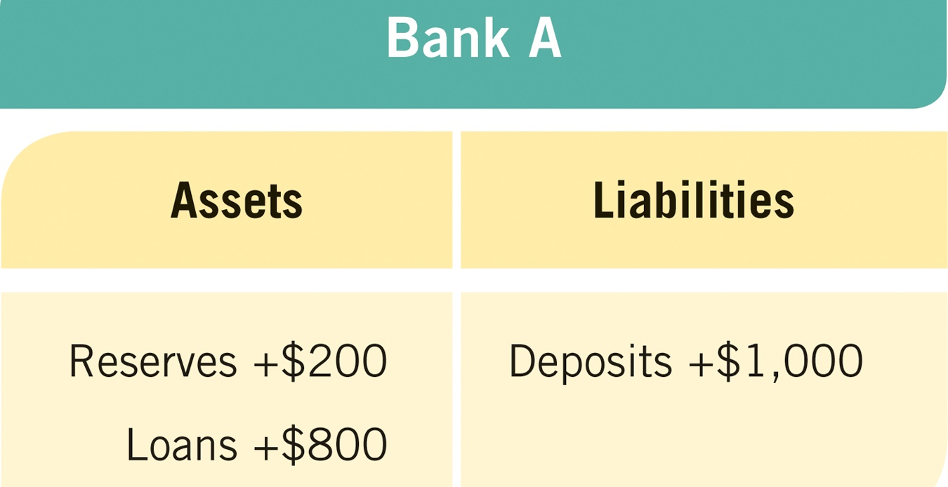
MONEY CREATION
Banks create money by lending excess reserves. Suppose $1,000 is deposited in Bank A, and the reserve requirement is 20%. Its balance sheet (T-account) looks like the following:
CHAPTER 23
SLIDE 8

Slide 9
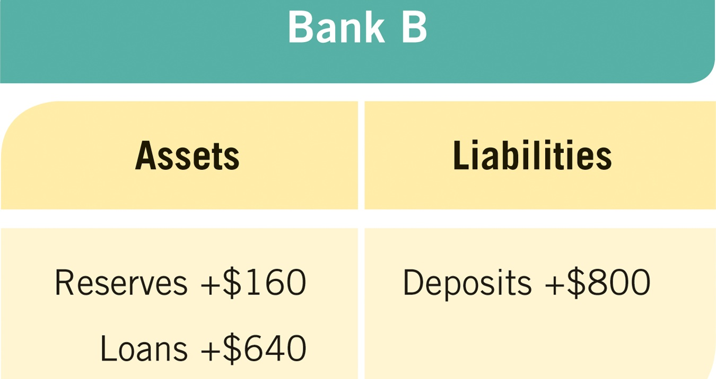
MONEY CREATION
The $800 that is lent out will end up in another bank. The second bank will then lend out 80%.
CHAPTER 23
SLIDE 9

Slide 10
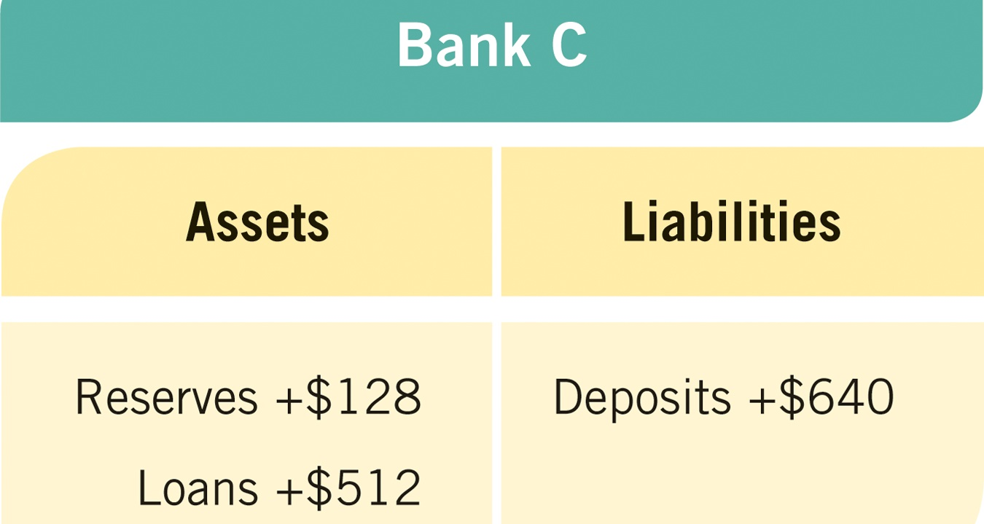
MONEY CREATION
The process continues with another round, the bank lending out 80% of $640.
CHAPTER 23
SLIDE 10

Slide 11
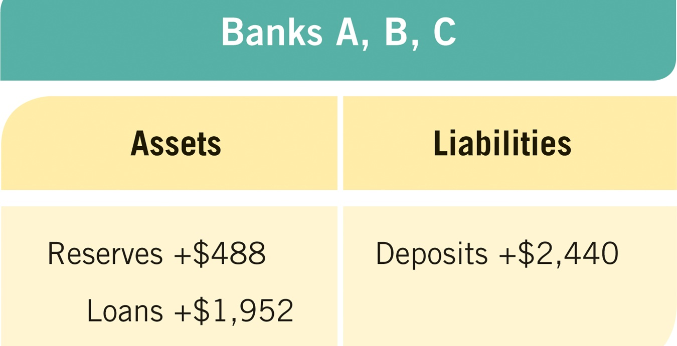
MONEY CREATION
Each time new deposits are made from the original $1,000, money is created. The total amount created from Banks A, B, and C:
CHAPTER 23
SLIDE 11

Slide 12
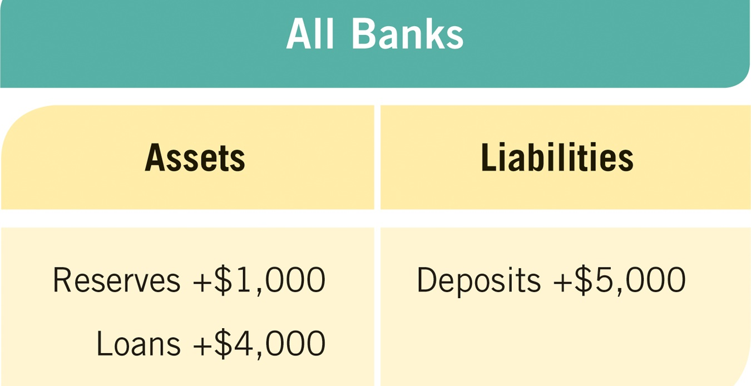
MONEY CREATION
If the process continues all the way through, the $1,000 original deposit turns into $5,000 in deposits.
CHAPTER 23
SLIDE 12

Slide 13
BANK RESERVES & MONEY MULTIPLIER
The money multiplier measures the maximum amount the money supply can increase when new deposits enter the system.
Multiplier = 1 / Reserve Requirement
The lower the reserve requirement, the higher the money multiplier.
CHAPTER 23
SLIDE 13

Slide 14
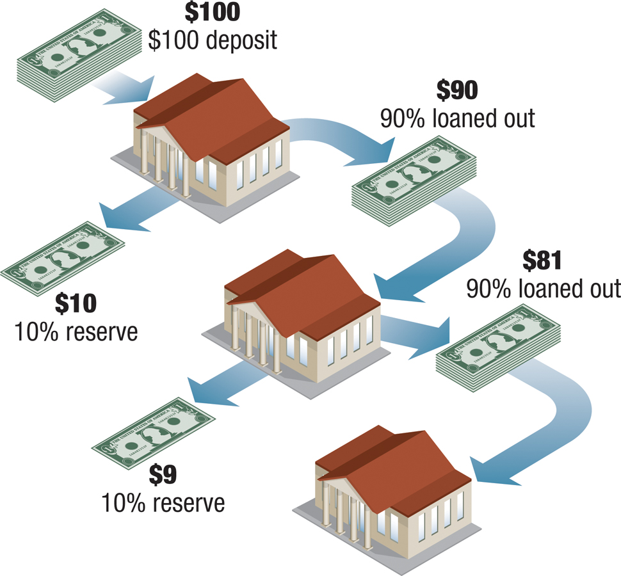
  A NEW $100 DEPOSIT CAN LEAD UP TO A $1,000 INCREASE IN THE MONEY SUPPLY WHEN THE RESERVE REQUIREMENT IS 10%.
CHAPTER 23
SLIDE 14

Slide 15
MONEY LEAKAGES
A leakage is the departure of money from the lending cycle because of an action taken by a bank, an individual, a business, or a foreign entity.
Leakages cause the actual money multiplier to be lower than the potential money multiplier.
CHAPTER 23
SLIDE 15

Slide 16

  STASHING MONEY AWAY AS CASH CAUSES A MONEY LEAKAGE BECAUSE THE CASH CANNOT BE LENT TO SOMEONE ELSE.
ERIC CHIANG
CHAPTER 23
SLIDE 16

Slide 17
CAUSES OF MONEY LEAKAGES
❶
  Banks choosing to hold excess reserves
  Individuals and businesses holding money in cash
  Cash held by foreign consumers, businesses, and governments
❷
❸
CHAPTER 23
SLIDE 17

Slide 18
LEAKAGE-ADJUSTED MONEY MULTIPLIER
Takes leakages into account in the money multiplier formula
Multiplier = 1 / Reserve Requirement
Leakage-adjusted multiplier = 1 / (Reserve Requirement + Excess Reserves + Cash Holdings)
CHAPTER 23
SLIDE 18

Slide 19
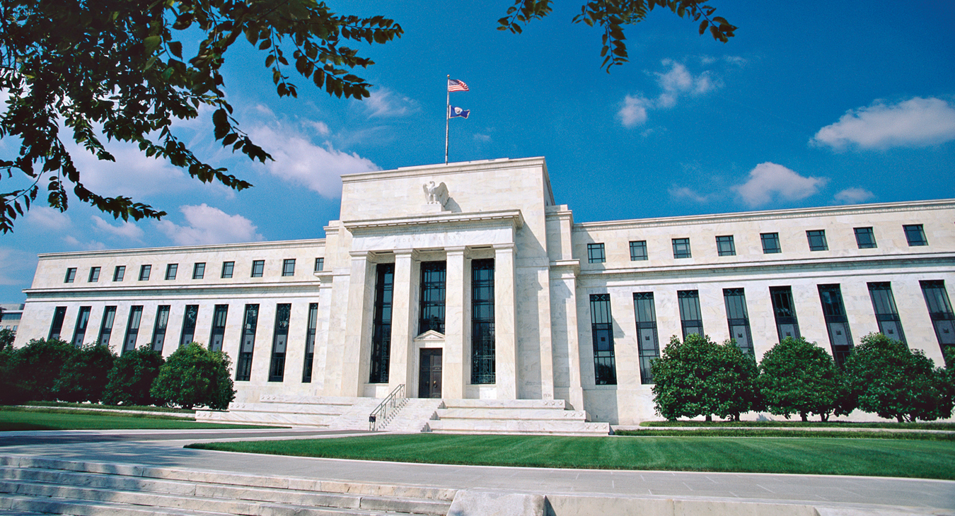
HISHAM IBRAHIM/CORBIS
  THE FEDERAL RESERVE SYSTEM IS THE CENTRAL BANK OF THE UNITED STATES, ESTABLISHED BY THE FEDERAL RESERVE ACT OF 1913.
CHAPTER 23
SLIDE 19

Slide 20
CHARACTERISTICS OF THE FED
The Fed is an independent central bank.
  Its actions are not subject to executive branch control.
  The entire Federal Reserve System is, however, subject to oversight from Congress.
CHAPTER 23
SLIDE 20

Slide 21
THE STRUCTURE OF THE FED
The Board of Governors
  Based in Washington, D.C.
  Seven members appointed by the president and confirmed by the Senate for a single 14-year term
12 regional Federal Reserve Banks
Federal Open Market Committee
  Composed of the Board of Governors and five of the 12 regional bank presidents (with the New York Fed president as a permanent member)
CHAPTER 23
SLIDE 21

Slide 22
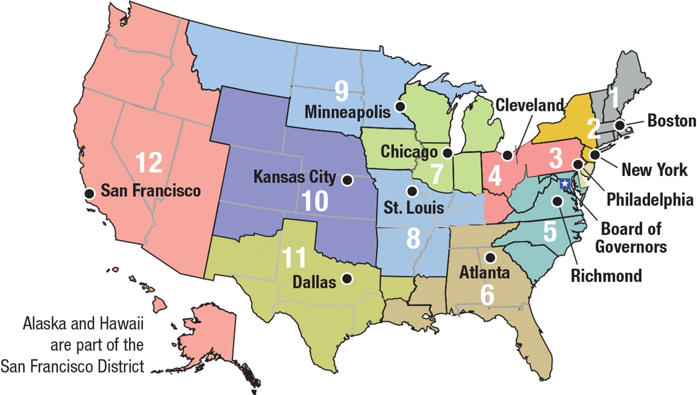
REGIONAL FEDERAL RESERVE DISTRICTS
CHAPTER 23
SLIDE 22

Slide 23
FUNCTIONS OF REGIONAL FED BANKS
❶
  Provide a nationwide payments system
  Distribute coins and currency
  Regulate and supervise member banks
  Serve as the banker for the U.S. Treasury
❷
❸
❹
CHAPTER 23
SLIDE 23

Slide 24
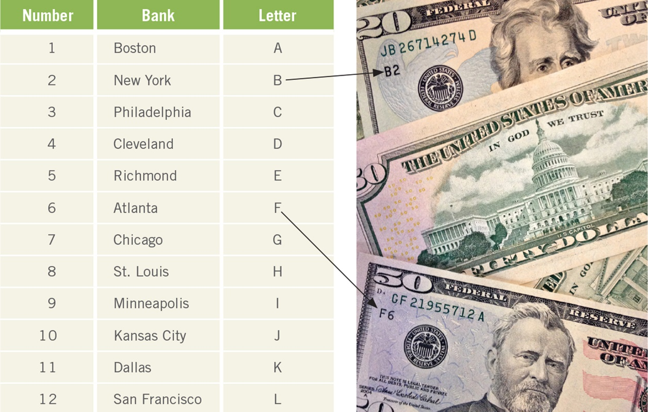
FEDERAL RESERVE REGIONAL BANKS
ERIC CHIANG
Each Federal Reserve regional bank issues currency, marked by a letter (A to L) corresponding to its location.
CHAPTER 23
SLIDE 24

Slide 25

PTOONE/DREAMSTIME.COM
  THE FEDERAL OPEN MARKET COMMITTEE OVERSEES OPEN MARKET OPERATIONS, THE MAIN TOOL OF MONETARY POLICY.
CHAPTER 23
SLIDE 25

Slide 26
THE FED AS LENDER OF LAST RESORT
During an economic crisis, the Fed can provide loans when no one else can (or will).
The 2008 financial crisis would likely have been worse without the Fed’s intervention.
The Fed lent more than $2 trillion to banks and other financial institutions, dramatically altering the Fed’s balance sheet.
CHAPTER 23
SLIDE 26

Slide 27
THE TOOLS OF THE FED
The Fed uses three primary tools for conducting monetary policy:
❶
  Reserve requirements: required ratio of deposit funds held in reserve
  Discount rate: interest rate charged by the fed to banks
  Open market operations: the buying and selling of bonds on the open market
❷
❸
CHAPTER 23
SLIDE 27

Slide 28
THE FEDERAL FUNDS RATE
THE INTEREST RATE THAT FINANCIAL INSTITUTIONS CHARGE EACH OTHER FOR OVERNIGHT LOANS USED AS RESERVES
This is a closely watched interest rate that affects many other interest rates.
The Fed sets the target federal funds rate, then alters the supply of money to achieve its target.
CHAPTER 23
SLIDE 28

Slide 29
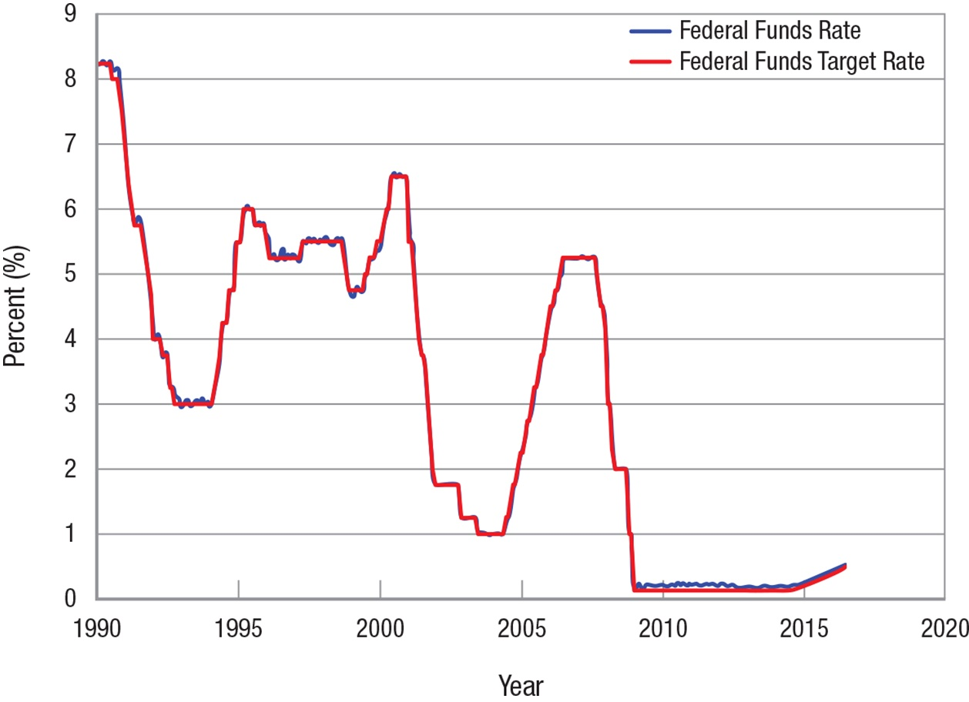
THE FEDERAL FUNDS TARGET RATE
The Fed has been very successful at hitting its federal funds target rate over the past 25 years.
CHAPTER 23
SLIDE 29

Slide 30
MONETARY POLICY LAGS
Like fiscal policy, monetary policy is subject to four major lags:
  information lags
  recognition lags
  decision lags
  implementation lags
The average time for monetary policy to affect the economy is 12 to 18 months.
CHAPTER 23
SLIDE 30

Slide 31
Reserve ratio
Reserve requirement
Fractional reserve banking system
Excess reserves
Money multiplier
Leakages
Solvency crisis
Federal Reserve System
Federal Open Market Committee (FOMC)
Federal funds rate
Discount rate
Open market operations
KEY CONCEPTS
CHAPTER 23
SLIDE 31

Slide 32
IF THE RESERVE REQUIREMENT IS 10%, HOW MUCH TOTAL MONEY (INCLUDING THE INITIAL DEPOSIT) WILL A NEW DEPOSIT OF $500 POTENTIALLY INJECT INTO THE ECONOMY?
A
$50
B
$500
C
$2,500
D
$5,000
CHAPTER 23
SLIDE 32
Notes:
Answer: D

Slide 33
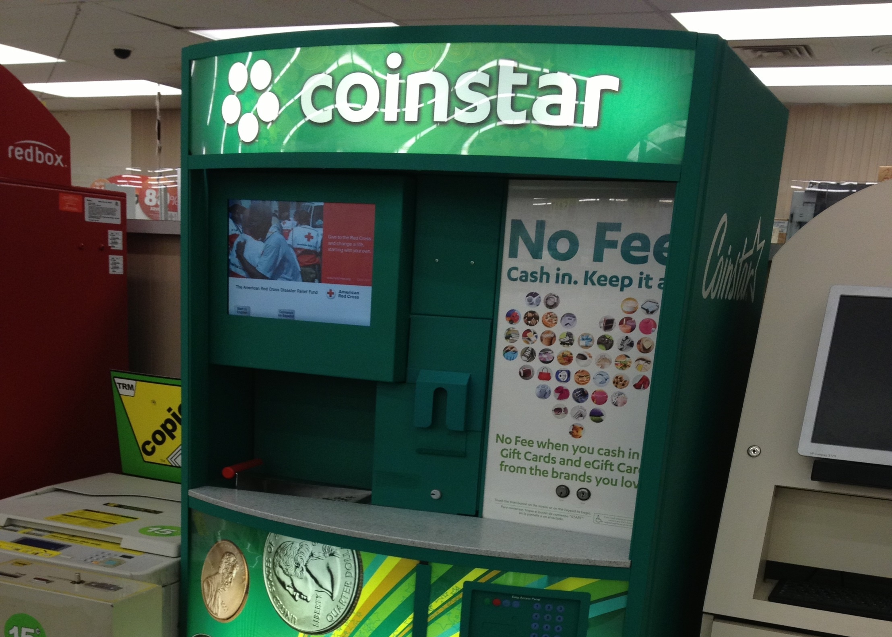
PRACTICE QUESTION
ERIC CHIANG
COINSTAR MACHINES CONVERT JARS OF COINS TO GIFT CARDS. HOW MIGHT THIS AFFECT MONEY CREATION?
CHAPTER 23
SLIDE 33
Notes:
Answer: These machines will likely increase money creation. Jars of coins sitting on a shelf are a money leakage; they do not contribute to money creation. However, when coins are converted into gift cards and then spent, the money will be deposited in the store’s bank and become part of money creation.

Slide 34
IF THE RESERVE REQUIREMENT IS 10% BUT BANKS HOLD AN EXTRA 10% IN RESERVES, HOW DOES THIS AFFECT THE MONEY MULTIPLIER?
A
IT FALLS FROM 10 TO 5.
B
IT FALLS FROM 20 TO 10.
C
IT RISES FROM 5 TO 10.
D
IT RISES FROM 10 TO 20.
CHAPTER 23
SLIDE 34
Notes:
Answer: A

Slide 35
PRACTICE QUESTION
HISHAM IBRAHIM/CORBIS
MEMBERS OF THE FED BOARD OF GOVERNORS SERVE 14-YEAR TERMS. WHY SO LONG? WOULDN’T SHORTER TERMS BE BETTER?
CHAPTER 23
SLIDE 35
Notes:
Answer: Members of the Fed board of governors serve a single 14-year term. The length of the term helps shield members from political influences, because they will serve over multiple presidential administrations. Also, terms cannot be renewed, so members do not worry about the effects of their decisions on reappointment.

Slide 36
WHICH OF THE FOLLOWING TOOLS IS THE FED MOST LIKELY TO USE TO DEAL WITH A MACROECONOMIC PROBLEM?
A
ADJUSTING THE RESERVE REQUIREMENT
B
CHANGING THE DISCOUNT RATE
C
USING OPEN MARKET OPERATIONS
D
RAISING THE DEPOSIT LIMIT PROTECTED BY FDIC
CHAPTER 23
SLIDE 36
Notes:
Answer: C

Slide 37
23
END OF CHAPTER
SLIDES CREATED BY ERIC CHIANG
Tshooter/Shutterstock; Anton Balazh/Shutterstock
CHAPTER 23
SLIDE 37

