Slide 1

Saving, Investment, and the Financial System
22
SLIDES CREATED BY ERIC CHIANG
JOHN LUND / GETTY IMAGES
CHAPTER 22 SLIDE 1

Slide 2
CHAPTER OBJECTIVES
Describe the functions of money.
Define the money supply according to M1 and M2.
Use the loanable funds model to show how savers and borrowers are brought together.
Describe how economic factors can lead to a change in the market for loanable funds.
Explain how financial intermediaries make it easier and less risky for people to save and borrow.

CHAPTER 22
SLIDE 2

Slide 3
CHAPTER OBJECTIVES
Describe the relationship between the price of bonds and interest rates.
Explain how the compounding effect makes debt and savings much larger over time.
Describe the tradeoff between risk and return, and how that influences the return on investment for bonds and stocks.
Understand how retirement saving programs function and the benefits they provide.
CHAPTER 22
SLIDE 3

Slide 4
WHAT IS MONEY?
Money is anything that is accepted in exchange for other goods and services or for the payment of debt. For a commodity to be used as money:
  Its value must be easy to determine.
  It must be divisible.
  It must be durable.
  It must be widely accepted by many people.
CHAPTER 22
SLIDE 4

Slide 5
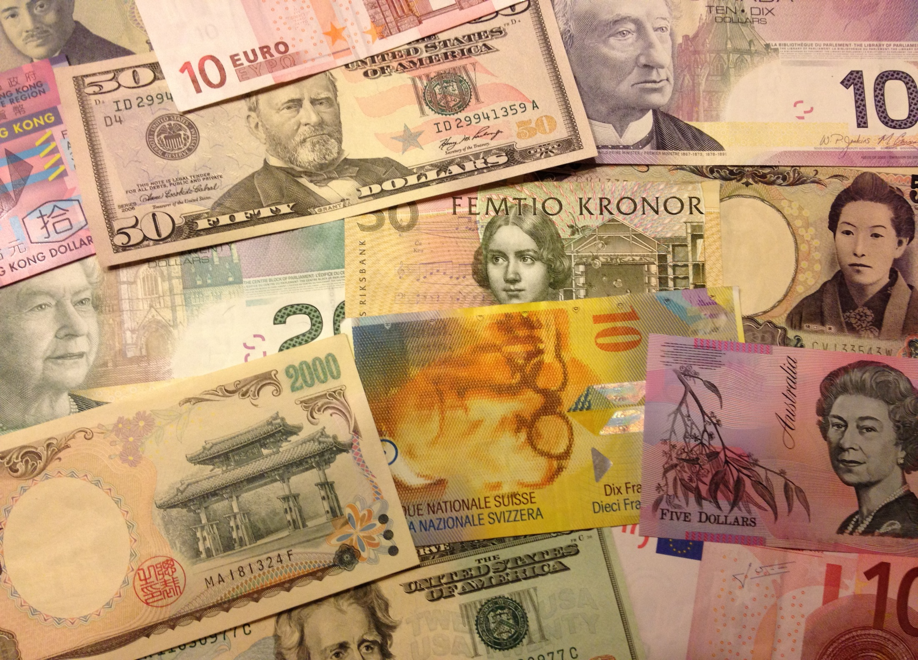
ERIC CHIANG
FIAT MONEY DOES NOT HAVE INTRINSIC VALUE (UNLIKE GOLD) BUT IS ACCEPTED AS MONEY BY GOVERNMENT DECREE.
CHAPTER 22
SLIDE 5

Slide 6

THE FUNCTIONS OF MONEY
❶
  MEDIUM OF EXCHANGE: GOODS AND SERVICES ARE EXCHANGED FOR MONEY.
  UNIT OF ACCOUNT: MONEY IS USED TO COMPARE VALUES OF A WIDE VARIETY OF GOODS AND SERVICES.
  STORE OF VALUE: MONEY IS SAVED AND USED FOR FUTURE PURCHASES.
❷
❸
CHAPTER 22
SLIDE 6

Slide 7

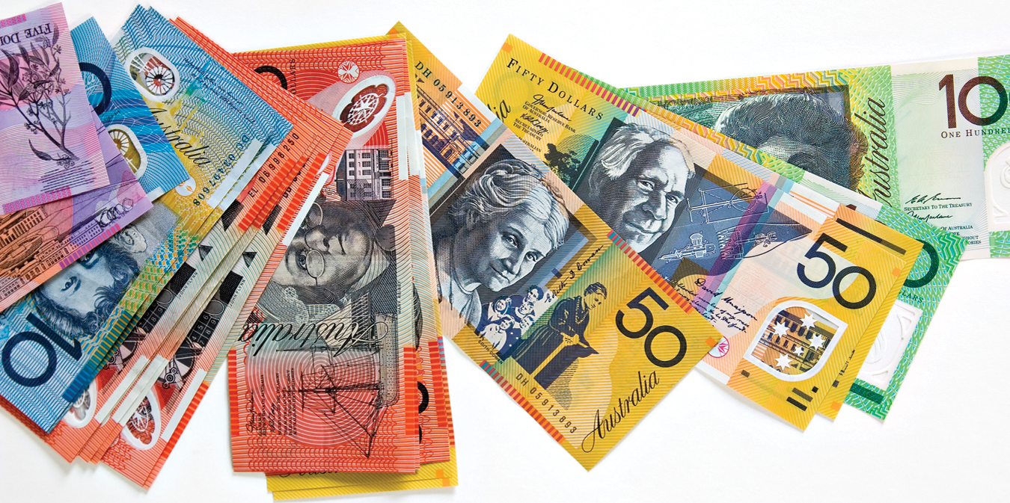
WOJTEK KALINOWSKI PHOTOGRAPHY/CORBIS
IN AUSTRALIA, ALL BANKNOTES ARE MADE OF PLASTIC, A MORE DURABLE FORM OF MONEY THAN PAPER CURRENCY.
CHAPTER 22
SLIDE 7

Slide 8
THE ALTERNATIVE TO MONEY IS BARTER, WHICH REQUIRES A DOUBLE COINCIDENCE OF WANTS: YOU WANT SOMETHING THAT I HAVE IN EXCHANGE FOR SOMETHING THAT YOU HAVE.
BARTER IS USED ONLY IN PRIMITIVE ECONOMIES.
CHAPTER 22
SLIDE 8

Slide 9
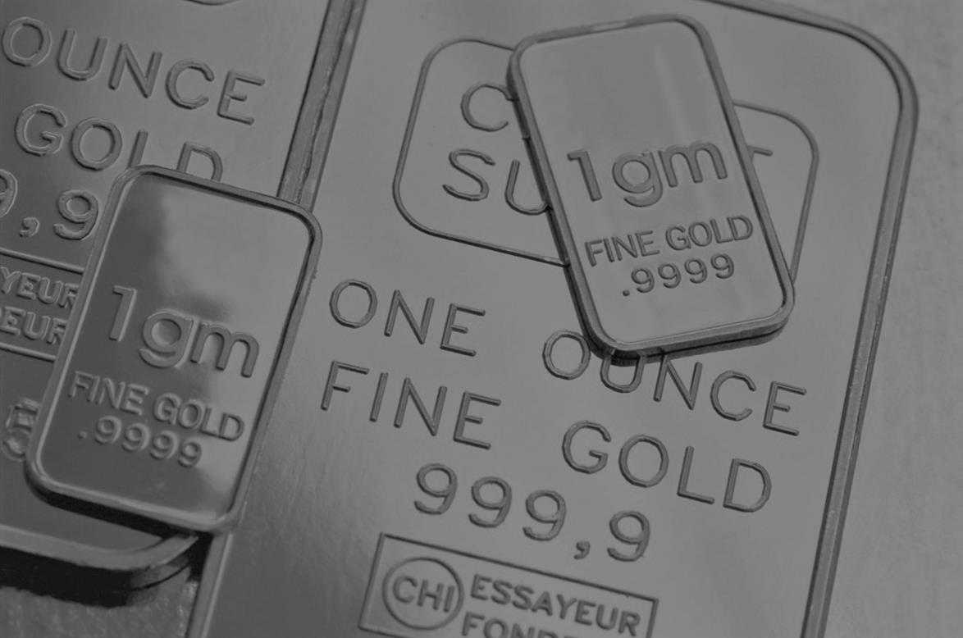
TOM GRILL/CORBIS
LIQUIDITY
AN ASSET’S LIQUIDITY IS DETERMINED BY HOW FAST, EASILY, AND RELIABLY IT CAN BE CONVERTED TO CASH.
CHAPTER 22
SLIDE 9

Slide 10
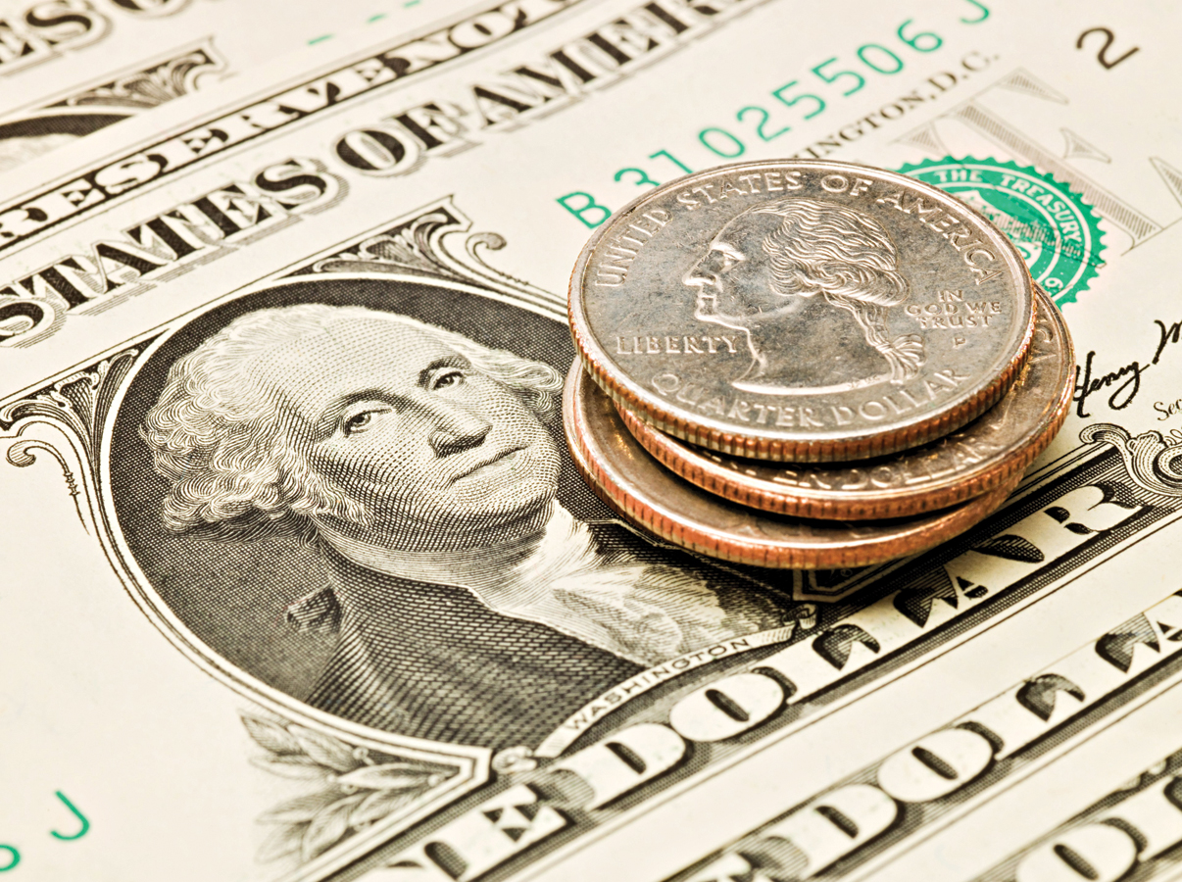
IMAGE SOURCE/CORBIS
MONEY IS HIGHLY LIQUID BECAUSE IT CAN BE USED IMMEDIATELY FOR THE PURCHASE OF GOODS AND SERVICES.
CHAPTER 22
SLIDE 10

Slide 11
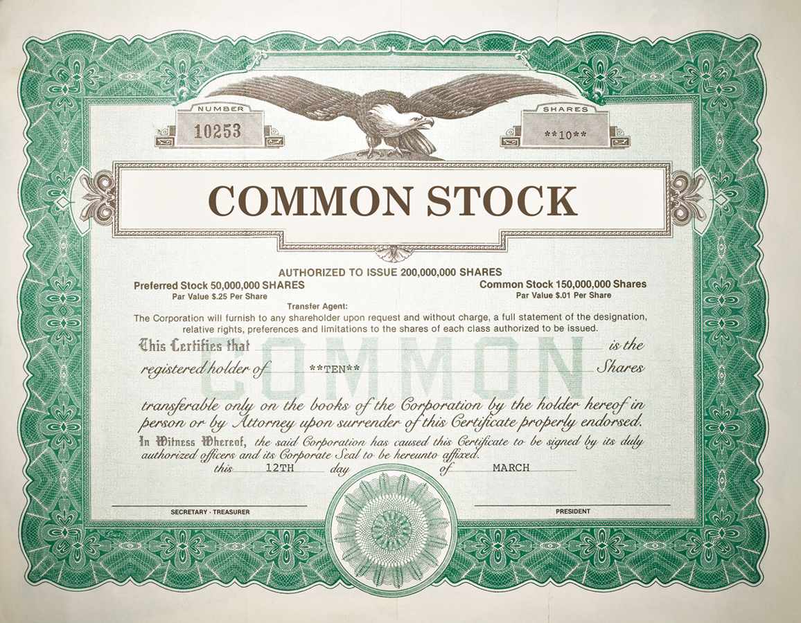
JEFFREY COOLIDGE/GETTY IMAGES
STOCKS, BONDS, AND PRECIOUS METALS ARE LESS LIQUID THAN MONEY BECAUSE THEY MUST BE CONVERTED TO MONEY BEFORE THEY CAN BE SPENT.
CHAPTER 22
SLIDE 11

Slide 12

ARIEL SKELLEY/BLEND IMAGES/CORBIS
HOUSES AND OTHER PHYSICAL ASSETS ARE THE LEAST LIQUID BECAUSE THEY REQUIRE MORE EFFORT TO CONVERT TO MONEY.
CHAPTER 22
SLIDE 12

Slide 13
DEFINING THE MONEY SUPPLY
The Federal Reserve (Fed) uses two primary measures of the money supply, M1 and M2.
  M1 = Currency (bills and coins)
  + demand deposits
  + other checkable deposits
CHAPTER 22
SLIDE 13

Slide 14
M1
The total value of M1 is about $3.2 trillion. It is the most liquid part of the money supply.
Currency constitutes about half of M1.
  Banknotes are more than 90% of currency.
  Coins constitute just a small part of M1.
Checking accounts make up the other half of M1.
CHAPTER 22
SLIDE 14

Slide 15
DEFINING THE MONEY SUPPLY
M2 is a broader measure of money. It includes all of M1 along with near monies:
  M2 = M1
  + savings deposits
  + money market deposits
  + small-value time deposits
  + money market mutual funds
CHAPTER 22
SLIDE 15

Slide 16
THE MARKET FOR LOANABLE FUNDS
Why do people save?
  People save for various reasons. The reward for saving is the interest rate.
  The supply of loanable funds is positively related to the interest rate.
Why do people borrow?
  People borrow to buy goods and services or to invest in capital.
  The demand for loanable funds is negatively related to the interest rate.
CHAPTER 22
SLIDE 16

Slide 17
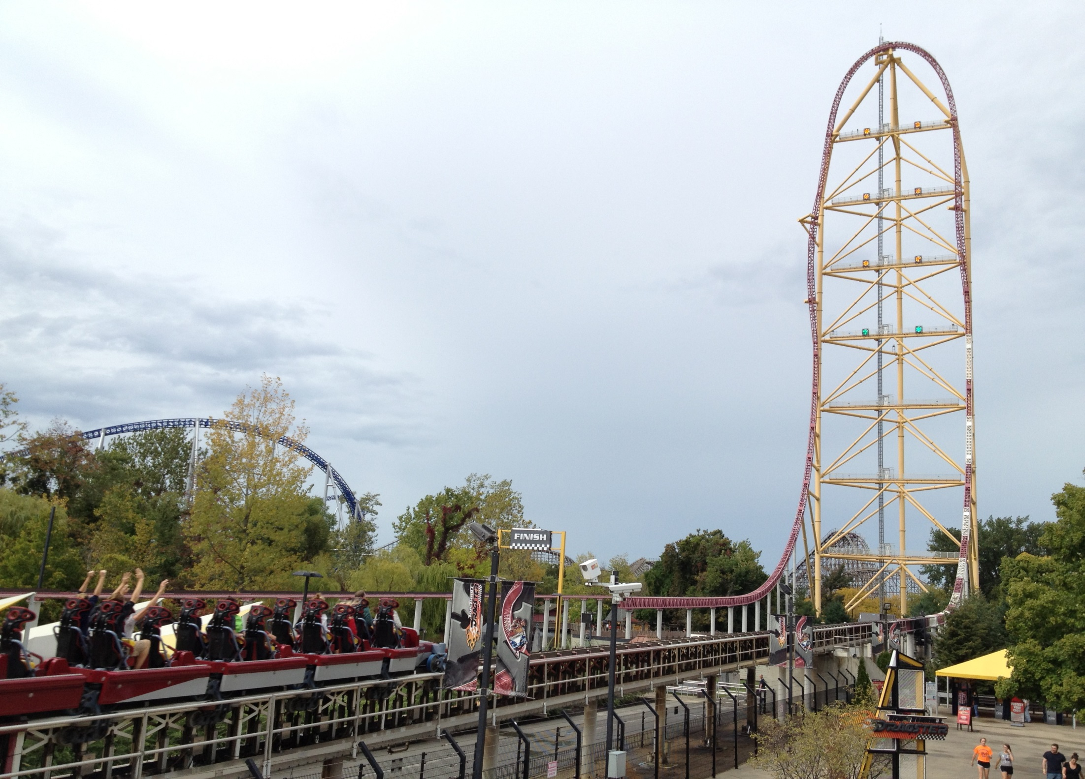
ERIC CHIANG
A THEME PARK PURCHASING CAPITAL, SUCH AS A NEW ROLLER COASTER, OFTEN RELIES ON THE MARKET FOR LOANABLE FUNDS.
CHAPTER 22
SLIDE 17

Slide 18
THE MARKET FOR LOANABLE FUNDS
S₀
5
The equilibrium interest rate is determined by borrowers (demand) and lenders (supply).
4
e
REAL INTEREST RATE (%)
3
2
1
D₀
0
100
200
300
400
500
600
LOANABLE FUNDS (BILLIONS)
CHAPTER 22
SLIDE 18

Slide 19
SHIFTS IN DEMAND FOR LOANABLE FUNDS
Anything that changes the rate of return on potential investment will cause the demand for loanable funds to change:
investment tax incentives
technological advances
regulations
product demand
business expectations
CHAPTER 22
SLIDE 19

Slide 20
SHIFTS IN SUPPLY OF LOANABLE FUNDS
A shift in the supply curve of loanable funds occurs when a factor increases or decreases the country’s willingness to save at any given interest rate:
economic outlook
incentives to save
income or asset prices
government deficits
CHAPTER 22
SLIDE 20

Slide 21
THE MARKET FOR LOANABLE FUNDS
A shift in either the supply or demand for loanable funds will change the interest rate.
S₀
5
S₁
4
e
REAL INTEREST RATE (%)
3
An increase in the supply of loanable funds reduces interest rates.
2
a
1
D₀
0
100
200
300
400
500
600
LOANABLE FUNDS (BILLIONS)
CHAPTER 22
SLIDE 21

Slide 22

RUDY SULGAN/CORBIS
THE FINANCIAL SYSTEM HELPS ALLOCATE SCARCE RESOURCES FROM SAVERS TO BORROWERS.
CHAPTER 22
SLIDE 22

Slide 23
ROLES OF FINANCIAL INSTITUTIONS
Financial institutions fulfill three important roles that facilitate the flow of funds to the economy:
❶
  REDUCING INFORMATION COSTS: Screen and evaluate the credit of potential borrowers.
  REDUCING TRANSACTION COSTS: Provide standardized financial products.
  DIVERSIFYING ASSETS TO REDUCE RISK: Pool funds from many savers and lend to many borrowers.
❷
❸
CHAPTER 22
SLIDE 23

Slide 24
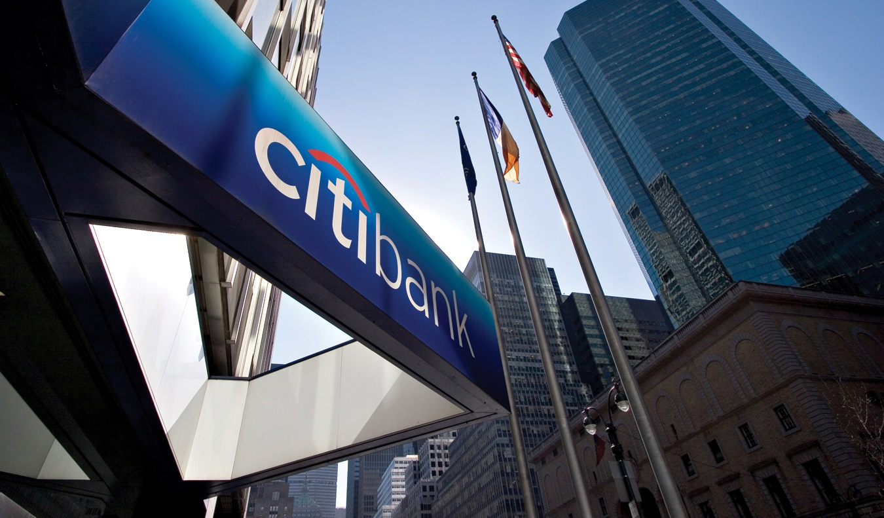
JAMES LEYNSE/CORBIS
FINANCIAL INTERMEDIARIES ARE BANKS, MUTUAL FUNDS, AND INSURANCE COMPANIES, WHICH ACQUIRE FUNDS FROM SAVERS AND LEND THEM TO BORROWERS.
CHAPTER 22
SLIDE 24

Slide 25
BOND PRICES AND INTEREST RATES
Most loanable funds are in the form of bonds. A bond is a form of debt used to fund a business. Bond contracts include:
coupon rate (interest rate of the bond).
maturity date.
face value of the bond (the value at maturity).
CHAPTER 22
SLIDE 25

Slide 26
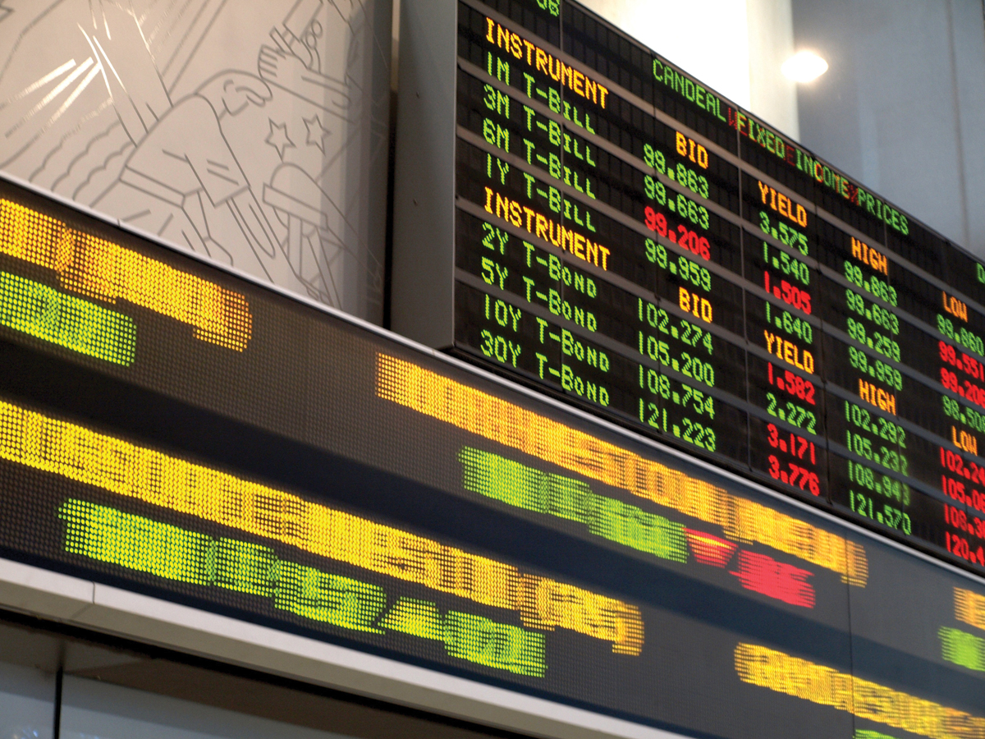
PTOONE/DREAMSTIME.COM
BOND PRICES FLUCTUATE IN RESPONSE TO FORCES OF THE MARKETPLACE. BOND PRICES AND INTEREST RATES MOVE IN OPPOSITE DIRECTIONS.
CHAPTER 22
SLIDE 26

Slide 27
BOND PRICES AND INTEREST RATES
The actual price of a bond changes with market interest rates, which determine its yield, the return earned over the life of the bond.
Yield = Interest payment / Price of bond
or
Price of bond = Interest payment / Yield
CHAPTER 22
SLIDE 27

Slide 28
BOND PRICES AND INTEREST RATES
$1,000 FACE VALUE
COUPON RATE
10% ($100/YEAR)
BOND PRICE
INTEREST RATE FALLS
$1,000
5%
BOND PRICE RISES
$100 / 0.05 = $2,000
CHAPTER 22
SLIDE 28

Slide 29
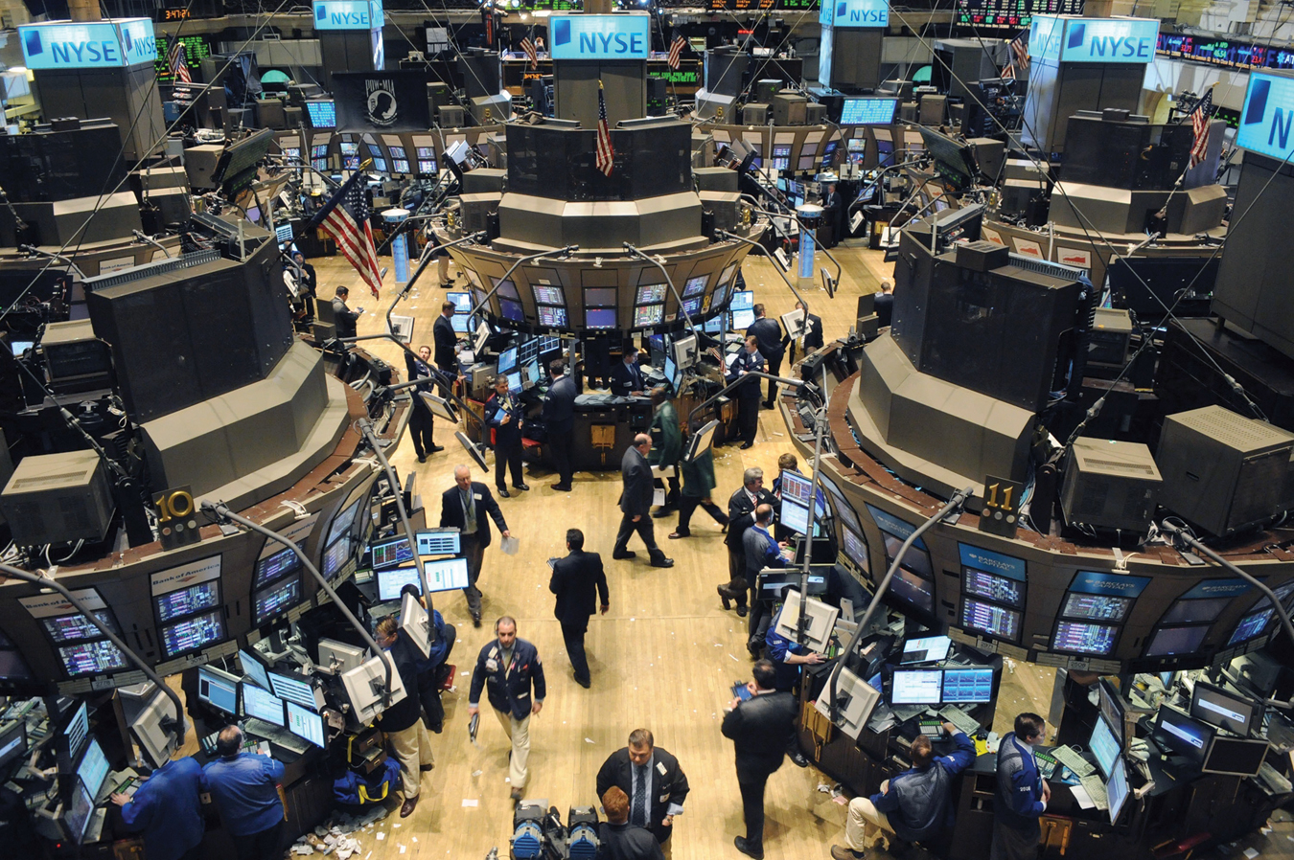
BRYAN SMITH/ZUMA PRESS/NEWSCOM
STOCKS REPRESENT OWNERSHIP IN A CORPORATION AND ENTITLE OWNERS TO A SHARE OF PROFITS (DIVIDENDS). SHARES ARE TRADED IN STOCK EXCHANGES.
CHAPTER 22
SLIDE 29

Slide 30

LIGHTKEEPER | DREAMSTIME.COM
RISK AND RETURN ARE A TRADEOFF: ON AVERAGE, THE RISKIER THE ASSET, THE GREATER THE RETURN.
CHAPTER 22
SLIDE 30

Slide 31

KOOBOOKI/THINKSTOCK
FINANCIAL TOOLS FOR A BETTER FUTURE
CHAPTER 22
SLIDE 31

Slide 32
COMPOUNDING INTEREST
$1,000 DEBT AT 10%
AFTER YEAR 1
$1,100
AFTER YEAR 2
$1,210
AFTER YEAR 3
AND
SO ON…
$1,331
CHAPTER 22
SLIDE 32

Slide 33
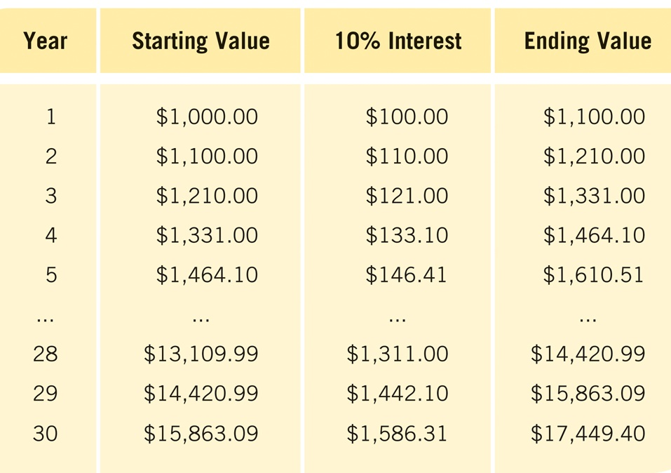
EFFECT OF COMPOUNDING INTEREST
CHAPTER 22
SLIDE 33

Slide 34
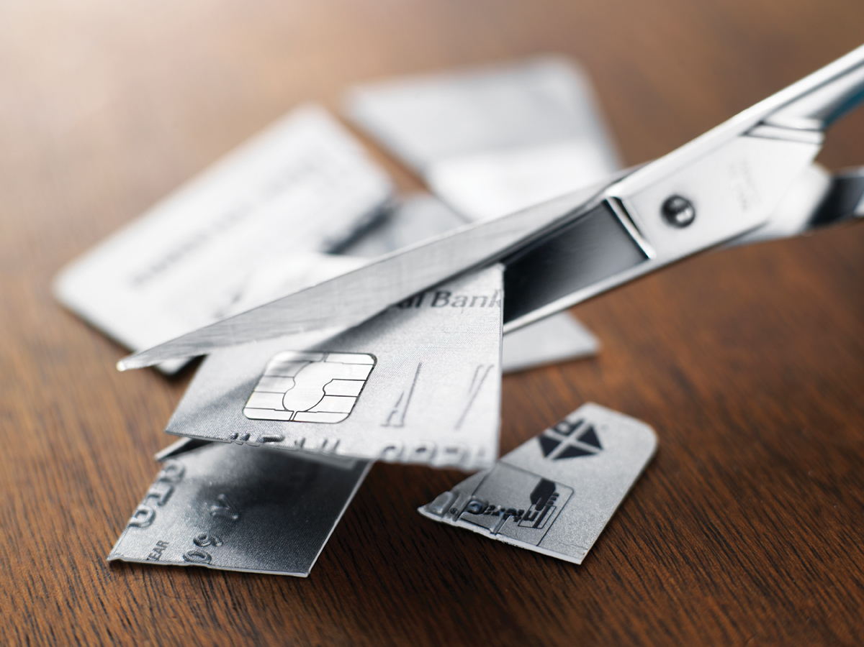
RODERICK CHEN/FIRST LIGHT/CORBIS
ELIMINATING HIGH-INTEREST CREDIT CARD DEBT CAN RESULT IN TREMENDOUS SAVINGS.
CHAPTER 22
SLIDE 34

Slide 35

SANFORD/AGIOLO/CORBIS
PARTICIPATING IN COMPANY RETIREMENT PLANS CAN LEAD TO A MORE COMFORTABLE FUTURE.
CHAPTER 22
SLIDE 35

Slide 36
SOCIAL SECURITY
Funded by the payroll tax (FICA)
  Collected by current workers to pay for current beneficiaries.
  Tax is 12.4% (6.2% paid by employees and 6.2% paid by employers) but is capped at a maximum yearly amount.
Minimum age to collect is 62, but payments rise if one waits until age 67.
Benefits are calculated by a formula based on one’s lifetime contributions.
CHAPTER 22
SLIDE 36

Slide 37

SPOTMATIK/DREAMSTIME.COM
PENSIONS ARE MONTHLY PAYMENTS MADE BY EMPLOYERS UNTIL ONE’S DEATH. AMOUNT RISES WITH THE NUMBER OF YEARS WORKED.
CHAPTER 22
SLIDE 37

Slide 38
TRADITIONAL IRA VERSUS ROTH IRA
  TRADITIONAL IRA
  ROTH IRA
    PRETAX (TAX-DEFERRED) CONTRIBUTIONS THAT CAN BE INVESTED. TAXES PAID UPON WITHDRAWAL.
AFTER-TAX CONTRIBUTIONS. NO PENALTY FOR EARLY WITHDRAWAL. NO TAXES ON EARNINGS.
CHAPTER 22
SLIDE 38

Slide 39
KEY CONCEPTS
Money
Fiat money
Barter
Medium of exchange
Unit of account
Store of value
Liquidity
M1
M2
Financial system
Financial intermediaries
Return on investment
Tradeoff between risk and return
Teaser rates
Compounding effect
Vesting period
Pensions
CHAPTER 22
SLIDE 39

Slide 40
SUPPOSE THE GOVERNMENT ENCOURAGES GREATER PARTICIPATION IN COMPANY RETIREMENT PLANS. WHAT HAPPENS TO LOANABLE FUNDS AND INTEREST RATES?
A
LOANABLE FUNDS FALL AND INTEREST RATES RISE.
B
LOANABLE FUNDS FALL AND INTEREST RATES FALL.
C
LOANABLE FUNDS RISE AND INTEREST RATES RISE.
D
LOANABLE FUNDS RISE AND INTEREST RATES FALL.
CHAPTER 22
SLIDE 40
Notes:
Answer: D

Slide 41

PRACTICE QUESTION
ALEXANDROS MICHAILDIS/DEMOTIX/DEMOTIX/CORBIS
IN GREECE IN 2012, WHAT TYPES OF PROBLEMS AROSE FROM RISING DEBT AND A BREAKDOWN OF FINANCIAL INSTITUTIONS AND LED TO MANY RIOTS?
CHAPTER 22
SLIDE 41
Notes:
Answer: Greece’s financial crisis led to a breakdown of its financial institutions, pushing interest rates from 4% in 2009 to 27% in 2012. With interest rates so high, few consumers and firms could borrow, which led to a drastic reduction in consumption and investment, hence to widespread unemployment.

Slide 42
IF A BOND HAS A FACE VALUE OF $1,000 AND PAYS $40 PER YEAR IN INTEREST, HOW MUCH IS THE BOND WORTH AFTER INTEREST RATES INCREASE TO 5%?
A
$200
B
$800
C
$1,250
D
$2,000
CHAPTER 22
SLIDE 42
Notes:
Answer: B

Slide 43
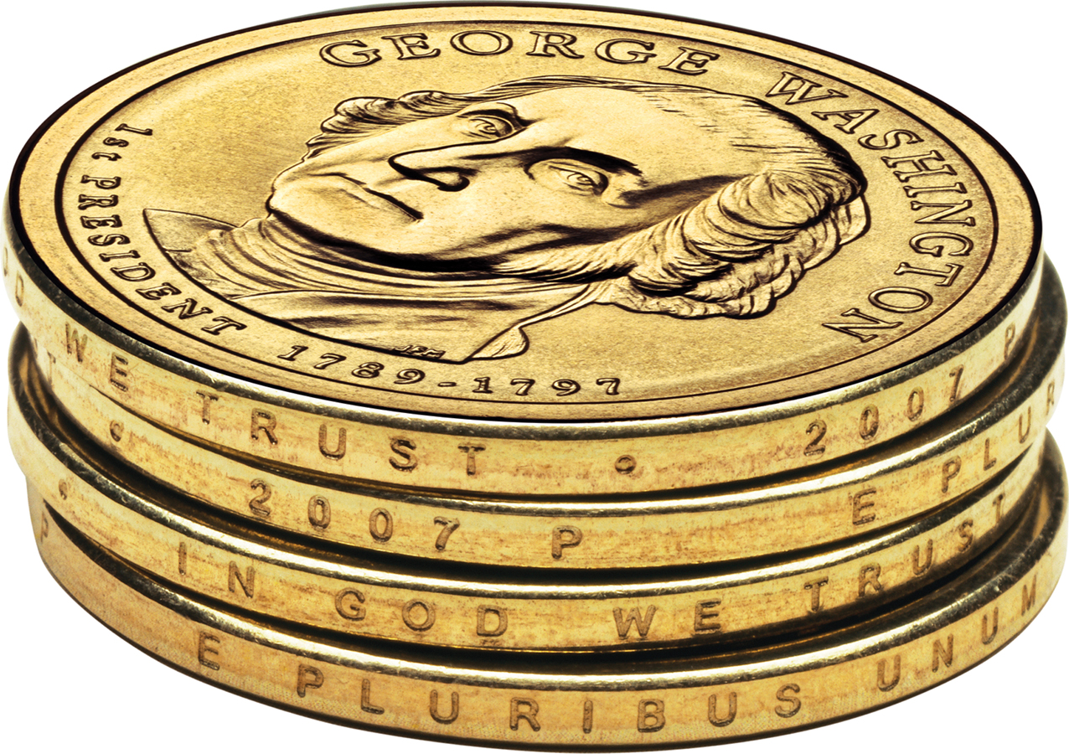
PRACTICE QUESTION
UNITED STATES MINT IMAGE
WHY HAVE MOST AMERICAN CONSUMERS AND FIRMS REJECTED THE EVERYDAY USE OF DOLLAR COINS?
CHAPTER 22
SLIDE 43
Notes:
Answer: Many consumers and firms find it more convenient to use dollar bills than dollar coins. For firms, counting and accepting dollar coins in addition to dollar bills adds to the cost of business. Many store clerks still do not readily recognize dollar coins, making their use more difficult by consumers. To make dollar coins more widely used, the government must stop printing dollar bills.

Slide 44
WHICH OF THE FOLLOWING ASSETS WILL LIKELY SHOW THE GREATEST INCREASE IN VALUE OVER TIME?
A
SAVINGS ACCOUNTS
B
CHECKING ACCOUNTS
C
U.S. TREASURY BONDS
D
BLUE CHIP STOCKS
E
HIGHLY RATED CORPORATE BONDS
CHAPTER 22
SLIDE 44
Notes:
Answer: D

Slide 45
22
END OF CHAPTER
SLIDES CREATED BY ERIC CHIANG
Tshooter/Shutterstock; Anton Balazh/Shutterstock
CHAPTER 22
SLIDE 45

