Slide 1
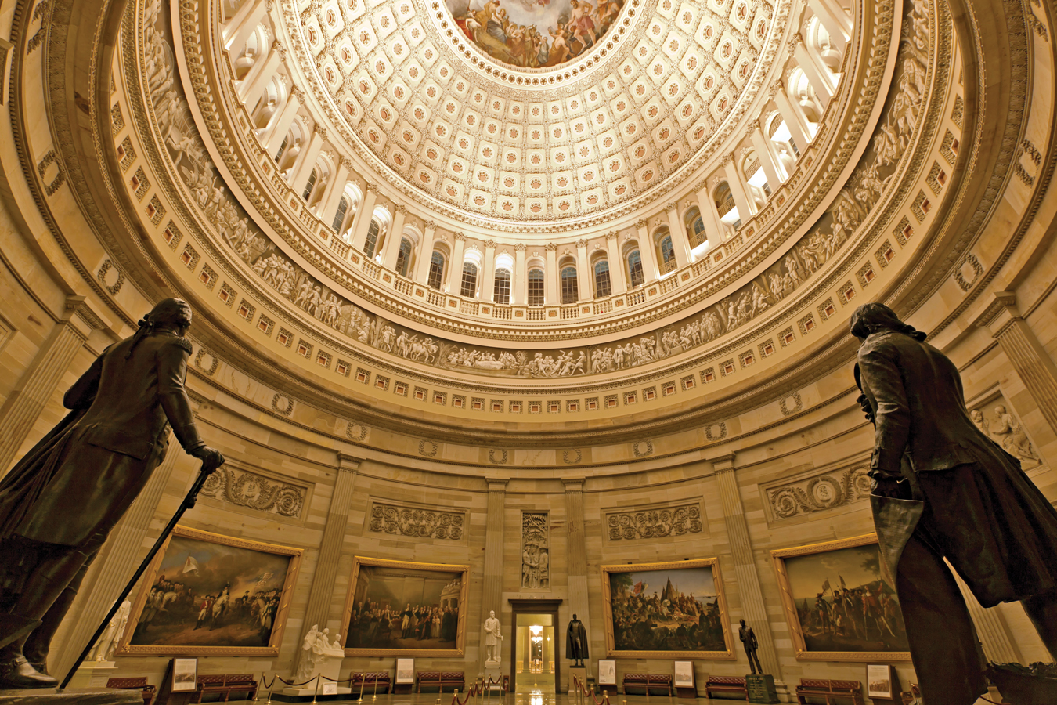
21
Fiscal Policy and Debt
SLIDES CREATED BY ERIC CHIANG
EFRAIN PADRO / ALAMY
CHAPTER 21 SLIDE 1

Slide 2
CHAPTER OBJECTIVES
Describe the tools that governments use to influence aggregate demand.
Describe expansionary and contractionary fiscal policy.
Determine the influence that the multiplier effect has on government spending and aggregate output.
Describe the fiscal policies that governments use to influence aggregate supply.

CHAPTER 21
SLIDE 2

Slide 3
CHAPTER OBJECTIVES
Describe the impact of automatic stabilizers, lag effects, and the propensity toward deficits from fiscal policymaking.
Identify the different lags that occur when implementing fiscal policy.
Define deficits and surpluses, and explain the difference between national debt and public debt.
Describe the potential consequences of maintaining high public debt.
CHAPTER 21
SLIDE 3

Slide 4
FISCAL POLICY AND AGGREGATE DEMAND
FISCAL POLICY IS THE USE OF GOVERNMENT REVENUE (MAINLY TAX RECEIPTS) AND SPENDING TO INFLUENCE THE ECONOMY.
In 2015, the federal government collected $3.25 trillion in revenues and spent $3.69 trillion, producing a deficit.
Since 2009, the federal deficit has decreased significantly.
CHAPTER 21
SLIDE 4

Slide 5
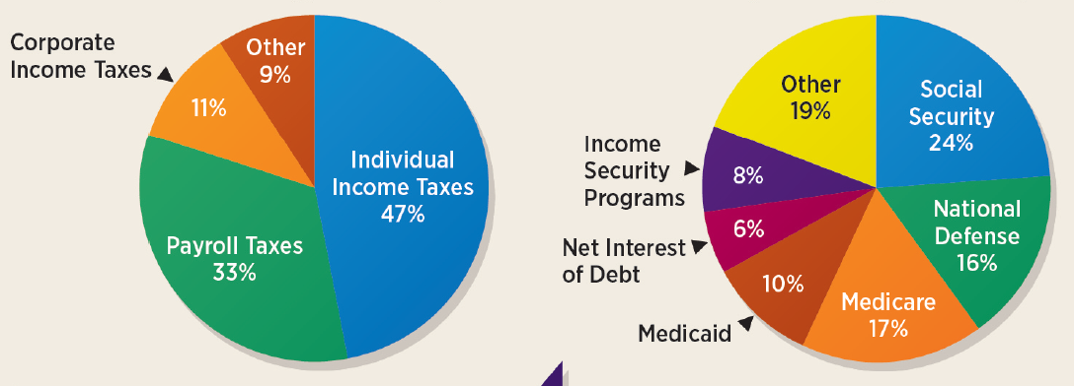

FEDERAL GOVERNMENT BUDGET (2015)
REVENUES ($3.25 TRILLION)
EXPENDITURES ($3.69 TRILLION)
CHAPTER 21
SLIDE 5

Slide 6

TWO TYPES OF FEDERAL SPENDING
  DISCRETIONARY SPENDING
  MANDATORY SPENDING
    SPENDING THAT WORKS THROUGH THE APPROPRIATIONS PROCESS IN CONGRESS EACH YEAR.
SPENDING THAT IS REQUIRED BY LAW. TO ADJUST SPENDING, CONGRESS MUST CHANGE THE LAW.
CHAPTER 21
SLIDE 6

Slide 7

US NAVY PHOTO/ALAMY
DISCRETIONARY SPENDING INCLUDES NATIONAL DEFENSE, TRANSPORTATION, SCIENCE, EDUCATION, ENVIRONMENTAL PROTECTION.
CHAPTER 21
SLIDE 7

Slide 8

TETRA IMAGES/CORBIS
MANDATORY SPENDING INCLUDES SOCIAL SECURITY, MEDICARE, AND INTEREST ON THE NATIONAL DEBT.
CHAPTER 21
SLIDE 8

Slide 9
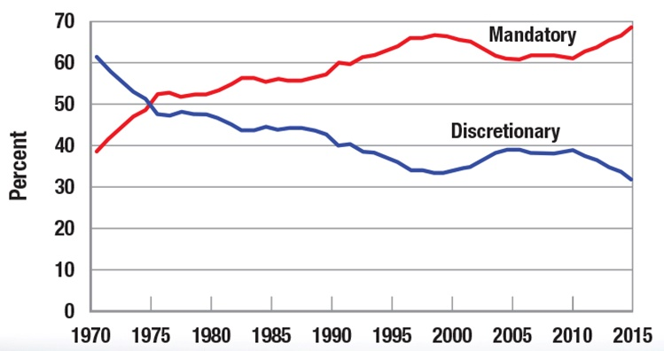
DISCRETIONARY AND MANDATORY SPENDING
CHAPTER 21
SLIDE 9

Slide 10
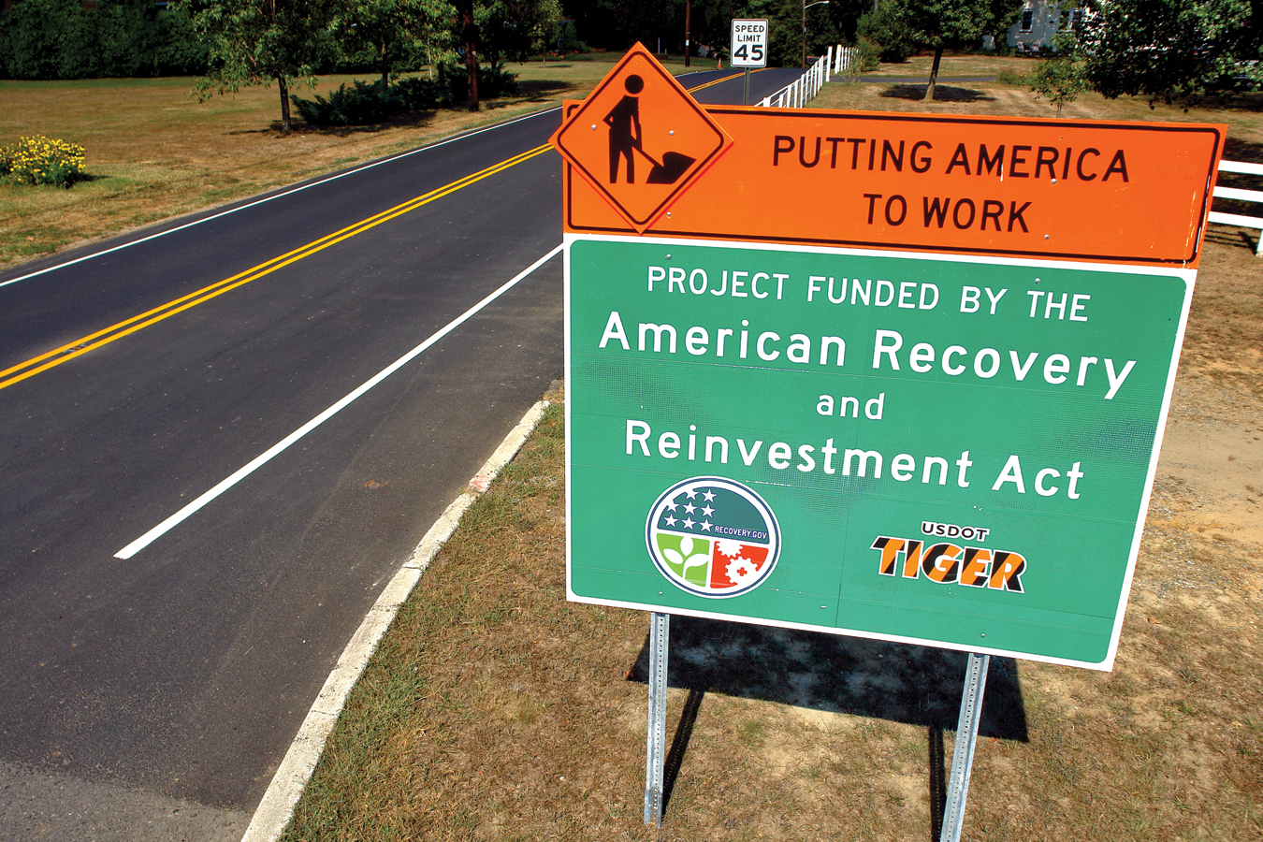
OLIVIER LE QUEINEC/DREAMSTIME.COM
DISCRETIONARY SPENDING IS A POWERFUL TOOL TO PUSH AN ECONOMY TOWARD ITS LONG-RUN EQUILIBRIUM OUTPUT.
CHAPTER 21
SLIDE 10

Slide 11
THE MULTIPLIER AND SPENDING
LRAS
SRAS
When an economy is below full employment…
a
…fiscal policy spending is magnified by the multiplier, shifting AD toward long-run equilibrium.
AGGREGATE PRICE LEVEL (P)
P₁
P₀
e
AD₁
AD₀
0
Q₀
Q_{f}
AGGREGATE OUTPUT (Q)
CHAPTER 21
SLIDE 11

Slide 12
TAXES
When taxes rise, money is withdrawn from the economy’s spending stream.
When taxes fall, consumers and businesses have more to spend.
Changes in taxes have a less direct impact on income and output than an equivalent change in government spending.
CHAPTER 21
SLIDE 12

Slide 13
SPENDING INJECTIONS
Injections include investment (I), government spending (G), and exports (X).
SPENDING WITHDRAWALS
Withdrawals include savings (S), taxes (T), and imports (M).
In a macroeconomic equilibrium:
  I + G + X = S + T + M
CHAPTER 21
SLIDE 13

Slide 14
THE EFFECT OF TAXES
An increase in taxes is paid in part by a reduction in saving, already a withdrawal from the economy.
Example: a $100 increase in taxes (MPC = 0.75)
  $25 is paid by reducing savings.
  The tax effect is a $75 withdrawal magnified by the multiplier.
  A $100 reduction in spending would have a larger impact on aggregate output.
CHAPTER 21
SLIDE 14

Slide 15
TWO TYPES OF FISCAL POLICY
  EXPANSIONARY FISCAL POLICY
  CONTRACTIONARY FISCAL POLICY
    INCREASING GOVERNMENT SPENDING OR DECREASING TAXES TO BOOST AGGREGATE DEMAND AND OUTPUT
DECREASING GOVERNMENT SPENDING OR INCREASING TAXES TO REDUCE INFLATIONARY PRESSURES
CHAPTER 21
SLIDE 15

Slide 16
EXPANSIONARY FISCAL POLICY
SRAS₁
Expansionary fiscal policy is effective when an economy is below long-run equilibrium.
LRAS
SRAS₀
P₂
P₁
a
AGGREGATE PRICE LEVEL (P)
e
But once long-run output is achieved, expansionary fiscal policy leads to demand-pull inflation.
P₀
AD₁
AD₀
0
Q_{f}
Q₁
AGGREGATE OUTPUT (Q)
CHAPTER 21
SLIDE 16

Slide 17
CONTRACTIONARY FISCAL POLICY
LRAS
When an economy is above its full employment output level…
SRAS₀
P₀
e
…contractionary fiscal policy can be used to shift AD back to long-run output, reducing inflationary pressures.
AGGREGATE PRICE LEVEL (P)
a
P₁
AD₀
AD₁
0
Q_{f}
Q₀
AGGREGATE OUTPUT (Q)
CHAPTER 21
SLIDE 17

Slide 18
FISCAL POLICY AND AGGREGATE SUPPLY
The goal of supply-side fiscal policy is to promote growth, reduce unemployment, and stabilize prices.
They are designed to shift the long-run aggregate supply curve to the right.
They do not always require a tradeoff between price levels and output.
They require more time to work than demand-side policies.
CHAPTER 21
SLIDE 18

Slide 19
SUPPLY-SIDE FISCAL POLICIES
EXAMPLES OF SUPPLY-SIDE POLICY:
Spending on infrastructure, education, and technology
Reducing tax rates
Expanding investment and reducing regulations
❶
❷
❸
These factors have helped to keep interest rates and inflation low for several decades.
CHAPTER 21
SLIDE 19

Slide 20
FISCAL POLICY AND AGGREGATE SUPPLY
SRAS₀
LRAS₀
LRAS₁
SRAS₁
If successful, fiscal policy directed at aggregate supply can lead to more employment and lower prices.
P₀
a
P₁
b
AGGREGATE PRICE LEVEL (P)
AD₀
0
Q₀
Q₁
AGGREGATE OUTPUT (Q)
CHAPTER 21
SLIDE 20

Slide 21
THE LAFFER CURVE
ARTHUR LAFFER SUGGESTED THAT REDUCING TAX RATES COULD LEAD TO INCREASED TAX REVENUES.
Lower taxes encourage people to work and encourage businesses to invest.
As investment grows, incomes rise, which leads to higher tax revenues.
Key questions: What is the optimal tax rate? Is maximizing tax revenues good for the economy?
CHAPTER 21
SLIDE 21

Slide 22
THE LAFFER CURVE
Tax revenues rise as tax rates increase from 0% to point c, then fall as tax rates increase further.
100%
a
c
Maximum tax revenues
AVERAGE TAX RATE
?
Different tax rates can lead to the same amount of tax revenues, such as point a and point b.
b
0%
TAX REVENUE
CHAPTER 21
SLIDE 22

Slide 23
ENCOURAGING INVESTMENT
Investment can be increased by:
  investment tax credits.
  more-rapid depreciation schedules for plant and equipment.
    allow firms to expense capital in a shorter period, reducing tax burden
  repealing unnecessary regulation.
  government grants for research.
CHAPTER 21
SLIDE 23

Slide 24
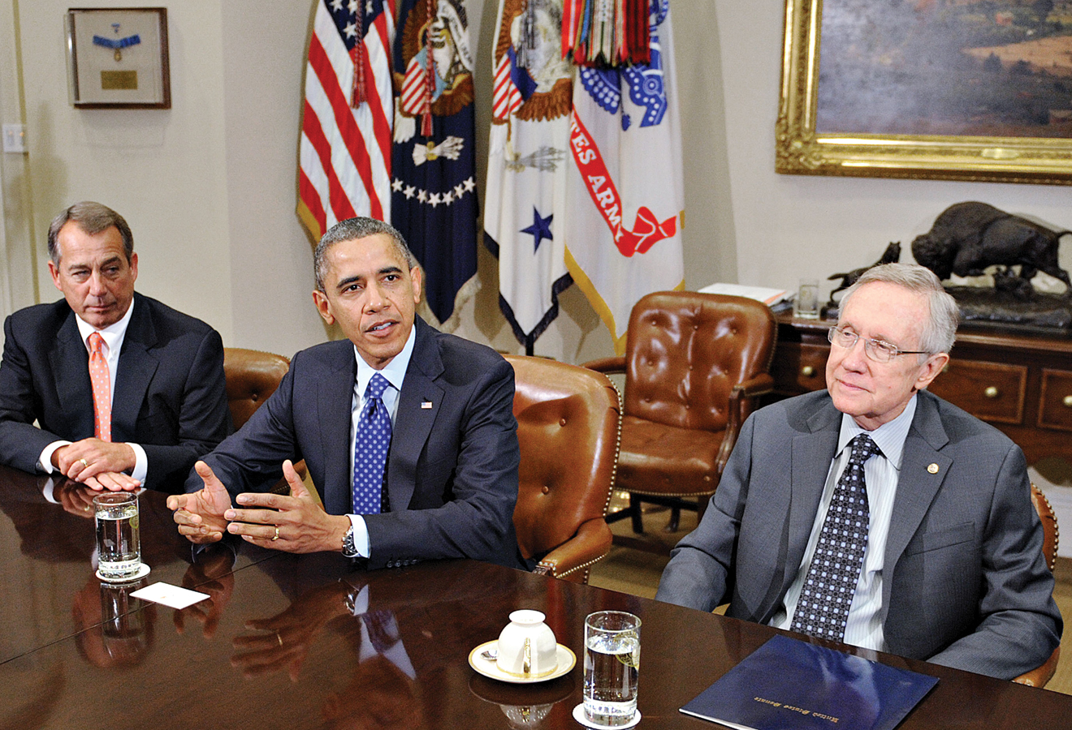
OLIVIER DOULERY-POOL/GETTY IMAGES
IT TAKES TIME TO RECOGNIZE PROBLEMS AND IMPLEMENT SOLUTIONS WITH FISCAL POLICY, ESPECIALLY IN A DIVIDED GOVERNMENT.
CHAPTER 21
SLIDE 24

Slide 25
AUTOMATIC STABILIZERS
TAX REVENUES AND TRANSFER PAYMENTS AUTOMATICALLY ADJUST TO ECONOMIC FLUCTUATIONS WITHOUT ACTION BY CONGRESS.
When the economy is growing, tax revenues rise (because of progressive taxation) and transfer payments fall as fewer people require income assistance. These effects temper the increase in economic output.
CHAPTER 21
SLIDE 25

Slide 26
FISCAL POLICY TIMING LAGS
INFORMATION LAG
Most data that policymakers need are not available until at least one quarter after the fact.
RECOGNITION LAG
It takes time to recognize trends in the data.
DECISION LAG
Policies must be debated and passed in Congress and signed by the president.
IMPLEMENTATION LAG
Once a policy becomes law, it takes time to plan, budget, and implement the new program.
CHAPTER 21
SLIDE 26

Slide 27
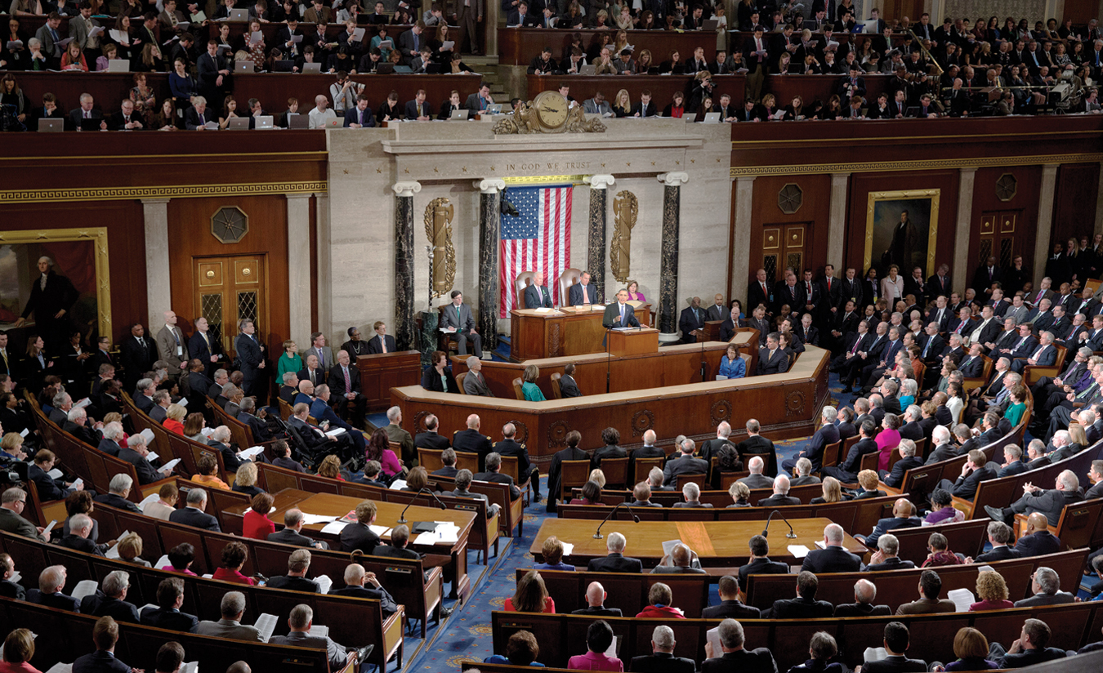
JOSHUA ROBERTS/BLOOMBERG VIA GETTY IMAGES
FISCAL POLICY IS OFTEN FINANCED BY DEFICITS BECAUSE POLICYMAKERS FIND IT DIFFICULT TO RAISE TAXES OR REDUCE SPENDING.
CHAPTER 21
SLIDE 27

Slide 28
DEFICITS AND THE NATIONAL DEBT
  DEFICIT
  SURPLUS
    AMOUNT BY WHICH ANNUAL GOVERNMENT SPENDING EXCEEDS TAX REVENUES
AMOUNT BY WHICH ANNUAL TAX REVENUES EXCEED GOVERNMENT SPENDING
The national debt is the total accumulation of past deficits less surpluses.
CHAPTER 21
SLIDE 28

Slide 29
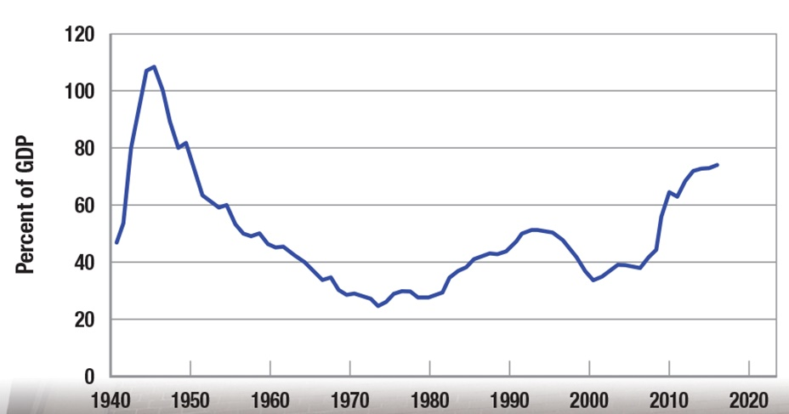
PUBLIC DEBT AS A PERCENT OF GDP
CHAPTER 21
SLIDE 29

Slide 30
BALANCED BUDGET AMENDMENTS
Annually Balanced Budget
Cyclically Balanced Budget
Functional Finance
There are several approaches to balancing the budget.
CHAPTER 21
SLIDE 30

Slide 31
BALANCED BUDGET AMENDMENTS
ANNUALLY BALANCED BUDGET
Revenues and spending must be equal each year. It generally makes recessions worse by forcing spending cuts during economic downturns, when tax revenues drop.
CYCLICALLY BALANCED BUDGET
The budget must be balanced over the business cycle by increases in taxes or reductions in spending during booms to offset deficits that occur during recessions. This is politically difficult to implement.
CHAPTER 21
SLIDE 31

Slide 32
BALANCED BUDGET AMENDMENTS
FUNCTIONAL FINANCE
The impact of the budget on the business cycle is ignored; the focus is on fostering economic growth and stable prices.
Balancing the budget should not be the primary concern of policymakers.
The focus should be on maintaining full employment with stable prices.
CHAPTER 21
SLIDE 32

Slide 33

FINANCING DEBT AND DEFICITS
The government budget constraint:
  G $–$ T = ΔM + ΔB + ΔA
G = government spending
T = tax revenues (G – T is the deficit)
ΔM = change in money supply (selling bonds to the Federal Reserve)
ΔB = change in bonds held by the public
ΔA = the sale of government assets
CHAPTER 21
SLIDE 33

Slide 34
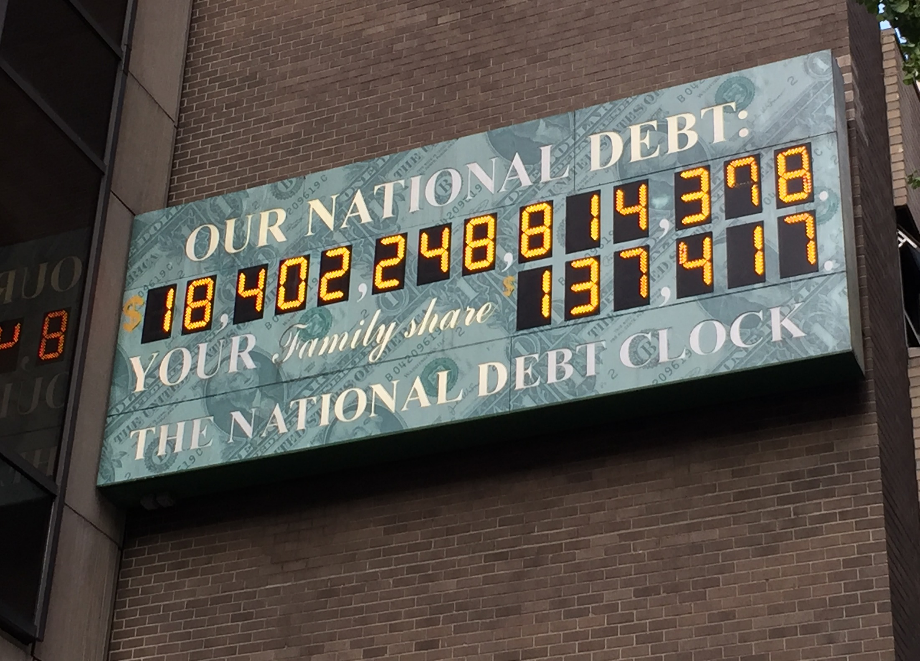
ERIC CHIANG
IS THE SIZE OF THE NATIONAL DEBT A PROBLEM? ONLY IF THE COST OF FINANCING THE DEBT PLACES AN EXCESSIVE BURDEN ON THE BUDGET.
CHAPTER 21
SLIDE 34

Slide 35
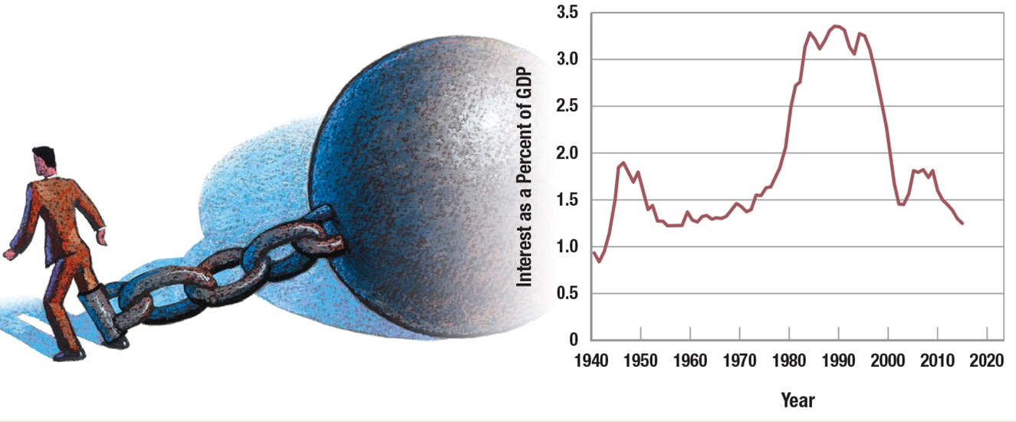
ECONOMIC BURDEN OF THE DEBT
JONATHAN EVANS/GETTY IMAGES
Because U.S. Treasury rates have been at historic lows in recent years, the interest payment on the national debt is less than 2% of GDP, a very manageable level.
CHAPTER 21
SLIDE 35

Slide 36

SCOTT SPEAKES/CORBIS
A LARGE PORTION OF THE NATIONAL DEBT IS OWED TO AMERICANS HOLDING TREASURY BONDS. INTEREST PAYMENTS ON THIS PORTION THEREFORE GO TO OTHER AMERICANS.
CHAPTER 21
SLIDE 36

Slide 37
EQUITY ASPECTS OF THE NATIONAL DEBT
A concern regarding the national debt is the effect on wealth distribution.
People who own part of the national debt tend to be wealthier than those who do not.
Interest payments on the debt therefore redistribute wealth to the rich, leading to greater income inequality.
CHAPTER 21
SLIDE 37

Slide 38
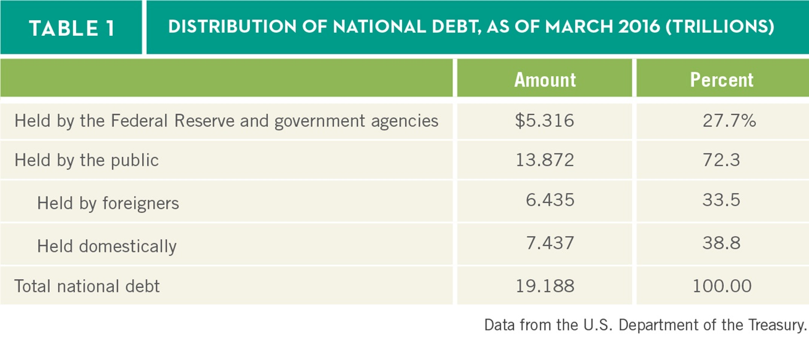

INTERNAL VERSUS EXTERNAL DEBT
Another concern is that nearly half of all debt held by the public is held by foreigners. Interest payments to foreigners are a real claim on U.S. output.
SLIDE 38
CHAPTER 21
SLIDE 38

Slide 39
THE CROWDING-OUT EFFECT OF DEBT
Another concern is that government finances its debt by selling bonds, pushing the interest rate higher.
Higher interest rates make consumers and businesses less likely to borrow for purchases and investment.
Therefore, debt crowds out consumption and investment, leading to a less productive future economy.
CHAPTER 21
SLIDE 39

Slide 40
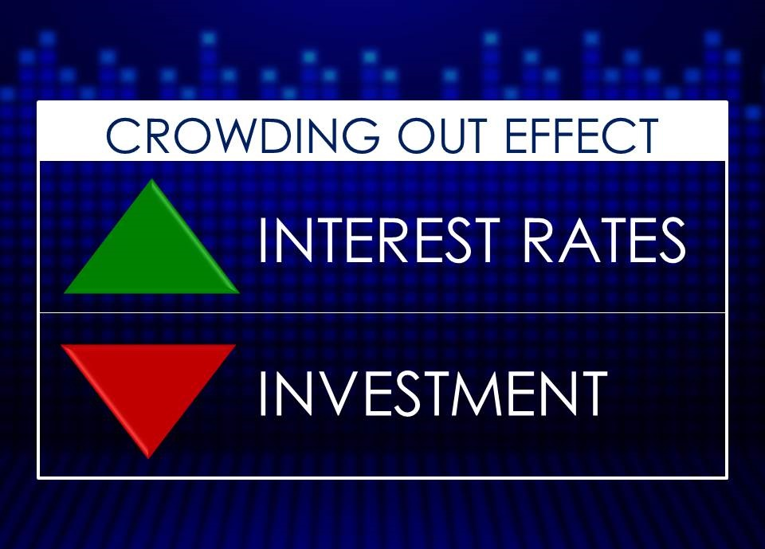
JAGATH WIJAYARATNE | DREAMSTIME.COM
A LARGE PORTION OF THE NATIONAL DEBT IS OWED TO AMERICANS HOLDING TREASURY BONDS. INTEREST PAYMENTS ON THIS PORTION THEREFORE GO TO OTHER AMERICANS.
CHAPTER 21
SLIDE 40

Slide 41

JAMES NAZZ/CORBIS
FISCAL SUSTAINABILITY OCCURS WHEN THE PRESENT VALUE OF ALL PROJECTED FUTURE REVENUES EQUALS THE PRESENT VALUE OF PROJECTED FUTURE SPENDING.
CHAPTER 21
SLIDE 41

Slide 42
KEY CONCEPTS
Discretionary spending
Mandatory spending
Discretionary fiscal policy
Expansionary fiscal policy
Contractionary fiscal policy
Supply-side fiscal policies
Laffer curve
Automatic stabilizers
Information lag
Recognition lag
Decision lag
Implementation lag
Public choice theory
Deficit
Surplus
National debt
Public debt
Annually balanced budget
Cyclically balanced budget
Functional finance
Government budget constraint
Internally held debt
Externally held debt
Crowding-out effect
Fiscal sustainability
CHAPTER 21 SLIDE 42

Slide 43
WHICH OF THE FOLLOWING IS MANDATORY SPENDING, WHICH CANNOT BE ADJUSTED WITHOUT CHANGING THE LAW?
A
SPENDING ON EDUCATION
B
SOCIAL SECURITY BENEFITS
C
MAINTAINING ROADS AND BRIDGES
D
NATIONAL DEFENSE
E
ENVIRONMENTAL PROTECTION
CHAPTER 21
SLIDE 43
Notes:
Answer: B

Slide 44
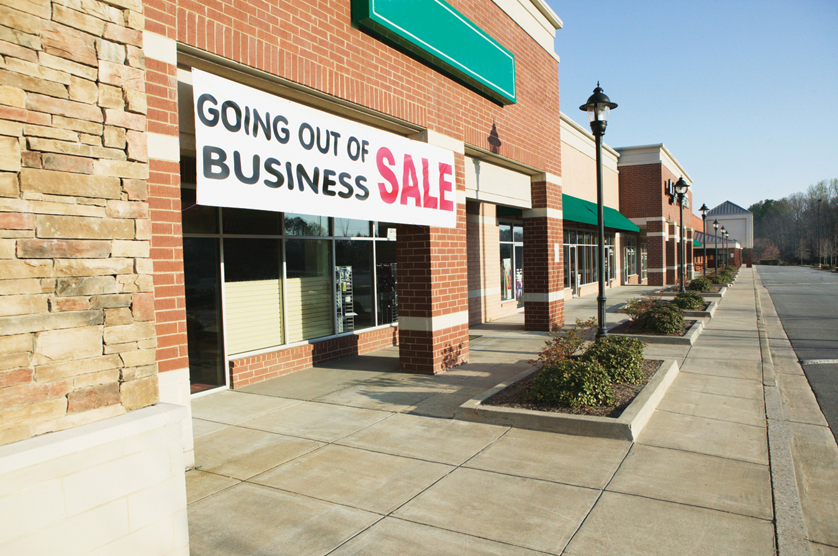
PRACTICE QUESTION
RICK BARRENTINE/CORBIS
IF THE ECONOMY IS IN A RECESSION, WHAT TYPES OF FISCAL POLICY CAN SPEED UP THE RECOVERY?
CHAPTER 21
SLIDE 44
Notes:
Answer: Expansionary fiscal policy can result in an increase in aggregate demand, speeding up the recovery. Expansionary fiscal policy includes increases in government spending, increased transfers of money, and tax cuts.

Slide 45
WHICH OF THE FOLLOWING IS AN EXAMPLE OF CONTRACTIONARY FISCAL POLICY?
A
INCREASING GOVERNMENT SPENDING
B
EXPANDING TRANSFER PAYMENTS
C
SUBSIDIZING BASIC RESEARCH
D
EXPANDING FEDERAL HEALTH CARE COVERAGE
E
RAISING INCOME TAX RATES
CHAPTER 21
SLIDE 45
Notes:
Answer: E

Slide 46
PRACTICE QUESTION
ERIC CHIANG
IF THE GOVERNMENT DEFICIT IS CUT IN HALF OVER THE NEXT FIVE YEARS, WHY DOES PUBLIC DEBT CONTINUE TO RISE?
CHAPTER 21
SLIDE 46
Notes:
Answer: A deficit is the amount the government spends above what it collects in taxes. Therefore, even if the deficit is dramatically reduced, the government is still spending more than it receives, which means the debt (the sum of all past deficits less surpluses) will continue to rise. As deficits fall, the rise in the debt will slow.

Slide 47
WHICH OF THE FOLLOWING IS NOT A WAY THE GOVERNMENT FINANCES ITS DEFICIT?
A
SELLING ASSETS OWNED BY THE GOVERNMENT
B
SELLING BONDS TO FOREIGN GOVERNMENTS
C
INCREASING THE MONEY SUPPLY BY PRINTING MONEY
D
SELLING BONDS TO DOMESTIC CITIZENS
E
BUYING BONDS FROM THE FEDERAL RESERVE
CHAPTER 21
SLIDE 47
Notes:
Answer: E

Slide 48
21
END OF CHAPTER
SLIDES CREATED BY ERIC CHIANG
Tshooter/Shutterstock; Anton Balazh/Shutterstock
CHAPTER 21
SLIDE 48

