Slide 1
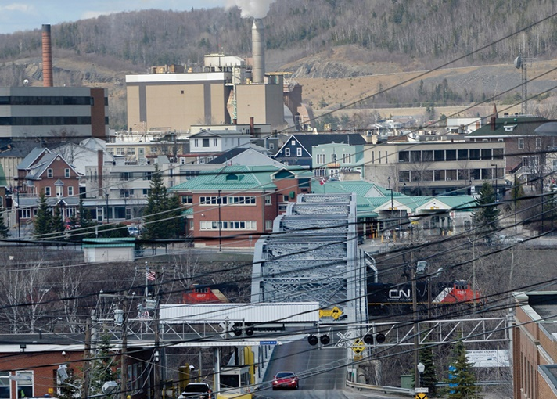
19
Aggregate Expenditures
SLIDES CREATED BY ERIC CHIANG
PORTLAND PRESS HERALD / Getty Images
CHAPTER 19 SLIDE 1

Slide 2
CHAPTER OBJECTIVES
Name the components of aggregate spending.
Analyze the relationship between consumption and income using a basic aggregate expenditures graph.
Analyze consumption and saving using marginal propensity to consume (MPC) and marginal propensity to save (MPS).
Describe the determinants of consumption, saving, and investment.
Determine macroeconomic equilibrium in the simple aggregate expenditures model of the private domestic economy.

CHAPTER 19
SLIDE 2

Slide 3
CHAPTER OBJECTIVES
Explain the multiplier process, how it is computed, and why it operates in both directions.
Describe macroeconomic equilibrium in the full aggregate expenditures model when government and the foreign sectors are added.
Explain why, at equilibrium, injections equal withdrawals in the economy.
Describe the differences between recessionary and inflationary gaps.
CHAPTER 19
SLIDE 3

Slide 4
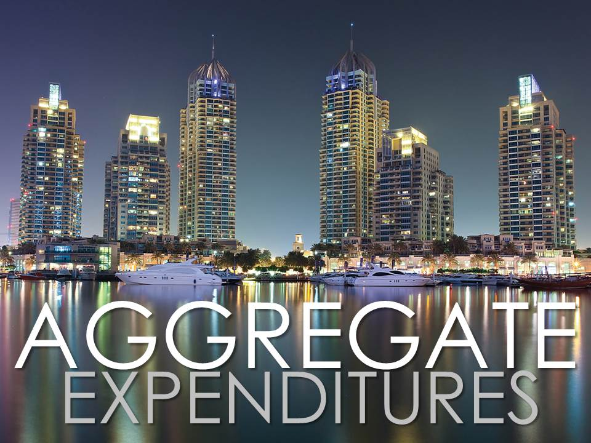
MOLIMA/DREAMSTIME.COM
CHAPTER 19
SLIDE 4

Slide 5
THE CLASSICAL MODEL
Pre-1930s mainstream economic thought argued that:
  a laissez-faire (leave it alone) approach was best for the economy.
  the economy was self-correcting; it always adjusted to full employment by the forces of demand and supply.
  prices, wages, and interest rates were flexible.
CHAPTER 19
SLIDE 5

Slide 6
THE GREAT DEPRESSION
The prolonged downturn challenged the classical perspective:
  John Maynard Keynes argued that government has an important role in stabilizing a distressed economy.
  Keynesians argued that prices and wages were sticky, or slow to adjust.
  Keynes published The General Theory… in 1936.
CHAPTER 19
SLIDE 6

Slide 7
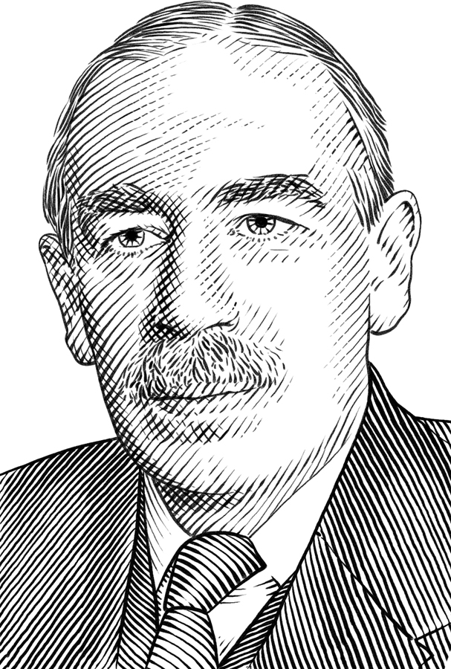
JOHN MAYNARD KEYNES (1883–1946)
Known as the father of macroeconomics.
Launched a critique of classical economics by focusing on spending as the key to growth.
His writings still influence economic policy (e.g., stimulus policies).
CHAPTER 19
SLIDE 7

Slide 8
AGGREGATE EXPENDITURES
Consist of the components of GDP that are measured by spending:
  GDP = AE = C + I + G + (X − M)
Consumption (C) is the largest component, representing nearly 70% of GDP. Consumption is the key factor in the AE model.
CHAPTER 19
SLIDE 8

Slide 9

YURI ARCURS/AGE FOTOSTOCK
CONSUMPTION IS THE PORTION OF INCOME NOT SAVED: INCOME = C + S.
CHAPTER 19
SLIDE 9

Slide 10
KEYNESIAN CONSUMPTION FUNCTION
6
Y = C + S
C
5
4
a
CONSUMPTION (thousands)
3
Saving is negative to the left of point a and positive to the right of point a.
2
1
1
2
3
4
5
6
INCOME (thousands)
CHAPTER 19
SLIDE 10

Slide 11
KEYNESIAN CONSUMPTION FUNCTION
Consumption spending grows as income grows but not as fast.
  As income rises, savings rise as a percentage of income.
Classical economists believe that interest rates determine saving, while Keynesians believe that income determines saving.
CHAPTER 19
SLIDE 11

Slide 12

AVERAGE PROPENSITY TO CONSUME (APC) AND SAVE (APS)
  APC
  APS
    PERCENTAGE OF INCOME THAT IS USED FOR CONSUMPTION (C / Y)
PERCENTAGE OF INCOME THAT IS SAVED (S / Y)
Because Y = C + S, APC + APS = 1.
CHAPTER 19
SLIDE 12

Slide 13
MARGINAL PROPENSITY TO CONSUME (MPC) AND SAVE (MPS)
  MPC
  MPS
    THE CHANGE IN CONSUMPTION GIVEN A CHANGE IN INCOME (ΔC/ΔY)
    THE CHANGE IN SAVING GIVEN A CHANGE IN INCOME (ΔS/ΔY)
Because Y = C + S, MPC + MPS = 1
CHAPTER 19
SLIDE 13

Slide 14
OTHER DETERMINANTS OF CONSUMPTION
Income is the principal determinant of consumption and saving, but other factors can shift the consumption and saving schedules:
  Wealth
  Expectations about future prices and income
  Household debt
  Taxes
CHAPTER 19
SLIDE 14

Slide 15

FRENC/DREAMSTIME.COM
INVESTMENT IS SPENDING BY BUSINESSES THAT ADDS TO THE PRODUCTIVE CAPACITY OF THE ECONOMY.
CHAPTER 19
SLIDE 15

Slide 16
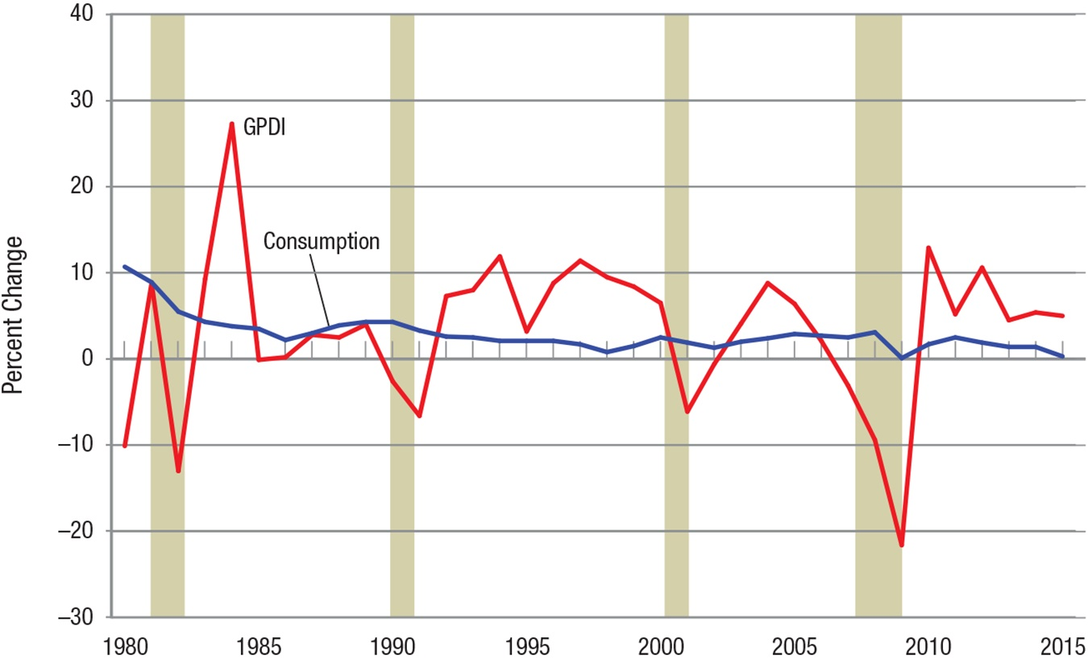
THE INSTABILITY OF INVESTMENT
Gross private domestic investment is much more volatile than consumption spending.
CHAPTER 19
SLIDE 16

Slide 17
INVESTMENT DEMAND
Investment levels depend primarily on the rate of return on capital.
  Investments earning a high rate of return are those undertaken first.
Interest rates also affect investment because most business investment is financed.
  As interest rates fall, investment rises.
CHAPTER 19
SLIDE 17

Slide 18
OTHER DETERMINANTS OF INVESTMENT
Investment demand also depends on:
  expectations about future revenues and return on investment.
  technological change.
  operating costs.
  capital goods on hand.
CHAPTER 19
SLIDE 18

Slide 19
AGGREGATE INVESTMENT SCHEDULE
Investment spending is autonomous (independent) of income.
INVESTMENT SPENDING (I)
I₀
I
1
2
3
4
5
6
INCOME (Y)
CHAPTER 19
SLIDE 19

Slide 20
SIMPLE AGGREGATE EXPENDITURES MODEL
Leaving out the government and foreign sectors, we ask the following questions:
❶
HOW MUCH WILL THE ECONOMY PRODUCE?
WHAT IS THE MACROECONOMIC EQUILIBRIUM?
WHAT CHANGES THE EQUILIBRIUM?
❷
❸
CHAPTER 19
SLIDE 20

Slide 21
THE TWO COMPONENTS IN THE SIMPLE AE MODEL (AE = C + I)
CONSUMPTION
ALMOST 70% OF AGGREGATE SPENDING: LARGE AND STABLE
INVESTMENT
ABOUT 15% OF AGGREGATE SPENDING: VOLATILE AND SENSITIVE TO ECONOMIC CONDITIONS
CHAPTER 19
SLIDE 21

Slide 22
SIMPLE AGGREGATE EXPENDITURES MODEL
Y = AE
5,500
AE = C + I₀
5,000
C
e
4,500
AGGREGATE EXPENDITURES
f
4,000
Point a in both panels represents zero saving (income equals consumption). If AE rises by $100, equilibrium income rises by $400, where S = I.
a
3,500
3,000
500
3,500
4,000
4,500
5,000
S
250
e
100
I₀
SAVING & INVESTMENT
a
0
3,500
4,000
4,500
5,000
INCOME (Y)
CHAPTER 19
SLIDE 22

Slide 23
MACROECONOMIC EQUILIBRIUM
The economy is at equilibrium where injections of spending (investment) equal withdrawals (saving), or:
  I = S
At this point, there is no reason for the economy to change its level of output or income.
CHAPTER 19
SLIDE 23

Slide 24
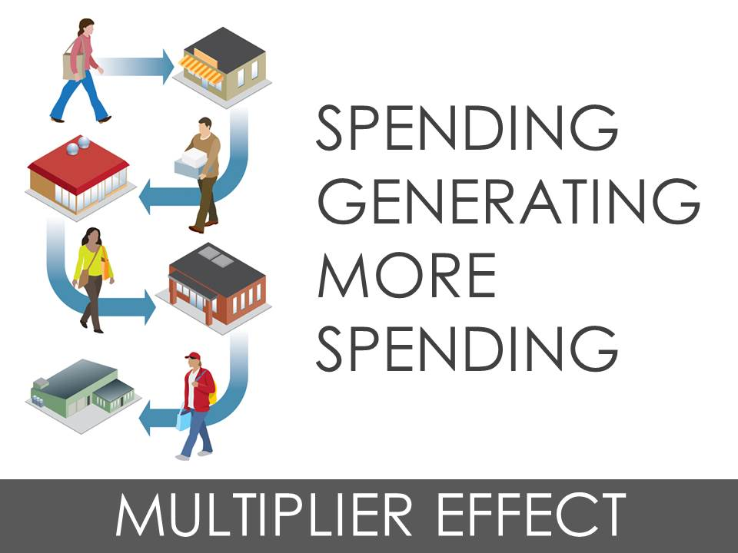
CHAPTER 19
SLIDE 24

Slide 25
THE MULTIPLIER EFFECT
Occurs when an initial amount of spending causes income to grow by a larger amount
The multiplier is calculated as:
  1 / (1 − MPC)
The greater the MPC, the higher the spending multiplier.
CHAPTER 19
SLIDE 25

Slide 26
MULTIPLIER IN ACTION (MPC = 0.8)
$100 CASH
SPEND
SAVE
$80
$20
SPEND
SAVE
$64
$16
SPEND
SAVE
AND SO ON…
$51.20
$12.80
CHAPTER 19
SLIDE 26

Slide 27
THE MULTIPLIER EFFECT
The total potential effect on income equals the initial change in spending times the multiplier.
When MPC = 0.8, the potential increase in income from a $100 increase in spending is $100 × 5 = $500. Saving will also increase by $100.
CHAPTER 19
SLIDE 27

Slide 28
SAVING AND INVESTMENT
S
b
I₁ = 100
200
e
100
I₀ = 100
SAVING AND INVESTMENT
0
3.6
4.0
4.4
4.8
5.2
INCOME (thousands)
−100
An increase in investment of $100 creates more than a $100 increase in income. In this case, $100 turns into a $400 rise in income (from point e to b).
−200
CHAPTER 19
SLIDE 28

Slide 29

IMAGE SOURCE/CORBIS
THE SPENDING MULTIPLIER ALLOWS US TO DETERMINE HOW MUCH SPENDING IS NEEDED TO BOOST INCOME TO A SPECIFIC LEVEL.
CHAPTER 19
SLIDE 29

Slide 30
THE MULTIPLIER WORKS IN BOTH DIRECTIONS
A decrease in spending during an economic downturn can cause a larger drop in income.
If consumers increase their saving during a recession, they may inadvertently make the recession worse because of the multiplier.
CHAPTER 19
SLIDE 30

Slide 31
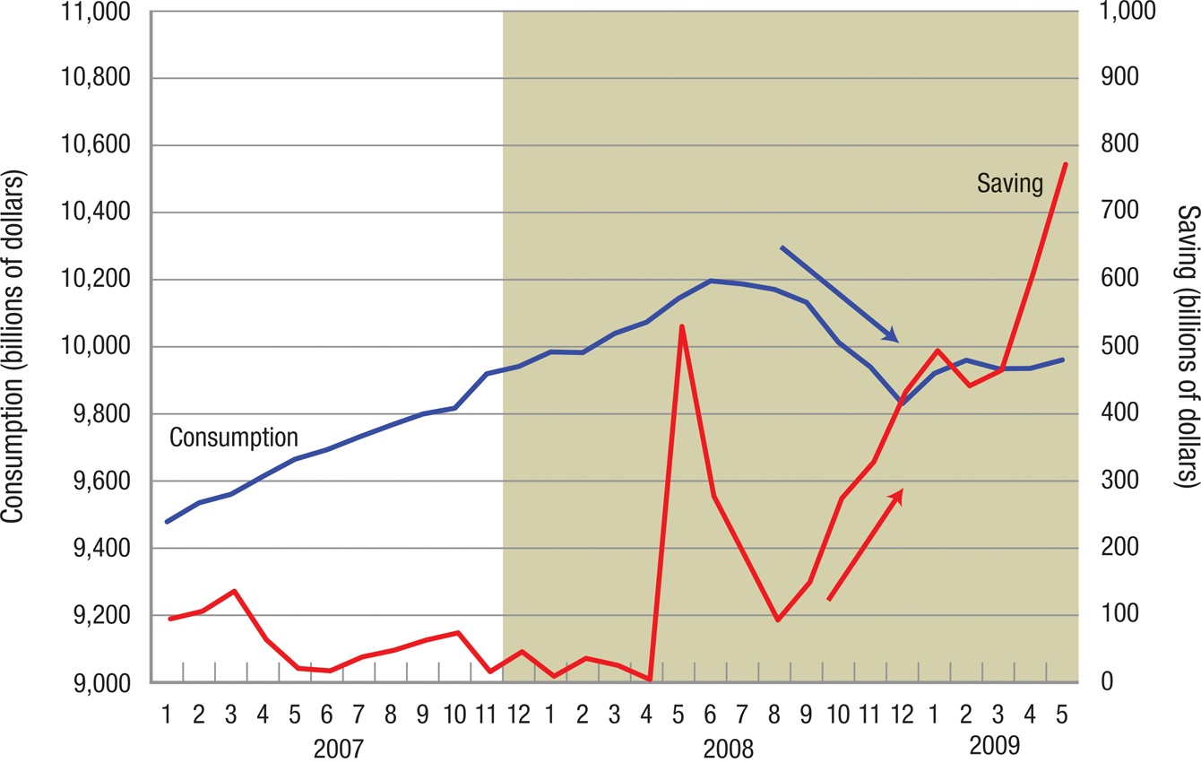
CONSUMPTION AND SAVING DURING THE 2007–2009 RECESSION
CHAPTER 19
SLIDE 31

Slide 32

KOOBOOKI/THINKSTOCK
PARADOX OF THRIFT: IF HOUSEHOLDS SAVE MORE, THE MULTIPLIER EFFECT LEADS TO REDUCED INCOME, LEADING TO LESS SAVING.
CHAPTER 19
SLIDE 32

Slide 33
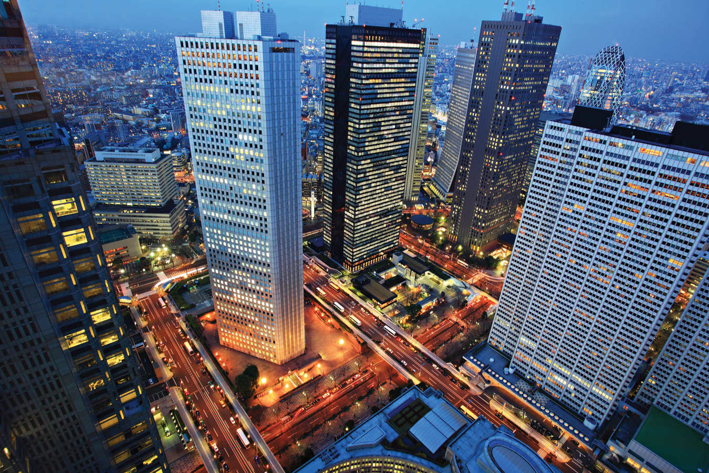
XIYE/DREAMSTIME.COM
THE FULL AGGREGATE EXPENDITURES MODEL TAKES ALL SPENDING COMPONENTS INTO ACCOUNT: C + I + G + (X − M)
CHAPTER 19
SLIDE 33

Slide 34
SPENDING INJECTIONS
INJECTIONS INCLUDE INVESTMENT (I), GOVERNMENT SPENDING (G), AND EXPORTS (X).
SPENDING WITHDRAWALS
WITHDRAWALS INCLUDE SAVINGS (S), TAXES (T), AND IMPORTS (M).
In a macroeconomic equilibrium:
  I + G + X = S + T + M
CHAPTER 19
SLIDE 34

Slide 35
SAVING, INVESTMENT, AND GOVERNMENT SPENDING
S
b
I + G
200
e
100
I
SAVING, INVESTMENT, GOVERNMENT SPENDING
0
3.6
4.0
4.4
4.8
5.2
INCOME (thousands)
−100
An increase of $100 in government spending has the same effect on income as an increase in investment. Both are injections to the economy.
−200
CHAPTER 19
SLIDE 35

Slide 36
SAVING, INVESTMENT, GOVERNMENT SPENDING, AND TAXES
S + T
S
g
200
I + G
b
e
100
I
SAVING, INVESTMENT, GOVERNMENT SPENDING
0
3.6
4.0
4.4
4.8
5.2
INCOME (thousands)
−100
Taxes have less direct impact on income than an equivalent change in government spending because some of a tax is paid using savings, both of which are withdrawals.
−200
CHAPTER 19
SLIDE 36

Slide 37
THE BALANCED BUDGET MULTIPLIER
Equal changes in government spending and taxation lead to an equal change in income.
If a $1 billion increase in spending is financed by a $1 billion tax increase, GDP rises $1 billion regardless of the MPC.
  THE BALANCED BUDGET MULTIPLIER IS ALWAYS 1.
CHAPTER 19
SLIDE 37

Slide 38
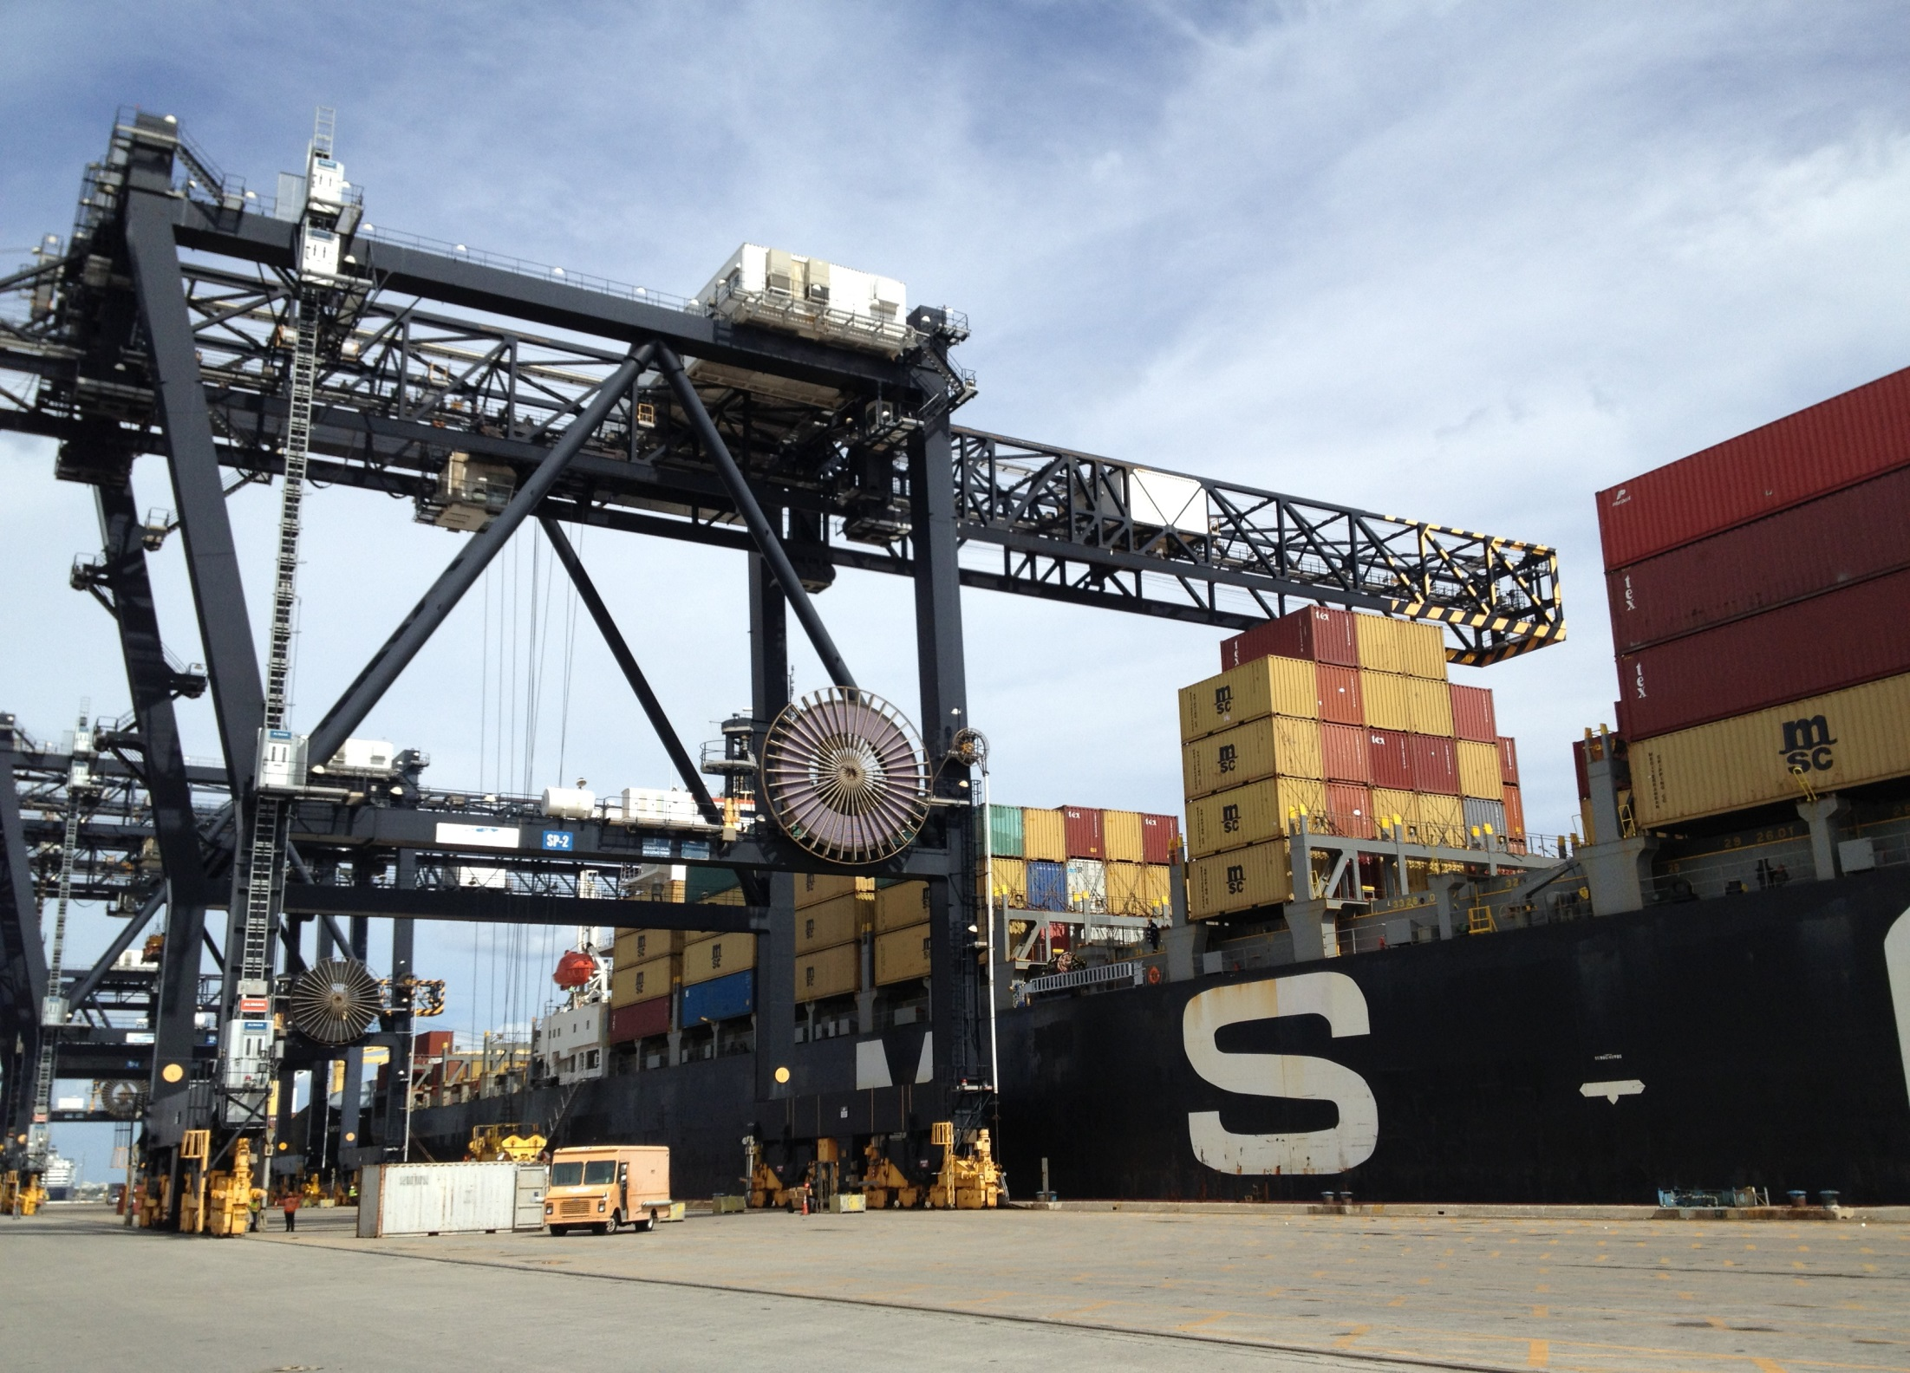
ERIC CHIANG
THE FOREIGN SECTOR IN THE KEYNESIAN MODEL IS ADDED THROUGH NET EXPORTS: EXPORTS MINUS IMPORTS (X − M).
CHAPTER 19
SLIDE 38

Slide 39
SAVING, INVESTMENT, GOVERNMENT SPENDING, AND NET EXPORTS
S
c
300
I + G + (X − M)
b
200
I + G
e
100
I
SAVING, INVESTMENT, GOVERNMENT SPENDING
0
3.6
4.0
4.4
4.8
5.2
INCOME (thousands)
−100
If exports exceed imports, AE rises and equilibrium income rises. If imports exceed exports, AE falls and equilibrium income falls.
−200
CHAPTER 19
SLIDE 39

Slide 40
RECESSIONARY GAP
THE INCREASE IN AGGREGATE SPENDING NECESSARY TO BRING A DEPRESSED ECONOMY BACK TO FULL EMPLOYMENT
This is not the total deficiency in GDP, which is called the GDP gap. The recessionary gap is the spending needed to close the GDP gap when boosted by the multiplier.
CHAPTER 19
SLIDE 40

Slide 41
INFLATIONARY GAP
THE DECREASE IN AGGREGATE SPENDING NECESSARY TO BRING AN OVERHEATED ECONOMY BACK TO FULL EMPLOYMENT
Inflationary pressures occur when an economy produces output above full employment. Excess spending results in higher prices, which can lead to other economic problems.
CHAPTER 19
SLIDE 41

Slide 42
THE GREAT DEPRESSION
At the height of the Great Depression, unemployment was 25% and the stock market fell 85%.
Keynes argued for a significant increase in government spending.
In the early 1940s, government spending rose 10 times for WWII, and the Great Depression ended.
CHAPTER 19
SLIDE 42

Slide 43
KEY CONCEPTS
Aggregate expenditures
Consumption
Saving
Average propensity to consume
Average propensity to save
Marginal propensity to consume
Marginal propensity to save
Investment
Keynesian macroeconomic equilibrium
Injections
Withdrawals
Multiplier
Paradox of thrift
Balanced budget multiplier
Recessionary gap
Inflationary gap
CHAPTER 19 SLIDE 43

Slide 44
IF THE MPC = 0.8 AND INCOME RISES BY $5,000, WHAT IS THE INCREASE IN CONSUMPTION?
A
$625
B
$1,000
C
$4,000
D
$5,000
E
$6,250
CHAPTER 19
SLIDE 44
Notes:
Answer: C

Slide 45
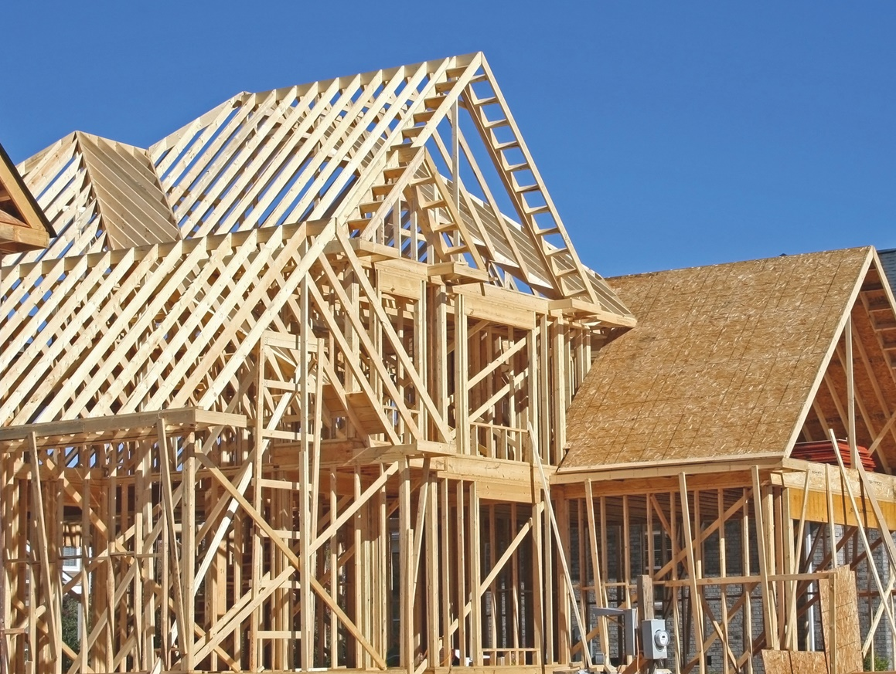
PRACTICE QUESTION
EXPLAIN HOW THE RECOVERY IN NEW HOUSING CONSTRUCTION WILL AFFECT THE ECONOMY AS A RESULT OF THE MULTIPLIER EFFECT.
SUE ASHE/SHUTTERSTOCK
CHAPTER 19
SLIDE 45
Notes:
Answer: As the housing industry recovers, construction of new homes will boost investment, an important component of AE. This injection into the economy will generate even more spending, up to the amount of investment times the multiplier. As a result, spending on homes will spur other economic activity, raising incomes.

Slide 46
WHICH OF THE FOLLOWING STATEMENTS CONCERNING CONSUMPTION IS INCORRECT?
A
WEALTHY PEOPLE CONSUME MORE THAN OTHER PEOPLE.
B
EXPECTATIONS ABOUT FUTURE PRICES AFFECT CONSUMPTION.
C
TAX INCREASES REDUCE CONSUMPTION.
D
SAVINGS RATES DECREASE AS INCOME INCREASES.
CHAPTER 19
SLIDE 46
Notes:
Answer: D

Slide 47

PRACTICE QUESTION
OLIVIER LE QUEINEC/DREAMSTIME.COM
WHAT WAS THE RATIONALE FOR CONGRESS AND THE PRESIDENT TO PASS A HUGE STIMULUS (SPENDING) PACKAGE IN 2009?
CHAPTER 19
SLIDE 47
Notes:
Answer: The United States was in a deep recession in early 2009, resulting in a very large recessionary gap. The stimulus package passed in early 2009 injected spending into the economy (primarily through government spending, G), and when boosted by the multiplier effect, attempted to speed up the economic recovery.

Slide 48
IF THE MULTIPLIER IS 4, GOVERNMENT SPENDING RISES BY $200, AND TAXES INCREASE BY $200, EQUILIBRIUM INCOME WILL:
A
FALL BY $200.
B
FALL BY LESS THAN $200.
C
NOT CHANGE.
D
RISE BY $200.
E
RISE BY MORE THAN $200.
CHAPTER 19
SLIDE 48
Notes:
Answer: D

Slide 49
19
END OF CHAPTER
SLIDES CREATED BY ERIC CHIANG
Tshooter/Shutterstock; Anton Balazh/Shutterstock
CHAPTER 19
SLIDE 49

