Slide 1

1
Exploring Economics
SLIDES CREATED BY ERIC CHIANG
BRUCE BENNETT/GETTY IMAGES
CHAPTER 1 SLIDE 1

Slide 2
CHAPTER OBJECTIVES
Explain how economic analysis can be used in decision making.
Differentiate between microeconomics and macroeconomics.
Describe how economists use models.
Describe the ceteris paribus assumption.
Discuss the difference between efficiency and equity.
Describe the key principles in economics.
Apply the key principles in economics to situations faced in everyday life.
CHAPTER 1
SLIDE 2

Slide 3

WAVEBREAKMEDIA LTD/DREAMSTIME.COM
ECONOMICS IS IMPORTANT
FOR SCHOOL
FOR WORK
FOR LIFE
CHAPTER 1
SLIDE 3

Slide 4

KRISTY PARGETER/DREAMSTIME.COM
ECONOMICS ISSUES ARE ALL AROUND US
CHAPTER 1
SLIDE 4

Slide 5
WHAT IS ECONOMICS ABOUT?
Economics is the study of the ways individuals, firms, and society make decisions to allocate limited resources to competing wants.
Economics assumes that people:
  are rational.
  are self-interested.
  respond to incentives.
CHAPTER 1
SLIDE 5

Slide 6

SYDA PRODUCTIONS/DREAMSTIME.COM
RATIONAL SELF-INTEREST: STUDENTS MAY CHEAT, BUT IF CAUGHT, THEY FACE SEVERE CONSEQUENCES.
CHAPTER 1
SLIDE 6

Slide 7
MICROECONOMICS
MICROECONOMICS IS THE STUDY OF DECISION MAKING BY INDIVIDUALS, BUSINESSES, AND INDUSTRIES.
MACROECONOMICS
MACROECONOMICS IS THE STUDY OF BROADER ISSUES IN THE ECONOMY, SUCH AS INFLATION, UNEMPLOYMENT, AND NATIONAL OUTPUT.
CHAPTER 1
SLIDE 7

Slide 8
QUESTION: IS THE FOLLOWING A MACROECONOMIC OR A MICROECONOMIC ISSUE?
LAWMAKERS ARE DISCUSSING HOW TO KEEP UNEMPLOYMENT FROM RISING IN THE COMING YEAR.
A
MACROECONOMICS
B
MICROECONOMICS
CHAPTER 1
SLIDE 8
Notes:
Answer: A

Slide 9
QUESTION: IS THIS A MACROECONOMIC OR A MICROECONOMIC ISSUE?
EXECUTIVES AT GENERAL MOTORS ARE DISCUSSING WHETHER RAISING PRICES WILL LEAD TO HIGHER PROFITS.
A
MACROECONOMICS
B
MICROECONOMICS
CHAPTER 1
SLIDE 9
Notes:
Answer: B

Slide 10

TERMINATOR3D/DREAMSTIME.COM
MODEL BUILDING: ECONOMIC ANALYSIS USES SIMPLIFIED MODELS.
CHAPTER 1
SLIDE 10

Slide 11
CETERIS PARIBUS
Assumption used in economics that all other relevant factors or variables are held constant.
Models are crafted from new ideas, then tested against real world data. For example, will more government spending lead to economic growth?
CHAPTER 1
SLIDE 11

Slide 12

EFFICIENCY VERSUS EQUITY
  EFFICIENCY
  EQUITY
    HOW WELL RESOURCES ARE USED AND ALLOCATED
THE FAIRNESS OF VARIOUS ISSUES AND POLICIES
Do people get the
goods and services they want at the lowest possible resource cost?
Should executive salaries and bonuses be capped for publicly traded corporations?
CHAPTER 1
SLIDE 12

Slide 13
POSITIVE VERSUS NORMATIVE
  POSITIVE QUESTION
  NORMATIVE QUESTION
ADDRESSES SOCIETY’S BELIEFS ABOUT WHAT SHOULD OR SHOULD NOT TAKE PLACE
    CAN BE ANSWERED BY AVAILABLE INFORMATION OR FACTS
CHAPTER 1
SLIDE 13

Slide 14
8
KEY
PRINCIPLES
CHAPTER 1
SLIDE 14

Slide 15

ROBERT HARDING WORLD IMAGERY/CORBIS
1
ECONOMICS IS CONCERNED WITH MAKING CHOICES WITH LIMITED RESOURCES.
CHAPTER 1
SLIDE 15

Slide 16
SCARCITY
UNLIMITED WANTS CLASH WITH LIMITED RESOURCES. EVERYONE FACES SCARCITY. ECONOMICS FOCUSES ON THE ALLOCATION OF SCARCE RESOURCES.
CHAPTER 1
SLIDE 16

Slide 17

SIMON JARRATT/CORBIS
2
WHEN MAKING DECISIONS, ONE MUST TAKE INTO ACCOUNT TRADEOFFS AND OPPORTUNTY COSTS.
CHAPTER 1
SLIDE 17

Slide 18
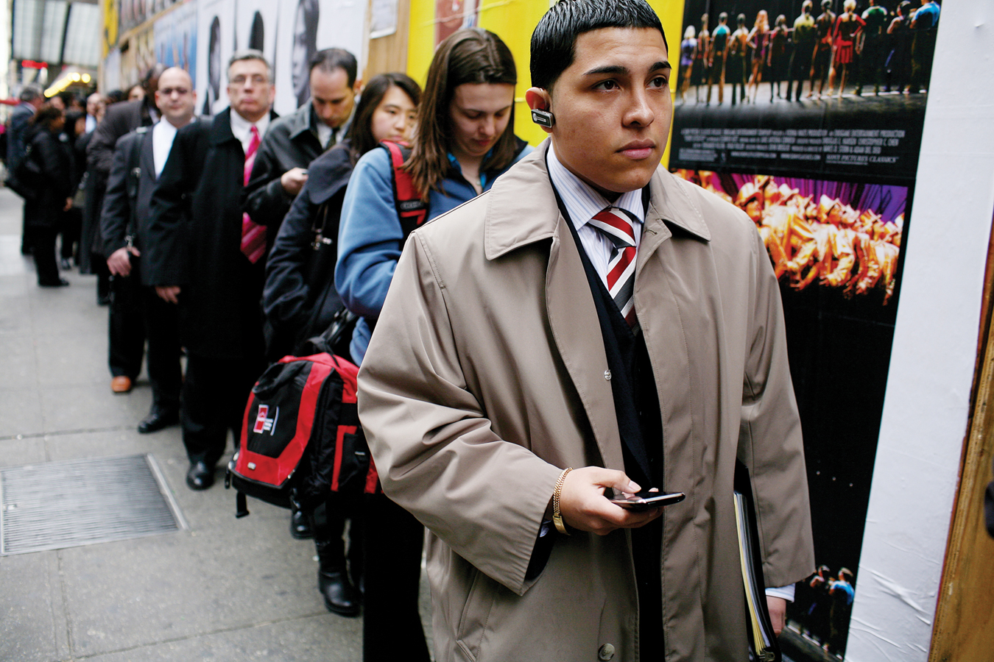
ANDREW LICHTENSTEIN/CORBIS
OPPORTUNITY COST: THE NEXT BEST ALTERNATIVE; WHAT YOU GIVE UP TO DO SOMETHING OR PURCHASE SOMETHING.
CHAPTER 1
SLIDE 18

Slide 19

AGSTOCK IMAGES, INC./ALAMY
3
SPECIALIZATION LEADS TO GAINS FOR ALL INVOLVED.
CHAPTER 1
SLIDE 19

Slide 20
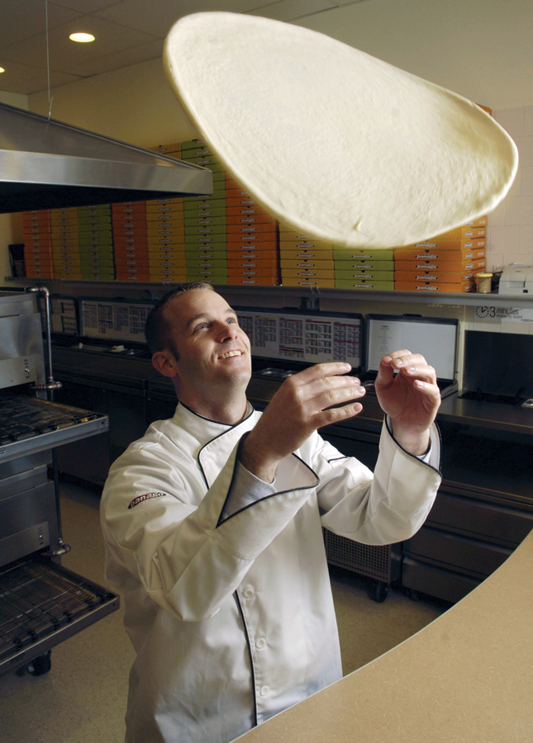
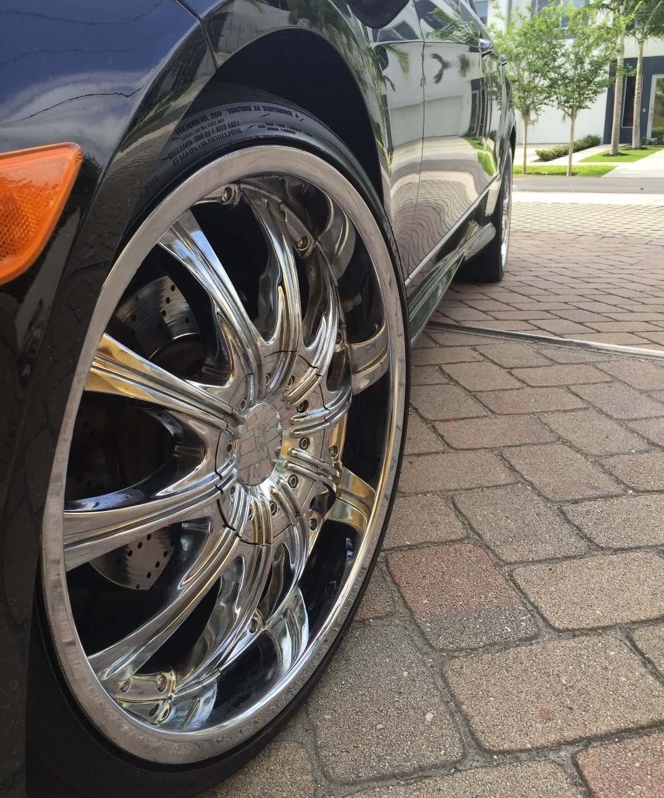
ZUMA WIRE SERVICE/ALAMY
Tony Bock/TorontoStar/ZUMA Press
INDIVIDUALS TEND TO WORK IN CAREERS
MOST SUITED TO THEM, SUCH AS
COOKING OR MECHANICS.
CHAPTER 1
SLIDE 20

Slide 21

4
TIM PANNELL/CORBIS
PEOPLE RESPOND TO INCENTIVES, BOTH GOOD AND BAD.
CHAPTER 1
SLIDE 21

Slide 22
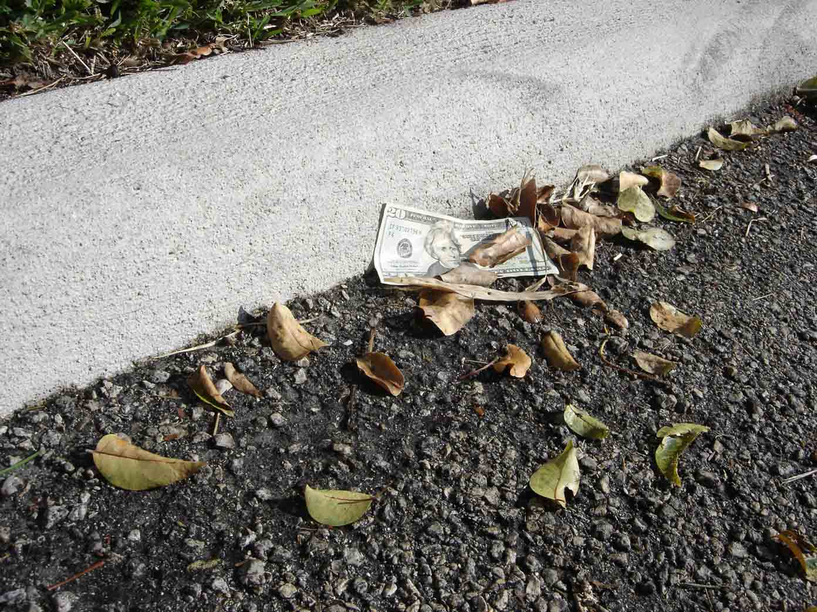
ERIC CHIANG
WOULD YOU PICK UP THIS $20 BILL? IS IT GREED, OR SIMPLY RESPONDING TO AN INCENTIVE, OR BOTH?
CHAPTER 1
SLIDE 22

Slide 23
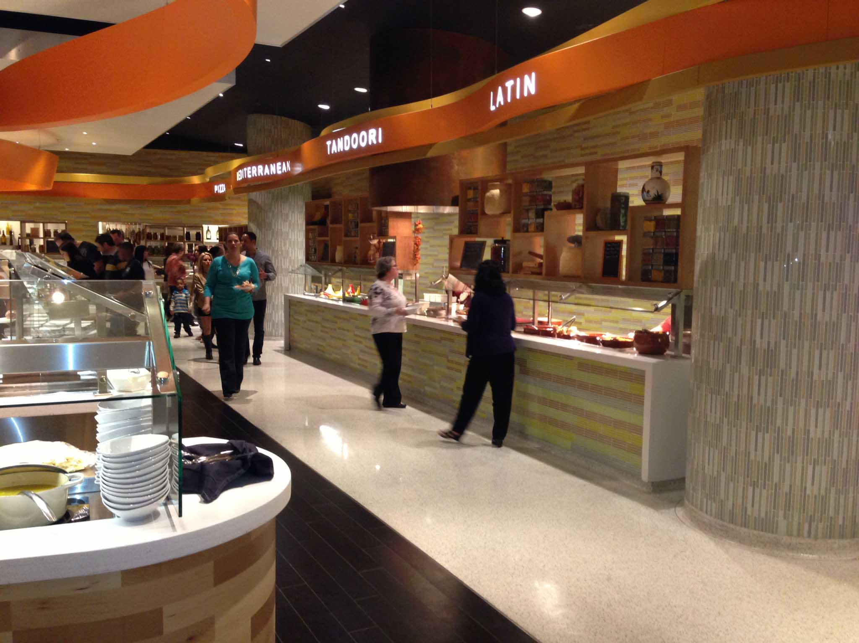
5
ERIC CHIANG
RATIONAL BEHAVIOR REQUIRES THINKING ON
THE MARGIN.
CHAPTER 1
SLIDE 23

Slide 24
ERIC CHIANG
AT AN ALL-YOU-CAN-EAT BUFFET, COMPARE THE BENEFIT OF ONE MORE PLATE OF FOOD TO THE COSTS (BLOATING, WEIGHT GAIN).
CHAPTER 1
SLIDE 24

Slide 25
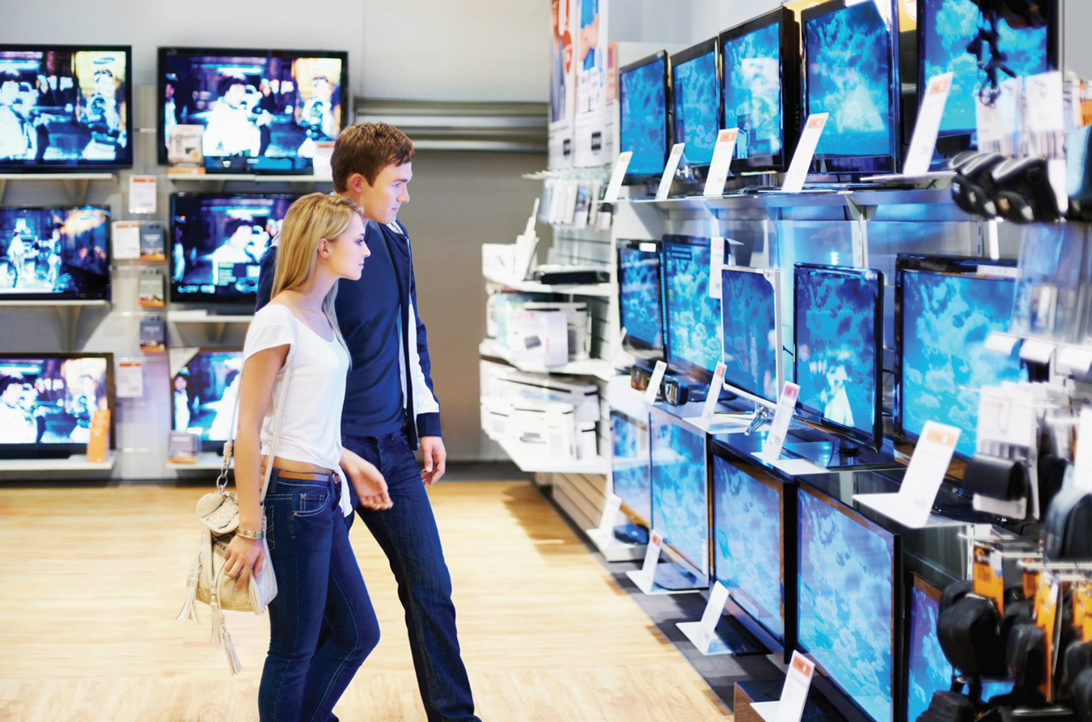
YURI ARCURS/AGE FOTOSTOCK
6
MARKETS ARE GENERALLY EFFICIENT; WHEN THEY AREN’T, GOVERNMENT CAN SOMETIMES CORRECT THE FAILURE.
CHAPTER 1
SLIDE 25

Slide 26
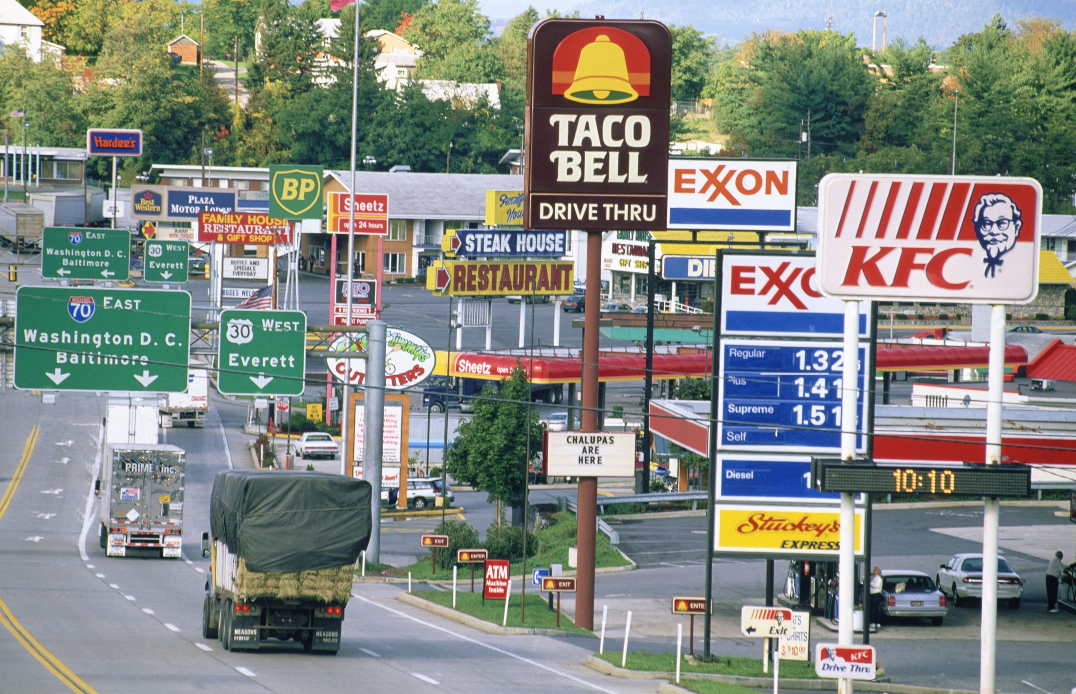
CLAVER CARROLL/AGE FOTOSTOCK
PRIVATE MARKETS AND COMPETITION FORCE BUSINESSES TO BE EFFICIENT OR BE DRIVEN OUT.
CHAPTER 1
SLIDE 26

Slide 27
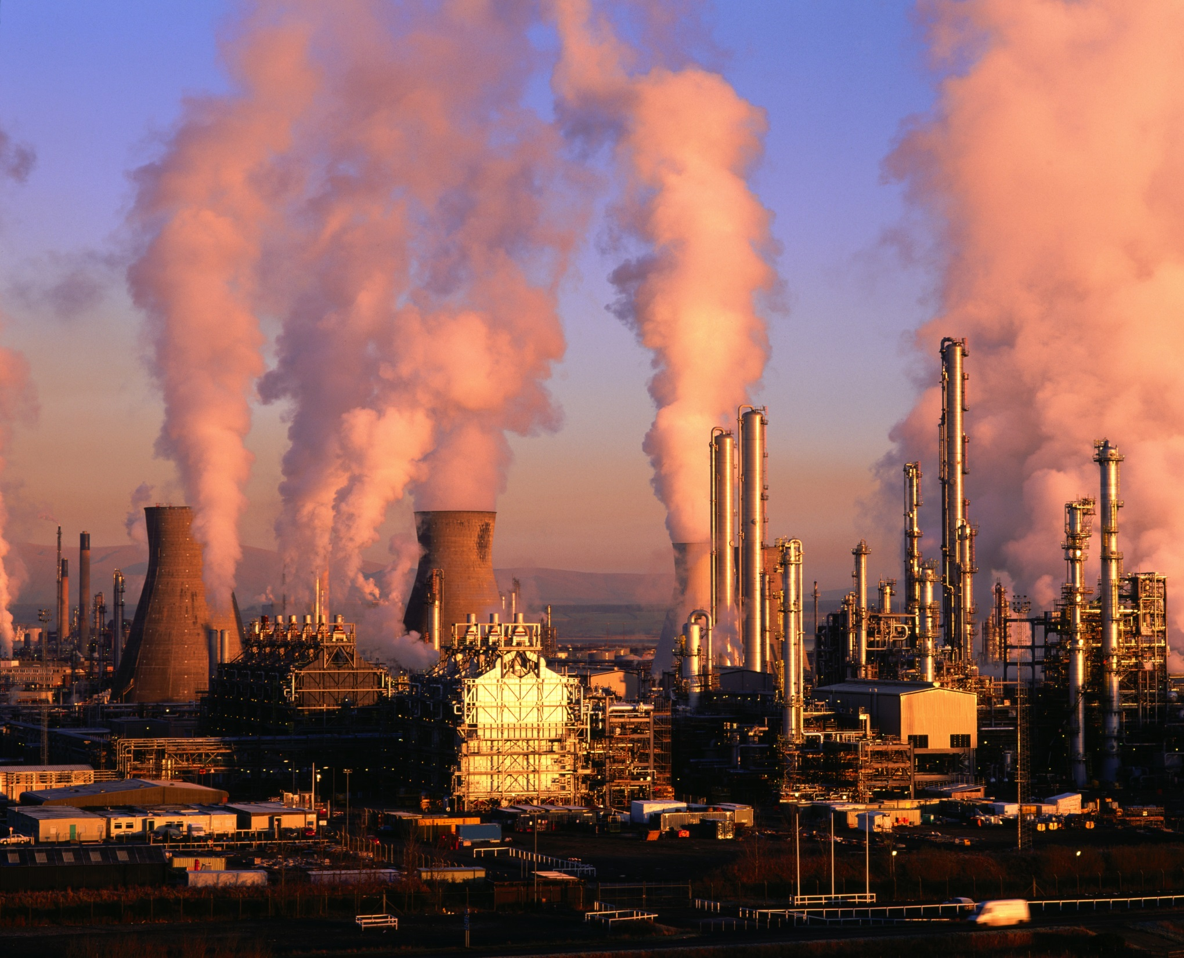
AGE FOTOSTOCK/SUPERSTOCK
MARKETS SOMETIMES RESULT IN UNDESIRABLE OUTCOMES, SUCH AS POLLUTION.
CHAPTER 1
SLIDE 27

Slide 28

ZRS MANAGEMENT
7
ECONOMIC GROWTH, LOW UNEMPLOYMENT, AND LOW INFLATION ARE ECONOMIC GOALS THAT DO NOT ALWAYS COINCIDE.
CHAPTER 1
SLIDE 28

Slide 29

ZRS MANAGEMENT
8
INSTITUTIONS AND HUMAN CREATIVITY HELP EXPLAIN THE WEALTH OF NATIONS.
CHAPTER 1
SLIDE 29

Slide 30
Economics
Scarcity
Incentives
Microeconomics
Macroeconomics
Ceteris paribus
Efficiency
Equity
Positive question
Normative question
Opportunity cost
KEY CONCEPTS
CHAPTER 1
SLIDE 30

Slide 31
WHICH OF THE FOLLOWING IS A NORMATIVE QUESTION?
A
WHAT IS THE SPEED LIMIT ON CAMPUS?
B
HOW MUCH DO TEXTBOOKS COST THIS TERM?
C
SHOULD CHEWING GUM BE BANNED IN CLASSROOMS?
D
HOW MUCH DOES STUDYING IMPROVE YOUR GRADE?
E
WHEN IS THE NEXT HOME FOOTBALL GAME?
CHAPTER 1
SLIDE 31
Notes:
Answer: C

Slide 32

PRACTICE QUESTION
WHAT ARE THE OPPORTUNITY COSTS OF GOING TO COLLEGE? IS IT WORTH IT? WHAT MIGHT CHANGE YOUR DECISION?
LYNGBYVEJ/DREAMSTIME.COM
CHAPTER 1
SLIDE 32
Notes:
Answer: The opportunity costs of college include the cost of tuition and books which would be used for other purchases, along with forgone wages if you chose to work instead of go to school. Statistics have consistently shown that the benefits of a college education far outweigh the costs. However, various factors might change your decision. Actors and star athletes sometimes forgo college because of the large sums of money earned. Also, the older you are, the less return from a college education you might receive, which is why most people choose to go to college right after high school.

Slide 33
IF YOU PAY $10 TO SEE A MOVIE AT A MULTISCREEN CINEMA, THEN SNEAK INTO A SECOND MOVIE WITHOUT PAYING, THE MARGINAL COST OF THE SECOND MOVIE IS:
A
$0.
B
$5.
C
$10.
D
$20.
CHAPTER 1
SLIDE 33
Notes:
Answer: A

Slide 34

PRACTICE QUESTION
WHAT ARE THE COSTS OF ECONOMIC PROGRESS? ARE WE BETTER OFF TODAY THAN 50 YEARS AGO? THAN 500 YEARS AGO? WILL WE BE BETTER OFF IN 100 YEARS?
MAJIAN/DREAMSTIME.COM
CHAPTER 1
SLIDE 34
Notes:
Answer: Economic progress comes in terms of higher economic growth rates, which translates into a higher standard of living. We are much better off today, on average, than 50 or 500 years ago. For example, we now have cures for many illnesses that previously led to high rates of death. We also have much better transportation and communications, allowing us to stay in contact with loved ones who live far away. And overall, incomes have risen, allowing us to consume more goods and services.

Slide 35
ECONOMISTS CREATE MODELS THAT INCLUDE THE ASSUMPTION OF CETERIS PARIBUS, WHICH MEANS:
A
ALL MARKETS ARE IN EQUILIBRIUM.
B
OPPORTUNITY COSTS ARE MINIMIZED.
C
MARKETS ARE FREE OF INTERVENTION.
D
ALL ELSE IS HELD CONSTANT.
CHAPTER 1
SLIDE 35
Notes:
Answer: D

Slide 36
1
END OF CHAPTER
SLIDES CREATED BY ERIC CHIANG
Tshooter/Shutterstock; Anton Balazh/Shutterstock
CHAPTER 1
SLIDE 36

