Slide 1
Math 3301 Foundations of Geometry
Chapter 9 Analytic Geometry
Dr. Geoff F. Clement

Slide 2
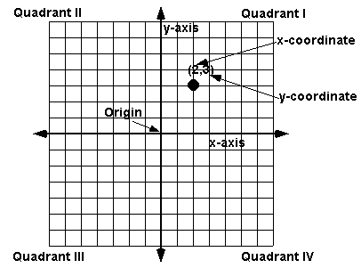
9.1 The Cartesian Coordinate System, Distance and Midpoint Formulas

Slide 3
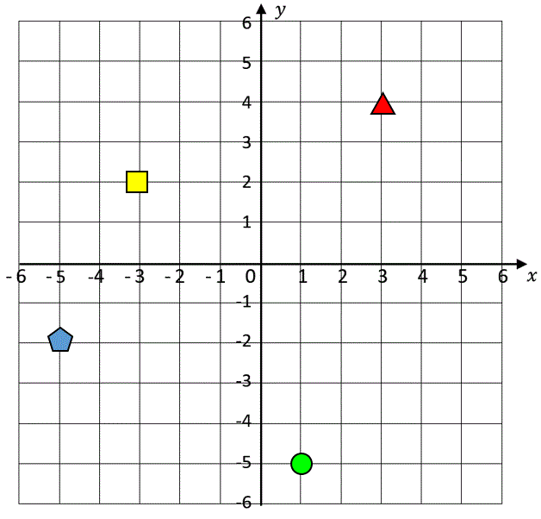
9.1 The Cartesian Coordinate System, Distance and Midpoint Formulas
Postulate 9.1: Associated with
each point in the plane, there
is one and only one ordered pair
of numbers.

Slide 4
9.1 The Cartesian Coordinate System, Distance and Midpoint Formulas
Linear or first-degree equations
General Form: ax + by + c = 0
Examples: x + 5 = 0
2x + 3y ̶ 8 = 0
-x + 5y + 10 = 0
x + y ̶ 2 = 0
y ̶ 2 = 0

Slide 5
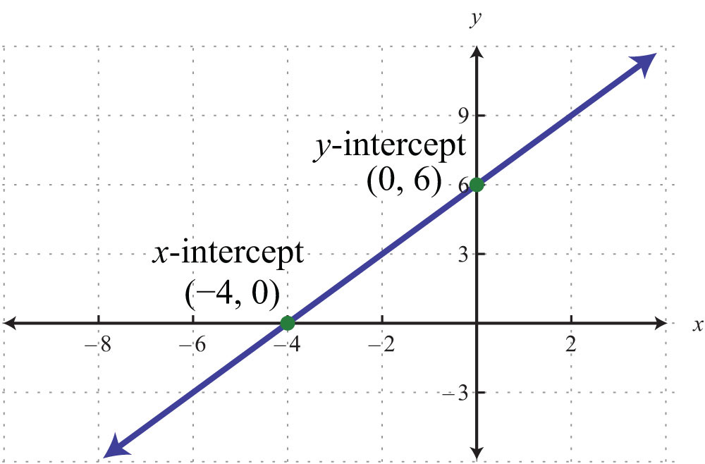
9.1 The Cartesian Coordinate System, Distance and Midpoint Formulas

Slide 6
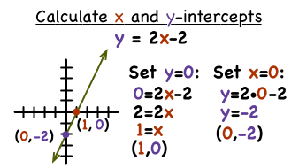
9.1 The Cartesian Coordinate System, Distance and Midpoint Formulas
Finding intercepts

Slide 7
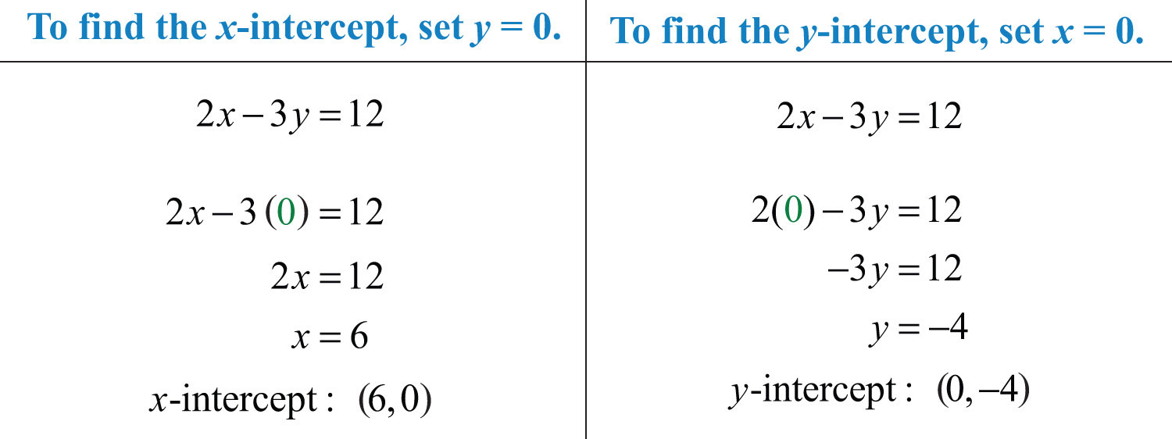
9.1 The Cartesian Coordinate System, Distance and Midpoint Formulas
Finding intercepts

Slide 8
9.1 The Cartesian Coordinate System, Distance and Midpoint Formulas
Find all intercepts of each linear equation.
x + 5 = 0
2x + 3y ̶ 8 = 0
-x + 5y + 10 = 0
x + y ̶ 2 = 0
y ̶ 2 = 0

Slide 9
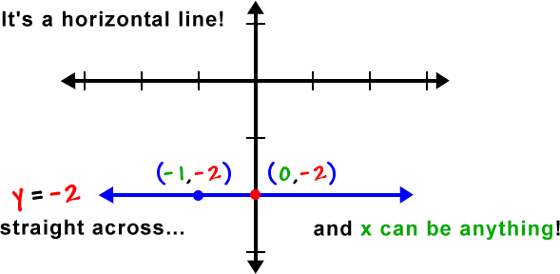
9.1 The Cartesian Coordinate System, Distance and Midpoint Formulas
In general, a horizontal line is of the form y = b, where b is a constant.

Slide 10
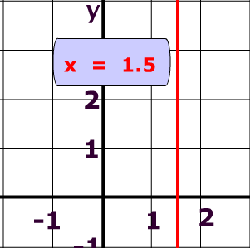
9.1 The Cartesian Coordinate System, Distance and Midpoint Formulas
In general, a vertical line is of the form x = a, where a is a constant.

Slide 11
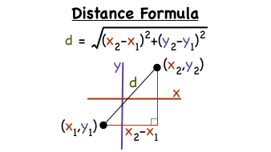
9.1 The Cartesian Coordinate System, Distance and Midpoint Formulas
Theorem 9.1: The distance between two points with coordinates (x₁, y₁) and (x₂, y₂) is determined with the formula

Slide 12
9.1 The Cartesian Coordinate System, Distance and Midpoint Formulas
Find the distance between
(0, 4) and (3, 8) (-1, 3) and ( 2, 9) (-5, 7) and (2, -1)

Slide 13
9.1 The Cartesian Coordinate System, Distance and Midpoint Formulas
Theorem 9.2: The midpoint of a line segment joining (x₁, y₁) and (x₂, y₂) is

Slide 14
9.1 The Cartesian Coordinate System, Distance and Midpoint Formulas
That is, the x-coordinate of the midpoint is the average of the x-coordinates of the two points, and the y-coordinate of the midpoint is the average of the y-coordinates of the points.
Find the midpoint of the segment joining
(0, 4) and (3, 8) (-1, 3) and ( 2, 9)
(-5, 7) and (2, -1)

Slide 15
9.2 Slope, Equation of a Line
Definition: Let P (x₁, y₁) and Q (x₂, y₂) be two points on a nonvertical line. The slope of the line is

Slide 16
9.2 Slope, Equation of a Line
Find the slope of the line passing through
(0, 4) and (3, 8) (-1, 3) and ( 2, 9) (-5, 7) and (2, -1)

Slide 17
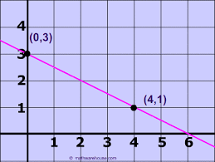
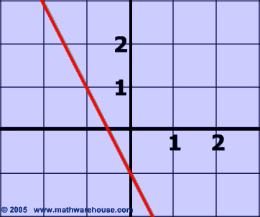
9.2 Slope, Equation of a Line
Find the slope of the given line.

Slide 18
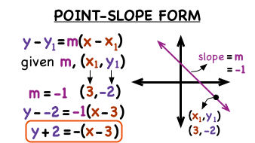
9.2 Slope, Equation of a Line
Definition: The equation of a line with slope m and passing through the point (x₁, y₁) is determined using the point-slope form

Slide 19
9.2 Slope, Equation of a Line
Find the equation of the line with slope -1 which passes through the point (-3, -5).
Find the equation of the line with slope ½ which passes through the point (-3, 4).
Find the equation of the line with slope 3 which passes through the point (-3, 0).

Slide 20
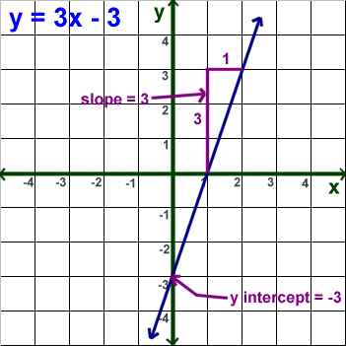
9.2 Slope, Equation of a Line
Definition: The equation of the line with slope m and y-intercept (0, b) is determined using the slope-intercept form y = mx + b.

Slide 21
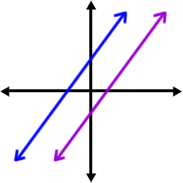
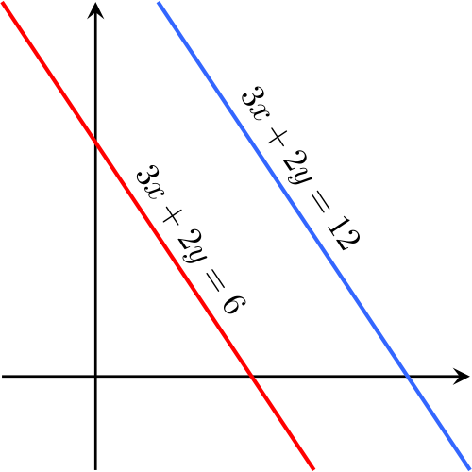
9.2 Slope, Equation of a Line
Theorem 9.3: Two distinct lines with slope m₁ and m₂ are parallel if and only if m₁ = m₂.

Slide 22
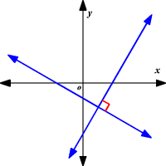
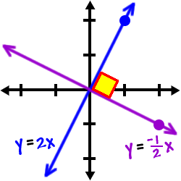
9.2 Slope, Equation of a Line
Theorem 9.4: Two distinct lines with slope m₁ and m₂ are perpendicular if and only if m₁m₂ = -1.

Slide 23
9.2 Slope, Equation of a Line
Determine whether the given pair of lines are parallel, perpendicular, or neither.
y = 2x + 3 x = 5
y = -2x ̶ 4 y = 5
3x ̶ 2y + 2 = 0 x ̶ 2y + 3 = 0 3x ̶ 2y ̶ 5 = 0 3x ̶ 6y ̶ 1 = 0

Slide 24
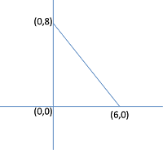
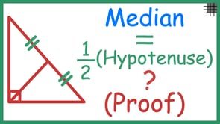
9.3 Proofs Involving Polygons
Theorem 5.16: The median from the right angle in a right triangle is one-half the length of the hypotenuse.

Slide 25
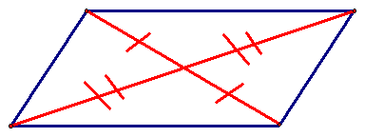
9.3 Proofs Involving Polygons
Theorem 4.4: The diagonals of a parallelogram bisect each other.

Slide 26
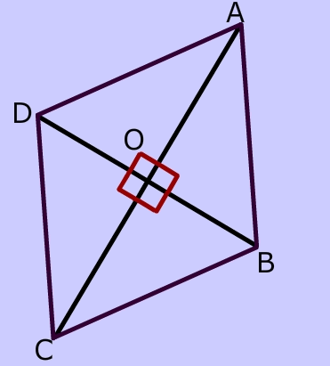
9.3 Proofs Involving Polygons
Theorem 4.4: The diagonals of a rhombus are perpendicular.

Slide 27
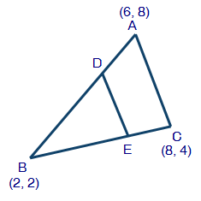
9.3 Proofs Involving Polygons
Theorem 4.19: The segment joining the midpoints of two sides of a triangle is parallel to the third side and its length is one-half the length of the third side.

