Slide 1
Math 3301 Foundations of Geometry
Chapter 8 Solid Geometry
Dr. Geoff F. Clement

Slide 2
8.1 Planes and Polyhedrons
Definition: A line is parallel to a plane if it does not intersect the plane.

Slide 3
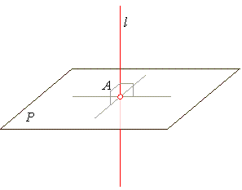
8.1 Planes and Polyhedrons
Definition: A line is perpendicular to a plane if each line in the plane that passes through the point of intersection is perpendicular to the line.

Slide 4
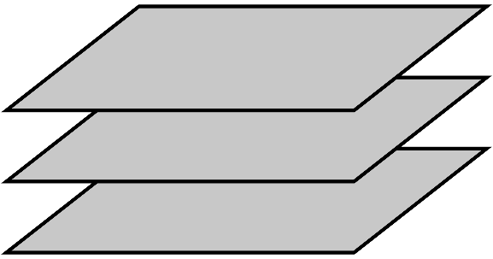
8.1 Planes and Polyhedrons
Definition: Two (or more) planes are parallel if they do not intersect.

Slide 5
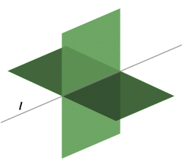
8.1 Planes and Polyhedrons
Postulate 8.1: The intersection of two distinct planes is a line.

Slide 6
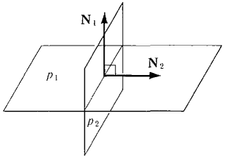
8.1 Planes and Polyhedrons
Definition: Two planes are perpendicular if either plane contains a line that is perpendicular to the other plane.

Slide 7
8.1 Planes and Polyhedrons
Definition: If two planes or a line and a plane intersect but are not perpendicular, they are called oblique.

Slide 8
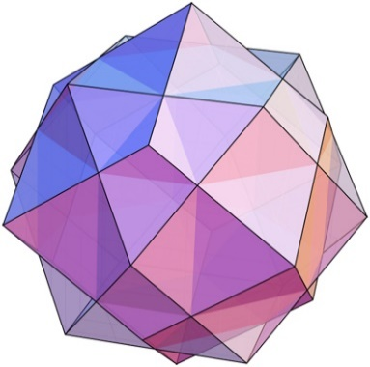
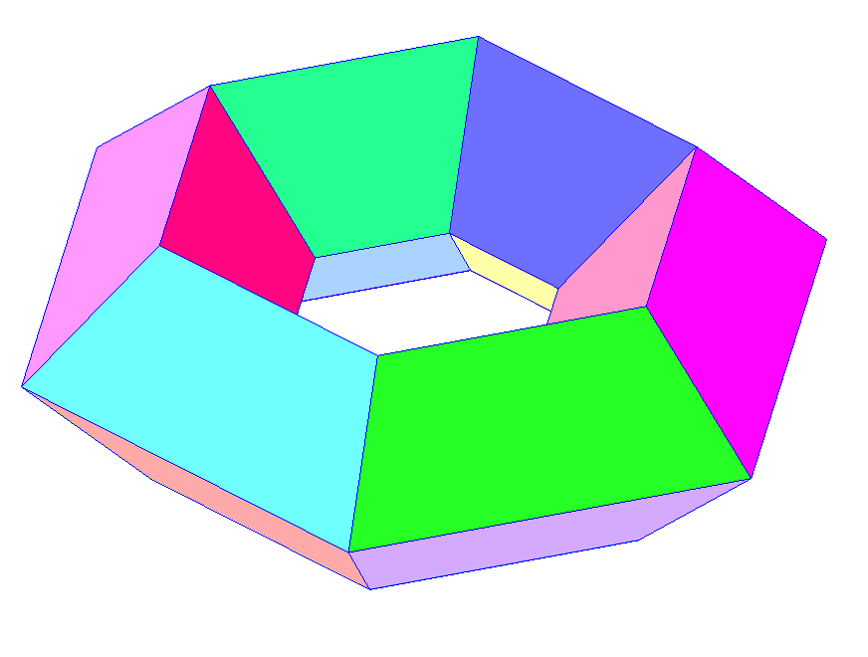
8.1 Planes and Polyhedrons
Definition: A solid formed by the intersection of planes is called a polyhedron.

Slide 9
8.1 Planes and Polyhedrons
Definition: A regular polyhedron is a solid figure in which all faces are congruent regular polygons.

Slide 10
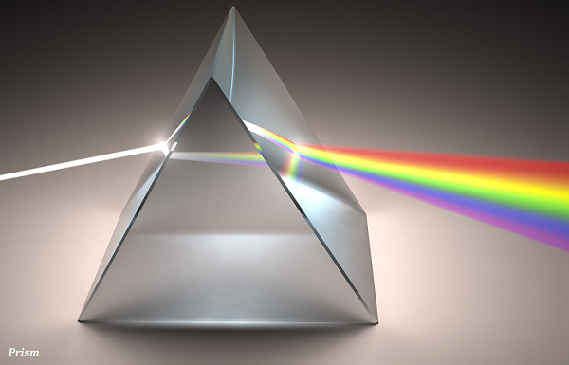
8.2 Prisms
Definition: The solid figure formed by joining two congruent polygonal regions in parallel planes is called a prism. The polygonal regions are called bases and the other surfaces are called lateral faces.

Slide 11
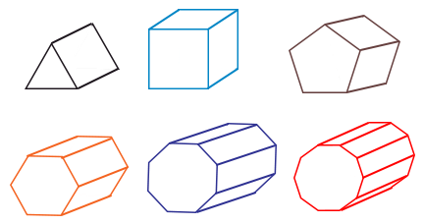
8.2 Prisms
Right prisms: Triangular, Square, Pentagonal, Hexagonal, Octagonal, Decagonal

Slide 12
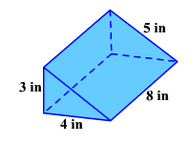
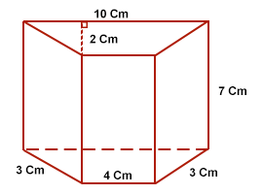
8.2 Prisms
Theorem 8.1: The lateral area (LA) of a right prism is determined with the formula LA = ph, where p is the perimeter of a base and h is the height of the prism.
The surface area (SA) is the total area of a prism and is determined with the formula SA = LA + 2B, where B represents the area of one base of the prism.

Slide 13
8.2 Prisms
Theorem 8.2: The volume of a right prism is determined with the formula V = Bh, where B is the area of a base and h is the height.

Slide 14
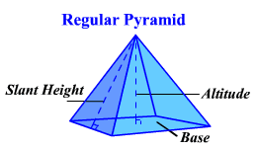
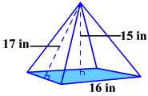
8.3 Pyramids
Theorem 8.3: The lateral area (LA) of a regular pyramid is determined with the formula LA = ½ pl, where p is the perimeter of a base and l is the slant height.
The surface area (SA) is the total area of a pyramid and is determined with the formula SA = LA + B, where B represents the area of the base.

Slide 15
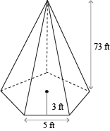
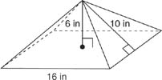
8.3 Pyramids
Theorem 8.4: The volume of a regular pyramid is determined with the formula V = ¹/₃ Bh, where B is the area of a base and h is the height.

Slide 16
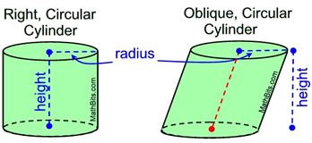
8.4 Cylinders and Cones
Definition: The solid figure formed by joining two congruent circles in parallel planes is called a cylinder.

Slide 17
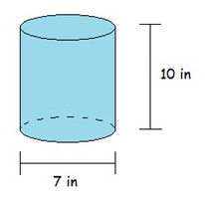
8.4 Cylinders and Cones
Theorem 8.5: The lateral area (LA) of a right circular cylinder is determined with the formula LA = Ch or 2πrh, where r is the radius of a base and h is the height, the length of the altitude.
The surface area (SA) is the total area of a right circular cylinder and is determined with the formula SA = LA + 2B or 2πrh + 2πr².

Slide 18
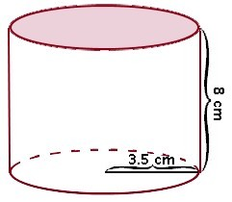
8.4 Cylinders and Cones
Theorem 8.6: The volume of a right circular cylinder is determined with the formula V = Bh or πr²h , where r is the radius of a base and h is the height.

Slide 19
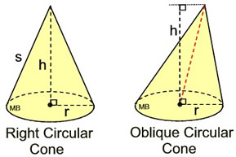
8.4 Cylinders and Cones
Definition: The solid figure formed by connecting a circle with a point (vertex) not in the plane is called a cone.

Slide 20
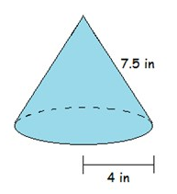
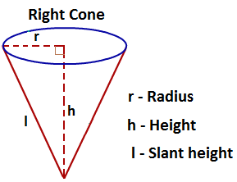
8.4 Cylinders and Cones
Theorem 8.7: The lateral area (LA) of a right circular cone is determined with the formula LA = πrl, where r is the radius of a base and l is the slant height.
The surface area (SA) is the total area of a right circular cone and is determined with the formula SA = LA + B or πrl + πr².

Slide 21
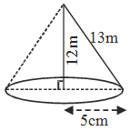
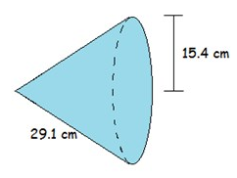
8.4 Cylinders and Cones
Theorem 8.6: The volume of a right circular cone is determined with the formula V = ¹/₃ Bh or ¹/₃ πr²h, where r is the radius of the base, B is the area of the base, and h is the height of the cone.

Slide 22
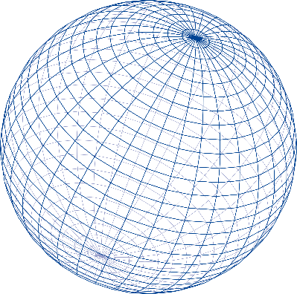
8.5 Spheres and Composite Figures
Definition: A sphere is the set of all points in space a given distance, called the radius, from a given point, called the center.

Slide 23
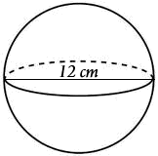
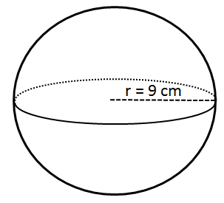
8.5 Spheres and Composite Figures
Postulate 8.2: For a sphere with radius r, the surface area is determined with the formula SA = 4πr² and the volume is determined with the formula V = ⁴/₃πr³.

Slide 24
8.5 Spheres and Composite Figures
If a plane is passed through the center of a sphere, two hemispheres are formed. A hemisphere is one-half a sphere.

Slide 25
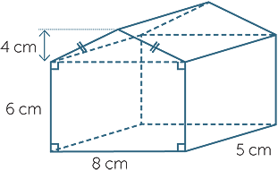
8.5 Spheres and Composite Figures
Find the surface area and volume of each figure.

Slide 26
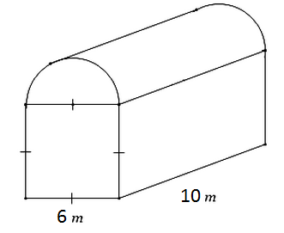
8.5 Spheres and Composite Figures
Find the surface area and volume of each figure.

Slide 27
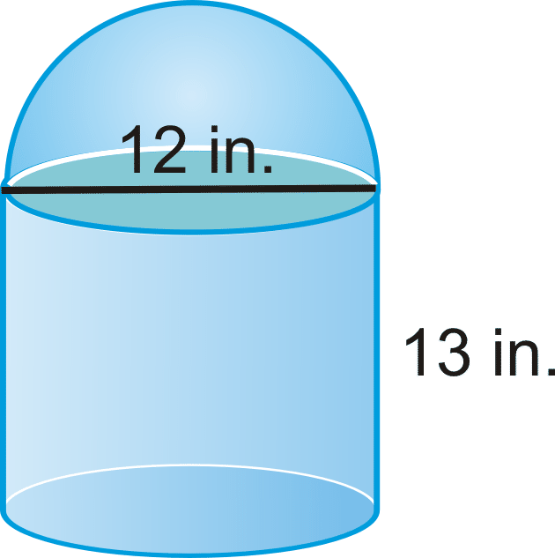
8.5 Spheres and Composite Figures
Find the surface area and volume of each figure.

Slide 28
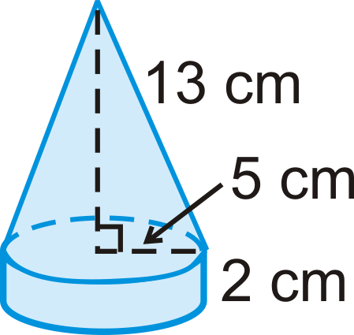
8.5 Spheres and Composite Figures
Find the surface area and volume of each figure.

