Slide 1
Math 3301 Foundations of geometry
Chapter 7 Areas of Polygons and Circles
Dr. Geoff F. Clement

Slide 2
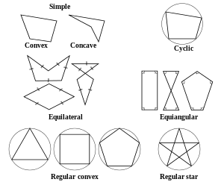
7.1 Areas of quadrilaterals

Slide 3
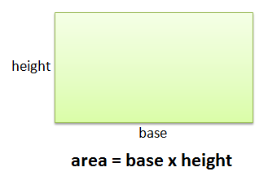
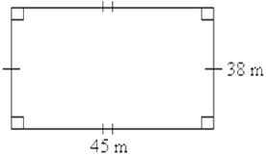
7.1 Areas of quadrilaterals
Postulate 7.1: The area of a rectangle with base b and height h is determined with the formula A = bh.

Slide 4
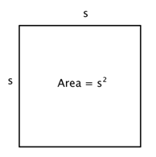
7.1 Areas of quadrilaterals
Corollary 7.1: The area of a square with sides of length s is determined with the formula A = s².

Slide 5
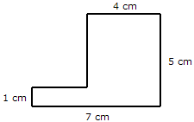
7.1 Areas of quadrilaterals
Postulate 7.2: If lines divide a given area into several smaller nonoverlapping areas, the given area is the sum of the smaller areas.
Postulate 7.3: Two congruent polygons have the same areas.

Slide 6
7.1 Areas of quadrilaterals
Definition: An altitude of a parallelogram is a segment from a vertex of the parallelogram perpendicular to a nonadjacent side (possibly extended). The length of the altitude is called the height of the parallelogram, and the side to which it is drawn is called the base of the parallelogram.
Theorem 7.2: The area of a parallelogram with base b and height h is determined with the formula A = bh.

Slide 7
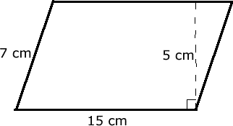
7.1 Areas of quadrilaterals
Find the area of the parallelogram.

Slide 8
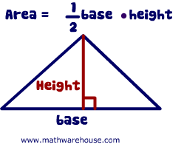
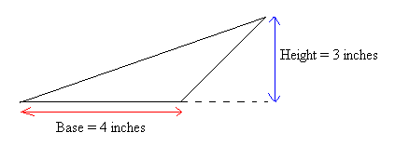
7.1 Areas of quadrilaterals
Theorem 7.3: The area of a triangle with base b and height h is determined with the formula A = ¹/₂ bh.

Slide 9
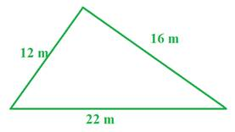
7.1 Areas of quadrilaterals
Theorem 7.4 (Heron’s Formula): If the three sides of a triangle have lengths a, b, and c, the area is , where s = ½(a + b + c).

Slide 10
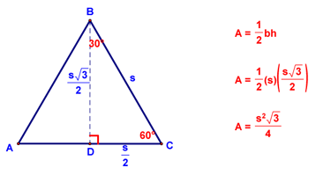
7.1 Areas of quadrilaterals
Corollary 7.5: The area of an equilateral triangle with sides of length a is

Slide 11
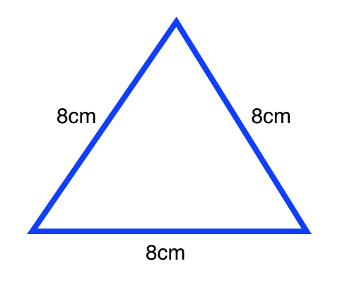
7.1 Areas of quadrilaterals
Find the area of the equilateral triangle shown below.

Slide 12
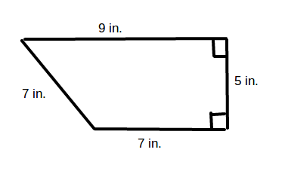
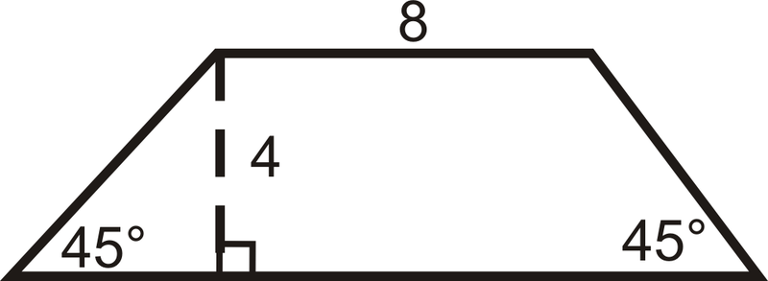
7.1 Areas of quadrilaterals
Theorem 7.6: The area of a trapezoid with length of bases b and b’ and height h is determined with the formula A = ½ (b + b’)h.

Slide 13
7.1 Areas of quadrilaterals
Theorem 7.7: The area of a rhombus with diagonals of length d and d’ is determined with the formula A = ¹/₂dd’.

Slide 14
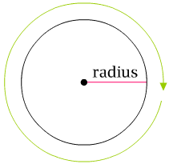
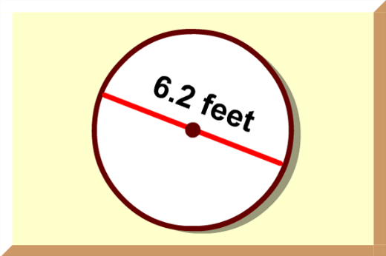
7.2 Circumference & Area of a Circle
Postulate 7.4: The circumference C of any circle with radius r and diameter d is determined with the formula C = 2πr = πd.

Slide 15
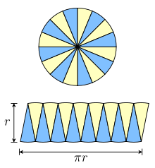
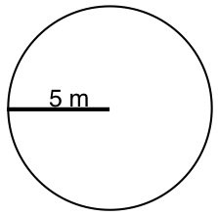
7.2 Circumference & Area of a Circle
Postulate 7.5: The area A of any circle with radius r is determined with the formula A= πr².

Slide 16
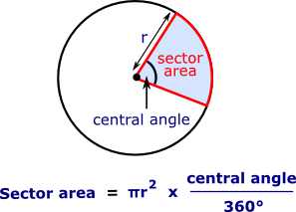
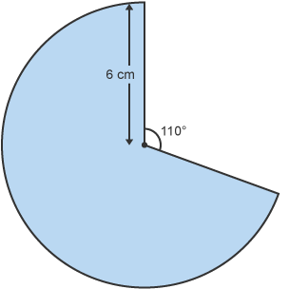
7.3 Area & Arc Length of a Sector
Definition: A sector of a circle is a region bounded by two radii of the circle and the arc of the circle determined by the radii.
Postulate 7.6: The area of a sector of a circle with radius r whose arc measures m° is determined with the formula A = ^{m}/₃₆₀ πr².

Slide 17
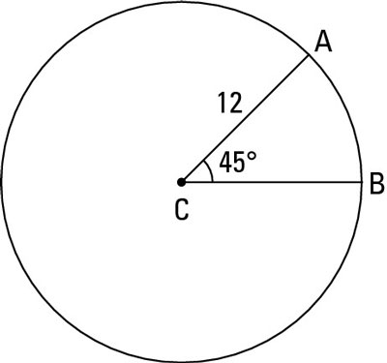
7.3 Area & Arc Length of a Sector
Postulate 7.6: The length of an arc measuring m° in a circle with radius r is determined with the formula L = ^{m}/₃₆₀ 2πr = ^{m}/₁₈₀ πr.
Find the length of
arc AB in the diagram.

Slide 18
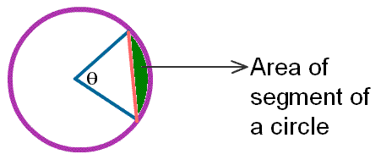
7.3 Area & Arc Length of a Sector
Definition: A segment of a circle is a region bounded by a chord of the circle and the arc formed by the chord.
Find the area of the sector
shown in the circle.

Slide 19
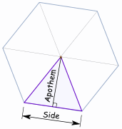
7.4 Area of regular polygons
Definition: An apothem of a regular polygon is a line segment from the center of the polygon perpendicular to one of its sides.
Theorem 7.8: Every apothem of a regular polygon has the same length.
Theorem 7.9: The apothem of a regular polygon bisects its respective side.

Slide 20
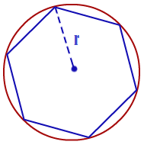
7.4 Area of regular polygons
Theorem 7.10: Every radius of a regular polygon bisects the angle at the vertex to which it is drawn.

Slide 21
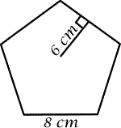
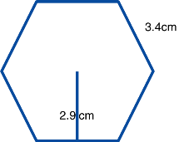
7.4 Area of regular polygons
Theorem 7.11: The area of a regular polygon with apothem of length a and perimeter p is determined with the formula A = ½ ap.

