Slide 1
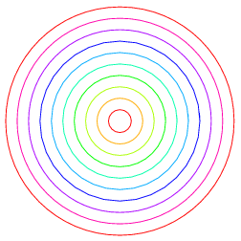
Math 3301 Foundations of Geometry
Chapter 6 Circles
Dr. Geoff F. Clement

Slide 2
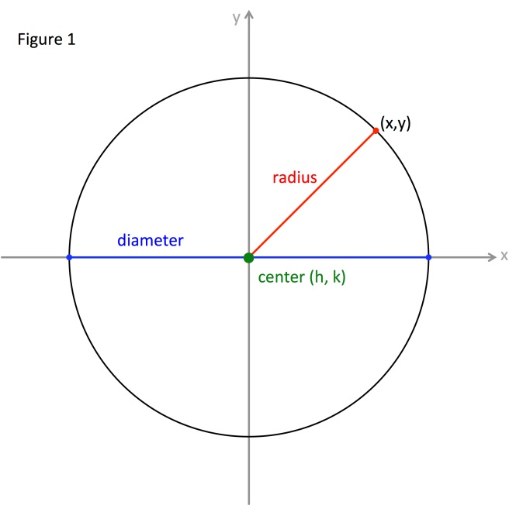
6.1 Circles and Arcs
Definition: A circle is the set of all points in a plane that are located a fixed distance from a fixed point called the center. A line segment joining the center of the circle to one of its points is called the radius of the circle.

Slide 3
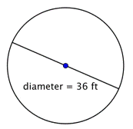
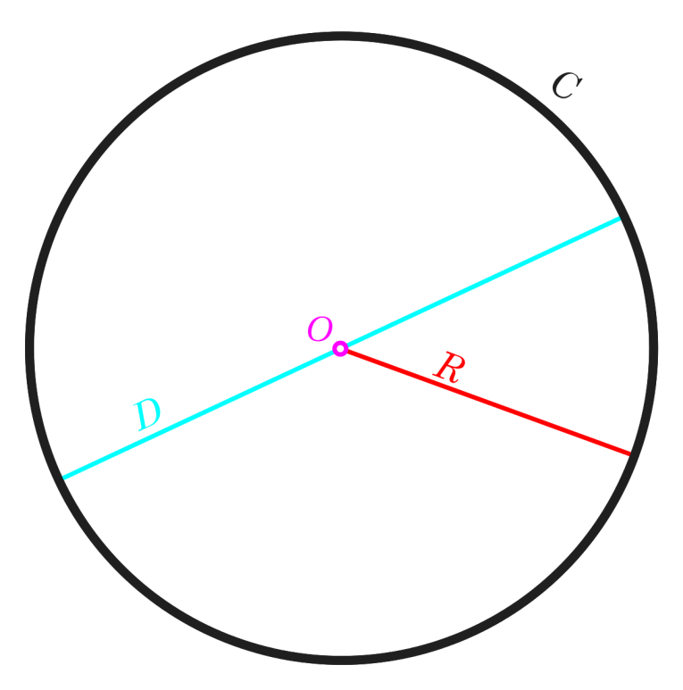
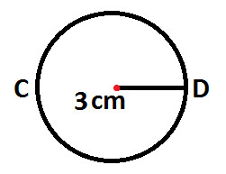
6.1 Circles and Arcs
Theorem 6.1: The diameter d of a circle is twice the radius r of the circle. That is, d = 2r.

Slide 4
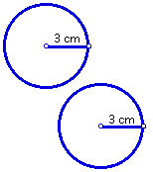
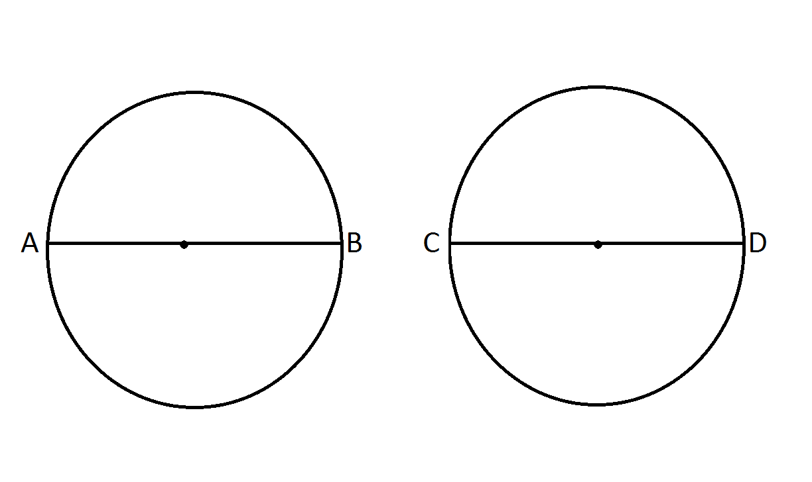
6.1 Circles and Arcs
Postulate 6.1 (Congruent Circles): If two circles are congruent, then their radii and diameters are congruent. Conversely, if the radii or diameters are congruent, then two circles are congruent.

Slide 5
6.1 Circles and Arcs
Definition: An arc of a circle forms a continuous part of the circle. An arc of a circle whose endpoints are the endpoints of a diameter of the circle is called a semicircle. An arc that is longer than a semicircle is called a major arc of the circle, and an arc that is shorter than a semicircle is called a minor arc of the circle.

Slide 6
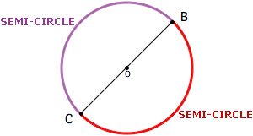
6.1 Circles and Arcs

Slide 7
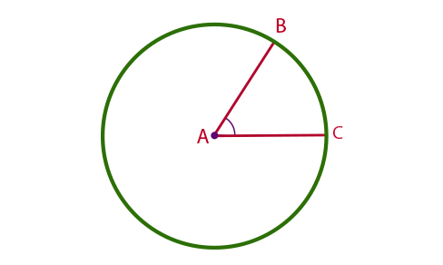
6.1 Circles and Arcs
Definition: An angle with sides that are radii of a circle and vertex the center of the circle is called a central angle.

Slide 8
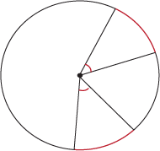
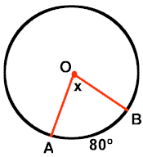
6.1 Circles and Arcs
Definition: The measure of an arc is the number of degrees in the central angle that intercepts the arc. Congruent arcs are arcs with equal measure.

Slide 9
6.1 Circles and Arcs
Postulate 6.2 (Arc Addition Postulate):

Slide 10
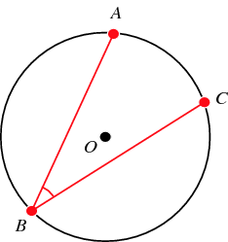
6.1 Circles and Arcs
Definition: An angle whose vertex is on a circle and whose sides intersect the circle in two other points is called an inscribed angle.

Slide 11
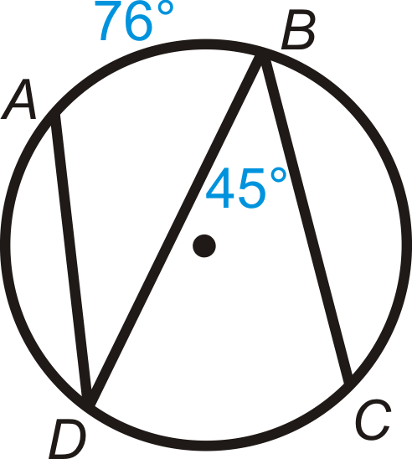
6.1 Circles and Arcs
Theorem 6.2: The measure of an inscribed angle is one-half the measure of its intercepted arc.

Slide 12
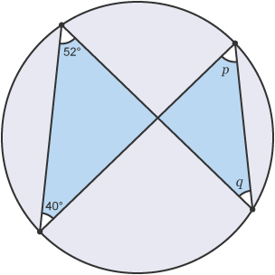
6.1 Circles and Arcs
Corollary 6.3: Inscribed angles that intercept the same or congruent arcs are congruent.

Slide 13
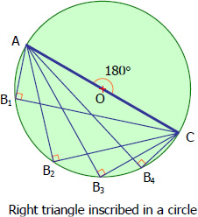
6.1 Circles and Arcs
Corollary 6.4: Every angle inscribed in a semicircle is a right angle.

Slide 14
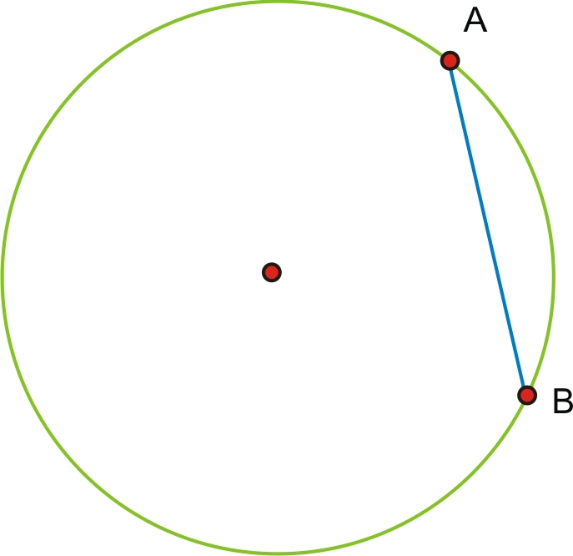
6.2 Chords and Secants
Definition: A line segment joining two distinct point on a circle is called a chord of the circle.

Slide 15
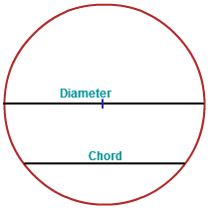
6.2 Chords and Secants
What is the longest chord in a circle?

Slide 16
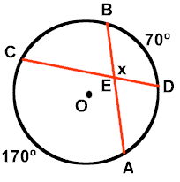
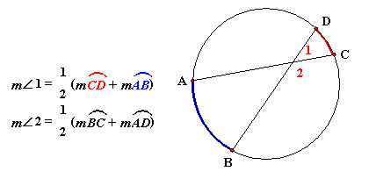
6.2 Chords and Secants
Theorem 6.5: When two chords of a circle intersect, the measure of each angle formed is one-half the sum of the measures of its intercepted arc and the arc intercepted by its vertical angle.

Slide 17
6.2 Chords and Secants
Theorem 6.6: In the same circle, the arcs formed by congruent chords are congruent.
Theorem 6.7: In the same circle, the chords formed by congruent arcs are congruent.

Slide 18
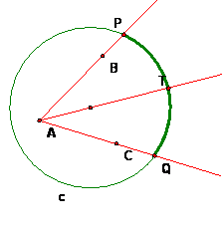
6.2 Chords and Secants
Definition: A line that divides an arc into two arcs with the same measure is called a bisector of the arc.

Slide 19
6.2 Chords and Secants
Theorem 6.8: A line drawn from the center of a circle perpendicular to a chord bisects the chord and the arc formed by the chord.

Slide 20
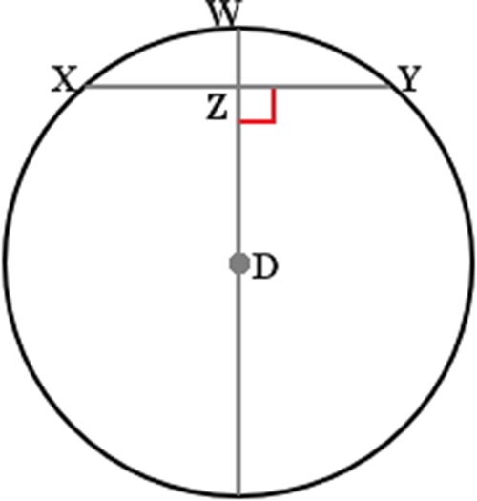
6.2 Chords and Secants
Theorem 6.9: A line drawn from the center of a circle to the midpoint of a chord (not a diameter) or to the midpoint of the arc formed by the chord is perpendicular to the chord.

Slide 21
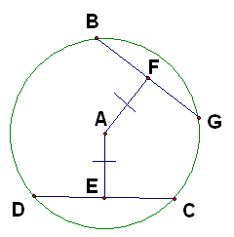
6.2 Chords and Secants
Theorem 6.10: In the same circle, congruent chords are equidistant from the center of the circle.

Slide 22
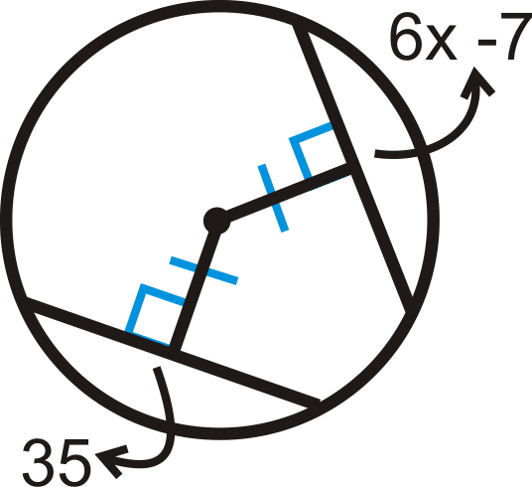
6.2 Chords and Secants
Theorem 6.11: In the same circle, chords equidistant from the center of the circle are congruent.

Slide 23
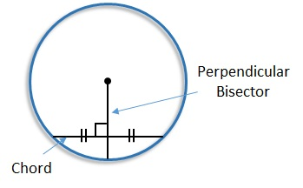
6.2 Chords and Secants
Theorem 6.12: The perpendicular bisector of a chord passes through the center of the circle.

Slide 24
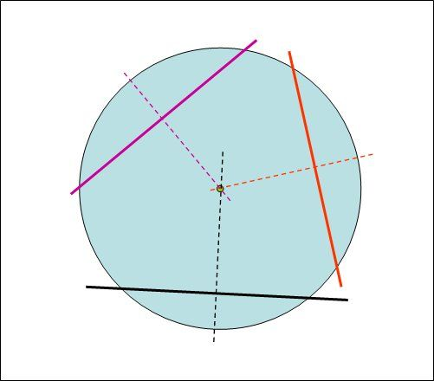
6.2 Chords and Secants
How to find the center of a circle …

Slide 25
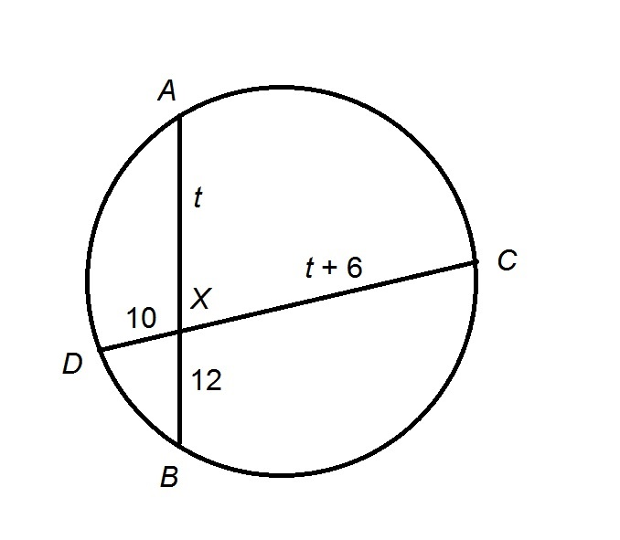
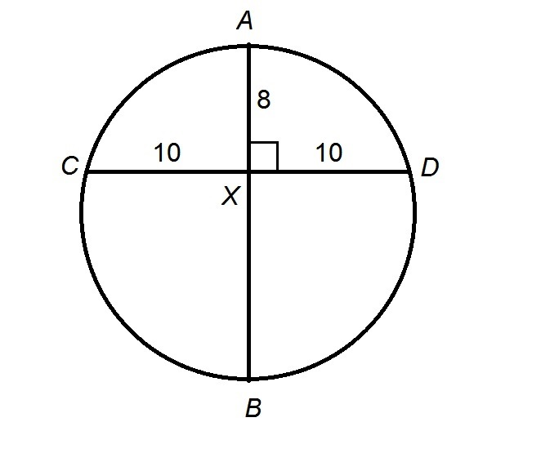
6.2 Chords and Secants
Theorem 6.13: If two chords intersect inside a circle, the product of the lengths of the segments on one chord is equal to the product of the lengths of the other chord.

Slide 26
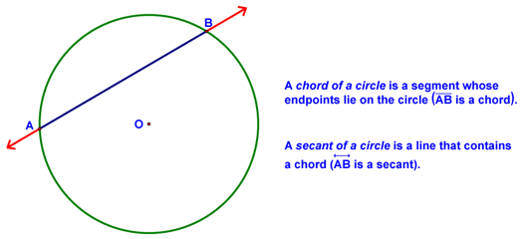
6.2 Chords and Secants
Definition: If a line intersects a circle in two points, the line is called a secant.

Slide 27
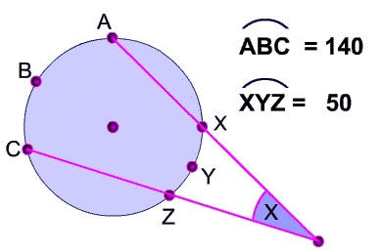
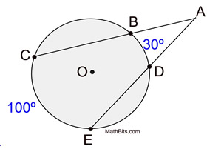
6.2 Chords and Secants
Theorem 6.14: If two secants intersect forming an angle outside the circle, then the measure of this angle is one-half the difference of the measures of the intercepted arcs.

Slide 28
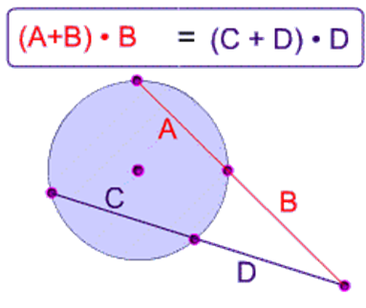
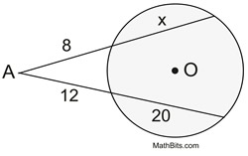
6.2 Chords and Secants
Theorem 6.15: If two secants are drawn to a circle from an exterior point, the product of the lengths of one secant segment and its external segment is equal to the product of the lengths of the other secant segment and its external segment.

Slide 29
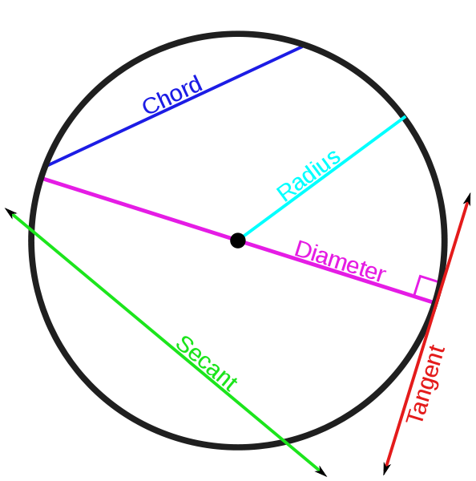
6.3 Tangents
Definition: If a line intersects a circle in one and only one point, the line is called a tangent to the circle. The point of intersection is called a point of tangency.

Slide 30
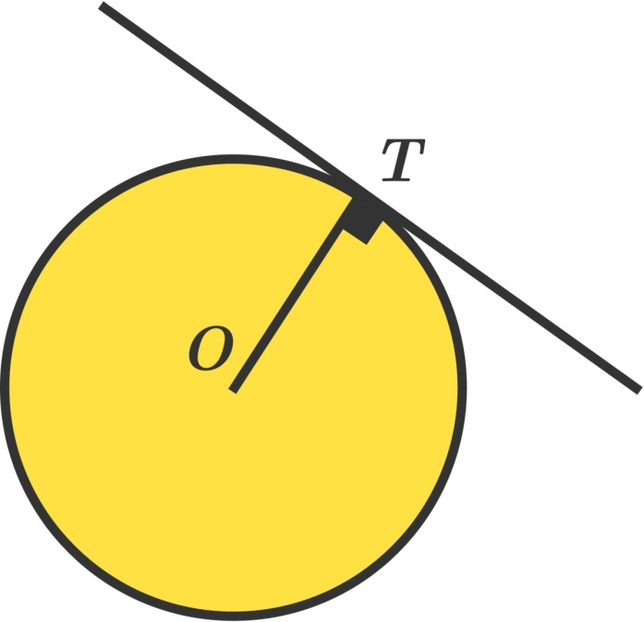
6.3 Tangents
Postulate 6.3: If a line is perpendicular to a radius of a circle and passes through the point where the radius intersects the circle, then the line is a tangent.

Slide 31
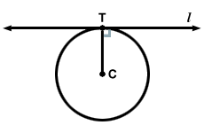
6.3 Tangents
Postulate 6.4: A radius drawn to the point of tangency of a tangent is perpendicular to the tangent.

Slide 32
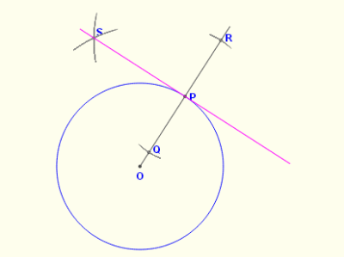
6.3 Tangents
Construction 6.1: Construct a tangent to a circle at a given point on the circle.

Slide 33
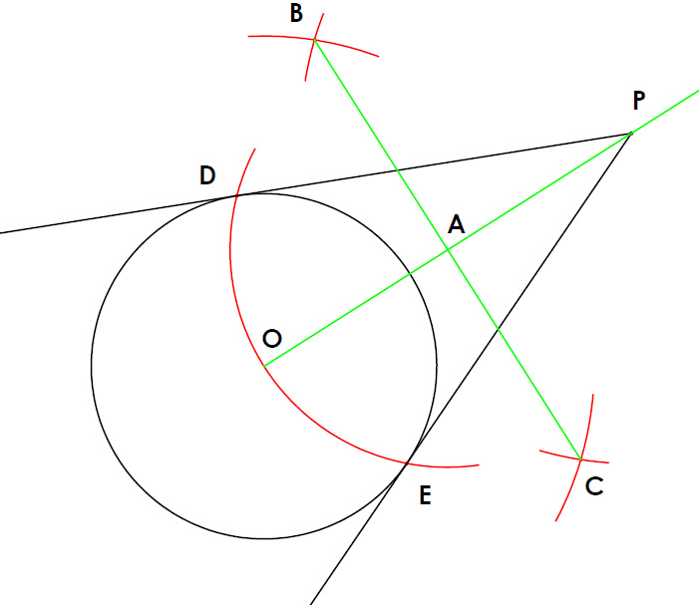
6.3 Tangents
Construction 6.2: Construct a tangent to a circle from a point outside the circle.

Slide 34
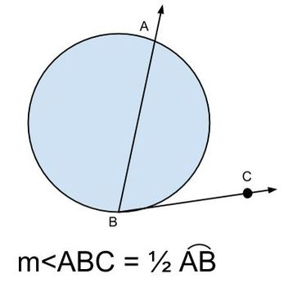
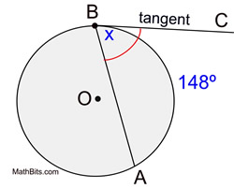
6.3 Tangents
Theorem 6.16: The angle formed by a tangent and a chord has a measure one-half the measure of its intercepted arc.

Slide 35
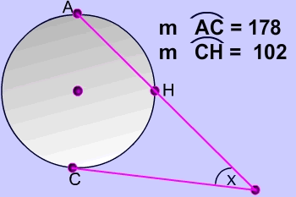
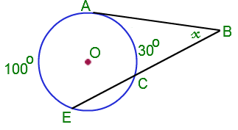
6.3 Tangents
Theorem 6.17: The angle formed by the intersection of a tangent and a secant has a measure one-half the difference of the measures of the intercepted arcs.

Slide 36
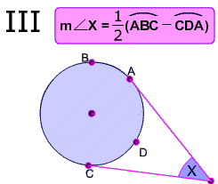
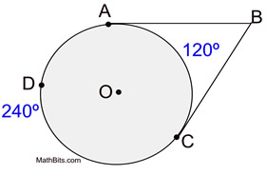
6.3 Tangents
Theorem 6.18: The angle formed by the intersection of two tangents has a measure one-half the difference of the measures of the intercepted arcs.

Slide 37
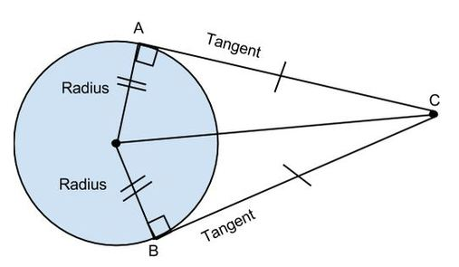
6.3 Tangents
Theorem 6.19: Two tangent segments to a circle from the same point have equal lengths.

Slide 38
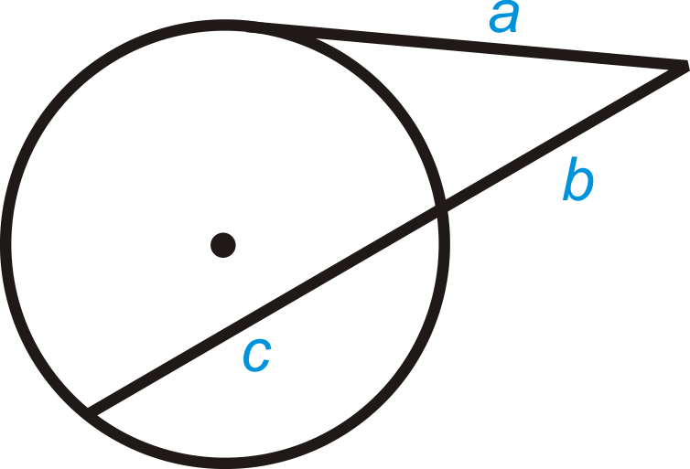
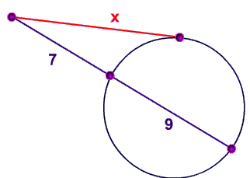
6.3 Tangents
Theorem 6.20: If a secant and a tangent are drawn to a circle from an external point, the length of the tangent segment is the geometric mean between the length of the secant segment and the external segment.
a² = b(b + c)

Slide 39
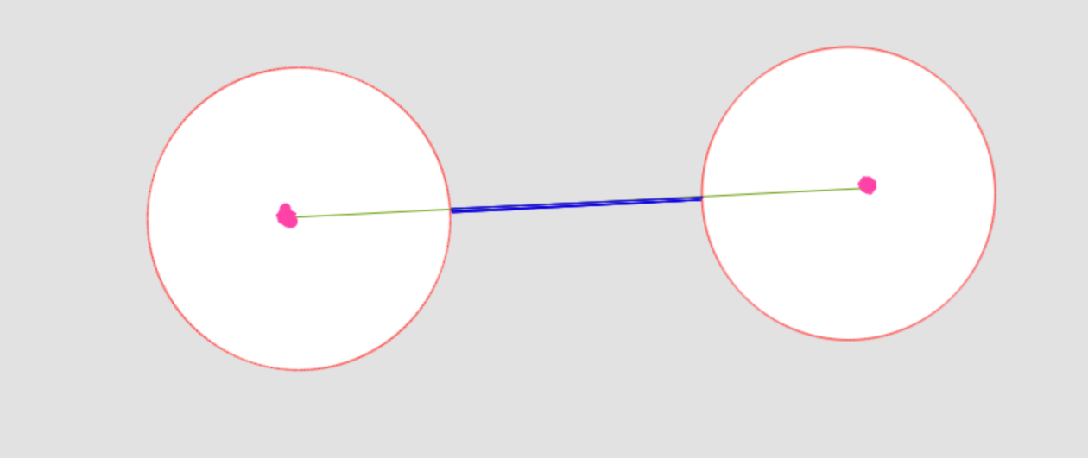
6.3 Tangents
Definition: The line passing through the centers of two circles is called their line of centers.

Slide 40
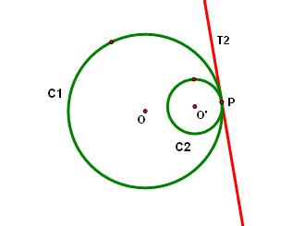
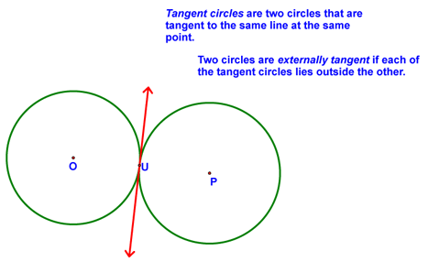
6.3 Tangents
Theorem 6.21: If two circles are tangent internally or externally, the point of tangency is on their line of centers.

Slide 41
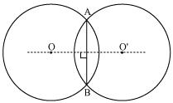
6.3 Tangents
Theorem 6.22: If two circles intersect in two points, then their line of centers is the perpendicular bisector of their common chord.

Slide 42
6.3 Tangents
Construction 6.3: Construct a common external tangent to two given circles that are not congruent.

Slide 43
6.3 Tangents
Construction 6.4: Construct a common internal tangent to two given circles.

Slide 44
6.4 Circles and Regular Polygons
Definition: If a polygon has its vertices on circle, the polygon is inscribed in the circle, and the circle is circumscribed around the polygon. If each side of a polygon is tangent to a circle, the polygon is circumscribed around the circle, and the circle is inscribed in the polygon.

Slide 45
6.4 Circles and Regular Polygons

Slide 46
6.4 Circles and Regular Polygons
Theorem 6.23: If a quadrilateral is inscribed in a circle, the opposite angles are supplementary.

Slide 47
6.4 Circles and Regular Polygons
Theorem 6.24: If a parallelogram is inscribed in a circle, then it is a rectangle.

Slide 48
6.4 Circles and Regular Polygons
Theorem 6.25: If a circle is divided into n equal arcs, n >2, then the chords formed by these arcs form a regular n-gon.

Slide 49
6.4 Circles and Regular Polygons
Theorem 6.26: If a circle is divided into n equal arcs, n > 2, and tangents are constructed to the circle at the endpoints of each arc, then the figure formed by these tangents is a regular n-gon.

Slide 50
6.4 Circles and Regular Polygons
Construction 6.5: Construct a circle that is circumscribed around a given regular polygon.

Slide 51
6.4 Circles and Regular Polygons
Construction 6.6: Construct a circle that is inscribed in a given regular polygon.

Slide 52
6.4 Circles and Regular Polygons
Definition: The center of a regular polygon is the center of the circle circumscribed around the polygon.
Definition: A radius of a regular polygon is the segment joining the center of the polygon to one of its vertices.

Slide 53
6.4 Circles and Regular Polygons
Theorem 6.27: All radii of a regular polygon are equal in length.

Slide 54
6.4 Circles and Regular Polygons
Definition: A central angle of a regular polygon is an angle formed by two radii to two adjacent vertices.

Slide 55
6.4 Circles and Regular Polygons
Theorem 6.28: All central angles of a regular polygon have the same measure.
Theorem 6.29 The measure a of each central angle in a regular n-gon is determined with the formula a = ^{360°}/_{n} .

Slide 56
6.4 Circles and Regular Polygons
Find the measure of
each central angle.

Slide 57
6.4 Circles and Regular Polygons
Find the number of sides in a regular polygon if each central angle measures: 30° 18°
Find the measure of each central angle in a regular
decagon hexagon

