Slide 1
Math 3301 Foundations of Geometry
Chapter 5 Similar Polygons and the Pythagorean Theorem
Dr. Geoff F. Clement

Slide 2
5.1 Ratios and Proportions
Definition: The ratio of one number a to another number b, b ≠ 0, can be expressed as the fraction a/b. The ratio a to b is sometimes also written as a:b and read “a is to b” or “a to b”.
Examples: 36 students to 2 teachers 15 hits in 50 at bats 1500 miles in 2.5 hours 12 boys and 17 girls 155 miles on 3 gallons of gas 3 pennies & 4 dimes $8.98 for 4 pounds of steak

Slide 3
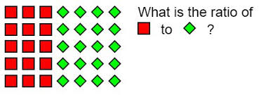
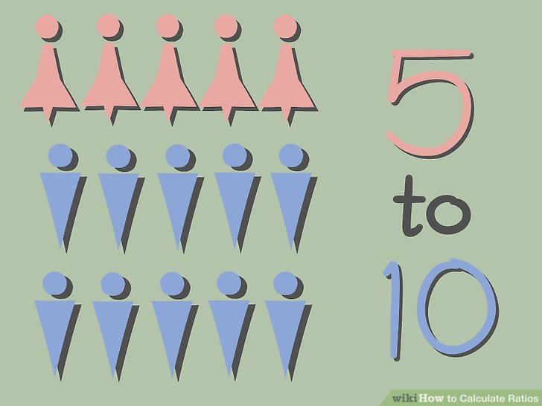
5.1 Ratios and Proportions
Simplify each ratio.

Slide 4
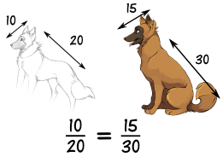
5.1 Ratios and Proportions
Definition: An equation showing that two ratios are equal is called a proportion.

Slide 5
5.1 Ratios and Proportions
Terms of a proportion:
Consider the proportion ª/_{b}= ^{c}/_{d}. The numbers a and b are called extremes, and b and c are called means of the proportion.

Slide 6
5.1 Ratios and Proportions
Definition: In the proportion ª/_{b}= ^{b}/_{c} , b is called the geometric mean or mean proportional between a and c.

Slide 7
5.1 Ratios and Proportions
Find the geometric mean between
6 and 54 →→→→→→→→
4 and 36
5 and 20
10 and 200

Slide 8
5.1 Ratios and Proportions
Theorem 5.1 (The Means-Extremes Property):
In any proportion, the product of the means is equal to the product of the extremes. That is,

Slide 9
5.1 Ratios and Proportions
Show that the product of the means equals the product of the extremes. Solve each proportion for the variable.

Slide 10
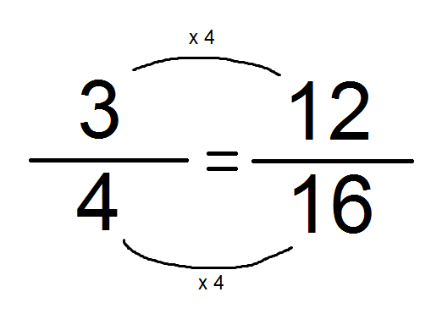
5.1 Ratios and Proportions
Theorem 5.2 (Reciprocal Property of Proportions): The reciprocals of both sides of a proportion are also proportional. That is, if ª/_{b}= ^{c}/_{d} , then ^{b}/_{a}= ^{d}/_{c} .

Slide 11
5.1 Ratios and Proportions
Theorem 5.3 (Means Property of Proportions): If the means are interchanged in a proportion, a new proportion is formed. That is, if ª/_{b}= ^{c}/_{d} , then ª/_{c}= ^{b}/_{d} .
Theorem 5.4 (Extremes Property of Proportions): If the means are interchanged in a proportion, a new proportion is formed. That is, if ª/_{b}= ^{c}/_{d} , then ^{d}/_{b}= ^{c}/_{a} .

Slide 12
5.1 Ratios and Proportions
Theorem 5.5 (Addition Property of Proportions): If the denominators in a proportion are added to their respective numerators, a new proportion is formed. That is, if ª/_{b}= ^{c}/_{d} , then ^{a+b}/_{b}= ^{c+d}/_{d} .
Theorem 5.6 (Subtraction Property of Proportions): If the denominators in a proportion are subtracted from their respective numerators, a new proportion is formed. That is, if ª/_{b}= ^{c}/_{d} , then
^{a ̶ b}/_{b}= ^{c ̶ d}/_{d} .

Slide 13
5.1 Ratios and Proportions
Theorem 5.7: If a, b, c, d, e, and f are numbers satisfying
ª/_{b}= ^{c}/_{d} = ^{e}/_{f} , then ^{a+c+e}/_{b+d+f} = ª/_{b} .

Slide 14
5.1 Ratios and Proportions
Definition (Proportional Segments): If the lengths of segments are proportional, the segments are called proportional segments. That is, segments AB and CD are proportional to segments EF and GH when
^{AB}/_{CD}= ^{EF}/_{GH .}

Slide 15
5.1 Ratios and Proportions
A baseball pitcher gave up 60 earned runs in 180 innings. How many earned runs did he give up every 9 innings. You are calculating the pitchers earned run average (ERA).
The sides of a triangle are in the ratio of 3:4:5. If the perimeter is 90 cm, find the length of each side.

Slide 16
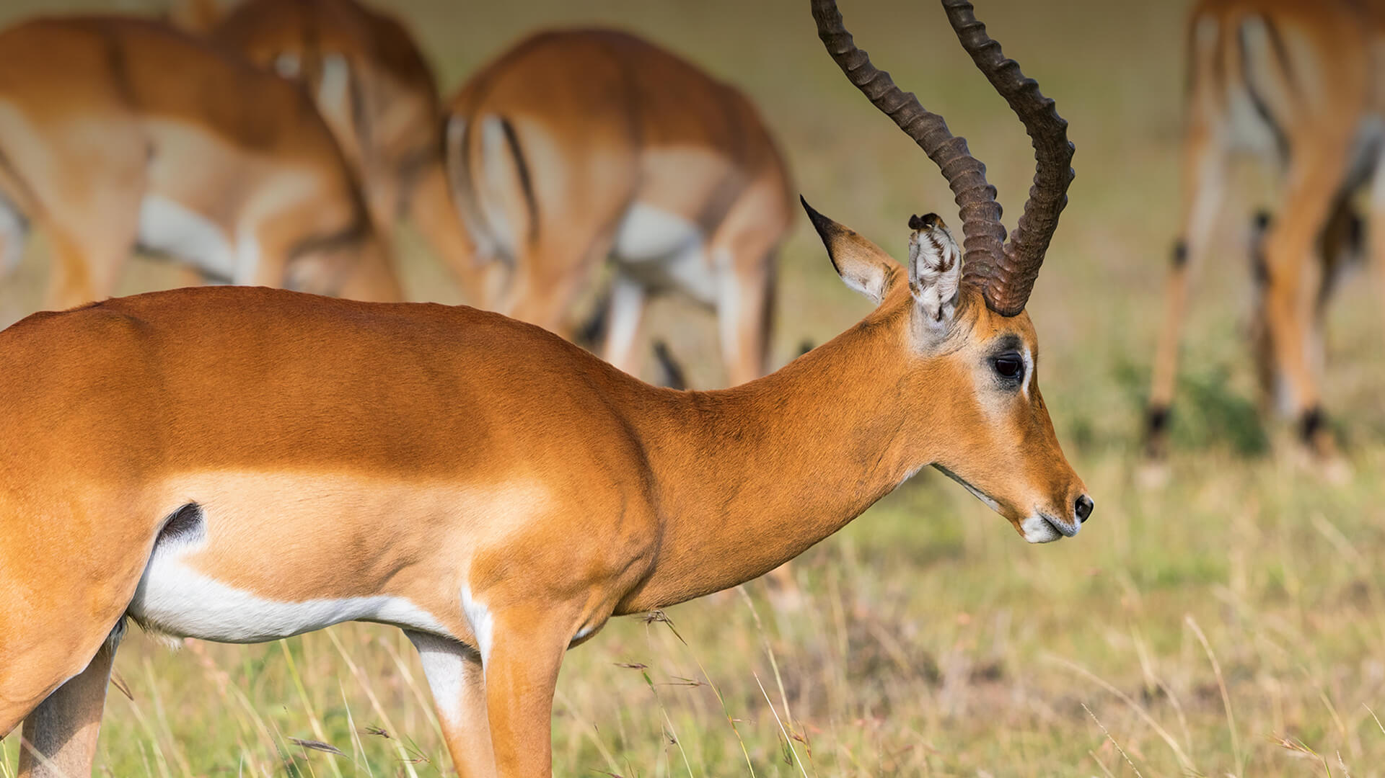
5.1 Ratios and Proportions
A ranger wants to estimate the number of antelope in a preserve. He catches 58 antelope, tags their ears, and returns them to the preserve. Some time later, he catches 29 antelope and discovers that 7 of them are tagged. Estimate the number of antelope in the preserve.

Slide 17
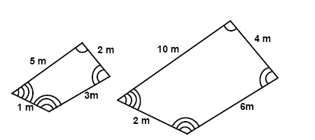
5.2 Similar Polygons
Definition: Two polygons are similar if their vertices can be paired in such a way that corresponding angles are congruent and corresponding sides are proportional.

Slide 18
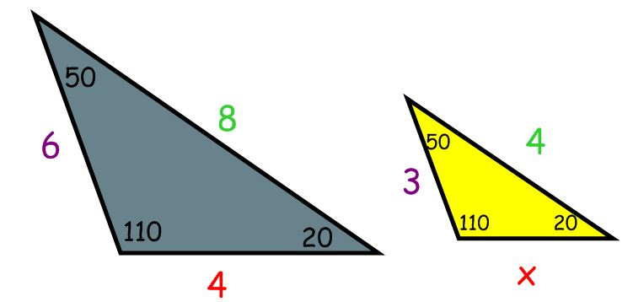
5.2 Similar Polygons
Postulate 5.1 (AAA or Angle-Angle-Angle): Two triangles are similar if three angles of one triangle are congruent to the corresponding three angles of another triangle.

Slide 19
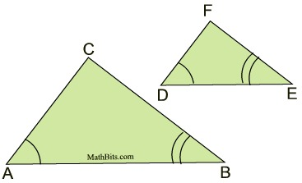
5.2 Similar Polygons
Theorem 5.8 (AA or Angle-Angle): Two triangles are similar if two angles of one triangle are congruent to the corresponding two angles of the other triangle.

Slide 20
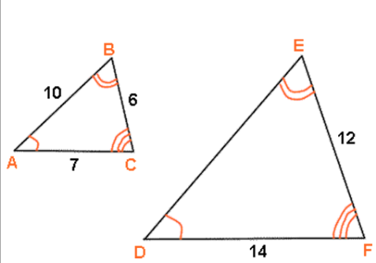
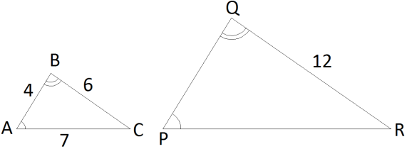
5.2 Similar Polygons
Find the missing lengths.

Slide 21
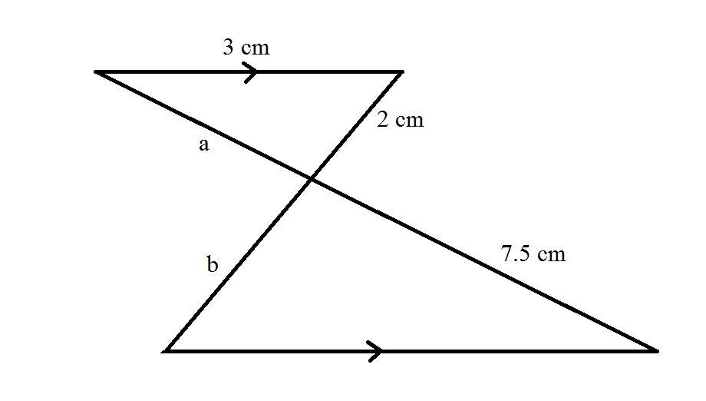
5.2 Similar Polygons
Find the missing lengths.

Slide 22
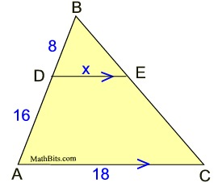
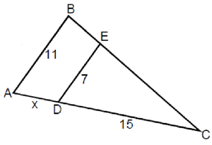
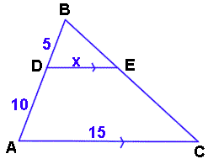
5.2 Similar Polygons
Solve for x.

Slide 23
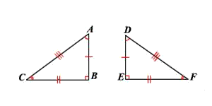
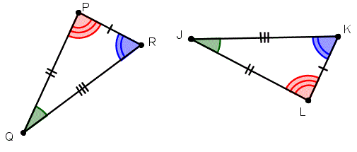
5.2 Similar Polygons
Theorem 5.9: If ∆ABC ∆DEF, then ∆ABC ~ ∆DEF.

Slide 24
5.2 Similar Polygons
Theorem 5.10 (Transitive Law for Similar Triangles): If ∆ABC ~ ∆DEF and ∆DEF ~ ∆GHI , then ∆ABC ~ ∆GHI.

Slide 25
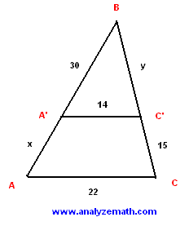
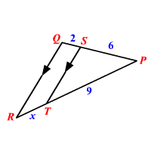
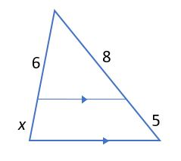
5.2 Similar Polygons
Theorem 5.11 (Triangle Proportionality Theorem): A line parallel to one side of a triangle that intersects the other two sides divides the two sides into proportional segments.

Slide 26
5.2 Similar Polygons
Construction 5.1: Construct a segment proportional to three given line segments.

Slide 27
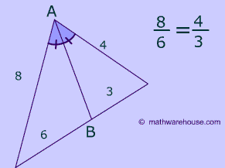
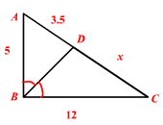
5.2 Similar Polygons
Theorem 5.12 (Triangle Angle-Bisector Theorem): The bisector of one angle of a triangle divides the opposite side into segments that are proportional to the other two sides.

Slide 28
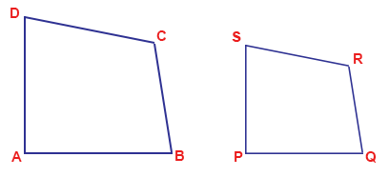
5.2 Similar Polygons
Construction 5.2: Construct a polygon similar to a given polygon.
Hint: Triangulate the polygon, then copy two angles from each triangle.

Slide 29
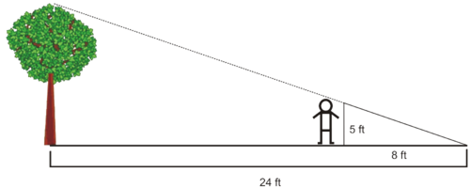
5.2 Similar Polygons
Use similar triangles to find the height of the tree to the nearest tenth of a foot.

Slide 30
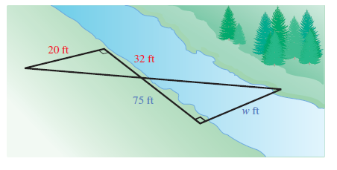
5.2 Similar Polygons
Use similar triangles to find the distance across the river to the nearest tenth of a foot.

Slide 31
5.3 Properties of Right Triangles
Theorem 5.13: The altitude from the right angle to the hypotenuse in a right triangle forms two right triangles that are similar to each other and to the original triangle.

Slide 32
5.3 Properties of Right Triangles
Corollary 5.14: The altitude from the right angle to the hypotenuse in a right triangle is the geometric mean or mean proportional between the segments of the hypotenuse.

Slide 33
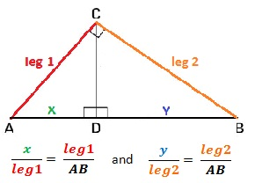
5.3 Properties of Right Triangles
Corollary 5.15: If the altitude is drawn from the right angle to the hypotenuse in a right triangle, then each leg is the geometric mean or mean proportional between the hypotenuse and the segment of the hypotenuse adjacent to the leg.

Slide 34
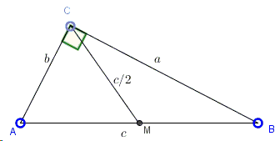
5.3 Properties of Right Triangles
Theorem 5.16: The median from the right angle in a right triangle is one-half the length of the hypotenuse.

Slide 35
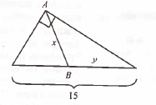
5.3 Properties of Right Triangles
Solve the following right triangles for the missing lengths.
Note: Segment AB is a median.

Slide 36
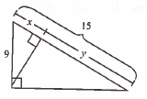
5.3 Properties of Right Triangles
Solve the following right triangles for the missing lengths.

Slide 37
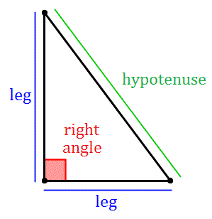
5.4 The Pythagorean Theorem
Theorem 5.17 (The Pythagorean Theorem): In a right triangle, the square of the length of the hypotenuse is equal to the sum of the squares of the lengths of the legs.

Slide 38
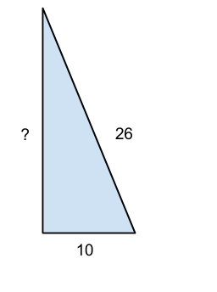
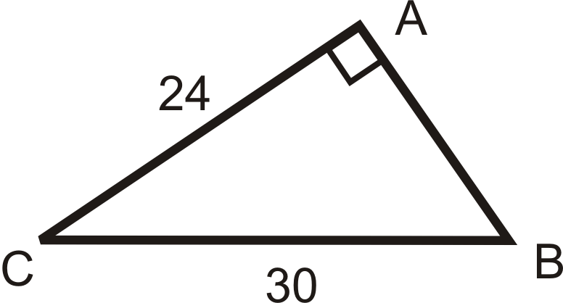
5.4 The Pythagorean Theorem
Find the missing side lengths.

Slide 39
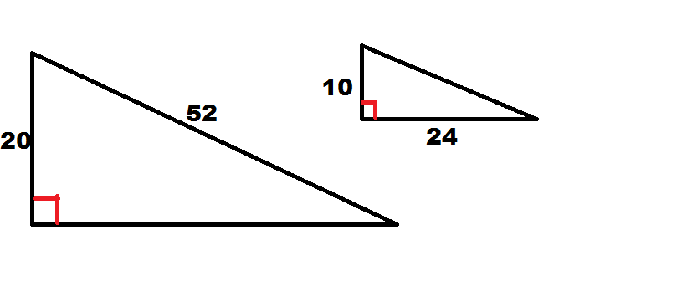
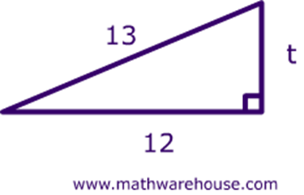
5.4 The Pythagorean Theorem
Find the missing side lengths.

Slide 40
5.4 The Pythagorean Theorem
Assume angle C measures 90˚ in each right triangle ABC.
If c = 35 ft and a = 18 ft, find the length of b.
If c = 3.2 m and b = 1.4 m, find the length of a.
If a = 24 cm and b = 8 cm, find the length of c.

Slide 41
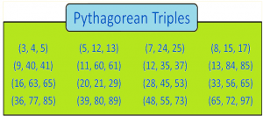
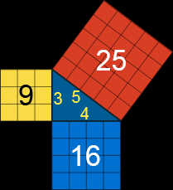
5.4 The Pythagorean Theorem

Slide 42
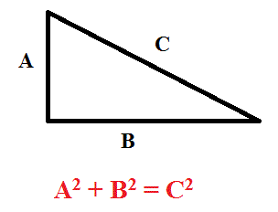
5.4 The Pythagorean Theorem
Theorem 5.18 (Converse of the Pythagorean Theorem):
If the sides of a triangle have lengths a, b, and c, and a² + b² = c², then the triangle is a right triangle.

Slide 43
5.4 The Pythagorean Theorem
Determine whether the triangle with the given side lengths is a right triangle.
(1)4 ft, 8ft, and 9 ft (2) 15 cm, 20 cm, and 25 cm
(3) (4)

Slide 44
5.4 The Pythagorean Theorem
Theorem 5.19 (45˚-45˚-90˚ Theorem):
In a 45˚-45˚-90˚ triangle, the hypotenuse is times as long as each (congruent) leg.

Slide 45
5.4 The Pythagorean Theorem
Theorem 5.20 (30˚-60˚-90˚ Theorem):
In a 30˚-60˚-90˚ triangle, the length of the hypotenuse is twice the length of the short leg, and the length of the longer leg is times as long as the length of the short leg.

Slide 46
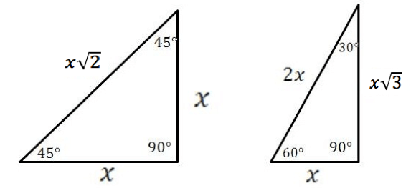
5.4 The Pythagorean Theorem
Special cases of the Pythagorean Theorem:

Slide 47
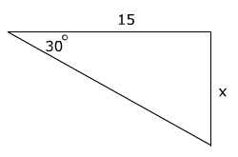
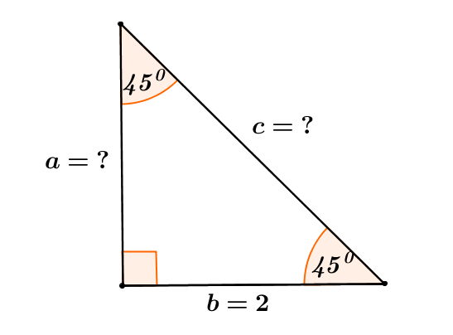
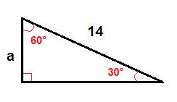
5.4 The Pythagorean Theorem
Solve the following special right triangles.

Slide 48
5.4 The Pythagorean Theorem
If a rectangular table has sides of 8 ft and 4 ft, what is the length of its diagonal? Round to the nearest tenth of a foot.
A 400-ft tower has a guy wire attached to it that makes a 60˚ angle with level ground. How far from the base of the tower is the cable anchored? Round to the nearest tenth of a foot.

