Slide 1
Math 3301 Foundations of Geometry
Chapter 4 Quadrilaterals
Dr. Geoff F. Clement

Slide 2
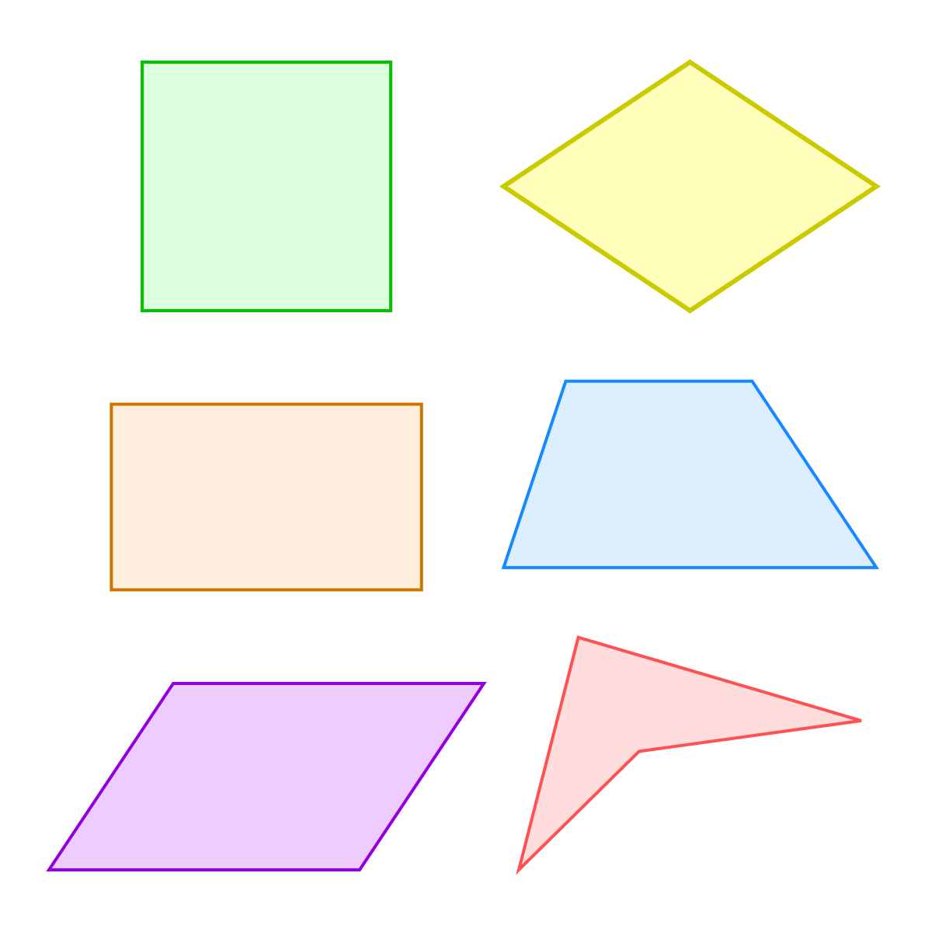
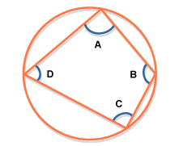
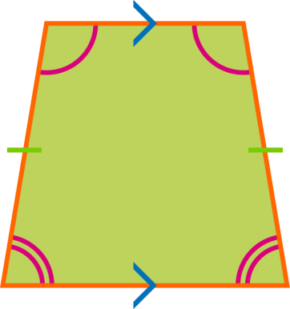
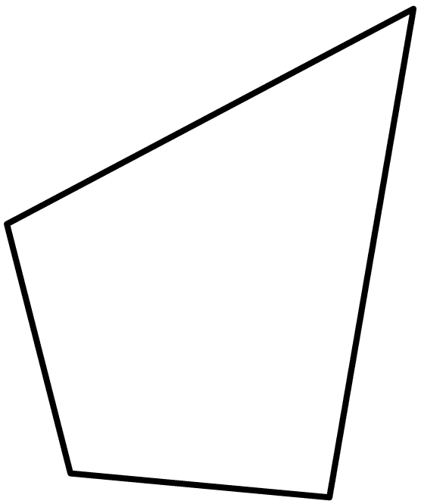

Slide 3
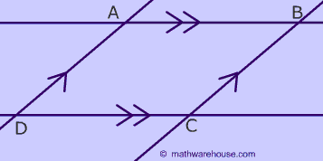
4.1 Parallelograms
Definition: A parallelogram is a quadrilateral whose opposite sides are parallel.

Slide 4
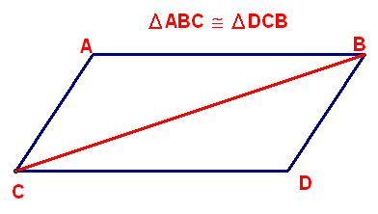
4.1 Parallelograms
Theorem 4.1: Each diagonal divides a parallelogram into two congruent triangles.

Slide 5
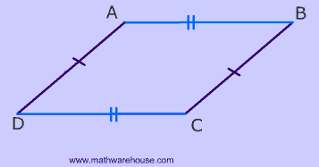
4.1 Parallelograms
Corollary 4.2: The opposite sides and the opposite angles of a parallelogram are congruent.

Slide 6
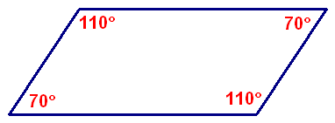
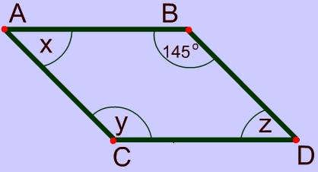
4.1 Parallelograms
Theorem 4.3: Consecutive angles of a parallelogram are supplementary.
Find x, y, and z.

Slide 7
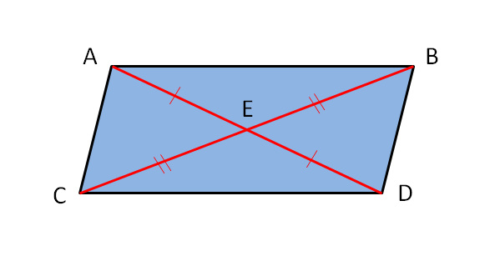
4.1 Parallelograms
Theorem 4.4: The diagonals of a parallelogram bisect each other.

Slide 8
4.1 Parallelograms
Summary: Properties of a Parallelogram
Opposite sides are parallel.
Each diagonal divides it into two congruent triangles.
Opposite sides are congruent.
Opposite angles are congruent.
Consecutive angles are supplementary.
Diagonals bisect each other.

Slide 9
4.1 Parallelograms
Theorem 4.5: If both pairs of opposite sides of a quadrilateral are congruent, then the quadrilateral is a parallelogram.
Theorem 4.6: If both pairs of opposite angles of a quadrilateral are congruent, then the quadrilateral is a parallelogram.
Theorem 4.7: If two opposite sides of a quadrilateral are congruent and parallel, then the quadrilateral is a parallelogram.

Slide 10
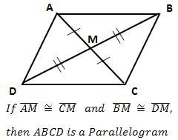
4.1 Parallelograms
Theorem 4.8: If the diagonals of a quadrilateral bisect each other, then the quadrilateral is a parallelogram.

Slide 11
4.1 Parallelograms
Summary: Methods to Prove a Quadrilateral is a Parallelogram
Show that both pairs of opposite sides are parallel.
Show that both pairs of opposite sides are congruent.
Show that both pairs of opposite angles are congruent.
Show that one pair of opposite sides are congruent and parallel.
Show that diagonals bisect each other.

Slide 12
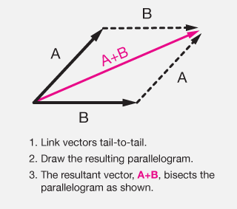
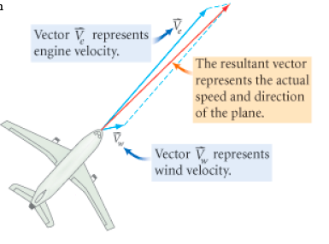
4.1 Parallelograms

Slide 13
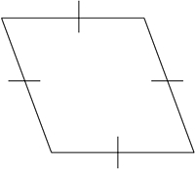
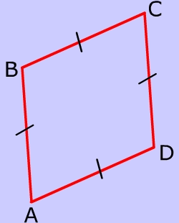
4.2 Rhombuses and Kites
Definition: A rhombus is a parallelogram that has two congruent adjacent sides.
Theorem 4.9: All four sides of a rhombus are congruent.

Slide 14
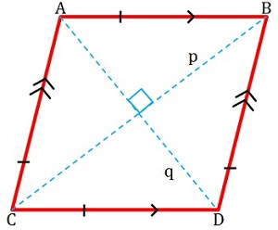
4.2 Rhombuses and Kites
Theorem 4.10: The diagonals of a rhombus are perpendicular.

Slide 15
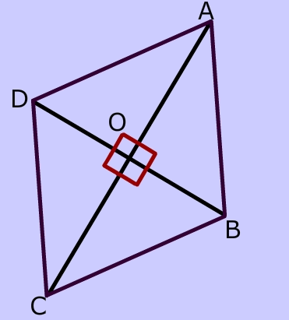
4.2 Rhombuses and Kites
Theorem 4.11: If the diagonals of a parallelogram are perpendicular, then the parallelogram is a rhombus.

Slide 16
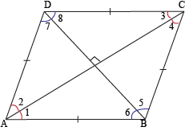
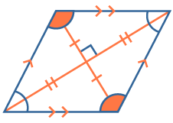
4.2 Rhombuses and Kites
Theorem 4.12: The diagonals of a rhombus bisect the angles of the rhombus.

Slide 17
4.2 Rhombuses and Kites
Summary: Properties of a Rhombus
Opposite sides are parallel.
Diagonals divide it into two congruent triangles.
Opposite sides are congruent.
Opposite angles are congruent.
Consecutive angles are supplementary.
Diagonals bisect each other.

Slide 18
4.2 Rhombuses and Kites
Summary: Properties of a Rhombus
7. All sides are congruent.
8. Diagonals are perpendicular.
9. Diagonals bisect angles.

Slide 19
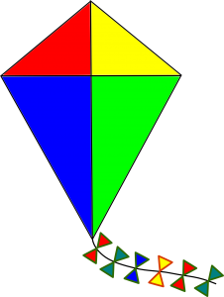
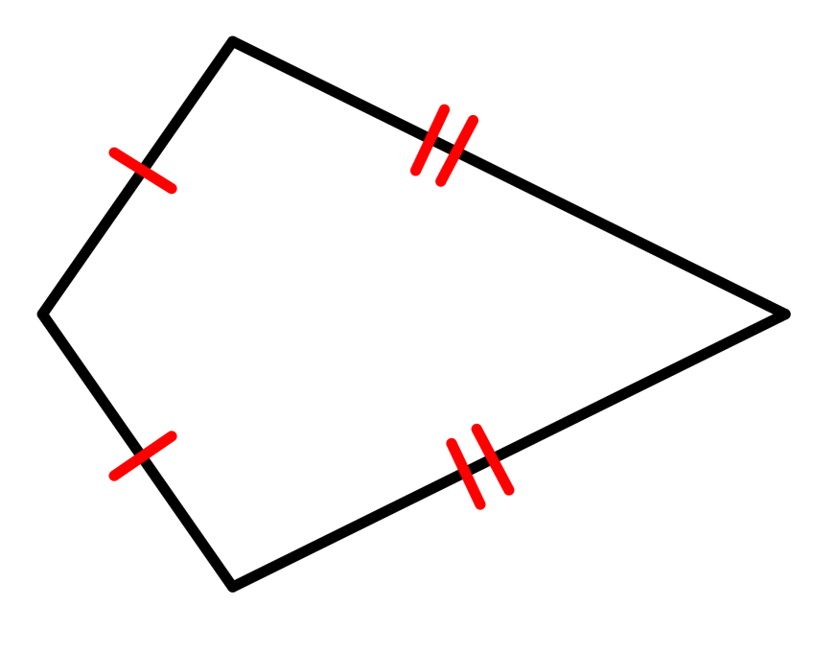
4.2 Rhombuses and Kites
Definition: A kite is a quadrilateral with exactly two distinct pairs of congruent consecutive sides.

Slide 20
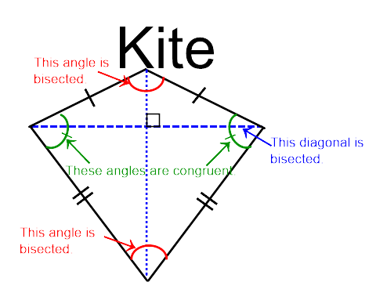
4.2 Rhombuses and Kites
Theorem 4.13: If a quadrilateral is a kite, one pair of opposite angles is congruent.

Slide 21
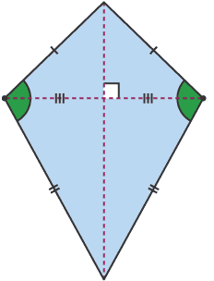
4.2 Rhombuses and Kites
Theorem 4.14: If a quadrilateral is a kite, one diagonal is the perpendicular bisector of the other diagonal.

Slide 22
4.2 Rhombuses and Kites
Summary: Properties of a Kite
It’s a quadrilateral but not a parallelogram with two pairs of congruent consecutive sides.
One pair of opposite angles are congruent.
One diagonal is the perpendicular bisector of the other diagonal.
One diagonal bisects two of the kite’s angles.

Slide 23
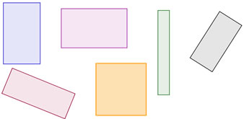
4.3 Rectangles and squares
Definition: A rectangle is a parallelogram with one right angle.
Theorem 4.15: All angles of a rectangle are right angles.

Slide 24
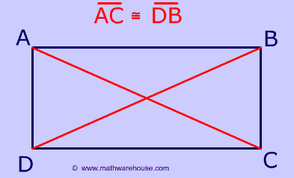
4.3 Rectangles and squares
Theorem 4.16: The diagonals of a rectangle are congruent.

Slide 25
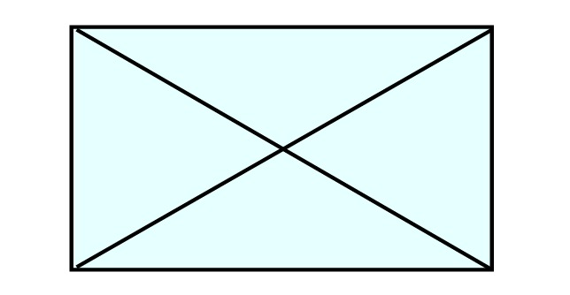
4.3 Rectangles and squares
Theorem 4.17: If the diagonals of a parallelogram are congruent, then the parallelogram is a rectangle.

Slide 26
4.3 Rectangles and squares
Definition: A square is a rhombus with one right angle.
A square is a rectangle with four congruent sides.
A square is a parallelogram with four congruent sides and four right angles.

Slide 27
4.3 Rectangles and squares
True or False.
Every square is a parallelogram.
Every rhombus is a square.
Every rectangle is equiangular.
Every square is a rectangle.
The diagonals of every parallelogram are congruent.

Slide 28
4.3 Rectangles and squares
Construction 4.1: Construct a rectangle when two adjacent sides are given.

Slide 29
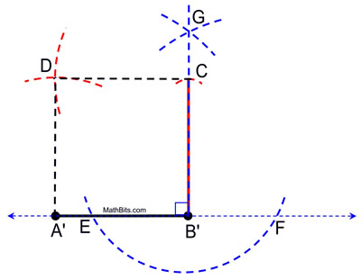
4.3 Rectangles and squares
Construction 4.2: Construct a square when a side is given.

Slide 30
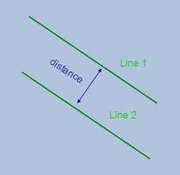
4.3 Rectangles and squares
Theorem 4.18: Two parallel lines are always the same distance apart.

Slide 31
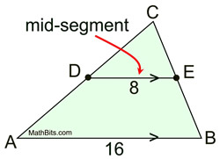
4.3 Rectangles and squares
Theorem 4.19: The segment joining the midpoints of two sides of a triangle is parallel to the third side and its length is one-half the length of the third side.

Slide 32
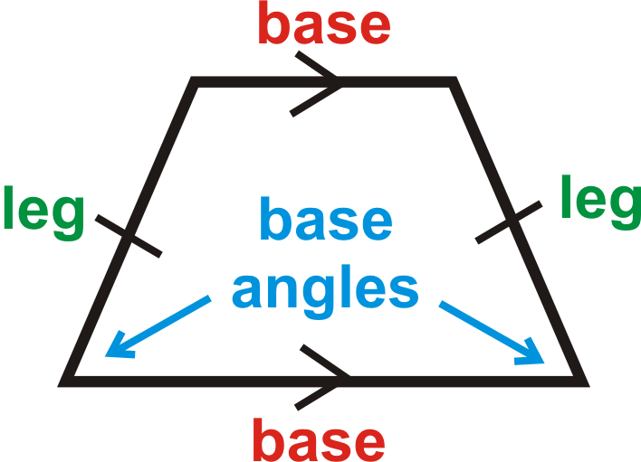
4.4 Trapezoids
Definition: A trapezoid is a quadrilateral with exactly one pair of parallel sides. The parallel sides are called bases, and the nonparallel sides are called legs. If the legs of a trapezoid are congruent, the trapezoid is an isosceles trapezoid. A pair of angles of a trapezoid are called base angles if they include the same base.

Slide 33
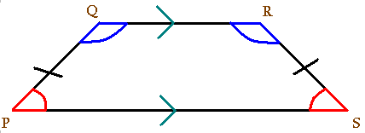
4.4 Trapezoids
Theorem 4.20: The base angles of an isosceles trapezoid are congruent.

Slide 34
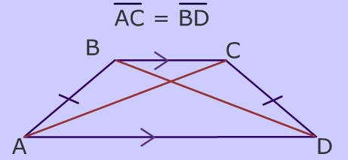
4.4 Trapezoids
Theorem 4.21: The diagonals of an isosceles trapezoid are congruent.

Slide 35
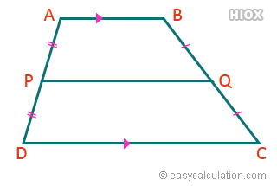
4.4 Trapezoids
Definition: The segment joining the midpoints of the legs of a trapezoid is the median of the trapezoid.

Slide 36
4.4 Trapezoids
Theorem 4.22: The median of a trapezoid is parallel to the bases and equal to one-half their sum.

Slide 37
4.4 Trapezoids
Theorem 4.23: If three or more parallel lines intercept congruent segments on one transversal, then they intercept congruent segments on all transversals.
Construction 4.3: Divide a given segment into a given number of congruent segments.

Slide 38
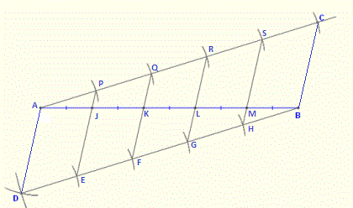
4.4 Trapezoids

Slide 39
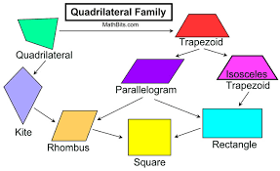
Chapter 4 QUadrilaterals

