Slide 1
Math 3301 Foundations of Geometry
Chapter 3 Parallel Lines
Dr. Geoff F. Clement

Slide 2
3.1 Indirect Proof and the Parallel Postulate

Slide 3
3.1 Indirect Proof and the Parallel Postulate
Definition: Two lines in the same plane that do not intersect are called parallel lines.

Slide 4
3.1 Indirect Proof and the Parallel Postulate
Postulate 3.1 (The Parallel Postulate):
For a given line l and a point P not on l, one and only one line through P is parallel to l.

Slide 5
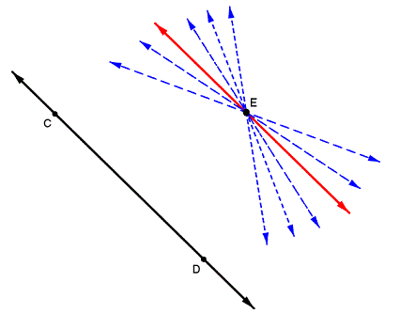
3.1 Indirect Proof and the Parallel Postulate
Postulate 3.1 (The Parallel Postulate):
For a given line l and a point P not on l, one and only one line through P is parallel to l.

Slide 6
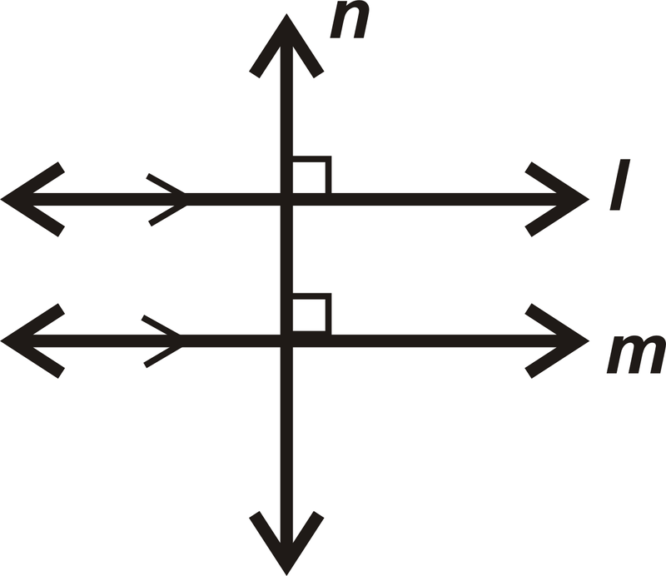
3.1 Indirect Proof and the Parallel Postulate
Theorem 3.1: If two lines in a plane are both perpendicular to a third line, then they are parallel.

Slide 7
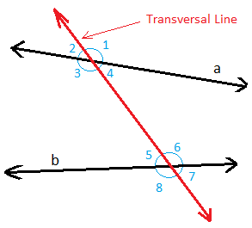
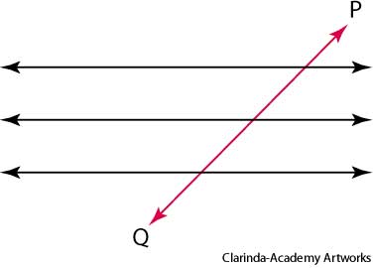
3.2 Transversals and Angles
Definition: A transversal is a line that intersects two or more distinct lines in different points.

Slide 8
3.2 Transversals and Angles
Definition (Angles Formed by a Transversal):
Suppose two lines are cut by a transversal.
The nonadjacent angles on opposite sides of the transversal but on the interior of the two lines are called alternate interior angles.
The nonadjacent angles on the same side of the transversal and in the same corresponding positions with respect to the two lines are called corresponding angles.
The nonadjacent angles on opposite sides of the transversal but on the exterior of the two lines are called alternate exterior angles.

Slide 9
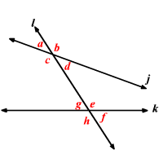
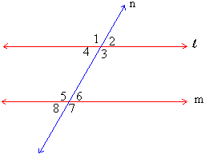
3.2 Transversals and Angles

Slide 10
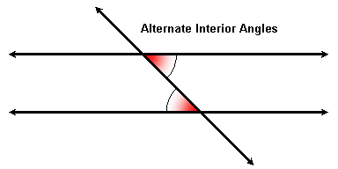
3.2 Transversals and Angles
Theorem 3.2: If two lines are cut by a transversal and a pair of alternate interior angles are congruent, then the lines are parallel.

Slide 11
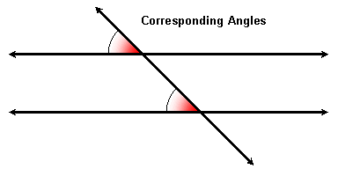
3.2 Transversals and Angles
Theorem 3.3: If two lines are cut by a transversal and a pair of corresponding angles are congruent, then the lines are parallel.

Slide 12
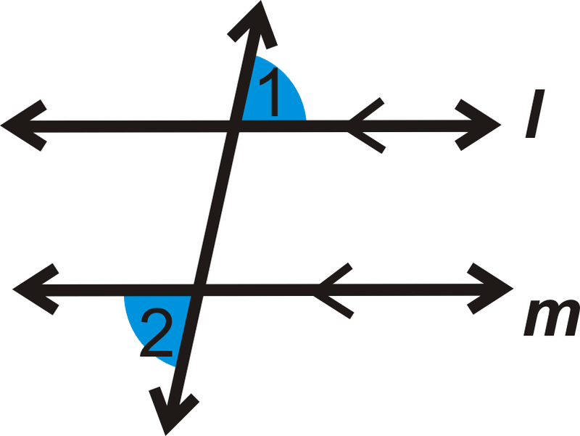
3.2 Transversals and Angles
Theorem 3.4: If two lines are cut by a transversal and a pair of alternate exterior angles are congruent, then the lines are parallel.

Slide 13
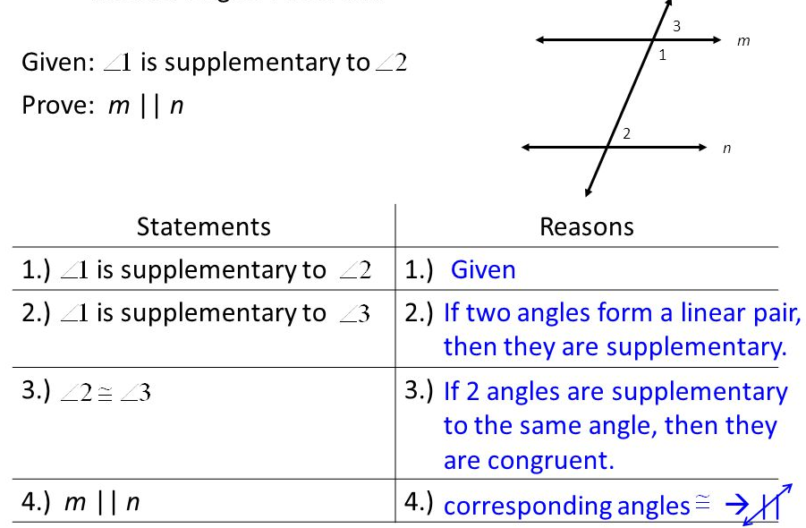
3.2 Transversals and Angles
Theorem 3.5: If two lines are cut by a transversal and two interior angles on the same side of the transversal are supplementary, then the lines are parallel.

Slide 14
3.2 Transversals and Angles
Theorem 3.6 (Converse of Theorem 3.2): If two parallel lines are cut by a transversal, then all pairs of alternate interior angles are congruent.
Theorem 3.7 (Converse of Theorem 3.1): If two lines are parallel and a third line is perpendicular to one of them, then it is also perpendicular to the other.

Slide 15
3.2 Transversals and Angles
Theorem 3.8 (Converse of Theorem 3.3): If two parallel lines are cut by a transversal, then all pairs of corresponding angles are congruent.
Theorem 3.9 (Converse of Theorem 3.4): If two parallel lines are cut by a transversal, then all pairs of alternate exterior angles are congruent.

Slide 16
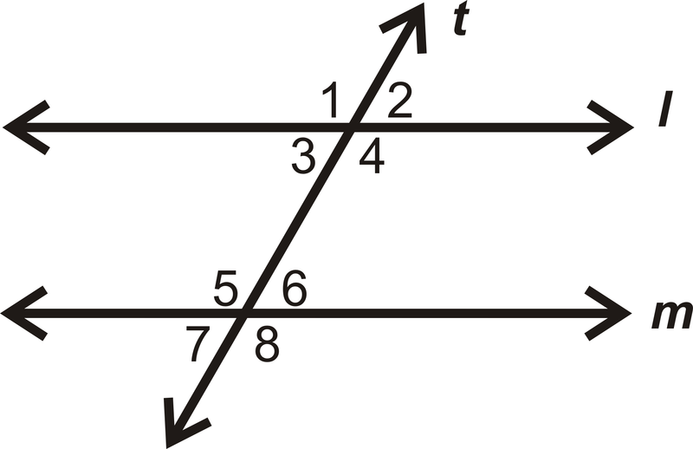
3.2 Transversals and Angles
Theorem 3.10 (Converse of Theorem 3.5): If two parallel lines are cut by a transversal, then all pairs of interior angles on the same side of the transversal are supplementary.

Slide 17
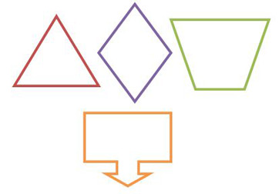
3.3 Polygons and Angles
Definition: A polygon is a closed figure in a plane. It has n segments (where n ≥ 3) called sides that intersect only at their endpoints. Each endpoint is called the vertex of the polygon. No two consecutive sides are on the same line.

Slide 18
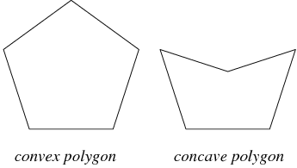
3.3 Polygons and Angles

Slide 19
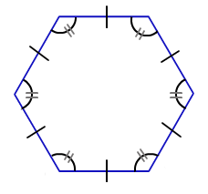
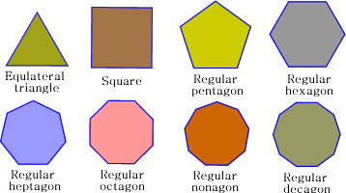
3.4 Polygons and Angles
Definition: A polygon is a regular polygon if all of its sides are congruent and all of its angles are congruent.

Slide 20
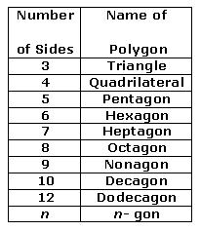
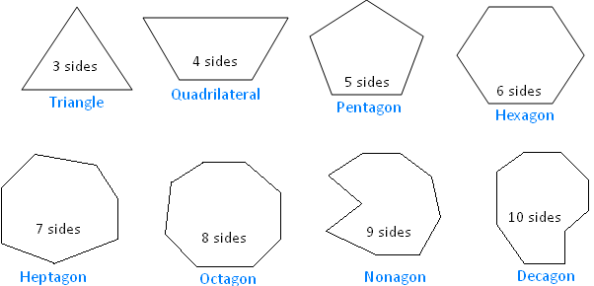
3.3 Polygons and Angles

Slide 21
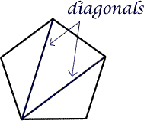
3.3 Polygons and Angles
Postulate 3.2: A polygon has the same number of angles as sides (and vertices).
Definition: A diagonal of a polygon is a segment that joins two nonadjacent vertices.

Slide 22
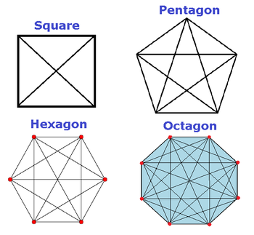
3.3 Polygons and Angles
The number of diagonals for a polygon with n sides is determined with the formula d = ½ n (n – 3).

Slide 23
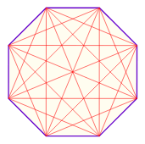
3.3 Polygons and Angles
If a polygon has 12 sides, how many diagonals does it have?
If a polygon has 35 diagonals, how many sides does it have?

Slide 24
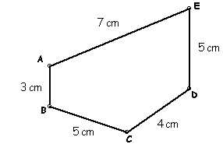
3.3 Polygons and Angles
Definition: The perimeter of a polygon is the sum of the lengths of its sides.
Find the perimeter of this irregular pentagon.

Slide 25
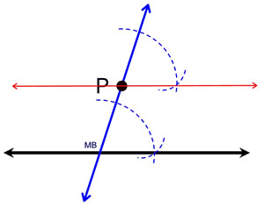
3.3 Polygons and Angles
Corollary 3.1: Construct the line parallel to a given line that passes through a point not on the given line.

Slide 26
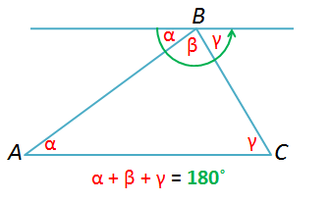
3.3 Polygons and Angles
Theorem 3.11: The sum of the measures of the angles of a triangle is 180°.

Slide 27
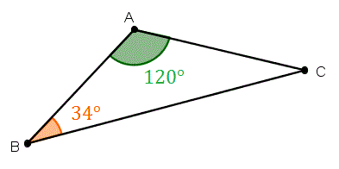
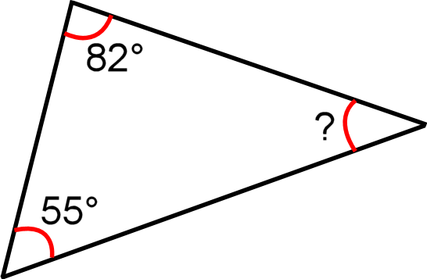
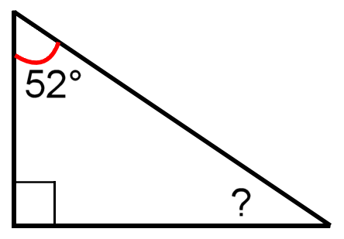
3.3 Polygons and Angles
Find the measure of the missing angle in each diagram.

Slide 28
3.3 Polygons and Angles
Corollary 3.12: Any triangle can have at most one right angle or at most one obtuse angle.

Slide 29
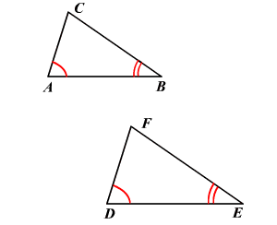
3.3 Polygons and Angles
Corollary 3.13: If two angles of one triangle are congruent, respectively, to two angles of another triangle, then the third angles are also congruent.

Slide 30
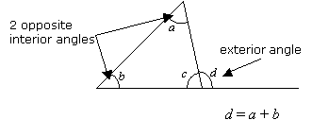
3.3 Polygons and Angles
Corollary 3.14: The measure of the exterior angle of a triangle is equal to the sum of the measures of the nonadjacent interior angles.

Slide 31
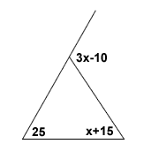
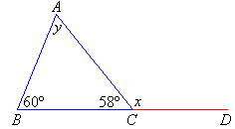
3.3 Polygons and Angles
Find the missing angles in each diagram.

Slide 32
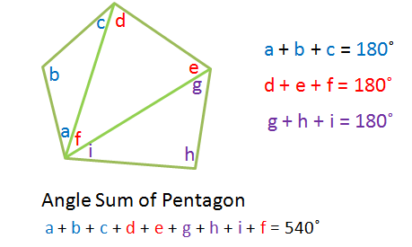
3.3 Polygons and Angles
Theorem 3.15: The sum of the measures of the angles of a polygon with n sides is given by the formula S = (n ̶ 2)180°.

Slide 33
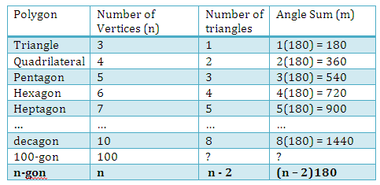
3.3 Polygons and Angles
Polygon Angle Sum Theorem

Slide 34
3.3 Polygons and Angles
If 1980° is the number of degrees of a polygon, how many sides does the polygon have?
If 900° is the number of degrees of a polygon, how many sides does the polygon have?
Find the sum of the measures of the angles in an octagon.

Slide 35
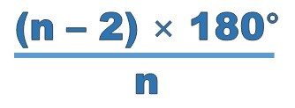
3.3 Polygons and Angles
Corollary 3.16: The measure of each angle of a regular polygon with n sides is given by the formula

Slide 36
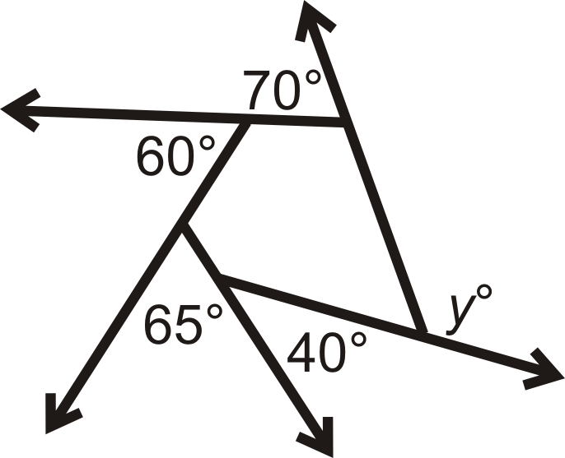
3.3 Polygons and Angles
Theorem 3.17: The sum of the measures of the exterior angles of a polygon, one at each vertex, is 360°.

Slide 37
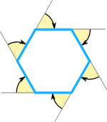
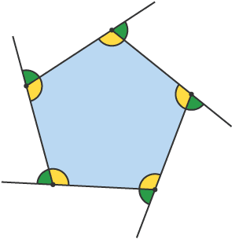
3.3 Polygons and Angles
Corollary 3.18: The measure of each exterior angle of a regular polygon with n sides is determined with the formula a = 360°/n.

Slide 38
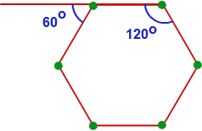
3.3 Polygons and Angles
Find the measure of each interior angle and each exterior angle of a regular
Triangle
Octagon
Dodecagon

Slide 39
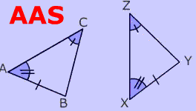
3.4 More Congruent Triangles
Theorem 3.19 (AAS or Angle-Angle-Side): If two angles and any side of one triangle are congruent to the corresponding two angles and side of another triangle, then the triangles are congruent.

Slide 40
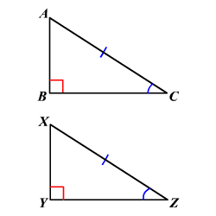
3.4 More Congruent Triangles
Theorem 3.20 (HA or Hypotenuse-Angle): If the hypotenuse and an acute angle of one right triangle are congruent to the hypotenuse and an acute angle of another right triangle, then the two right triangles are congruent.

Slide 41
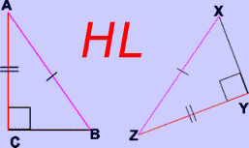
3.4 More Congruent Triangles
Theorem 3.21 (HL or Hypotenuse-Leg): If the hypotenuse and a leg of one right triangle are congruent to the hypotenuse and a leg of another right triangle, then the two right triangles are congruent.

Slide 42
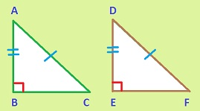
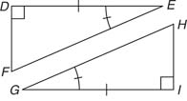
3.4 More Congruent Triangles
Name the congruent right triangles in each diagram, and explain your reasoning.

Slide 43
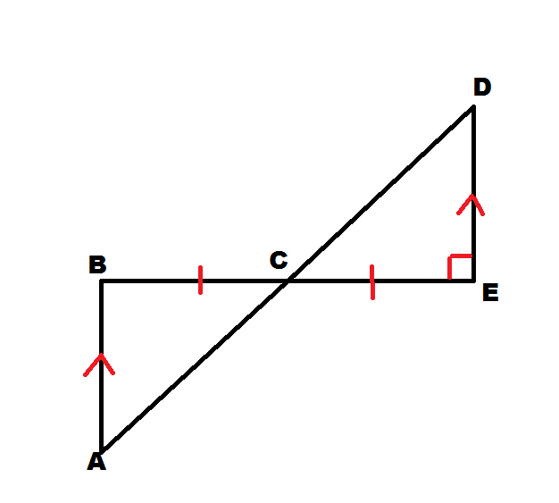
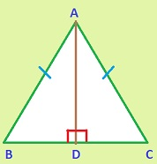
3.4 More Congruent Triangles
Name the congruent triangles in each diagram, and explain your reasoning.

Slide 44
3.4 More Congruent Triangles
Summary: Methods to Prove Triangles Congruent
All Triangles: SAS, ASA, SSS, AAS
Only Right Triangles: LA, LL, HA, HL

