Slide 1
Math 3301 Foundations of Geometry
Chapter 2 Triangles
Dr. Geoff F. Clement

Slide 2
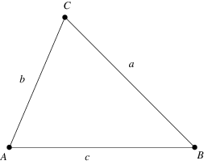
2.1 Classifying Triangles
Definition: Let A, B, and C be three points not on the same line. The figure joined by the three segments is called a triangle, denoted by ∆ABC. The three segments are the sides that form ∆ABC, and the three points A, B, and C are the vertices (singular – vertex) of ∆ABC.

Slide 3
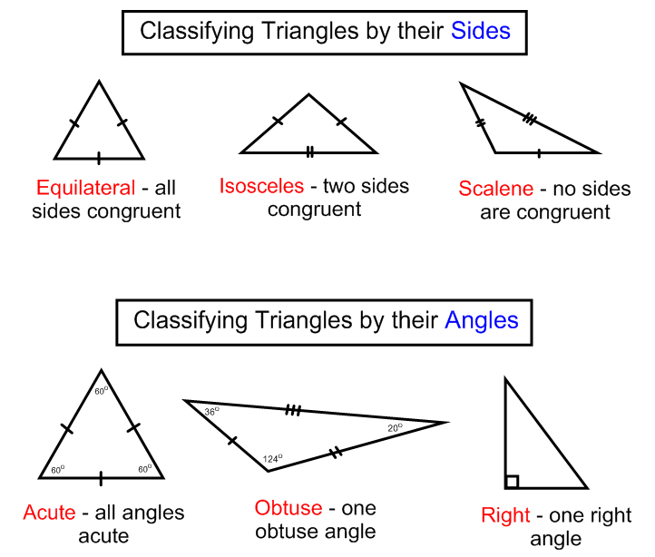
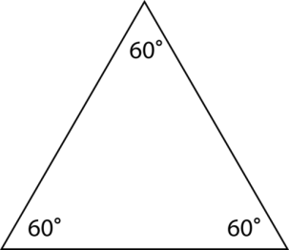
2.1 Classifying Triangles
Equiangular – all three angles are congruent

Slide 4
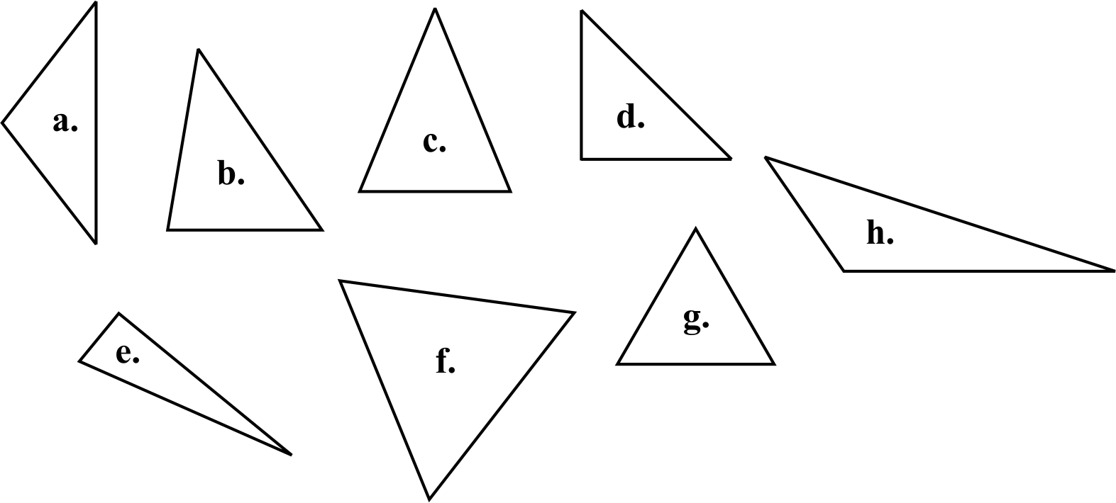
2.1 Classifying Triangles
Identify each triangle by their angles and by their sides.

Slide 5
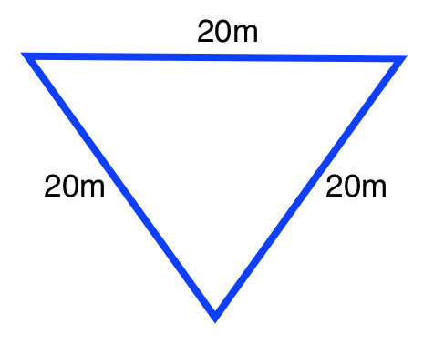
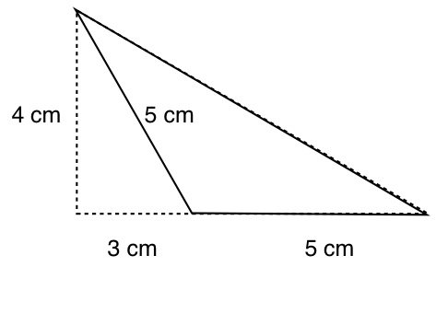
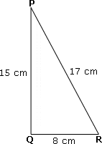
2.1 Classifying Triangles
Definition: Perimeter is the sum of the lengths of a shape’s sides.
Find the perimeter of each triangle.

Slide 6
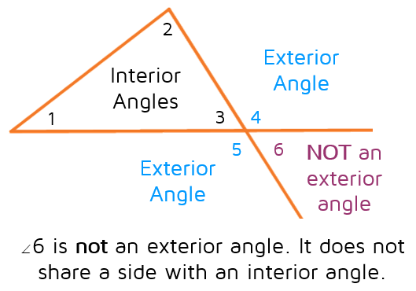
2.1 Classifying Triangles
Definition: An interior angle is an angle formed by two sides of the triangle such that the angle is on the inside of the triangle. An exterior angle of a triangle is an angle formed by a side of the triangle and an extension of another side. Both these sides have a common endpoint. The angle lies on the outside of the triangle.

Slide 7
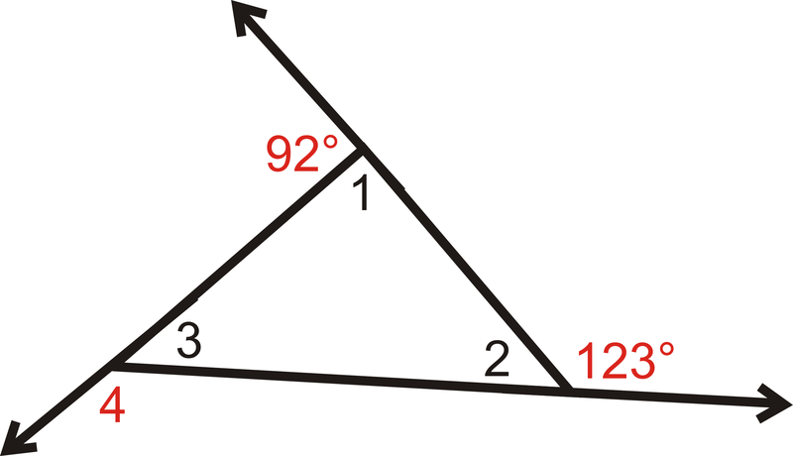
2.1 Classifying Triangles
Name the interior angles and the exterior angles in the diagram.

Slide 8
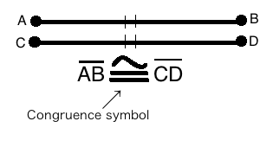
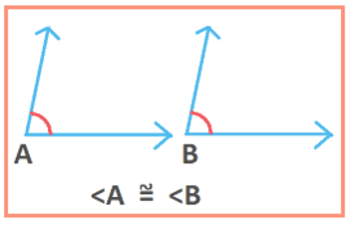
2.2 Congruent Triangles
Definition: Congruent segments are two segments with the same measure.
Definition: Congruent angles are two angles with the same measure.

Slide 9
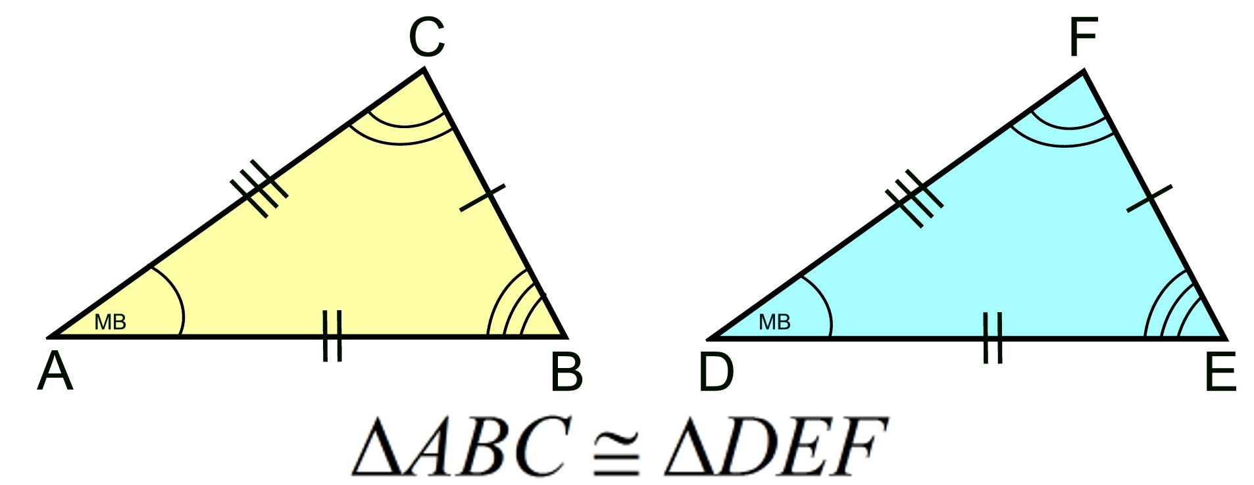
2.2 Congruent Triangles
Definition: If all six parts of one triangle (three angles and three sides) are congruent to the corresponding parts of another triangle, the two triangles are congruent. The notation is ∆ABC ∆DEF.

Slide 10
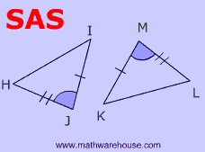
2.2 Congruent Triangles
Postulate 2.1 (SAS or side-angle-side): If two sides and the included angle of one triangle are congruent to two corresponding sides and the included angle of a second triangle, then the triangles are congruent.

Slide 11
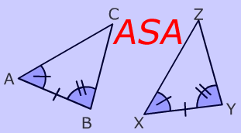
2.2 Congruent Triangles
Postulate 2.2 (ASA or angle-side-angle): If two angles and the included side of one triangle are congruent to two corresponding angles and the included side of a second triangle, then the triangles are congruent.

Slide 12
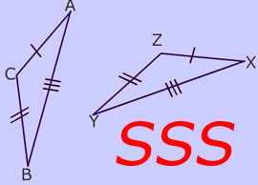
2.2 Congruent Triangles
Postulate 2.3 (SSS or side-side-side): If three sides of one triangle are congruent to the corresponding three sides of a second triangle, then the triangles are congruent.

Slide 13
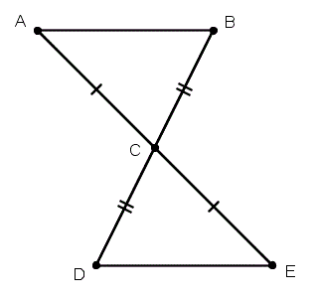
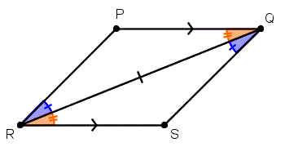
2.2 Congruent Triangles
Determine which triangles in each diagram are congruent, and explain your reasoning.

Slide 14
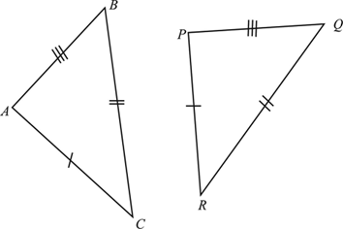
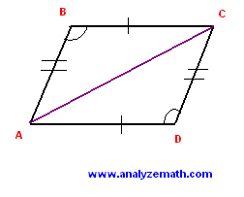
2.2 Congruent Triangles
Determine which triangles in each diagram are congruent, and explain your reasoning.

Slide 15
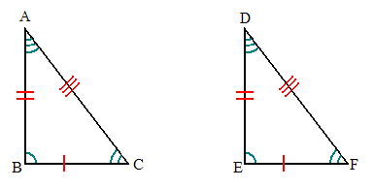
2.3 Proofs Involving Congruence
Definition (CPCTC or Corresponding Parts of Congruent Triangles are Congruent): If two triangles are congruent, the six pairs of corresponding parts are congruent.

Slide 16
2.3 Proofs Involving Congruence
Theorem 2.1 (Transitive Law for Congruent Triangles, Etc.):

Slide 17
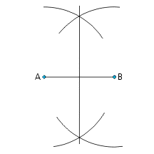
2.3 Proofs Involving Congruence
Theorem 2.2 (Segment Bisector Theorem): Construction 1.3 gives the perpendicular bisector of a given line segment.
Theorem 2.3: Every point on the perpendicular bisector of a segment is equidistant from the two endpoints.

Slide 18
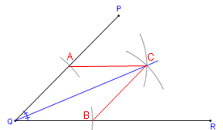
2.3 Proofs Involving Congruence
Theorem 2.4 (Angle Bisector Theorem): Construction 1.6 gives the bisector of a given angle.

Slide 19
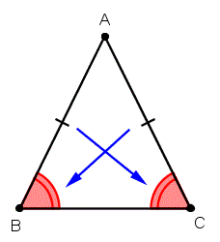
2.4 Isosceles Triangles, Medians, Altitudes, and Concurrent Lines
Theorem 2.5: If two sides of a triangle are congruent, then the angles opposite these sides are also congruent.

Slide 20
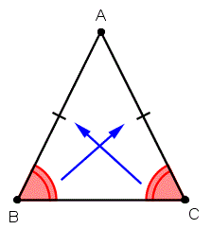
2.4 Isosceles Triangles, Medians, Altitudes, and Concurrent Lines
Theorem 2.7: If two angles of a triangle are congruent, then the sides opposite these angles are also congruent.

Slide 21
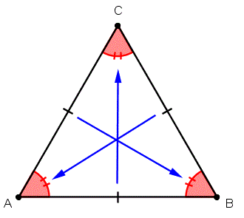
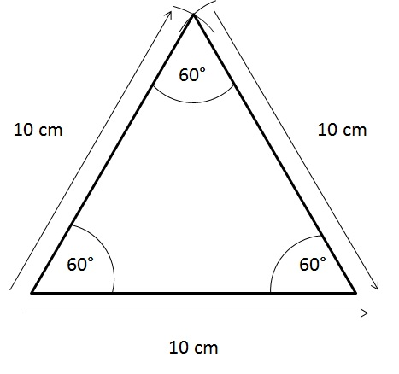
2.4 Isosceles Triangles, Medians, Altitudes, and Concurrent Lines
Corollary 2.6: If a triangle is equilateral, then it is equiangular.
Corollary 2.8: If a triangle is equiangular, then it is equilateral.

Slide 22
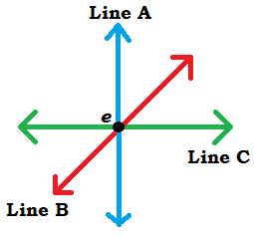
2.4 Isosceles Triangles, Medians, Altitudes, and Concurrent Lines
Definition: Two or more lines are concurrent if they intersect in one and only one point.

Slide 23
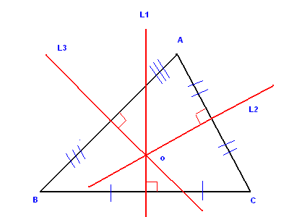
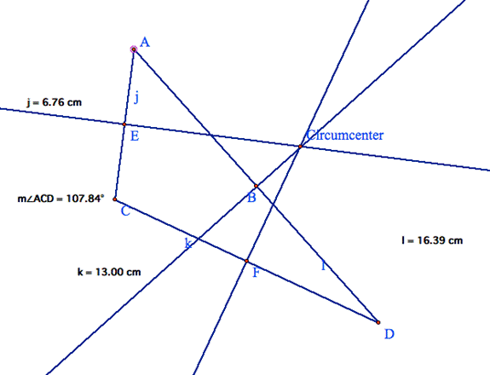
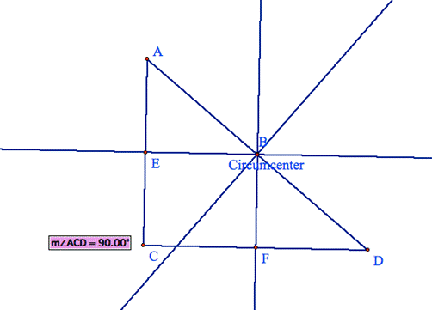
2.4 Isosceles Triangles, Medians, Altitudes, and Concurrent Lines
Theorem 2.9: The perpendicular bisectors of the sides of a triangle are concurrent.
Definition: The circumcenter of a triangle is the point of intersection of the perpendicular bisectors of a triangle.

Slide 24
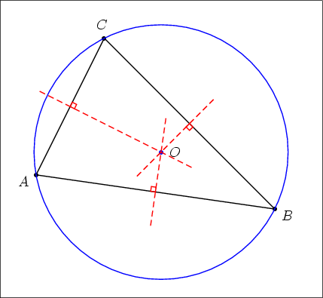
2.4 Isosceles Triangles, Medians, Altitudes, and Concurrent Lines

Slide 25
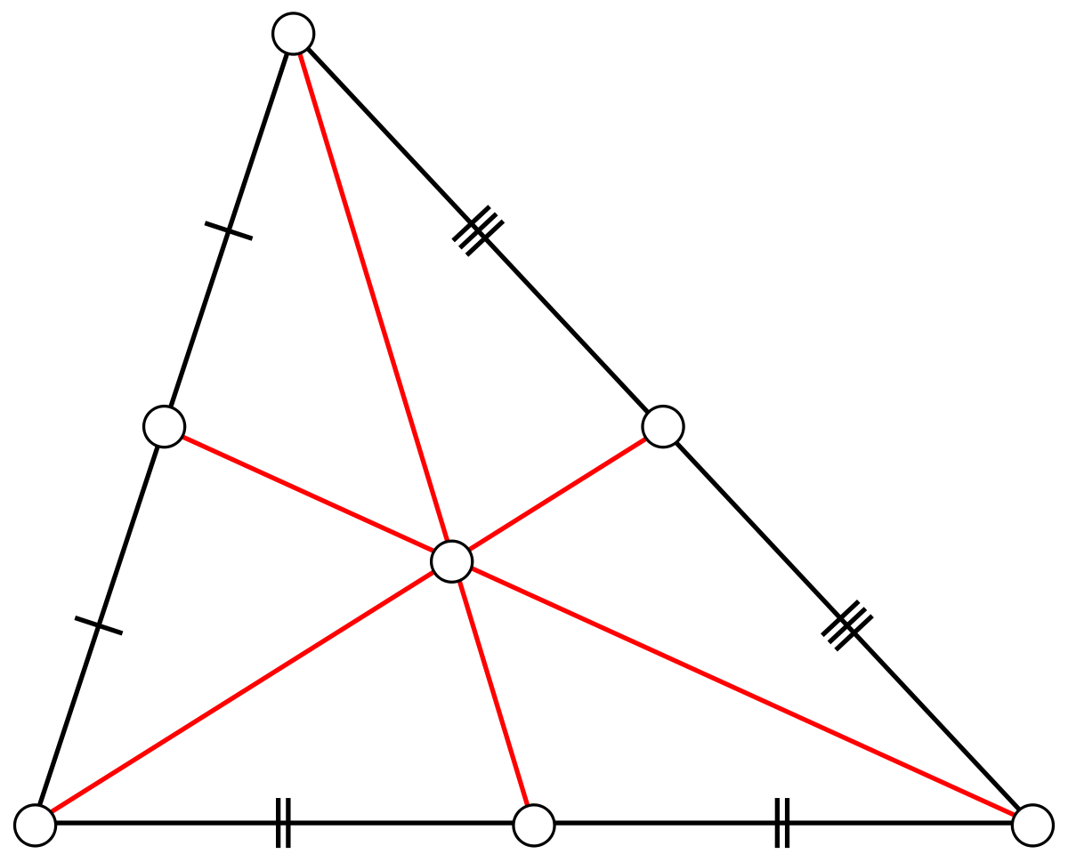
2.4 Isosceles Triangles, Medians, Altitudes, and Concurrent Lines
Definition: A median of a triangle is the segment joining a vertex to the midpoint of the side opposite that vertex.
Definition: The centroid of a triangle is the point of intersection of the medians of a triangle.

Slide 26
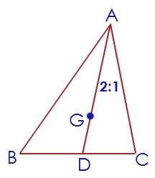
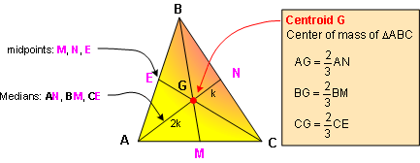
2.4 Isosceles Triangles, Medians, Altitudes, and Concurrent Lines
Theorem 2.10: The medians of a triangle are concurrent and meet at a point that is two-thirds the distance from the vertex to the midpoint of the opposite side.

Slide 27
2.4 Isosceles Triangles, Medians, Altitudes, and Concurrent Lines
Definition: An altitude of a triangle is a line segment from a vertex perpendicular to the side opposite that vertex (possibly extended).
Definition: The orthocenter of a triangle is the point of intersection of the three altitudes of a triangle.
Theorem 2.11: The altitudes of a triangle are concurrent.

Slide 28
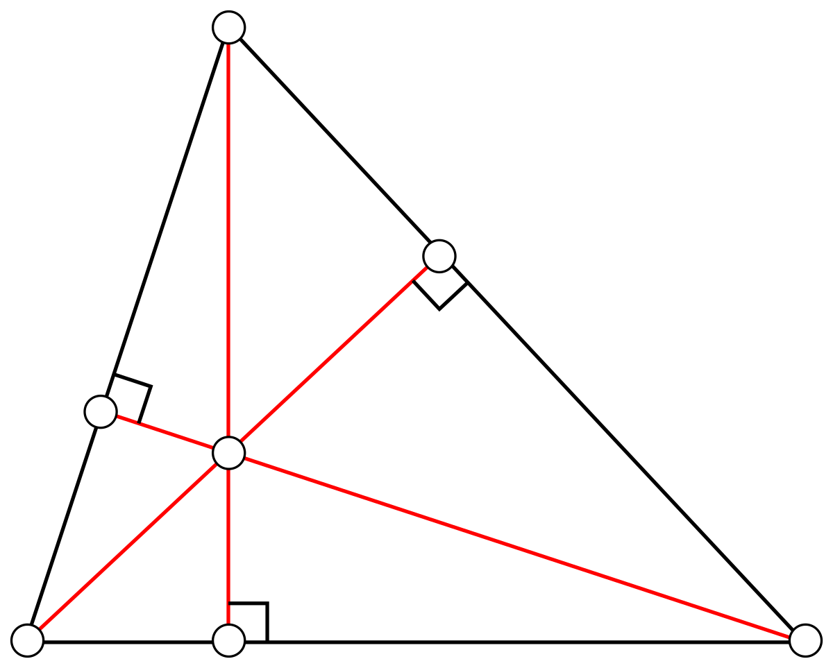
2.4 Isosceles Triangles, Medians, Altitudes, and Concurrent Lines
Three altitudes and the orthocenter

Slide 29
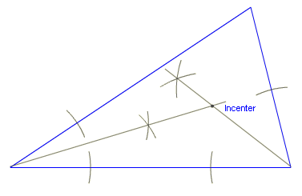
2.4 Isosceles Triangles, Medians, Altitudes, and Concurrent Lines
Definition: An angle bisector of a triangle is a line segment (or a ray) that separates the given angle into two congruent adjacent angles.
Definition: The incenter of a triangle is the point of intersection of the three angle bisectors of the triangle.

Slide 30
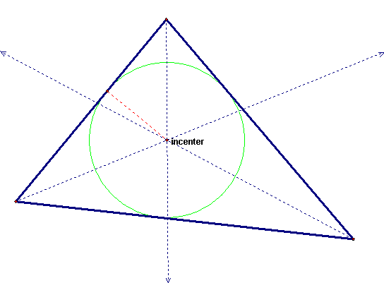
2.4 Isosceles Triangles, Medians, Altitudes, and Concurrent Lines
Theorem 2.12: The bisectors of the angles of a triangle are concurrent and meet at a point equidistant from the sides of the triangle.

Slide 31
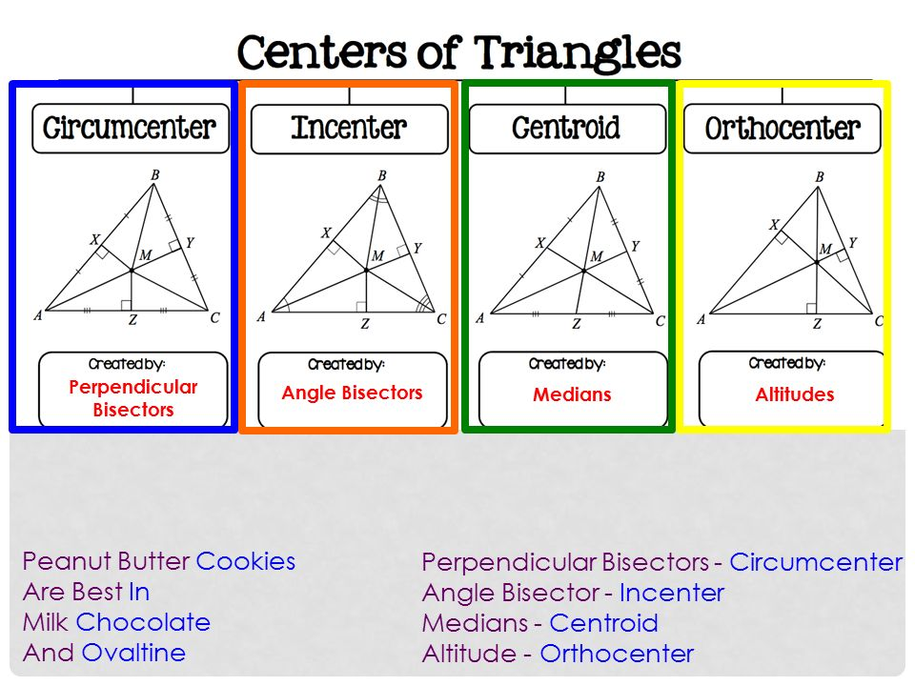
2.4 Isosceles Triangles, Medians, Altitudes, and Concurrent Lines

Slide 32
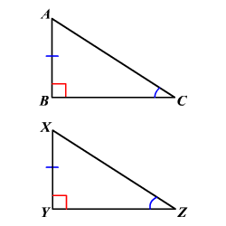
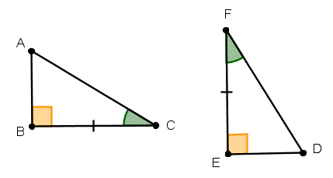
2.5 Proving Right Triangles Congruent
Theorem 2.13 (LA or Leg-Angle): If a leg and acute angle of one right triangle are congruent to a leg and the corresponding acute angle of another right triangle, then the two right triangles are congruent.

Slide 33
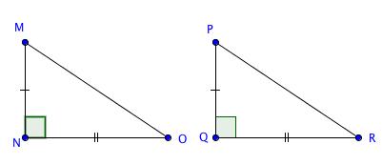
2.5 Proving Right Triangles Congruent
Theorem 2.14 (LL or Leg-Leg): If the two legs of one right triangle are congruent to the two legs of another right triangle, then the two right triangles are congruent.

Slide 34
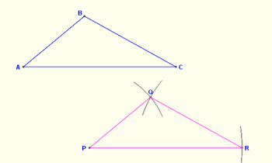
2.6 Constructions Involving Triangles
Construction 2.1: Construct a triangle that is congruent to a given triangle.

Slide 35
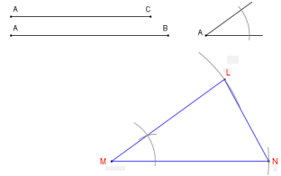
2.6 Constructions Involving Triangles
Construction 2.2: Construct a triangle with two sides and the included angle given.

Slide 36
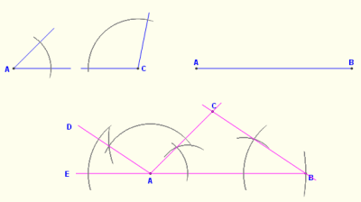
2.6 Constructions Involving Triangles
Construction 2.3: Construct a triangle with two angles and the included side given.

Slide 37
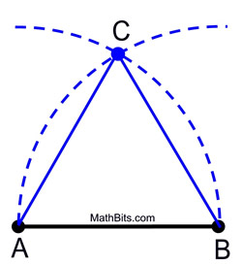
2.6 Constructions Involving Triangles
Construction 2.4: Construct an equilateral triangle when given a single side.

Slide 38
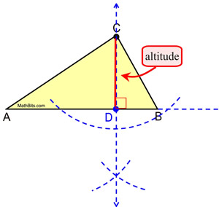
2.6 Constructions Involving Triangles
Construction 2.5: Construct an altitude of a given triangle.

Slide 39
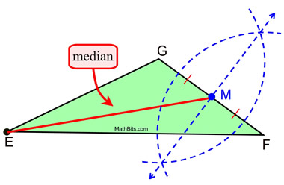
2.6 Constructions Involving Triangles
Construction 2.6: Construct a median of a given triangle.

