Slide 1
Math 3301 Foundations of Geometry
Chapter 10 Introduction to (Right Triangle) Trigonometry
Dr. Geoff F. Clement

Slide 2
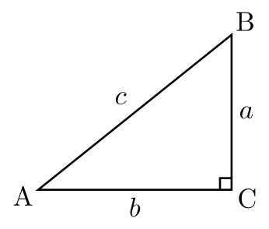
10.1 Sine and Cosine Ratios
Definition: Let <A be an acute angle of the right triangle

Slide 3
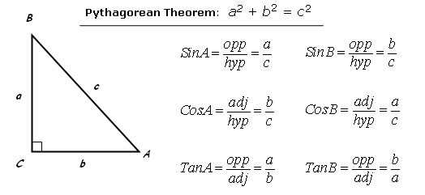
10.1 Sine and Cosine Ratios

Slide 4
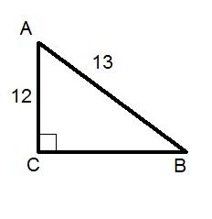
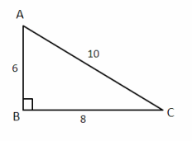
10.1 Sine and Cosine Ratios
Determine sin A, cos A, sin B, cos B for each of the following right triangles.

Slide 5
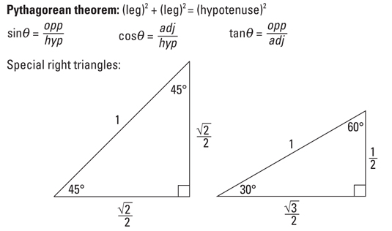
10.1 Sine and Cosine Ratios
For the following special right triangles, find sin 45°, cos 45°, sin 30°, cos 30°, sin 60°, and cos 60°.

Slide 6
10.1 Sine and Cosine Ratios
Using the given trigonometric ratio, find either the sine or cosine of <A. Assume A is an acute angle.
sin A = ⁵/₇ cos A = ¼
sin A = ⁵/₁₃ cos A = ⁴/₅

Slide 7
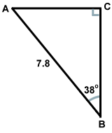
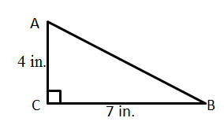
10.1 Sine and Cosine Ratios
Solve the following right triangles.

Slide 8
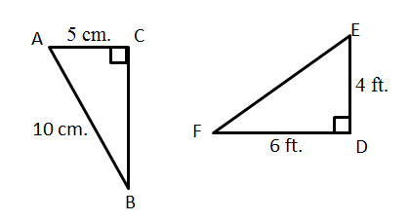
10.1 Sine and Cosine Ratios
Solve the following right triangles.

Slide 9
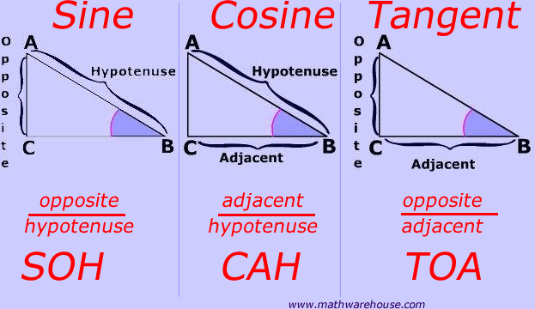
10.2 Tangent Ratios
Definition: Let <A and <B be acute angles of a right triangle.

Slide 10
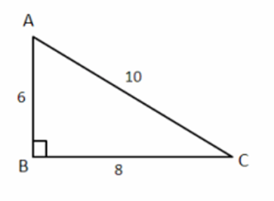
10.2 Tangent Ratios
Using the given figure, find tan A and tan B. Express each answer as a ratio.

Slide 11
10.2 Tangent Ratios
For the following special right triangles, find tan 45°, tan 30°, and tan 60°.

Slide 12
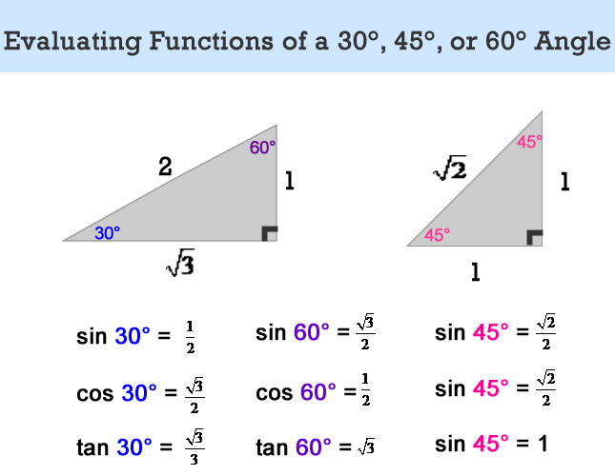
10.2 Tangent Ratios

Slide 13
10.2 Tangent Ratios
Find A to the nearest tenth of a degree if
cos A = 0.7500 sin A = 0.3859 tan A = 0.1263

Slide 14
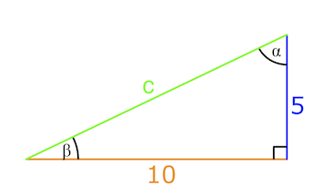
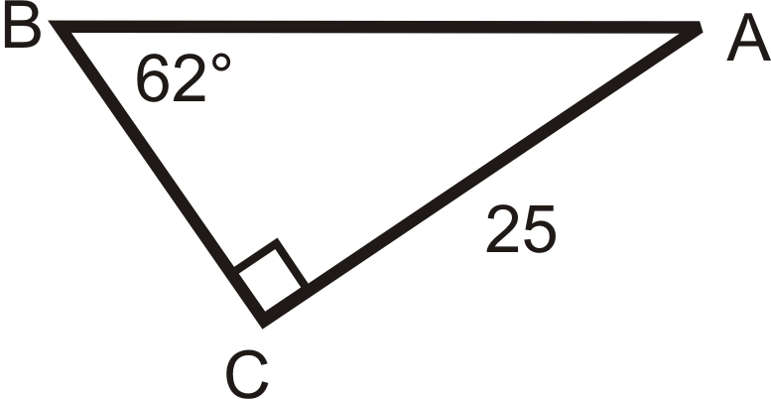
10.3 Solving Right Triangles
Solve the following right triangles.

Slide 15
10.3 Solving Right Triangles
Solve each right triangle. Assume <C measures 90˚. Round to the same number of decimal places as in the given information.
1. a = 9 and m<A = 30˚
2. m<A = 27.6˚ and c = 13.5
3. a = 7 and c = 25

Slide 16
10.3 Solving Right Triangles
Solve each right triangle. Assume <C measures 90˚. Round to the same number of decimal places as in the given information.
4. c = 27 and m<B = 57˚
5. a = 6 and b = 8
6. m<B = 43.15˚ and a = 3.152

Slide 17
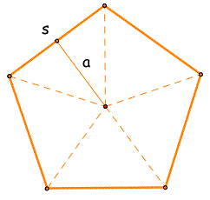
10.3 Solving Right Triangles
Find the length of the apothem in a regular pentagon whose radius is 10 inches.

Slide 18
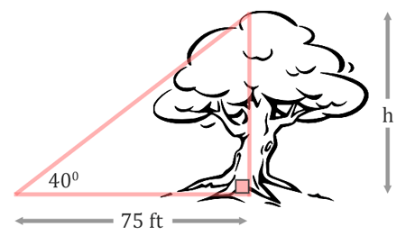
10.4 Applications Involving Right Triangles
Find the height of the tree to the nearest foot.

Slide 19
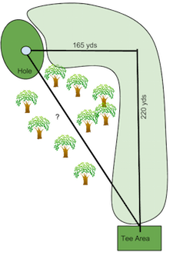
10.4 Applications Involving Right Triangles
Find the distance to the tee on this hole of golf.

Slide 20
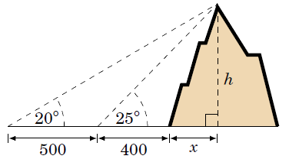
10.4 Applications Involving Right Triangles
Find the height of the mountain using the two right triangles in the diagram. Assume all lengths are in meters.

Slide 21
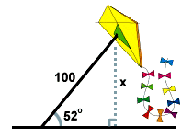
10.4 Applications Involving Right Triangles
Find the height of the kite. Assume the lengths are in feet.

Slide 22
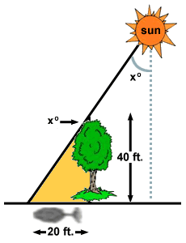
10.4 Applications Involving Right Triangles
Find the measure of the angle x to the nearest tenth of a degree.

Slide 23
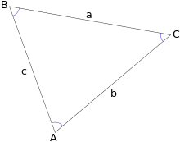
Law of Sines
In trigonometry, the law of sines, sine law, sine formula, or sine rule is an equation relating the lengths of the sides of a triangle (any shape) to the sines of its angles. According to the law,
a / sin ⁡ A = b / sin ⁡ B = c / sin ⁡ C = d, where a, b, and c are the lengths of the sides of a triangle, and A, B, and C are the opposite angles (see the figure below), while d is the diameter of the triangle's circumcircle. When the last of these equations is not used, the law is sometimes stated using the reciprocals:
sin ⁡ A / a = sin ⁡ B / b = sin ⁡ C / c .

Slide 24
Law of Sines
When using the law of sines to find a side of a triangle, an ambiguous case occurs when two separate triangles can be constructed from the data provided (i.e., there are two different possible solutions to the triangle). In the case shown below they are triangles ABC and AB′C′.
Given a general triangle, the following conditions would need to be fulfilled for the case to be ambiguous:
The only information known about the triangle is the angle A and the sides a and c.
The angle A is acute (i.e., A < 90°).
The side a is shorter than the side c (i.e., a < c).
The side a is longer than the altitude h from angle B, where h = c sin A (i.e., a > h).

Slide 25
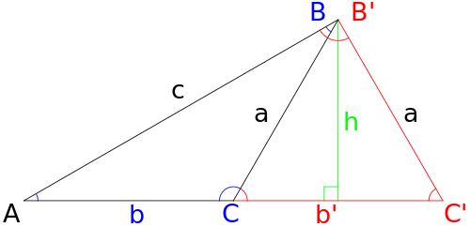
Law of Sines

Slide 26
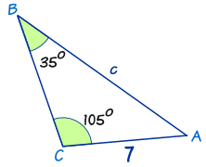
Law of Sines

Slide 27
Law of Cosines
In trigonometry, the law of cosines (also known as the cosine formula or cosine rule) relates the lengths of the sides of a triangle to the cosine of one of its angles. In a formula
notation, the law of cosines states:
c²= a² + b² − 2ab cos C, where C denotes the angle contained between sides of where C denotes the angle contained between sides of lengths a and b and opposite the side of length c. Similarly,
a²= b² + c² − 2bc cos A
b²= a² + c² − 2ac cos B

Slide 28
Laws of Sines & Cosines

