Slide 1
Math 3301 Foundations of Geometry
Chapter 1 Foundations of Geometry
Dr. Geoff F. Clement

Slide 2
1.1 Geometry is an axiomatic system …
Undefined terms
Definitions (new terms)
Axioms or Postulates (accepted as true without proof)
Theorems (proven with definitions, postulates, other theorems, with the rules of deductive reasoning)

Slide 3
1.1 Inductive and Deductive Reasoning
Definition: We use inductive reasoning when we reach a general conclusion based on a limited collection of specific observations.
Definition: We use deductive reasoning when we reach a specific conclusion based on a limited collection of generally accepted assumptions.

Slide 4
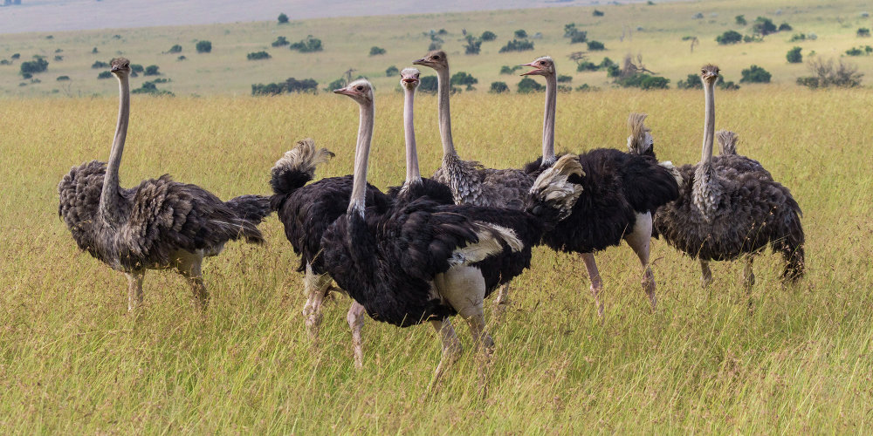
1.1 Inductive Reasoning
Cardinals can fly.
Goldfinches can fly.
Eagles, hawks, and falcons can fly.
Therefore, all birds can fly.

Slide 5
1.1 Inductive Reasoning
Find the next terms in each sequence:
1, 2, 4, 8, 16, _____ , _____
o, t, t, f, f, s, s, e, _____ , _____
6, 10, 14, 18, _____ , _____
1, 1, 2, 3, 5, 8, _____ , _____

Slide 6
1.1 Deductive Reasoning
This year is a leap year. Therefore, next year will not be a leap year.
All athletes are in good physical condition.
Serena is an athlete.
Therefore, Serena is in good physical condition.

Slide 7
1.1 Deductive Reasoning
A coach tells his athletes, “If we are to win the game, then we will have to play hard.”
The team played hard.
Can we conclude that the team won?
If the second premise is that the team won the game, what can we logically conclude?

Slide 8
1.1 Fun logical puzzles
A rancher had 20 cattle. All but 12 died. How many did he have left?
An inflatable raft will carry a maximum of 200 lb. How can a man weighing 200 lb and his 2 daughters, each weighing 100 lb, use the raft to reach the island?
The number of marbles in a jar doubles every minute. If the jar is full in 10 minutes, when was the jar half full?

Slide 9
1.1 Fun logical puzzles
We know there are 12 one-cent stamps in a dozen. How many two-cent stamps are there in a dozen?
What arithmetic symbol can be placed between 2 and 3 to form a number that is greater than 2 and less than 3?

Slide 10
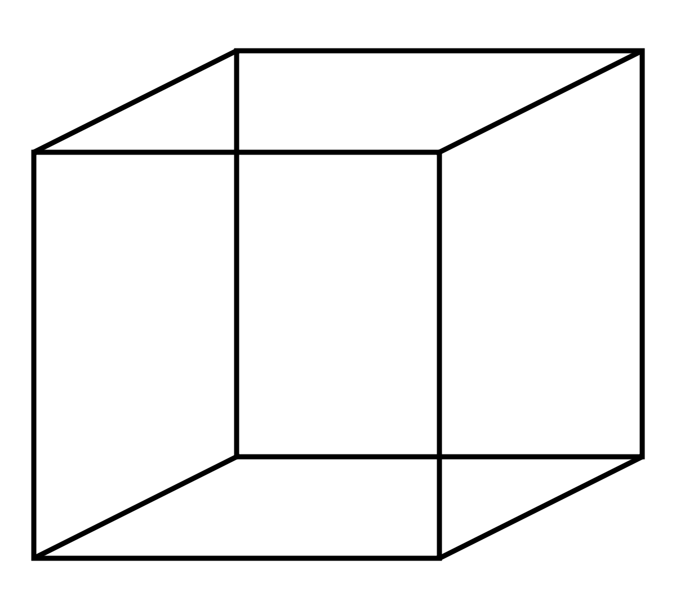
1.1 Fun logical puzzles
A bug is sitting on the surface of a solid cube at point A. If he wants to get to point B by the shortest possible route along the surface, how should he go?
B
A

Slide 11
1.1 Fun logical puzzles
There are 8 marbles. One is heavier than the rest of them. How can you decide which is heavier with a balance scale in
3 weighings?
2 weighings?

Slide 12
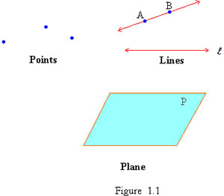
1.2 Points, Lines, and Planes
Definition: The set of all points is called space. Any set of points, lines, or planes in space is called a geometric figure.

Slide 13
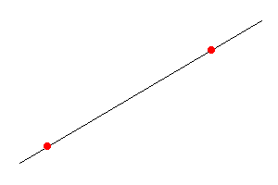
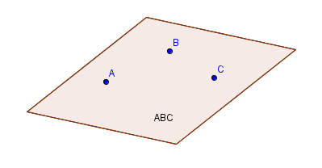
1.2 Points, Lines, and Planes
Postulate 1.1: Given any two points in space, there is exactly one line that passes through them.
Postulate 1.2: Given any three distinct points in space not on the same line, there is exactly one plane that passes through them.

Slide 14
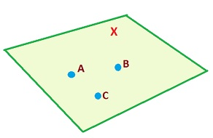
1.2 Points, Lines, and Planes
Postulate 1.3: The line determined by any two distinct points in a plane is also contained in the plane.
Postulate 1.4: No plane contains all points in space.
Postulate 1.5 (The Ruler Postulate): There is a one-to-one correspondence between the set of all points on a line and the set of all real numbers.

Slide 15
1.2 Points, Lines, and Planes
Postulate 1.6 (The Reflexive Law): Any quantity is equal to itself. (x = x)
Postulate 1.7 (The Symmetric Law): If x and y are any two quantities and x = y, then y = x.
Postulate 1.8 (The Transitive Law): If x, y, and z are any three quantities with x = y and y = z, then x = z.
Postulate 1.9 (The Addition-Subtraction Law): If w, x, y, and z are any four quantities with w = x and y = z, then w + y = x + z and w − y = x − z.

Slide 16
1.2 Points, Lines, and Planes
Postulate 1.10 (The Multiplication-Division Law): If w, x, y, and z are any four quantities with w = x and y = z, then wy = xz and ^{w}/_{y} = ^{x}/_{z} (provided y ≠ 0 and z ≠ 0).
Postulate 1.11 (The Substitution Law): If x and y are any two quantities with x = y, then x can be substituted for y in any expression containing y.
Postulate 1.12 (The Distribution Law): If x, y, and z are any three quantities, then x(y + z) = xy + xz.

Slide 17
1.3 Segments, Rays, and Angles
Definition: Let A and B be two distinct points on a line. The geometric figure consisting of all points between A and B, including A and B, is called a line segment or segment, denoted by . The points A and B are called endpoints.

Slide 18
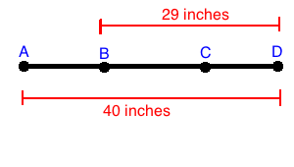
1.3 Segments, Rays, and Angles
Postulate 1.13 (Segment Addition Postulate): Let A, B, and C be three points on the same line with B between A and C. Then AC = AB + BC, BC = AC – AB, and AB = AC – BC.
If AC = 17 inches, find AB and BC.

Slide 19
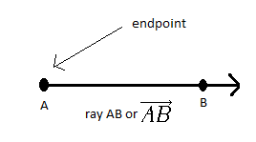
1.3 Segments, Rays, and Angles
Definition: Let A and B be two distinct points on a line. The geometric figure consisting of the point A together with all points on line AB on the same side of A as B is called a ray, denoted by .
The point A is called the endpoint of ray AB.

Slide 20
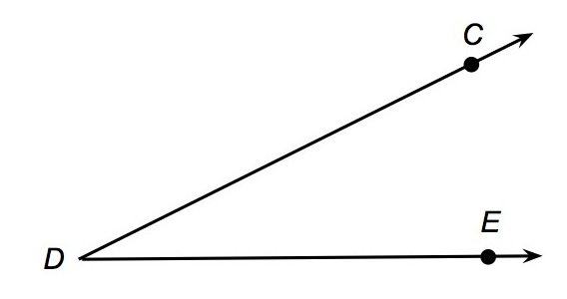
1.3 Segments, Rays, and Angles
Definition: An angle is a geometric figure consisting of two rays that share a common endpoint, called the vertex of the angle. The rays are called sides of the angle.

Slide 21
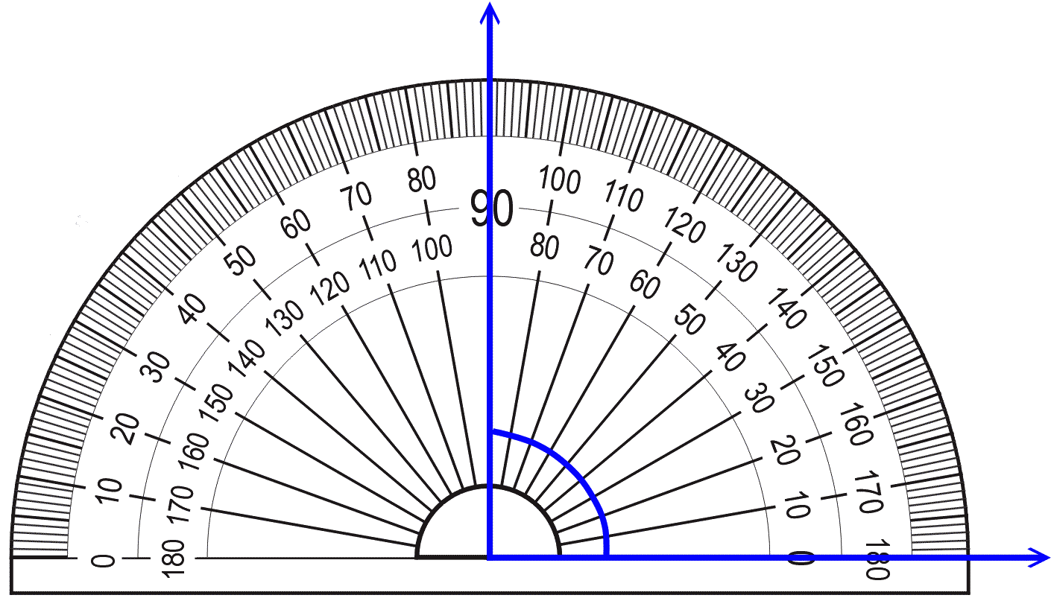
1.3 Segments, Rays, and Angles

Slide 22
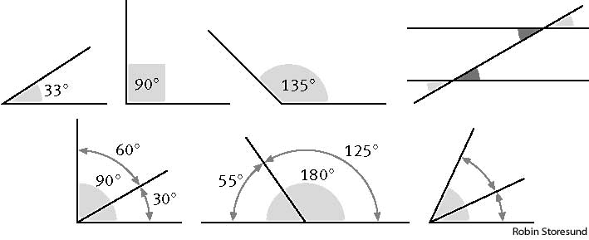
1.3 Segments, Rays, and Angles

Slide 23
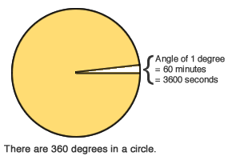
1.3 Segments, Rays, and Angles
360˚ = 1 revolution
1˚ = 60 minutes = 60’
1 minute = 1’ = 60 seconds = 60”

Slide 24
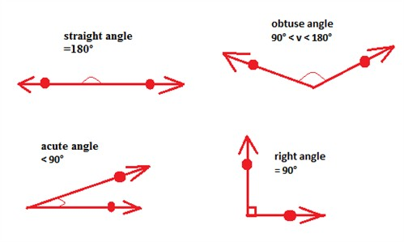
1.3 Segments, Rays, and Angles
Definition (Special Angles): An angle whose sides form a line is called a straight angle. An angle with measure 90˚ is called a right angle. An angle with measure between 0˚ and 180˚ is called an acute angle. An angle with measure between 90˚ and 90˚ is called an obtuse angle.

Slide 25
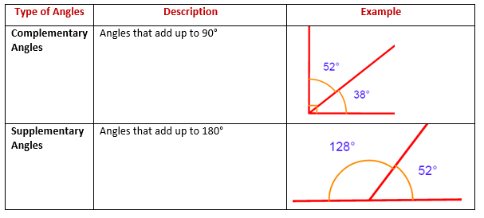
1.3 Segments, Rays, and Angles
Definition: Two angles whose measures total 90˚ are called complementary angles, and each is called the complement of the other. Two angles whose measures total 180˚ are called supplementary angles, and each is called the supplement of the other.

Slide 26
1.3 Segments, Rays, and Angles
If m<A = 27˚ and <A and <B are complementary, find the measure of <B.
If m<P = 74˚25’30” and <P and <Q are supplementary, find the measure of <Q.
If m<A = (2x)˚, m<B = (x + 4)˚ and <A and <B are complementary, find x.
If m<A = (2y + 5)˚, m<B = (y − 3)˚ and <A and <B are supplementary, find y.

Slide 27
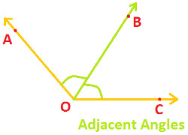
1.3 Segments, Rays, and Angles
Definition: Two angles are called adjacent angles if they have a common vertex, share a common side, and have no interior points in common.

Slide 28
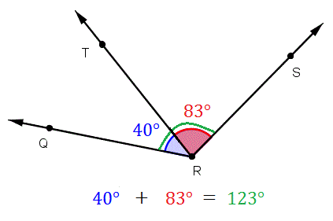
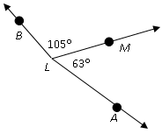
1.3 Segments, Rays, and Angles
Postulate 1.14 (The Angle Addition Postulate): Let A, B, and C be points that determine <ABC with P a point in the interior of the angle. Then m<ABC = m<ABP + m<PBC, m<PBC = m<ABC – m<ABP, and m<ABP = m<ABC – m<PBC.

Slide 29
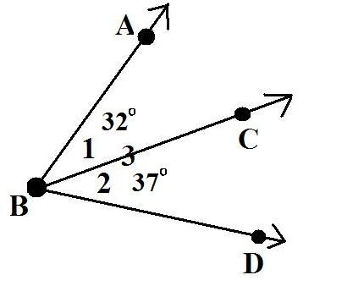
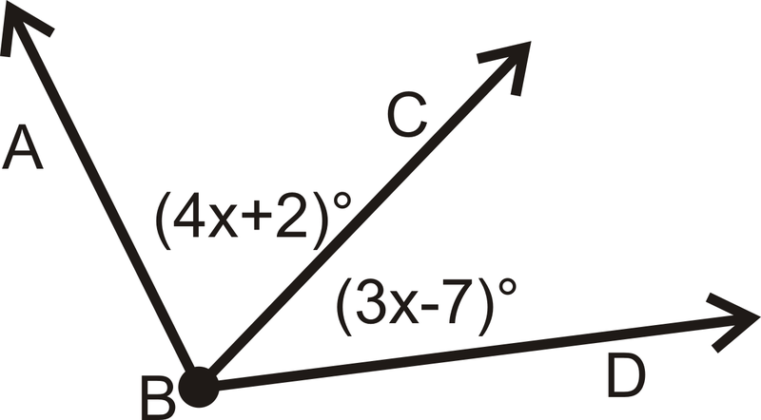
1.3 Segments, Rays, and Angles
Find m<ABD. Find m<ABD.

Slide 30
1.3 Segments, Rays, and Angles

Slide 31
1.4 Introduction to Deductive Proofs
Negation of a Statement Not p
Conditional Statement: If p, then q.
Converse: If q, then p.
Inverse: If not p, then not q.
Contrapositive: If not q, then not p.

Slide 32
1.4 Introduction to Deductive Proofs
Find the negation of the given statement.
The tree is an oak.
I earned an A in the course.
The Beatles are not a British band.

Slide 33
1.4 Introduction to Deductive Proofs
For the given statements, find the converse, the inverse, and the contrapositive.
Congressman’s promise: If I get elected, then the minimum wage will increase to $10 per hour.
If the Clement family goes camping, then it will rain.

Slide 34
1.4 Introduction to Deductive Proofs
For the given statements, find the converse, the inverse, and the contrapositive.
If it rains, then I will stay indoors.
If the figure is a rectangle, then it is a parallelogram.
If x = -3, then x² = 9.

Slide 35
1.4 Introduction to Deductive Proofs
An example of a direct proof: If a quadrilateral is a parallelogram, then opposite angles are congruent.

Slide 36
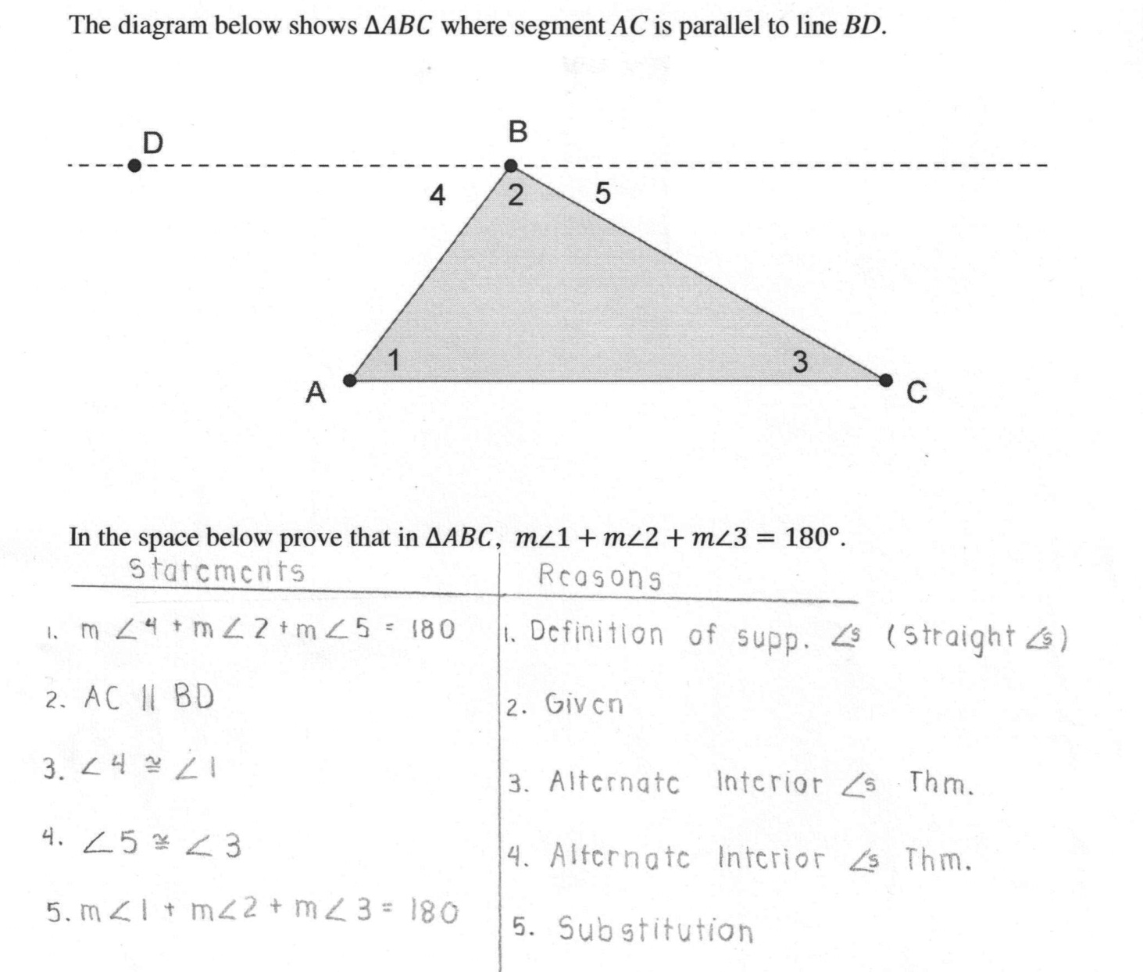
1.4 Introduction to Deductive Proofs
An example of a direct proof of the Triangle Angle Sum theorem:

Slide 37
1.5 Formalizing Geometric Proofs
The following can be used as reasons in a formal geometric proof:
Given (part or all of the hypothesis)
Postulates
Definitions
Theorems (previously proved)

Slide 38
1.5 Formalizing Geometric Proofs
Theorem 1.1 (Addition Theorem for Segments):
If B is a point between A and C on segment AC, Q is a point between P and R on segment PR, AB = PQ, and BC = QR, then AC = PR.
Theorem 1.2 (Subtraction Theorem for Segments):
If B is a point between A and C on segment AC, Q is a point between P and R on segment PR, AC = PR, and AB = PQ, then BC = QR.

Slide 39
1.5 Formalizing Geometric Proofs
Theorem 1.3 (Addition Theorem for Angles):
If D is a point in the interior of <ABC, S is a point in the interior of <PQR, m<ABD = m<PQS, and m<DBC = m<SQR, then m<ABC = m<PQR.
Theorem 1.4 (Subtraction Theorem for Angles):
If D is a point in the interior of <ABC, S is a point in the interior of <PQR, m<ABC = m<PQR, and m<DBC = m<SQR, then m<ABD = m<PQS.

Slide 40
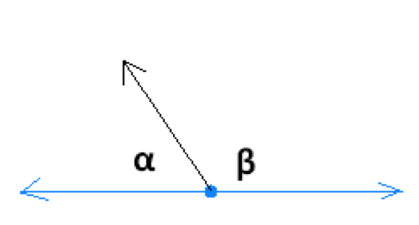
1.5 Formalizing Geometric Proofs
Theorem 1.5: Two equal supplementary angles are right angles.

Slide 41
1.5 Formalizing Geometric Proofs
Theorem 1.6: Complements of equal angles are equal in measure. Corollary 1.7: Complements of the same angle are equal in measure.

Slide 42
1.5 Formalizing Geometric Proofs
Theorem 1.8: Supplements of equal angles are equal in measure.
Corollary 1.9: Supplements of the same angle are equal in measure.

Slide 43
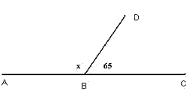
1.5 Formalizing Geometric Proofs
Theorem 1.10: If A, B, and C are three points on a line, with B between A and C, and <ABD and <DBC are adjacent angles, then <ABD and <DBC are supplementary.

Slide 44
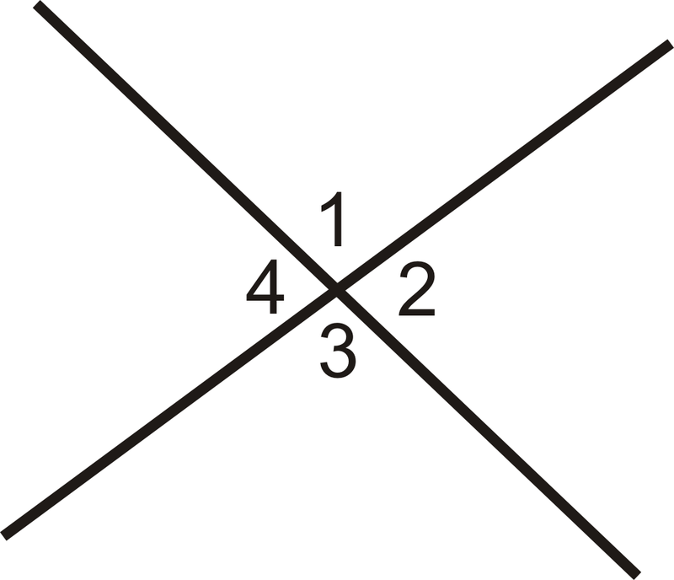
1.5 Formalizing Geometric Proofs
Definition: Two nonadjacent angles formed by two intersecting lines are called vertical angles.

Slide 45
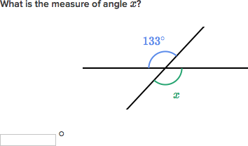
1.5 Formalizing Geometric Proofs
Theorem 1.11 Vertical angles are equal in measure.

Slide 46
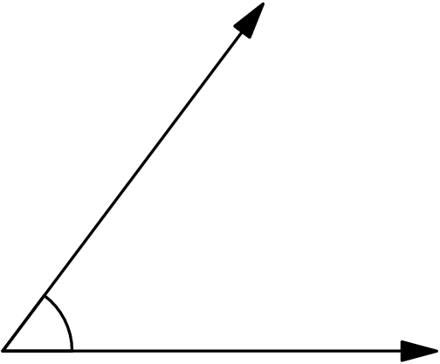
1.6 Constructions Involving Lines and Angles
Construction 1.1 Construct a line segment with the same length as a given line segment.
Construction 1.2 Construct an angle with the same measure as a given angle.

Slide 47
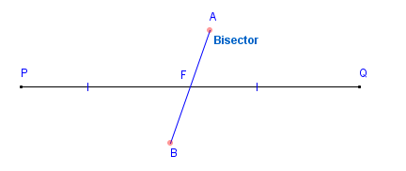
1.6 Constructions Involving Lines and Angles
Definition: Let be a line segment. To bisect this segment is to identify a point C between A and B such that AC = CB. Point C is called the midpoint of . The midpoint is a point on a line segment that separates the segment into two equal parts. A line segment that contains the midpoint C but no other point of is called a bisector of .
Construction 1.3 Construct a bisector of a given line segment.

Slide 48
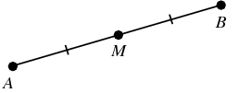
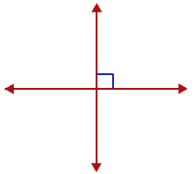
1.6 Constructions Involving Lines and Angles
Postulate 1.15 (Midpoint Postulate): Each line segment has exactly one midpoint.
Definition: Two lines are perpendicular if they intersect and form equal adjacent angles. The angles formed are right angles. If line AB is perpendicular to line CD, we write . Two line segments are perpendicular if they intersect and are contained in perpendicular lines.

Slide 49
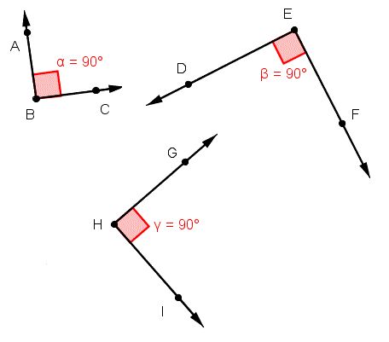
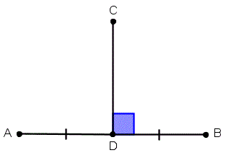
1.6 Constructions Involving Lines and Angles
Theorem 1.12: All right angles are equal in measure.
Definition: A line that both bisects and is perpendicular to a given line segment is called a perpendicular bisector of the segment.

Slide 50
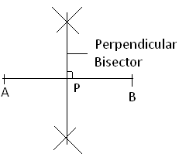
1.6 Constructions Involving Lines and Angles
Postulate 1.16 (Perpendicular Bisector Postulate): Each given line segment has exactly one perpendicular bisector.
Construction 1.4: Construct a line perpendicular to a given line passing through a given point on the line.
Postulate 1.17: There is exactly one line perpendicular to a given line passing through a given point on the line.

Slide 51
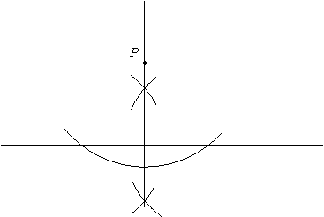
1.6 Constructions Involving Lines and Angles
Construction 1.5: Construct a line perpendicular to a given line passing through given point not on that line.
Postulate 1.18: There is exactly one line perpendicular to a given line passing through a given point not on the line.

Slide 52
1.6 Constructions Involving Lines and Angles
Definition:

Slide 53
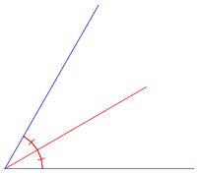
1.6 Constructions Involving Lines and Angles
Definition: Let <ABC be an angle. To bisect <ABC is to identify ,
where D is in the interior of <ABC and m<ABD = m<DBC. Ray BD is called the angle bisector of <ABC.

Slide 54
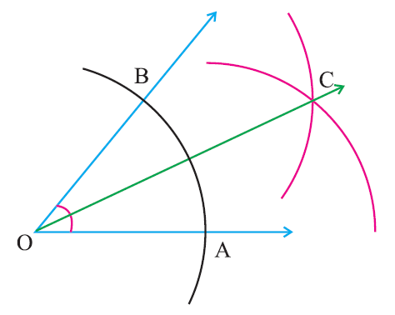
1.6 Constructions Involving Lines and Angles
Construction 1.6: Construct a bisector of a given angle.
Postulate 1.19 (Angle Bisector Postulate): Each angle has exactly one bisector.

