Slide 1
Algebraic thinking
SPONGE ACTIVITIES

Slide 2
True or false.
8 + 4 = 5 + 7
5 = 4 + 1
6 × 0 = 6

Slide 3
Identities
5 + 0 = ____
10 + 0 = ____
8 + 0 = ____
+ 0 =

Slide 4
Identities
5 – 0 = ____
12 – 0 = ____
7 – 0 = ____
– – 0 =

Slide 5
Identities
5 × 0 = ____
11 × 0 = ____
4 × 0 = ____
– × 0 = ____

Slide 6
Identities
6 × 1 = ____
23 × 1 = ____
3 × 1 = ____
– × 1 =

Slide 7
Identities
8 ÷ 1 = ____
17 ÷ 1 = ____
2.5 ÷ 1 = ____
– ÷ 1 =

Slide 8
SOLVE.
5 + ___ = 13
7 × ___ = 42
___ – 4 = 3
½ + ___ = 1
___ + ___ = 10
___ × ___ = 16

Slide 9
Solve the following Open Sentences.
(2 × ____ ) + 7 = 15
____ × 11 + 5 = 71
____ × 5 – 10 = 20

Slide 10
sOLVE.
11 + 6 + ____ = 27
2 × 4 + ____ = 16
(____ + 15 + 5) × 6 = 150

Slide 11
Complete the Table. GuEss THE RULE.
In | Out
0 | 0
1 | 2
2
3 | 6
 | 8
5 | 10
10
20
50
x | y = _____
If x is the input and
y is the output, find a
general equation for the
relationship between x and y.
Let x = the number of dogs
and y = their number of eyes

Slide 12
Complete The Table. Guess The RUle.
In | Out
5 | 11
6 | 13
7 | 15
10 | 21
3 | ____
x | y = _______

Slide 13
Complete The Table. Guess The RUle.
In | Out
0 | 5
1 | 10
2 | 20
3 | 40
4 | _____
x | y = _______

Slide 14
Acknowledgement
The following problems were all adapted from
Blanton, M. L. 2008. Algebra and the elementary classroom: Transforming thinking, transforming practice. Heinemann: Portsmouth, NH.
Candy Problem p. 20 Growing Caterpillar Problem pp. 53, 169
T-shirt Problem pp. 21-22 Handshakes Problem pp. 61, 175
Triangle Puzzle Problem p. 25 Triangle Dots Problem pp. 64, 185
Chickens Problem p. 26 Paper Folding Problem pp. 76, 168
Squares/Vertices Problem pp. 44, 181

Slide 15
The Candy Problem
John and Mary each have a box of candies. Their boxes contain the same number of candies. Mary has 3 additional candies in her hand. How would you describe the amount of candy they each have? (adapted from Carraher, Schliemann, & Schwartz, 2008)

Slide 16
The T-shirt Problem
I want to buy a t-shirt that costs $14. I have $8 saved already. How much more money do I need to earn to buy the shirt? What if the t-shirt costs $15? $16? $17?
If $P stands for the price of any t-shirt I want to buy, write an expression using P that describes how much more money I need to buy the t-shirt.

Slide 17
The Triangle puzzle Problem
12
7
4

Slide 18
The magic Square Problem
Can you place the numbers 1, 2, 3, 4, 5, 6, 7, 8, and 9 in the figure below, so that when you are done, the sum of each row, column, and main diagonal is the same? This is called a magic square.
If you think this is too easy, try a 4 x 4 magic square using the numbers 1 through 16.

Slide 19
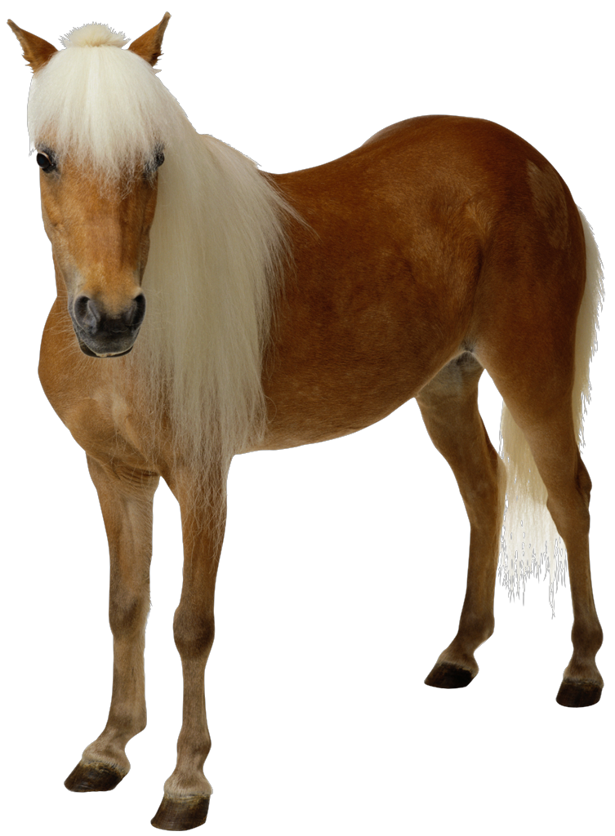
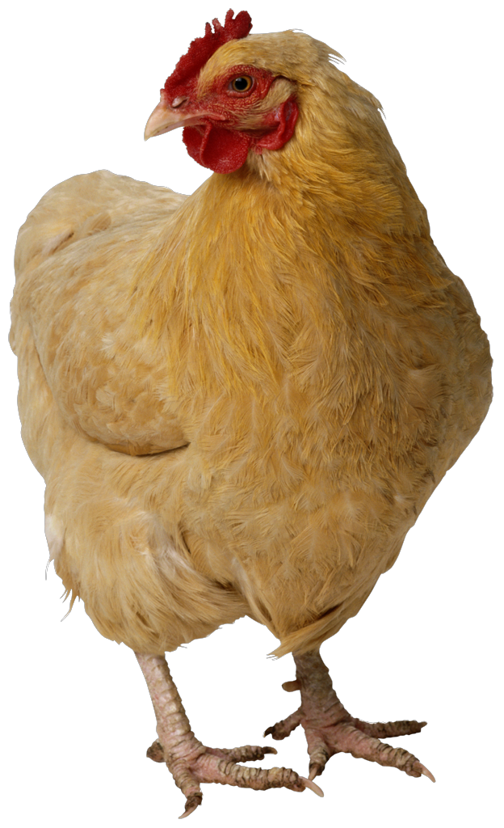
The Chicken problem
Suppose Farmer Joe looks into his farm stall and counts 24 legs. He has 3 horses. If the remaining legs are on his prized chickens, how many chickens does he have?

Slide 20
The Squares Problem
How many vertices are there in Figure 1? Figure 2? Figure 3? Figure 4? How many vertices would there be in a figure with n squares?
Figure 1 Figure 2 Figure 3 Figure 4

Slide 21
The Growing Caterpillar Problem
Day 1
Day 2
Day 3
A caterpillar grows according to the chart above. If this continues, how long will the caterpillar be on Day 4? Day5? Day 10? Day 100? Day x? (Measure length by the number of circle body parts.)

Slide 22
The Handshakes Problem
How many handshakes will there be if 3 people shake hands, with each person shaking the hands of every other person once?
How many handshakes will there be if 4 people shake hands?
How many handshakes will there be if 5 people shake hands?
How many handshakes will there be if 6 people shake hands?
How many handshakes will there be if 50 people shake hands?
How many handshakes will there be if n people shake hands?

Slide 23
The Triangle Dots Problem
The figure below contains a drawing of a 5-dot triangle made by using 5 dots on each side of the triangle. The 5-dot triangle requires a total of 12 dots to construct. How many dots will be used to make a 3-dot triangle? A 4-dot triangle? A 10-dot triangle? A 100-dot triangle? An n-dot triangle?

Slide 24
The Paper folding Problem
1. Fold the paper in half. Open the paper and count the regions.
2. Refold the paper, then fold it in half again. How many regions do you have now?
3. Fold the paper in half a third time. Count the number of regions.
4. Make a table.
5. If you continued this process until you folded your original piece of paper 10 times, how many regions would this create? (Answer this without actually folding any paper.)
f | r
1
2
3

Slide 25
A Balanced Scale Problem
Source: Stiff, L. V. and Curcio, F. R. (Eds.). 1999. Developing mathematical reasoning in grades K-12.
National Council of Teachers of Mathematics: Reston, VA. (p. 129)

Slide 26
Fill in the Blank with <, >, or =.
1.
2.

Slide 27
Looking for a Pattern
Find the remainder when $2^{625}$ is divided by 3.

