Slide 1
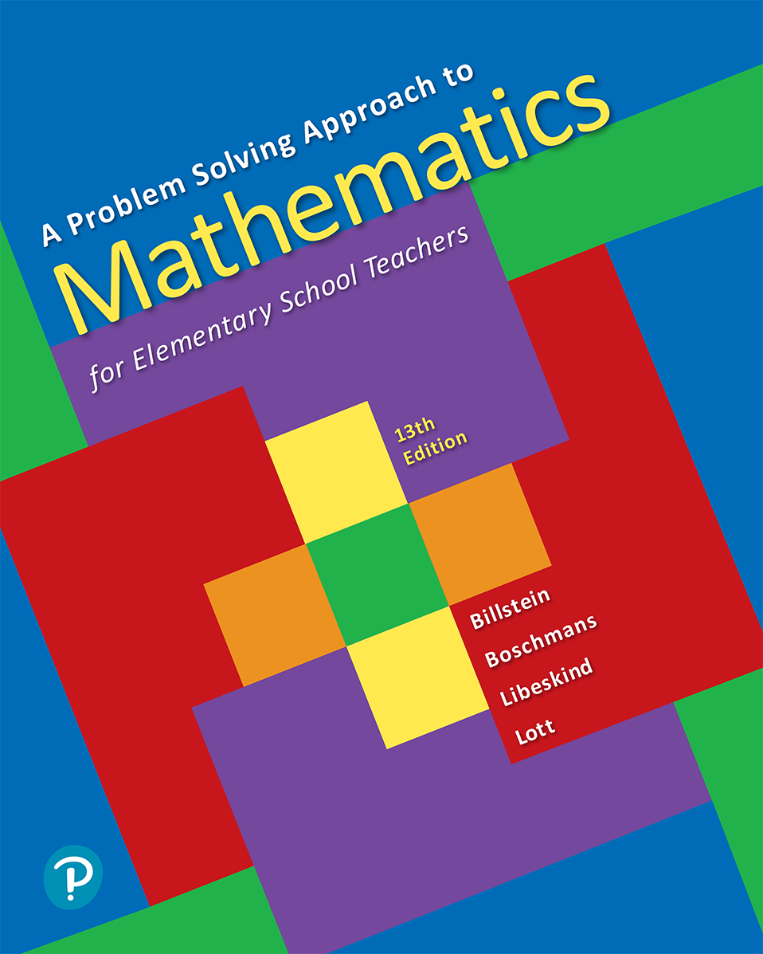
A Problem Solving Approach to Mathematics for Elementary School Teachers
Thirteenth Edition
Chapter 8
Algebraic Thinking
Copyright © 2020, 2016, 2012 Pearson Education, Inc. All Rights Reserved
Notes:
If this PowerPoint presentation contains mathematical equations, you may need to check that your computer has the following installed:
1) MathType Plugin
2) Math Player (free versions available)
3) NVDA Reader (free versions available)

Slide 2
Section 8-4 Equations in a Cartesian Coordinate System
Students will be able to understand and explain
Equations of lines.
The slope of a line and the slope formula.
Graphic and algebraic solutions for systems of linear equations.
Ways to determine if a system of linear equations has a unique solution, infinitely many solutions, or no solutions.

Slide 3
Cartesian Coordinate System (1 of 3)
The Cartesian coordinate system enables us to study both geometry and algebra simultaneously.
A Cartesian coordinate system is constructed by placing two number lines perpendicular to each other.

Slide 4
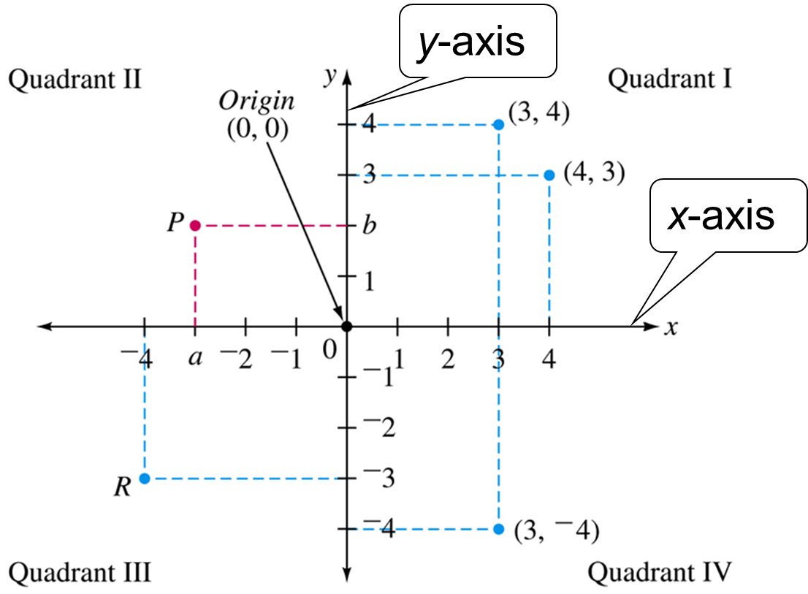
Cartesian Coordinate System (2 of 3)

Slide 5
Cartesian Coordinate System (3 of 3)
The location of any point P can be described by an ordered pair of numbers (a, b), where a perpendicular from P to the x-axis intersects at a point with coordinate a and a perpendicular from P to the y-axis intersects at a point with coordinate b;
the point is identified as

Slide 6
Equations of Vertical and Horizontal Lines (1 of 2)
Every point on the x-axis has a y-coordinate of zero. Thus, the x-axis can be described as the set of all points (x, y) such that y = 0.
The x-axis has equation y = 0.
Every point on the y-axis has a x-coordinate of zero. Thus, the y-axis can be described as the set of all points (x, y) such that x = 0 and y is an arbitrary real number.
The y-axis has equation x = 0.

Slide 7
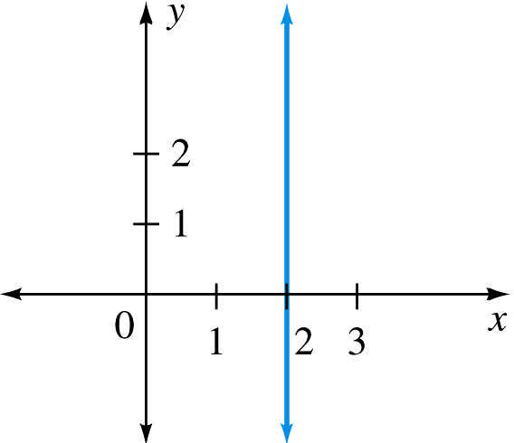
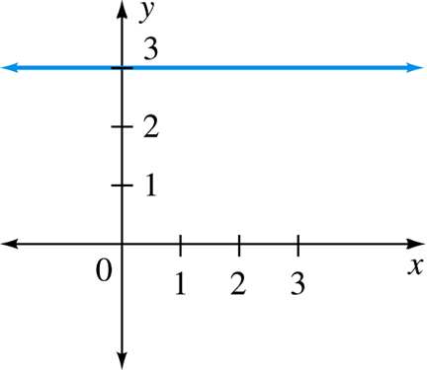
Example 16 (1 of 2)
Sketch the graph for each of the following:
a. x = 2
b. y = 3

Slide 8
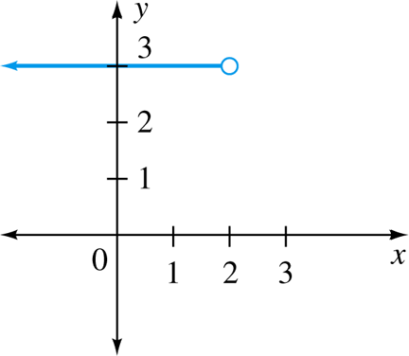
Example 16 (2 of 2)
c. {(x, y)| x < 2 and y = 3}

Slide 9
Equations of Vertical and Horizontal Lines (2 of 2)
In general, the graph of the equation x = a, where a is some real number, is the line perpendicular to the x-axis through the point with coordinates (a, 0).
Similarly, the graph of the equation y = b is the line perpendicular to the y-axis through the point with coordinates (0, b).

Slide 10
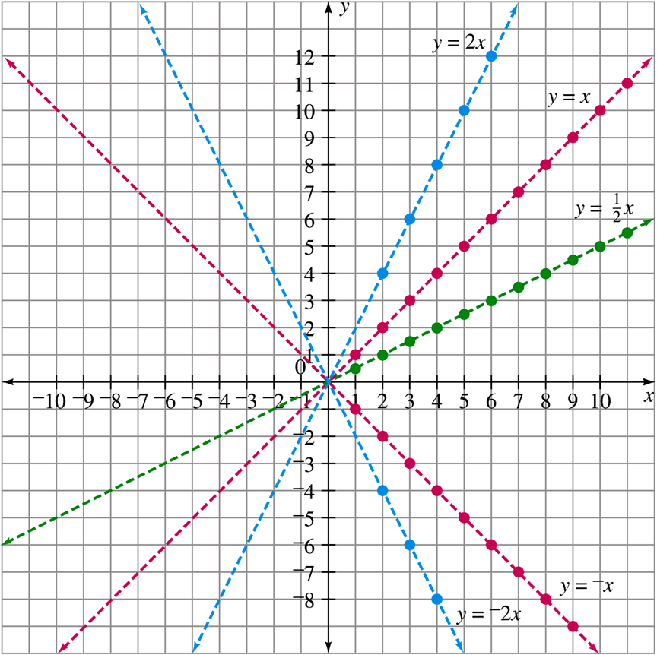
Equations of Lines (1 of 4)
All points corresponding to arithmetic sequences lie along lines.

Slide 11
Slope
The slope of the line, usually represented by m, is a measure of steepness.
m > 0
m = 0
m < 0
A line with a positive slope increases from left to right, a line with negative slope decreases from left to right, and a line with zero slope is horizontal.

Slide 12
Example 17
Find the equation of the line that contains (0, 0) and (2, 3).
The line passes through the origin, so it has the
form
Substitute 2 for x and 3 for y in the equation
and solve for m:
The equation is

Slide 13
Equations of Lines (2 of 4)
For a given value of m, the graph of
is a
straight line through (0, b) and parallel to the line
whose equation is
The graph of the line
can be obtained
from the graph of
by sliding
up (or down) b units depending on the value of b.

Slide 14
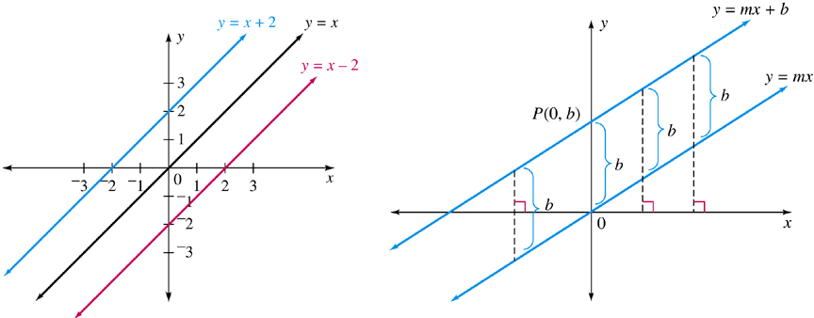
Equations of Lines (3 of 4)
Any two parallel lines have the same slope or are vertical lines with no slope.

Slide 15
Equations of Lines (4 of 4)
The graph of
crosses the y-axis at point
The value of y at the point of intersection of any line with the y-axis is the y-intercept.
The slope-intercept form of a linear equation is
The value of x at the point of intersection of any line with the x-axis is the x-intercept.

Slide 16
Example 18 (1 of 2)
Given the equation
Find the slope, the
y-intercept, the x-intercept, then graph the line.
The slope is 3 and the y-intercept is
Substitute 0 for y in the equation
to find the x-intercept.
The x-intercept is 2.

Slide 17
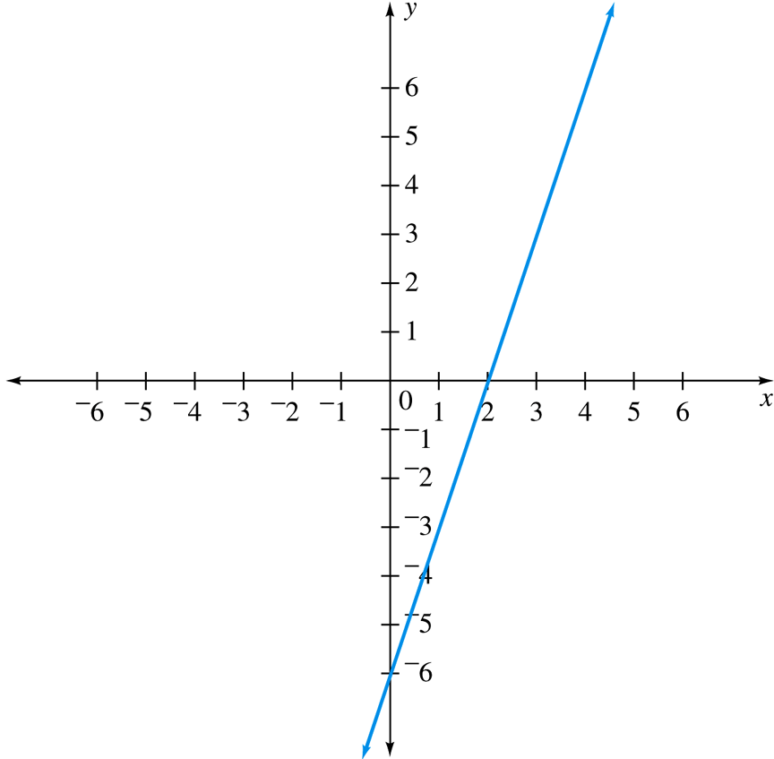
Example 18 (2 of 2)
and (2, 0) lie on
the line, so plot these points and draw the line through them.

Slide 18
Linear Equations
Every line has an equation of the form either
or x = a, where m is the slope and b is
the y-intercept.
Any equation that can be put in one of these forms is a linear equation.

Slide 19
Determining Slope
Given two points
and
with
the slope m of the line
is

Slide 20
Example 19
a. Given
and
find the slope of
b. Find the slope of the line passing through
and

Slide 21
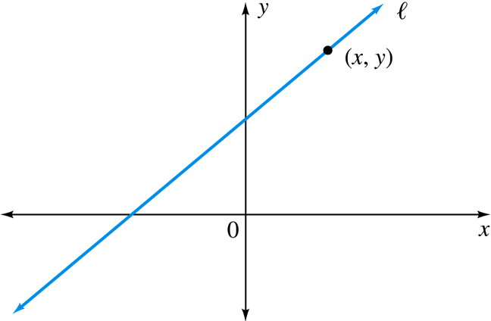
Example 21
The points
and
(1, 4) are on line l. Find the slope of the line and the equation of the line.

Slide 22
Systems of Linear Equations
The mathematical descriptions of many problems involve more than one equation, each having more than one unknown. To solve such problems, we must find a common solution to the equations, if it exists.

Slide 23
Example 22 (1 of 3)
May Chin paid $18.00 for three soyburgers and twelve orders of fries. Another time she paid $12 for four soyburgers and four orders of fries. Assume the prices have not changed. Set up a system of equations with two unknowns representing the prices of a soyburger and an order of fries, respectively.

Slide 24
Example 22 (2 of 3)
Let x be the price in dollars of a soyburger and y be the price of an order of fries.
Three soyburgers cost
dollars, and twelve
orders of fries cost
dollars.
Because May paid $18.00 for one order, we have
or
Because May paid $12.00 for the other order, we
have
or

Slide 25
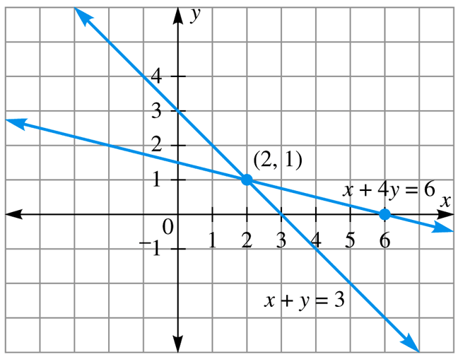
Example 22 (3 of 3)
If we graph these two lines, the point of intersection is the solution of the system.
The lines intersect at (2, 1), so a soyburger costs $2 and fries cost $1.

Slide 26
Substitution Method
Solve one of the equations for one of the variables.
Substitute this for the same variable in the other equation.
Solve the resulting equation.
Substitute the result back into step 1 to find the other variable.
Check solution(s), if required.
Write the solution.

Slide 27
Example 23 (1 of 3)
Solve the system
Rewrite one equation, expressing y in terms of x.

Slide 28
Example 23 (2 of 3)
Equate the expressions for y and solve the resulting equation for x.

Slide 29
Example 23 (3 of 3)
Now substitute
for x in
and solve
for y.
The solution of the system is

Slide 30
Elimination Method (1 of 2)
Write both equations in standard form,
Multiply both sides of each equation by a suitable real number so that one of the variables will be eliminated by addition of the equations. (This step may not be necessary.)
Add the equations and solve the resulting equation.

Slide 31
Elimination Method (2 of 2)
Substitute the value found in step 3 into one of the original equations, and solve this equation.
Check the solution(s), if required.
Write the solution.

Slide 32
Example Using The Elimination Method (1 of 3)
Solve the system
Multiply both sides of the first equation by 2.

Slide 33
Elimination Method (4 of 5)
Add the equations, then solve for x.

Slide 34
Elimination Method (5 of 5)
Now substitute
for x in either of the original
equations, then solve for y.
The solution of the system is

Slide 35
Solutions to Systems of Linear Equations
Geometrically, a system of two linear equations can be characterized as follows:
The system has a unique solution if, and only if, the graphs of the equations intersect in a single point.
The system has no solution if, and only if, the equations represent parallel lines.
The system has infinitely many solutions if, and only if, the equations represent the same line.

Slide 36
Example 24 (1 of 3)
Identify the system as having a unique solution, no solution, or infinitely many solutions.
a.
Write each equation in slope-intercept form:
The slopes of the two lines are different, so the lines are not parallel and, therefore, intersect in a single point.
There is a unique solution.

Slide 37
Example 24 (2 of 3)
b.
Write each equation in slope-intercept form:
The two lines are identical.
The system has infinitely many solutions.

Slide 38
Example 24 (3 of 3)
c.
Write each equation in slope-intercept form:
The lines have the same slope, but different y-intercepts, so they are parallel.
The system has no solution.

