Slide 1
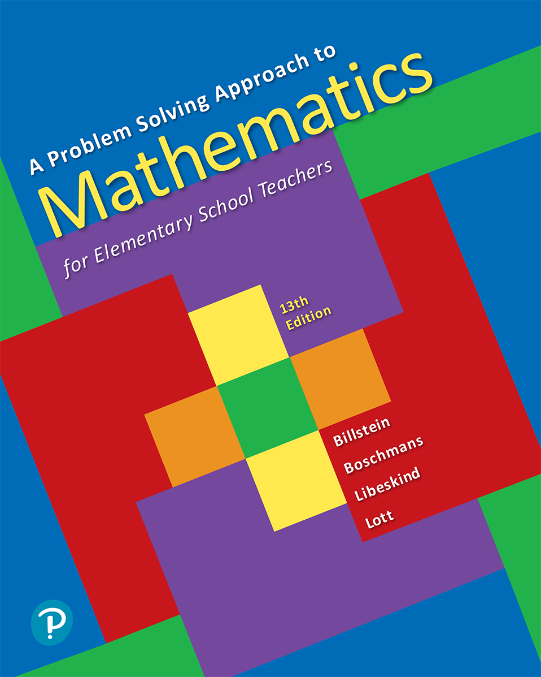
A Problem Solving Approach to Mathematics for Elementary School Teachers
Thirteenth Edition
Chapter 8
Algebraic Thinking
Copyright © 2020, 2016, 2012 Pearson Education, Inc. All Rights Reserved
Notes:
If this PowerPoint presentation contains mathematical equations, you may need to check that your computer has the following installed:
1) MathType Plugin
2) Math Player (free versions available)
3) NVDA Reader (free versions available)

Slide 2
Section 8-3 Functions
Students will be able to understand and explain
The concept of a function including domain and range.
Different representations of functions.
Derivation of the formulas for the sum of n terms of arithmetic and geometric sequences.

Slide 3
Functions as Rules
One can think of a function as a “rule” whereby when one value is given, the function, or “rule,” specifies a resulting value.

Slide 4
Example 7 (1 of 2)
Guess the teacher’s rule for the following responses.
a.
Student | Teacher
1 | 3
0 | 0
4 | 12
10 | 30
b.
Student | Teacher
2 | 5
3 | 7
5 | 11
10 | 21
a. Multiply the given number n by 3, that is
b. Double the original number n and add 1, that is

Slide 5
Example 7 (2 of 2)
Guess the teacher’s rule for the following responses.
c.
Student | Teacher
2 | 0
4 | 0
7 | 1
21 | 1
c. If the number n is even, answer 0; if the number is odd, answer 1.
Note that other answers are possible.

Slide 6
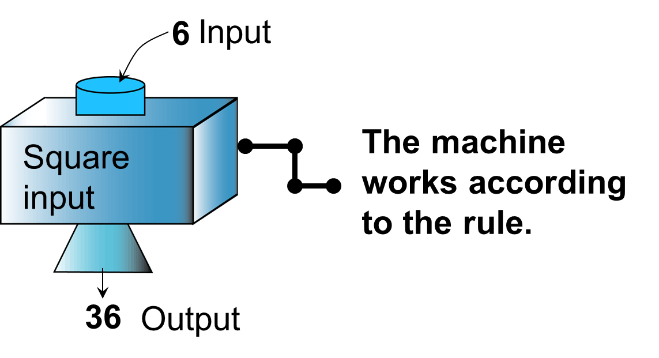
Functions as Machines
Another way to think of a function is a machine. The machine has an input and an output.

Slide 7
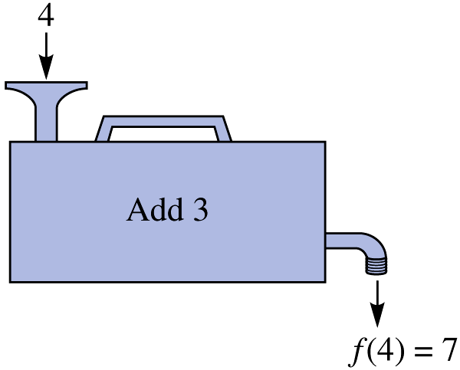
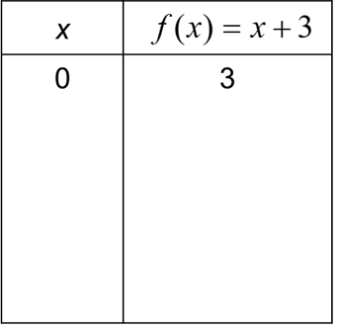
Example 8
For the function named f, what will happen if the numbers 0, 1, 3, 4 and 6 are input?

Slide 8
Functions as Equations
We can write an equation to depict the rule in the previous example. If the input is x, the output is

Slide 9
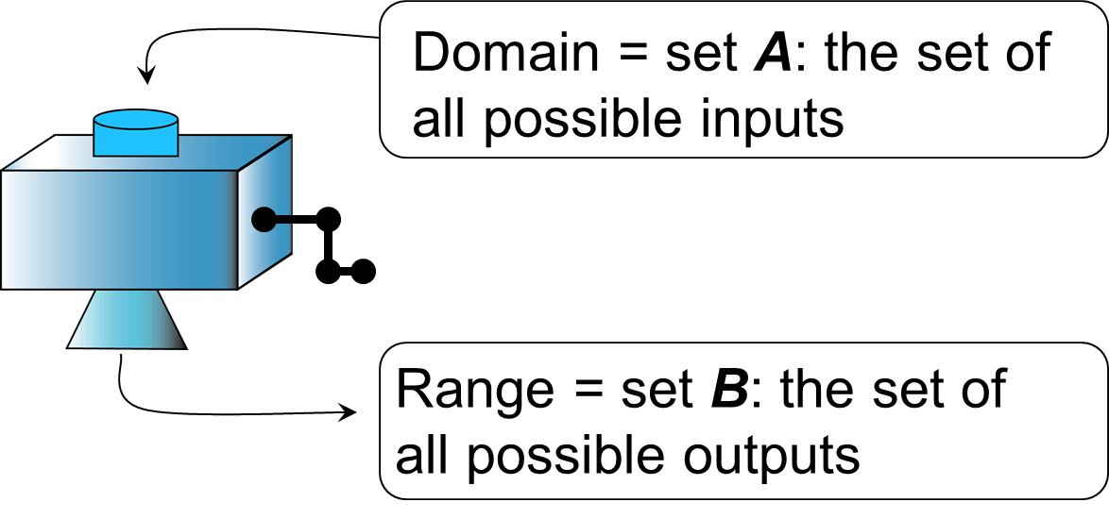
Definition of Function
A function from set A to set B is a correspondence from A to B in which each element of A is paired with one, and only one element of B.

Slide 10
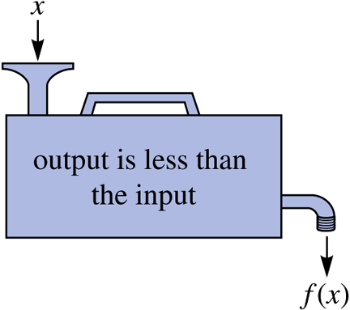
Functions
Is this input-output machine a function machine? For any natural-number input x, the machine outputs a number that is less than x.
No. For example, if you input the number 10, the machine may output 9, since 9 is less than 10. If you input 10 again, the machine may output 3, since 3 is less than 10.
This is not a function machine because the same input may give different outputs.

Slide 11
Example 9 (1 of 3)
A bicycle manufacturer incurs a daily fixed cost of $1400 for overhead expenses and a cost of $500 per bike manufactured. a. Find the cost
of manufacturing x bikes in a day.
Since the cost of producing a single bike is $500,
the cost of producing x bikes is
dollars.
Because of the fixed cost of $1400 per day, the
total cost,
in dollars, of producing x bikes in a
given day is

Slide 12
Example 9 (2 of 3)
b. If the manufacturer sells each bike for $700, and the profit (or loss) in producing and selling x bikes
in a day is
in terms of x.

Slide 13
Example 9 (3 of 3)
c. Find the break-even point, that is, the number of bikes, x, produced and sold at which break-even occurs (to break even means to make neither a profit nor a loss).
We need to find the number of bikes x to be
produced so that
The manufacturer needs to produce and sell 7 bikes to break even.

Slide 14
Functions as Arrow Diagrams
Arrow diagrams can be used to determine whether a correspondence represents a function.
This is a function.
This is not a function.

Slide 15
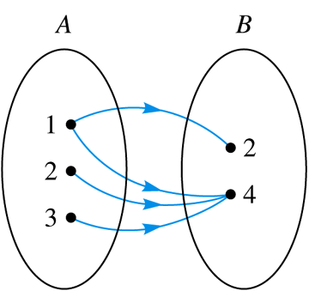
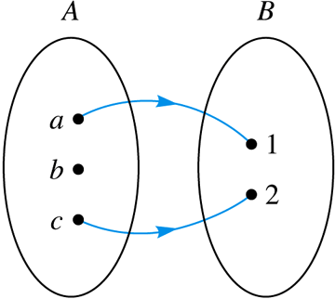
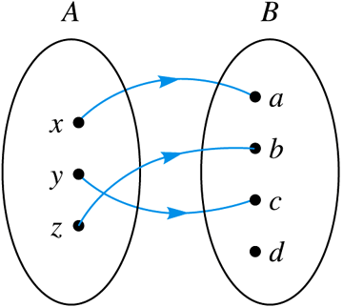
Example 10 (1 of 2)
Which, if any, of the figures exhibit a function from A to B? If a correspondence is a function from A to B, find the range of the function.
Not a function
Function Range:
Not a function

Slide 16
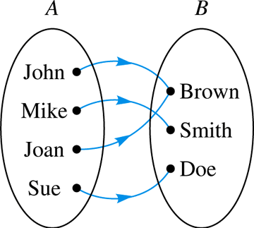
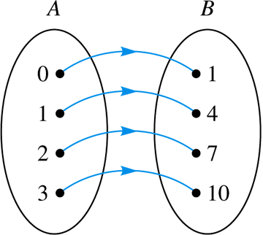
Example 10 (2 of 2)
Function Range:
Function Range:

Slide 17
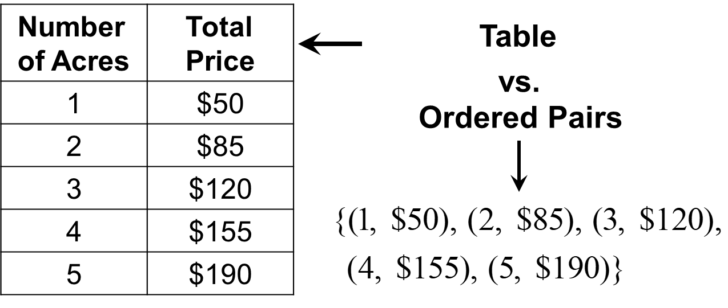
Functions as Tables and Ordered Pairs
The L & B Lawn Service distributes the following fee schedule to their customers. It gives the price for mowing large lots given the number of acres in the lot.

Slide 18
Example 11 (1 of 2)
Which of the following sets of ordered pairs represent functions? If a set represents a function, give its domain and range. If it does not, explain why.
a.
Not a function because the input 1 has two different outputs.
b.
Function. Domain:
Range:

Slide 19
Example 11 (2 of 2)
c.
Function. Domain:
Range:
d.
Function. Domain: N. Range: E, the set of all even numbers.

Slide 20
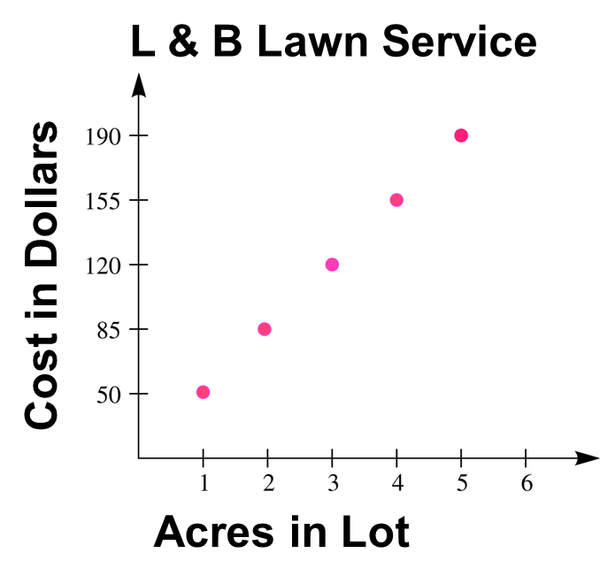
Functions as Graphs
Graphs are probably the most commonly known ways of representing functions.

Slide 21
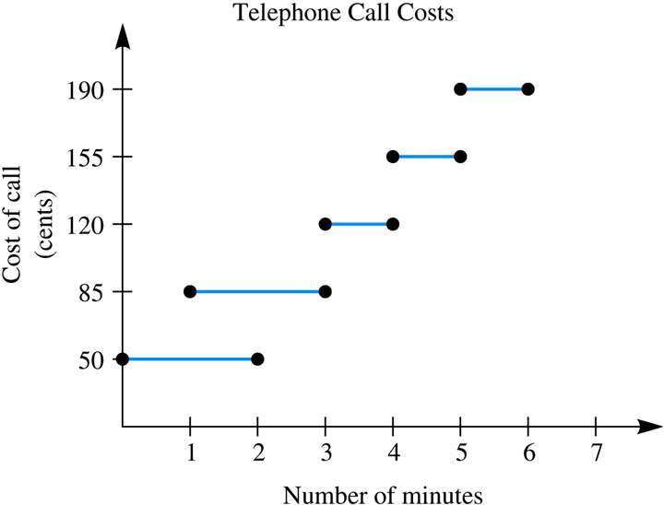
Example 12 (1 of 2)
Explain why a telephone company would not set rates for telephone calls as depicted on the graph.

Slide 22
Example 12 (2 of 2)
The graph does not depict a function.
For example, a customer could be charged either $0.50 or $0.85 for a 2-min call; thus, not every input has a unique output.

Slide 23
Sequences as Functions
Arithmetic, geometric, and other sequences can be thought of as functions whose inputs are natural numbers and whose outputs are the terms of a particular sequence.
For example, the arithmetic sequence
whose nth term is
can be described as a
function from the set N (natural numbers) to the set E (even natural numbers) using the rule
where n is a natural number and
stands for the value of the nth term.

Slide 24
Example 13
If
denotes the nth term of a sequence, find
in terms of n for each of the following.
a. An arithmetic sequence whose first term is 3 and whose difference is 3.
where n is a natural number.
b. A geometric sequence whose first term is 3 and whose ratio is 3.
where n is a natural number.

Slide 25
Sums of Sequences as Functions (1 of 2)
The sum of n terms of an arithmetic sequence with
first term
and nth term
is given by

Slide 26
Example 14
Find the sum of the first 100 terms of the following
arithmetic sequence:
The difference is

Slide 27
Sums of Sequences as Functions (2 of 2)
The sum of n terms of a geometric sequence
whose first term is
whose ratio is
is

Slide 28
Example
Find the first 10 terms of the geometric sequence:
The ratio:
Sum:

Slide 29
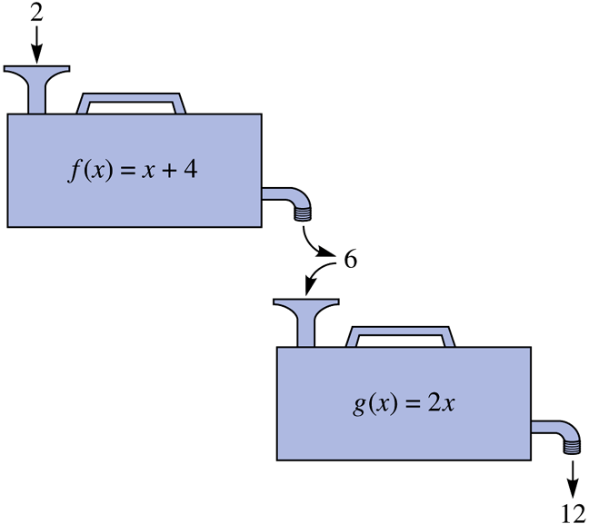
Composition of Functions
If 2 is entered in the top
machine, then
The number 6 is then entered in the second
machine and
This illustrates composition of functions.
Note the range of f is the domain of g.

Slide 30
Example 15 (1 of 2)
If
find the following:
a.
b.

Slide 31
Example 15 (2 of 2)
c.
d.

