Slide 1
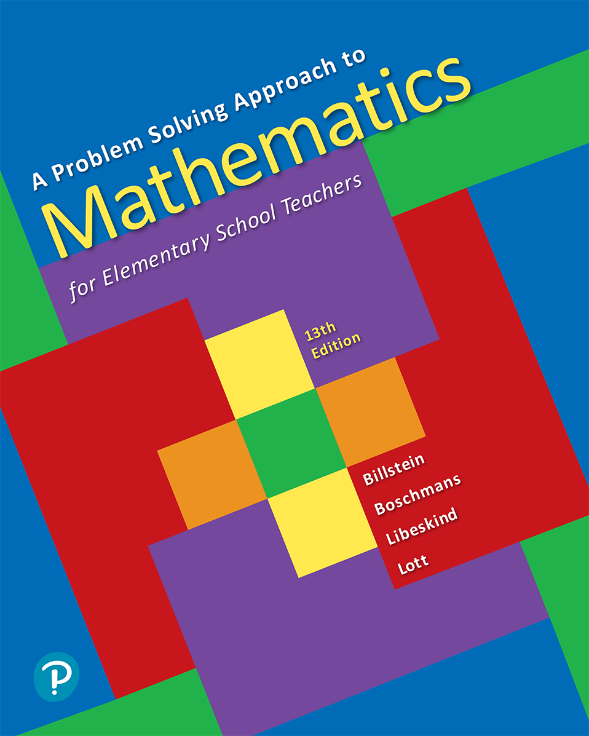
A Problem Solving Approach to Mathematics for Elementary School Teachers
Thirteenth Edition
Chapter 8
Algebraic Thinking
Copyright © 2020, 2016, 2013 Pearson Education, Inc. All Rights Reserved
Notes:
If this PowerPoint presentation contains mathematical equations, you may need to check that your computer has the following installed:
1) MathType Plugin
2) Math Player (free versions available)
3) NVDA Reader (free versions available)

Slide 2
Section 8-2 Equations
Students will be able to understand and explain
Properties of equality and equations.
Solutions of equations using properties of equations.
Solutions of word problems.

Slide 3
Properties of Equality (1 of 2)
Addition Property of Equality
For any real numbers a, b and c, if a = b, then a + c = b + c.
Multiplication Property of Equality
For any real numbers a, b and c, if a = b, then

Slide 4
Properties of Equality (2 of 2)
Cancellation Properties of Equality
For any real numbers a, b and c, if a + c = b + c then a = b.
For real any numbers a, b and c, with
if
then a = b.

Slide 5
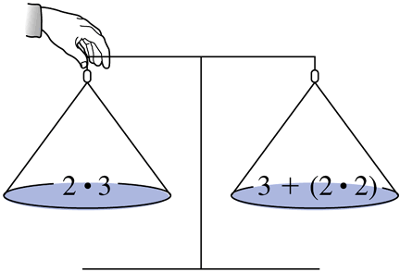
Solving Equations (1 of 4)
The balance-scale model is an excellent way to foster understanding of the basic concepts used in solving equations and inequalities, and equations can be explored using a balance scale. Inequalities tilt the scale.
If the pan on the left is released, the scale will tilt down on the right side. We have an inequality.

Slide 6
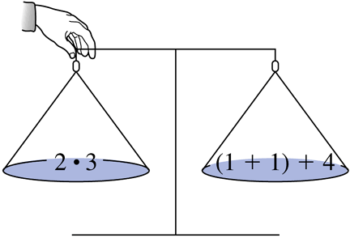
Solving Equations (2 of 4)
If the pan on the left is released, the scale will balance. We have an equality.

Slide 7
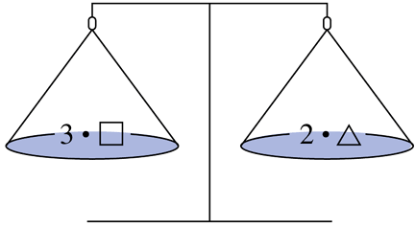
Solving Equations (3 of 4)
Find some solutions for the variables that will keep the scale balanced.

Slide 8
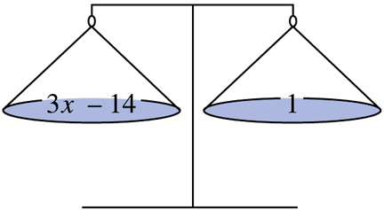
Solving Equations (4 of 4)
Solve for x:

Slide 9
Example 6 (1 of 2)
Solve each of the following for x.
a.
b.
c.

Slide 10
Example 6 (2 of 2)
Solve each of the following for x.
d.

Slide 11
Problem Solving: Overdue Books
Bruno has five books overdue at the library. The
fine for overdue books is
a day per book. He
remembers that he checked out an astronomy book a week before he checked out four novels. If his total fine was $8.70, how long was each book overdue?

Slide 12
Understand the Problem (1 of 2)
Bruno has five books overdue. He checked out an astronomy book seven days earlier than the four novels, so the astronomy book is overdue seven days more than the novels. The fine per day for
each book is
and the total fine was $8.70. We
need to find out how many days each book is overdue.

Slide 13
Devise a Plan (1 of 4)
Let d be the number of days that each of the four novels is overdue. The astronomy book is overdue seven days longer, that is, d + 7 days. The total fine is $8.70. This fine in cents equals the fine for the astronomy book plus the fine for the four novels.
Fine for each of the novels = fine per day times number of overdue days

Slide 14
Devise a Plan (2 of 4)
Fine for the four novels = 1 day’s fine for novels times number of overdue days
Fine for the astronomy book = fine per day times number of overdue days
Fine for the novels + fine for the astronomy book = total fine

Slide 15
Carry Out the Plan (1 of 2)
Solve the equation for d.
Each of the four novels was 16 days overdue, and the astronomy book was d + 7 = 23 days overdue.

Slide 16
Look Back (1 of 2)
Each of the four novels was 16 days overdue, and the astronomy book was 23 days overdue.
Because the fine was
per day per book, the
fine for each of the novels was
Hence, the fine for all four novels was
The fine for the astronomy book was
The total fine was
which
agrees with the given information.

Slide 17
Problem Solving: Newspaper Delivery
In a small town, three children deliver all the newspapers. Abby delivers 3 times as many papers as Bob, and Connie delivers 13 more than Abby. If the three children delivered a total of 496 papers, how many papers does each deliver?

Slide 18
Understand the Problem (2 of 2)
The problem asks for the number of papers that each child delivers. It gives information that compares the number of papers that each child delivers as well as the total number of papers delivered in the town.

Slide 19
Devise a Plan (3 of 4)
Let a, b, and c be the number of papers delivered by Abby, Bob, and Connie, respectively.
Abby delivers 3 times as many papers as Bob:
Connie delivers 13 more papers than Abby:
c = a + 13
Total delivery is 496:
a + b + c = 496

Slide 20
Devise a Plan (4 of 4)
To reduce the number of variables, substitute
for a in the second and third equations:
c = a + 13 becomes
a + b + c = 496 becomes
Make an equation in one variable, b, by substituting
for c in the equation
solve for b, and then find a and c.

Slide 21
Carry Out the Plan (2 of 2)
Solve the equation for b.
So, Abby delivers 207 papers, Bob delivers 69 papers, and Connie delivers 220 papers.

Slide 22
Look Back (2 of 2)
The information in the first sentence, “Abby delivers 3 times as many papers as Bob,” checks, since
The second sentence, “Connie delivers 13 more papers than Abby,” is true because 220 = 207 + 13.
The information on the total delivery checks, since 207 + 69 + 220 = 496.

