Slide 1
A Problem Solving Approach to Mathematics for Elementary School Teachers
Thirteenth Edition
Chapter 8
Algebraic Thinking
Copyright © 2020, 2016, 2013 Pearson Education, Inc. All Rights Reserved
Notes:
If this PowerPoint presentation contains mathematical equations, you may need to check that your computer has the following installed:
1) MathType Plugin
2) Math Player (free versions available)
3) NVDA Reader (free versions available)

Slide 2
Section 8-1 Variables
Students will be able to understand and explain
Variables to translate word phrases into algebraic expressions.
Solving equations and word problems.
The formula for the nth term of arithmetic and geometric sequences.

Slide 3
Variables
Variables can be used in generalizations of patterns. If we were to use actual values instead of variables, the instructions would only apply to a limited set of situations.
A variable can also be an element of a set, or a set itself; for example, in the definition of the
intersection of two sets
x is any element that belongs to both sets.

Slide 4
Example 1 (1 of 4)
Write each of the following statements in algebraic form:
a. The cost of renting a car for any number of days at $40 per day
40n dollars
b. The distance a car traveled at a constant speed of 65 mph for any number of hours.
65h miles

Slide 5
Example 1 (2 of 4)
c. One weekend, a store sold twice as many 8-G B flash drives as 64-G B flash drives and 25 fewer 256-G B drives than 8-G B drives. If the store sold d 64-G B drives, how many 256-G B drives and 8-G B drives did it sell?
Because d 64-G B drives were sold, twice as many 8-G B drives as 64-G B drives implies 2 d 8-G B drives. Thus, 25 fewer 256-G B drives than 8-G B drives implies 2 d − 25 256-G B drives.

Slide 6
Example 1 (3 of 4)
d. French fries have about 3 calories apiece. A hamburger has about 250 calories. Mateo is on a diet of 1200 calories per day. If he ate f french fries and one hamburger, how many more calories can he consume that day?
First, find how many calories Mateo consumed eating f french fries and one hamburger. Then, to find how many more calories he can consume, subtract this expression from 1200

Slide 7
Example 1 (4 of 4)
Therefore, the number of calories in f french fries
and one hamburger is
The number of calories left for the day is

Slide 8
Example 2 (1 of 5)
A teacher instructed a student as follows:
Take any number and add 15 to it. Now multiply that sum by 4. Next subtract 8 and divide the difference by 4. Now subtract 12 from the quotient and tell me the answer. I will tell you the original number.
Analyze the instructions to see how the teacher was able to determine the original number.

Slide 9
Example 2 (2 of 5)
Translate the information into an algebraic form:

Slide 10
Example 2 (3 of 5)
Translating what the teacher told the class to do results in the algebraic expression
The teacher is told the answer obtained and then she produces the original number. Use the work-backward strategy to determine what happens.

Slide 11
Example 2 (4 of 5)
Suppose the final result is r.
The last step was to subtract 12, so we add 12 to
reverse that operation:
The step before that was to divide by 4. To reverse
that, we multiply
The step before that was to subtract 8. To reverse
that, we add 8 to

Slide 12
Example 2 (5 of 5)
The step before that was to multiply by 4, so we
divide
The step before that was to add 15, so we
subtract 15 from
Thus, the original number is 1 less than the result or the result is 1 more than the original number.

Slide 13
Example 3 (1 of 2)
In an arithmetic sequence with the second term 11
and the fifth term 23, find the 100th term.

Slide 14
Example 3 (2 of 2)
In an arithmetic sequence with the second term 11
and the fifth term 23, find the 100th term.
To find the first term, we have
To find the 100th term.

Slide 15
Example 4 (1 of 2)
a. Find the nth term of the following geometric
sequence:
Ratio of the sequence can be found by dividing
two consecutive terms
Formula for the nth term is

Slide 16
Example 4 (2 of 2)
b. If a geometric sequence has first term 3 and ratio
find its 10th term.

Slide 17
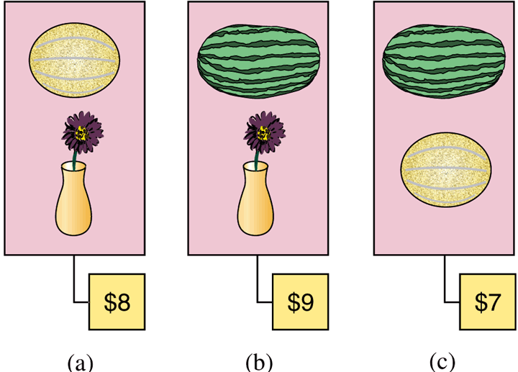
Example 5 (1 of 3)
At a local farmer’s market, three purchases were made for the prices shown in the figure. How much does each object cost?

Slide 18
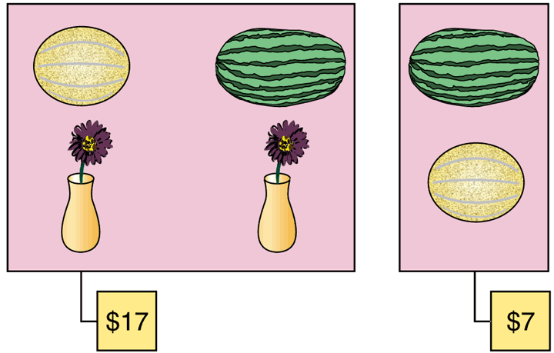
Example 5 (2 of 3)
Suppose the objects in the first two purchases are put together.
The cost for two vases, a cantaloupe, and a watermelon is $17.

Slide 19
Example 5 (3 of 3)
Now if the cantaloupe and watermelon are taken away from that total, then according to the cost of those two objects from the tag on the right, the cost should be reduced to $10 for two vases. That means each of the two vases costs $5.
This in turn tells us that the cantaloupe costs
and the watermelon costs

