Slide 1
Early Algebra ECE Course Dr. Geoff Clement, July 2017

Slide 2
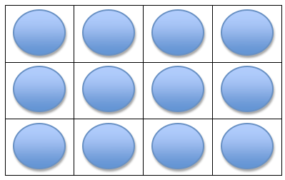
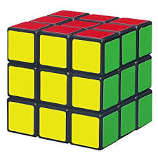
Exponents Introduction
Repeated addition is a way to look at _____________________ .
For example, 3 + 3 + 3 + 3 = ________ .
Repeated multiplication is equivalent to
_________________ .
For example, 3 × 3 × 3 × 3 = ________ .

Slide 3
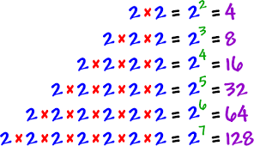

Slide 4
Exponents Introduction
For each figure, give the corresponding base and exponent, then give the meaning and value of each of these expressions.

Slide 5
Exponents Introduction
Write each expression as an exponent, and then find its value.
2 × 2 × 2 × 2 × 2 × 2 × 2 × 2 × 2 × 2
5 × 5 × 5 × 5 × 5 × 5 × 5
3 × 3 × 3 × 3
10 × 10 × 10 × 10 × 10 × 10

Slide 6
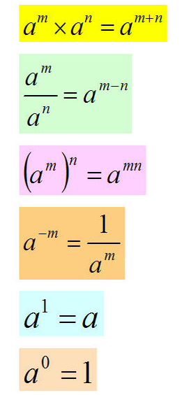
Exponents Rule!

Slide 7
Multiplying Two Powers With the Same Base

Slide 8
Dividing Two Powers With the Same Base

Slide 9
Finding a power of a power

Slide 10
Numbers Raised to Negative Exponents

Slide 11
Raising a Number to the Zero Power

Slide 12
Raising a Product to a Power

Slide 13
Raising a Quotient to a Power

Slide 14
Examples

Slide 15
Examples

Slide 16
Examples

Slide 17
A mixture of many of the rules . . .

Slide 18
A mixture of many of the rules . . .

