Slide 1
Library of Functions
COLLEGE ALGEBRA

Slide 2
The Building Blocks
There are some basic building block functions that typically dominate algebra courses. What follows are images from a Texas Instruments graphing calculator, along with a brief description for 7 of these major functions. For each function, we also include both an x-y table of ordered pairs and the corresponding graph.
For each of these functions, the Y = input is shown on the next slide, along with the window used for all graphs.

Slide 4
THE SQUARING FUNCTION

Slide 5
The SQUARING FUNCTION
The first function in our chart is the squaring function y = x² whose graph is the parabola shown on the previous slide. This is a simple quadratic function, and its main feature is its vertex, the point given by (0, 0). Its domain includes any real numbers, and its range is all nonnegative real numbers (y ≥ 0). This is an even function, with symmetry about the y-axis (the line x = 0).

Slide 6
THE IDENTITY (LINEAR) FUNCTION

Slide 7
THE IDENTITY (LINEAR) FUNCTION
Next, we have the simplest of all linear functions, known as the identity function, y = x. This line passes through the origin (its x- and y-intercept), and its slope is m = 1. This line “splits” the first and third quadrants, making a 45° angle with the positive x-axis.

Slide 8
The SQUARE ROOT Function
The square root function, y = sqrt(x) or y = √(x) resembles the squaring function. Its domain is x ≥ 0, and its range is y ≥ 0. Its endpoint is the origin, (0, 0). Notice the error message in the table: √(-1) = i (the imaginary unit).

Slide 9
THE ABSOLUTE VALUE FUNCTION

Slide 10
THE ABSOLUTE VALUE FUNCTION
The absolute value function, y = |x| , makes a “V” shape, splitting both the first and second quadrants. The angle formed by the equation is a right angle, and the minimum point or vertex of the angle is the origin. Its x- and y-intercepts are also (0, 0). Its domain is all real numbers, and its range is y ≥ 0. Just like the squaring function, this is an even function with symmetry about the y-axis.

Slide 11
THE RATIONAL FUNCTION

Slide 12
THE RATIONAL FUNCTION
The next function, a rational function given by the equation y = 1/x, has several unique features. The curve approaches the line y = 0 as x increases toward positive infinity and approaches the same line as x decreases toward negative infinity. This line is called a horizontal asymptote. Clearly x cannot be zero (a domain issue since division by 0 is not defined). Notice the “ERROR” message in the table. As x values approach 0 from the right side, y values approach +∞, and as x values approach 0 from the left side, y values approach -∞, . The line x = 0 is called a vertical asymptote. This is also considered an odd function, with point symmetry about the origin (180° rotational symmetry).

Slide 13
THE CUBING FUNCTION
The next two functions are related. The cubing function, y = x³, shown on the next slide has an inflection point at the origin. This is the point about which the curve has 180° rotational symmetry. The point (0, 0) is also the x- and y-intercept of the graph. Like the rational function, this is an odd function.

Slide 14
THE CUBING FUNCTION

Slide 15
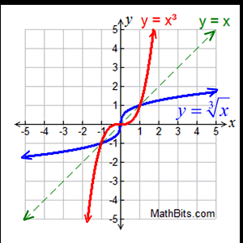
THE CUBE ROOT FUNCTION
The cube root function is considered the inverse of the cubing function. [There will be more about inverses later in the course.] This function (blue in the graph below) has the point (0, 0) as the x- and y-intercept, and the origin is also a point about which the curve has 180° rotational symmetry. You should see some similarities and differences between the cubing and cube root graphs and tables.

Slide 16
THE CUBE ROOT FUNCTION

Slide 17
THE UNIT CIRCLE
There are MANY other interesting basic curves. We include two more.
Here is a circle with center (0, 0) and radius 1 unit. The circle is called a unit circle and is a major part of the study of trigonometry.
Its equation is x² + y² = 1, and this graph has reflectional symmetry about the x- and y-axis. It also has point symmetry about the origin. The circle is the perfectly symmetrical shape.

Slide 18
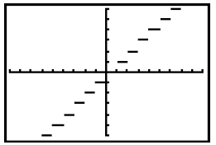
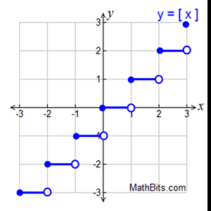
THE GREATEST INTEGER (≤) Function

Slide 19
THE GREATEST INTEGER (≤) Function
And lastly, the greatest integer function is a type of step function in which the steps are one unit long and the segments are closed on the left side and open on the right side. The equation is given by y = int(x) or y = [[x]], and y values are defined as the greatest integer less than or equal to given x values. For instance, the greatest integer less than or equal to 5.1, 5.5 and 5.9 is 5 each time, so the points (5.1, 5), (5.5, 5) and (5.9, 5) are all on one of the steps. Similarly, the greatest integer less than or equal to 2 is 2 and –3 is –3, so the points (2, 2) and (-3, -3) are on the graph; both are left endpoints of a step. The greatest integer less than or equal to –0.1, -0.5 and –0.99 is –1 each time, so the points (-0.1, -1), (-0.5, -1), and (-0.99, -1) are all on one of the steps.

