Slide 1
Exponent Rules & Scientific Notation
Geoff Clement, July 2013

Slide 2
“The Big Three”
We assume
a ≠ 0.

Slide 3
Examples

Slide 4
Examples

Slide 5
Related Rules
We assume
a ≠ 0 and b ≠ 0.

Slide 6
The Home Stretch
We assume
a ≠ 0 and b ≠ 0.

Slide 7
Examples

Slide 8
Examples

Slide 9
A mixture of many of the rules . . .

Slide 10
Scientific Notation
We assume 1 ≤ a < 10
and b is an integer.

Slide 11
Scientific Notation
We assume 1 ≤ a < 10
and b is an integer.

Slide 12
Fascinating Examples
The body of a 150-lb person contains 2.3 x 10^{–4} lb of copper. What percent of the person’s body weight is composed of copper?

Slide 13
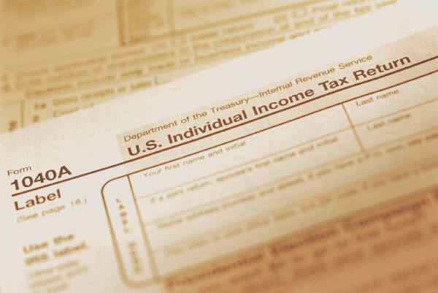
Fascinating Examples
In a recent tax year, the IRS averaged collecting $7,000 per person in the U.S. If the population of taxpayers in that year was 140,000,000, find the total revenue they collected.

Slide 14

Fascinating Examples
1 “light year” is defined as the distance light travels in one Earth year. The speed of light is roughly .
Approximate the number of miles in a light year.

