Slide 1
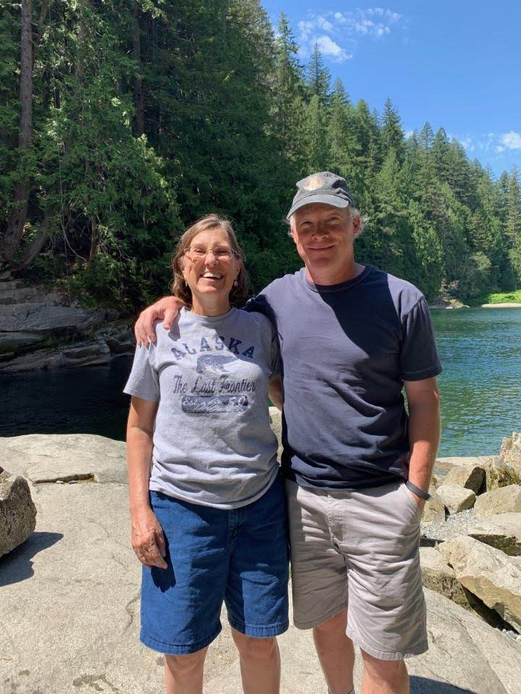
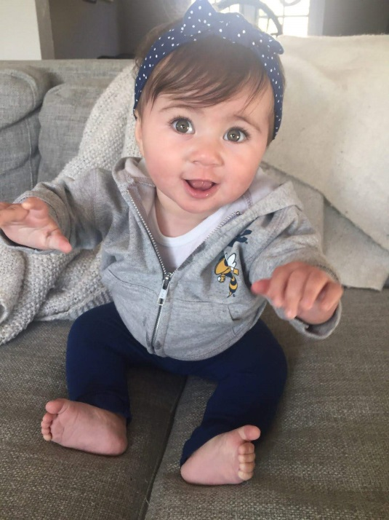
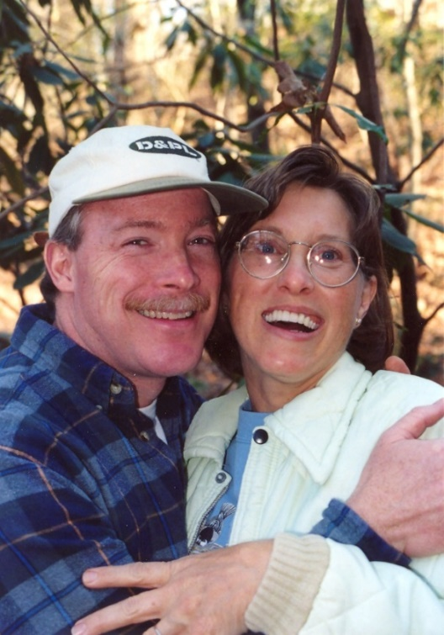
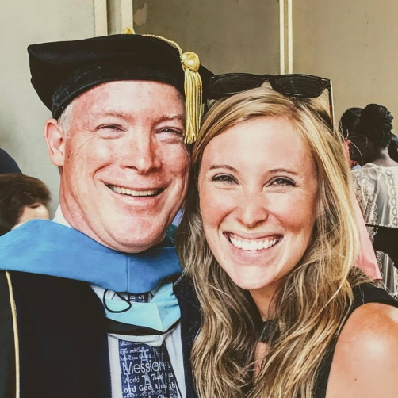
Dr. Geoff F. Clement
Personal Introduction

Slide 2
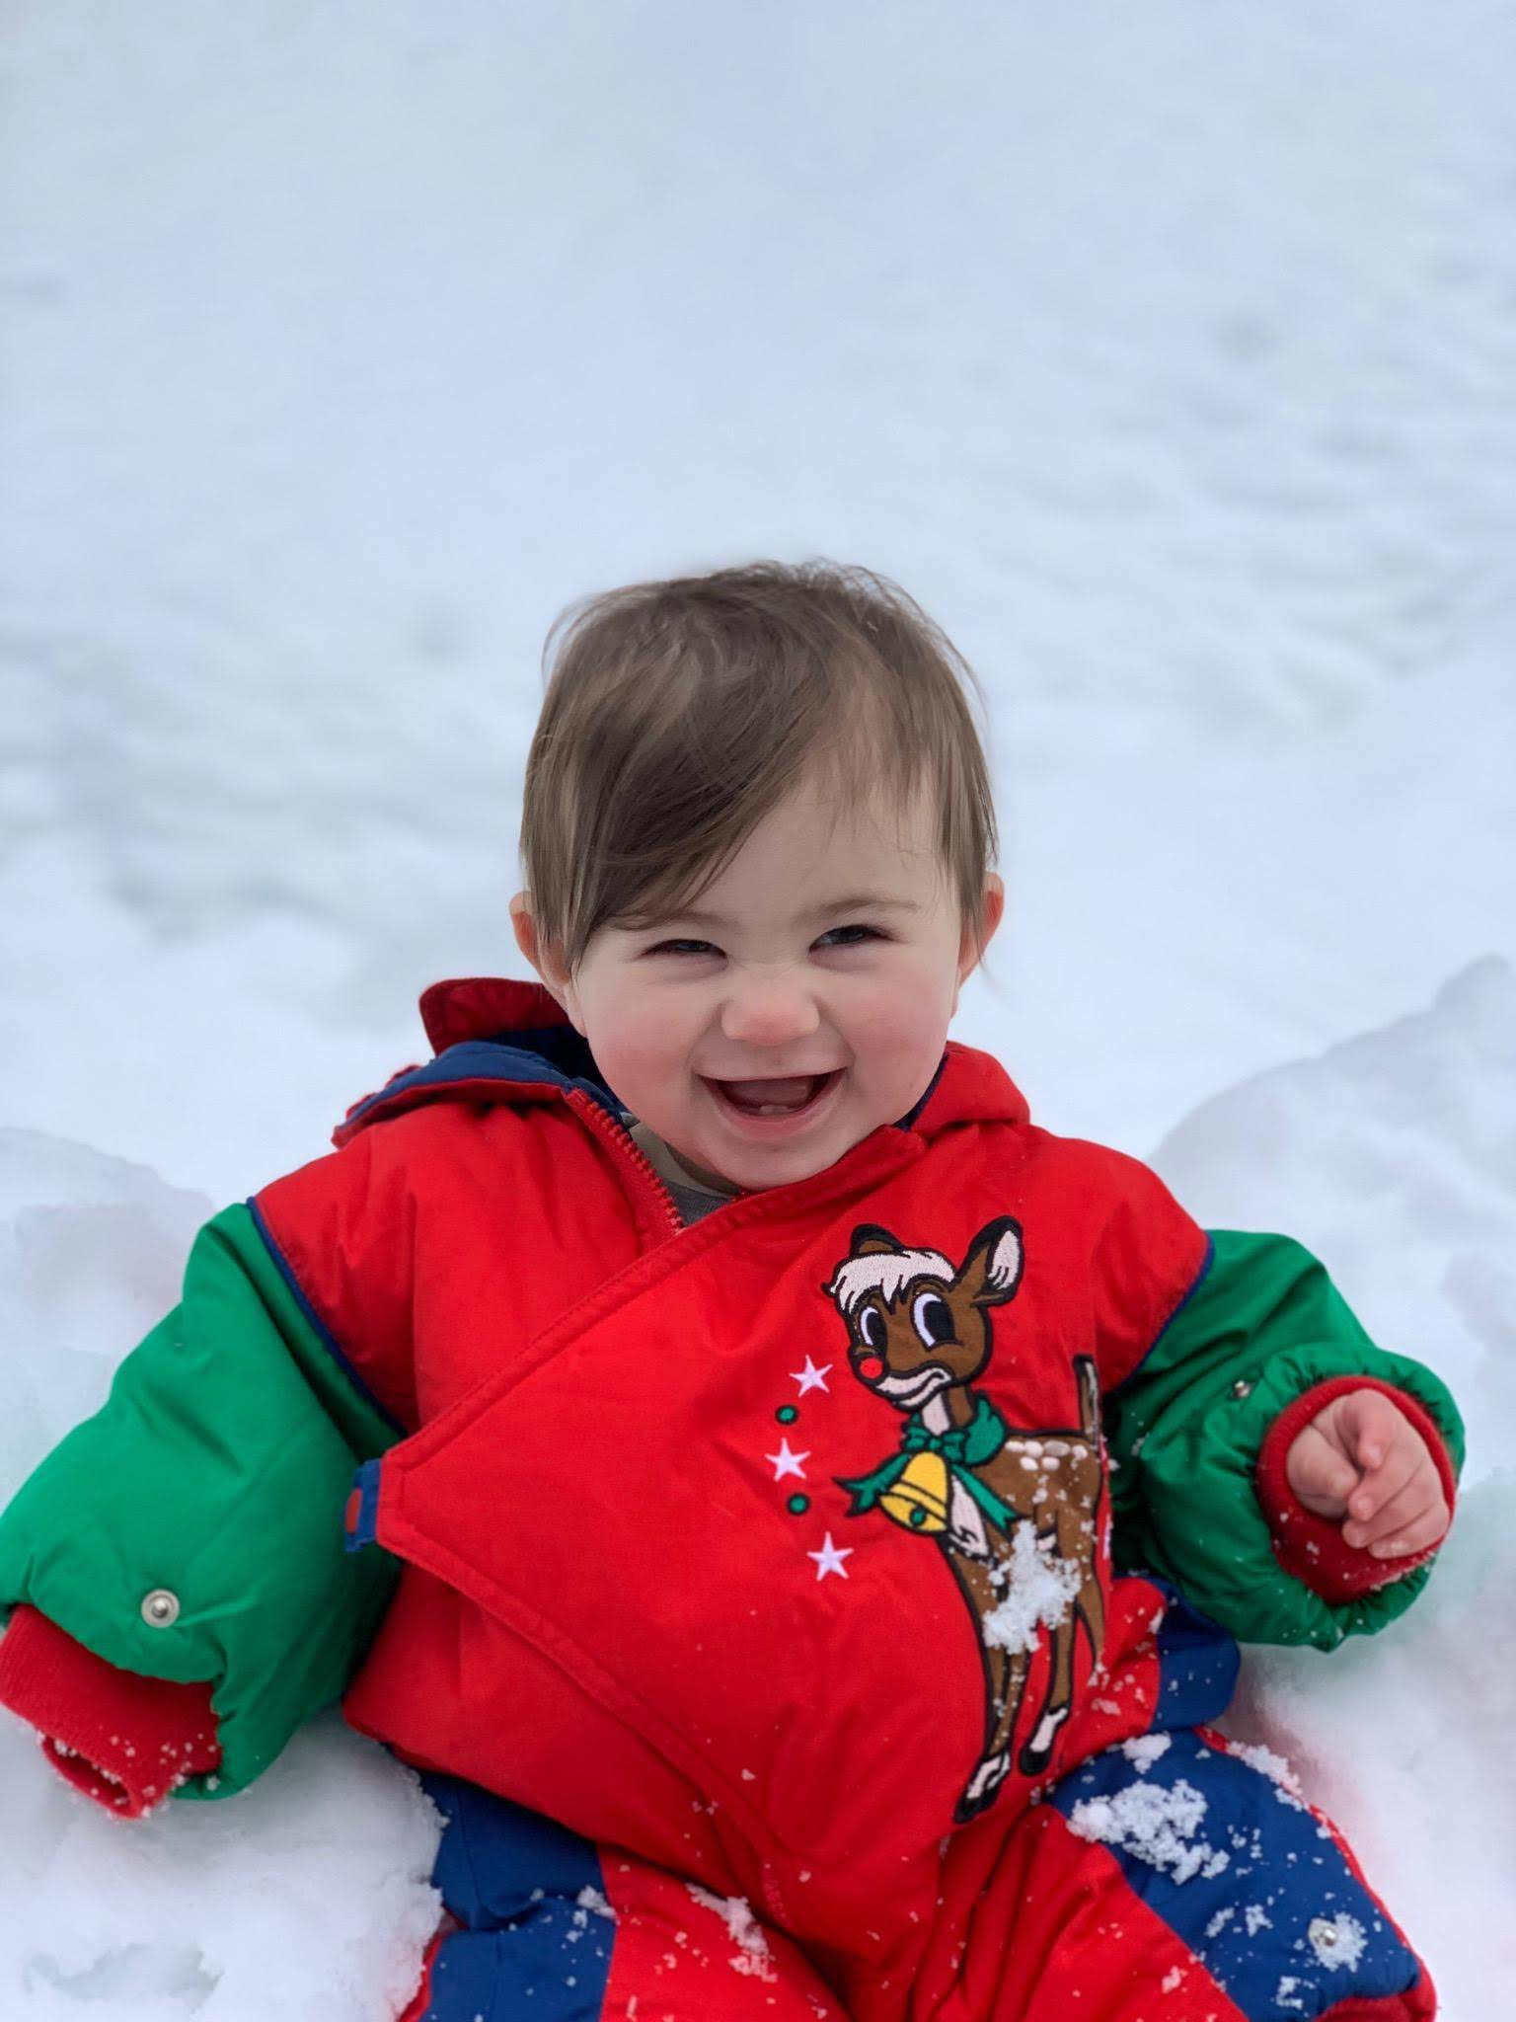
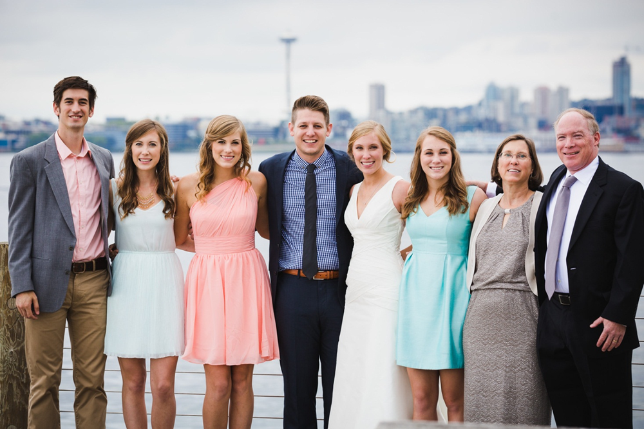
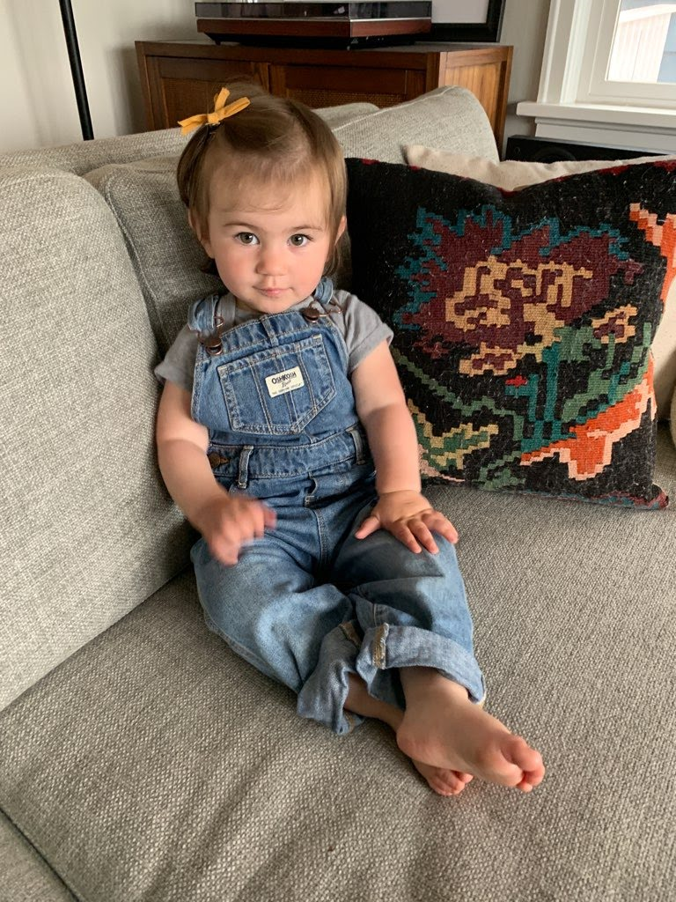
Family life

Slide 3
Education
I grew up in Atlanta, and earned my B.S. degree in Mathematics from Emory University in 1983. I finished my M.Ed. degree in Math Education at Georgia State University in 1987. Thirty years later, in 2017, I completed an Ed. D. degree in Curriculum and Instruction with an emphasis on early childhood and elementary education/mathematics education at Georgia State University.

Slide 4
Teaching & Learning
My peers voted me College Park High “Teacher of the Year” in 1988 (Fulton Co. Schools).
At ABAC, I was awarded the Donaldson Award for Teaching Excellence during the 2001-2002 academic year and again during the 2007-2008 academic year.
I strive to use the gifts God has given me and give Him glory for anything He has done in and through me as a classroom instructor of a variety of mathematics and mathematics education classes over the years.

Slide 5
Education/Teaching Career
I have enjoyed teaching high school and middle school math for a total of 11 years in College Park, in Colombia (South America), and in Coffee County, and I taught at ABAC (Abraham Baldwin Agricultural College) from 1995-2011 (16 years). Though I loved ABAC, I have been glad to be at Gordon State College since 2011.

Slide 6
Important numbers in my life
44
8/10/1961
5/31/1962
11/23/1985
4
6
13 (and counting!)
38 (and counting!)
π
3^5

Slide 7
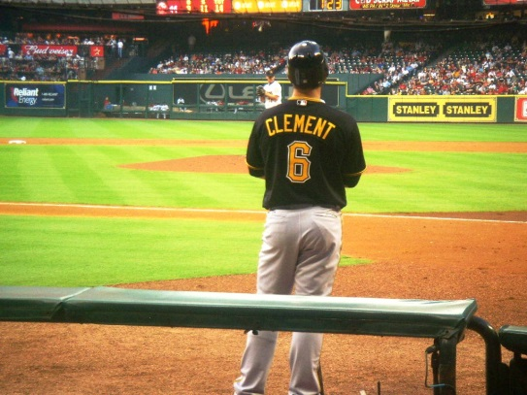
Hobbies and Interests
I enjoy biking, walking my dog (Ramsey), watching movies, woodworking (lately with pallet wood), yard work, reading, sports, and, of course, math problems! I am especially interested in international methods for teaching operations and problem solving.
I am very grateful for God's grace and love through Jesus Christ. I desire to honor Him in my life as a husband, father, teacher, and granddad (Calla’s “Pops”), and in my church and community involvement.
I hope you "live and learn", enjoying the process of working hard and having breakthroughs in understanding, and that you "do your best" to "rise to the challenge" of MKT/doing mathematics!

Slide 8
Publications
Dissertation: Exploring the influence of the Singapore Modeling Method on prospective elementary teachers in a university mathematics course (2017)
Roundtable presentation at CIES Conference (2017)
Submitted for publication in 2018 to The New Educator and PRIMUS
Math 1101 Mathematical Modeling Textbook (Written in 2000 and revised in 2003, 2005, and 2008)

