Slide 1
Elementary and Middle School Mathematics Teaching Developmentally 10th Edition
Chapter 9
Developing Basic Fact Fluency
Copyright © 2019, 2016, 2013 Pearson Education, Inc. All Rights Reserved
Notes:
If this PowerPoint presentation contains mathematical equations, you may need to check that your computer has the following installed:
1) MathType Plugin
2) Math Player (free versions available)
3) NVDA Reader (free versions available)

Slide 2
Learner Outcomes
9.1 Describe approaches to developing fact fluency, especially the three-phase strategy-based process.
9.2 Illustrate strategies for helping students derive addition, subtraction, multiplication, and division facts.
9.3 Justify an effective approach for reinforcing and remediating basic fact fluency.

Slide 3
Standards-Based Development
K-2 Fact fluency begins in kindergarten and continues through grade 2.
Grade 2 Students must know addition facts from memory or automaticly and multiplication, and division fact fluency begins.
Grade 3 Multiplication and division fact mastery or automaticity is often expected by the end of grade 3.

Slide 4
Developmental Phases for Learning the Basic Facts (1 of 2)
Phase 1: Counting strategies - Using object counting or verbal counting to determine the answer (Chapters 7-8)
Phase 2: Reasoning strategies - Using known information to logically determine an unknown combination (Chapter 9)
Phase 3: Mastery - Producing answers efficiently (Chapter 9)

Slide 5
Developmental Phases for Learning the Basic Facts (2 of 2)
Blank | Addition | Subtraction
Counting | Direct modeling (counting objects and fingers) Counting all Counting on from first Counting on from larger Counting abstractly Counting all Counting on from first Counting on from larger | Counting objects Separating from Separating to Adding on Counting fingers Counting down Counting up Counting abstractly Counting down Counting up
Reasoning | Properties ɑ + 0 = ɑ ɑ + 1 = next whole number Commutative property Known-fact derivations (e.g., 5 + 6 = 5 + 5 + 1; 7 + 6 = 7 + 7 − 1) Redistributed derived facts (e.g., 7 + 5 = 7 + (3 + 2) = (7 + 3) + 2 = 10 + 2 = 12) | Properties ɑ - 0 = ɑ ɑ - 1 = previous whole number Inverse/complement of known addition facts (e.g., 12 − 5 is known because 5 + 7 = 12) Redistributed derived facts (e.g., 12 − 5 = (7 + 5) − 5 = 7 + (5 − 5) = 7)
Retrieval | Retrieval from long-term memory | Retrieval from long-term memory

Slide 6
Approaches to Teaching the Basic Facts
Memorization of facts - Four operations total over 300 facts - There is strong evidence that this does not work - inefficient, inflexibility, and inappropriate applications
Explicit strategy instruction - Support student thinking by giving them a choice of strategies to use in recall of facts.
Guided invention - Students select a strategy based on their knowledge of number relationships.

Slide 7
Teaching Basic Facts Effectively
Story problems provide a context that help students understand the situation and apply flexible strategies for doing the computation.
Example of a problem that students could use Making 10 strategy.
Rachel had 9 ponies in one barn and 6 ponies the pasture. How many ponies did she have altogether?
Using Quick Images moves students beyond counting to seeing the way numbers can be composed and decomposed.
Explicit teaching of reasoning strategies is for students to make use of known facts and relationships to derive unknown facts.
Example of Double and add one more set

Slide 8
Assessing Basic Facts Effectively
Three reasons NOT to use Timed Tests:
They do not assess the four elements of fluency (flexibly, accurately, efficiently ad appropriately solve problems).
They negatively affect students number sense and recall of facts.
They take up time that could be used in more meaningful learning experiences.

Slide 9
Effective Strategies for Assessing Basic Fact Fluency
Aspects of Fluency | Observation | Interview Probes | Writing (Journals or Tests)
Appropriate strategy selection | As they play a game, are they picking a strategy that makes sense for that fact? For example, for 9 + 2 they might count on, but not for 9 + 6. | Nicolas solved 6 + 8 by changing it in his mind to 4 + 10. What did he do? Is this a good strategy? Tell why or why not. | Review the multiplication table. Write which facts are your “toughies.” Next to each one, tell a strategy that you want to remember to use.
Flexibility | As for strategy selection, do they pick Making 10 for 9 + 6? Do they notice that 8 × 3 is also 3 × 8? | Solve 6 × 7 using one strategy. Now try solving it using a different strategy. | Explain how you think about these two problems: 13 − 3 = 12 − 9 =
Efficiency | How long does it take to select a strategy? Are they quick to use doubles? Does efficiency vary with certain facts, like facts over 10 (add) or the 7s facts (multiply)? | Go through this stack of cards and sort by the ones you just know and the ones you use a strategy. | Solve these (basic fact) problems (provide a set of 10). If you just knew the answer, circle it. If you used a strategy, write the strategy’s name (e.g., Close Fact).
Accuracy | Which facts are they consistently getting correct? | What is the answer to 7 × 8? How do you know it is correct (how might you check it)? | Review your (3s facts) with your partner. Make a stack of the ones when you were correct and not correct. Record which facts you have “down pat” and which you are still learning.

Slide 10
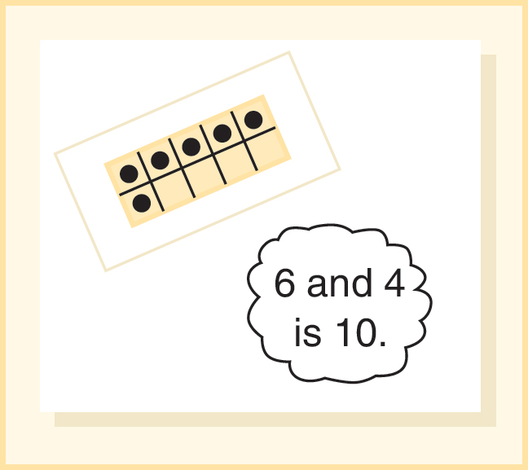
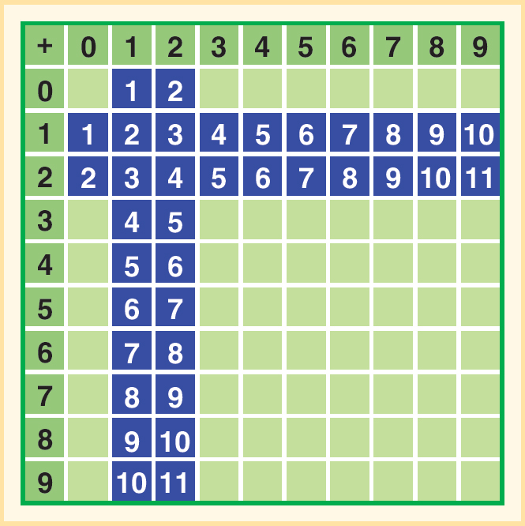
Reasoning Strategies for Addition Facts (1 of 4)
Combinations of 10
One more than and two more than (Count on)
36 highlighted facts have at least one addend of 1 or 2
Foundational fact - Consider this story situation:
Ten boys and girls are on the bus. How many girls and boys are on the bus altogether?
Story problems are easy to make up.

Slide 11
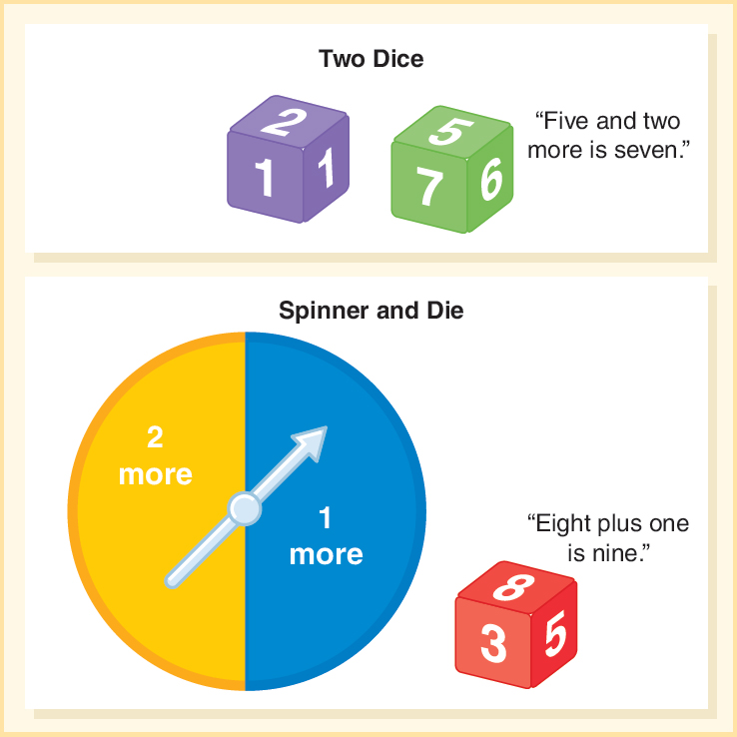
Activity 9.3
Materials:
One die with +1, +2, +1, +2 and one more, two more
Spinner with 2 more, 1 more
One die with 3, 4, 5, 6, 7, 8
Directions - Children roll dice and say the complete fact 2 plus 5 is 7.
Children spin and roll die and say the complete fact 1 plus 8 is 9.

Slide 12
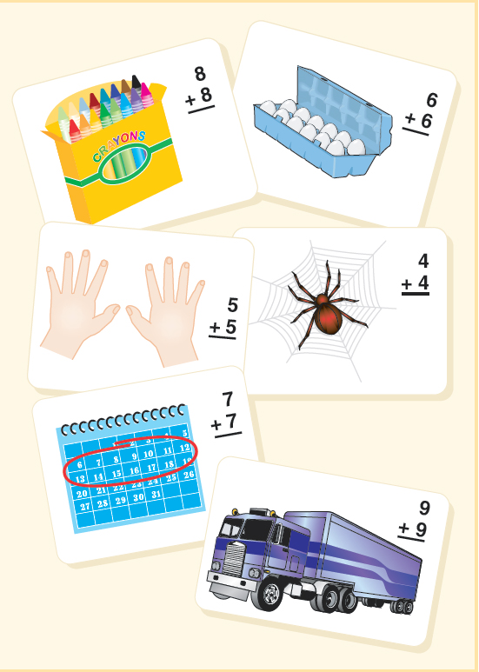
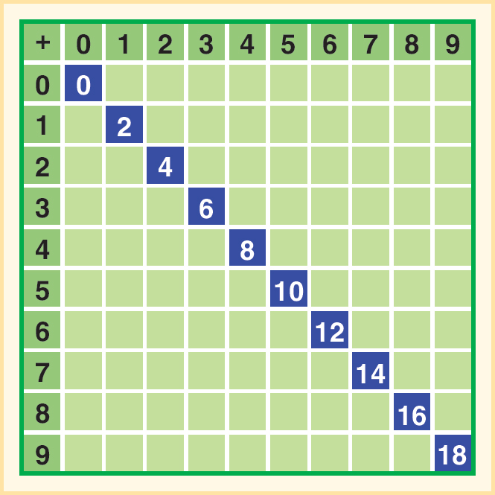
Reasoning Strategies for Addition Facts (2 of 4)
Doubles have a rhythmic nature and can be anchors for other facts.
Situations for doubles facts

Slide 13
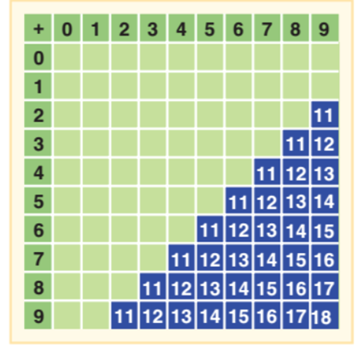
Reasoning Strategies for Addition Facts (3 of 4)
Combinations of 10 and 10+ fill in the blank facts are prerequisite for Making 10. All basic facts with sums greater between 11 and 20 can be solved by using the Making 10 strategy.
Also called
Breaking Apart to Make Ten
Up Over 10
Can be applied to larger numbers
28 + 7 = 30 + 5

Slide 14
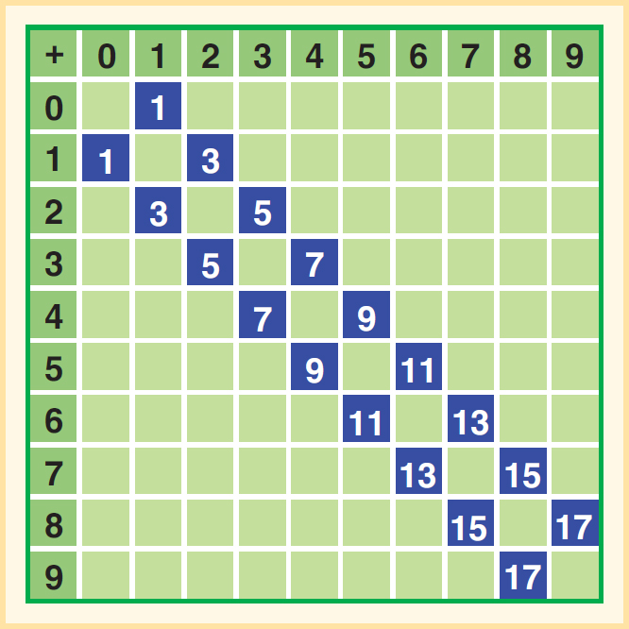
Reasoning Strategies for Addition Facts (4 of 4)
Using 5 as an anchor means looking for five in the numbers of the problem.
7 + 6
Sees 7 as 5 + 2
Sees 6 as 5 + 1
Student then adds 5 + 5 (=10) and the 1 one from the six and 2 from the 7 adding up to 13 total.
Near Doubles - Doubles plus one; this strategy uses a known fact to derive an unknown fact.
Write 5+ 5 and near double 5 + 6 right underneath

Slide 15
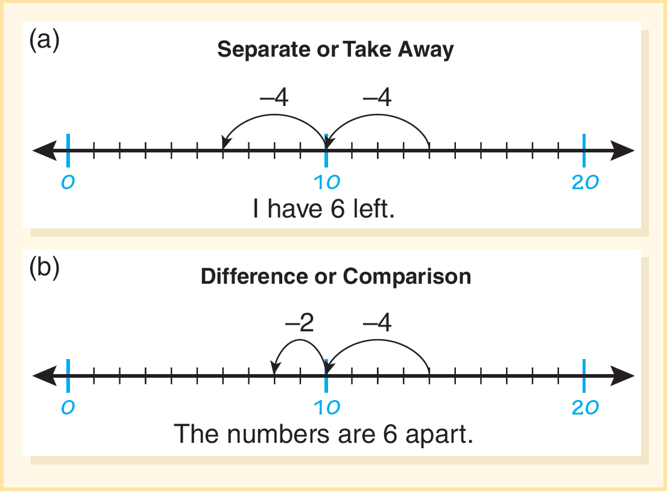
Reasoning Strategies for Subtraction Facts
Think-addition - Use known addition facts to produce the unknown quantity or part of the subtraction.
Story problems promote think-addition. For example,
Janice had 5 fish in her aquarium. Grandma gave her some more fish. Then she had 12 fish. How many fish did grandma give Janice?
Down Under 10 − Reverse of Making 10
14 − 8 = 14 – 4 – 4
Separate situation where student takes 4 to get to ten and then 4 more to 6.
Comparison or difference - Finding how far apart are 14 and 8? Jump down 4 to 10 and 2 more to 8. This makes them 6 apart.

Slide 16
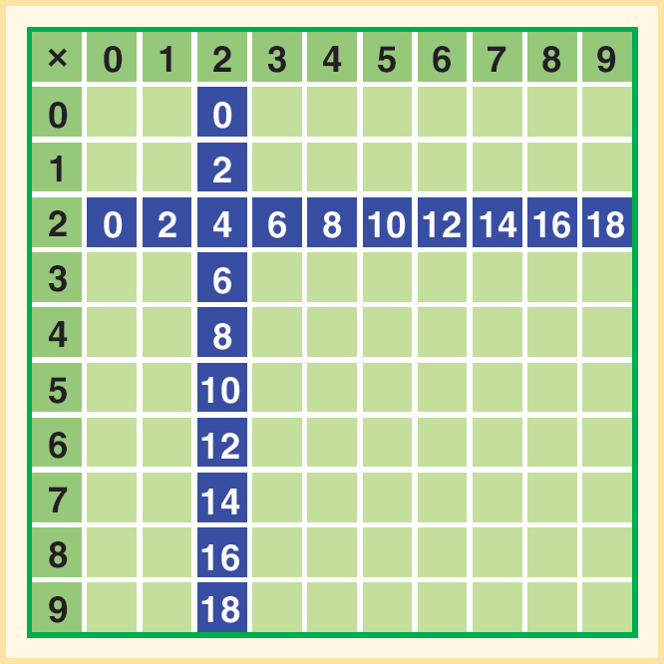
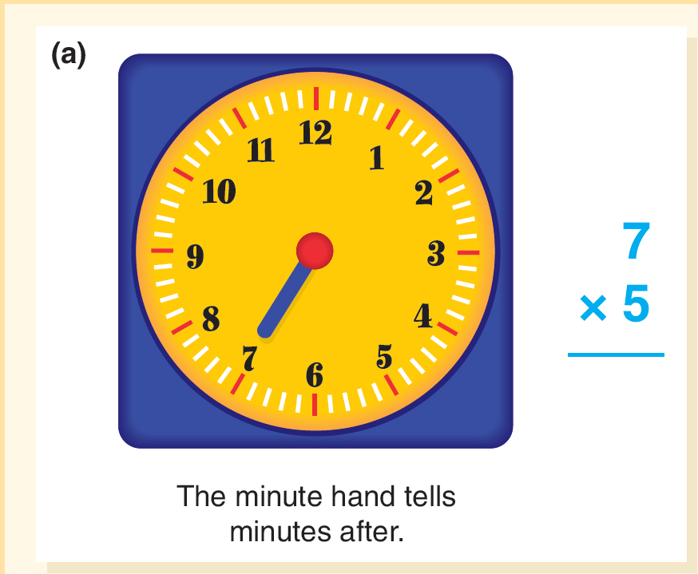
Reasoning Strategies For Multiplication and Division Facts (1 of 3)
Foundational Facts: 2,5, 10, 0,1
Activity 9.13 Fives
Materials - Cock face with hands
Try this - George was making sock puppets. Each puppet needed 2 buttons for eyes. If George makes 7 puppets how many buttons will he need for eyes?
Directions - How many minutes is it past the hour?
Relating the 5s to the clock

Slide 17
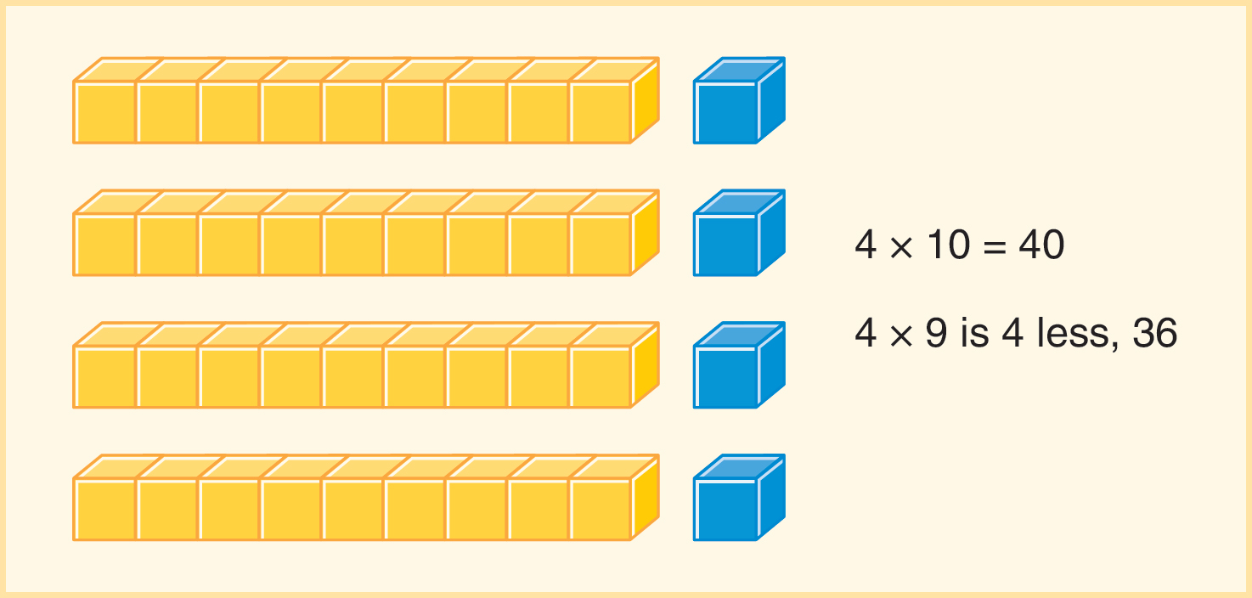
Reasoning Strategies For Multiplication and Division Facts (2 of 3)
Nines can be derived from 10s − 4 × 9 can be found by finding 4 × 10 and removing one set of 4.
Nifty Nines - Nine facts have interesting patterns
Hold up fingers and starting with pinky count to the fourth finger and bend it down- you have 3 to the left of the folded finger and 6 to the right.
3 tens and six to the right to equal 36

Slide 18
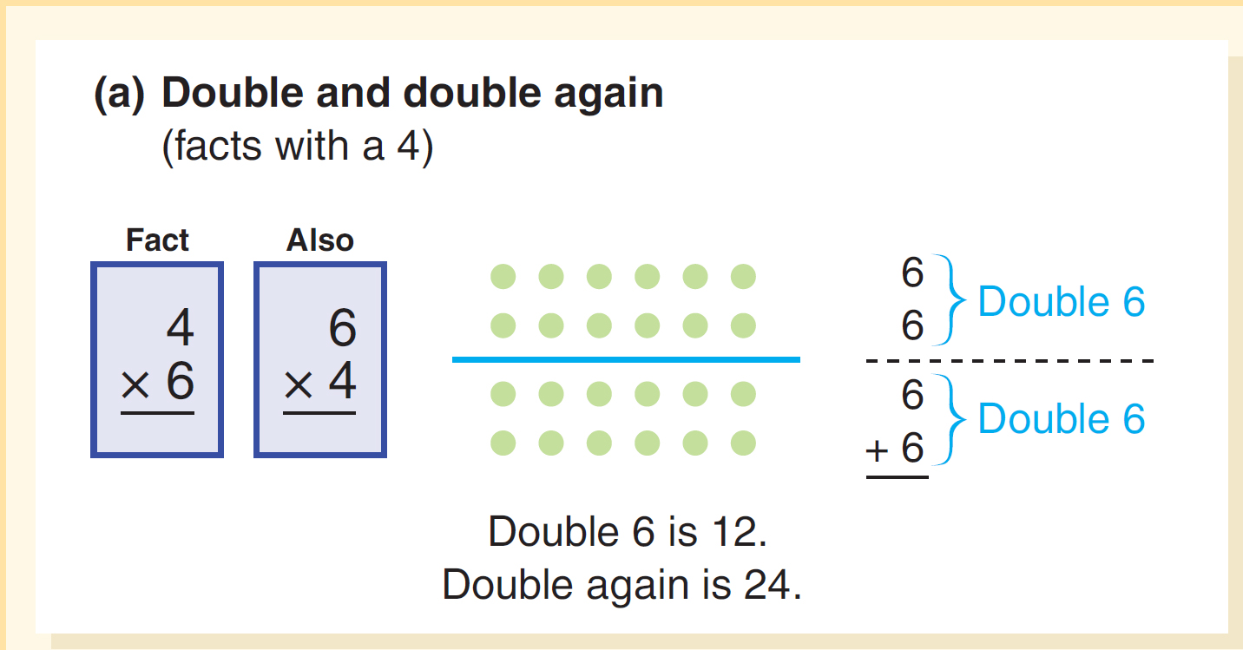
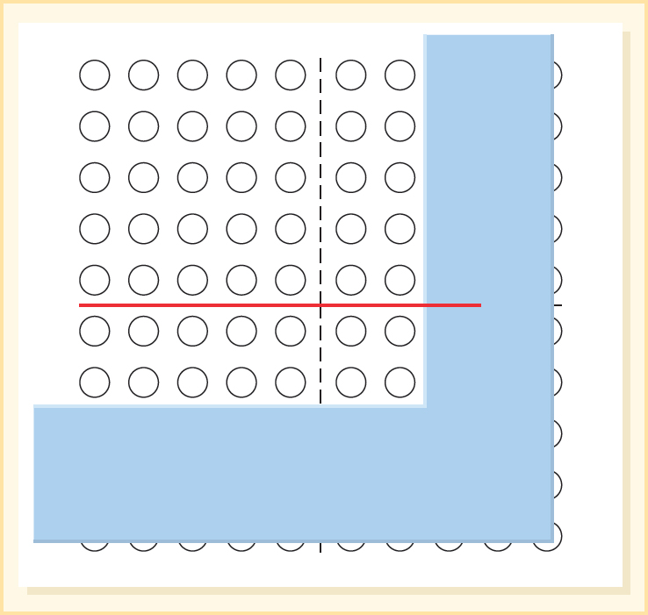
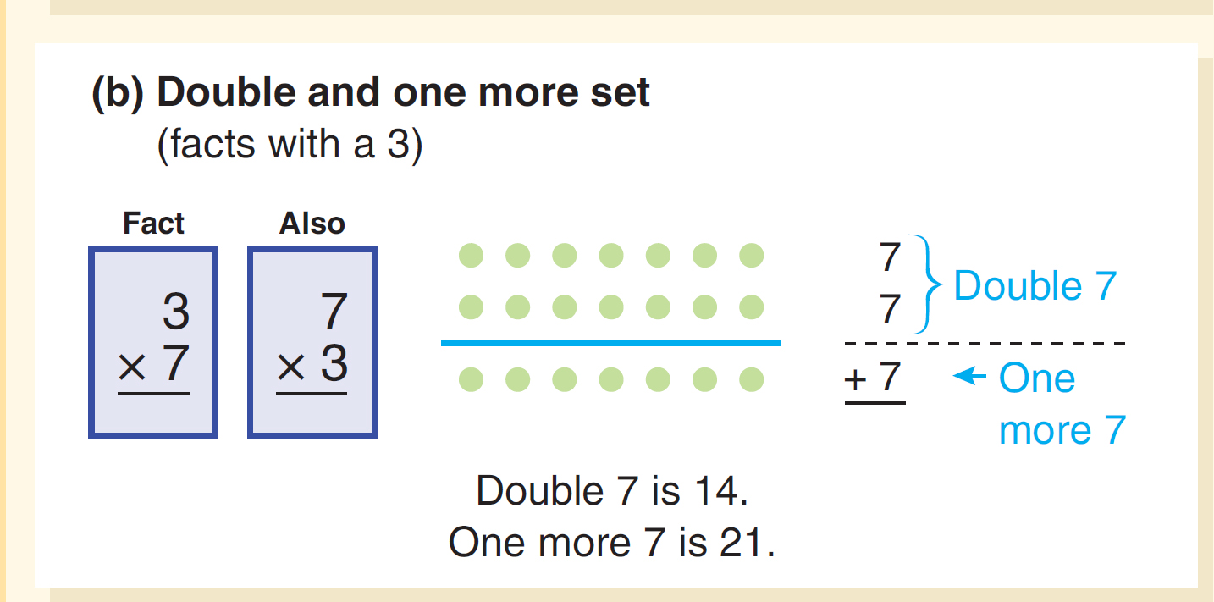
Reasoning Strategies For Multiplication and Division Facts (3 of 3)
Decomposing a Factor
Example 7 × 7 can be thought of as (5 × 7) + (2 × 7) or 35 + 14 = 49
Partitioning a fact
Double and Halving applies the × 2 foundational facts
Double and one more set works applies the × 3 facts

Slide 19
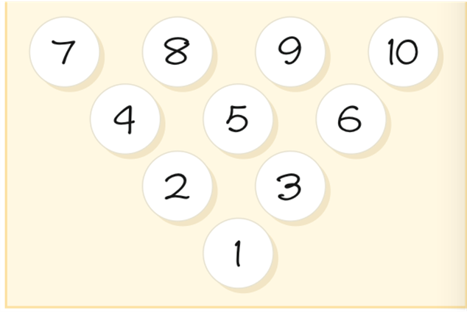
Reinforcing Basic Fact Mastery
Games support basic act fluency and provide repeated experiences for students to learn facts.
Activity 9.17 Bowl-a-fact
Materials – Board as shown below, three dice
Directions - Students roll three dice and come up with equations that result in answers that are on the pins.
For example if the rolled 4,2,3 they could say 4 × 2 is 8 minus 3 is 5 and knock down the five.
A strike is when they have successfully created equations to knock down all 10 pins.

Slide 20
What to Do When Teaching Basic Facts
Ask students to self monitor, building a sense of what you don’t know and what you need to learn.
Focus on self-improvement, helping students notice they are getting quicker or learning new facts or strategies.
Work on facts over time – Work over months and months on reasoning strategies and sets of facts.
Involve families - Share the big plan on how to learn facts over the year.
Make fact practice enjoyable - Many games are designed to reinforce facts that are not competitive or anxiety inducing,
Use technology - Students get immediate feedback and reinforcement (e.g., My Math Lab).
Emphasize the importance of knowing their facts.

Slide 21
What Not to Do When Teaching Basic Facts
Don’t
Use lone timed tests (e.g. 30 items).
Use public comparisons of mastery of facts.
Proceed through facts in order from 0 to 9.
Expect automaticity too soon.
Use facts as a barrier to good mathematics.
Use fact mastery as a prerequisite for calculator use.

Slide 22
Common Challenges and Misconception Related to Basic Facts
Common Challenges and Misconception | What It Looks Like | How to Help
1. Students do not recognize inverse relationship | Student is not able to think of 14 − 9 as, “What plus 9 equals 14?” or 36 ÷ 4 as “How many groups of 4 are in 36?” | Use the triangle and T cards. Explicitly practice the language used here.
2. Students do not apply the commutative property | Student is slower to add 2 + 8 than 8 + 2 (they may be counting on from the first number). Student can solve 3 × 8, but not 8 × 3. | For addition, Use a ten-frames for each addend and reverse them Add contexts that can be reversed (part-part-whole stories). For multiplication, use areas and arrays that can be rotated to show that 3 × 8 = 8 × 3.
3. In multiplication, applying the adding (or subtracting) a group, students lose track of the group size. | For 9 × 8, student uses 10 × 8 but instead of subtracting one group of 8, they subtract 1 getting the answer of 79. | Provide examples of the problems using an array. Show how the known fact is used to add or subtract a row (or column) from the array. Emphasize the group/row.

