Slide 1
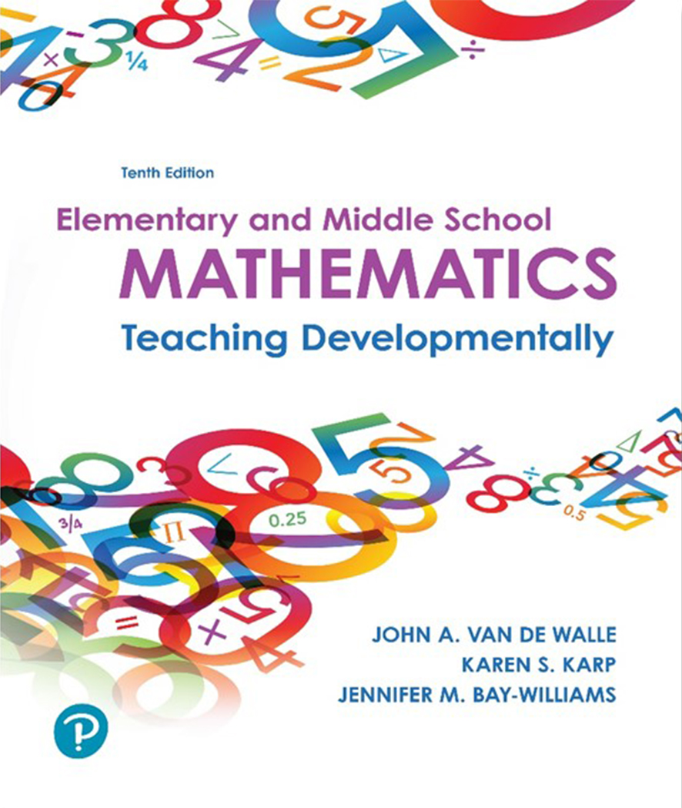
Elementary and Middle School Mathematics Teaching Developmentally
10th Edition
Chapter 8
Developing Meanings for the Operations
Copyright © 2019, 2016, 2013 Pearson Education, Inc. All Rights Reserved
Notes:
If this PowerPoint presentation contains mathematical equations, you may need to check that your computer has the following installed:
1) MathType Plugin
2) Math Player (free versions available)
3) NVDA Reader (free versions available)

Slide 2
Learner Outcomes
8.1 Demonstrate how to develop children’s skills in generalizing the problem structures with additive situations involving joining, separating, part-part-whole, and comparison where the unknown can be in any position.
8.2 Explain how students can apply the properties of the operations as strategies to either add, or subtract.
8.3 Demonstrate how to develop children’s skills in generalizing the problem structures with multiplicative situations involving equal groups, comparison, area, and arrays where the unknown can be in any position.
8.4 Explain how students can apply the properties of the operations as strategies to either multiply, or divide.
8.5 Describe strategies for teaching students how to solve contextual problems.

Slide 3
Standards-Based Development (1 of 2)
K -2 Think about addition and subtraction situations involving adding to, taking from, putting together and taking apart using increasingly sophisticated strategies.
2nd Solving compare situations as an exploration of multiplication as equal groups, using rectangular arrays to model problems
3rd Solving two-step problems using all four operations and develop an understanding of the relationship between multiplication and division, as well as applying properties of multiplication

Slide 4
Standards-Based Development (2 of 2)
4th Expanding the interpretation of multiplicative situations as a comparison with a reference unit, solve multi-step word problems, interpret remainders and learn algorithm for adding and subtracting multi-digit numbers.
5th Expected to perform fluently with all operations using multi-digit whole number using strategies that consider place value and the application of the properties of the operations as well as the algorithm for multiplication.

Slide 5
Developing Addition and Subtraction Operation Sense
Contextual problems are the primary teaching tool to help children activate problem-solving strategies and gain a rich understanding of the operations.
Contextual problems are more easily solved with multiple representations - Words, pictures and numbers
Contextual problems provide opportunities for children to reason and explaining what they did and why it makes sense within the context

Slide 6
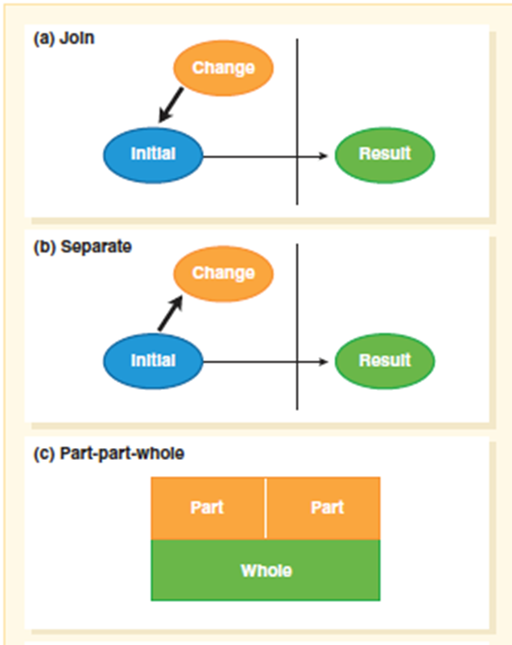
Addition Problem Structures (1 of 2)
Join (add to) - Change being “added to” the initial
Separate (take from) - Change is being removed from initial
Part-part-whole - Either missing the whole or one of the parts must be found

Slide 7
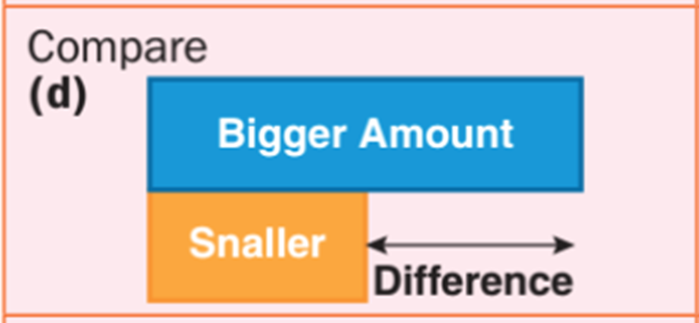
Addition Problem Structures (2 of 2)
Compare - There are three ways to present compare problems, corresponding to which quantity is unknown (smaller = “referent”,
larger = “quantity”, or difference).
Smaller

Slide 8
Identify What Structure is Represented in These Problems
Lou had 12 toy cars. Mia gave him 6 more. How may toy cars does Lou have altogether?
Will has seven crackers and six peanuts. How many snacks does he have?
Sara had some books. Mary gave her five more. Now she has 12. How many books did Sara begin with?
Kate had six more pets than Liz. Liz has 2 pets. How many pets does Kate have?

Slide 9
Problem Difficulty
Join and Separate problems with start unknown
Hard for children to model. They do not know how many counters to put down initially.
Part-part-whole problems
No action to model since it is a conceptual bringing together of quantities.
Challenge for children to grasp a quantity represents two things at once.
Compare problems
Challenged by language of “how many more?”

Slide 10
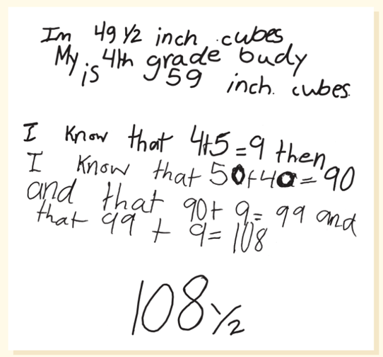
Teaching Addition and Subtraction (1 of 5)
Contextual Problems
Lessons built on context or stories that are connected to children’s lives.
Contextual problems derived from recent experiences in the classroom; field trip, children’s literature, art, science discussion.
Yesterday, we measured how long you were using cubes. Dion and Rosa asked how many cubes long they are when they lay down head to foot. Rosa was
cubes long and Dion was 59 cubes long. How long are Rosa and Dion when lying head to foot?

Slide 11
Teaching Addition and Subtraction (2 of 5)
Model-Based Problems
Addition 5 + 3 = 8
Action situations-Join and Separate
No-action situations
  Part-part-whole model with cubes or hops on a number line
  Compare problems

Slide 12
Teaching Addition and Subtraction (3 of 5)
Bar diagrams – Strip or tape generate “meaning-making space” precursor to use of number lines
Number lines – Shift from counting number of objects in a collection to length units

Slide 13
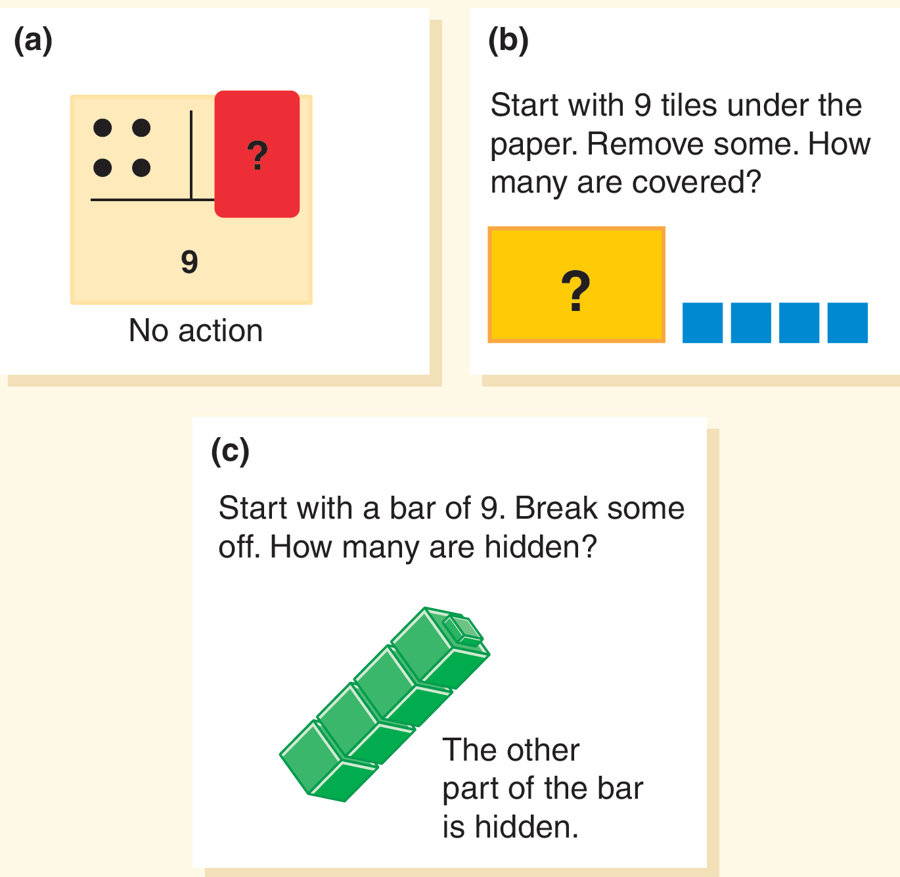
Teaching Addition and Subtraction (4 of 5)
Subtraction
“Think-addition” versus “take away” significant for mastering subtraction facts
What goes with the part I see to make the whole?
Important to use same models that connect the two operations

Slide 14
Teaching Addition and Subtraction (5 of 5)
Comparison Models
Comparison situations - Two distinct sets and the difference between them.
Discuss the differences between the two (dots, bars, jumps)
How many more do we need to match the fill in the blank?

Slide 15
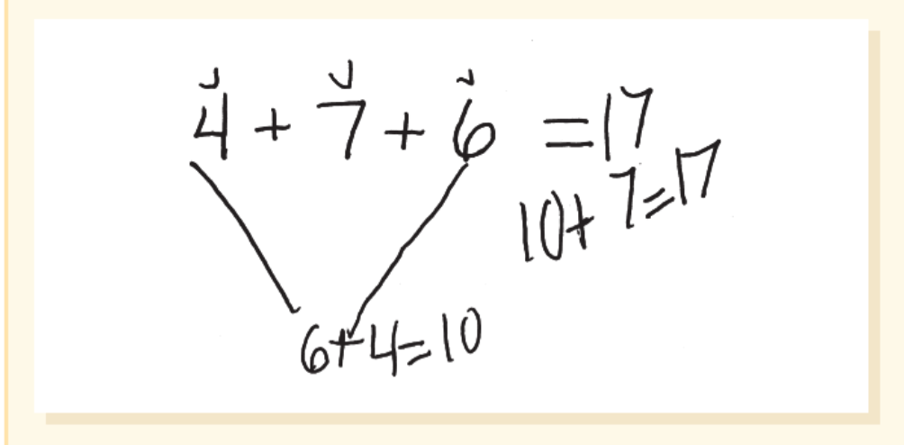
Properties of Addition and Subtraction
Commutative Property
Order of addends does not change the answer.
Essential for problem solving
Mastery of basic facts
Mental mathematics
Associative Property
Adding three or more numbers does not matter what numbers are added first.
Mental mathematics

Slide 16
Developing Multiplication and Division Operation Sense
Sense making means facilitating students:
connecting the different meanings of multiplication and division to each other
connecting multiplication and division to addition and subtraction
effective application of these operations in real-world settings

Slide 17
Multiplication and Division Problem Structures (1 of 3)
Equal-group problems [a × b = c]
The first factor [a] counts how many sets, groups or parts of equal size.
The second factor [b] tells the size of each set, group or part.
The third number [c] is the whole or product.
When number and size is know the problem is multiplication.
When either group size or number of groups is unknown the problem is division.

Slide 18
Multiplication and Division Problem Structures (2 of 3)
Comparison Problems
Two different sets or groups
The comparison is based on one group being a particular multiple of the other
Three possibilities for the unknown:
Product
group size
number of groups

Slide 19
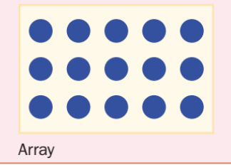
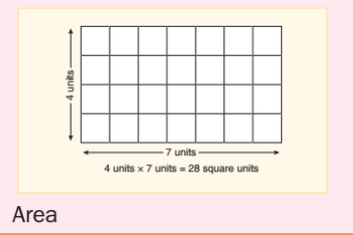
Multiplication and Division Problem Structures (3 of 3)
Array and Area Problems
Array – Equal group situation
first factor number of rows
second factor number of items in equal groups found in each row
Area – Two-dimensional units
Product a different type of unit from the two factors

Slide 20
Teaching Multiplication and Division
Use interesting contextual problems instead of more sterile story problems (or naked numbers)
Focus on sense making and student thinking, solving a few problems using tools such as physical materials, drawings and equations.
Introducing symbolism as a way to record children’s thinking
Remainders — What to do with remainders is central to teaching division- three effects on answers
  discard remainder
  force the answer up to the next highest whole number
  rounded to nearest whole number
Should not just think of remainders as “R 3” or “left over.”

Slide 21
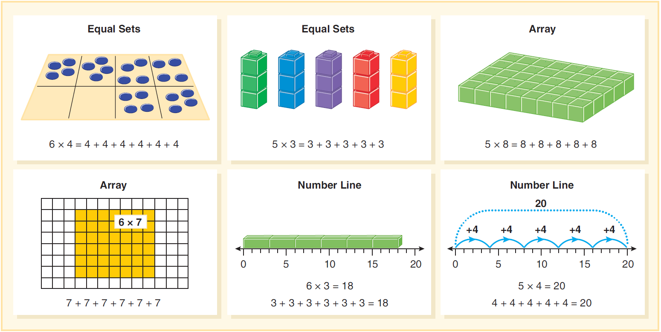
Model-Based Problems
Students benefit from activities with varied models to focus on the meaning of the operation and the associated symbolism.

Slide 22
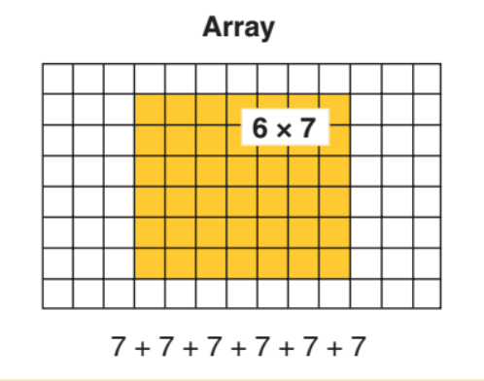
Activity 9.5 Finding Factors
Materials- square tiles, cubes, grid paper
Have students find the many arrays and record them on grid paper
Have students write the corresponding multiplication equations
Try Factorize applet on the N C T M Illuminations website
Directions:
Think of a context that involves arrays ( i.e. parade formation, seats in a classroom, patches on a quilt)
Assign a number that has several factors — e.g., 12, 18, 24, 30, or 36.

Slide 23
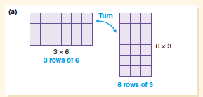
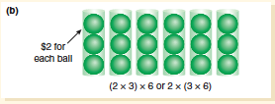
Properties of Multiplication and Division (1 of 2)
Commutative property for multiplication:
The array provides a clear picture that the two represent equivalent products.
Associative property for multiplication:
This property allows that when you multiply three numbers in an expression you can multiply either the first pair of numbers or the last pair, and the product remains the same.

Slide 24
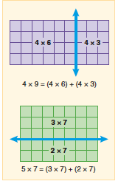
Properties of Multiplication and Division (2 of 2)
Zero and Identity Properties
Contextual examples help children use reason with 0 and 1.
How many grams of fat are in 7 servings of celery if celery has 0 grams of fat?
Where would 0 hops of 5 put you on a number line?
Model an array of 6 × 0.
Distributive Property
Factors can be split (decomposed) on an array to show how to partition factors.

Slide 25
Strategies Teaching Operations (1 of 2)
Think about the answer before solving the problem.
Focus on the problem and the meaning of the answer instead of on numbers.
The numbers are not important in thinking about the structure of the problem.
What is happening in this problem?
Focus on the structure of the problem, identify the numbers that are important and unimportant.
What will the answer tell us?
Thinking leads to a rough estimate of the answer and the unit of the answer.
Will it be a small or large number? About how many will it be?

Slide 26
Strategies Teaching Operations (2 of 2)
Work a simpler problem.
Substitute small whole numbers.
Model the problem.
Write an equation.
Write the corresponding equation.
Calculate.
Write answer in complete sentence.

Slide 27
Cautions About the “Key Word” Strategy
Sends a wrong message about doing mathematics
Children ignore the meaning and structure of the problem.
Mathematics is about reasoning and sense making.
Key words are often misleading.
Many times the key word or phrase suggest an operation that is incorrect.
Many problems do not contain key words.
Children are left with no strategy for solving the problem.
Key words do not work with two-step problems.
Using this approach with simpler problems sets students up for failure on more complex problems.

Slide 28
Common Errors and Misconceptions (1 of 2)
Common Error or Misconception | What It Looks Like | How to Help
1. Student treats the equal sign as an operation symbol or as a signal to compute | For 5 + 4 = fill in the blank + 3, says the fill in the blank should be 9 because 5 + 4 = 9. When asked if 6 = 6, says no, because there is no computation to do. When asked if 7 = 3 + 4, says no, because “you can’t write it that way because there is no computation to do. Its backwards.” | Use a number balance to illustrate the relational meaning of the equal sign. Read the equal sign as “is the same as” and “equals.” Avoid reading 5 + 3 “makes” 8 because the word “makes” sounds like an operation or that you have to carry out an action. Pose true/false number sentences in a variety of equation formats.

Slide 29
Common Errors and Misconceptions (2 of 2)
Student overgeneralizes the commutative property of addition and subtraction.
Student thinks that adding zero makes a number bigger and subtracting zero makes a number smaller.
There is no relationship between addition and subtraction and /or multiplication and division.
Addition or multiplication make numbers bigger.
Subtraction and division make numbers smaller. The divisor must be less than the dividend.
Students choose the wrong operation in word problems.
Students the think the remainder is left over and not part of the answer.

