Slide 1
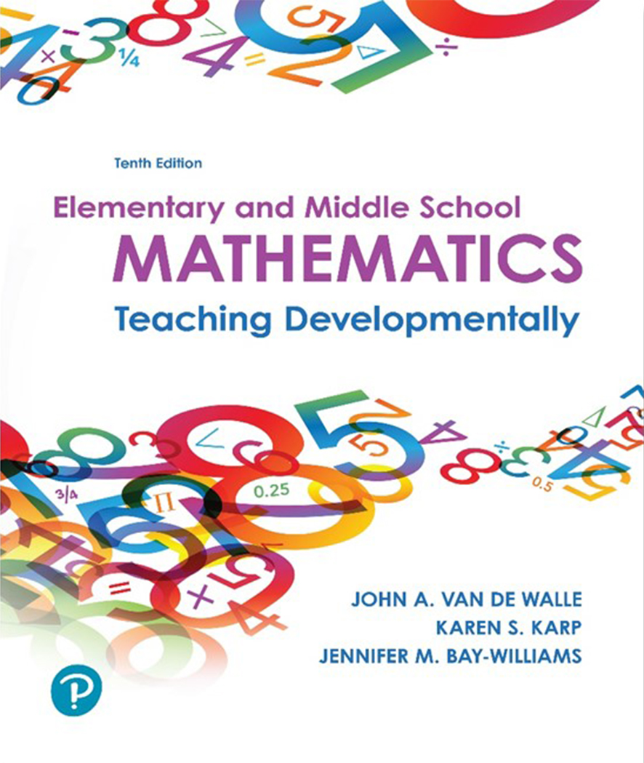
Elementary and Middle School Mathematics Teaching Developmentally
10th Edition
Chapter 7
Developing Early Number Concepts and Number Sense
Copyright © 2019, 2016, 2013 Pearson Education, Inc. All Rights Reserved
Notes:
If this PowerPoint presentation contains mathematical equations, you may need to check that your computer has the following installed:
1) MathType Plugin
2) Math Player (free versions available)
3) NVDA Reader (free versions available)

Slide 2
Learner Outcomes
7.1 Recognize that teaching mathematics to very young children involves providing high quality number activities using a developmental approach.
7.2 Demonstrate how to develop children’s counting skills, including subitizing (immediately recognizing a total number of objects in an organized collection) to three or five without counting each object.
7.3 Plan ways to teach children to compare quantities and describe relationships between numbers.
7.4 Develop ways to connect mathematical ideas to the real-world activities of young learners.

Slide 3
Research-Based Recommendations for High-Quality Learning Activities in the First 6 Years of Life
Enhance children’s natural interest in mathematics.
Build on children’s experience and knowledge.
Base mathematics curriculum and teaching practices on solid mathematical knowledge and child development.
Use formal and informal experiences to strengthen children’s problem-solving and reasoning processes.
Provide opportunities for children to explain their thinking as they interact with the mathematical ideas.
Assess children’s mathematical knowledge, skills and strategies through observation and other informal practices.

Slide 4
Standards-Based Development
Preschool children:
Counting, one to one correspondence, cardinality and comparing and ordering
Kindergarten children:
Count by 100 by ones and tens, count from numbers other than one, write numbers up to 20, make comparisons between groups using greater than, less than or equal to the other
First Grade children:
Read and write numbers to 120 including counting from numbers other than one, move to place value concepts relating counting to the operations of addition and subtraction

Slide 5
The Number Core: Quantity, Counting and Cardinality
Quantity and the ability to subitize
Subitizing - When you look at an amount of objects, sometimes you are able to just “see” how many are there.
Activity 7.1
Materials - Counters, paper plates, dot plates
Directions-
Hold up dot plate. Make the pattern you saw on this plate with your counters. Then show the plate again as a self-check. (Include zero and what it means when there are no dots.)

Slide 6
Early Counting
Counting the sequence of number words is a rote procedure.
The meaning attached to the counting is the key conceptual idea on which all other number concepts are developed.
Research-based learning trajectories provide a path for instructional direction. Verbal counting has at least two separate skills:
    Produce the standard string of counting words in order
    Connect the sequence in a one-to-one correspondence with objects in the set being counted

Slide 7
Meaning Attached to Counting of Objects
In counting, each number identifies a quantity that is one more than the previous number. The new quantity is embedded in the previous quantity

Slide 8
Cardinality
Children learn how to count (matching counting words with objects) before they understand that the last word stated in a count indicates the amount of the set.
Show a card with 5-9 large dots, and ask “How many dots are on the card?”
Indicators to watch for:
Child does not count but instead takes out counters and makes a similar pattern.
Child recounts the dots on the card.
Child places the counters in a one-to-one correspondence with the dots on the card.

Slide 9
Numeral Writing and Recognition
Reading and writing numerals is similar to teaching them to read and write letters of the alphabet. Mathematics is a language to be learned.
Engaging ways:
Make numerals with clay.
Trace numerals in shaving cream.
Write numerals on the interactive whiteboard.
A calculator keypad is a good instructional tool.

Slide 10
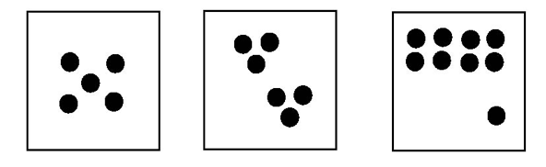
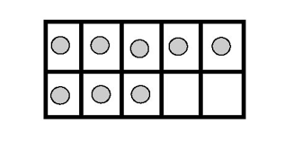
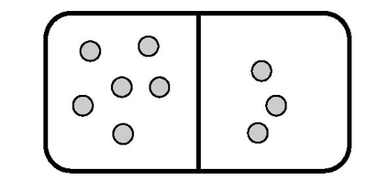
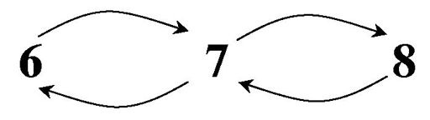
Developing Number Sense by Building Number Relationships
Spatial Relationships
Benchmark numbers 5 and 10
One and Two More/One and Two Less
Part-Part-Whole

Slide 11
Make Sets of More/ Less/ Same
Children need to construct sets using counters and to make comparisons or choices between two or more sets.
Activity 7.13
Materials - Picture of sets of objects of 4-12, set of counters, word cards labeled More, Less, Same
Directions - Next to each card, have children make three collections.

Slide 12
Number Relationships 1-10
Students need to know that 7, for example, is 1 more than 6 and 2 less than 9.
The numbers 5 and 10 play a large role in our numeration system.
Conceptualize a number as being composed of two more parts.
Principal tool children will use: Counting skills

Slide 13
Building Relationships
Five-Frame Tell-About Materials - Five frame and counters: Ask children to show three on their five-frame.
Ask “What can you tell us about looking at your five-frame?” Accept any answers i.e. space in the middle.
Keep giving them numbers and focus on how many more counters needed to make 5.
Using a ten frame, try numbers between 5 and 10 in the frame.

Slide 14
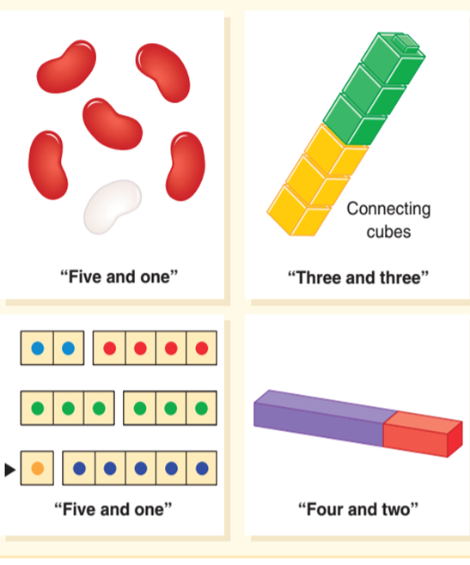
Part-Part-Whole Basic Ingredients
Compose.
Build designated quantities in two or more parts.
Decompose.
Start with a full amount and separate into 2 or more parts.
When children read and write the combinations, they focus on the relationships of the parts.

Slide 15
Number Relationships 10-20 and Beyond
A set of 10 plays a major role in the the understanding of the numbers 10-20.
Three-level progression of children’s understanding of ten:
Child understands ten as ten ones and does not see ten as a unit.
Child understands ten as a unit but relies on materials to complete tasks involving ten.
A facile concept of ten - Solves tasks without using materials

Slide 16
Ten and Some More
  Activity 7.26
  Materials – Two-part mat, counters or coffee
  stirrers, and a story
  Directions - Ask students to complete the ten
  frame and count out 7 counters/stirrers on
  the other side.
  Have them count all together.
  Chorus the combination - e.g., 10 and 7 equal 17
  Turn mat around - 7 and 10 equal 17
  Repeat with other numbers in random order, but always keep 10 on the left side (e.g., 5 + 10 = 10 + 5)
  Work to be able to bundle 10 stirrers together.

Slide 17
Number Sense in Their World
Estimation and Measurement - best way for children to think about real quantities
Cut out a large footprint 18 inches long. Ask children to tell you about how many will it take to measure the rug in our classroom?
More or less than fill in the blank?
Closer to fill in the blank or to fill in the blank?
About fill in the blank?
Connecting numbers to real situations - Activity 7.28 and 7.29 Suggest units to use with a number nine fill in the blank. Also give a number and unit and figure out when that would be reasonable-15 feet.

Slide 18
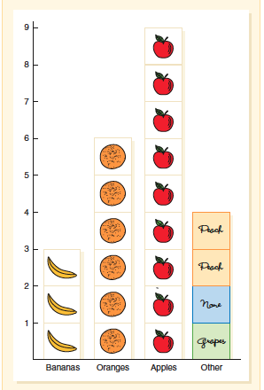
Represent and Interpret Data
Encourage children to generate ideas for what data to gather.
Use the graphed data to compare number relationships rather than only referencing more and less. For instance,
More students brought apples for snack than bananas.
Three less people brought oranges than brought apples.
Three more people brought oranges than brought bananas.

Slide 19
Common Errors and Misconceptions: Early Number Concepts (1 of 2)
Concept
Child does not understand the cardinality principle.
What it looks like: When asked “How many?”, the child recounts all the objects or points to last object counted
How to Help
Provide lots of counting opportunities, followed by asking “How many?”
When counting collections together, say, “1, 2, 3, 4, 5”. We have 5 pencils.”

Slide 20
Common Errors and Misconceptions: Early Number Concepts (2 of 2)
Does not know the counting sequence
Counts without using one-to-one correspondence
Does not count on
Difficulty counting the teen numbers or decade numbers
Writes the numeral backwards or reverses the digits in the teen numbers
Not sure of the magnitude of numbers from 1-20

