Slide 1
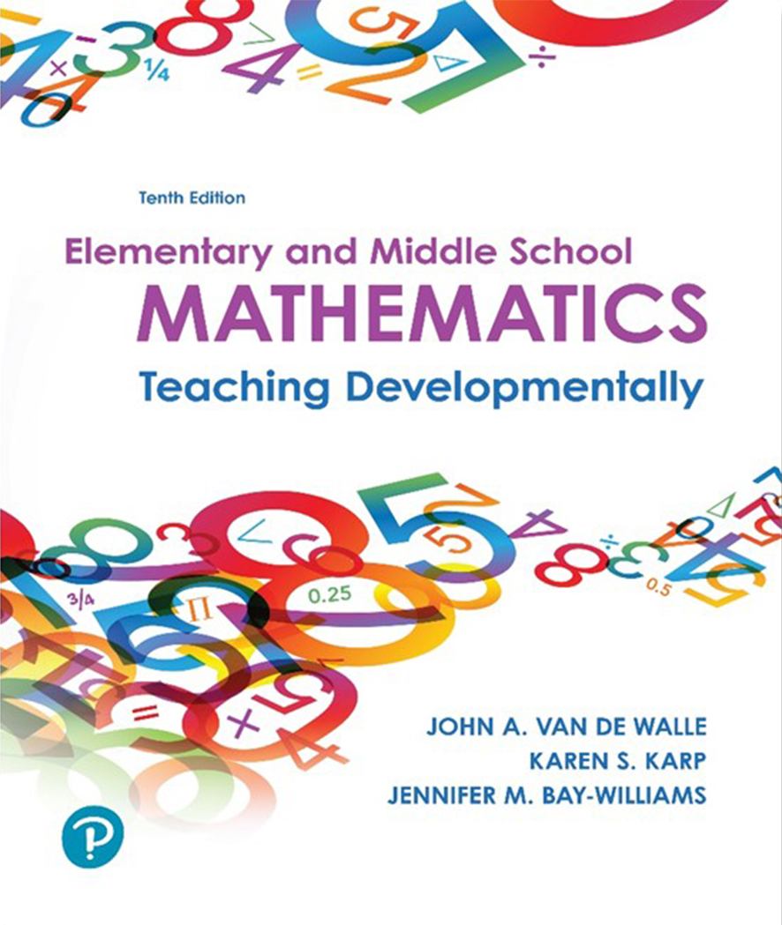
Elementary and Middle School Mathematics Teaching Developmentally 10th Edition
Chapter 6
Teaching Mathematics Equitably to All Students
Copyright © 2019, 2016, 2013 Pearson Education, Inc. All Rights Reserved
Notes:
If this PowerPoint presentation contains mathematical equations, you may need to check that your computer has the following installed:
1) MathType Plugin
2) Math Player (free versions available)
3) NVDA Reader (free versions available)

Slide 2
Learner Outcomes
6.1 Differentiate between a modification and an accommodation.
6.2 Describe the components of a multitiered system of support for struggling students and identify successful components of interventions for students with disabilities.
6.3 Explain characteristics of culturally responsive instruction, including how to focus on developing academic vocabulary during mathematics instruction.
6.4 Apply knowledge of working with students who are gifted and talented mathematically.
6.5 Illustrate approaches that are used to develop students’ resilience and reduce resistance in learning mathematics.

Slide 3
N C T M Access and Equity in Mathematics Education
Achievement gaps are actually instructional gaps of expectation gaps.
Some teachers operate under the belief that some students cannot do mathematics.
Have you heard these statements?
My class can’t do group work they are too unruly.
This class can’t solve word problems because they don’t have the reading skills.
How do we design instruction in ADVANCE of finding weak student performance?

Slide 4
Mathematics for All Students
Addressing the needs of All means:
Students who are identified as struggling or have a disability
Students from different backgrounds
Students who are English language learners (E L L s)
Students who are mathematically gifted
Students who are unmotivated or need to build resilience

Slide 5
Two Paths for Making a Task Accessible to All Students
Accommodation - Response to the needs of the environment or learner, i.e.,
Write directions in larger font.
Say and print the directions.
Modification - Changes the task to make it more accessible to the student, i.e.,
Break task into smaller components.
Scaffold to the original task.

Slide 6
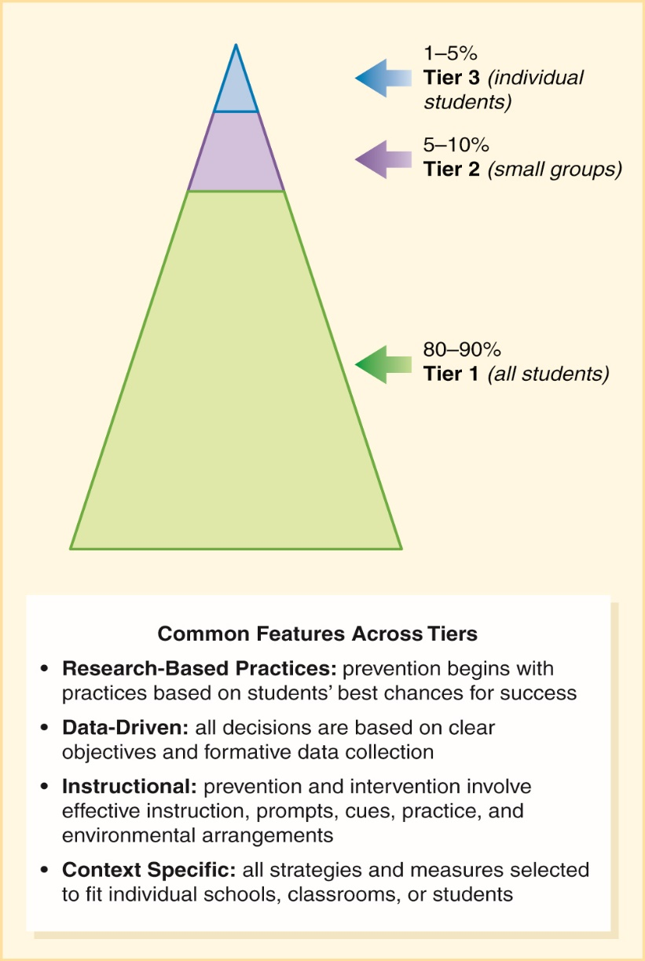
Response to Intervention (R T I)
Each tier represents a level of intervention with corresponding monitoring of results.
How would progress-monitoring inform you of the level of student needs?
Source: Scott, T., and Lane, H. (2001). Multi-Tiered Interventions in Academic and Social Contexts. Unpublished manuscript, University of Florida, Gainesville.

Slide 7
Research Proven Strategies for Tier 2 & 3 Students (1 of 2)
Explicit strategy instruction
Assess student to know what to target
Model the strategy and self instructive prompts for student to use through the model
Teacher-led explanations highlight critical connection building and meaning making.
Concrete, Semi-Concrete, Abstract (C S A) Sequence
Concrete representations - Working with manipulatives
Semi-concrete - Drawings or pictures
Abstract - Using numbers and symbols

Slide 8
Research Proven Strategies for Tier 2 & 3 Students (2 of 2)
Peer-Assisted Learning
Students learn best when placed in the role of apprentice working with peer or “expert” (ZPD)
Uses “as-needed” versus explicit strategy model
Think-Alouds
Teacher verbalizes the thinking process steps from student starting point
Teacher identifies the reasoning by asking questions as they move through the process

Slide 9
Teaching and Assessing Students with Learning Disabilities (1 of 3)
Structure the environment
Centralize attention - Face student and remove competing stimuli
Avoid confusion - Word directions carefully and specifically
Create smooth transitions - Limit off-task time
Identify and Remove Potential Barriers
Help students remember - Memory aids (Mnemonic devices, songs, etc.)
Provide vocabulary and concept support
Vary task size

Slide 10
Teaching and Assessing Students with Learning Disabilities (2 of 3)
Provide clarity
Repeat the timeframe - Repeat reminders of time left.
Ask students to share their thinking - Think-alouds or think-pair-share.
Emphasize connections - Provide visual representations.
Adapt delivery mode - Use materials, images and examples.
Support organization of written work - Tools and templates
Provide examples and nonexamples.

Slide 11
Teaching and Assessing Students with Learning Disabilities (3 of 3)
Consider alternative assessments
Propose alternative products - Verbal response scribed by someone else or electronically.
Encourage self-monitoring and self-assessment.
Consider feedback charts - Monitoring their growth.
Emphasize practice and summary
Consolidate ideas - Study guides for review.
Provide extra practice - Carefully selected problems to use with manipulatives.

Slide 12
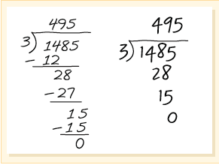
Culturally and Linguistically Diverse Students
Focus on students’ strengths, their “funds of knowledge”.
How we do mathematics is culturally determined.
Think about these questions-
Will you require students to show steps, disregarding the way they learned?
Will you ask students to elaborate on how they did it?
Will you have students show other students their way?

Slide 13
Culturally Responsive Instruction
Stay focused on standards-based mathematics.
Make content relevant.
Attend to students’ mathematical identities by:
Assigning competence
Sharing personal stories puts a face on mathematical contributions
Ensure shared power and value students’ ideas and thinking
Is mathematics presented meaningfully, and is it connected to other content?
Is mathematics presented so that it connects to authentic situations in their lives?

Slide 14
Teaching Strategies That Support Culturally and Linguistically Diverse Students (1 of 2)
Focus on Academic Vocabulary
Encourage students to work together and discuss problems in their native language.
Utilize dual objectives in language and mathematics.
Intentional vocabulary instruction must be part of instruction. E L L s do not use mathematical vocabulary in their everyday lives.
i.e. Personal math dictionaries – Link concepts, terms with drawings or clip art.

Slide 15
Teaching Strategies That Support Culturally and Linguistically Diverse Students (2 of 2)
Focus on Student Participation during Instruction:
Building background knowledge involves considering native language and culture as well as content.
Comprehensible input means that the message the teacher is communicating is understandable.
Engage students in discourse that reflects language needs, i.e., revoicing with gestures and visuals.
Plan cooperative/interdependent groups to support language development.

Slide 16
Strategies for Mathematically Gifted Students
Acceleration and Pacing
Curriculum compacting
Students’ increase their own pace of learning
Complexity
Pursuing greater rigor of content
Integrate core content for explorations or research projects
Depth
Go beyond topic of study
Extension of original mathematics
Creativity
Open ended problems and investigation to use divergent thinking
Options for culminating experiences

Slide 17
Reducing Resistance and Building Resilience
Give students choices that capitalize on their unique strengths.
Nurture traits of resilience.
Make mathematics irresistible.
Give students leadership in their own learning.

