Slide 1
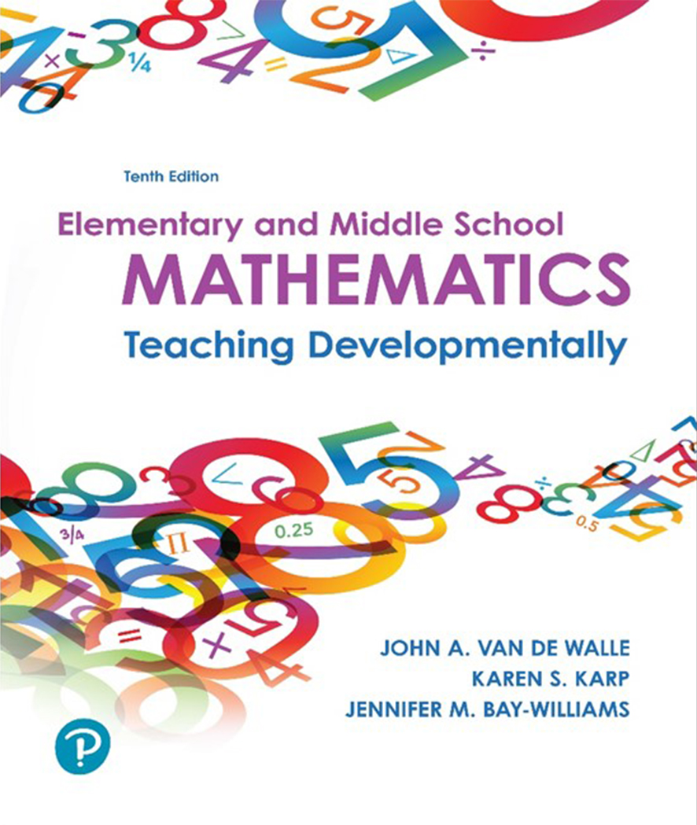
Elementary and Middle School Mathematics Teaching Developmentally
10th Edition
Chapter 5
Creating Assessments for Learning
Copyright © 2019, 2016, 2013 Pearson Education, Inc. All Rights Reserved
Notes:
If this PowerPoint presentation contains mathematical equations, you may need to check that your computer has the following installed:
1) MathType Plugin
2) Math Player (free versions available)
3) NVDA Reader (free versions available)

Slide 2
Learner Outcomes
5.1 Differentiate between formative and summative assessment.
5.2 Describe four important methods for assessing students’ mathematics understanding.
5.3 Analyze types of rubrics and their uses.
5.4 Explain the value of having students self-assess.
5.5 Identify ways that tests can be used in the classroom to enhance learning.
5.6 Explore ways to show evidence of and communicate about student learning that result in grades and more targeted instructional decisions

Slide 3
Integrating Assessment into Instruction
“How do I access?”
Assessment should enhance student’s learning.
Assessment is a valuable tool for making instructional decisions.
Feedback should help learners progress.
These ideas align with assessment of learning - students evaluated on what they know at a given moment.
These ideas aligns with assessment for learning - students continually evaluated so instruction can be targeted to gaps.

Slide 4
Main Assessment Types
Summative
Cumulative evaluations
Takes place after instruction is completed
Generate a single score
Measures overall progress
Does not shape day to day teaching decisions
Formative
Check status of students’ development
Takes place during instruction or as pre- assessment
Provides targeted feedback
Results and evidence used to inform decisions about next steps

Slide 5
What Should Be Assessed?
Conceptual Understanding and Procedural Fluency
Competence and Adaptive Reasoning
Problem Solving
Reasoning
Communication
Connections
Representation
Productive Disposition
Discuss what type of assessment would provide for the range of mathematical behaviors listed above?

Slide 6
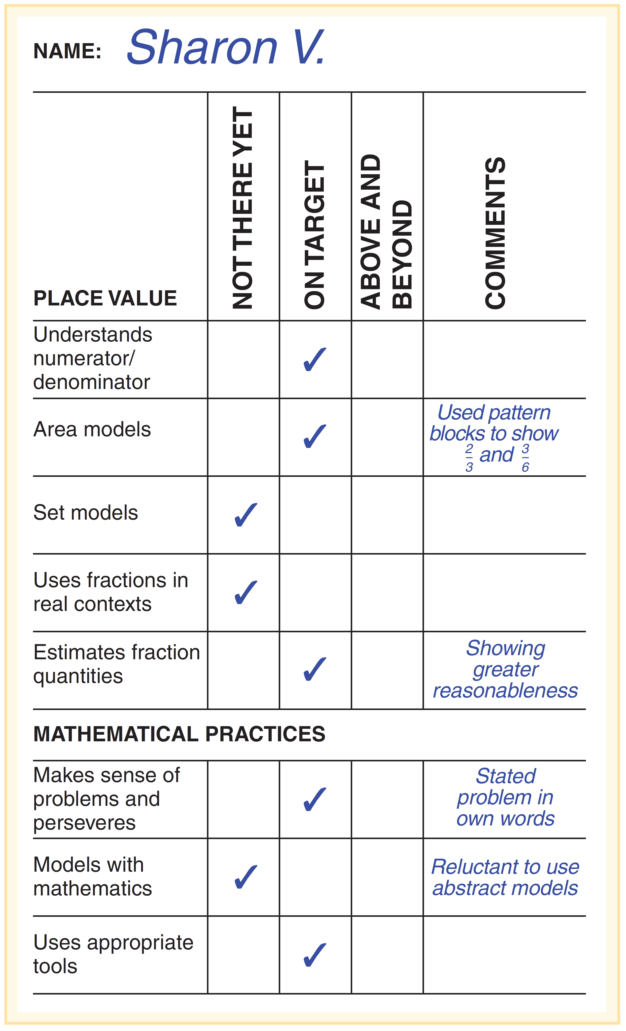
Observations
Anecdotal notes and checklists are a systematic plan for gathering evidence during and after portions of the lesson.
What are some of the effective observation strategies suggested in this chapter?

Slide 7
Questions
Type of Question | Sample Questions
Information gathering | What does the equal sign mean? Share an example. What are the properties of a trapezoid?
Student thinking | How does the model you drew relate to this fraction equivalence problem? How does your equation fit the story in the word problem?
Mathematical structures, connections, and relationships | Are both of these expressions equivalent? How do you know? What is the maximum number of digits you can get in a sum when you add two 3-digit numbers? Why?
Reflection and justification | How are the two solutions strategies you used to solve the problem today alike? Different? When would you choose to use each one? What does it mean that multiplication and division are inverse operations?
Probing student thinking through questioning can provide useful data and insights that inform your instruction.

Slide 8
Interviews (1 of 2)
Diagnostic interview is a one-on-one investigation of a student’s thinking about a concept, procedure, process or mathematical practice.
Hearing students descriptions of strategies
Probe their understanding
Identify strengths and gaps
Examples-
Which is greater? 7/8 or 7/9
Are the two numbers underlined the same?
6,561

Slide 9
Interviews (2 of 2)
Flexibility is key to diagnostic interviews.
Avoid revealing whether an answer is right or wrong.
Wait silently for student to answer.
Avoid interjecting clues or teaching.
Give opportunities for students to share their thinking without interruption.
Be prepare to probe students thinking, i.e.
  How would you explain this to a second grader (or younger sibling)?
  Can you explain what you just did?
  Why did you solve it that way?

Slide 10
Tasks
Any product, including problem-based tasks, writing and student self-assessment
Problem-based tasks critical components
Focus on important mathematics concept or skill.
Stimulate connection of students prior knowledge to new knowledge.
Allow multiple solution methods and variety of tools.
Include opportunities for students to correct themselves along the way.
Create occasions for students to confront misconceptions.
Encourage students to use reasoning and explain their thinking.
Create opportunities to observe student use of mathematical processes and practices.
Generate data for instructional decision making.

Slide 11
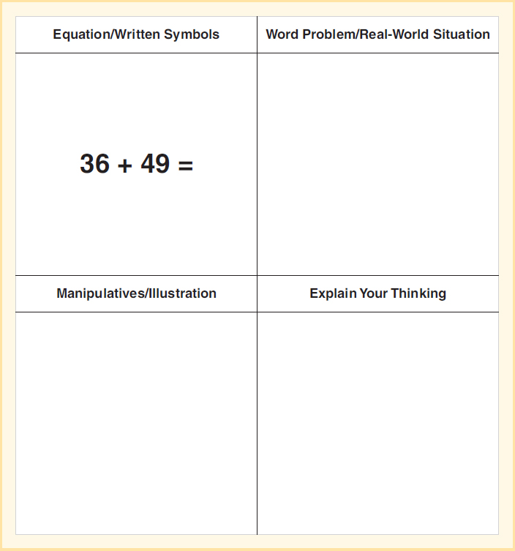
Translation Template

Slide 12
Rubrics and Their Uses
Analyzing problem-based learning through formative and summative assessment provide large amounts of information.
A rubric is a scale based on predetermined criteria serves two important functions:
Permits students to see what is central to excellent performance
Provides scoring guidelines for teacher that supports equitable analysis of students’ work

Slide 13
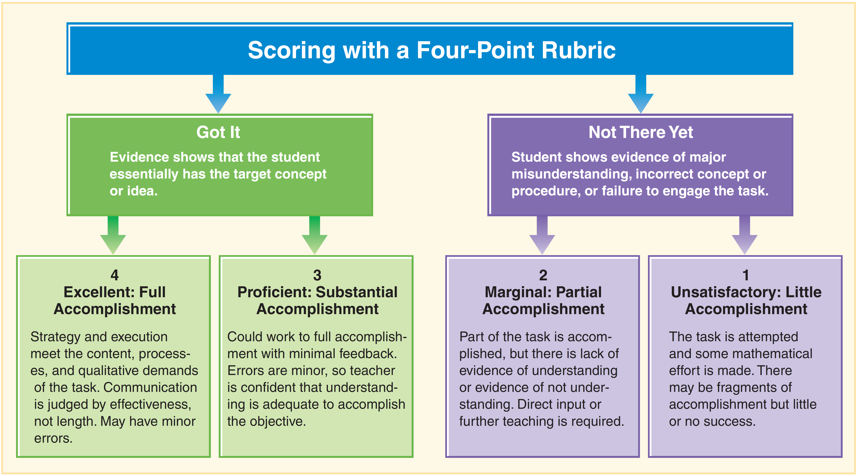
Generic Rubrics Identify Broad Categories of Performance

Slide 14
Tips for Effective Use of Rubrics
Self-check by writing out indicators for proficient or on target before using the task - Be aware of indicators. If they are drill or practice, a task-specific rubric is not right.
Post your rubric, and make it a habit to discuss students’ performance in terms of the rubric.
Unexpected methods and solutions do happen - Don’t limit students demonstrating their understanding only as you thought they would.
Sharing indicators ahead of time clearly conveys what is valued and expected.

Slide 15
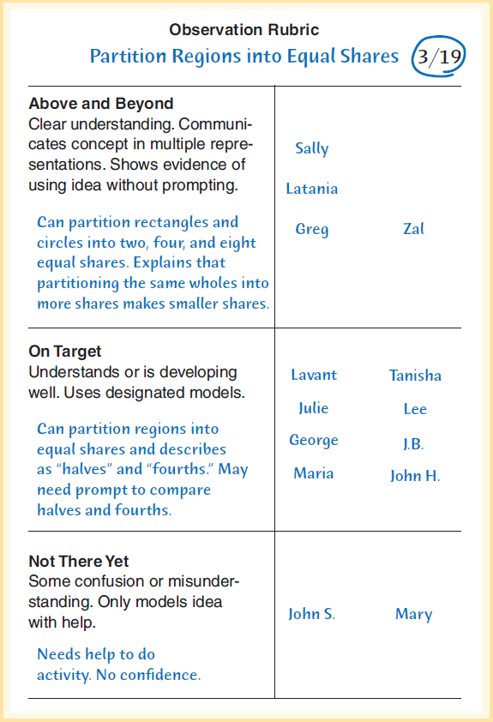
Example of an Observation Rubric
Determining performance indicators is always a subjective process. Here is an example.

Slide 16
Student Self-Assessment
Represent a measure of the student’s learning or disposition
Record of how they perceive their strengths and weaknesses
Assessment of their own progress
Methods to gather this data: exit slips on paper or web application
Open-ended prompts
Write two of the important things you learned in class today
Which problems did you find the most challenging? Or the easiest?

Slide 17
Expanding the Usefulness of Tests
Tests need to go beyond requiring students to demonstrate only procedural knowledge.
Tests need to be designed so they match the goals of the instruction.
Test considerations:
Permit technology when appropriate.
Permit students to use manipulatives and drawings.
Include opportunities for explanation.
Use open-ended questions.

Slide 18
Improving Performance of High Stakes Tests
External tests need to be a part of your assessment plan.
Teach the big ideas in the mathematics curriculum that are aligned to state and local standards.
Identify the broad conceptual foundations in the standards and select problem-based tasks that foster this understanding.

Slide 19
Communicating Grades and Shaping Instruction
A grade:
is a statistic to communicate to others the achievement level,
Accuracy and validity is dependent on information used to generate the grade, the professional judgment of the teacher, and alignment of assessment with goals and objectives of the instruction.
should be used with other information about a student’s work (problem solving processes, attitudes and beliefs).
What gets graded by teachers is what gets valued by students?

