Slide 1
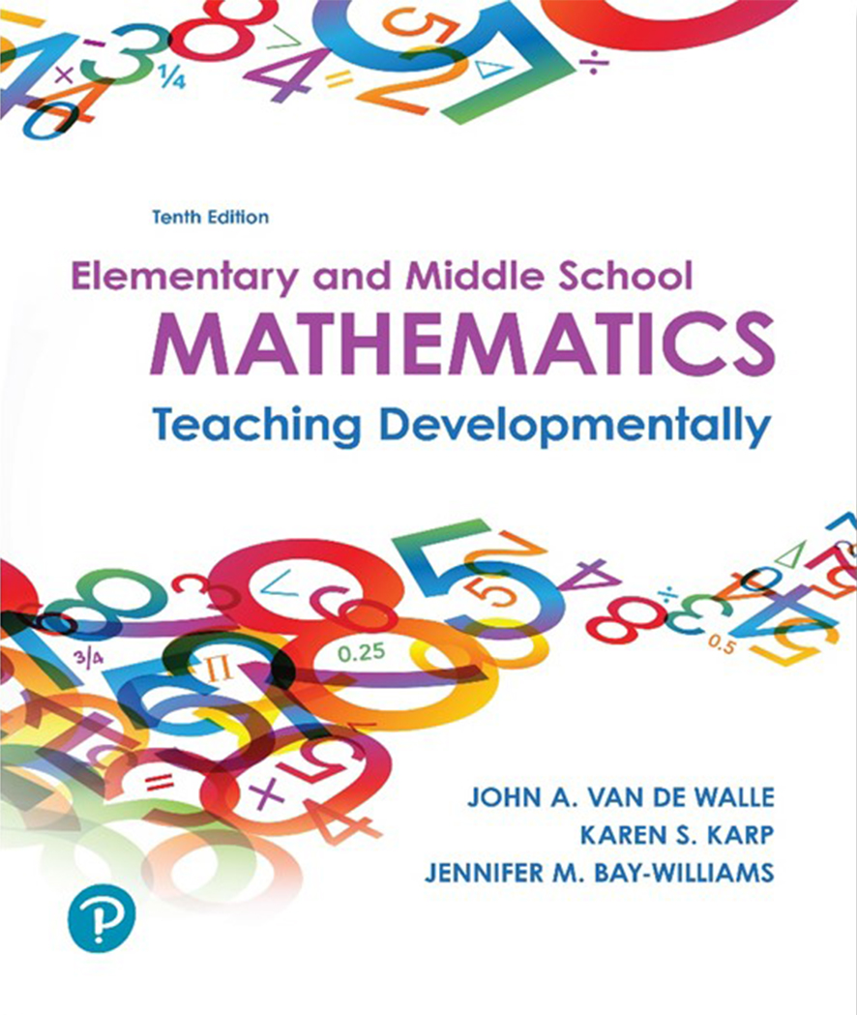
Elementary and Middle School Mathematics Teaching Developmentally 10th Edition
Chapter 4
Planning in the Problem-Based Classroom
Copyright © 2019, 2016, 2013 Pearson Education, Inc. All Rights Reserved
Notes:
If this PowerPoint presentation contains mathematical equations, you may need to check that your computer has the following installed:
1) MathType Plugin
2) Math Player (free versions available)
3) NVDA Reader (free versions available)

Slide 2
Learner Outcomes
4.1 Explain the features of a three-phase lesson plan format for problem-based lessons.
4.2 Design lessons using a planning process focused on mathematical inquiry.
4.3 Describe specific lesson design ideas, including ways to differentiate instruction.
4.4 Explain strategies for working with families, including effective homework.

Slide 3
Number One Reason to Plan Lessons…..
Those who fail to plan plan to fail.

Slide 4
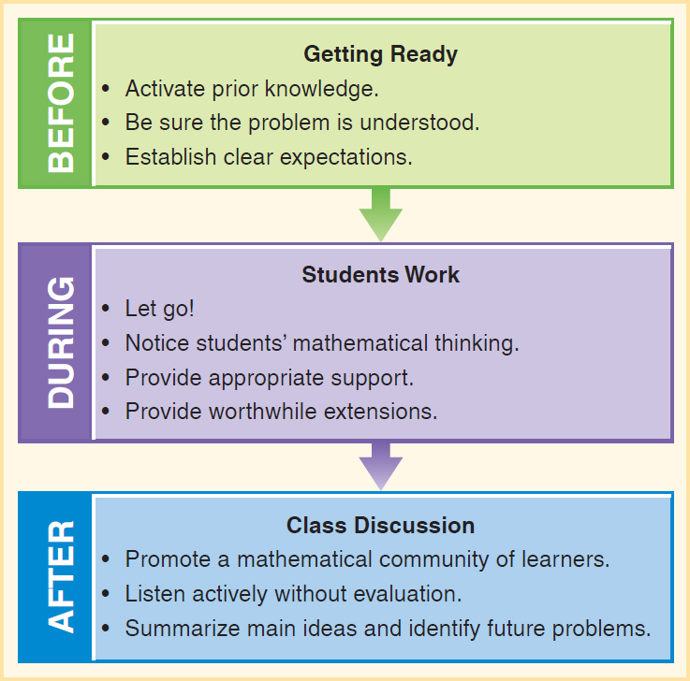
A Three-Phase Structure for Lessons

Slide 5
The Before Phase- First 5 to 10 Minutes
Activate prior knowledge.
Remind students what they learned previously.
Connect to personal experiences.
Relate to the day’s mathematical learning goal.
Be sure the task is understood.
Analyze problem and anticipate student approaches.
Ask Questions - What are we trying to figure out? Do we have enough information? What do you already know to get started?
Establish clear expectations.
How you want the students to work
What products they are to prepare for the discussion

Slide 6
The During Phase
Let go!
Allow and encourage students to embrace the struggle.
Notice student’s mathematical thinking.
Take time to find out what they are thinking and ideas they are using and their approach.
Provide appropriate support.
Think of ways to support without taking away their responsibility for designing and solving the problem.
Provide worthwhile extensions.
Be prepared for students who finish quickly and how you can extend their thinking without it seeming like extra work.

Slide 7
The After Phase
Promote a mathematical community of learners working together and having productive discussions (respect).
Listen actively without evaluation and use this as second chance to find out how students are thinking (wait time).
Summarize main ideas and make connections or lay groundwork for future problems (exit slips).

Slide 8
Eight Step Lesson Planning Process (1 of 5)

Slide 9
Eight Step Lesson Planning Process (2 of 5)
Step 1. Know your focused mathematical learning goals - “What is it that my students should be able to do when this lesson is over?”
Step 2. Consider your students’ needs.
What do your students already know or understand that can serve as a launching point (funds of knowledge)?
What context might be engaging to this range of learners?
What misconceptions might need to be addressed?
What visuals or models might support the learning?
What vocabulary support might be needed?

Slide 10
Eight Step Lesson Planning Process (3 of 5)
Step 3. Select a task and use the four-step guide for activity evaluation and selection (Chapter 3)
Does the task address the content goals and needs of my students?
Does the task have potential to engage students in the Mathematical Practices?
Will the task require students to apply problem-solving strategies?
Step 4. Carefully design lesson assessments.
Plan assessments that will allow students to demonstrate their deep understanding of the content goals.

Slide 11
Eight Step Lesson Planning Process (4 of 5)
Step 5. Before (Getting Ready)
Elicit prior knowledge.
Provide context.
Establish clear expectations.
Step 6. During (Students Work)
Let go! Avoid stepping in front of the struggle.
Notice student mathematical thinking.
Provide appropriate support and challenges.
Provide accommodations and extensions.
Step 7. After (Class Discussion)
Promote a community of learners.
Listen actively without evaluation.
Summarize main ideas and make connections.

Slide 12
Eight Step Lesson Planning Process (5 of 5)
Step 8. Reflect and Refine.
Make sure all three parts (before, during, and after) are aligned and balanced with your learning goals.
Review to see if you are truly offering opportunities for students to engage in Mathematical Practices and problem solving strategies are evident.
High level questions are based on the learning goals and posed in the during and after phases of the lesson.
Be prepared with key essential questions that students will extend, analyze, compare, generalize and synthesize.

Slide 13
High Leverage Practices (1 of 2)
High-leverage routines are routines or practices designed around developing student numeracy and engaging students in actively doing mathematics.
3-Act Math Tasks
Act 1: Share a visual context (video) to peak interest.
Act 2: Students identify the variables needed to solve the problem and define a solution path.
Act 3 concludes with the reveal through digital media and sharing out and discussing the mathematics that students have learned.
Number Talks
Present a problem and engage students talking about how it might be solved.
Teacher facilitates discussion with questions about student thinking and strategies.

Slide 14
High Leverage Practices (2 of 2)
Worked Examples
Is an already-solved task that students analyze.
Students looks for correct and partial solutions as well as incorrect solutions
Brings light to alternative solution strategies, common errors, and misconception.
Can be used as a number talk, full lesson, or homework.

Slide 15
Differentiating Instruction
A lesson plan includes strategies to support the range of different academic backgrounds found in a classroom (academically, culturally and linguistically).
Consider what can be differentiated:
Content (what you want each student to know?)
Process (how you will engage them in thinking about the content?)
Product (what they will show, write, or tell to demonstrate what they have learned?)
Consider the physical learning environment-Seating, grouping, and access to materials

Slide 16
Methods for Differentiating Instruction
Open Questions - Broad-based questions that invite meaningful responses from all students from all developmental levels.
Example-One number is about one-half of another. Their product is close to 100. What might the numbers be?
Tiered Lessons – a set of similar problems focused on the same mathematical goals, with adaptations to meet the range of learners, i.e., ♦ Degree of assistance ♦ Structure of the task ♦ Complexity of the task ♦ Complexity of the process

Slide 17
How Would You Tier This Problem?
Lynn has nine 14-ounce bags of popcorn to repackage and sell at the school fair. A small bag holds 3 ounces. How many small bags can she make?
Degree of assistance - What examples would you use?
How structured the task is - What adaptations would you make to help the problem be more accessible to special needs students or to make it more open-ended for gifted students?
Complexity of the task - What models or manipulatives would make it more concrete?
Complexity of the process - What time frame would students need?

Slide 18
Parallel Tasks
Parallel tasks involve choice. Choice helps motivate students and to become more self-directed learners.
Grade 8 Scientific Notation
Example: Select one of the numbers below and represent it at least four different ways.
4,500,000,000
0.003
Grades 2-3 Problem Solving
Eduardo has (12,60,121) marbles. He gives Ericka (5,15,46). How many marbles does Eduardo have now?
What students choose provides useful formative assessment.

Slide 19
Flexible Grouping
Allows for collaboration on tasks.
Provides support and challenges.
Increases chance to communicate about mathematics.
The size and makeup of small groups vary in purpose and strategic manner.
The key to successful grouping is individual accountability (each person responsible for content, process and product).
The goal is to establish team building for shared responsibility (all members participate in the learning process).

Slide 20
Planning for Family Engagement
Providing support for parents to understand the mathematics goals students are experiencing in the 21st century.
Family Math Nights - Showcase the mathematics program, and provide opportunities for parents to-
Engage in Doing mathematics
Talk about learning through inquiry
Describe the role of a teacher in an inquiry-based classroom
Justify the use of cooperative groups
Advocate the use of technology
Provide support for how parents can help their child in problem solving
Address concerns about procedures

Slide 21
Planning for Family Engagement

Slide 22
Homework Practices
Teaching parents how to help their children has been found to make a difference in supporting student achievement ( Cooper, 2007)
Mimic the “three-phase lesson model to make sure students understand the homework (before) at home they complete the (during) phase and sharing (after) can be done at home and school
Distributed-content approach means that students can practice current content as reinforcement or upcoming content as groundwork.
Ask-before-Tell approach asks parents to have the child explain how she or he did the task before telling to encourage self-correction.
Provide good questioning prompts for parents to use as a guide for connecting school and home practices.

Slide 23
Family Resources
What about asking families to make a Math Promise?
They explicitly agree to do math together, get to know each others mathematical reasoning, play math games and notice mathematics in their daily lives.
Build a rapport with All families by:
Honoring different strategies for doing mathematics.
Communicating with positive notes and phone calls
Hosting informal gatherings to discuss mathematics teaching and learning
Incorporating homework that involves the family
Putting homework on your web page

