Slide 1
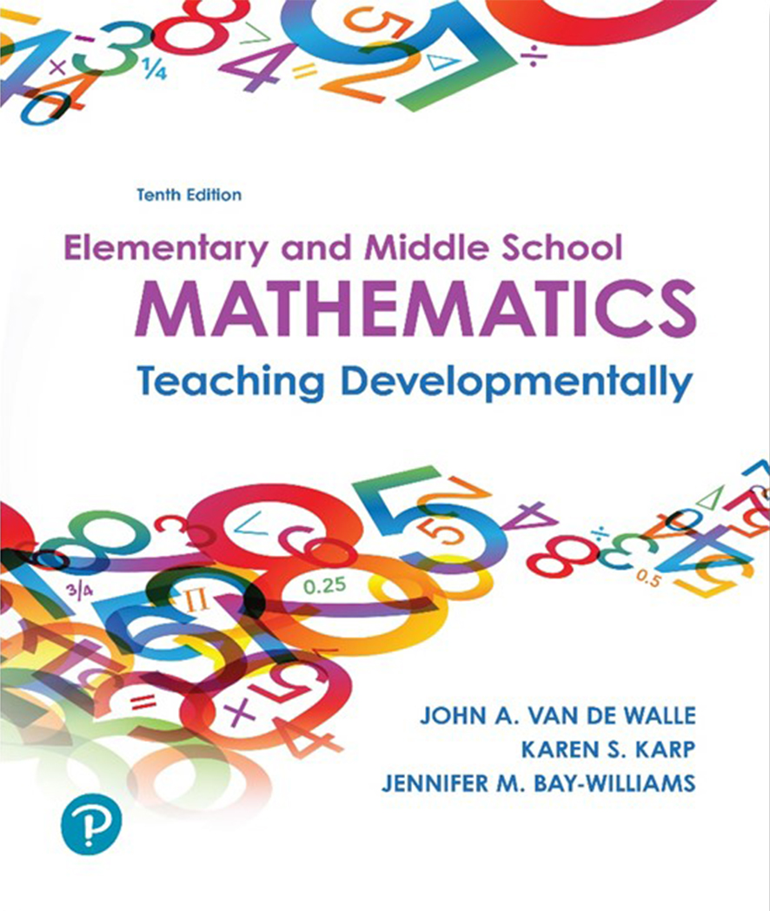
Elementary and Middle School Mathematics Teaching Developmentally 10th Edition
Chapter 3
Teaching Through Problem Solving
Copyright © 2019, 2016, 2013 Pearson Education, Inc. All Rights Reserved
Notes:
If this PowerPoint presentation contains mathematical equations, you may need to check that your computer has the following installed:
1) MathType Plugin
2) Math Player (free versions available)
3) NVDA Reader (free versions available)

Slide 2
Learner Outcomes
3.1 Contrast and describe approaches to problem solving.
3.2 Describe teaching practices that support student learning for all students.
3.3 Critique mathematical tasks to determine if they promote problem solving and procedural fluency.
3.4 Explain ways to engage students in classroom discourse.

Slide 3
Problem Solving
Teaching for problem solving
teaching skills, then providing problems to practice those skills (explain-practice- apply)
Teaching about problem solving
Polya’s four-step problem solving process (understand, devise a plan, carry out the plan, look back)
Teaching through problem solving
teaching content through real context, problems, situations, models and exploration

Slide 4
Ensuring Success for Every Student N C T M Teaching Practices
Teaching through problem solving:
Focuses students’ attention on ideas and sense making.
Develops mathematical practices and processes.
Develops student confidence and identities.
Build on students’ strengths.
Allows for extensions and collaboration.
Engages students so there are fewer discipline problems.
Provides formative assessment data.
Invites Creativity.

Slide 5
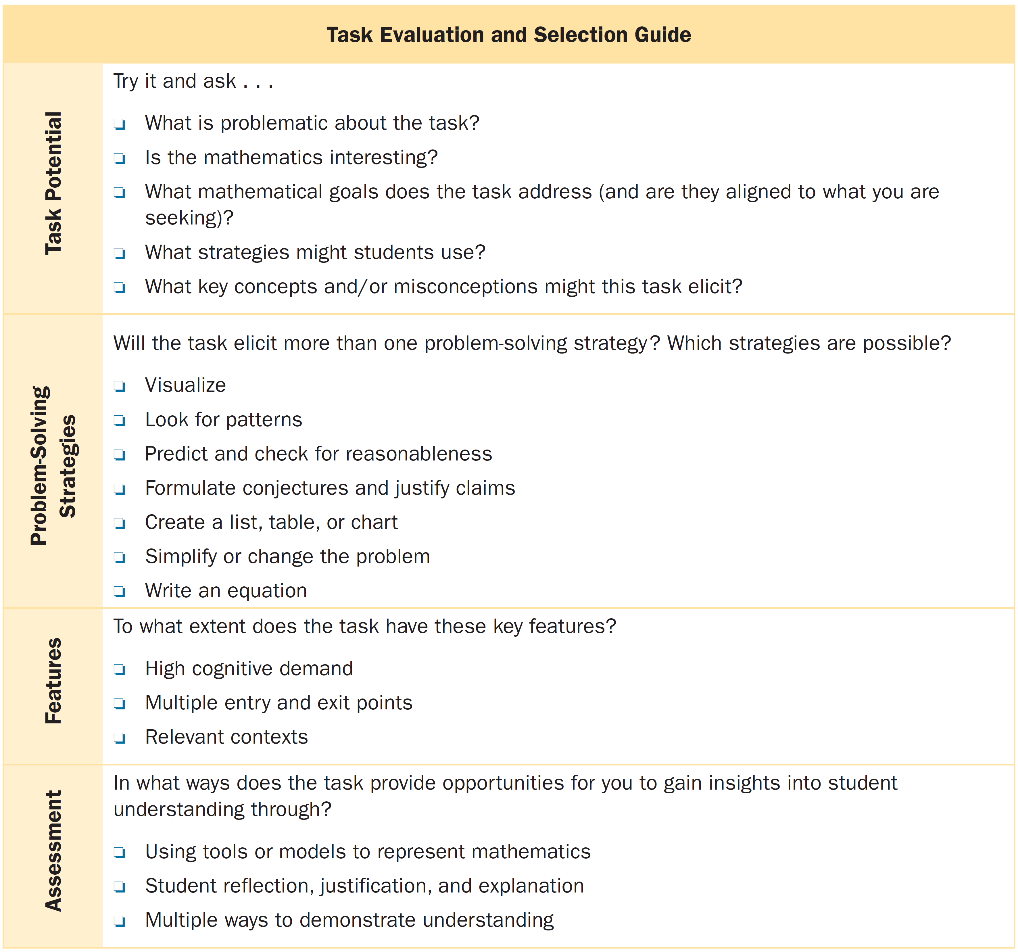
What is a Worthwhile Task or Problem for Learning Mathematics?

Slide 6
What is a Worthwhile Task or Problem for Learning Mathematics?

Slide 7
Levels of Cognitive Demand (1 of 2)
Low-Level Cognitive Demand | High-Level Cognitive Demand
Memorization Tasks Involve either producing previously learned facts, rules, formulas, or definitions or memorizing Are routine—involving exact reproduction of previously learned procedure Have no connection to related concepts | Procedures with Connections Tasks Focus students’ attention on the use of procedures for the purpose of developing deeper levels of understanding of mathematical concepts and Ideas Suggest general procedures that have close connections to underlying conceptual ideas Are usually represented in multiple ways (e.g., visuals, manipulatives, symbols, problem situations) Require that students engage with the conceptual ideas that underlie the procedures in order to successfully complete the task

Slide 8
Levels of Cognitive Demand (2 of 2)
Low-Level Cognitive Demand | High-Level Cognitive Demand
Procedures without Connections Tasks Use of the procedure is specifically call for Are straightforward, with little ambiguity about what needs to be done and how to do it Have no connection to related concepts Are focused on producing correct answers rather than developing mathematical understanding Require no explanations, or explanations focus solely on the procedure that was used | Doing Mathematics Tasks Require complex and nonalgorithmic thinking (i.e., nonroutine—there is not a predictable, known approach) Require students to explore and understand the nature of mathematical concepts, processes, or relationships Demand self-monitoring or self-regulation of one’s own cognitive processes Require students to access relevant knowledge in working through the task Require students to analyze the task and actively examine task constraints that may limit possible solution strategies and solutions Require considerable cognitive effort
Source: Adapted from Smith, M. S., & Stein, M. K. (1998). Selecting and creating mathematical tasks: From research to practice. Mathematics Teaching in the Middle School, 3(5): 344–350. Reprinted with permission.

Slide 9
How Can I Teach All Operations Through Problem Solving?
Topic #1: Partitioning in Grades K–1: Six bowls of cereal are placed at two different tables. Draw a picture to show a way that six bowls might be placed at two tables. Can you find more than one way? How many ways are there?
Does this task:
Allow for multiple ways in an exploratory manner?
Use a visual representation as a means for students to reason and think of other ways?
Open up opportunities to make connections between concept and procedures?

Slide 10
Children’s Literature a Rich Source for Problem Solving
Create high cognitive demand tasks
Multiple tasks from one story
Resonates with children’s experiences and imagination

Slide 11
Drill and Practice: A New or Different Perspective
Practice is the opportunity to:
Develop conceptual ideas and more elaborate and useful connections.
Develop alternative and flexible strategies.
Make connections between concepts and procedures.
Send a clear message that mathematics is about figuring things out.
Drill provides students with:
Improved procedural knowledge but not conceptual understanding.
When drill is short and time is spent connecting procedures to related concepts, drill is more effective.

Slide 12
Orchestrating Classroom Discourse
Involves three out of the eight SMP teaching practices-Facilitate meaningful mathematical discourse; pose purposeful questions; and elicit and use evidence of student thinking.
Five teacher actions for orchestrating productive mathematics discussion:
Anticipating - Planning before a lesson starts
Monitoring - Critically observing strategies that students are using
Selecting - From observations, selecting strategies for public discussion.
Sequencing - Strategically sequencing the presentations to emphasize mathematical ideas
Connecting - Designing questions that connect strategies and mathematical concepting

Slide 13
Questioning Considerations
Level of question - There are various models but the key idea is to ask higher-level questions throughout your mathematics teaching.
Type of targeted understanding - Questions must address procedural and conceptual understanding-Both are important!
Patterns of questions - Initiation-response-feedback (I R F) do not lead to class discussions. Focusing is a pattern that uses probing questions to negotiate class discussions.
Who is thinking of the answer? - Use strategies to be sure everyone is accountable to think of the answer. Ask students to “talk to a partner” about the question. Employ the talk moves for supporting classroom discourse.
How you respond to an answer - When you confirm a correct solution, rather than use one of the talk moves, you lose an opportunity to engage students in meaningful discussions about mathematics, and thereby limit the learning opportunities.

Slide 14
How Much to Tell or Not Tell
Researchers suggest three things that teachers do need to tell students:
Mathematical conventions - Symbols(+ =), terminology and labels
Alternative methods - an important strategy that does not emerge naturally from students should be introduced as “another” way, but not the only way.
Clarification or formalization of students’ methods - Help students interpret their ideas and point out related ideas - e.g., for 38 + 5 = ___ , a student adds 38 + 2 = 40 and 3 more is 43. Here, the student utilized the “make 10” strategy.

Slide 15
Writing to Learn Mathematics
Importance of student writing about mathematics:
a rehearsal for classroom discussion
can serve as a written record that remains long after the lesson
focus students on the need for precise language in mathematics
written product provides evidence of student understanding
engages students on reflecting on what strategy makes sense

Slide 16
I-THINK Framework Supports Metacognitive Skill Development
Individually think about the task.
Think about the problem.
How can it be solved?
Identify a strategy to solve the the problem.
Notice how your strategy helped you solve the problem.
Keep thinking about the problem. Does it make sense?

