Slide 1
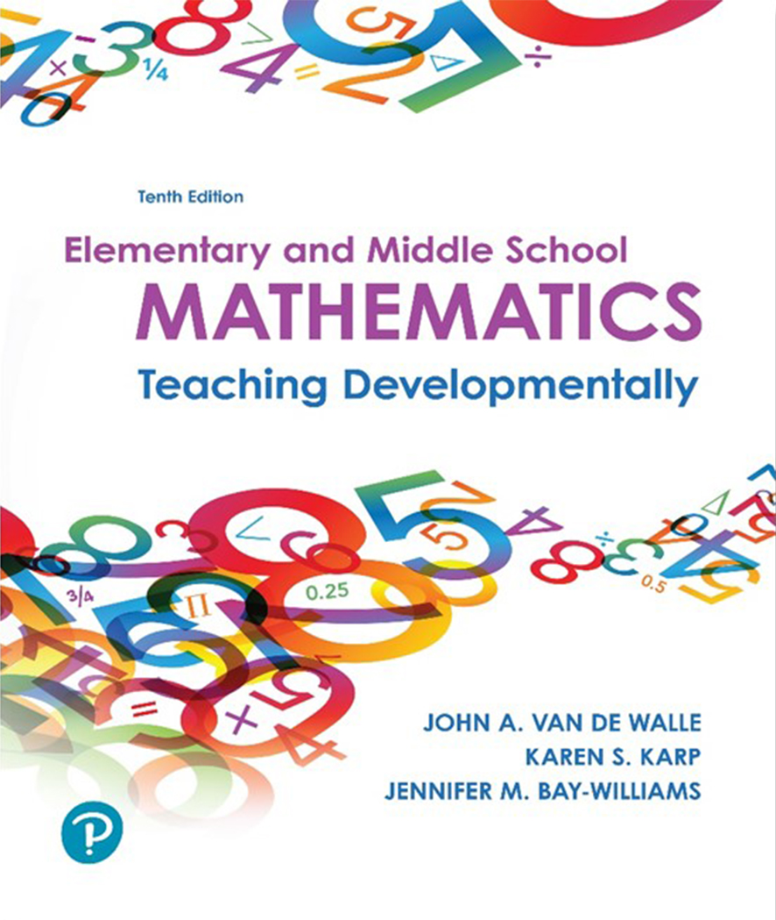
Elementary and Middle School Mathematics Teaching Developmentally
10th Edition
Chapter 22
Developing Concepts of
Exponents, Integers, and Real Numbers
Copyright © 2019, 2016, 2013 Pearson Education, Inc. All Rights Reserved
Notes:
If this PowerPoint presentation contains mathematical equations, you may need to check that your computer has the following installed:
1) MathType Plugin
2) Math Player (free versions available)
3) NVDA Reader (free versions available)

Slide 2
Learner Outcomes
22.1 Describe strategies to meaningfully engage students in understanding exponents, order of operations, scientific notation, and very large and very small numbers.
22.2 Compare quantity and number line visuals for teaching integers, and contrast the different contexts for teaching about positive and negative numbers.
22.3 Illustrate and explain conceptual approaches to teaching operations with positive and negative numbers.
22.4 Construct a visual that illustrates the relationships among different types of numbers (irrational, whole, etc.) and describe conceptual ways to introduce irrational numbers.

Slide 3
Standards-Based Development
3rd Graders need to know the order of operations.
5th Graders introduced to exponents related to powers of ten and place value.
6th Grade students learn to write and evaluate numeric expressions involving whole-number exponents.
Introduced to positive and negative numbers and how they are used to describe quantities having opposite directions or values.
Able to represent integers on a number line as well as a coordinate axis.
Introduced to absolute value
7th Graders solve multi-step real-life and mathematical problems posed with positive and negative rational numbers in any form.
8th Graders students work with radical and integer exponents and use scientific notation.
Explore irrational numbers, and find their rational approximation.

Slide 4
Exponents in Expressions and Equations
Exponential notation is more efficient for conveying numeric or quantitative information.
Exponent indicated the number of times the base is used as a factor.
Minia knows that square animal pens are the most economical for the amount of area they provide (assuming straight sides). Can you provide a table for Minia that shows the areas of square pens that have between 4 meters and 10 meters of fence on each side?

Slide 5
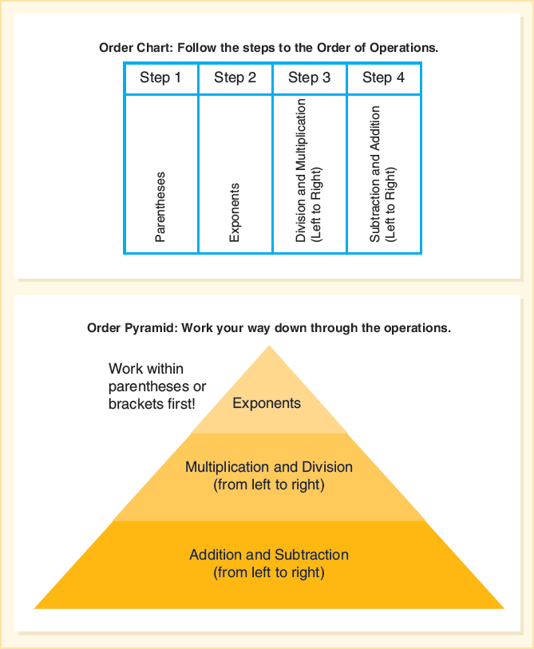
Order of operations
Order of operations is not just a convention. It is based on the meaning of the operations.
Mnemonics - Please Excuse My Dear Aunt Sally P E M D A S
This must not replace understanding of why the order of operation is what it is.
Consider
P = Parenthesis
E = Exponents
M D = multiplication and division (whichever is first from left to right
A S = addition and subtraction (whichever is first from left to right)

Slide 6
Apply Order of Operations Activity 22.2 Guess My Number
Guess My Number
In this activity, you will give hints about a number and students will think backwards to find it (by using logical reasoning). For E L Ls and students with disabilities, provide the statements in writing and verbally. Students create equations, using parentheses appropriately to reflect the clues you give, as in the following three examples:
I am thinking of a number; I add 5, double it, and get 22.
I am thinking of a number; I subtract 2, square it, and get 36.
I am thinking of a number; I double it, add 2, cube it, and get 1000.
For students with disabilities, you may want to start with a known number rather than an unknown number—for example, start with 5, square it, add 11, divide by 6. They should write

Slide 7
Integer Exponents
Explore power of 10 changes
Explore negative exponents with a calculator.
Use fraction-to-decimal conversion feature.
Negative exponent is the reciprocal of the value it would be with a positive sign.

Slide 8
Context for Very Large Numbers
State lottery - Exploring lottery combination and then probabilities can help students understand social justice issues using mathematics. A lottery with 40 numbers from which to pick 6 (4 million possible combinations)
The estimated diameter of the universe is 40 billion light-years.
The average human body has 100 billion cells.
The distance to the sun is about 150 million kilometers.
The population in the world is approximately 7.63 billion (July, 2018).
Connect large numbers to meaningful points of reference to help them get an idea of true magnitude.

Slide 9
Context for Very Small Numbers
Length of D N A strand in a cell
Human hair growth rate
Chances of winning the lottery
Mass of one atom of hydrogen
Sound to travel the length of a football field
Finding real data that are very, very, small can build meaning and insights.

Slide 10
Contexts for Exploring Positive and Negative Numbers
Quantity contexts
Golf scores
Money: Payments
and Deposits
Item | Payments or Deposits | Balance
Mowing lawn | +12.00 | $34.00
Phone bill | −55.00 | −21.00
i Tunes downloads | −9.00 | −30.00
Paycheck | +120.00 | 90.00
Linear Contexts
Temperature
Altitude
Timelines
Football

Slide 11
Tools for Illustrating Positive and Negative Numbers
Two color counters
Number Lines
Deciding which tool to use we must remember that integers involve two concepts, magnitude (counters or length of arrows) and direction (different colors or directions), as well as the context.

Slide 12
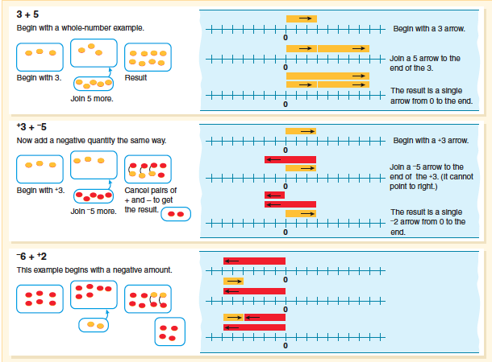
Addition with Integers

Slide 13
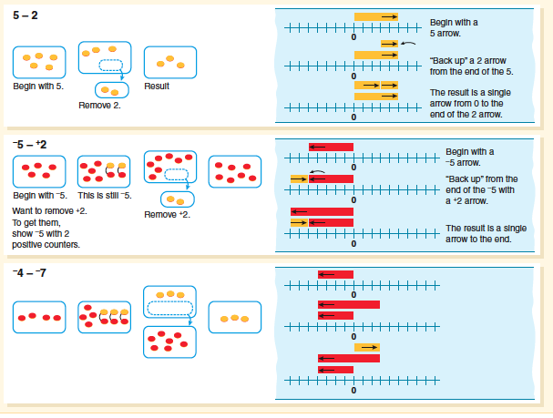
Subtraction with Integers

Slide 14
Connecting Visual Representations with Equations
Notate number line illustrations.

Slide 15
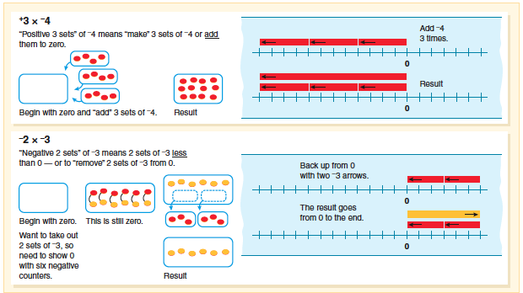
Multiplication with Integers

Slide 16
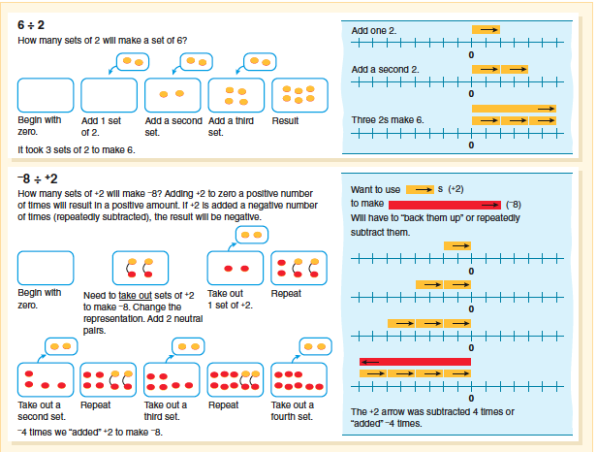
Division with Integers

Slide 17
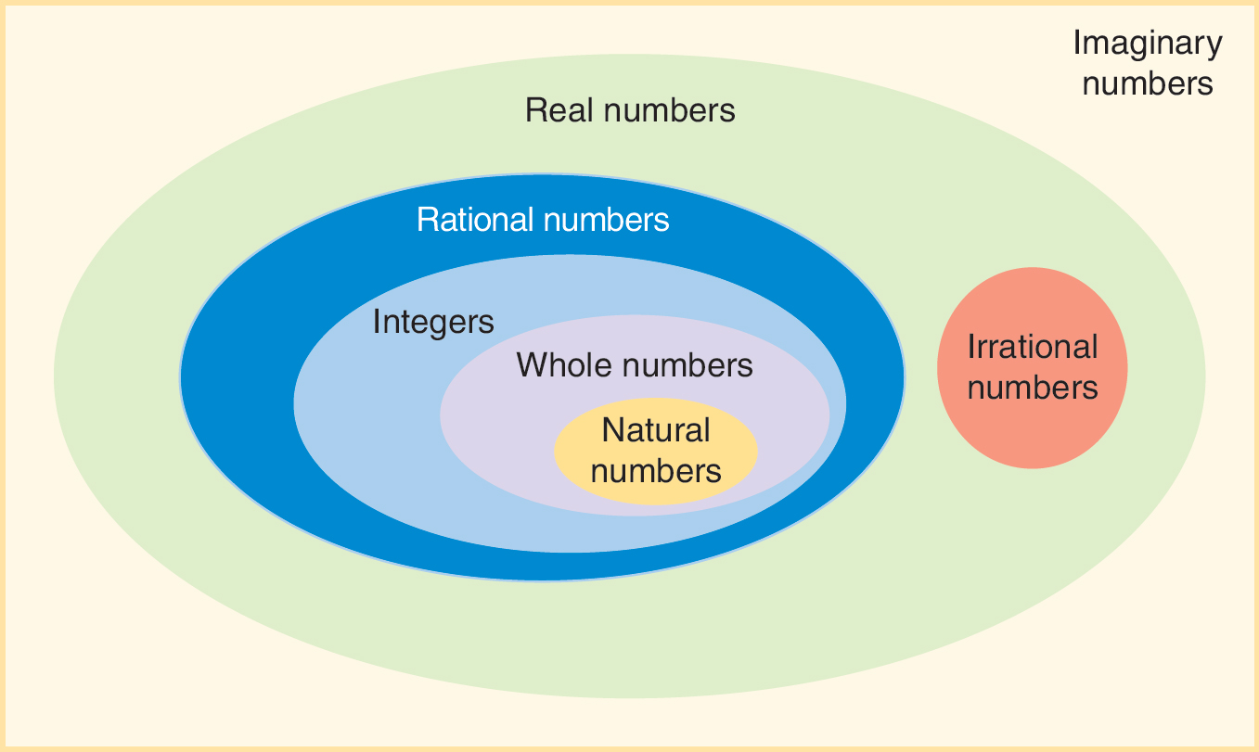
Real Numbers
Rational numbers are all numbers that can be represented as a fraction (irrational numbers cannot be represented as a fraction).
Integers are whole numbers and their negatives or opposites.

Slide 18
Activity 22.15 Repeat or Terminate?
Repeater or Terminator?
Have students generate a table listing in one column the first 20 unit fractions
The second column is to list the prime factorization of the denominators; and the third column is the decimal equivalent for the fraction (use calculators to get the precise decimal form).
After completing the table, ask students if they can determine a rule that will tell in advance if the decimal will repeat or terminate. They can test the rule with fractions with denominators beyond 21. Challenge students to conform that their rule applies even if the numerator changes.

Slide 19
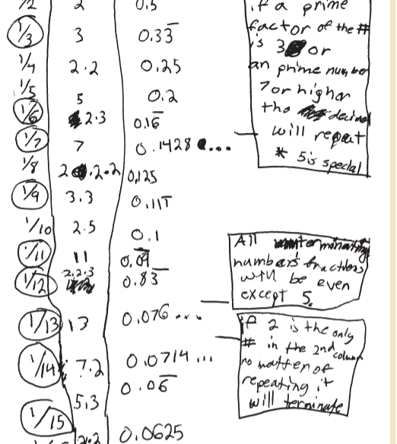
Student Example:
This student discovered that only fractions with terminating decimals have denominations that factor with only combinations of twos and fives.
Middle school students must understand that any rational number, positive or negative, whole or not whole, can be written as a fraction and as a decimal.

Slide 20
Roots and Cubes
Activity 22.16 Edges of Squares and Cubes
Show students pictures of three squares (or three cubes) as in Figure 23.16. The sides (squares) and edges (cubes) of the first and last figure are consecutive whole numbers. The areas or volumes of all three figures are provided. Ask students to use a calculator to find the length of the sides (squares) or edges (cubes) of the figure in the center. Explain to students that they are not to use the square root or cube root key, but to estimate what they think the length of the side would be and test it by squaring or cubing it. Ask students to continue to estimate until they have found a value to the hundredths place that gets as close to 45 as possible (or 30 in the case of the cube). Solutions will satisfy these equations:

Slide 21
Common Errors and Misconceptions Relate to Exponents, Order of Operations, Negative Numbers and Real Numbers (1 of 2)
Common Challenge or Misconceptions | What It Looks Like | How to Help
1. Order of Operations. Thinking addition precedes subtraction. | Simplifies the expression 15 − 10 + 5 by first adding, getting an incorrect answer of 0. The correct answer is ____ . | Do not use P E M D A S as the way to remember the order of operations. Give many examples where subtraction appears before addition in the expression. Use worked examples with this error in it.
2. Order of Operations. Thinking multiplication precedes division. | Simplifies the expression 60 ÷ 10 × 2 by first multiplying, getting an incorrect answer of 3. The correct answer is ____ . | See strategies in (1).

Slide 22
Common Errors and Misconceptions Relate to Exponents, Order of Operations, Negative Numbers and Real Numbers (2 of 2)
Not distinguishing between exponents and multiplication
With scientific notation, thinking the exponent tells the numbers of zeros to “add on” to a number
Locating negative non-integer values on the number line
Multiple meanings of the minus sign
Integer operations: making sense of the meaning of the operation and the answer
Thinking square root notation indicates an operation

