Slide 1
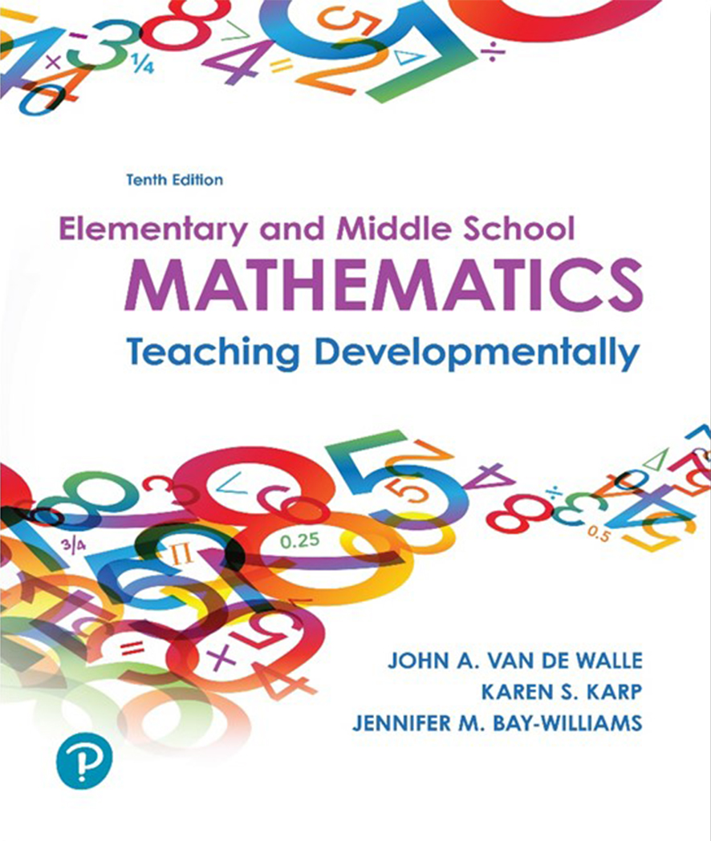
Elementary and Middle School Mathematics Teaching Developmentally 10th Edition
Chapter 2
Exploring What it Means to Know and Do Mathematics
Copyright © 2019, 2016, 2013 Pearson Education, Inc. All Rights Reserved
Notes:
If this PowerPoint presentation contains mathematical equations, you may need to check that your computer has the following installed:
1) MathType Plugin
2) Math Player (free versions available)
3) NVDA Reader (free versions available)

Slide 2
Learner Outcomes
2.1 Investigate what it means to do mathematics.
2.2 Describe essential components of mathematical proficiency, including the importance of a relational understanding.
2.3 Connect learning theories to effective teaching practices.

Slide 3
What Does it Mean to Do Mathematics?
Doing mathematics means:
Demonstrating mathematical processes;
Establishing goals for students that reflect these practices; and
Posing worthwhile tasks that open opportunities for mathematical processes to develop strong conceptual understanding.

Slide 4
Verbs for Doing Mathematics?
Lower Level Thinking
Listen
Copy
Memorize
Drill
Compute
Higher Level Thinking
Compare
Construct
Explore
Predict
Investigate
Formulate

Slide 5
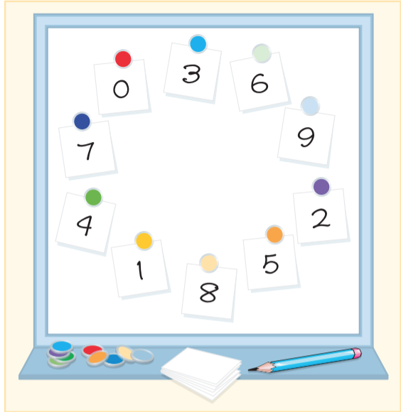
An Invitation to Do Mathematics (1 of 2)
Searching for Patterns
Begin with a number (start) and add (jump) a fixed amount. For example, start with 3 and jump by 5s.
Analyzing a Situation
Ron’s Recycle Shop started when Ron bought a used paper-shredding machine. Business was good, so Ron bought a new shredding machine. The old machine could shred a truckload of paper in 4 hours. The new machine could shred the same truckload in only 2 hours. How long will it take to shred a truckload of paper if Ron runs both shredders at the same time?

Slide 6
An Invitation to Do Mathematics (2 of 2)
Generalizing Relationships
Addition
When you add 7 + 7, you get 14. When you make the first number 1 more and the second number 1 less, you get the same answer:
8 + 6 = 14
Experimenting and Explaining
Samuel, Susan, and Sandu are playing a game. The first one to spin “purple” wins! Purple means that one spin lands on red and one spins lands on blue. Each person chooses to spin each spinner once or one of the spinners twice. Samuel chooses to spin spinner A twice; Susan chooses to spin spinner B twice; and Sandu chooses to spin each Spinner once. Who has the best chance of purple? (based on Lappan & Even, 1989)

Slide 7
Where are the Answers?
No answers are provided in the test. How do you feel about that? What about the “right answers”? What makes the solution to any investigation “correct”?
When the teacher provides answers and solutions it sends a clear message to the students that they must find the answer the teacher already has.
Problem solving outside of the classroom does not have a teacher or textbook with the answer.

Slide 8
What Does it Mean to Know Mathematics?
Understanding and knowing is the measure of quality and quantity of connections between new ideas and existing ideas.
Knowing
Understanding (Students may know something about fractions, for example, but not understand them.)
Richard Skemp’s continuum of understanding:

Slide 9
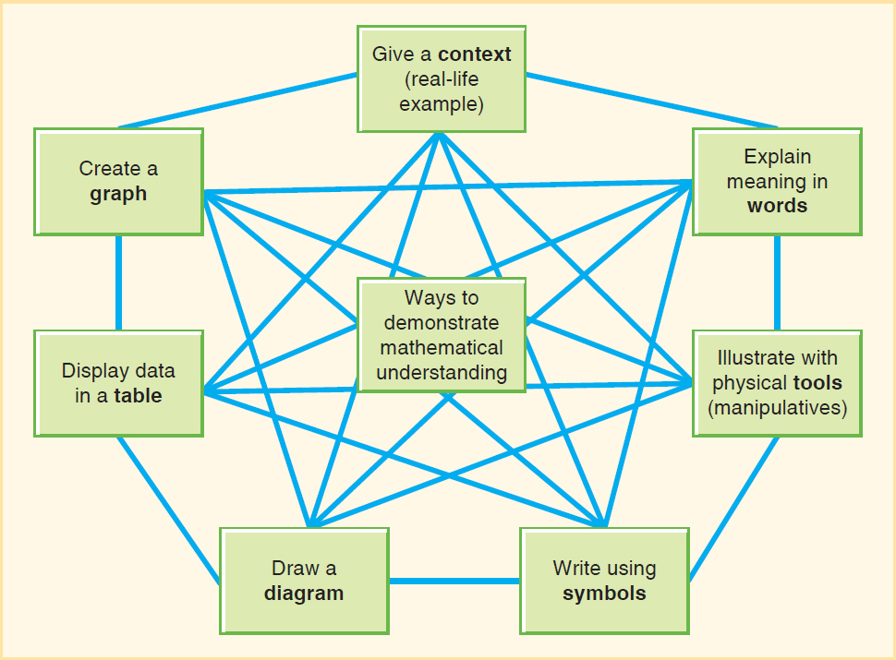
Use and Connect Different Representations to Support Relational Understanding

Slide 10
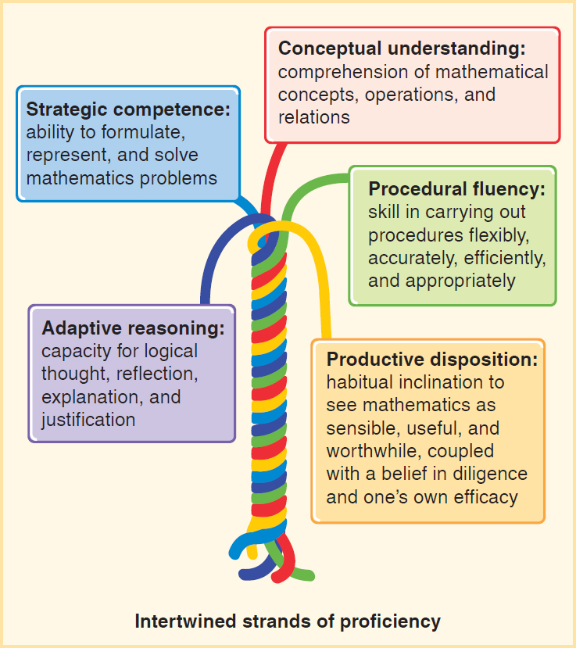
Adding it up National Research Council 2001
Conceptual and procedural understanding
Five strands of mathematical proficiency:
Conceptual understanding
Procedural fluency
Strategic competence
Productive disposition
Adaptive reasoning

Slide 11
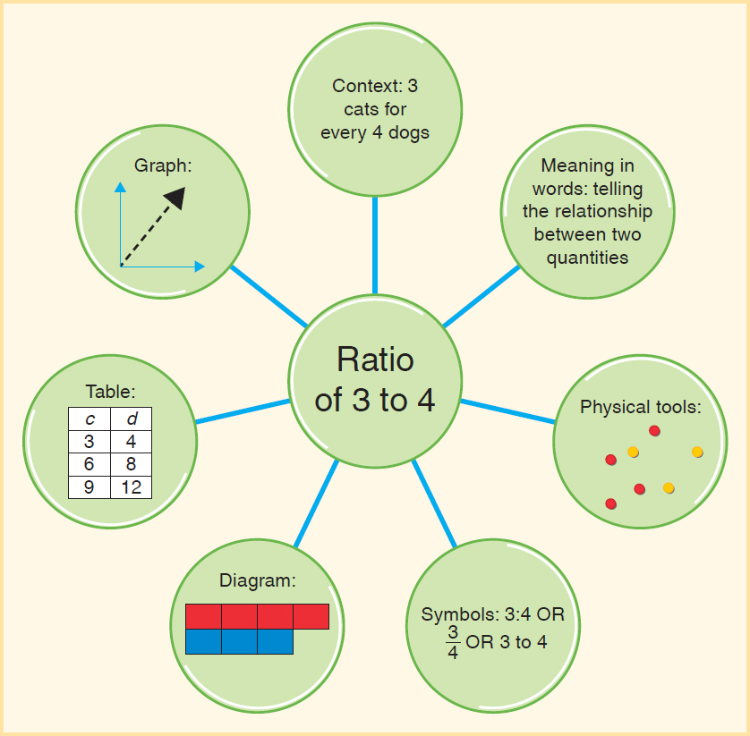
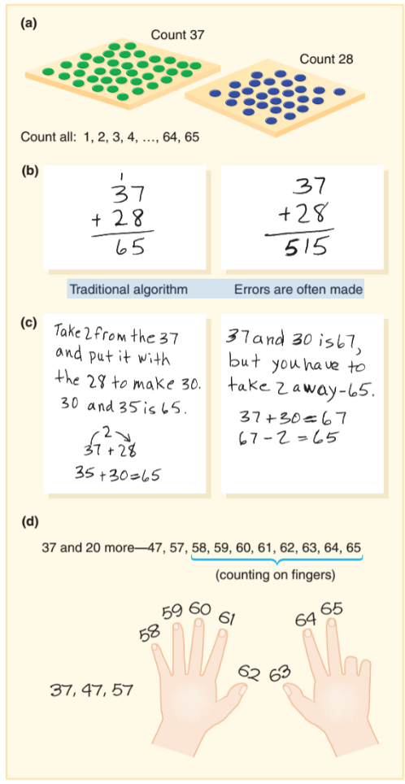
Mathematical Proficiency
Conceptual understanding
Procedural fluency

Slide 12
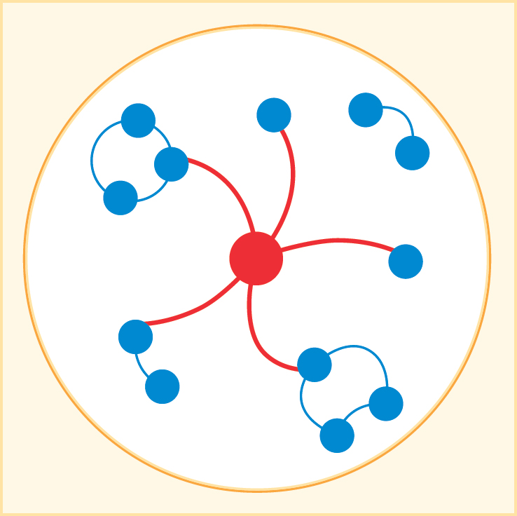
Constructivism Theory by Jean Piaget
Learners are not blank slates but creators of their own knowledge.
Networks and cognitive schema are the product of constructing knowledge.
Reflective thought is how people modify schemas to incorporate new ideas.
Assimilation - New idea fits with prior knowledge-blue dots connect to red
Accommodation - New idea does not fit with existing knowledge

Slide 13
Sociocultural Theory by Lev Vygotsky
Basic Tenet
Mental processes exist between and among people in social interactions
Learner (working in his or her Z P D)
Semiotic mediation is how beliefs, attitudes and goals are affected by sociocultural practices and institutions

Slide 14
Implications of Constructivist Theory and Sociocultural Theory
There is no need to choose between theories.
These theories are not teaching strategies but should instead guide teaching.

Slide 15
Implications for Teaching Mathematics
Build new knowledge from prior knowledge.
Provide opportunities to communicate about mathematics.
Create opportunities for reflective thought.
Encourage multiple approaches.
Engage students in productive struggle.
Treat errors as opportunities for learning.
Scaffold new content.
Honor diversity.

Slide 16
Connecting the Dots Between Theory and Practice
Consider this short list of reflective prompts. Which ones might a proficient student say “yes” to often?
When you read a problem you don’t know how to solve, do you think, “Cool-something challenging, I can solve this, let me now think how”?
Do you consider several possible approaches before diving in to solve a problem?
Do you recognize a wrong path and try something else (persevere)?
Do you look for patterns across examples and try to see a new short cut or approach that might work?
As you work, do you decide to draw a picture, use a calculator, or model the problem with a manipulative (direct modeling)?

