Slide 1
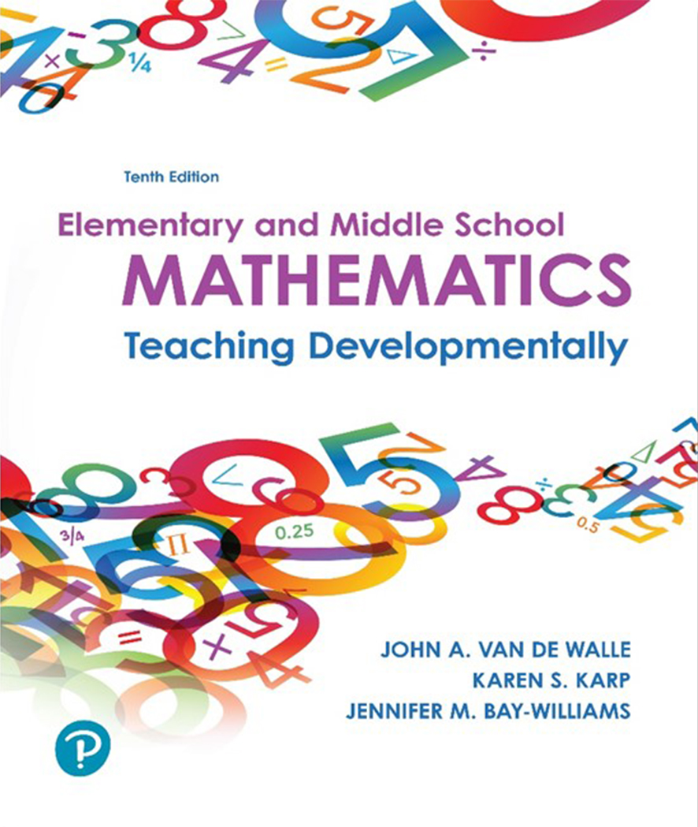
Elementary and Middle School Mathematics Teaching Developmentally
10th Edition
Chapter 17
Ratios, Proportions, and Proportional Reasoning
Copyright © 2019, 2016, 2013 Pearson Education, Inc. All Rights Reserved
Notes:
If this PowerPoint presentation contains mathematical equations, you may need to check that your computer has the following installed:
1) MathType Plugin
2) Math Player (free versions available)
3) NVDA Reader (free versions available)

Slide 2
Learner Outcomes
17.1 Describe the essential features of a ratio, including how it relates to fractions, and articulate ways to help students understand and be able to use ratios.
17.2 Contrast proportional and nonproportional situations using additive and multiplicative examples.
17.3 Illustrate the different ways to solve proportional problems and describe a developmental progression for these ways.
17.4 Compare traditional methods of teaching proportional reasoning to research-based methods.

Slide 3
Standards-Based Development
Grade 4: Solve multiplication problems involving a multiplicative comparison.
Grade 5: Identify relationships between two varying quantities.
Grade 6: A critical area focuses on connecting ratio and rate to multiplication and division; students solve problems involving ratios and rates.
Grade 7: A critical area focuses on proportionality, solving multistep problems; students write proportions as equations and graph them, as well solve problems involving interest, tax, gratuities and so on.

Slide 4
Types of Ratios
Part-to-part ratios
Represents one part in relation to another part of a whole
9 females and 7 males in a group, 9/7 meaning a ratio of nine to seven (This is not a fraction.)
Part-to-whole ratios
Comparison of a part to a whole
9 girls to 16 students in the group, 9/16 meaning nine-sixteenths of the class (a fraction)
Ratios as quotients
Thought of as quotients
Buy 4 kiwis for $1.00. Ratio of money $1.00 to 4 kiwis or
Ratios as rates
Miles per gallon, miles per hour, $ per square yard, passengers per busload, and roses per bouquet are all rates
Relationships between two units of measure, inches per foot, milliliters per liter are also rates.

Slide 5
Two Ways to Think About Ratio
Forming a ratio is a cognitive task not a writing task
Multiplicative Comparison
Wand A is 10 inches long and Wand B is 15 inches long.
There are two ways to show the relationship- The ratio is 10 to 15 or 15 to 10.
The short wand is two-thirds as long as the long wand; the long wand is three-halves as long as the short want.
How many times greater is one thing than another?
What fractional part is one thing of another?
Composed Unit
Thinking of the ratio as one unit
4 kiwi for $1.00 then 8 for $2.00, 16 for $4.00
This is iterating.
Partitioning examples:
2 for

Slide 6
Proportional Reasoning (1 of 2)
Proportional thinkers:
Understand ratios as distinct entities representing relationship different from the quantities they compare.
Recognize proportional relationships as distinct from nonproportional relationships in real-world contexts.
Have a sense of covariation.
Develop a wide variety of strategies for solving proportions or comparing ratios, most of which are based on informal strategies rather than prescribed algorithms

Slide 7
Proportional Reasoning (2 of 2)
Early ideas of proportional reasoning;
One-to-one correspondence, place value, fraction concepts and multiplicative reasoning
Compare situations, and discuss whether it is an additive, multiplicative or constant relationship.
A ratio is a number that expresses a multiplicative relationship (part-part or part-whole) that can be applied to a second situation.

Slide 8
Examine These Situations and Identify the Proportional Reasoning You Would Use
Janet and Jeanette were walking to school, each walking at the same rate. Jeanette started first. When Jeanette has walked 6 blocks, Janet has walked 2 blocks. How far will Janet be when Jeanette is 12 blocks?
Lisa and Linda are planting corn on the same farm. Linda plants 4 rows and Lisa plants 6 rows. If Linda’s corn is ready to pick in 8 weeks, how many weeks will it take for Lisa’s corn to be ready?
Kendra and Kevin are baking cookies using the same recipe. Kendra makes 6 dozen and Kevin makes 3 dozen. If Kevin is using 6 ounces of chocolate chips, how many ounces will Kendra need?

Slide 9
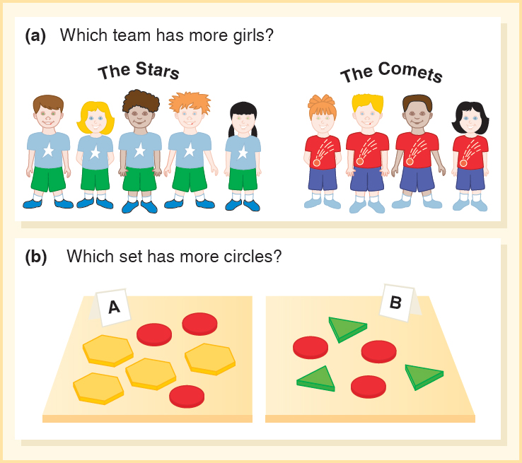
Additive and Multiplicative Comparisons
How are these two tasks alike and how are they different?
A red car and a silver car are traveling at the same constant rate. When the red car has traveled 20 miles, the silver car has traveled 12 miles. How far will the red car be when the silver car has traveled 32 miles?
A red and silver car are traveling at different but constant rates. They pass Exit 95 at the same time. When the red car has traveled 20 miles past Exit 95, the silver car has traveled 16 miles. How far will the red car be when the silver car has traveled 32 miles?
Decide which has more, and share your reasoning.

Slide 10
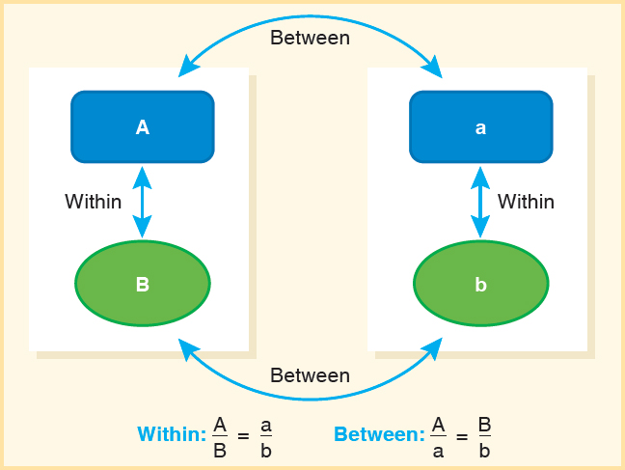
Covariation
Two different quantities (a ratio) vary together.
The ratio of two measures in the same setting is a within ratio.
Example – A ratio of oranges to money may involve 4 oranges for $1.00: 4/$1 = 16/$4
Both of these are within ratios.
Ratio of two corresponding measures in different situations is a between ratio.
Example – Comparing the ratio of the original number of oranges (4 to $1.00) to the number of oranges (16 to $4.00) in a second situation: 4/16 = $1/$4
Both of these are between ratios.

Slide 11
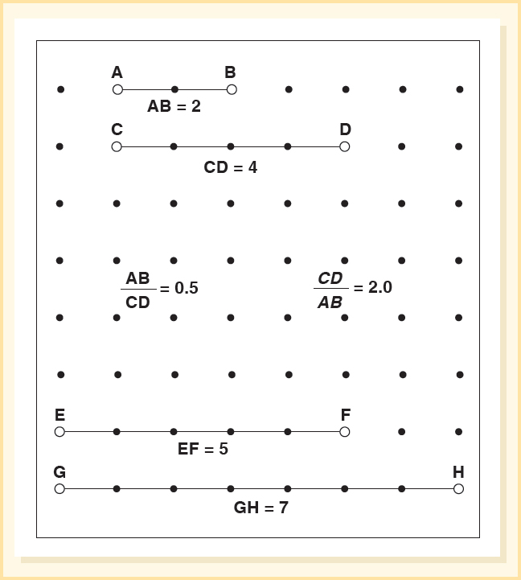
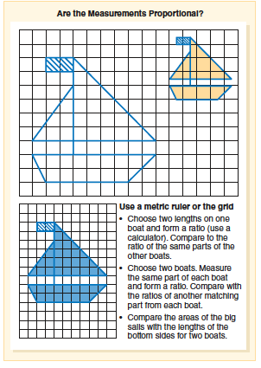
Covariation in Geometry and Measurement

Slide 12
Covariation in Algebra
Proportional situations are always linear situations.
Graphs provide a way of thinking about proportions and connect proportional thoughts to algebra.

Slide 13
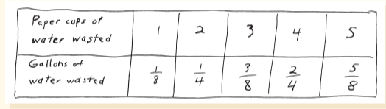
Activity 17.9 Dripping Faucet
Materials – Pose this problem:
If you brush your teeth twice a day and leave the water running when you brush. How many gallons of water will you waste in one day? In a week? A month? Any number of days?
Students need to gather data and record it in a ratio table.
Students found ratio was
Formula y = ¹/₈ x

Slide 14
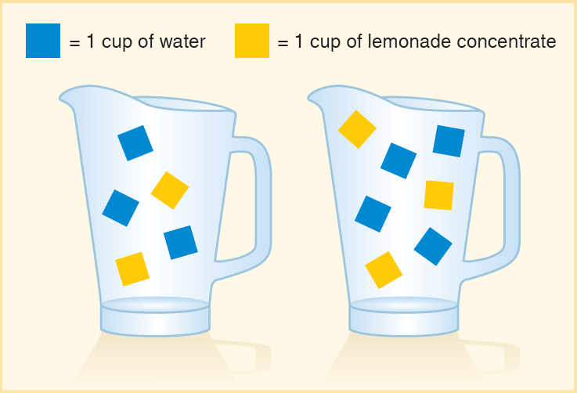
Activity 17.10 Comparing Lemonade Recipes Unit Rate or Scale Factor?
Recipes are
3 cups water
2 cups concentrate
4 cups of water
3 cups of concentrate
Which pitcher will have the stronger lemon flavor, or will they both taste the same?

Slide 15
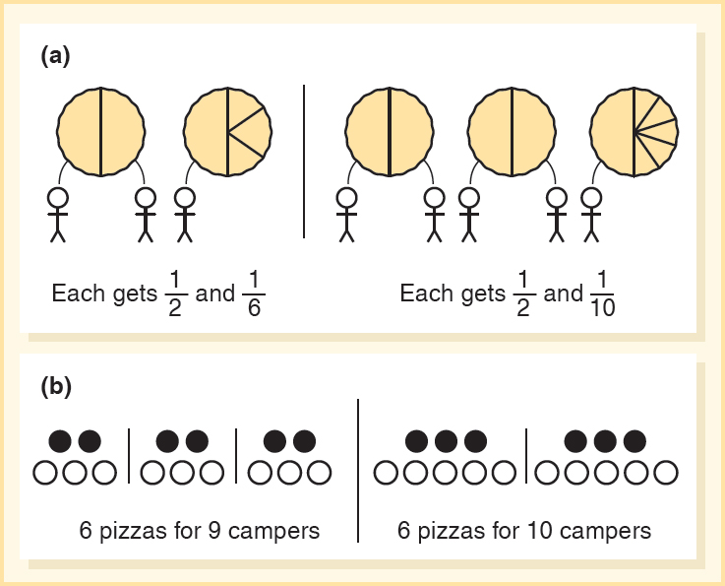
Activity 17.12 Which Camp Gets More Pizza? Unit Rate or Scale Factor
Two Camps of Scouts are having pizza parties. The leader of the Bear Camp ordered enough so that every 3 campers will have 2 pizzas. The leader of the Raccoon Camp ordered enough for every 5 campers. Did the Bear Campers have more pizza?

Slide 16
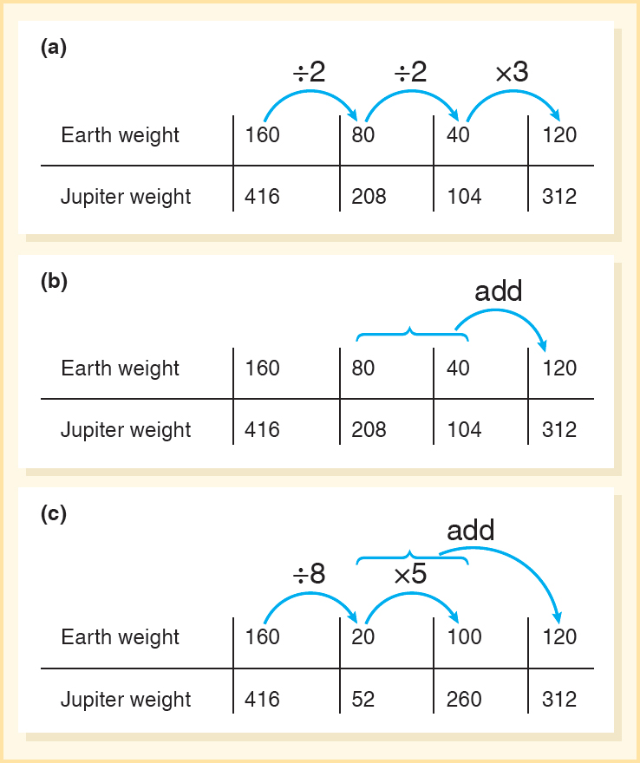
Solving Problems Using Ratio Tables
Something weighing 160 pounds on Earth is 416 pounds on Jupiter. If something weighs 120 pounds on Earth, how many pounds would it weigh on Jupiter?
Review the three solutions.

Slide 17
Solving Proportion Problems with Tape or Strip Diagram
The ratio of boys to girls in this class is 3 to 4.
If there are 12 girls, how many boys are there?
If there are 21 children, how many boys are there?
There are 5 more girls than boys. How many girls are there?

Slide 18
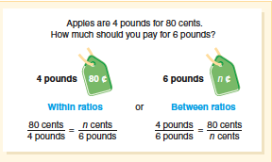
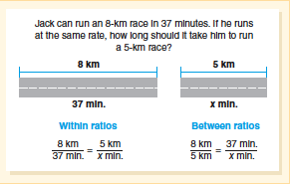
Equations (Cross Products)
Central to teaching students to reason proportionally is to teach ideas and restrain the quick path to computation.
Visual of correct proportional equation to determine unit rate or price or scale factor
Line segments can also model a unit rate scale factor.

Slide 19
Teaching Proportional Reasoning
Used composed unit and multiplicative comparison ideas in building understanding of ratio.
Help students distinguish constant, additive, and multiplicative comparisons by providing examples of each and discussing differences.
Provide ratio and proportion tasks in a wide range of contexts, including situations involving measurement, prices, geometric and other visual contexts, and rates of all sorts.
Engage students in a variety of strategies for solving proportions, sequencing instruction from most intuitive to more abstract.
Recognize that the cross product algorithm, while important to understand and use, is not the goal of teaching proportions- the goal is that students are able to recognize proportional situations and to solve them efficiently.

Slide 20
Common Challenges and Misconceptions Related to Ratios and Proportions
Challenge or Misconception | What It Looks Like | How to Help
1. Use additive reasoning when the situation requires multiplicative reasoning. | Student thinks that because a giant’s pencil is 15 inches longer than a typical pencil, the giant is 15 inches taller than a typical person (see Activity 17.4). | See the discussion and tasks in Types of Comparing Situations section. Use Activities 17.3 and 17.4.
2. Use phrases that imply confusion between additive and multiplicative reasoning (Rathouz, Cengiz, Krebs, & Rubenstein, 2014). | Student says “is four times more than” rather than “is four times as long as” for a multiplicative comparison. | Compare the two statements and their meanings. Use precise language. Use revoicing to help students use the correct language.
3. Experience difficulty determining how to graph ratios (Kastberg, D’Ambrosio, Lynch-Davis, Mintos, & Krawczyk, 2014). | Students cannot decide which axes to use for the two measures; students have difficulty interpreting a completed graph. | Discuss that with ratios, the choice of which variable is on the x-axis and which variable goes on the y-axis is arbitrary. Compare graphs that are done both ways. Point at values and ask what they mean related to the context.

