Slide 1
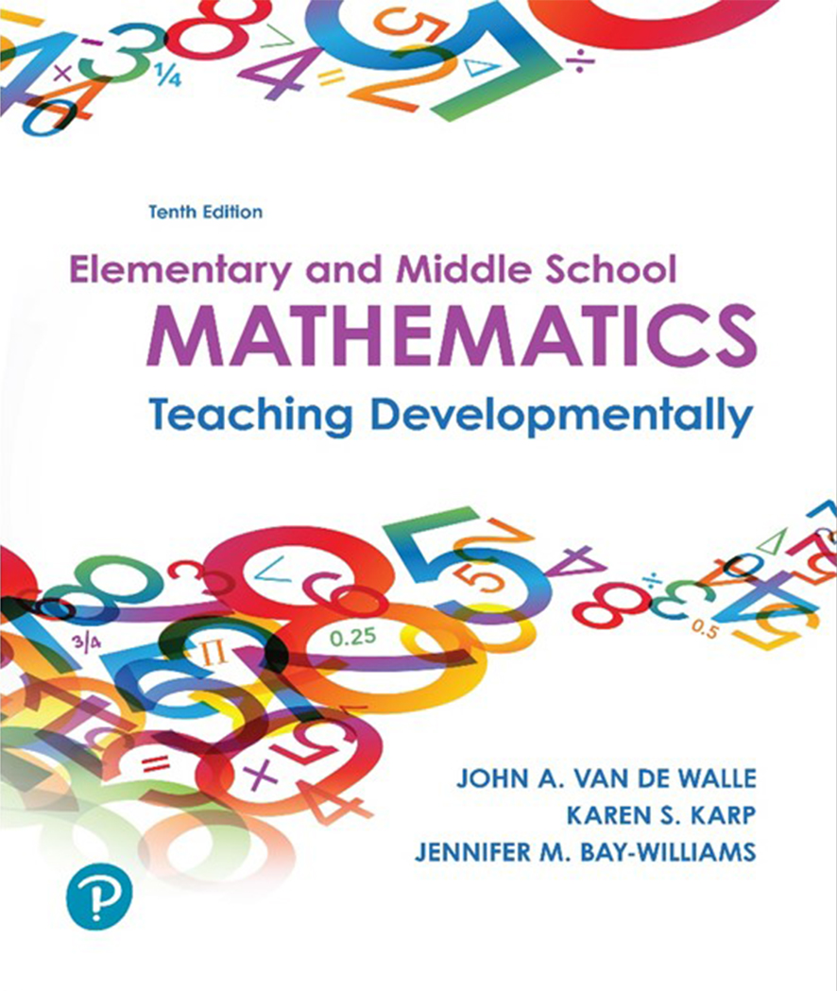
Elementary and Middle School Mathematics Teaching Developmentally 10th Edition
Chapter 16
Developing Decimal and Percent Concepts and Decimal Computation
Copyright © 2019, 2016, 2013 Pearson Education, Inc. All Rights Reserved
Notes:
If this PowerPoint presentation contains mathematical equations, you may need to check that your computer has the following installed:
1) MathType Plugin
2) Math Player (free versions available)
3) NVDA Reader (free versions available)

Slide 2
Learner Outcomes
16.1 Describe how the place-value system is central to the understanding of decimal fractions.
16.2 Identify physical models that connect fractions to decimals.
16.3 Demonstrate how to compare and order decimal fractions.
16.4 Explain multiple strategies for computing with decimals.
16.5 Explain how percents are related to fractions and decimals.

Slide 3
Standards-Based Development
Grade 4: Develop an understanding of decimal notation (to hundredths) for fractions and compare decimal fractions.
Grade 5: Perform operations with decimals (to hundredths), expanding comparisons of decimals to thousandths, and rounding decimals.
Grade 6: Extend decimal operations beyond tenths and hundredths to all decimals, develop standard algorithms for all four decimal operations and explore percent of a quantity as a rate.
Grade 7: Develop a “unified understanding of number” to be able to move fluently between decimals, fractions, and percents.

Slide 4
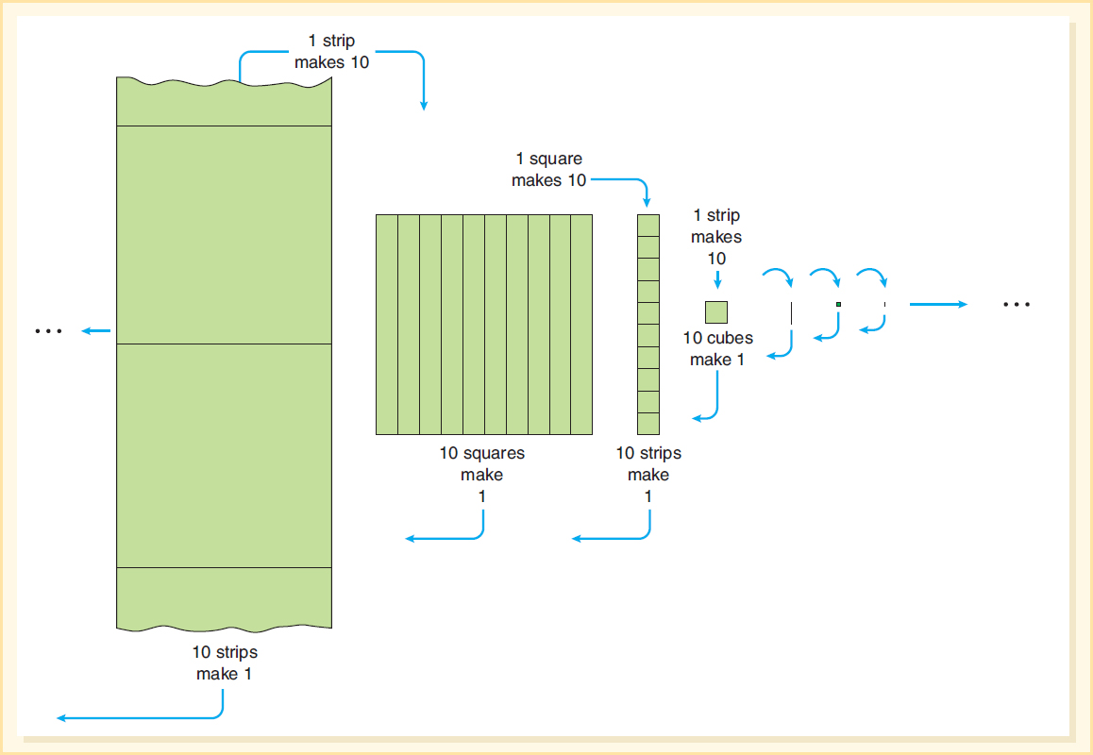
10-to-1 Relationship - Now in Two Directions

Slide 5
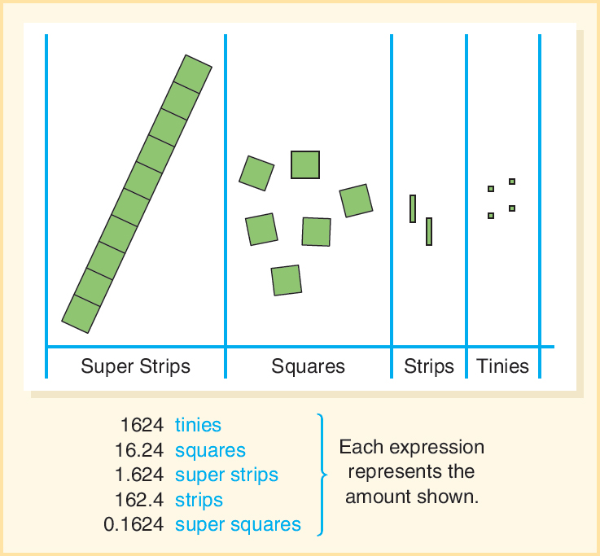
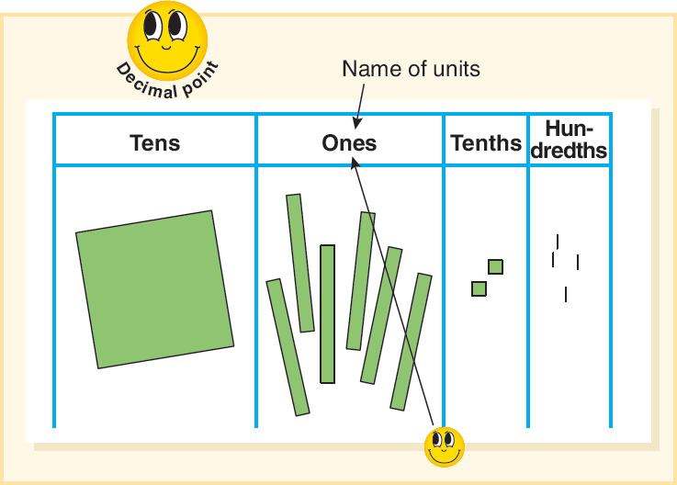
Role of the Decimal Point
Placement of the decimal point indicates the position of the unit.
The decimal point always looks up at the name of the units position.

Slide 6
Precision and Equivalence
Mathematically proficient students express numerical answers with a degree of precision appropriate for the problem context.
Consider two measurements:
0.06 and 0.060 - Which one communicates a greater level of precision?
When would that level of precision be important?

Slide 7
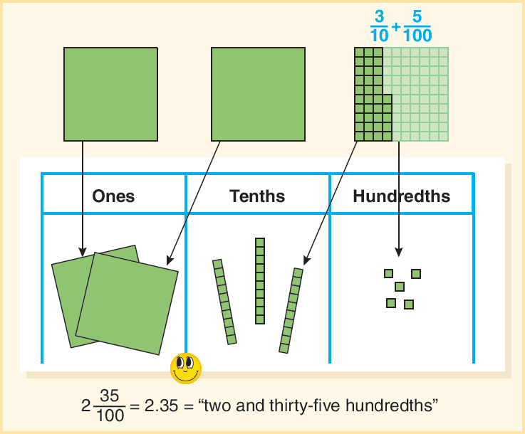
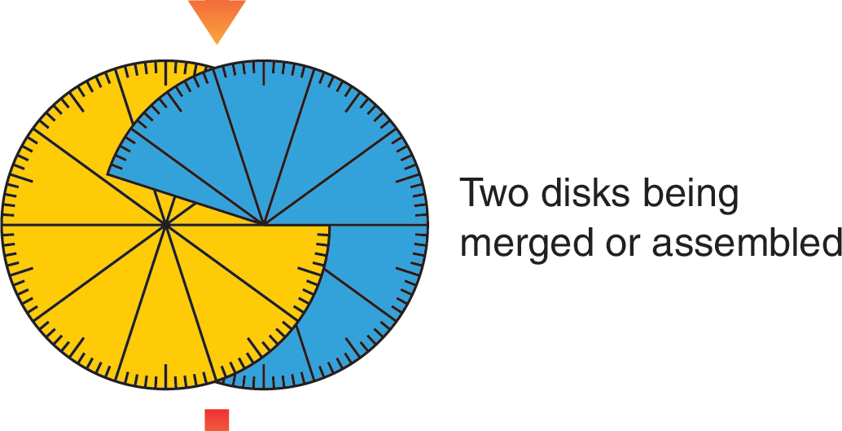
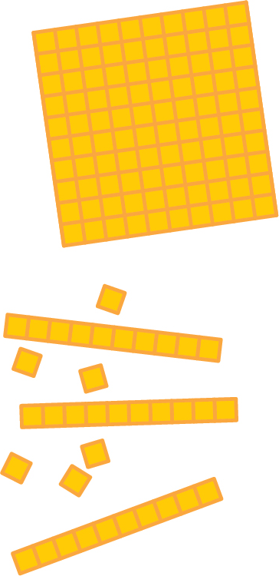
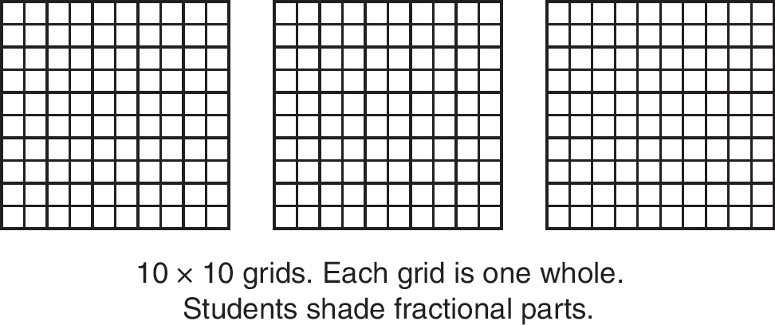
Connecting Fractions and Decimals
Say decimals correctly, E.g., 5.2 is “five and two tenths” not “five point two”.
Visual models for decimal fractions
Translation of a fraction to a decimal using models.

Slide 8
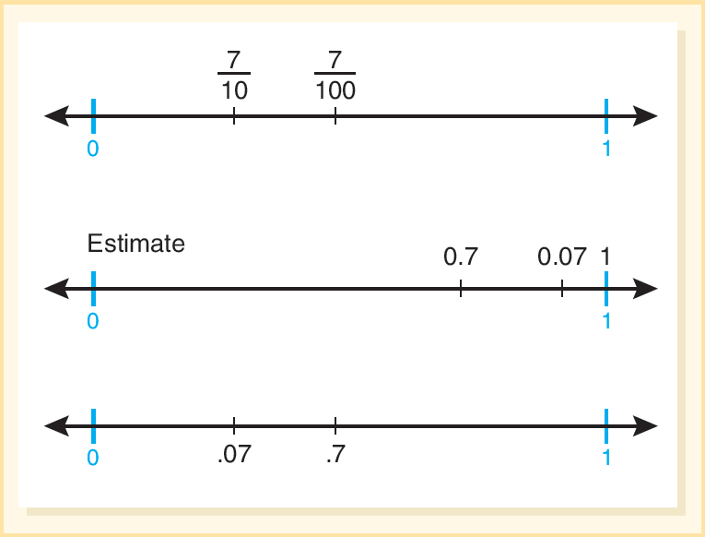
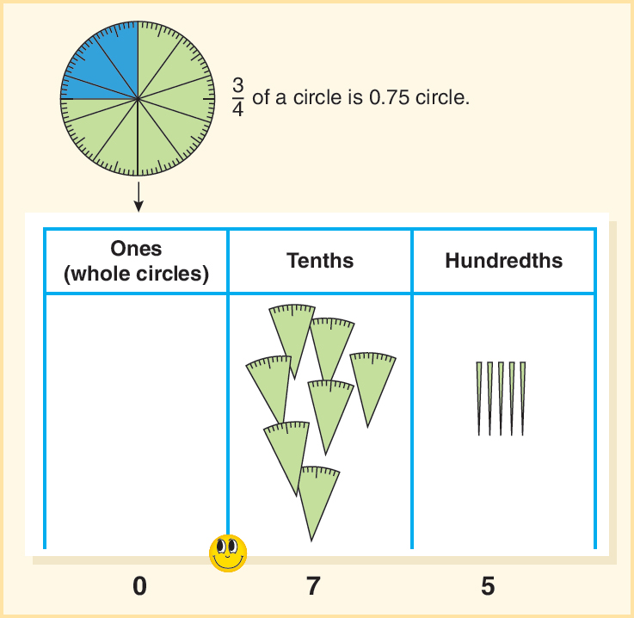
Developing Decimal Number Sense
Familiar fractions connected to decimals:
Translations of a fraction to a decimal using a number line.
Use the base-ten models to have students show common fractions

Slide 9
Common Errors and Misconceptions with Comparing and Ordering Decimals (1 of 2)
Common Error or Misconception | What It Looks Like | How to help
Longer is larger | 0.375 is greater than 0.97 or 0.44 is less than 0.440. | Students are overgeneralizing using whole number reasoning and selecting the number with more digits as being larger. Have students use decimal models to show each number and compare. Two 10 × 10 Grids with each number shaded will help students make the accurate comparison.
Shorter is larger | 0.4 is greater than 0.97 because “a tenth is larger than a hundredth.” | Have students create representations of these two decimals focusing on the quantities. For example, ask “Is any number of tenths larger than any number of hundredths?”
Internal zero | 0.58 is less than 0.078 thinking that “zero has no impact.” Also, suggesting that 34.08 and 34.8 have the same value. | When students are confused by a zero in the tenths position for example, have them build the number using Decimal Number Cards. Match this numerical value to a physical model if needed or match it to a number line.

Slide 10
Common Errors and Misconceptions with Comparing and Ordering Decimals (2 of 2)
Common Error or Misconception | What It Looks Like | How to help
Less than zero | 0.36 is less than 0, because zero is a whole number positioned in the ones column (to the left of the decimal point), and therefore is greater than a decimal fraction (to the right of the decimal point). | Use contexts, for example, ask students whether they would rather have 0 or 0.50 of a dollar. Use decimal representations on grid paper to visualize the size of each decimal as compared to zero.
Reciprocal thinking | When students compare 0.4 and 0.6, they select 0.4 as larger because they connect 0.4 to 1 over 4 and 0.6 to 1 over 6 and erroneously decide 0.4 is greater. | Use decimal materials such as shading 10 × 10 Grids to visualize the size of each decimal.
Equality | Students think that 0.4 is not close to 0.375 and/or that 0.3 is smaller than 0.30. | Show the connections between these values through area models or placing these values on the number line to help students see if the amounts are close in size or as in the case of 0.3 and 0.30 are equal.

Slide 11
Density of Decimals
Important concept is that there is always another number between any two numbers.
Activity 16.12 Close Decimal
Have students name a decimal between 0 and 1.0. Next, have them name another decimal that is even closer to 1.0 than the first. Continue for several more decimals in the same manner, each one being closer to 1.0 than the previous decimal. Similarly, try close to 0 or close to 0.5. Let students with disabilities use models or a number line to help them with their decision making. Later, confirm if they can explain their thinking without representations.
Activity 17.11 Zoom
Materials - Clothesline or cash register tape
Directions - Ask students to mark 0.75 and 1.0 on the line. Then ask students to “zoom in” and find and record three more values between those two.

Slide 12
Computation with Decimals
Make whole-number estimates of the following:
4.907 + 123.01 + 56.1234
459.8 − 12.345
24.67 × 1.84
514.67 ÷ 3.59
Share Your Thinking And Discuss Strategies (front-end, rounding, compatible numbers)

Slide 13
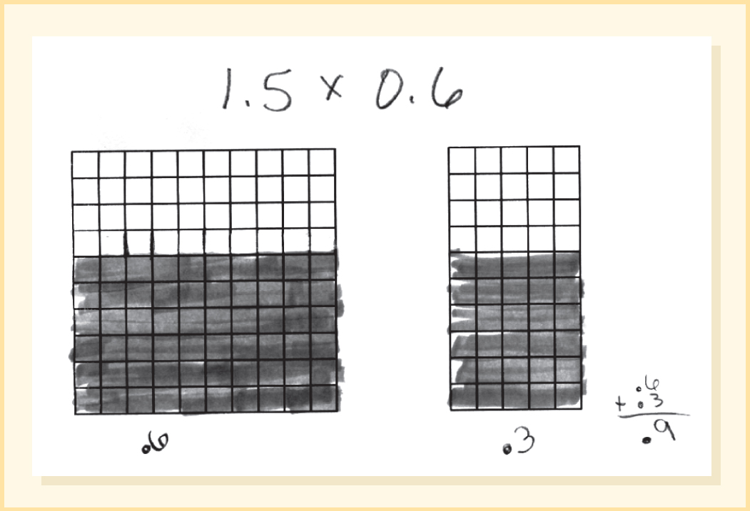
Multiplication of Decimals
Present problems with a context.
The farmer fills each jug with 3.7 liters of cider. If you buy 4 jugs, how many liters of cider is that?
Encourage estimation - Is it more than 12 liters?
What is the most it could be?
Physical models - Example of a 10 × 10 grid and number line used for other problems

Slide 14
Where Does the Decimal Go? Multiplication
Activity 16.16:
Have students compute 24 × 63 = _____
Use the result of the computation to quickly give the exact answer to the each of the following:
0.24 × 6.3 24 × 0.63 2.4 × 63 0.24 × 0.63 2.4 × 0.063
Ask students to explain their rationale for how they placed the decimal point.
When the focus is on rote procedures, the students lose out on understanding and meaning of operations.

Slide 15
Division of Decimals
Estimation and the use of concrete materials are both needed to build a strong understanding of the division of decimals.
The trip to Washington was 282 miles. It took 4.5 hours to drive. What was the average speed in miles per hour?
Estimate Quotients
282 ÷ 4.5
Think what times 4 or 5 would be close to 282
Because 4 × 60 is 240, the estimate is near 61 or 62.
Actual quotient is 62.6666.

Slide 16
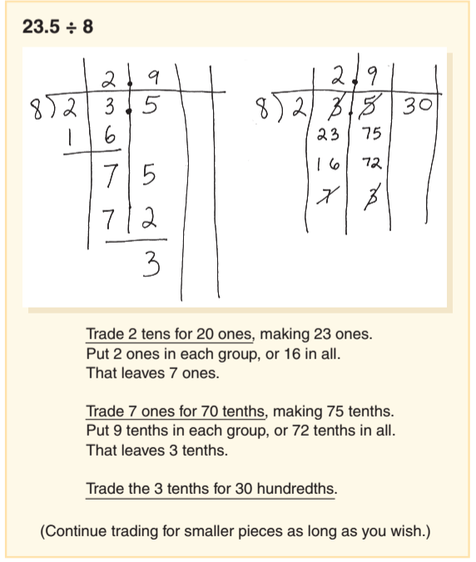
Where does the Decimal Go? Division
Ignore the decimal, and divide as if you were using whole numbers. Then place the decimal using estimation.

Slide 17
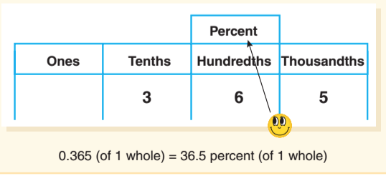
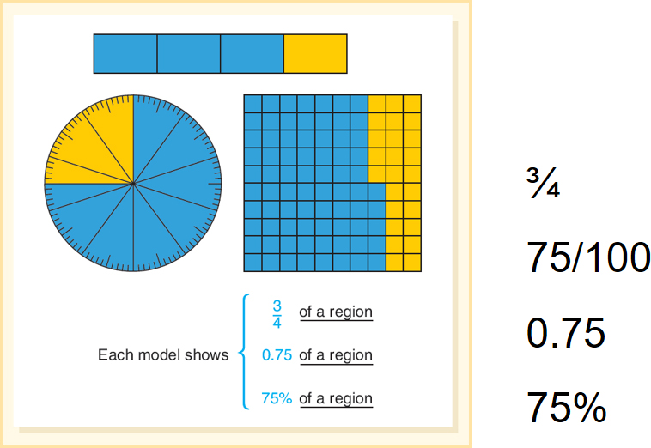
Percent is Another Name for Hundredths
Physical models and terminology link fractions, decimals and percents

Slide 18
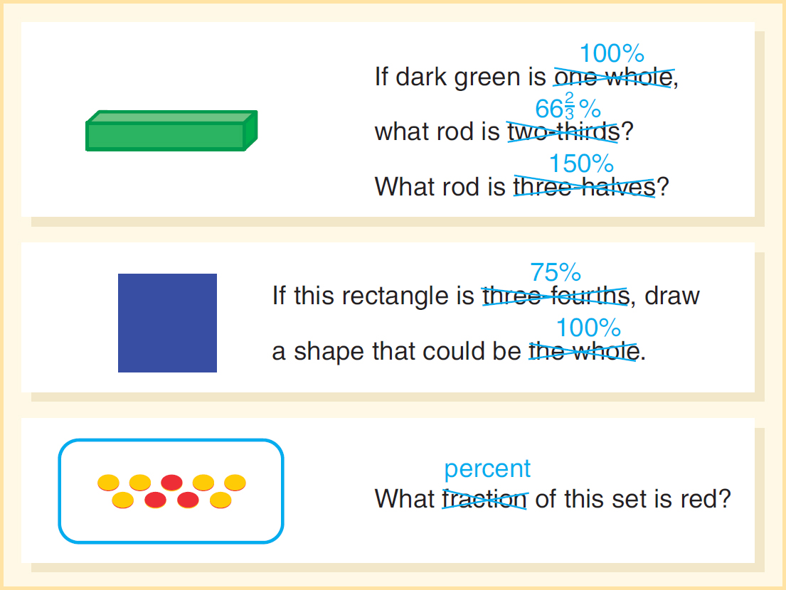
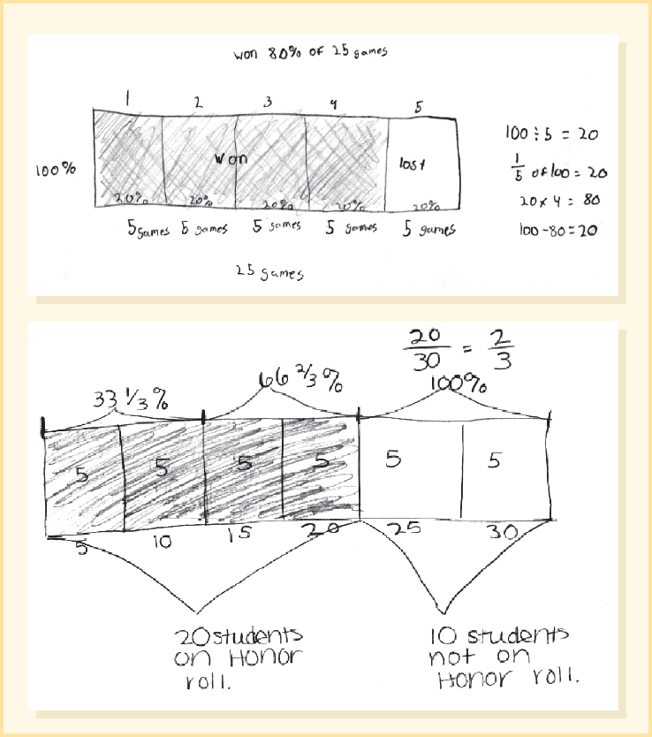
More Physical Models Fractions, Decimals and Percents
Part-whole fractions
Bar diagrams to solve percent problems.

Slide 19
Estimation of Percent Problems
When percent is not a simple one- substitute a close percent, fraction or compatible number
Use
(75%) and 80,000
– for an estimate of about 60,000 people.
The 83,000-seat stadium was 73 percent full. How many people were at the game?
The treasurer reported that 68.3 percent of the dues had been collected, for a total of $385. How much money could the club expect to collect if all dues are paid?
Use
(66.7%) and $380
to show that the club will collect
more so about $190.

Slide 20
Common Errors and Misconceptions in Decimals and Percents (1 of 2)
Common Error or Misconception | What It Looks Like | How to Help
Confusion about when zero is important in interpreting the decimal quantity and when it can be omitted from the decimal. | Students think that 0.80 is ten times larger than 0.8 (Irwin, 2016) Students are not sure that 0.6 and 0.60 are equal | This confusion links to the inaccurate rule that to multiply by 10 just put a zero at the end of a number. Students should continue to model what these values look like, using shading of 10 × 10 grids and then compare.
Students confuse whole numbers notation with decimal fraction notation. | Students write one hundredth as 0.100 (Irwin, 2016) | Present two “anonymous” students’ answers to this question and have students talk about why the reasoning for one is correct and why the other is not.
When fractions are represented as decimals student thinking is incompatible with the magnitude of the fraction and/or place value understanding. | Students write: 4 over 5 as 4.5 1 over 4 as 1.4 or 0.4 | Discuss what 4 over 5 of a pizza and 4.5 pizzas look like using models. Shade in 10 × 10 grids to show 1 over 4, 1.4 and 0.4.

Slide 21
Common Errors and Misconceptions in Decimals and Percents (2 of 2)
Multiplication makes “bigger” and division makes “smaller”.
Students confuse fractional percents with fractions or decimals.
They may align addition and subtraction problems as right justified rather than by lining up the decimal points to align place value parts.
Students confuse the decimal addition algorithm with the procedure for multiplication of decimals.
They confuse whole number multiplication with decimal multiplication.
Students may lose track of the place value of percents and think single digit percents are tenths (E.g., 7 % = 0.7)
They add the percent change on as an increase.

