Slide 1
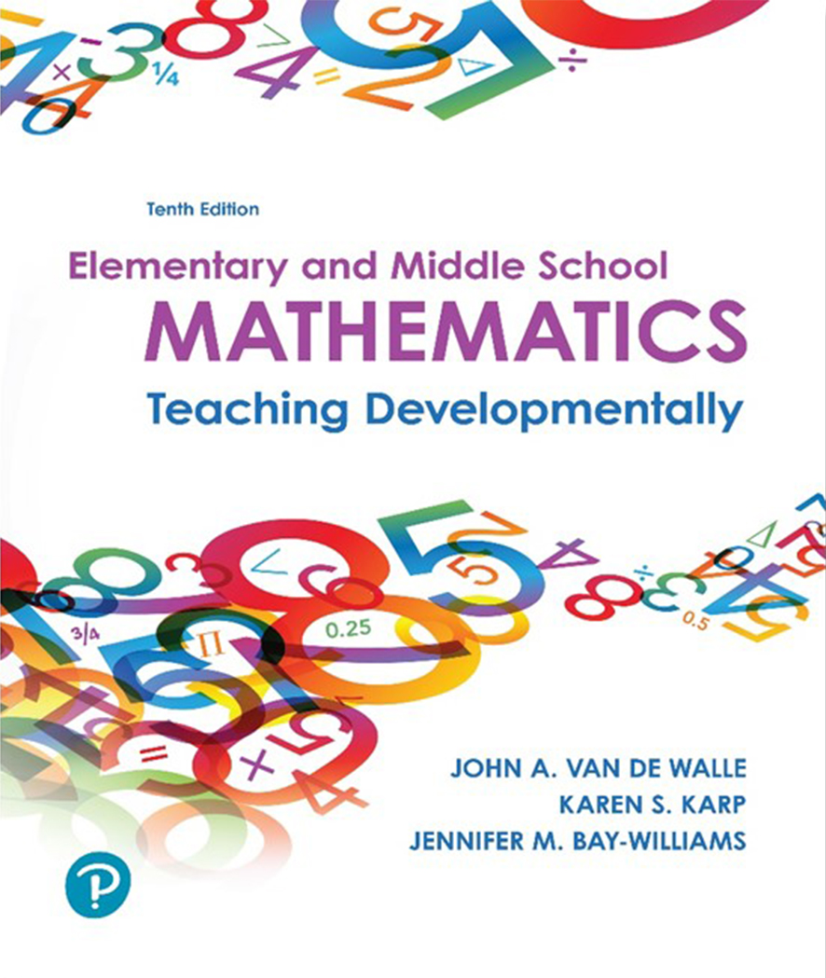
Elementary and Middle School Mathematics Teaching Developmentally
10th Edition
Chapter 15
Developing Fraction Operations
Copyright © 2019, 2016, 2013 Pearson Education, Inc. All Rights Reserved
Notes:
If this PowerPoint presentation contains mathematical equations, you may need to check that your computer has the following installed:
1) MathType Plugin
2) Math Player (free versions available)
3) NVDA Reader (free versions available)

Slide 2
Learner Outcomes
15.1 Describe a process for teaching fraction operations with understanding.
15.2 Illustrate and explain how to add and subtract fractions with different fraction models.
15.3 Connect whole-number multiplication to fraction multiplication, including connecting fraction multiplication to meaningful contexts.
15.4 Connect whole-number division to fraction division using both measurement and partitive real-life examples.

Slide 3
Standards-Based Development
Grade 4: Adding and subtracting of fractions with like denominators, and multiplication of fractions by whole numbers
Grade 5: Developing fluency with addition and subtraction of fractions, and developing understanding of the multiplication of fractions and of division of fractions in limited cases (unit fractions divided by whole numbers and whole numbers divided by unit fractions)
Grade 6: Completing understanding of division of fractions
Grade 7: Solve real-world and mathematical problems involving the four operations with rational numbers

Slide 4
Effective Teaching Process
Goal- Help students understand why procedures for computations with fractions make sense Use contextual tasks
Four steps
  Use contextual tasks - familiar contexts which fit the type of fractions in the problem
  Explore each operation with a variety of models- area, length and set models.
  Let invented methods play a big role in the development of strategies.
  Address challenges, common errors and misconceptions regarding computational procedures.

Slide 5
Addition and Subtraction of Fractions
Contextual Examples - Contexts should vary and be interesting to students i.e.
Jacob ordered 3 pizzas. But before his guests arrived he got hungry and ate
of one pizza. How much was left for the party?
On Friday, Lydia ran
miles and on Sunday she ran
miles, on Saturday she ran
miles. How many miles did she run over the weekend?
Sammy gathered
pounds. Who gathered the most? How much more?
In measuring the wood needed for a picture frame, Elizabeth figured that she needed two pieces that were
pounds of walnuts and Chala gathered
inches and two pieces that were
inches. What length of wood does she need to buy to build her picture frame?

Slide 6
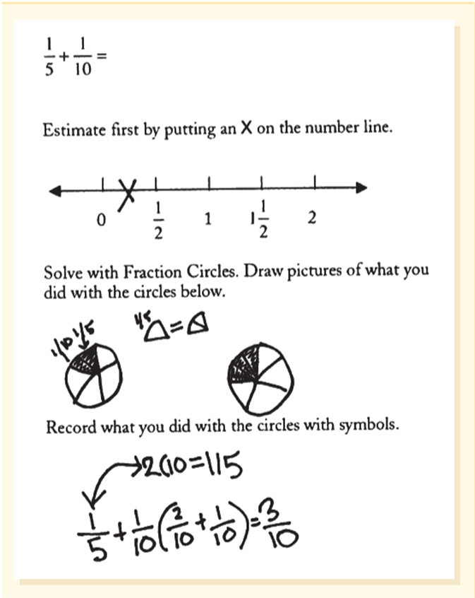
Addition and Subtraction of Fractions (1 of 3)
Area models -
Circle models are effective for adding and subtracting fractions
Circle models offer an effective visual and allow students to develop mental images of the sizes of different pieces.

Slide 7
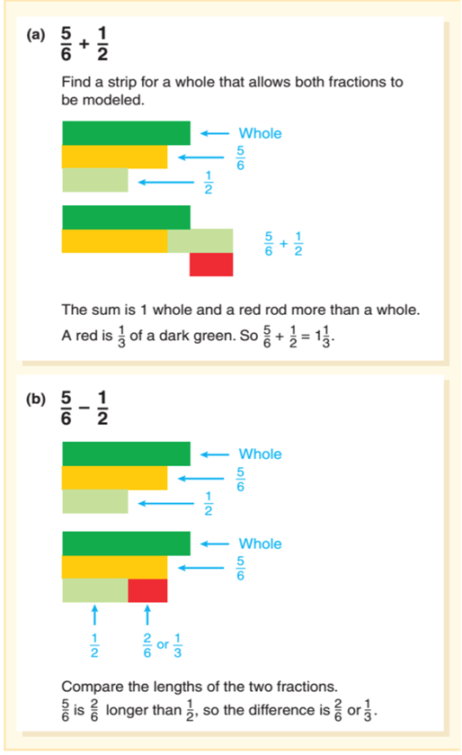
Addition and Subtraction of Fractions (2 of 3)
Linear Models -
Cuisenaire rods are linear models.
The first decision is what strip to use as the whole.
Then determine the smallest rod that will represent the sixths.
Use the rod models to find and construct the sum and difference.

Slide 8
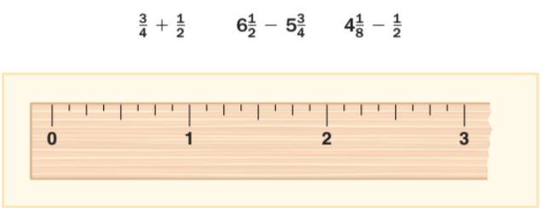
Addition and Subtraction of Fractions (3 of 3)
Linear Models -
Activity 15.2 Jumps on the Ruler
Materials: Ruler/Add a context/Grass growing/Hair growing
Directions: Use the ruler as a visual, and find the results of these three problems without using common denominators.

Slide 9
Estimation
Ways to estimate fraction sums and differences:
Benchmarks- Decide whether fractions are closest to
Relative size of unit fractions-Decide how big the fraction is, based on its unit (denominator)

Slide 10
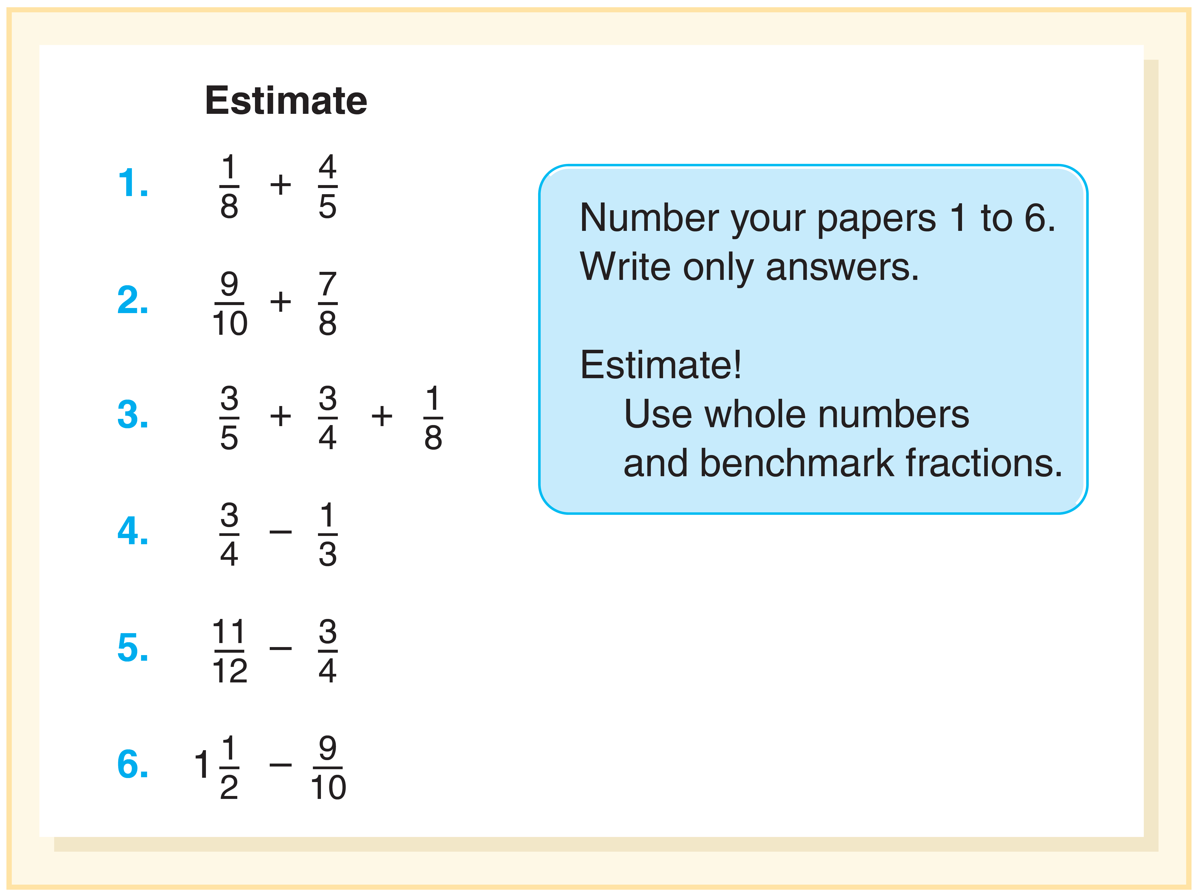
Activity 15.3 Over or Under 1
Materials - Estimating Addition and Subtraction of Fractions Problems
Directions - Project a sum or difference for 10 seconds.
Ask students to write “over or under” one.
Discuss each problem and discuss how they decided on their estimates.

Slide 11
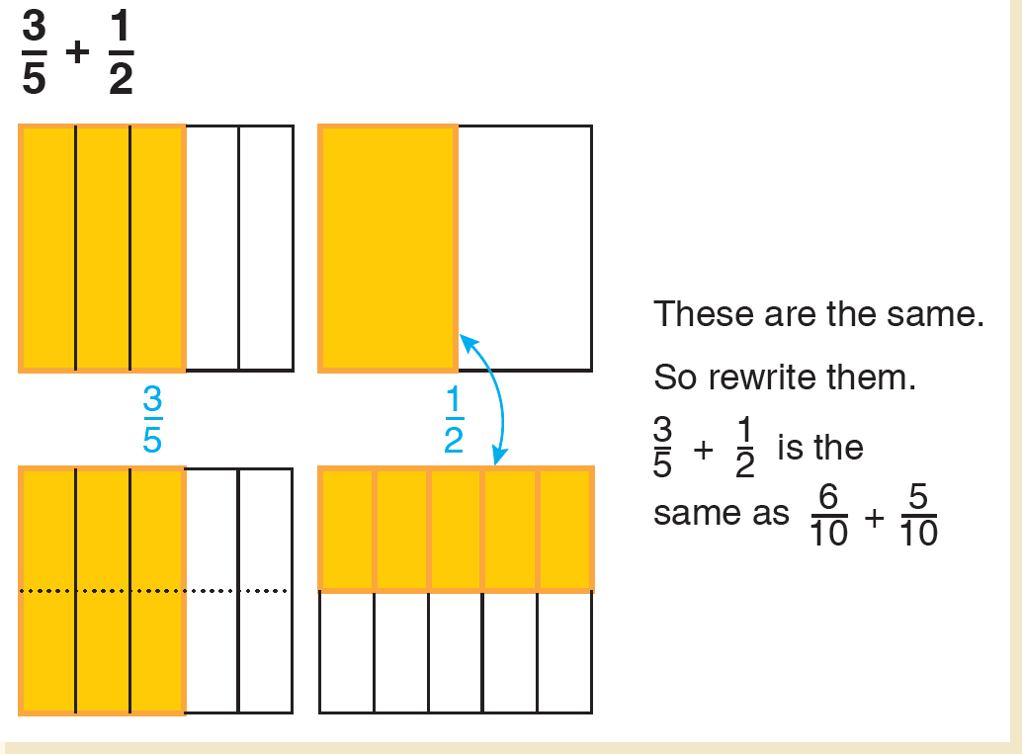
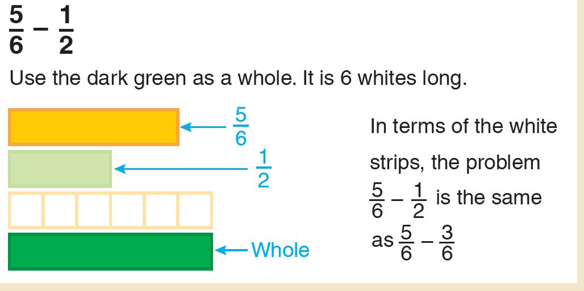
Developing the Algorithms (1 of 2)
  Develop side by side with visual and situations
  Like denominators - Focus on the key idea that the units must be the same so they can be combined.
How many fourths altogether?
    is counting back eighths or finding the number of eighths between the two quantities Unlike denominators- Invite students to use models to determine equal parts.

Slide 12
Are Common Denominators “Required”?
Reasoning strategies will show students that there are many correct solutions without ever finding a common denominators.
Looks for ways different fractional parts are related, e.g., halves, fourths, and eighths.
Number line would be a powerful tool for mentally adding and subtracting fractions.

Slide 13
Common Challenges and Misconceptions for Adding and Subtracting Fractions (1 of 2)
2. Get different answer with models than with symbols (and aren’t bothered that the two answers are different (Bamberger et al., 2010). | For a task such as: Ms. Rodriguez baked a pan of brownies for the bake sale and cut the brownies into 8 equal-sized parts. In the morning, three of the brownies were sold; in the afternoon, two more were sold. What fractional part of the brownies had been sold? What fractional part is still for sale? Student correctly illustrates: A rectangle has 8 equal parts. 3 parts are shaded orange, 2 parts are shaded red. But then writes eights + 2eights = 5 sixteenth. | Ask students to decide whether both answers could be right. Ask students to defend which is right and why the other answer is not right. Ask students to use the same model to show the solution. Encourage students to do the problem on a number line.

Slide 14
Common Challenges and Misconceptions for Adding and Subtracting Fractions (2 of 2)
Apply whole number operation rules.
Do not find a common denominator, but apply standard algorithm.
Struggle to find common denominator (involving lack of fluency of basic facts and common multiples).
Mixed numbers: Students subtract the smaller fraction from the larger.
Mixed numbers: Students don’t know what to do when one number is a whole number.
Mixed numbers: Focus only on the whole-numbers in the problem

Slide 15
Multiplication of Fractions
Foundational ideas:
Iterating (counting) fractional parts
Partitioning
Multiplication of fractions is about Scaling
Scale by factor of 2 you multiply by 2
Scale by factor of 1 the amount is unchanged
Scale by
means taking half of the original size
Begin with multiplying a Fraction by a Whole Number

Slide 16
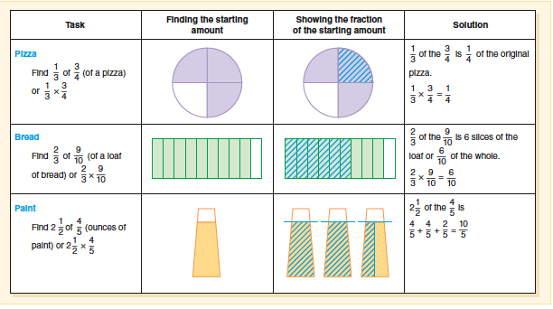
Connecting Representation to the Procedure

Slide 17
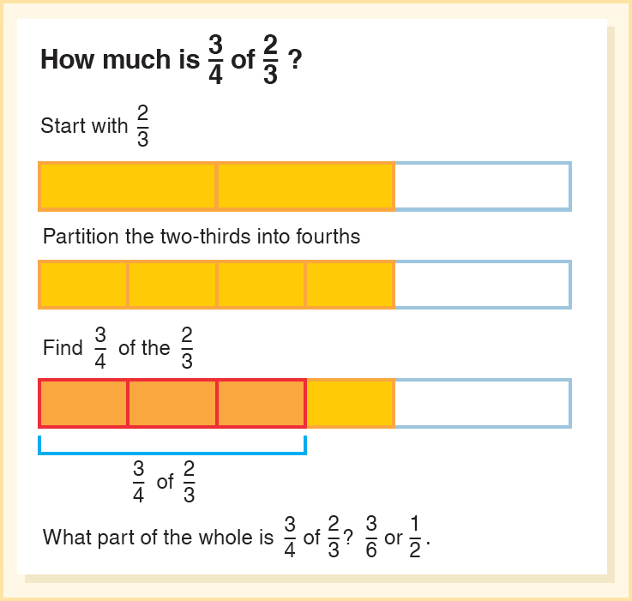
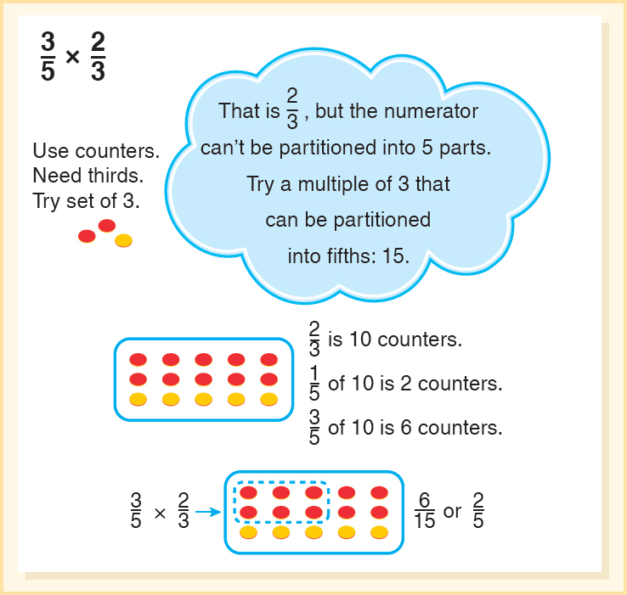
Multiply a Fraction by a Fraction - with Subdividing

Slide 18
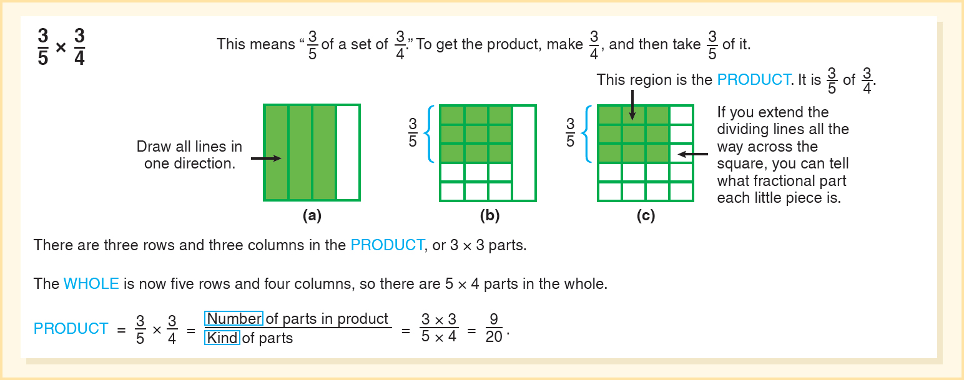
Using Rectangles to Illustrate Multiplication
Start with a model and a context, e.g., quilting.
Model how to subdivide the parts.
Articulate the model as the algorithm.

Slide 19
Developing the Algorithms (2 of 2)
Begin with models. Use a square, and partition it vertically and horizontally to model the problem
Tell me how you figured out what the unit of the fraction (denominator) was?
How did you figure out the denominator would be 12ths?
Can you find a similar pattern for how the number of parts is determined?

Slide 20
Common Challenges and Misconceptions for Multiplying Fractions (1 of 2)
Challenge or Misconception | What It Looks Like | How to Help
1. Treat the denominator the same as in addition/ subtraction problems. | 1 fourth times 3 eights = 2 eights times 3 eights = 6 eights | Engage students in comparing addition and multiplication and why they are different procedures, for example comparing rectangle illustrations for both operations and comparing on a number line. Be sure that visuals are connected to procedures. Reinforce estimation before solving, and comparing answer to the estimate after solving.
2. Inability to estimate approximate size of the answer. | For a problem such as 8 over 9 times 3 over 5, the student think of 8 over 9 as close to 1 and use that to estimate; student multiplies and then rounds to find the answer. Estimate Approximate Size of the Answer. | Explicitly teach and practice each of the estimation strategies suggested above. Encourage and discuss estimation for all computations, using estimates to make sure answers are reasonable.

Slide 21
Common Challenges and Misconceptions for Multiplying Fractions (2 of 2)
Challenge or Misconception | What It Looks Like | How to Help
3. Think answer is wrong because it is smaller than the factors. | Student multiplies 1 fourths times 4 and 1 half and gets the product 1 and 1 over 16, but thinks it must be wrong. | Use visuals to illustrate. Add contexts or ask students to create a context to fit the problem.
4. Confuse whether to multiply or divide by the given fraction. | For “What is 1 third of $24?” rather than divide by 3 or multiply by 1 third (both of which are correct), student divides by 1 third. | Estimate. Ask, “Should the result be more or less than the initial amount?” Ask students to interpret the situation and the answer and see if they make sense.
5. Misinterpret words like “of” in story situations. | In Zach’s mowing problem above left parenthesis 3 fourths of 2 third, right parenthesis a student may think the problem is: 3 fourths minus 2 third or 3 fourths divided by 2 third. among other options. | Avoid key word approach with story problems—it not only doesn’t work, it makes things harder on students as problems get more complex! Focus students’ attention on the situation qualitatively (without a focus on actual numbers). Encourage students to rewrite the situation more simply and then translate to symbols.

Slide 22
Division: Contextual Examples and Models (1 of 2)
Whole number divided by whole number- partitive and sharing context i.e. 5 sandwiches shared with 4 friends is
or 1 ¼
Partitive (sharing problems) you asking, “How much is the share for one friend?”
Provide students with different situations to explore the same problem. Here are three stories (one area, one linear, and one set):
of an acre for their plots. What part of an acre is each gardener’s plot?
Garden Plots. Three gardeners are equally sharing

Slide 23
Division: Contextual Examples and Models (2 of 2)
of a gallon of water that is poured equally into three water bottles. How much is poured into each?
Cheese Sticks. Arlo buys a bag of cheese sticks. (24 in the bag). He takes
Water Bottles. There is
of the cheese sticks to a picnic. At the picnic he decides to share the cheese sticks equally with 2 friends (and himself). What fraction of the bag does each person get?
After they finish, compare their different visuals and connect the meaning of the operation to the visuals. Ask students to write an expression for each (they should be the same!). Emphasize the notion of “How much for one?” After exploring this initial task, students can be challenged to create their own stories to match problems like

Slide 24
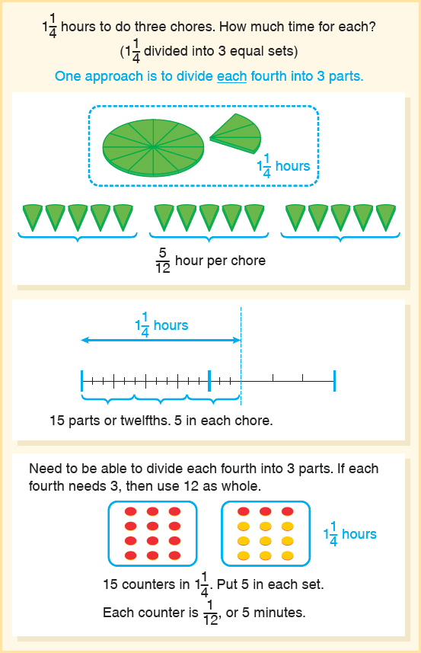
Dividing a Whole Number with a Fraction
hours to finish his three chores. If he divides his time evenly, how many hours can he give to each chore?
Question: How many hours for one chore?
Look at these three models.
Mark has

Slide 25
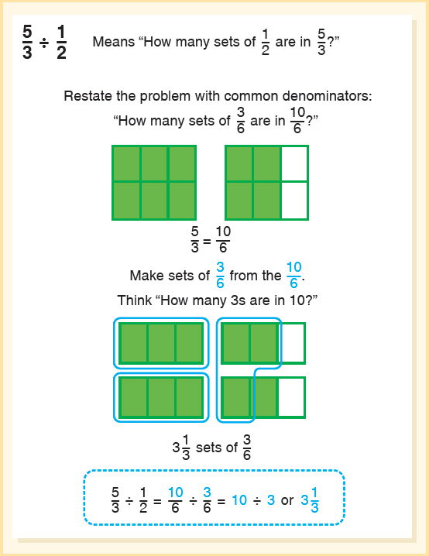
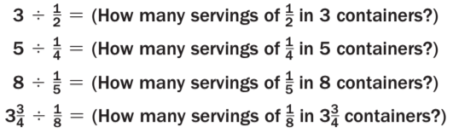
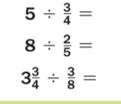
Developing the Algorithm
Provide a series of tasks and have students look for patterns.
Pose problems beginning with the divisor as a unit fraction.
Move to a problem with second fraction not a unit fraction.
Articulate the model as the algorithm.

Slide 26
Common Challenges and Misconceptions for Dividing Fractions (1 of 2)
Challenge or Misconception | What It Looks Like | How to Help
1. Think the answer should be smaller. | Students solve a problem like 4 over 5 divided by 1 tenth = 8 and do not think the answer can be 8 because it is bigger than the fractions in the problem. | Devote time to estimating. Estimation can be the goal, as in Activity 15.16, or it can be a beginning to doing a computation to later check for reasonableness. Use visuals to illustrate Add contexts or ask students to create a context to fit the problem.
2. Do not connect the illustration with the correct numeric answer. | Student understands that 1 and 1 half divided by 1 fourth means “How many fourths are in 1 and half ?” They count and get 6, but think the answer is 6 over 4 (rather than 6) (Cramer et al., 2010). | Emphasize the unit. Ask, “How many fourths?” Use visuals and contexts. Discuss why it is not 6 over 4 (use a worked example to launch a discussion).

Slide 27
Common Challenges and Misconceptions for Dividing Fractions (2 of 2)
Challenge or Misconception | What It Looks Like | How to Help
3. Do not know what the unit is. | A student gets an answer of 3 eights, but when you say “3 eights of what?” he doesn’t know. | Challenges 3 and 4 are inter-related. To support students: Emphasize what the unit is (the divisor). Ask, “What is the unit?” “What is the whole?” Use contexts for units (e.g., servings of quesadillas, feet, etc.). For the remainder, ask, “What fraction of the next serving/piece do you have?”
4. Write remainders based on the whole, rather than the share/serving. | In the problem 3 and 3 eights divided by a student counts 4 fourths for each whole (12 fourths) and one more for 2 eights and then puts the extra 1 eights on the answer: 13 and 1 eights (rather than realize that 1 eights is half of the unit 1 fourth resulting in the correct answer: 13 ½ . | Blank

