Slide 1
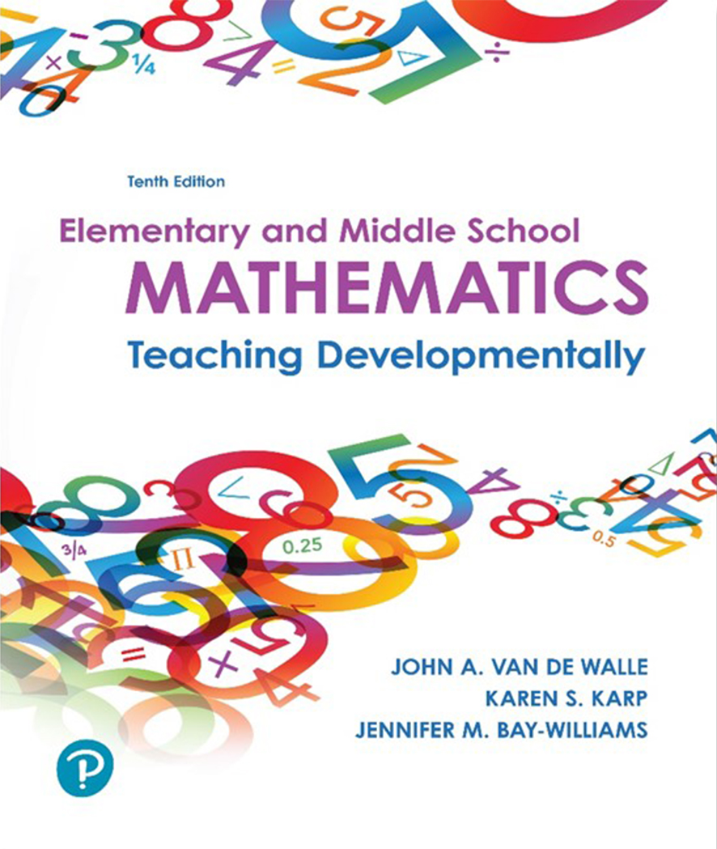
Elementary and Middle School Mathematics Teaching Developmentally
10th Edition
Chapter 14
Developing Fraction Concepts
Copyright © 2019, 2016, 2013 Pearson Education, Inc. All Rights Reserved
Notes:
If this PowerPoint presentation contains mathematical equations, you may need to check that your computer has the following installed:
1) MathType Plugin
2) Math Player (free versions available)
3) NVDA Reader (free versions available)

Slide 2
Learner Outcomes
14.1 Describe and give examples for fractions constructs and fraction models.
14.2 Explain foundational concepts of fractional parts, including iteration and partitioning.
14.3 Illustrate the concept of equivalence across fraction models.
14.4 Describe strategies for comparing fractions and ways to teach this topic conceptually.

Slide 3
Standards-Based Development
Students need significant time and experiences to develop a deep conceptual understanding of this important topic.
1st and 2nd Students partition shapes and refer to the fraction amounts as equal shares.
3rd Major emphasis with attention to using fraction symbols, exploring unit fractions, and comparing fractions
4th The focus is on fraction equivalence and beginning work on fraction operations (+, -, ×, ÷).

Slide 4
Fraction Constructs
Part-whole
Shading a region
Part of a group of objects
Part of a length
Measure
Identifying a length and using that as a measurement unit to determine the length
Fractions as multiples of unit fractions
Division
Sharing into equal-sized groups
Often not thought of with fractions
Operator
Used to indicate an operation
Ratio
the probability of an event is one in four

Slide 5
Models for Fractions
Model Category | Description | Examples of Visuals and Manipulatives | Examples of Contexts
Area | Fractions are determined on how a part of a region or area relatives to the whole area or region. | Fraction Circles/ Rectangles Pattern Blocks Tangrams Geoboard Grid paper regions | Clock Pan of Brownies Quesadillas (circular food) Garden Plot or Playground
Length | Fractions are illustrated as a subdivision of a length of a paper strip (representing a whole), or on a number line that shows the fraction’s position from zero (either positive or negative fractions). | Paper stripes Cuisenaire Rods Number lines Fraction towers Measuring cup | Walking/Distance travelled String lengths Music measures
Set | Fractions are determined based on how many discrete items are in the whole set, and how many items are in the part. | Counters (e.g., two color counters, colored cubes) Objects (e.g., pencils, toys) Egg carton | Students in the class, school, stadium Type of item in a bag of items

Slide 6
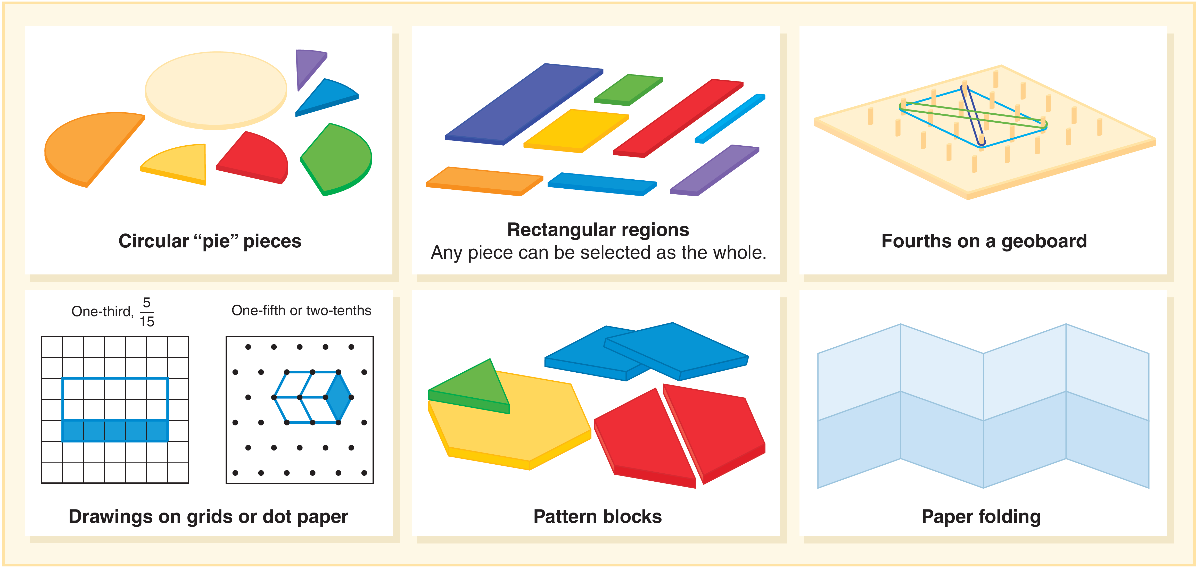
Fraction Area Models
Area models are a good place to begin with because they lend themselves well for equal sharing and partitioning.

Slide 7
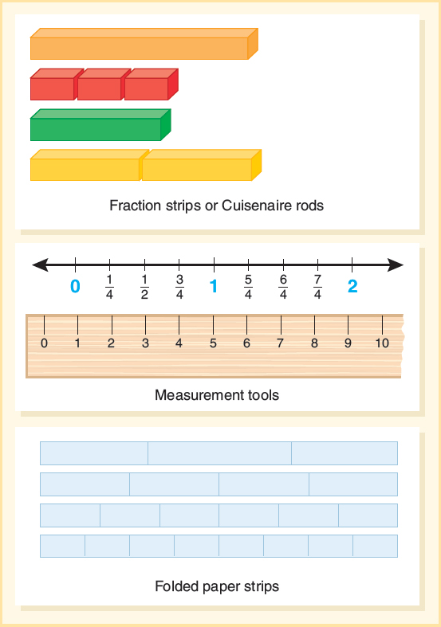
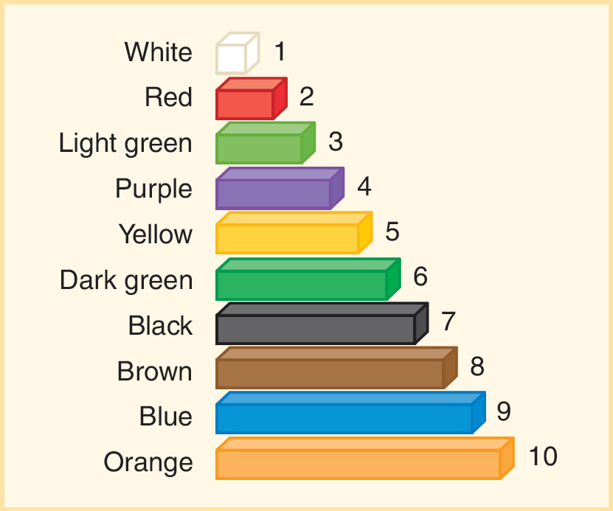
Fraction Length Models
Length models are physical materials that are compared on the basis of length or number lines are subdivided.
Fractions are numbers that expand our number system beyond whole numbers.

Slide 8
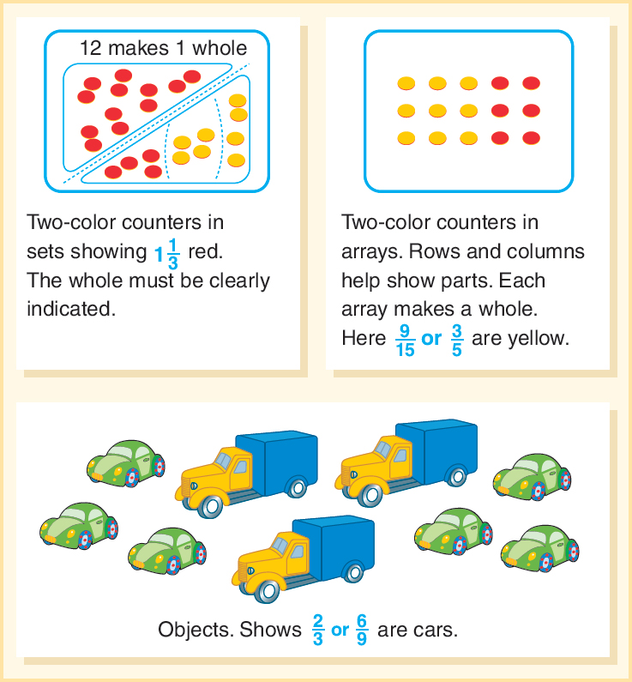
Fraction Set Models
Set models
The whole is understood to be a set of objects, and the subsets of the whole make up fractional parts.

Slide 9
Activity 14.3 Class Fractions
Materials- students
Directions – see below
Use a group of students as the whole — for example, six students if you want to work on halves, thirds, and sixths. Invite them to come to the front of the room. Say to the group, “If you [are wearing tennis shoes, have brown hair, etc.], move to the right. If not, move to the left.” Ask everyone, “What fraction of our friends [are wearing tennis shoes]?” Invite them to whisper to a partner, then share with the class.
Change the number of selected students in the whole. You can ask, “How many friends in one-half of this group? One-fourth of this group?” Connect to the symbols for fractions
asking students to write the fraction that tells how many students are wearing [tennis shoes]. Also, if you have six students in your group, and have three in your subgroup, then students are likely to say “three-sixths” and “one-half”. Discuss that these values are equivalent.

Slide 10
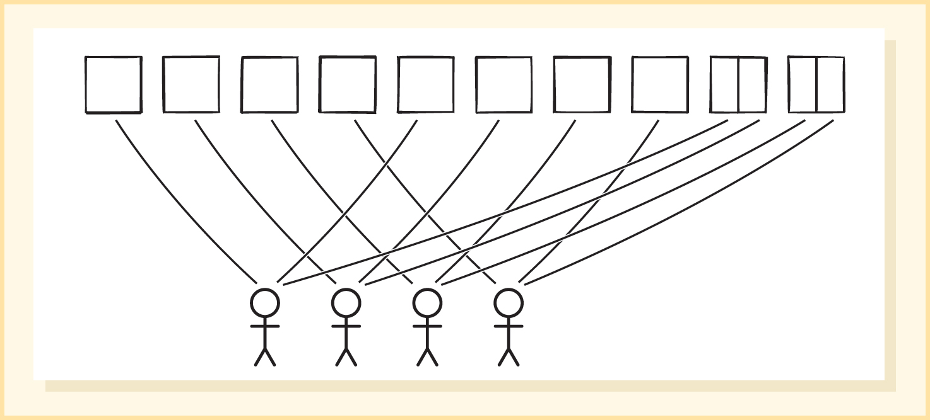
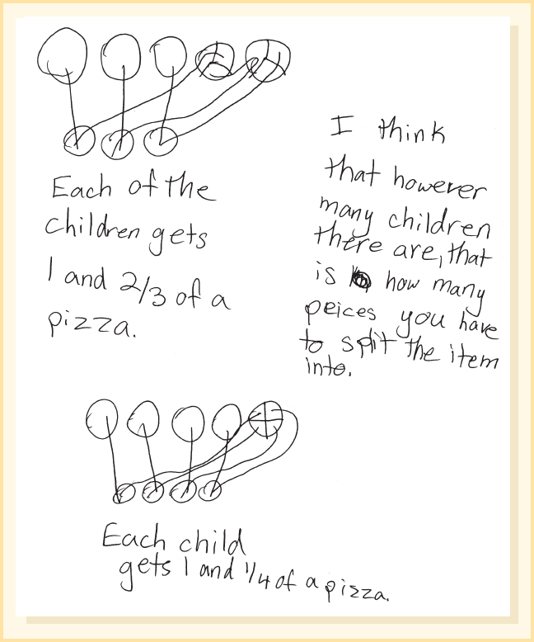
Sharing Tasks
Students need experiences with fairly sharing items to begin the development of fractions.
Student thinking about sharing brownies and pizza
Three features:
Objects in story are easy to draw and partition
No fractions in the story - they emerge from the partitioning.
Can be solved with no formal fraction instruction or fraction symbols

Slide 11
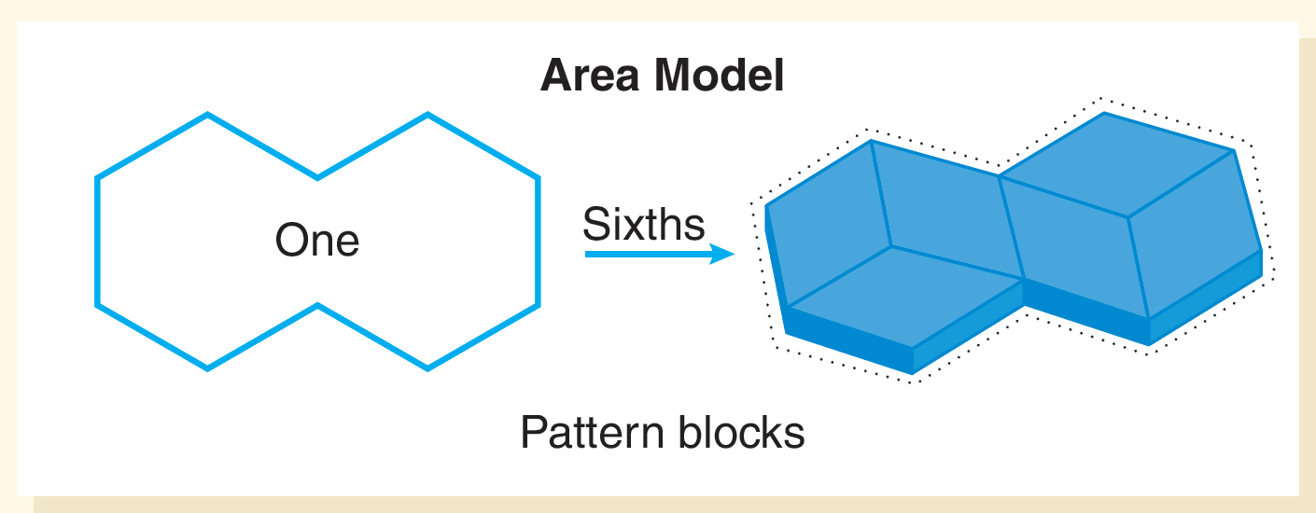
Partitioning with Area Model (1 of 2)
Fractional parts must be the same size, though not necessarily the same shape.
The number of equal-sized parts that can be partitioned within the unit determines the fractional amount.

Slide 12
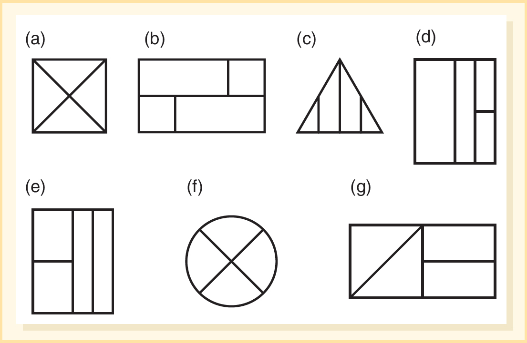
Partitioning with Area Model (2 of 2)
Which of these shows fourths?
Same shape, same size: a and f (equivalent)
Different shape, same size: e and g (equivalent)
Different shape, different size: b and c (not equivalent)
Same shape, different size: d (not equivalent)
Which category do these fall into?

Slide 13
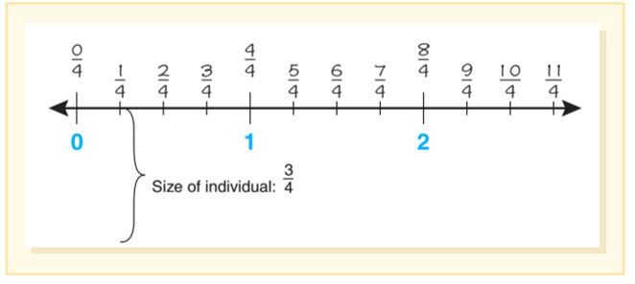
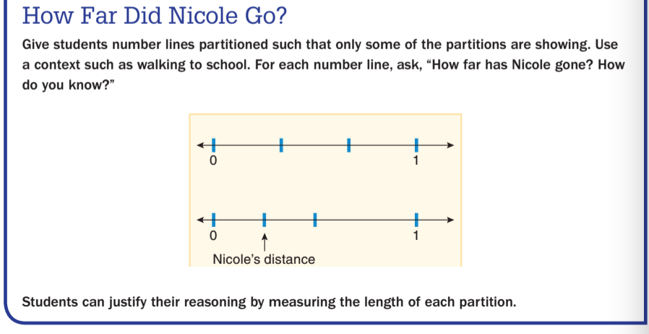
Partitioning with Length Models (1 of 2)
Students need to be able to partition a number line into parts and realize what part of the whole the section represents.
Activity 14.7 Materials-Partitioned number lines

Slide 14

Partitioning with Length Models (2 of 2)
Partitioning using a length diagram is a strategy commonly used in Singapore as a way for solving story problems.
Try This One
A nurse has 54 bandages. If ²/₉ are white and the rest are brown, how many are brown?
A length diagram is used by a student to partition into nine parts and then figure out the equal shares of the bandages for each partition.

Slide 15
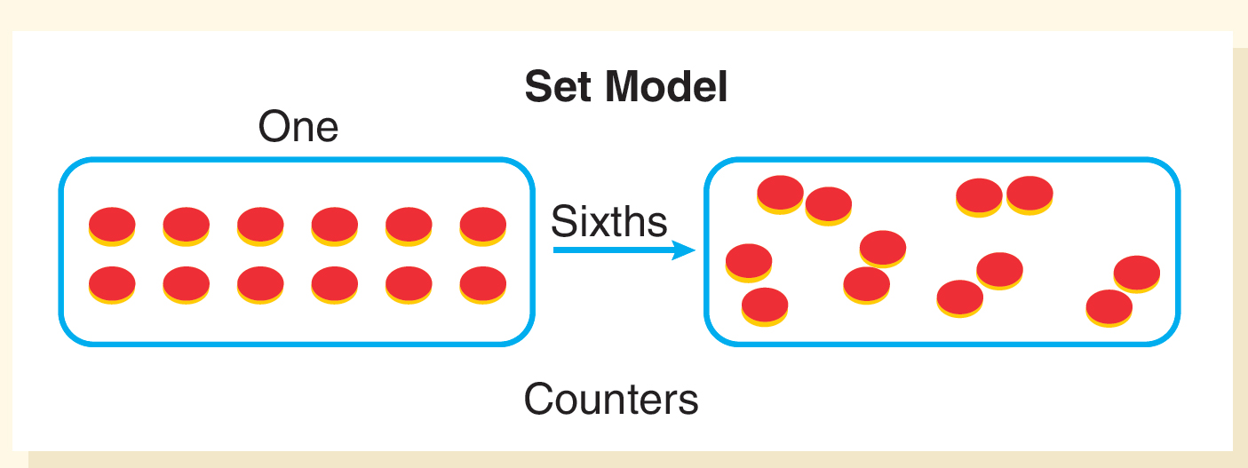
Partitioning with Set Models
Students can partition with set models such as coins, counters, or baseball cards.
When equal parts are not already figured out, students may not see how to partition.
Understanding that parts of the whole must be partitioned into equal-sized parts across different models is important.

Slide 16
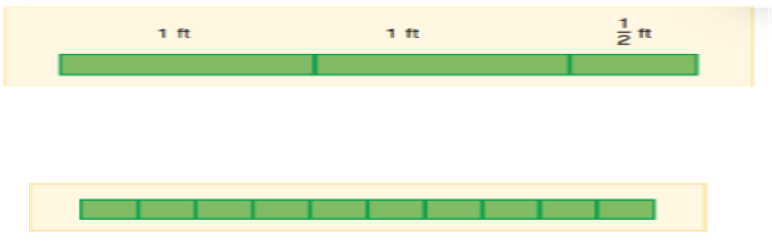
Iterating
Counting fractional parts, or iterating helps students understand the relationship between the parts (numerator) and the whole (denominator).
The top number (numerator) counts;
The bottom number (denominator) tells what is being counted;
is a count of three parts called fourths, for example
of ribbon and needs pieces that are one-fourth yards for making bows. How many pieces can she cut?
Draw a strip or line to represent the
Partition the strip into fourths.

Slide 17
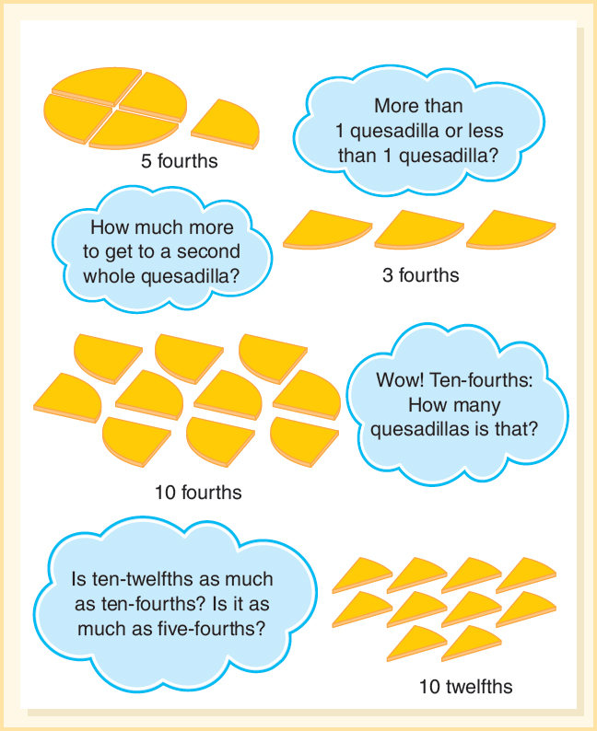
Iterating Fractions Greater Than One Whole
Count the parts one-fourth, two fourths, three fourths, four fourths, five fourths
Ask questions to make comparisons between different collections of parts.

Slide 18
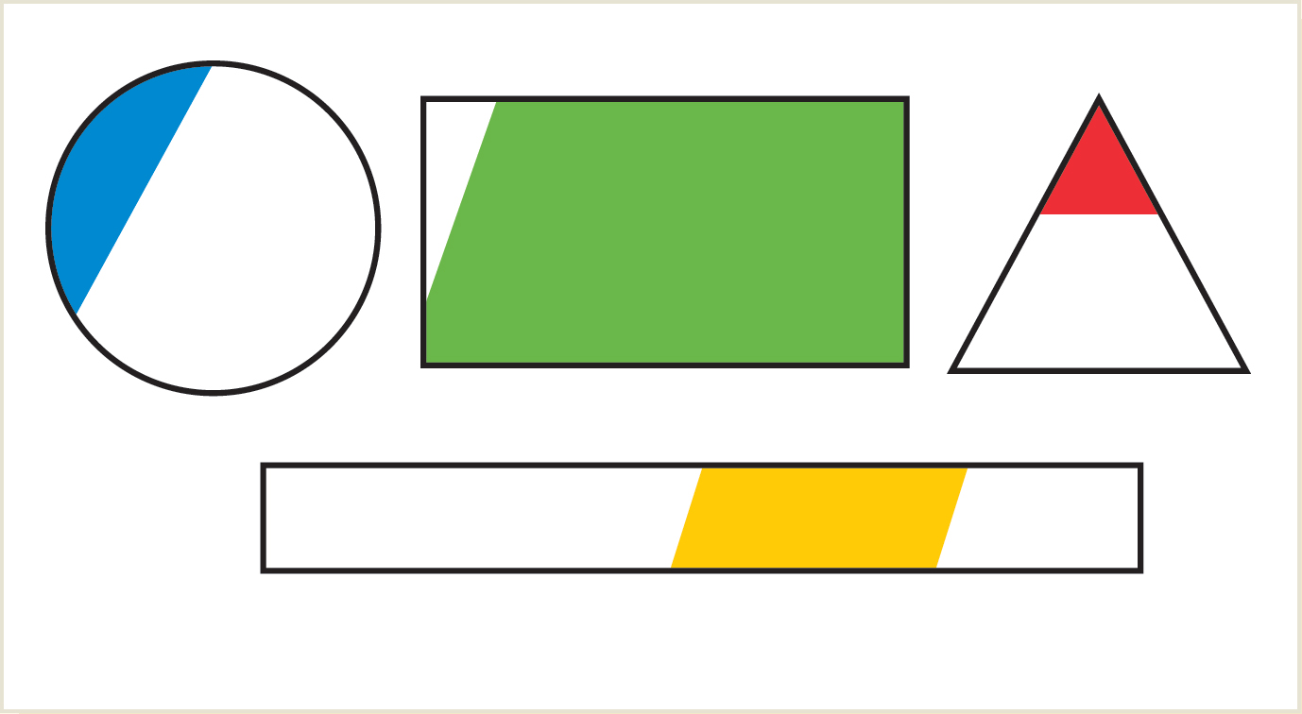
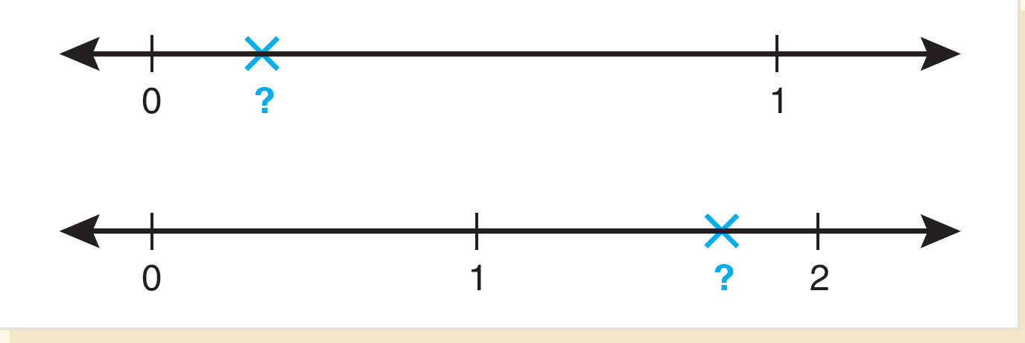
Estimating with Fractions
Benchmarks of zero, one-half, and one
Using number sense to compare
About how much
  Name a fraction for each drawing and explain why you chose that fraction.
  Focus on the infinite number of fractions that can be use to explain between 0, 1 and .

Slide 19
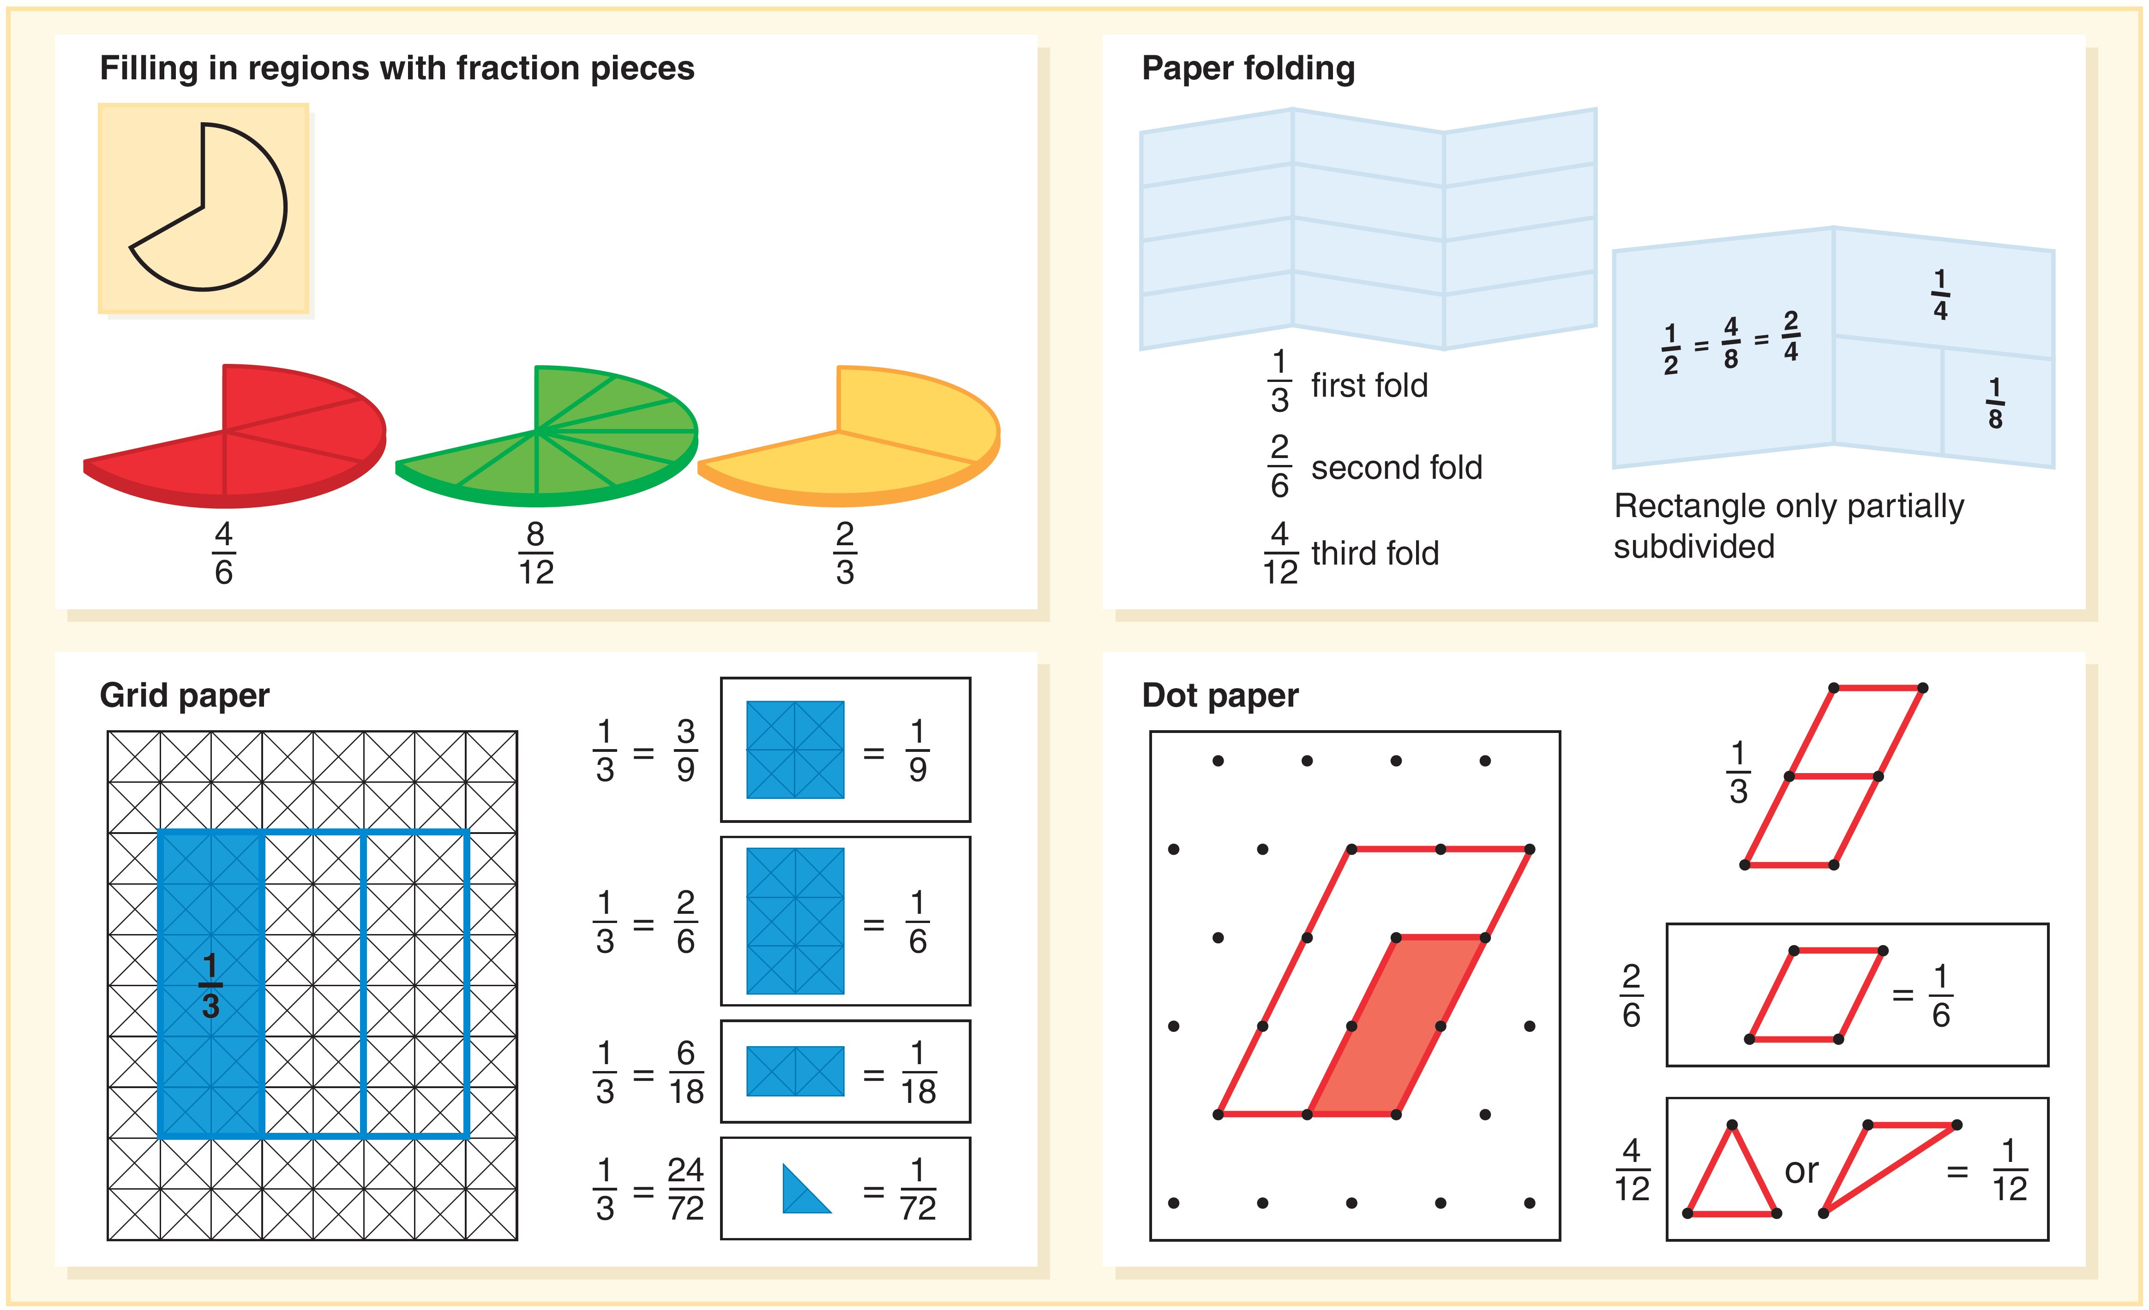
Equivalent Fraction Models
Area models for equivalent fractions help students create understanding.

Slide 20
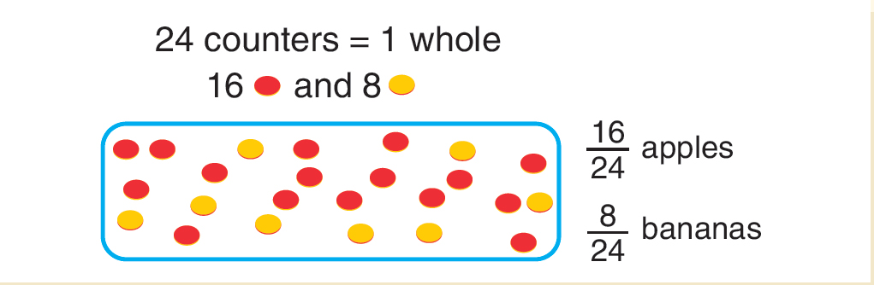
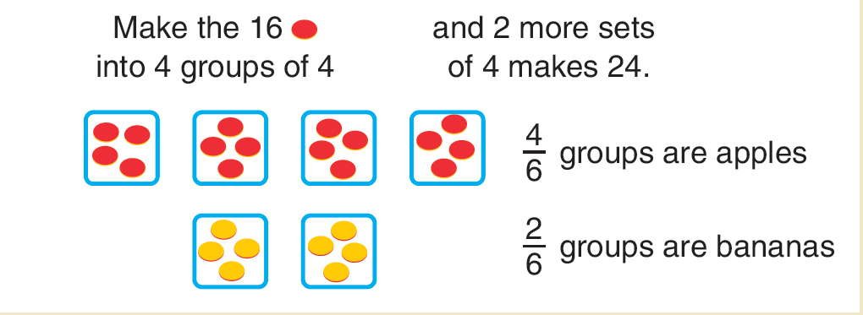
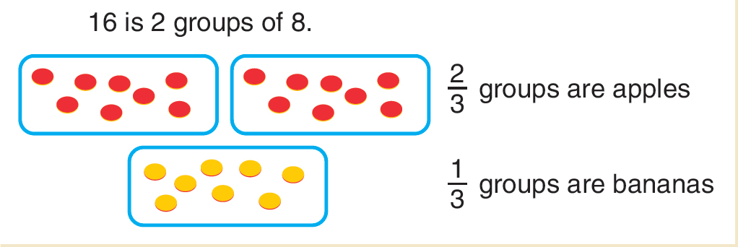
Activity 14.17 Apples and Bananas
Materials - 24 counters in all - Two colors: 16 red and 8 yellow
Directions - Group the counters into different fractional parts of the whole and use parts to create fraction names for the fractions that are apples and fractions that are bananas.
Ask- Is it possible to have fruit in groups of 4?

Slide 21
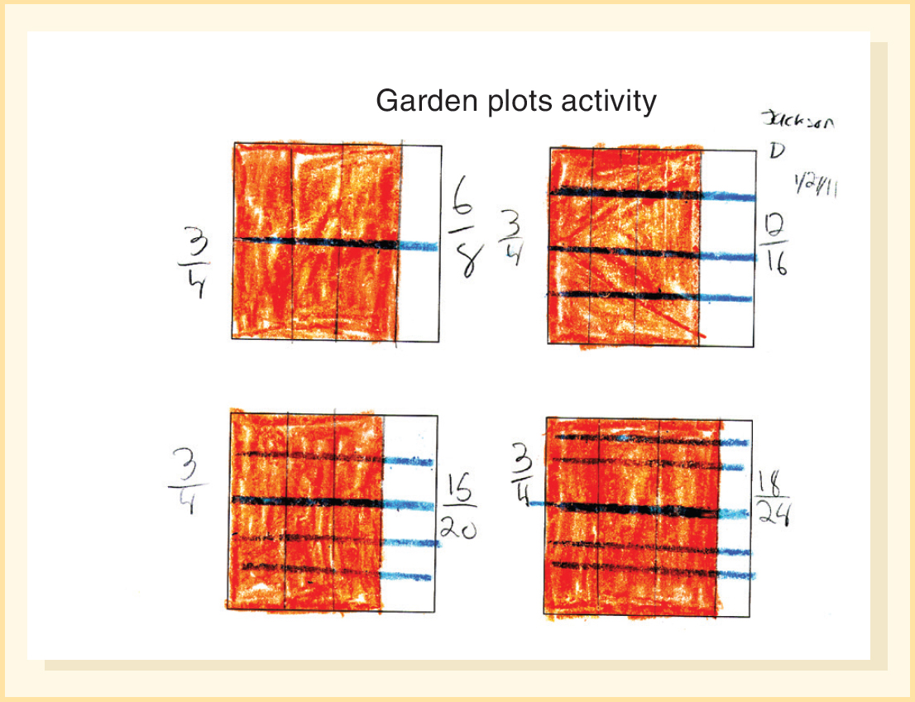
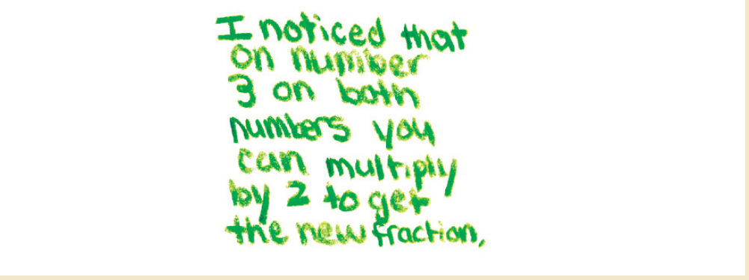
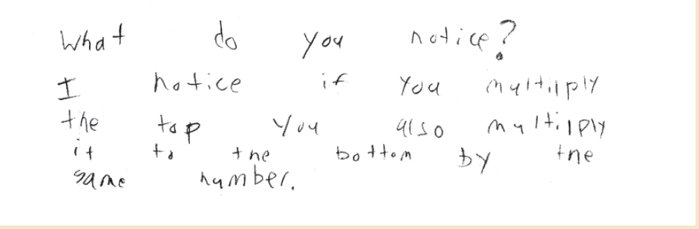
Developing Equivalent-Fraction Algorithm
Area model is a good visual to connect concept of equivalence to the standard algorithm.
The approach would be to look for a patterns in the way that the fractional parts in both the part and whole are counted.

Slide 22
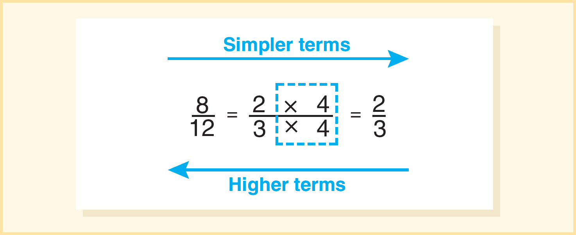
Writing Fractions in Simplest Terms
A fraction in simplest terms means that the numerator and denominator have no common whole-number factors.
Reducing fractions implies that the fraction is getting smaller and this is not true. Avoid that term.
Accept all equivalent fractions and not say that an answer is “incorrect” if not in simplest terms.

Slide 23
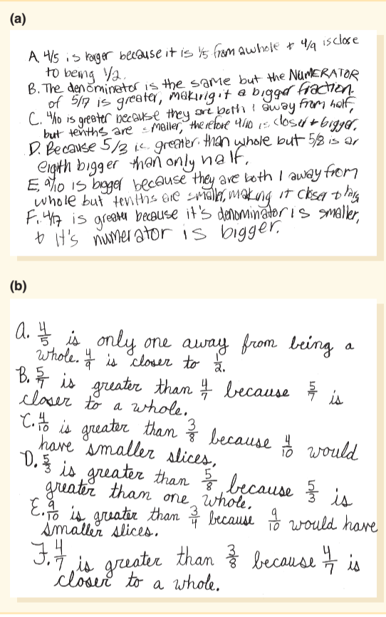
Comparing Fractions
Which fraction in each pair is greater?
Give one or more reasons. Try not to use drawings or models. Do not use common denominators or cross-multiplication.
Ways that the fractions could have been compared:
Same-size denominator
Same numerator
More than/less than benchmark (0, ½, or 1)
Closeness to a benchmark

Slide 24
Teaching Considerations for Fractions Concepts
Emphasize number sense and meaning of fractions.
Provide a variety of models and contexts.
Emphasize that fractions are numbers-Make extensive use of number lines in representing fractions.
Dedicate time for understanding of equivalence (concretely, symbolically).
Link fractions to key benchmarks and encourage estimation.

Slide 25
Common Challenges and Misconceptions for Fraction Concepts (1 of 2)
Challenges and Misconceptions | What It Looks Like | How to Help
1. Numerator and denominator are separate numbers (not seeing a fraction as a number) | Three fourths is seen as a 3 over a 4. Student cannot locate a fraction such as three fourths on a number line because they don’t think it is a number. | Find fraction values on a number line (e.g., a warm-up activity each day where students place values on a classroom number line). Measure with inches to various levels of precision (e.g., to the nearest fourth, eighth, or sixteenth). Avoid the phrase “three out of four” (unless you are talking about ratios or probability) or “three over four”; instead, say “three-fourths” (Siebert & Gaskin, 2006).
2. Fractional parts do not need to be equal-sized | Three fourths (three-fourths) of the figure below is light gray.* The figure has 4 block shapes. At the center is a trapezoid, with a triangle aligned against each of its left, right, and top sides. how to help. *green if using pattern blocks | Have students create their own representations of fractions across various types of models. Provide problems like the one illustrated here, in which all the partitions are not already drawn and have students draw or show the equal-sized parts.

Slide 26
Common Challenges and Misconceptions for Fraction Concepts (2 of 2)
Fractional parts must be the same size.
Fractions with larger denominators are bigger.
Fractions with larger denominators are smaller.
Representing fractions greater than 1.
Determining a whole when given a part.

