Slide 1
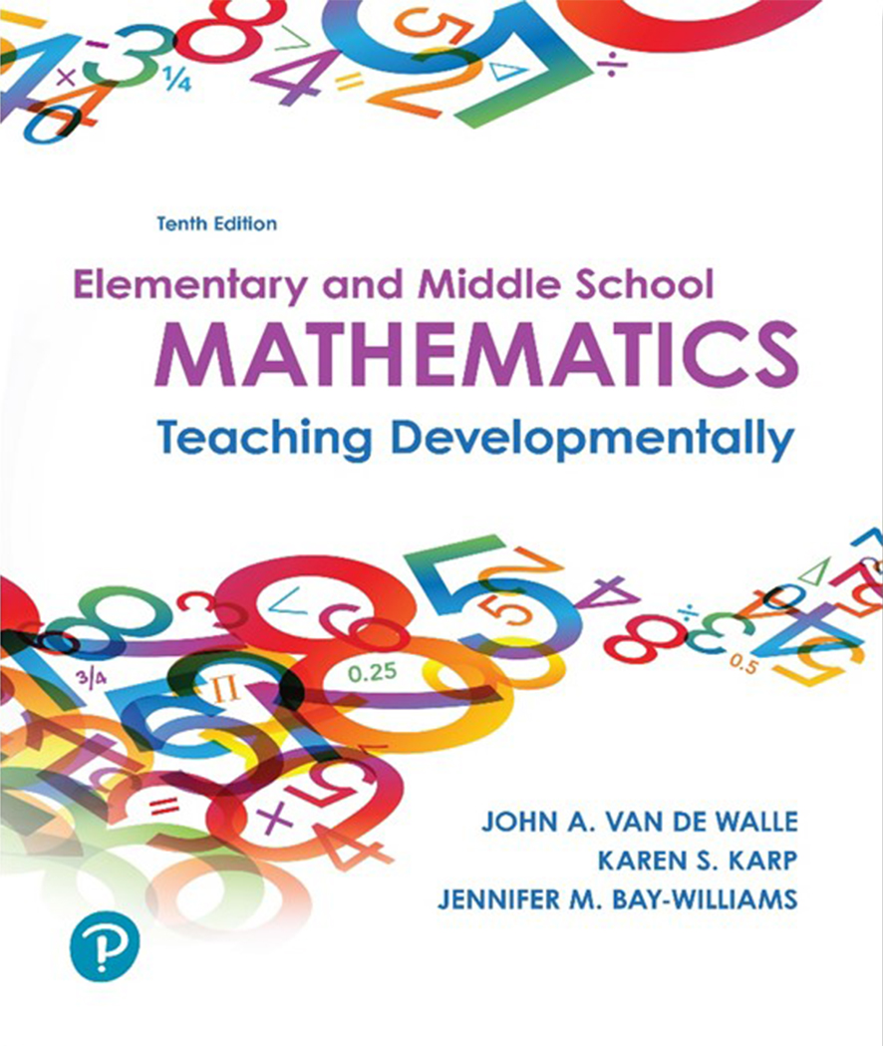
Elementary and Middle School Mathematics Teaching Developmentally 10th Edition
Chapter 13
Algebraic Thinking, Equations, and Functions
Copyright © 2019, 2016, 2013 Pearson Education, Inc. All Rights Reserved
Notes:
If this PowerPoint presentation contains mathematical equations, you may need to check that your computer has the following installed:
1) MathType Plugin
2) Math Player (free versions available)
3) NVDA Reader (free versions available)

Slide 2
Learner Outcomes
13.1 Describe ways to connect number and algebraic thinking, including using properties of the operations to build number sense and procedural fluency.
13.2 Illustrate and describe how to infuse teaching of patterns and functions in K–8.
13.3 Identify strategies that can builds strong understanding of equivalence, recognizing the challenges students have with symbols (e.g., equal and inequalities signs and variables).
13.4 Define mathematical modeling and describe grade-appropriate examples of it.

Slide 3
Standards-Based Development
K indergarten students represent addition and subtraction with objects, fingers, mental images, drawings and sounds, acting out situations, giving verbal explanations, and using expressions and equations.
Elementary students are capable of understanding and applying significant algebraic ideas including connections between arithmetic and algebra and functional thinking.
Middle school students study algebra in more abstract and symbolic ways, focusing on understanding and using variables, expression and equations Grade 8-Functions

Slide 4
Strands of Algebraic Thinking
Research suggests three strands of algebraic reasoning, all infusing the central notions of generalization and symbolization:
Study of structures in the number system “algebra as generalized arithmetic”
Study of patterns, relations and functions
Process of mathematical modeling, including the meaningful use of symbols (esp. the equal sign)
Algebra must be presented in a way that students see it as a useful tool for making sense of all areas of mathematics and real-world situations.

Slide 5
Connecting Number and Algebra
Number Combinations - Looking for generalizations begins early with decomposition of numbers.
Seven birds have landed in your backyard, some landed on a tree and some are at your feeder. How many birds might be in the tree and how many at the feeder?
Place Value Relationships-
The sum of 49 +18 can be found with the use of a hundreds chart. Moves on the chart can be recorded with arrows for up and down (down 1, right 8)
Algorithms - Shifts in how arithmetic problems are presented can open up opportunities for generalizations. Sets of problems are good ways for students to look for and describe patterns and build understanding for the operation

Slide 6
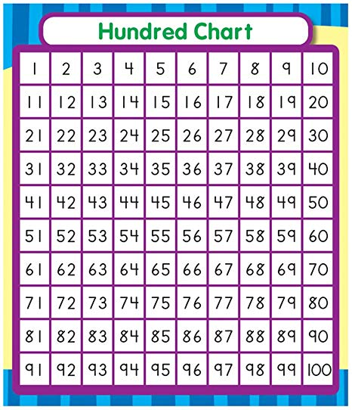
49 + 18
15 + 23
57 – 14
82 – 39

Slide 7
Properties of the Operations (1 of 2)
Addition
Properties of the Operations Name of Property | Symbolic Representation | How a Student Might Describe the Pattern or Structure
Commutative | a + b = b + a | “When you add two numbers in any order you will get the same answer.”
Associative | (a + b) + c = a + (b + c) | “When you add three numbers you can add the first two and then add the third or add the last two numbers and then add the first number. Either way you will get the same answer.”
Additive Identity | a + 0 = 0 + a = a | “When you add zero to any number you get the same number you started with.”
Additive Identity | a − 0 = a | “When you subtract zero from any number you get the number you started with.”
Additive Inverse | a − a = a + (−a) = 0 | “When you subtract a number from itself you get zero.”
Inverse Relationship of Addition and Subtraction | If a + b = c then c − b = a and c − a = b | “When you have a subtraction problem you can ‘think addition’ by using the inverse.”

Slide 8
Properties of the Operations (2 of 2)
Multiplication
Properties of the Operations Name of Property | Symbolic Representation | How a Student Might Describe the Pattern or Structure
Commutative | a × b = b × a | “When you multiply two numbers in any order you will get the same answer.”
Associative | (a × b) × c = a × (b × c) | “When you multiply three numbers you can multiply the first two and then multiply the answer by the third or multiply the last two numbers and then multiply the answer by the first number. Either way you will get the same answer.”
Multiplicative Identity | a × 1 = 1 × a = a | “When you multiply one by any number you get the same number you started with.”
Multiplicative Inverse | a times start fraction 1 over a end fraction = start fraction 1 over | “When you multiply a number by its reciprocal, you will get one.”
Inverse Relationship of Multiplication and Division | If a × b = c then c ÷ b = a and c ÷ a = b | “When you have a division problem you can ‘think multiplication’ by using the inverse.”
Distributive (Multiplication over Addition) | a times left parenthesis bnthesis = a times b + a times c | “When you multiply two numbers, you can split one number into two parts (7 can be 2 + 5), multiply each part by the other number, and then add them together.”

Slide 9
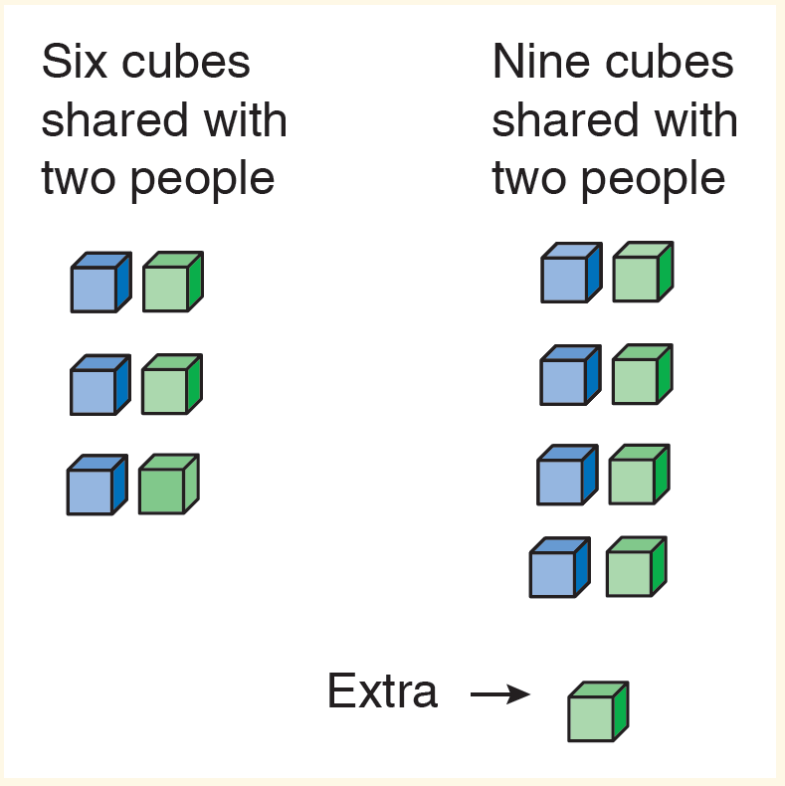
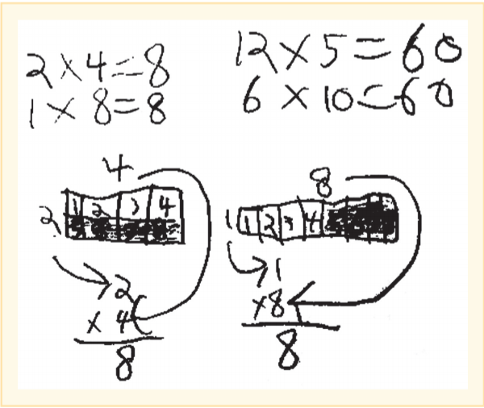
Applying the Properties of Addition and Multiplication
At the heart of what it means to do mathematics is noticing generalizable properties like 1 + 6 = 6 + 1, as well as exploring odd and even numbers to generalize mathematical relationships. Justifying a conjecture provides exploration of the number system.

Slide 10
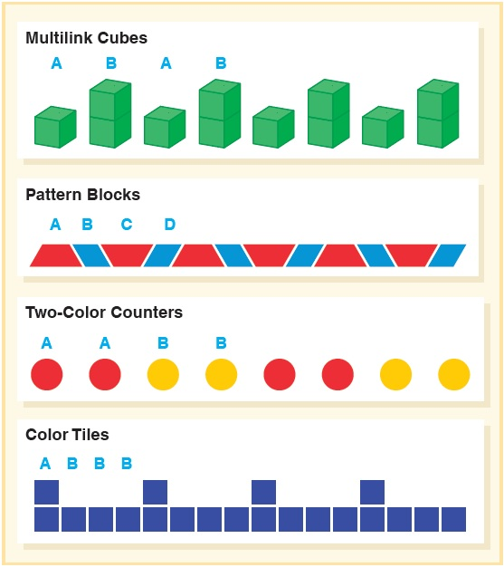
Study of Patterns and Functions (1 of 5)
Repeating patterns:
Patterns that have a core that repeats
It’s important that students identify the core of the pattern
Repeating patterns in seasons, days of week, simple singing do, mi, mi, do, mi, mi

Slide 11
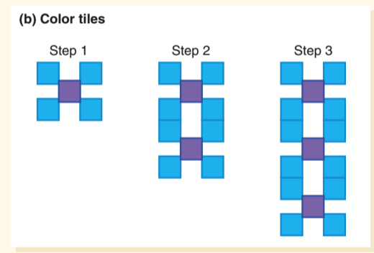
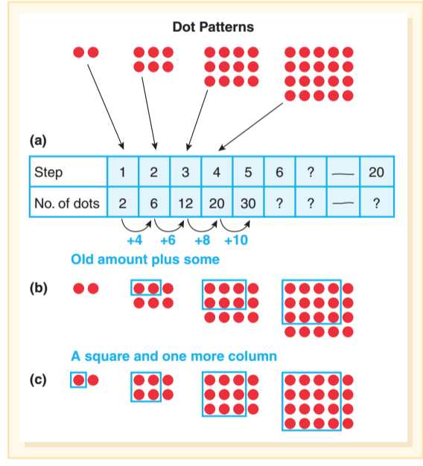
Study of Patterns and Functions (2 of 5)
Growing or sequence patterns:
Explore patterns that involve a progression from step to step (sequences).
Analyzing how the pattern is changing
Look at the visuals and then reasoning about the numerical relationship- Extend to n^{th} case

Slide 12
Study of Patterns and Functions (3 of 5)
Three types of patterns:
Recursive – How a pattern changes from step to step, x to x and y to y
Covariational thinking – How 2 quantities vary in relation, e.g., As a step increases by 1, the number of tiles in T goes up by 3.
Explicit relationship – A correlation between two quantities expressed in a function rule. Look across the table to see how to use the input to generate the output
3 x + 1
Support student development of functional thinking:
What is changing, what is staying the same?
What quantities are you comparing?
How could you organize your information in a table?
How might the quantities be represented in a graph?
How can you represent the rule in words? In symbols?

Slide 13
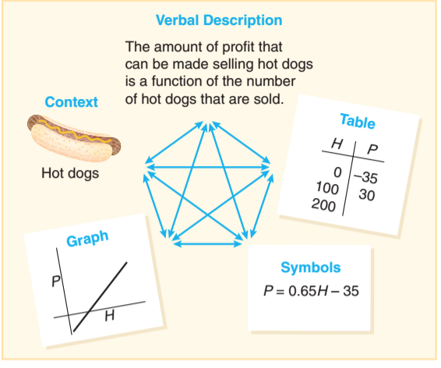
Study of Patterns and Functions (4 of 5)
Growing patterns represented by
Physical models
Table
Words
Symbols
Graph

Slide 14
Study of Patterns and Functions (5 of 5)
Table 13.2 Characteristics of Functions
Concepts | Description | Example
Independent and dependent variables | The independent variable is the input, or whatever value is being used to find another value. The dependent variable represents the output. | In the “Pattern Blocks Perimeter” problem, the independent variable is the number of blocks in the string; the dependent variable is the perimeter. You can say that the perimeter of the block structure depends on the number of blocks used.
Discrete and continuous functions | When isolated or selected values are the only ones appropriate for a context, the function is discrete. If all values along a line or curve are solutions to the function, then the function is continuous. | Discrete: “Pattern Blocks Perimeter” problem. Only whole-number values make sense. Continuous: Walking rate, where at any given time, there is a distance walked (even if that distance is 0 meters).
Domain and range | The domain of a function comprises the possible values for the independent variable. The range is the corresponding possible values for the dependent variable. | In the “Pattern Blocks Perimeter” problem, the domain and range are all positive whole numbers.

Slide 15
Activity 13.9 Sketch-a-Graph
Materials - Graph paper
Directions - Sketch a graph to match the following situations - Do not label.
The temperature of a frozen dinner 30 minutes before removed from the freezer until removed from the microwave and placed on the table.
The value of a 1970 Volkswagen Beetle from the time it was purchased to the present.
The level of water in the bathtub from the time you begin to fill it to the time it is completely empty after your bath.
Profit in terms of number of items sold
The height of a thrown baseball from when it is released to the time it hits the ground
Speed of the same baseball versus time
Exchange to see if students can match a rough graph to each situation.

Slide 16
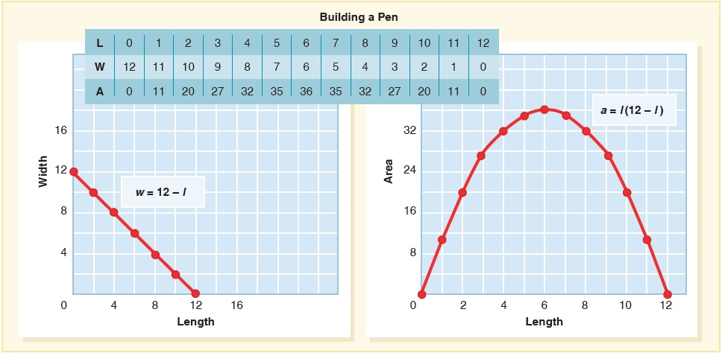
Linear Functions
Linear and quadratic functions are special and common types of functions.
Miah has 24 yards of fence to build a rectangular pen. She is considering what dimensions to build it and wants to analyze it algebraically. (1) Write an equation to describe the relationship between the length and width. (2) Write an equation to describe the relationship between the length and the area.
Rate of Change and Slope

Slide 17
Meaningful Use of Symbols
In algebra symbols represent real situations and are useful tools in representing situations
Equivalence and equal and inequality signs:
Are some of the most important symbols in elementary arithmetic, algebra and in all mathematics.
Are critically important to understand and symbolize relationships in our number system.
Are how we mathematically represent quantitative relationships.
Require students to see both sides of the equal sign as equivalent expressions.
Require students to conceptualize the equal sign as a balance.

Slide 18
Relational Thinking
Developmental in nature:
Operational view - Equal sign means “do something” 6 + 7 = fill in the blank
Relational-operational or computational view - Equal sign symbolizes a relation between two calculations.
7 + n = 6 + 9
6 + 9 = 15 so I have to figure out 7 plus what equals 15
Relational-structural view - Equal sign signifies a numeric relationship 7 + n = 6 + 9
7 is one more than 6 on the other side, so n should be one less than 9
[This invented algorithm is called compensation.]

Slide 19
Activity 13.14 True or False
Materials- True or False sentences or open sentences/equations
Directions-
Introduce true/false sentences or equations with simple examples to explain what is meant by a true equation and a false equation. Then put several simple equations on the board, some true and some false. The following are appropriate for primary grades:
7 = 5 + 2 4 + 1 = 6 17 = 17
4 + 5 = 8 + 1 8 = 10 − 1 5 + 3 = 0 + 8
Your collection might include other operations, but keep the computations simple. Ask students to talk to their partners and decide which of the equations are true equations (and why) and which are not (and why not).
More challenging problems use fractions, decimals and larger numbers.

Slide 20
Meaning of Variables (1 of 3)
Variables can be used to
represent a unique but unknown quantity.
represent a quantity that varies
Example of a variable used as an unknown:
Ball Weights
Students will figure out the weight of three balls, given the following three facts:
[This is a linear system with 3 equations and 3 unknowns.]

Slide 21
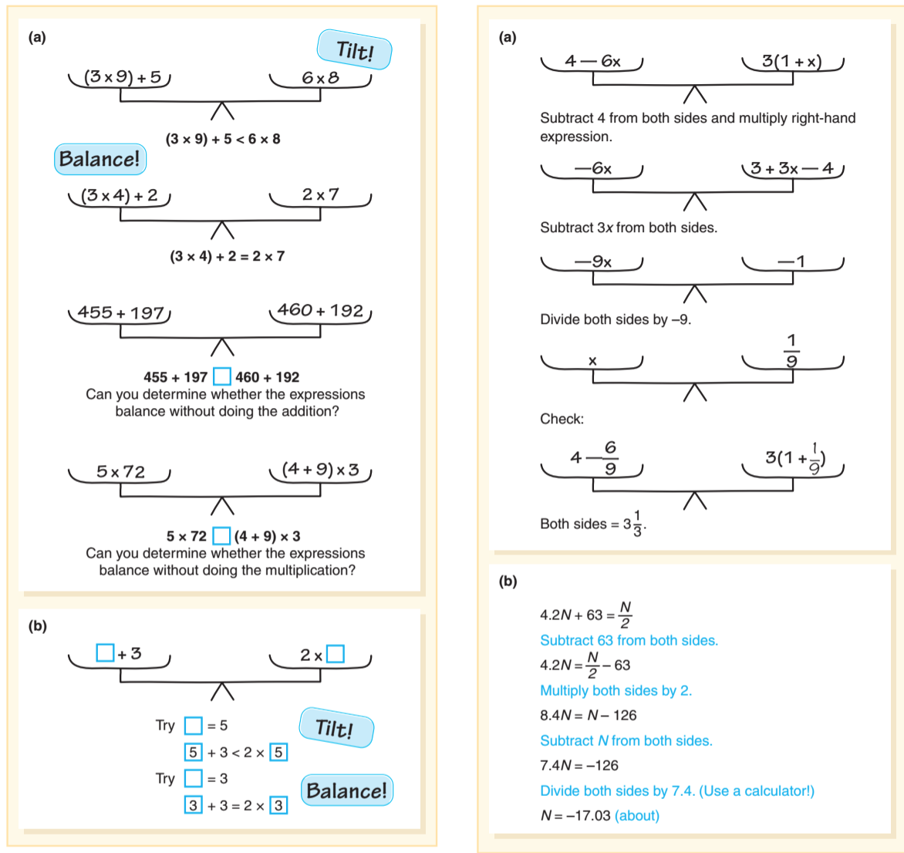
Using Expressions and Variables

Slide 22
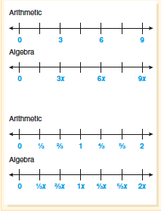
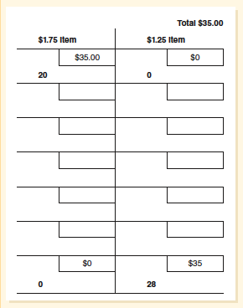
Meaning of Variables (2 of 3)
Number line used to build understanding
Table used to guide thinking and recording variables

Slide 23
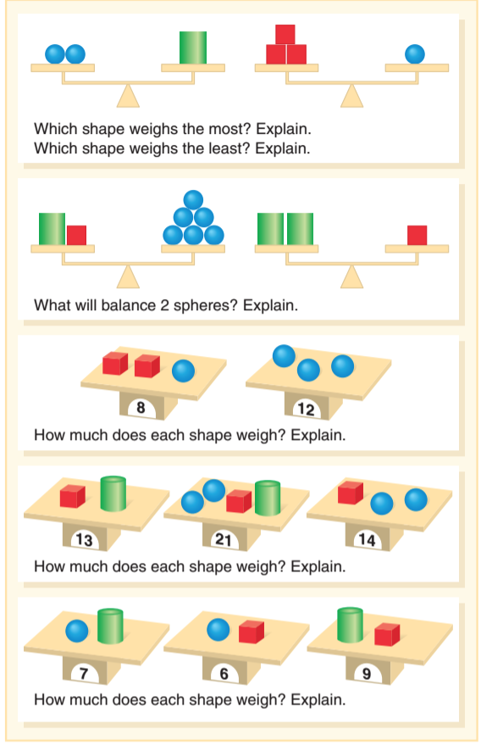
Meaning of Variables
5 examples of problems with multiple scales with quantities and variables that may vary:

Slide 24
Mathematical Modeling
Mathematical modeling is the process that uses mathematics to represent, analyze, make predictions or otherwise provide insight into real-world phenomena.
Creating equations to describe situation is an important skill.
14 × 25 = 7 × 50 True or False? Justify your answer
Eloise wants to read 25 books over the summer vacation, which is 9 weeks long. How much does she need to read each week?

Slide 25
Common Challenges and Misconceptions Related to Algebraic Thinking (1 of 2)
Common Challenge or Misconception | What It Looks Like | How to Help
The equal sign means “and the answer is . . . ” | For the equation 8 + 4 = __ + 5, a student puts 12 in the box (or 17). Equations such as 8 = 5 + 3 and 6 = 6 does not make sense it doesn’t ‘fit’ with their interpretation of the equal sign. | Revisit/develop the concept of balance (two-pan balances, true/false equations, open sentences, etc.). Read the equal sign as “is the same as,” or “is equal to.” For example, read 4 + 5 = 9 as “four plus five is the same as or is equal to 9.” Revoice students’ use of the word “makes” (e.g., 5 + 12 makes 17, restate as 5 + 12 is equal to 17). Record children’s equivalent expressions when they solve problems in different ways (e.g., 8 + 7 = 8 + 2 + 5).
Thinking an equation is written “improperly” if it is not in the form of a + b = c (for example). | Student is confused by equations such as: 17 = 17 (identity statements) 5 + 7 = ? * 2 (operations on both sides of the equation) 62 = ? − 24 (operation on the right side of the equation). | Use a variety of equation formats all year long. When recording equations (e.g., that represent story problems), write more than one way (e.g., as multiplication and division).

Slide 26
Common Challenges and Misconceptions Related to Algebraic Thinking (2 of 2)
Thinking a variable is a label rather than a quantity i.e. 6c interpreted as 6 cans instead of 6 times the number of can in the package
To see if something always works - Student checks a few examples, i.e., decides that two odd numbers always add to even number because 5 + 7 = 12 and 15 + 17 = 32.
Confusing the variable x for a multiplication symbol × or vice versa.
Simplifying expressions involving variable - ignoring the variable or the need for parenthesis 5x + 9 = 14 vs. 5(x + 9) = 14
Matching words with equations in solving story problems.
Interpreting inequalities and their solutions, i.e., do not know symbols
Determining an equation for linear situations, particularly when in the form y = mx + b

