Slide 1
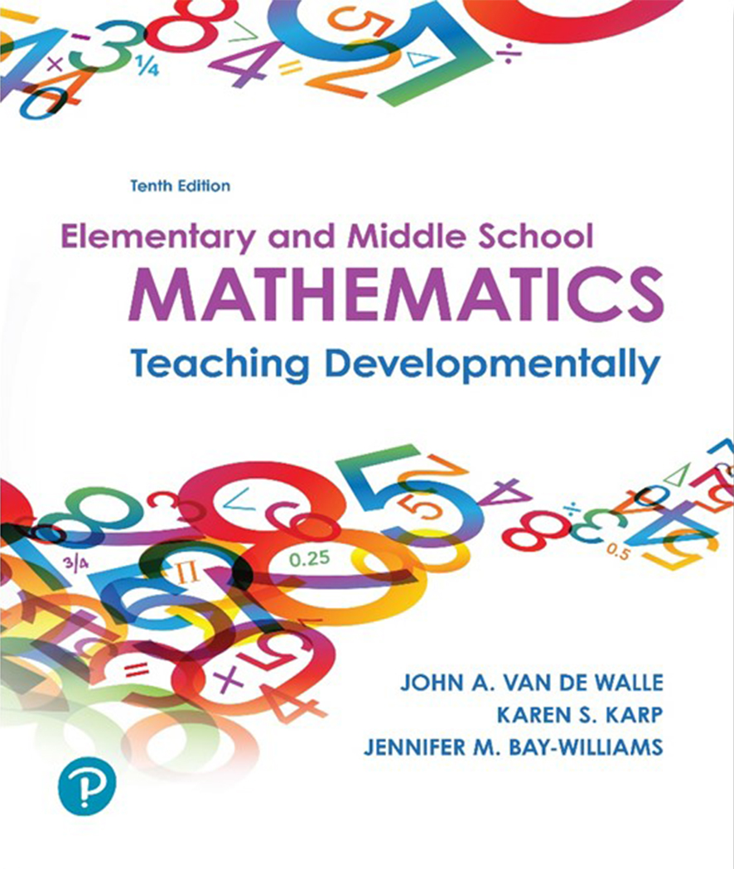
Elementary and Middle School Mathematics Teaching Developmentally 10th Edition
Chapter 11
Developing Strategies for Addition and Subtraction Computation
Copyright © 2019, 2016, 2013 Pearson Education, Inc. All Rights Reserved
Notes:
If this PowerPoint presentation contains mathematical equations, you may need to check that your computer has the following installed:
1) MathType Plugin
2) Math Player (free versions available)
3) NVDA Reader (free versions available)

Slide 2
Learner Outcomes
11.1 Identify the interplay between place value understanding and addition and subtraction computational strategies.
11.2 Identify three types of computational strategies.
11.3 Explain multiple invented strategies for addition and subtraction with multi-digit numbers.
11.4 Explain the development of the standard algorithms for addition and subtraction including ways to record students’ thinking.
11.5 Identify ways to teach computational estimation to develop students’ flexibility and ability to recognize reasonable answers.
11.6 Describe computational estimation strategies for addition and subtraction.

Slide 3
Standards-Based Development
Students should solve addition and subtraction problems with numbers appropriate for their grade level:
K within 10
1st within 100 to add two-digit to one-digit numbers
2nd within 1000 to add two- and three-digit numbers
Intermediate grades fluently solve addition and subtraction problems within 1000 using varied strategies

Slide 4
Connecting Addition and Subtraction to Place Value (1 of 2)
Activities that students can apply emerging understanding of place value to computation.
Activity 11.1 Calculator Challenge Counting
Materials - Calculator
Directions - Ask students to press any number on the calculator, i.e., 17 and then +10. They must say the sum before pressing =. Continue pressing different numbers and adding 10 to see how far they can go without making a mistake.
Activity 11.3 The Other Part of 100
Materials - Pairs work with sets of ten-frames
Directions - One partner makes a two-digit number with the ten-frames, then they work together to determine what goes with the ten-frame amount to make 100. E.g., 32 + ___ = 100, 51 + ___ = 100

Slide 5
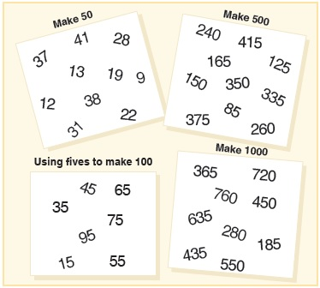
Connecting Addition and Subtraction to Place Value (2 of 2)
Activity 11.4 Compatible Pairs (To Make 50, 100, 500, and 1000)
Materials - Display of varied combinations (as shown)
Directions - Project a search (see cards) and ask students to name or connect the compatible pairs.

Slide 6
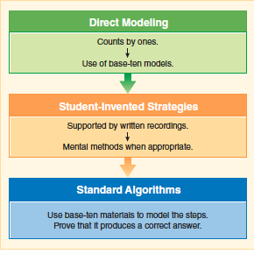
Three Types of Computational Strategies

Slide 7
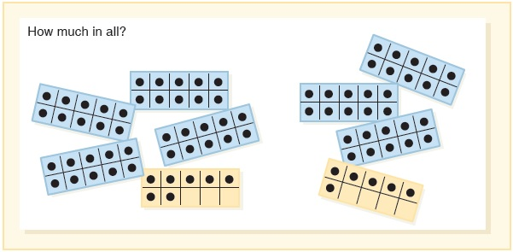
Direct Modeling
Students who consistently count by ones need support to develop base-ten grouping concepts.
Figure 11.8 Using little ten frame cards to add.
The goal is to move them from direct modeling to invented strategies derived from number sense and the properties of operations.
Figure 11.10 A possible direct modeling of 36 + 27 using base-ten models.

Slide 8
Invented Strategies
Invented strategies are any strategy other than the standard algorithm or that does not involve the use of physical materials or counting by ones
C C S SM describe these expectations in First and Second grade.
Strategies based on place value, properties of operations, and/or relationships between addition and subtraction
Develop, discuss and use efficient, accurate, and generalizable methods to compute sums and differences of whole numbers in base-ten notation.

Slide 9
Contrasts of Invented Strategies with Standard Algorithms
Invented strategies are-
1. number-oriented rather than digit-oriented.
Standard 45 + 32 – students think 4 + 3 instead of 40 + 30
2. left-handed rather than right-handed.
Standard 263 + 126 – students begin with 3 + 6 = 9
Invented – Students begin with 200 + 100 = 300 a focus on the whole number and some sense of size of the eventual answer in one step
3. a range of flexible options rather than “one right way”.

Slide 10
Benefits of Invented Strategies
Students make fewer errors- they understand their own method.
Less reteaching is required.
Students develop number sense.
Invented strategies are the basis for mental computation and estimation.
Flexible methods are often faster than the traditional algorithm.
Algorithm invention is itself a significantly important process of “doing mathematics”.
They serve students well on standardized tests.

Slide 11
Standard Algorithms Must Be Understood
If you use it, you must understand why it works and be able to explain it.
Three main components of the trajectory for learning the standard algorithm:
Knowing the step-by-step procedure and how it is performed (as a precise, effective procedure)
Knowing why the algorithm works and how it can be applied (its reliability- always a correct answer if carried out properly)
Knowing when an algorithm should be used and comparing the value and usefulness of different algorithms (its transparency- process is understandable and its generalizability- solves a collection of similar problems)

Slide 12
Delay, Delay, Delay
Students are unlikely to invent standard algorithms.
Standards require students to learn a variety of strategies based on place value and properties of operations one or two years before standard algorithm is to be mastered.
Standard Algorithm | When Topic Is Introduced and Developed | When Standard Algorithm Is Required
Add and Subtract Multidigit Whole Numbers | Grades 1–3 | Grade 4
Multiply Multidigit Whole Numbers | Grades 3 and 4 | Grade 5
Divide Multidigit Whole Number | Grades 3 and 4 | Grade 6
Add, Subtract, Multiply, and Divide Decimals | Grade 5 | Grade 6
Standard algorithm (once it is understood) are one more strategy for the students’ toolbox of methods.

Slide 13
Development of Invented Strategies in Addition and Subtraction
Creating a Supportive Environment for Invented Strategies
Avoid immediately identifying the right answer.
Expect and encourage student-to-student interactions, questions, discussions, conjectures.
Encourage students to clarify previous knowledge.
Promote curiosity and an openness to trying new things.
Talk about right and wrong ideas in non-evaluative or nonthreatening way.
Move unsophisticated ideas to more sophisticated thinking through coaching and strategic questioning.
Use familiar contexts and story problems to build background and connect to students’ experiences.
Show samples of anonymous students’ work and allow students to critique the reasoning.

Slide 14
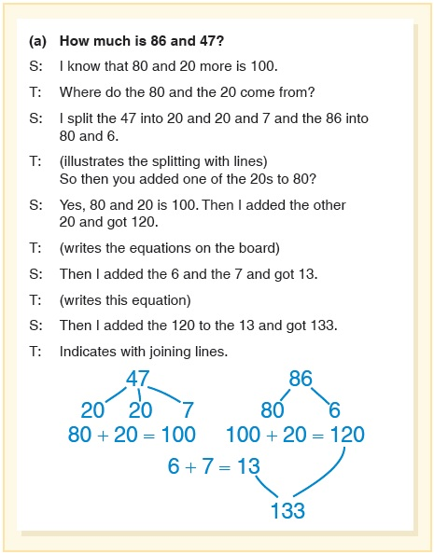
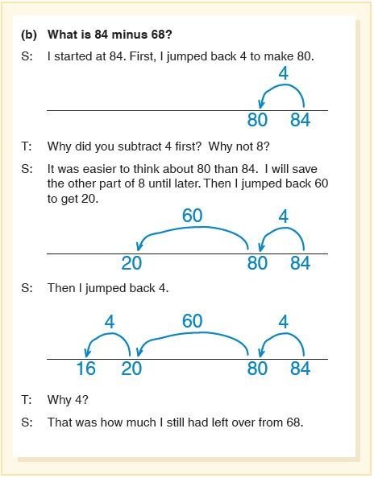
Models to Support Invented Strategies (1 of 5)
Break Apart
Jump

Slide 15
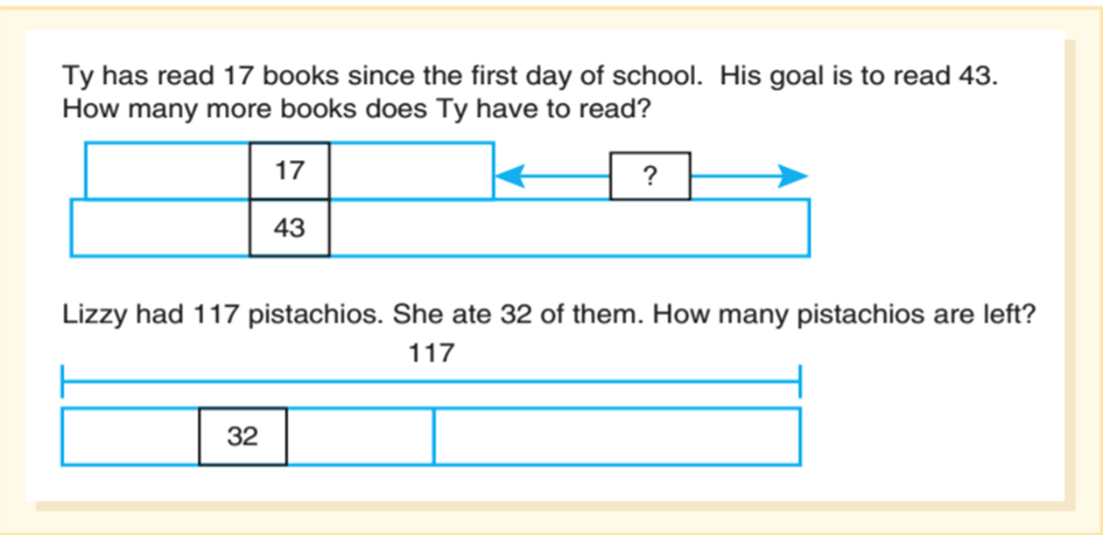
Models to Support Invented Strategies (2 of 5)
Bar diagrams can be used to shortcut strategy

Slide 16
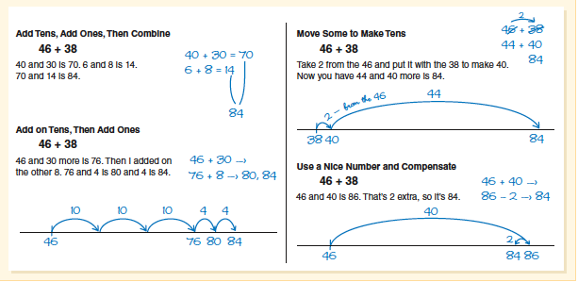
Models to Support Invented Strategies (3 of 5)
Try These Strategies - Explain how you solved the problem to a person next to you.

Slide 17
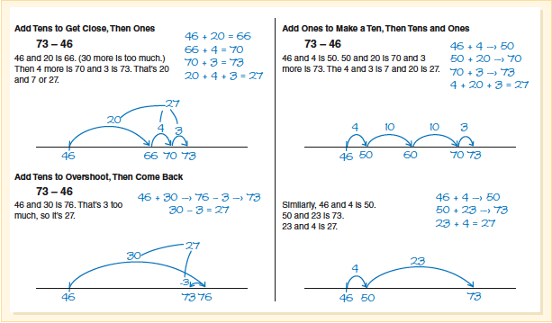
Models to Support Invented Strategies (4 of 5)
Try These Strategies - Explain how you solved the problem to a person next to you.

Slide 18
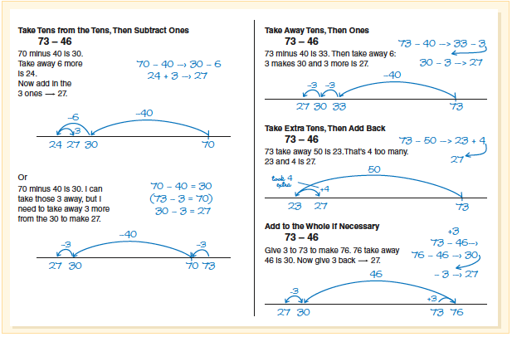
Models to Support Invented Strategies (5 of 5)

Slide 19
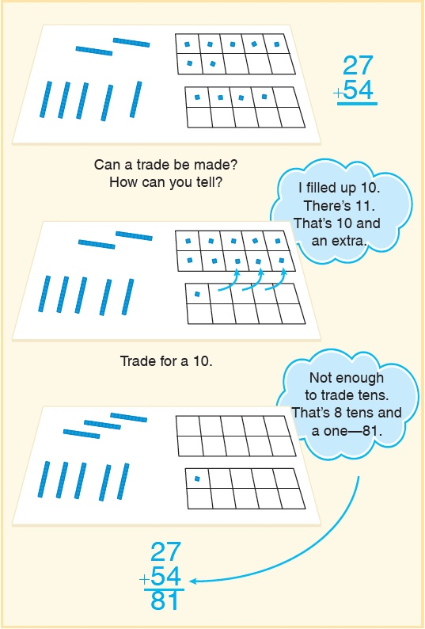
Standard Algorithm for Addition (1 of 2)
Standard Algorithm for Addition:
Begin with models only.
Provide place-value mats and base-ten materials.
Begin in ones column.
One or two problems with lots of discussion is more productive than a lot of problems.

Slide 20
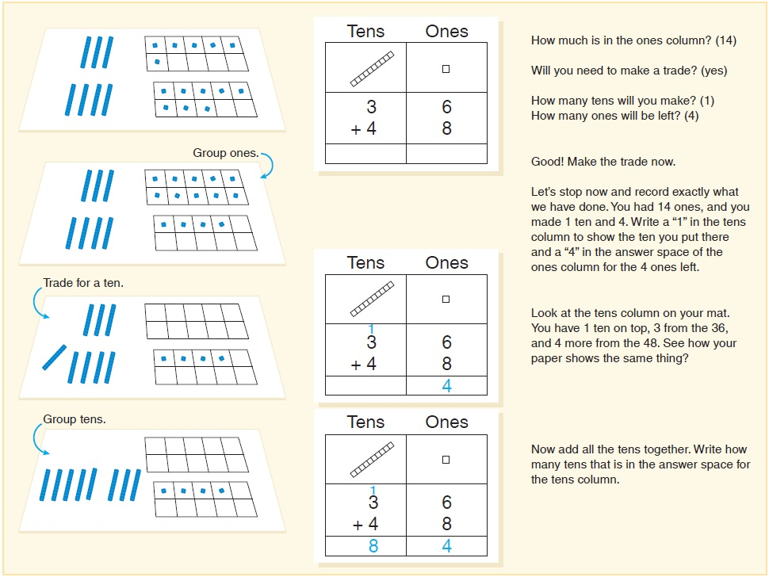
Standard Algorithm for Addition (2 of 2)
Develop the written record.

Slide 21
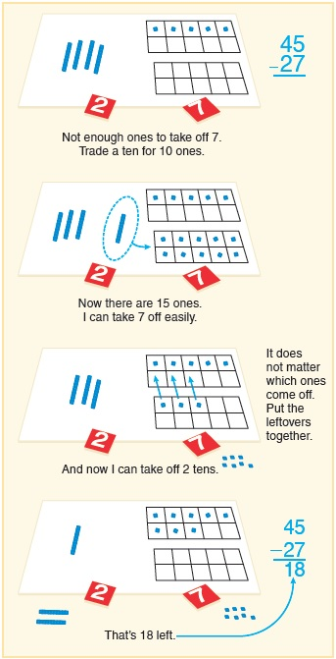
Standard Algorithm for Subtraction
Begin with models only.
Anticipate difficulties with zeros.
Develop the written record.

Slide 22
Introducing Computational Estimation
Goal of computational estimation is to be able to flexibly and quickly produce an approximate result that will work for the situation and be reasonable.
Good estimators tend to employ a variety of computational strategies they have developed over time.
Three types of estimation - Each involve reasoning and sense making.
Measurement - Determining and approximating measure (length, weight, time, etc.)
Quantity - Approximating the number of items in a collection
Computational - Determining a number that is an approximation of a computation

Slide 23
Teaching Computational Estimation
General principles:
Use real examples like shopping, distance to travel, monthly budgets, cost of entertainment like sporting events, movies, etc.
Use the language of estimation - about, close, just about, a little more or less than, and between
Use context to help determine the reasonableness of the estimate.
- E.g., Would attendance at a school play be 30 or 300 or 3000?
Accept and offer a range of estimates as an option.
Focus on flexible methods, not answers.

Slide 24
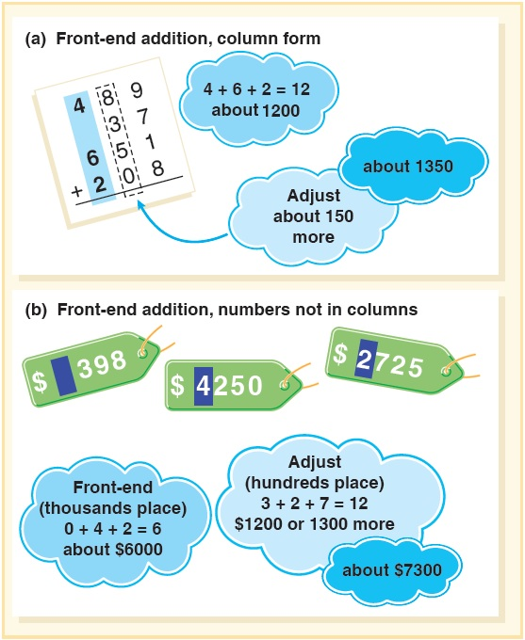
Computation Estimation Strategies (1 of 4)
Front-End Method:
Front digits in largest place value are used, and computation is then done as if there were zeros in the other positions.

Slide 25
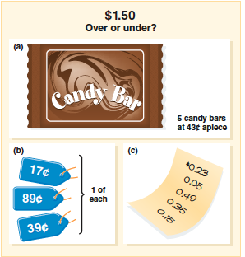
Computation Estimation Strategies (2 of 4)
Activity 11.15 Over or Under
Materials – Document camera to project the figure
Directions – Provide contexts for students to use computational estimation strategies
i.e. 37 + 75 (over or under 100)
712 - 458 (over or under 300)

Slide 26
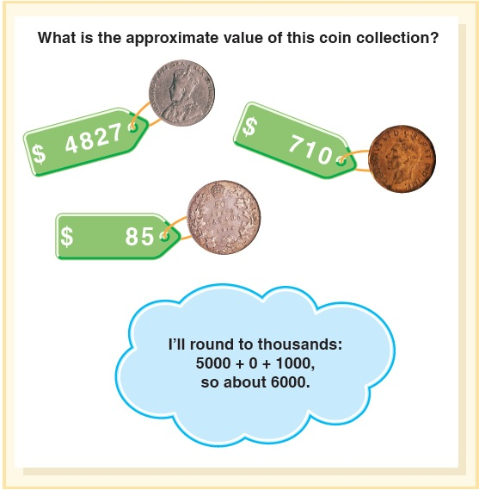
Computation Estimation Strategies (3 of 4)
Rounding Methods
Whole numbers can be rounded to the same place-value for addition
E.g., Using the hundreds place, we add 4800 + 700 + 100 = $5,600

Slide 27
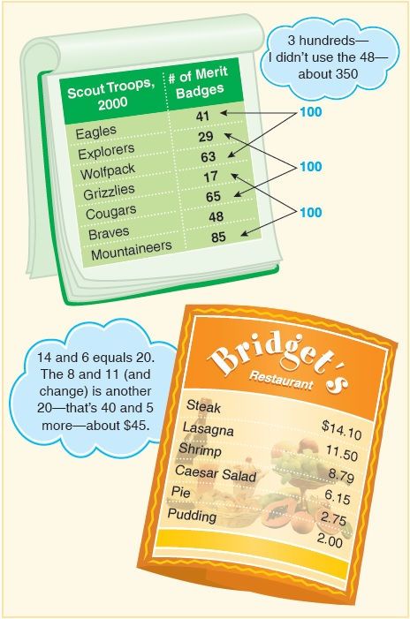
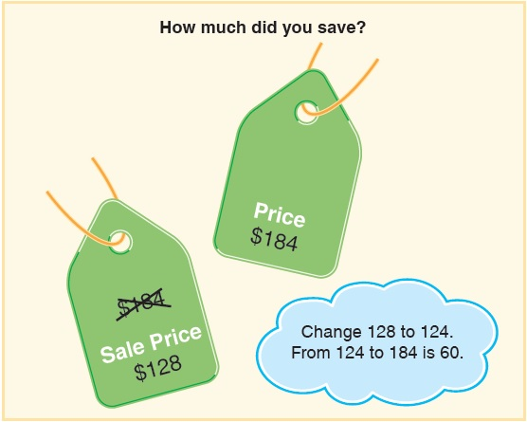
Computation Estimation Strategies (4 of 4)
Using Compatible numbers:

Slide 28
Common Challenges and Misconceptions for Addition and Subtraction Computation (1 of 2)
Common Challenge or Misconception | What It Looks Like | How to Help
1. Students incorrectly record the algorithm for addition by not regrouping and ignoring place value. | When students add: Vertical addition top number 56 with 97 below it equals 1413 Students record the entire sum of the digits in each column. | Have students show with base-ten materials the value of these two numbers on a place value mat. Avoid reading numbers in addition or subtraction problems as digits (for example, just saying 5, instead of 5 tens or fifty) as this language confuses students and they may put down the individual sums rather than regrouping. Have students estimate the answer first. Do they expect the answer will be in the hundreds? Thousands? Then ask, “Is this answer reasonable?” Have the student use partial sums to record and find total. Have the student use another strategy to check answer.

Slide 29
Common Challenges and Misconceptions for Addition and Subtraction Computation (2 of 2)
Reverse grouping – Start in tens place and add backwards.
Confuses the multiplication algorithm with the addition algorithm
When subtracting two multi-digit numbers, student always subtracts the smaller number from the larger number rather than regrouping 70−23 = 53.
Makes mistakes when regrouping across zeros in a subtraction problem
Overgeneralizes the “equal additions” or the “same difference” strategy in addition situations
Thinks they have to find an exact answer after finding an estimation

